Slide 1
Trendspotting
Douglas Rutzen
President and CEO www.icnl.org

Slide 2


Slide 3
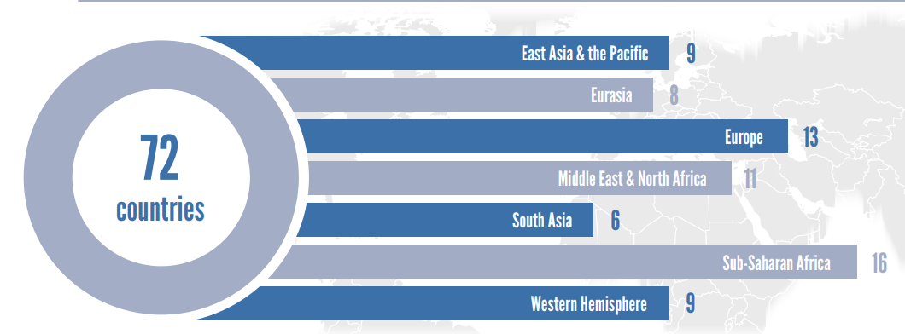
Countries with restrictive initiatives since 2012
Notes:
72 Countries have proposed or enacted more than 144 restrictions on civil society since 2012. Of these initiatives, 74% are restrictive.

Slide 4
Notes:
Since 2012, 80 countries have proposed or enacted over 175 initiatives related to lifecycle, funding, and assembly. 29% of these initiatives are enabling, and 71% are restrictive.

Slide 5
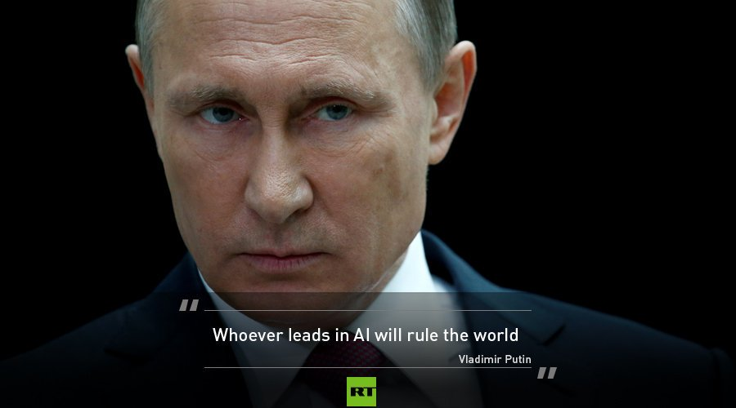

Slide 6

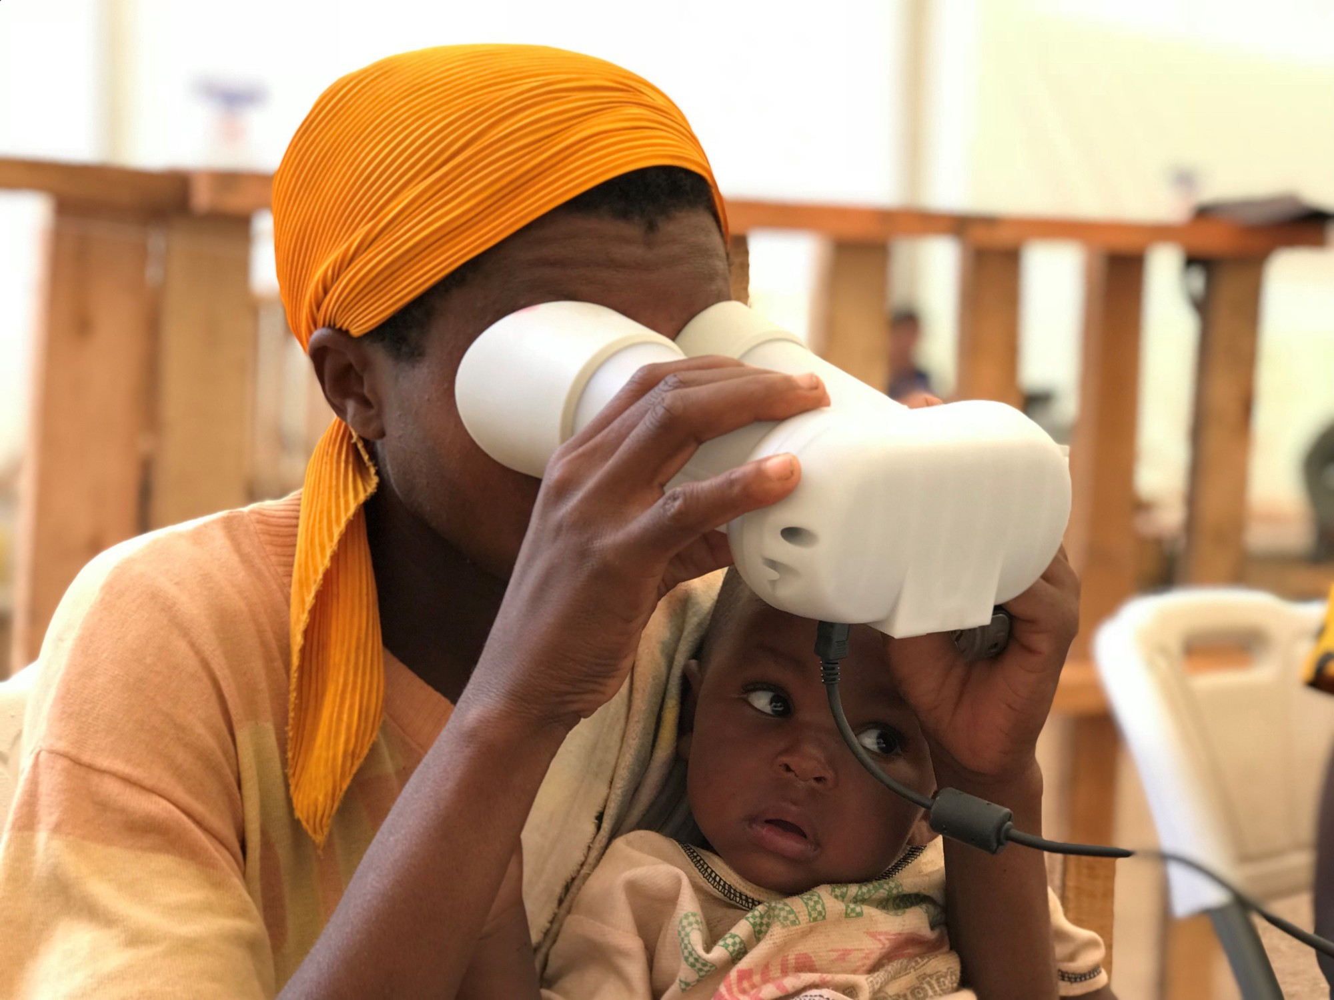
A Congolese woman uses an iris scanner for biometric identification to receive food in Uganda, under the new WFP procedures.

Slide 7

Notes:
EV slide

Slide 8


Slide 9

Intelligence officials warn that China could access your Grindr profile following $245m buyout
January 17, 2018

Slide 10

Guarding against Foreign Interference

Slide 11
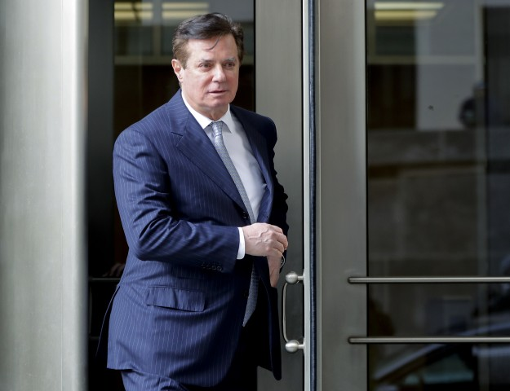
Foreign Agent Fiasco: Congress Swings at Manafort, Hits Environmentalists
September 20, 2018

Slide 12
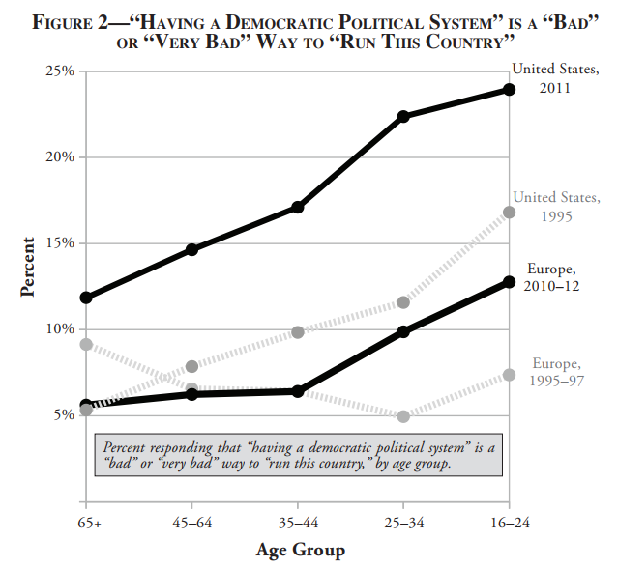

Slide 13
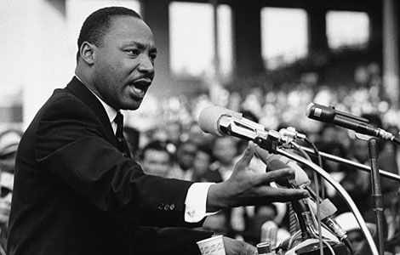

Slide 14
Trendspotting
Douglas Rutzen
President and CEO www.icnl.org

