Slide 1
Debt module
Lecture 1
The EU Financial support
and rising debt vulnerabilities
Notes:
Trainers present themselves briefly.
NB:Troughout the training keep in mind new names!!!
GGDC is now SDG-C Sustainable Development Goals Contract
SRC is now SRPC Sector Reform Performance Contract
SBC is now SRBC State and Resilience Building Contract

Slide 2
Outline
  What is blended finance?
  Rising debt vulnerability in the low-income countries.
  A high level of debt is a source of vulnerability.
  A need to help the countries in their debt management.
Notes:
In the first section, explain that blended finance is now used by the bilateral and multilateral donors as a tool to promote growth in the developing countries (low-income countries). To increase the positive impact of blending, the recipient countries need to reinforce their debt capacity management. The course is about showing how this could be done through the new DSF tools and DeMPA developed by the IMF and the World Bank to better monitor external and public debts.

Slide 3
What is blended finance?
  Using EU limited financial support
  for mobilizing significant amount
  of additional finance from other partners
Donor governments.
Development agencies regional and multilateral banks).
Prominent place to private sector participation (commercials banks, financial entities).

Slide 4
Blending = bridge between grants and market financing
  Components of project financing mix
Equity funds (own private funds).
Government (domestic public financing).
Multilateral financial institutions (WB, AfD, KfW, EIB, AfDB, IaDB, ….).
Grant donors and loans (foreign governments and private financial sector).
EU financial support.
Notes:
Blending implies that the recipient countries now have multiple sources of loans. This requires a thorough monitoring of debt.

Slide 5
Blending = bridge between grants and market financing
  Find an optimal combination
  between market funds and concessional funding
Attract finance development with limited public funds.
Many investments do not reach self-financing threshold when based on market funds.
Use leverage ratio to mobilize market funds (share of public funds needed to finance a project).
Public funds are scarce : basic amounts needed to finance a project (ex. 1: target groups to benefit from the project; ex2: national development projects with no sufficient income to cover the debt service at market rate).

Slide 6
Blending = bridge between grants and market financing
Blending:
different degrees of concessionality
Grants
Market rate
Notes:
Blending aims at increasing the non-concessional share of countries’ loans. Concessionality cannot be a permanent situation. Therefore the governments are encouraged to find an optimal structure of their public loans. When non-concessional loans are scheduled, the investors charge a market rate which reflects the expected return of the projects that are financed plus a risk-premium.

Slide 7
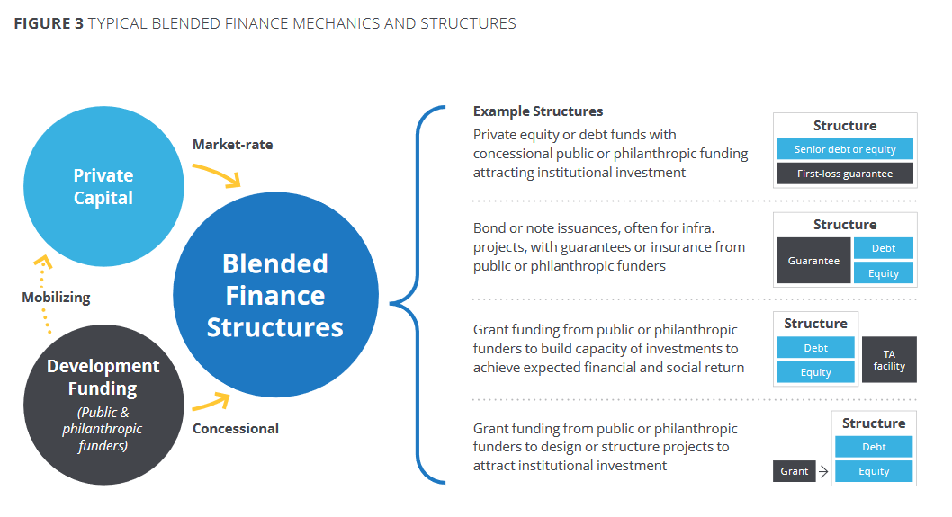
Source the State of blended finance 2018
Convergence, Blending Global Finance

Slide 8
EU blending instruments
Investment grant and interest subsidy.
Aim : reduce the cost of the projects.
Technical assistance.
Aim : Ensure quality, efficiency, sustainability of the project.
Risk capital.
Aim : attract additional financing (equity).
Guarantees.
Aim : reduce risk to attract financing for development.

Slide 9
EU blending facilities
ENI : European Neighbourhood Instrument.
NIP : Neighbourhood Investment Facility (capital intensive infrastructure projects in EU Partner countries : transport, energy, social development).
Eastern neighbourhood region & Southern neighbourhood region.
IPA: Instrument for Pre-accession Assistance.
WBIF : Western Balkans Investment Framework.

Slide 10
EU blending facilities
DCI : Development cooperation Instrument.
LAIF : Latin America Investment Facility.
AIF : Asian Investment Facility.
IFCA : Investment facility for Central Asia.
EDF : European Development Fund.
AfIF & ITF: Africa Investment Facility & EU-Africa Infrastructure Trust Fund.
CIF : Caribbean Investment Facility.
IFP : Investment Facility for the Pacific.
Thematic initiatives : Electrification Financing Initiative (ElectriFI), Agriculture Financing Initiative (AgriFI), Climate Finance Initiative.

Slide 11
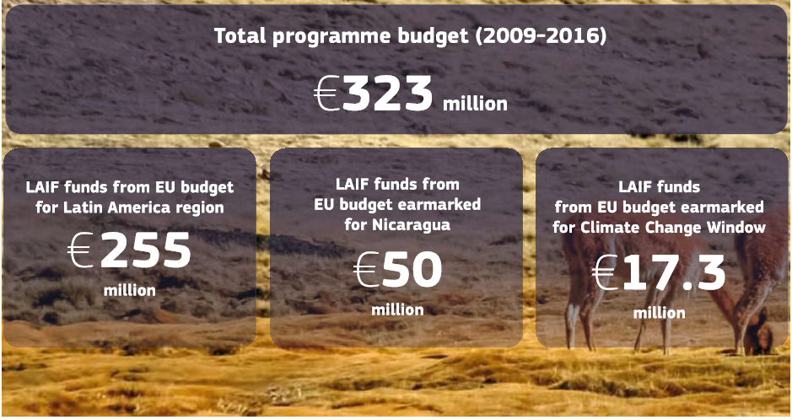
LAIF

Slide 12
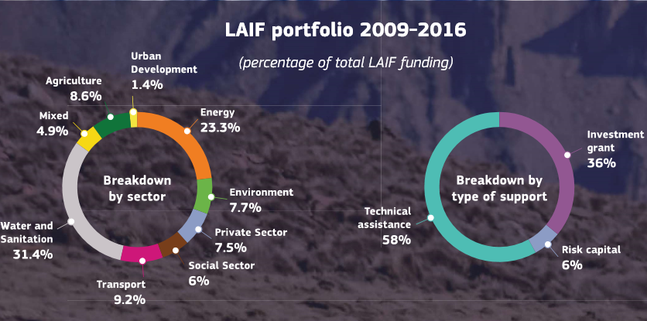

Slide 13
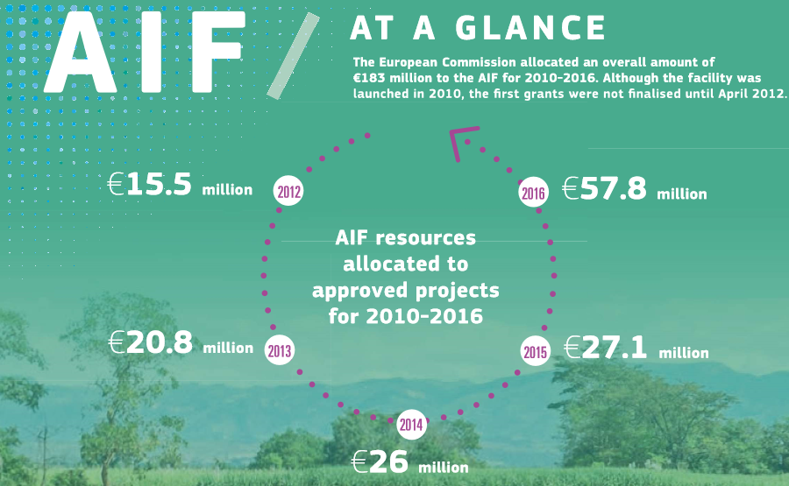

Slide 14
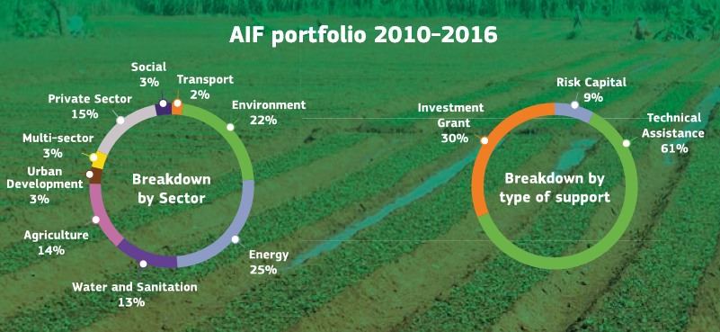

Slide 15
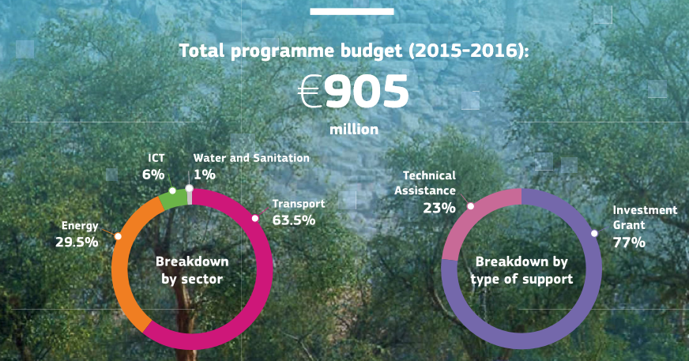
AfIF

Slide 16
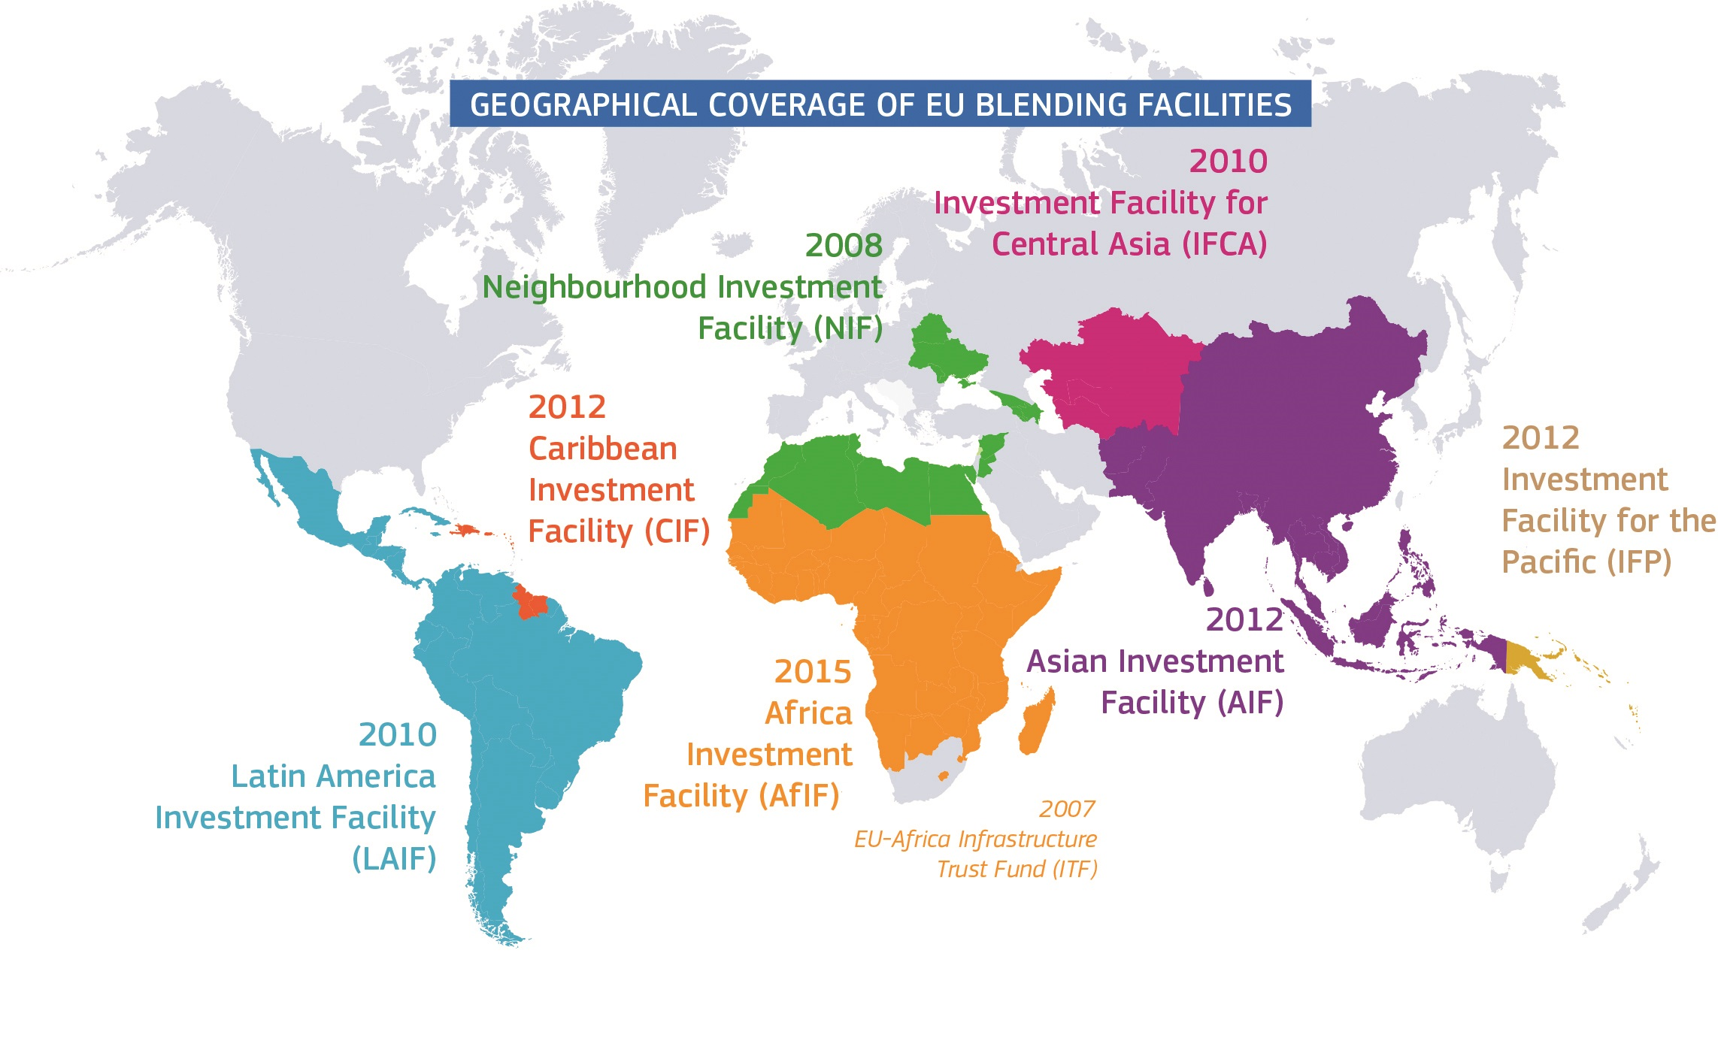
Notes:
The geographical coverage of EU blending is large. This reflects a new strategy to help the countries achieve more rapidly the objectives of the sustainable development goals (SDG). This can be motivated by the high amounts needed, for instance to reach water sanitation, road infrastructures, access to energy.

Slide 17
Outline
  What is blended finance?
  Rising debt vulnerability in the low-income countries.
  A high level of debt is a source of vulnerability.
  A need to help the countries in their debt management.
Notes:
In the first section, explain that blended finance is now used by the bilateral and multilateral donors as a tool to promote growth in the developing countries (low-income countries). To increase the positive impact of blending, the recipient countries need to reinforce their debt capacity management. The course is about showing how this could be done through the new DSF tools and DeMPA developed by the IMF and the World Bank to better monitor external and public debts.

Slide 18
Roughly 40% of LIC are in a situation of high risk or in a situation of debt crisis.
Important to complement the usual key-requirement check lists used by the EU by :
  Assessment of debt risk.
  Debt sustainability.
  Debt management policies.

Slide 19
Several categories of countries
Countries that have defaulted and are unable to service their debt (Congo, Mozambique, Venezuela).
Countries in debt distress and which make intermittent loan payments – or cut in their expenses to repay their debt (Chad, Sudan, Somalia, South Sudan, …).
Countries in high risk of debt distress or likely to fall soon in a debt distress (Ghana, Zambia, Haiti, Yemen, Grenada, …).
Countries in low and moderate risk (Côte d’Ivoire, Honduras, …).

Slide 20
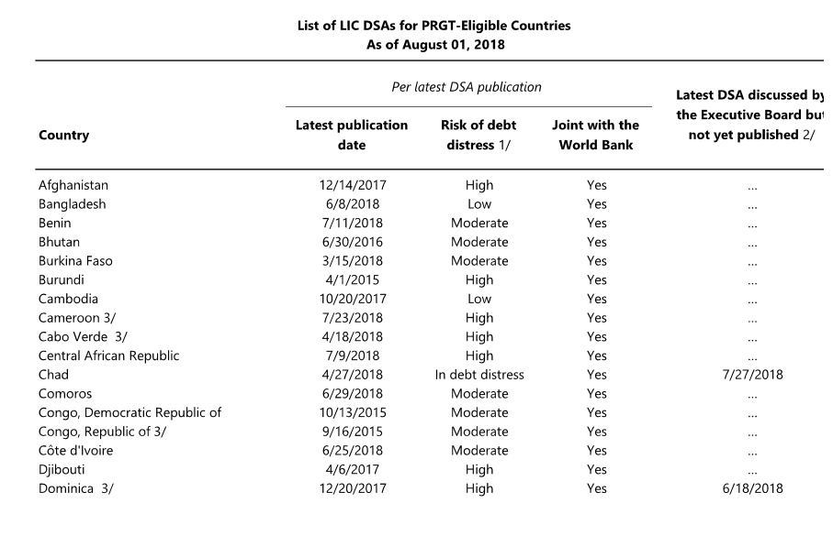
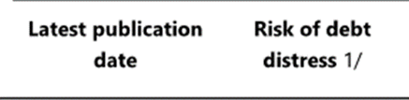
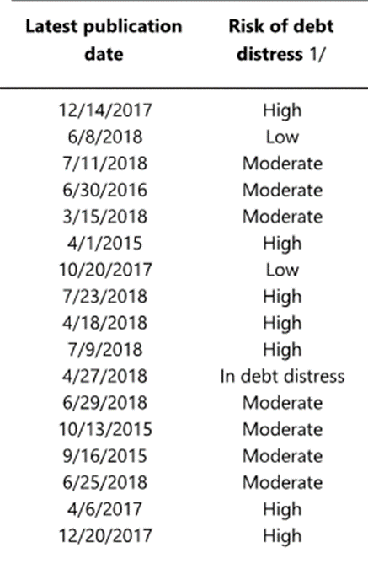
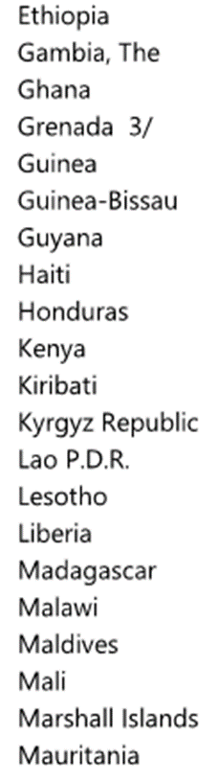
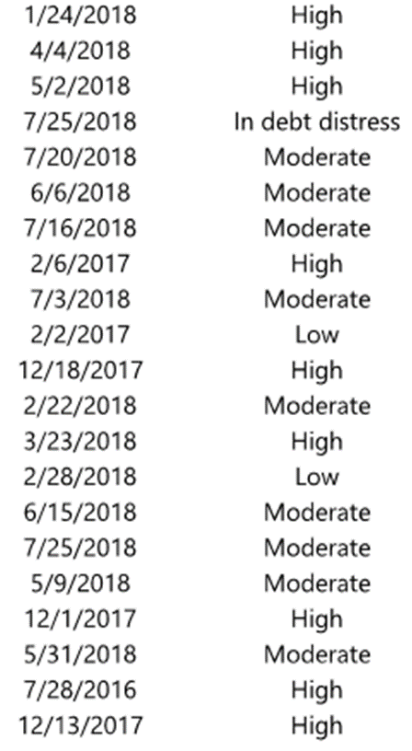
Countries with low.moderate debt – Examples
Benin – Burkina Faso – Côte d’Ivoire – Nepal – Rwanda
Notes:
The risk od debt distress is high in many countries.

Slide 21
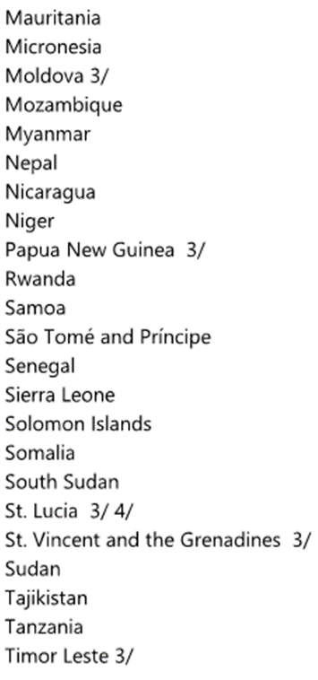
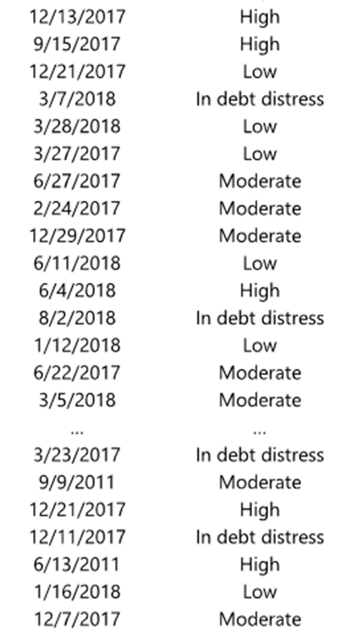
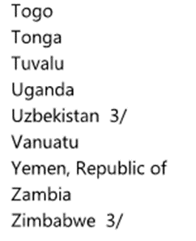

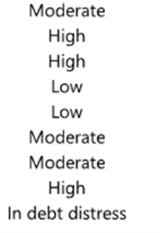
Countries in debt distress
Chad, Grenada, Mozambique, Sao-Tome & Principe, South Sudan, Sudan, Venezuela, Zimbabwe
Many countries with high debt.

Slide 22
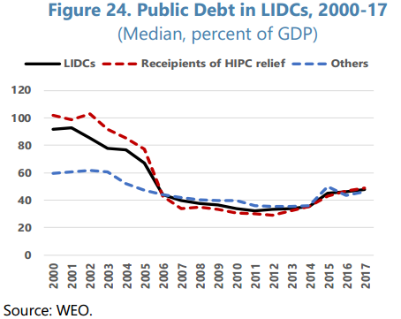
Main characteristics of debt accumulation over the recent years
2000-2013 :
debt-GDP ratios fall
Decrease from 94% to 33% (median).
Combination of rapid growth and debt relief programmes (HIPC and MDRI).
Notes:
We can see the effect of debt relief programs between 2000 and 2006 : public debt ratios have decreased substantially. But since 2015 they are on an upward trend.

Slide 23
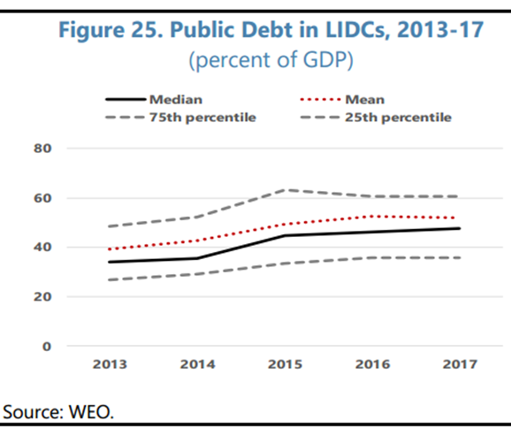
Main characteristics of debt accumulation over the recent years
Since the end-2013 :
fast rise
Debt ratios reach 47% (in 29 countries increase by 13.5%).
Fast rise in Sub-Saharan African countries and already elevated levels in Central Asia and Middle East.
Interest expenses are rising as well as fiscal and external gross financing needs.

Slide 24
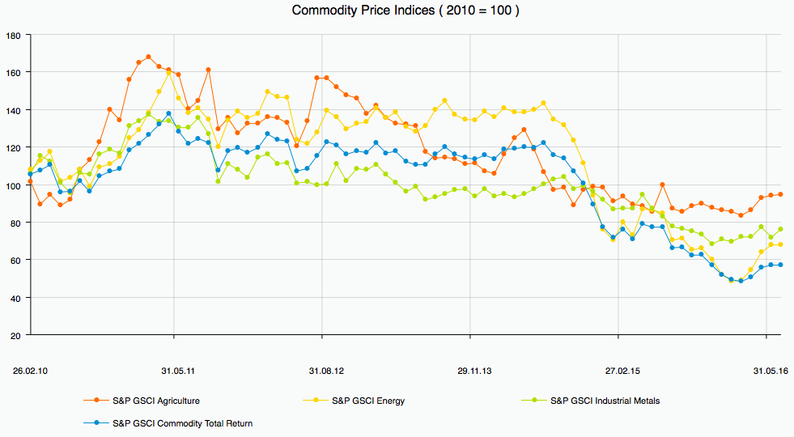
Factors that contributed
to debt accumulation
  Declining commodity prices > Falling income > Lower budget revenues > Capital outflows and currency depreciations > Current account deterioration > Former financial strategies become unsustainable during commodity-price busts.
Notes:
We can consider here the example of the Latin American countries, or MENA countries that have suffered from commodity price declines. These leads to higher budget and external account deficits and to new debts.

Slide 25
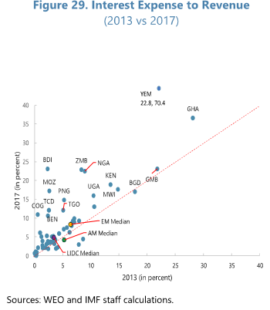
Factors that contributed
to debt accumulation
Fast integration to the international capital markets (commodity exporters):
> LIC increases international sovereign bond issuance from $2 billion in 2009 to $18 billion en 2014.
Notes:
The higher integration to the international financial markets (higher volume of Eurobonds for instance issued over the recent 5 years) implies that the share of interest payment has increased. The line shows a positive correlation: a country that was paying a higher interest in 2013 was likely to continue paying high interest in 2017. This illustrates the facts interest payments are on a rising trend (persistence) which could in turn generate liquidity crises.

Slide 26
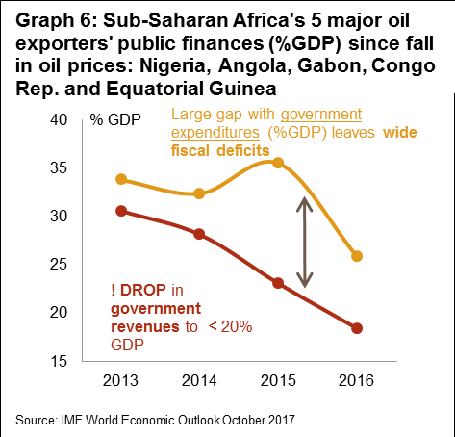
Factors that contributed
to debt accumulation
Procyclical bias of government spending
Few countries have adopted counter-cyclical budget rules.

Slide 27
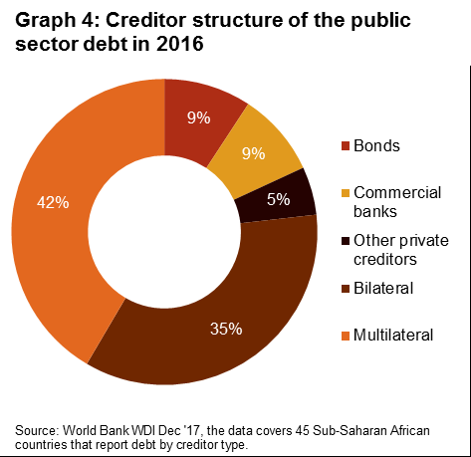
Changing composition of public debt
Development of domestic financial markets and non-traditional creditors
New sources of credit: commercial creditors.
Higher currency-denominated debts.
Lower correlation between saving and investment (Africa)
1990-1995 : 0.74
2011-2016 : 0.58
Notes:
Though multilateral debt still accounts for a large share of total debt, we see that the share of loans at market rates are increasing. In particular, the share of loans from the issuance of bonds (in the LIC, Eurobonds).

Slide 28
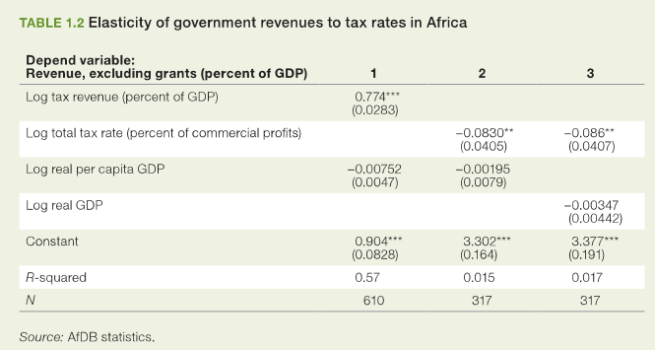
Weak tax administration performance
Development of domestic financial markets and non-traditional creditors.
Higher marginal tax rate on production is counterproductive and distortiary.
Tax revenue-GDP ratio : 17% < 25% threshold.
Low tax payer compliance, poor governance, prevalence of hard-to-tax sectors, lack of transparent fiscal regimes (resource-rich countries).

Slide 29
Outline
  What is blended finance?
  Rising debt vulnerability in the low-income countries.
  A high level of debt is a source of vulnerability.
  A need to help the countries in their debt management.

Slide 30
Debt defaults
Historical evidence: Reinhart and Rogoff
2009, This Time is Different: Eight Centuries of Financial Folly, Princeton University Press.
They study 66 countries, 5 continents, 8 centuries of economic history.
Sovereign debt and default crises have been common historically (this is a norm when sovereign debt ratios go up).
Global economic factors such as commodity prices and center country interest rates have played a major role in causing debt crises (not new).

Slide 31
Major Types
of Sovereign Debt Defaults
External debt default: a country defaults on its payments to foreign debt holders.
The country runs into a sovereign debt crisis > Interest rates rise > Capital flows stop > Severe economic contraction.
The country can choose a debt repudiation: it renegs on its debt to foreign debt holders entirely.
Debt restructuring and debt rescheduling : the country negotiates a settlement. Usually, the creditors are forced to take a loss on some portion of the debt, known as a “haircut”, interest rates are renegotiated towards more favorable terms and external lending resumes.
Many LIC countries benefited from such debt relief at the Paris and London Clubs (concessionary rates, changes in debt maturities).
The HIPC (Heavily Indebted Poor Countries) was another example of debt relief.

Slide 32
Bilateral debt
rescheduling : Paris Club
Rescheduling of debt service, with increasing percentages of forgiveness during the 1990s.
But only on debt service due during period of IMF agreement. Usually ESAF, 3 years.
No stock cancelations.
Limited effects:
Debt relief was too limited.
Rescheduling on flows, not on stocks.
New loans from multilateral development banks.

Slide 33
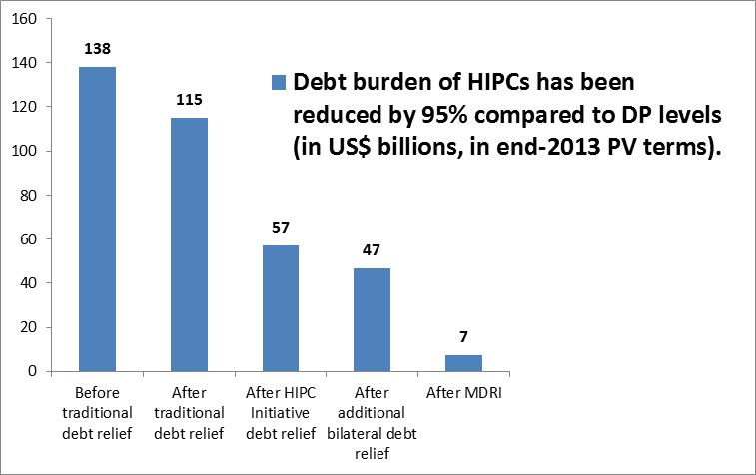
Considerable progress has been achieved under HIPC Initiative.

Slide 34
Multilateral debt rescheduling : HIPC and MDRI initiatives
Rescheduling of debt service, with increasing percentages of forgiveness during the 1990s.
But only on debt service due during period of IMF agreement. Usually ESAF, 3 years.
No stock cancelations.
Limited effects on stocks and flows:
Debt relief too limited
Wrong modalities: mostly on flows, not on stocks

Slide 35
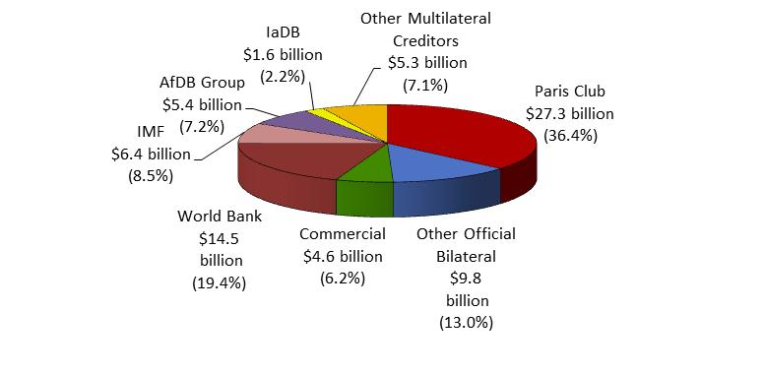
Substantial debt relief has been committed
to 39 HIPC eligible countries:
  Estimated US$116 billion have been committed under the HIPC (US$75 billion) and the MDRI (US$41 billion) Initiatives.
  Paris Club (36.4%) with Multilaterals – IDA (19.4%), other MDBs (16.5%) and the IMF (8.5%) – account for 4/5 of the HIPC debt relief costs.

Slide 36
Major Types
of Sovereign Debt Defaults
Internal debt default: inability to service its debts to its citizens but not forced to default, because the government has the power to print money to service its debts.
Rise in unexpected inflation
> Economic stagnation / stagflation.
Inflation shifts the burden of debt from the state to its citizens and represents the ultimate form of taxation.
The inflation > Reduces the real value of the bonds held by debt holders > The government lessens the burden of its debts.

Slide 37
Debt overhang
Disincentive to invest:
Debt needs to be repaid in the future > Outflows of future income apart from investment to debt servicing.
Markets do no longer trust the capacity of the country to repay > Lower ability to roll over debt (accentuated if countries involved in previous debt crises ≅ earlier debt mismanagement).
Capital flights:
Debt = Replacement of capital outflows > Vicious circle (higher external debt > Capital flights > New debt > Increases the likelihood of sovereign debt crises.

Slide 38
Debt overhang
Reduce the fiscal space
Countries loose the possibility to use debt as a “buffer” (shock absorber) > Less resilient to negative shocks < > Inability to engage in counter-cyclical if a temporary stabilization of the economy is needed.
Increased sovereign debt > Raises interest rates on new debt > Distortionary taxation.
Increases the probability of fiscal crises (lost in investors' confidence about budget sustainability > Interest rates shoot up > Increase in debt service).

Slide 39
Outline
  What is blended finance?
  Rising debt vulnerability in the low-income countries.
  A high level of debt is a source of vulnerability.
  A need to help the countries in their debt management.

Slide 40
A need to help
the countries in their debt management
Taking into account the debt profile:
Some countries have a worsening debt profile.
The gross stock of debt can increase, but government need to improve their debt management (taking into account their debt level).
The loan conditions of the EIP should take into account the countries’ debt profile.
What is the capacity of the country to carry new debt?
Important to monitor the countries’ debt management capacity.
Important to fully understand the debt risk assessment (identify which factors will change the distance of debt indicators to the threshold level triggering a debt crisis or a situation od dent distress).

Slide 41
The results from 65 DEMPAs indicate deficiencies in the following DEM areas:
The quality of debt management strategies.
Performance audits of debt-management policies and functions.
Weak policies and procedures for external borrowings.
Operational risk management and cash balance management.
Source: World Bank (PREM)

Slide 42
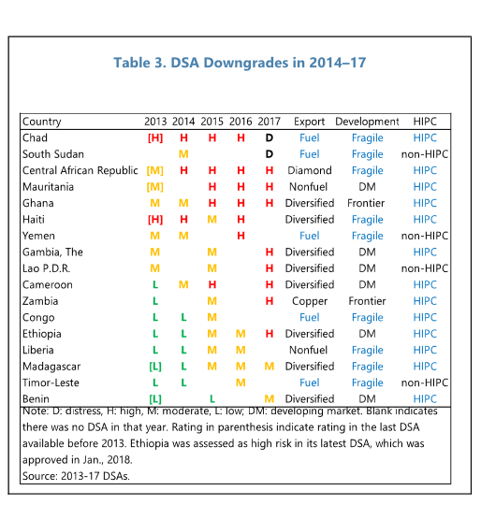
See how countries shift:
L > M > H > D
Granularity :
Distance from thresholds:
Further upward shift expected ?
Likelihood of downgrades in the periods ahead?
Will the distance narrow?
Factors influencing the distance:
Exogenous : Ebola, political conflicts, natural disasters.
Investment « push » financed through commercial loans.
Mismanagement of fiscal and macro-policies
Granularity analysis
Notes:
Granularity is certainly the most important ingredient to prevent the occurrence of debt crisis, because it helps countries to progressively adjust their policy. A gradual adjustment is less harmful than a brutal adjustment when a debt crisis is already ongoing.

Slide 43
Thank you
for your attention

