Slide 1
Debt module
Lecture 2
Assessing the debt management capacities of the countries
DeMPA

Slide 2
Outline
  Why a DeMPA and what is a DeMPA?
  Structure of DeMPA
  Debt performance indicators (DPI)
  DeMPA indicators : examples

Slide 3
Why a DeMPA?
Debt management objectives.
  Meet government financing needs and monitor performance.
  Minimize borrowing costs.
  Ensure consistency with prudent degree of risk.
  Promote the development of domestic debt markets.
Debt strategy.
  Trade-off between interest rate and roll over risk.
  Foreign currency risk.
  Pre-requisites: good governance, depolitization of decisions, independent debt management office,…

Slide 4
What is a DeMPA?
A tool to evaluate the capacity of a sovereign borrower to manage debt, based on a set of indicators:
  5 core areas.
  14 Debt Management Indicators (DPI).
  33 dimensions.
Scoring useful,
but the analyses are more important.
Scoring methodology : scores ranked from A to D.
  Meet minimum requirement = Score C.
  Absence of minimum = Score D.
  Sound practice = Score A (B intermediate for more granularity).
  Not applicable (N/A) – if the activity is not undertaken, e.g., loan guarantee is not issued in last five years.
  Not rated (N/R) – if impossible to assess due to insufficient information.

Slide 5
Outline
  Why a DeMPA and what is a DeMPA?
  Structure of DeMPA
  Debt performance indicators (DPI)
  DeMPA indicators : examples

Slide 6
Structure of DeMPA?
DeMPA 2009 |  | DeMPA 2015
Governance and Strategy Development |  | Governance and Strategy Development
DPI-1 | Legal Framework (1dimension) | DPI-1 | Legal Framework (1 dimension)
DPI-2 | Managerial Structure (2 dimensions) | DPI-2 | Managerial Structure (2 dimensions)
DPI-3 | Debt Management Strategy (2 dimensions) | DPI-3 | Debt Management Strategy (2 dimensions)
DPI-4 | Evaluation of Debt Management Operations (1 dimension) | DPI-4 | Reporting and Evaluation (2 dimensions)
DPI-5 | Audit (2 dimensions) | DPI-5 | Audit (2 dimensions)
Coordination with Macroeconomic Policies |  | Coordination with Macroeconomic Policies
DPI-6 | Coordination with Fiscal Policy (2 dimensions) | DPI-6 | Coordination with Fiscal Policy (2 dimensions)
DPI-7 | Coordination with Monetary Policy (3 dimensions) | DPI-7 | Coordination with Monetary Policy (3 dimensions)
Borrowing and Related Financing Activities |  | Borrowing and Related Financing Activities
DPI-8 | Domestic Market Borrowing (2 dimensions) | DPI-8 | Domestic Borrowing (2 dimensions)
DPI-9 | External Borrowing (3 dimensions) | DPI-9 | External Borrowing (3 dimensions)
DPI-10 | Loan Guarantees, On-Lending, and Derivatives (3 dimensions) | DPI-10 | Loan Guarantees, On-lending and Derivatives (3 dimensions)

Slide 7
Structure of DeMPA?
DeMPA 2009 |  | DeMPA 2015
Cash Flow Forecasting and Cash Balance Management |  | Cash Flow Forecasting and Cash Balance Management
DPI-11 | Cash Flow Forecasting and Cash Balance Management (2 dimensions) | DPI-11 | Cash Flow Forecasting and Cash Balance Management (2 dimensions)
Operational Risk Management |  | Debt Recording and Operational Risk Management
DPI-12 | Debt Administration and Data Security (4 dimensions) | DPI-12 | Debt Administration and Data Security (4 dimensions)
DPI13 | Segregation of Duties, Staff Capacity, and Business Continuity (3 dimensions) | DPI-13 | Segregation of Duties, Staff Capacity, and Business Continuity (3 dimensions)
 |  | DPI14 | Debt Records (2 dimensions)
Debt Recording and Reporting
DPI-14 | Debt Records (2 dimensions)
DPI-15 | Debt Reporting (3 dimensions)

Slide 8
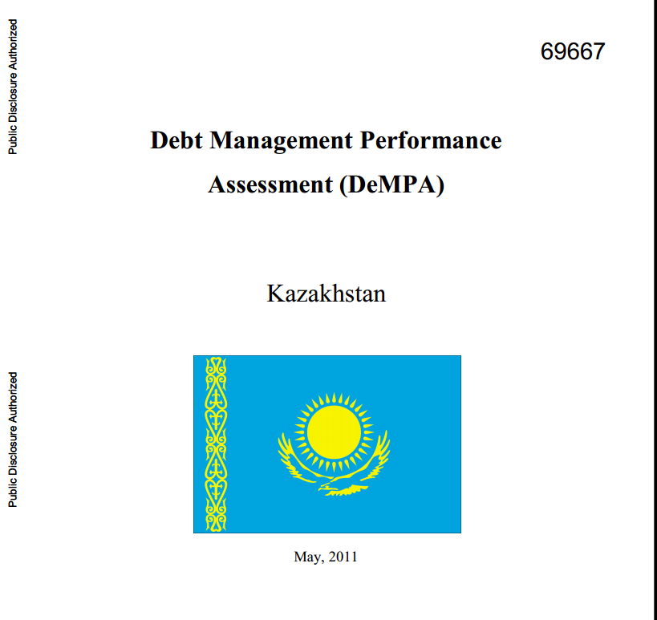
All DeMPAs have the same structure

Slide 9
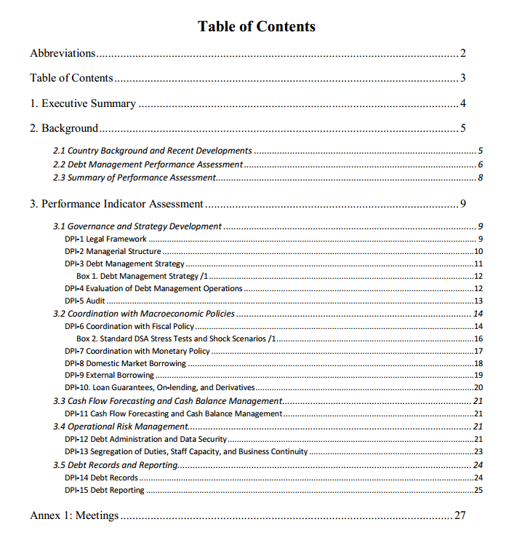
Notes:
This slide is intended to show that the structure of a DeMPA proposes a “calibrated” approach for all countries. Once we know how to read one DeMPA, we know how to read all DeMPAs for any country. The important point here is the motivation of the scores. So, a careful reading of the points raised in the report is needed.

Slide 10
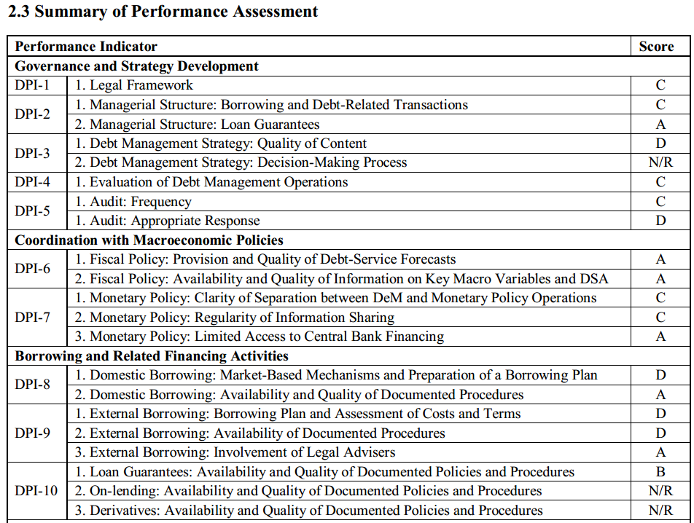

Slide 11
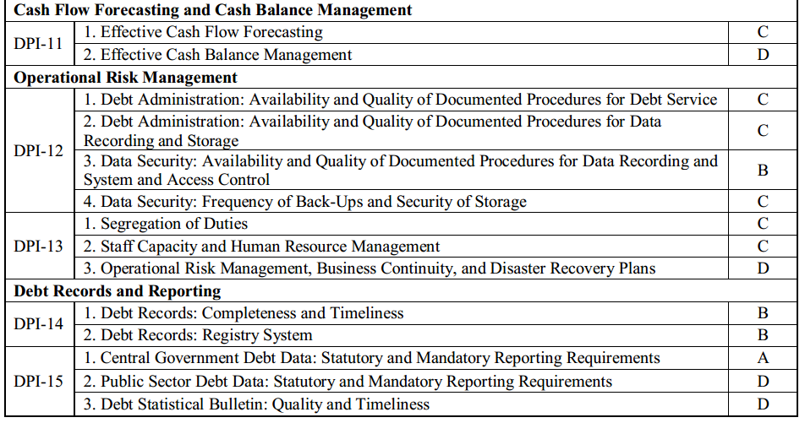

Slide 12
Outline
  Why a DeMPA and what is a DeMPA?
  Structure of DeMPA
  Debt performance indicators (DPI)
  DeMPA indicators : examples

Slide 13
Legal framework DPI1
Existence, coverage, content of the legal framework
Rules on debt in budget code and budget law.
  Rules determining the central and local gvts’ annual borrowing limits.
  Limits on the provision of guarantees.
  Purpose of state borrowing (funding of the budget deficit? Promotion of the domestic debt market?).
Designation of a debt management entity.
  Evaluation of debt against the limit for outstanding debt.
  Measures to optimize the structure of debt and debt servicing.
  Management of the risk of debt (instruments).

Slide 14
Managerial structure DPI2
Responsibility for debt management.
  Debt department ? Ministry of Finance? What about the organization: units, divisions?
  Which divisions are responsible for debt planning? For information about borrowing?
  Is there a financial advisor? Specialized agencies? Central bank?

Slide 15
Debt Management Strategy DPI3
  Is there a formal DeM strategy, decision making process?
  Is external borrowing only for investment purpose?
  Importance of the historical context of debt strategy.
  Description of market risk (currency, interest rate), fiscal and debt projections.
  What is the average maturity of debt ? What is the share of short-term to long-term? What is the share of floating rate-to- fixed rate?

Slide 16
Evaluation of debt management operations (DPI4) and Audit (DPI5)
Evaluation of debt management operations
  Is there a mandatory annual report (central gvt debt, outcomes against stated objectives)?
  Is the document submitted to parliament and made public?
Audit
  Are there annual audits of budget execution and debt?
  Compliance with laws governing the execution of the budget? Integrity of the financial accounts and reporting? What is the effectiveness of operations and executions
  Is the audit submitted to the parliament for discussions?

Slide 17
Coordination
with macroeconomic policies
Coordination with fiscal policy (DPI6)
  Availability of key fiscal variables and analysis of debt sustainability to be given to the Gvt’s debt department.
  The information should be accurate, and timely forecasts should be provided.
Coordination with monetary policy (DPI7)
  Price stability objective not to be compromised by debt cost minimization (monetary policy and debt management separated).
  Coordination through information (current and future debt transactions, central gvt’s cash flow).
  Limit to the direct access of resources from the central bank.

Slide 18
Borrowing and financial activities
Domestic borrowing (DPI8)
  Are the mechanisms clear enough (auctions- syndication-tap issuance – retailed issuance)?
  Capability to borrow from the domestic markets (is debt issuance based on market based mechanisms? Are there publications of borrowing plans?).
  Transparency for participants (procedures, calendar, ….).
External Borrowing (DPI9)
  Assessment of the most cost-effective borrowing + terms & conditions (lenders, currency, interest rate, maturity).
  Availability of documents with good quality (for borrowing in foreign markets).
  Involvement of legal advisors.

Slide 19
Loan guarantees on-lending
and debt-related transactions (DPI10)
  Availability and quality of document procedures (approval and issuance of loan guarantees).
  Availability of quality of document (procedures for on-lending of borrowed funds).
  Availability of a debt-management system (example: procedure for the use of derivatives).

Slide 20
Cash flow forecasting
and cash balance management (DPI11)
Cash flow forecasting : usually the responsibility of the Treasury unit.
  Effectiveness of forecasting the aggregate level of cash balances in gvt bank accounts.
Cash flow forecasting : usually the responsibility of the Treasury unit or Debt Management.
  Decision of an appropriate cash balance (liquidity buffer) and effectiveness of managing this cash balance in gvt bank accounts (including the integration with any domestic debt borrowing program, if required).

Slide 21
Debt recording and operational risk
Debt administration and data security (DPI12).
Segregation of duties, staff capacity and business continuity (DPI13).
Debt records(DPI14).
  Record all holders of Gvt securities, loan guarantee, debt relief.
  Avoid : miscalculation of payments / loss of public & investors' confidence.
  Needed : debt database, domestic security registry system, debt statistical bulletin.

Slide 22
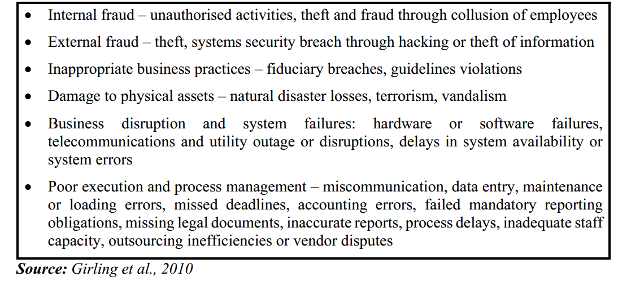
Examples of incidences
if DPI12, DPI13, DPI14 not met

Slide 23
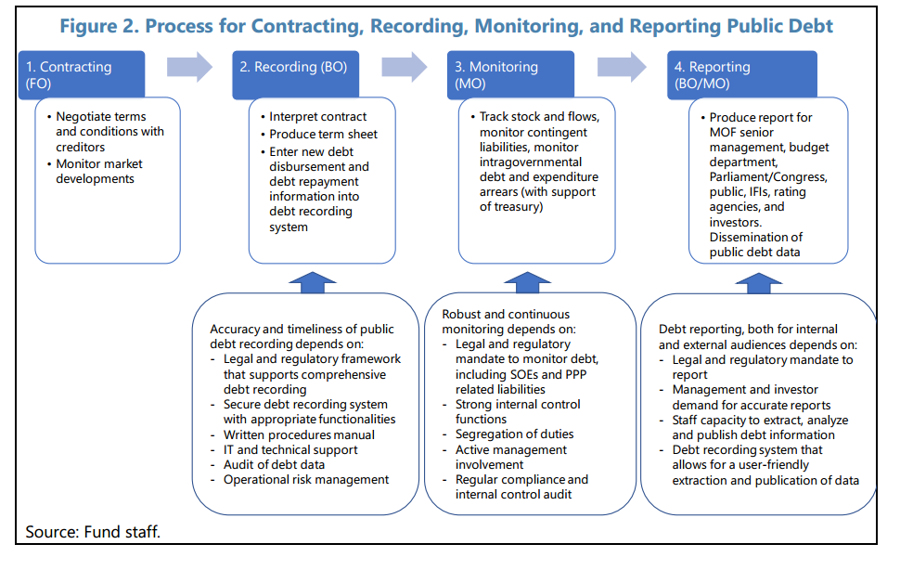

Slide 24
Outline
  Why a DeMPA and what is a DeMPA?
  Structure of DeMPA
  Debt performance indicators (DPI)
  DeMPA indicators : examples

Slide 25
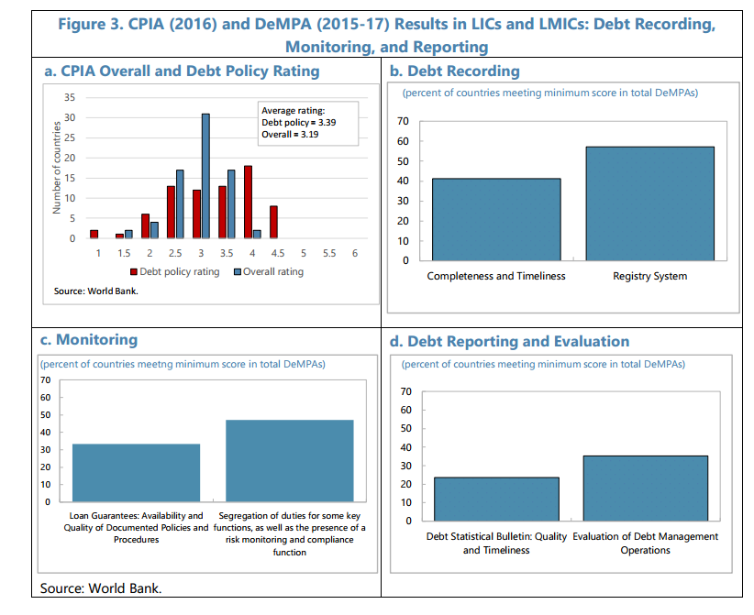
Notes:
The weakness in DeMPAs come very often from a weak quality of monitoring as well as in debt reporting and evaluation.

Slide 26
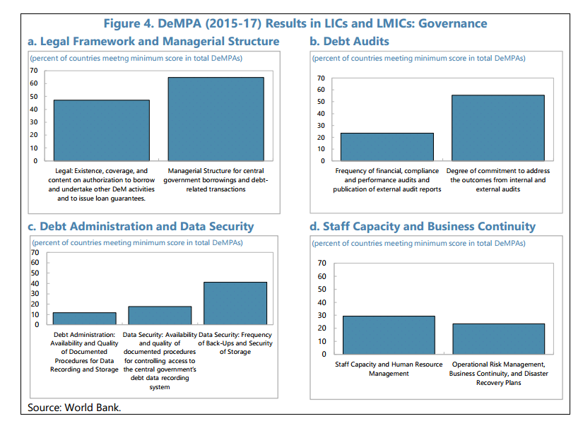
Notes:
This slide shows other two areas where some strong progresses still need to be achieved : debt administration and data security, and staff capacity. The World bank has increased its assistance of low-income countries in these fields.

Slide 27
Example of hidden debt: Mozambique
Debt crisis in Mozambique
  January 2017 : Mozambique ceased paying back its debt
  > Considered insolvent.
Notes:
We see the exponential growth of the debt ratio in a few years.

Slide 28
Mozambique:
unreported and/or mis-reported loans
Loans
  2013 & 2014 : $1.15 bn + $ 850 mn. Credit Suisse + VTB (Russian lender) lent to 3 SOEs for the purchase of naval equipment and fishing fleet.
  6 bilateral loans ($ 334 million).
  Both with a State guarantee.
  Weakness of debt capacity management
  Not approved by the parliament, or administrative court.
  Undisclosed to IMF (discontinuity with the rule : ceiling of 35% of non-concessional loans).
  Lack of transparency (supply contract, direct transfer of $ 500 millions to the gvt budget).

Slide 29
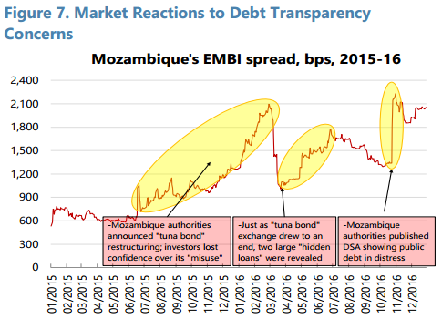
Mozambique:
unreported and/or mis-reported loans
  Consequences
  Has been cut off from international credit markets.
  Commercial banks stopped buying commercial bonds.

Slide 30
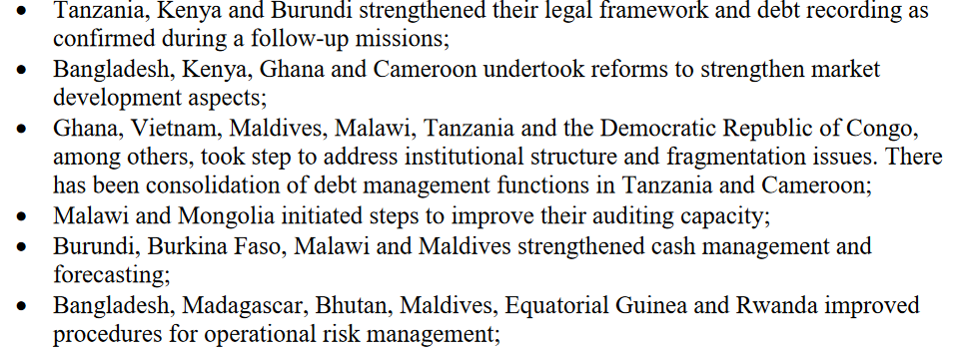
Countries example of reforms in DeMPA

Slide 31
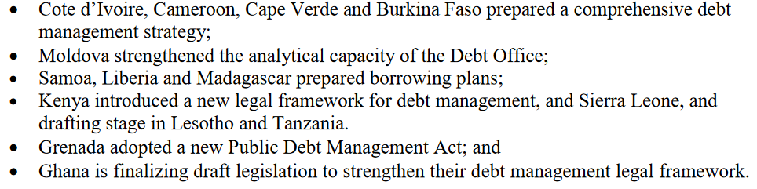
Countries example of reforms in DeMPA

Slide 32
Thank you
for your attention

