Slide 1
Debt module
Lecture 3
The New IMF/WB low-income countries debt sustainability framework

Slide 2
Outline
  What is debt sustainability?
  What is debt vulnerability?
  The IMF/WB low-income countries DSF (2018)
  Debt limit policy (DLP 2015)

Slide 3
What is debt sustainability?
Several approaches of debt sustainability.
Indicators for assessing the debt burden.
What is debt vulnerability? The issue of granularity.

Slide 4
Several approaches
of debt sustainability
Liquidity risk.
Solvency risk.
Economic policy approach.
Intertemporal solvency.

Slide 5
Liquidity risk
Can a country pay today ? (debt servicing)
Liquid assets available to meet the maturing liabilities.
Factors of liquidity risks.
  Markets perception.
  Maturities of debt portfolio.
  Composition of debt (external versus domestic)
  What are the loan terms (NPV of debt, concessional part, grant element)?

Slide 6
Solvency risk
Is a country likely to pay at all points in the future?
  What is the current debt? (High? Low?)
  What are the current policies (growth, inflation, interest rate)?
  What is the governance strength (fiscal rules, management, tax and custom administration efficiency)?
  What are the loan terms (NPV of debt, concessional part, grant element)?
Non-explosive debt to GDP ratio (debt ratio stabilizes or declines in the long term).
Debt ratio ≈
(Interest Rate – Growth Rate) x
Initial Debt Ratio – Primary Balance Ratio
Condition: Interest Rate < Growth Rate

Slide 7
Solvency risk
Liquid assets available to meet the maturing liabilities.
Factors of liquidity risks
  Markets perception.
  Maturities of debt portfolio.
  Composition of debt (external versus domestic).
  What are the loan terms (NPV of debt, concessional part, grant element)?

Slide 8
Economic policy approach
Debt is sustainable if:
  The country has a capacity to pay in the future without strong policy adjustment (spending retrenchment, fiscal consolidation).
  The country does not need to default, or renegotiate the loan terms (no debt restructuration needed).

Slide 9
Intertemporal solvency
Initial
debt
+
Discounted stream of primary expenditures
=
Discounted future stream of budget revenues
Primary Expenditure = Total Expenditure – Interest Expenditure.
Intertemporal solvency: a country can service its current debt with future surpluses.
No Ponzi game: initial debt is not serviced by relying on new loans.

Slide 10
Indicators
for assessing the debt burden
Ratios based on the capacity to pay.
Ratios based on debt service.

Slide 11
Ratios of debt to capacity to pay.
  Capacity to pay: income, exports, fiscal revenues.
  Debt sustainability: nominal debt does not growth at a rate faster than the capacity to repay it.
Ratios of debt service over indicators of liquidity risks.
  Debt service = Interest plus Amortization.
  Amortization = Principal payments on medium-to-long term + Short-term Debt (maturity < 1 year).
  Gross financing needs = Primary Deficit + Amortization

Slide 12
Main variables used in a LIC-DSF
 |  | Quality of policies and institutions
 |  | Weak | Medium | Strong
Solvency Ratio | NPV Debt/GDP | Threshold values
 | NPV Debt/EXPORT
 | NPV Debt/Revenue
Liquidity Ratio | Debt service/Exports
 | Debt service/revenue

Slide 13
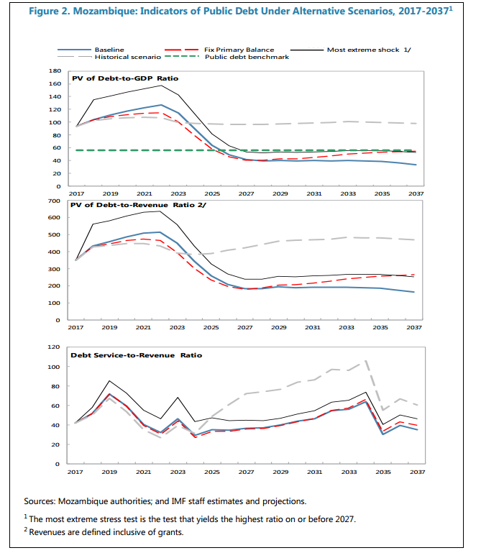
Notes:
The PV of debt solvency and liquidity indicators is evaluated under different scenarios, both baseline and in case of extreme shocks, to see how the thresholds are breached in different cases. Such graphs are also useful to see how persistent a shock is.

Slide 14
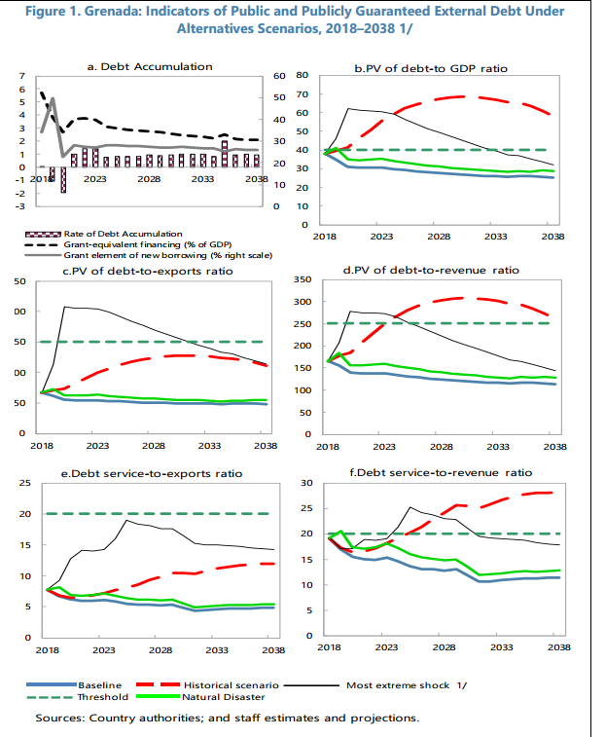
Notes:
Grenada is in a much better situation than Mozambique. As is seen, in many cases, the ratios remain below their threshold value.

Slide 15
Outline
  What is debt sustainability?
  What is debt vulnerability?
  The IMF/WB low-income countries DSF (2018)
  Debt limit policy (DLP 2015)

Slide 16
What is debt vulnerability?
Vulnerability
  A risk that a country violates the solvency and liquidity conditions and enters a crisis.
Importance of granularity
  Emphasis on the run-up to high debt and debt distress situations.
  Allows a more accurate assessing of risks.
  Early warning signals of increase in debt vulnerabilities (indicators in % of thresholds).

Slide 17
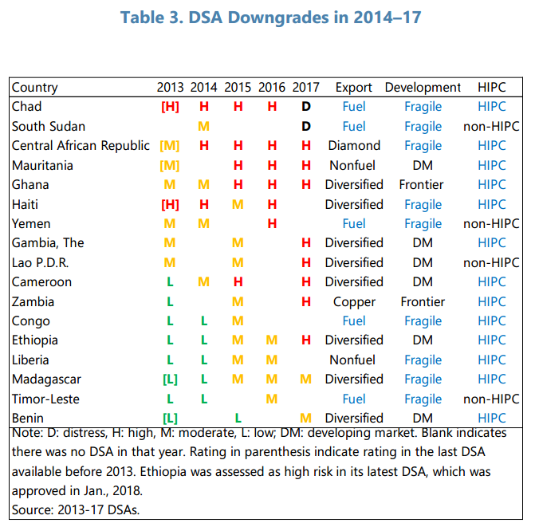
Notes:
This table illustrates the principle of granularity, meaning that we need to see how a country’s situation deteriorates (or improve) across time. Granularity allows “early warning” signals of higher risks of forthcoming debt distress.

Slide 18
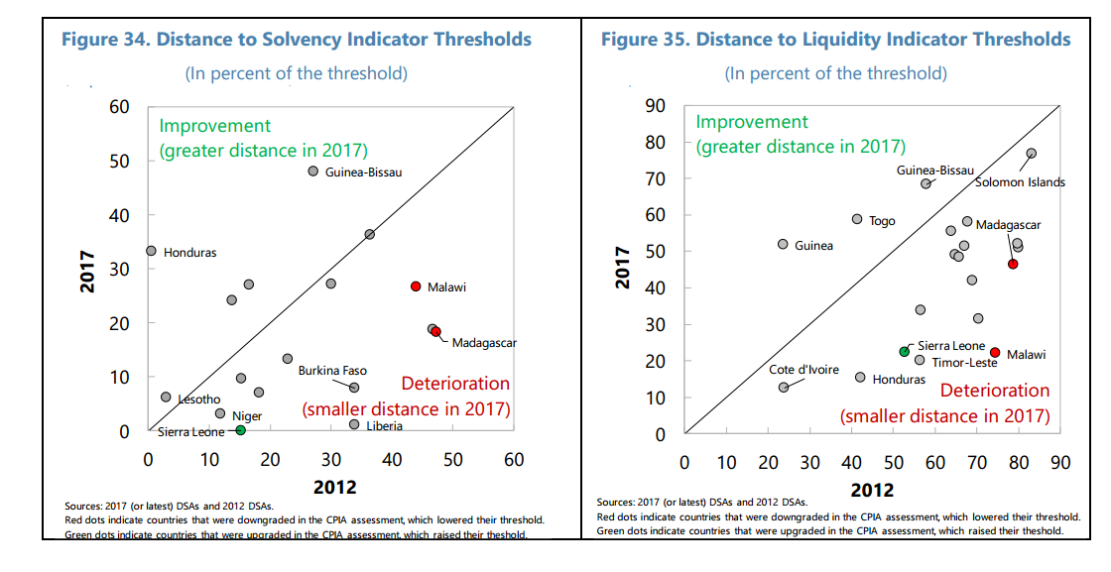
Notes:
Very few countries have improved their initial situation since 2012.

Slide 19
Outline
  What is debt sustainability?
  What is debt vulnerability?
  The IMF/WB low-income countries DSF (2018)
  Debt limit policy (DLP 2015)

Slide 20
Outline
  The IMF/WB low-income countries DSF (2018).
  Present value of debt.
  Grant element and concessionality of a loan.
  Presentation of the Debt Sustainability Framework.

Slide 21
Present value of debt
Question: Would you agree if I borrow € 1000 from you today and give you back € 1000 one year later?
€ 1000
January 2019
=
€ 1000
January 2020
?
Answer: Probably not. Because you could have invested these € 1000 and earn interest on your investment.

Slide 22
Present value of debt
Present value of a given amount in future years = The amount DISCOUNTED to calculate its equivalent current values.
Year | Nominal value | Present value
2019 | € 1000 | € 1000
2020 | € 1000 | € 1000 / (1+10%) = 909,1
2021 | € 1000 | € 1000 / (1+10%)² = 826,4
. | . | .

Slide 23
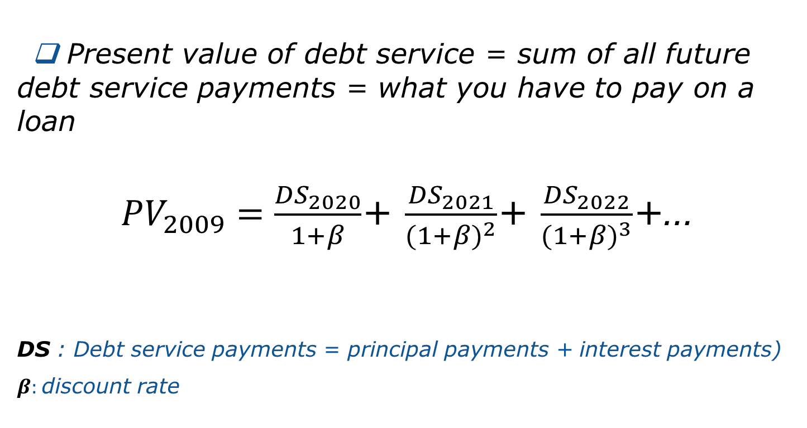
Present value of debt
Present value of debt service = Sum of all future debt service payments = What you have to pay on a loan.
DS : Debt Service payments = Principal payments + Interest payments.
β : Discount Rate.

Slide 24
Example: a one-year loan in 2019 of € 1000 at an interest rate
i = 5% and a discount rate β = 10%.
Year | Nominal value (principal payment) | Nominal value (interest payment) | Nominal value (debt service) | Present value (debt service)
2019 | - | - | - | -
2020 | € 1000 | i x 1000 = 5% x 1000 = € 50 | 1000 + i x 1000 = 1000 x 1,05 = € 1050 | (1000 + i x 1000) / (1 + β)
Present value of debt service PV
= (€ 1000 + 5% . € 1000) / (1+0.1) = 1050/1.1 = € 954.4

Slide 25
Example: a one-year loan in 2019 of € 1000 at an interest rate
i = 5% and a discount rate β = 10%.
Present Value of debt service (PV) = ( € 1000 + 5% . € 1000 ) / (1+0.1) = 1050/1.1 = € 954.4.
Nominal value of debt NV: what we borrow.
Present value of debt PV: what we pay on the loan in the present value.

Slide 26
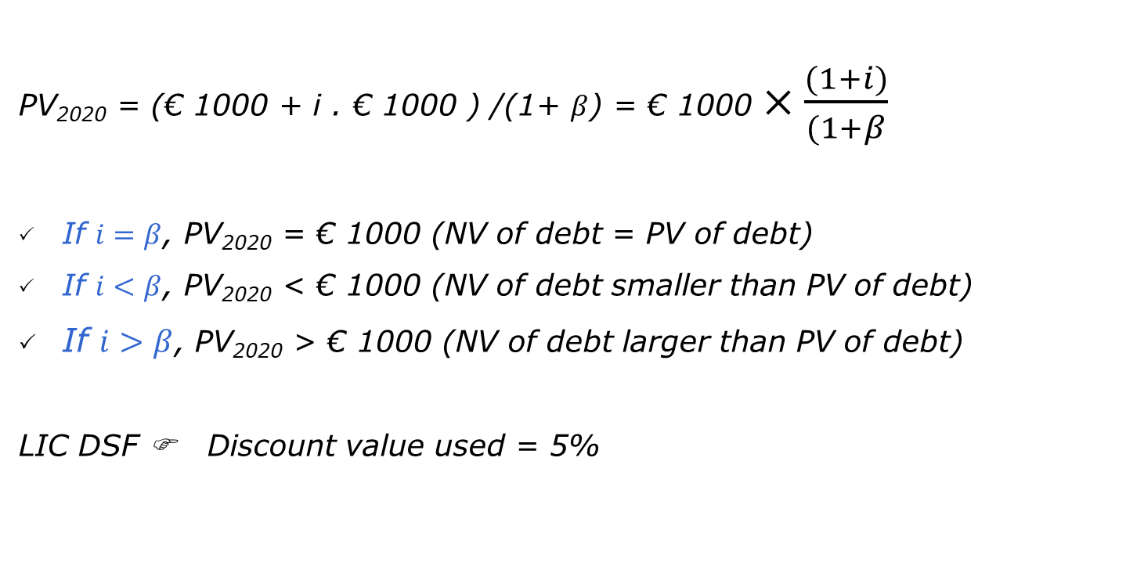
Present value of debt

Slide 27
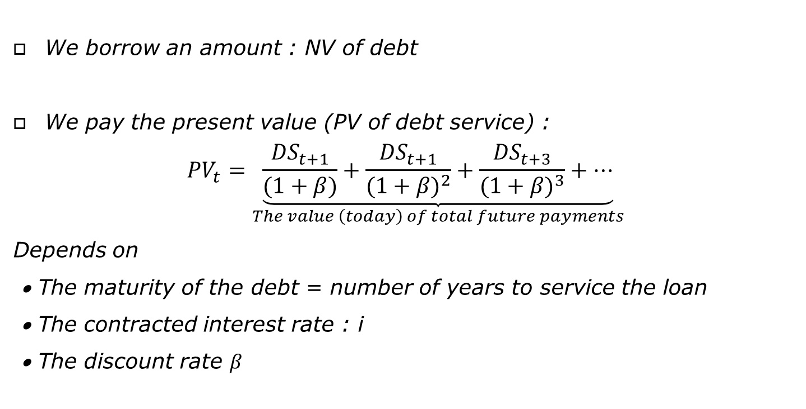
Present value of debt

Slide 28
Concessionality of a loan
Concessionality: Total (discounted) payment is lower than the amount borrowed.
The degree of concessionality depends on:
  The interest rate i.
  The maturity of the loan.
  The grace period: when we start reimbursing the principal.
  The frequency of payments.

Slide 29
Concessionality of a loan
Example: The maturity is 5 years, no principal schedule in the first 2 years and the frequency of payment is annual.
Year | Nominal value (principal payment) | Nominal value (interest payment)
2019 | - | -
2020 | Grace period | I₂₀₂₀
2021 |  | I₂₀₂₁
2022 | P₂₀₂₂ | I₂₀₂₂
2023 | P₂₀₂₃ | I₂₀₂₃
2024 | P₂₀₂₄ | I₂₀₂₄
When i < β, NB of debt is smaller than PV and the PV can be lowered by:
  Increasing the maturity.
  Increasing the grade period.
  Reducing the frequency of payment.

Slide 30
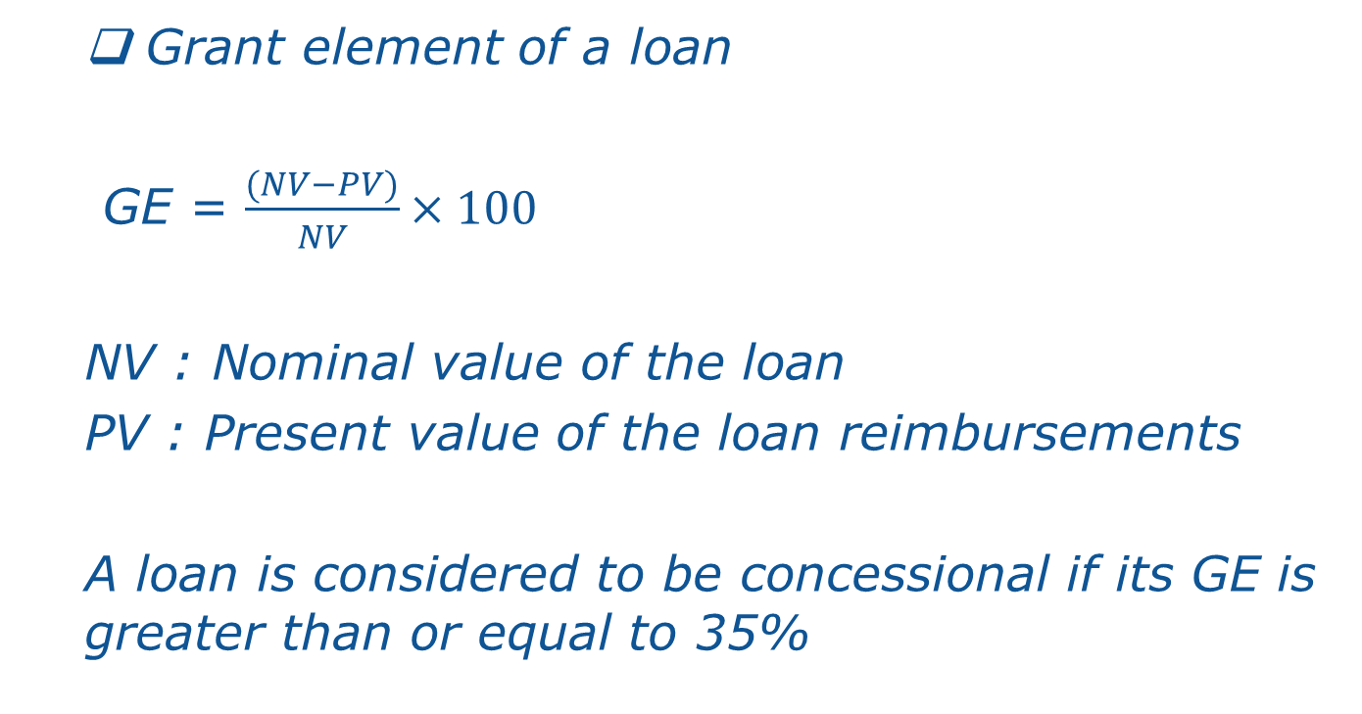
Grant element of a loan

Slide 31
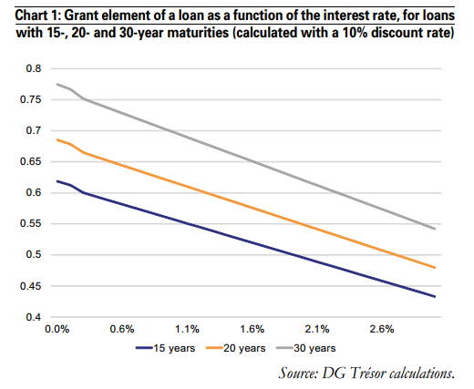
Grant element of a loan
Source: DG Trésor Calculations

Slide 32
Presentation of the Debt Sustainability Framework (July 2018)
Scope: An operational approach to assess debt sustainability in LICs (external + public debts).
Forward-looking: 20-year forecast of debt burden indicators under baseline assumptions and stress tests.
To capture long maturity and grace period
of concessional loans and investment returns.
Institutional indicators: combined with policy specific debt thresholds > Lead to a risk scoring.
Countries eligible to:
  Poverty Reduction and Growth Trust (PRGT) facilities
  International Development Association (IDA) resources

Slide 33
Outline
  The IMF/WB low-income countries DSF (2018).
  Debt carrying capacity: composite indicator.
  An overview of the DSF tool.

Slide 34
Debt carrying capacity
NOT relying exclusively on the CPIA to classify countries’ debt-carrying capacity.
INSTEAD use a composite measure based on a set of economic variables.
  Composite index = weighted sum of the non-debt determinants of debt distress and CPIA.
  CI = 0.385*CPIA + 2.719*Growth + 4.052*Reserves - 3.990*Reserves^2 + 2.022*Remittances + 13.520*World Growth

Slide 35
A composite
Indicator to replace the standard CPIA
  CI = 0.385*CPIA + 2.719*Growth + 4.052*Reserves - 3.990*Reserves^2 + 2.022*Remittances + 13.520*World Growth
Weights: average estimated coefficients across the statistical models.
Reserves and remittances: scaled by imports and GDP, respectively.
Country classification depends upon other countries’ situation and global factors.
The CI uses ten years of data (5 years of history and 5 years of projections) to smooth out economic cycles and encourage forward-looking policy discussions (CPIA, growth, reserves, remittances, world growth).

Slide 36
A composite
Indicator to replace the standard CPIA
  CI = 0.385*CPIA + 2.719*Growth + 4.052*Reserves - 3.990*Reserves^2 + 2.022*Remittances + 13.520*World Growth
Weights: average estimated coefficients across the statistical models.
Reserves and remittances: scaled by imports and GDP, respectively.
Country classification depends upon other countries’ situation and global factors.
The CI uses ten years of data (5 years of history and 5 years of projections) to smooth out economic cycles and encourage forward-looking policy discussions (CPIA, growth, reserves, remittances, world growth).
Debt carrying capacity rating : weak – medium – strong

Slide 37
CPIA index
Country Policy and Institutional Assessment (16 indicators)
  Economic management.
  Structural policies.
  Policies for social inclusion and equity.
  Public sector management and institutions.
Annually compiled by the WB
for IDA-eligible countries.

Slide 38
Outline
  An overview of the DSF tool.
  Main features.
  Main macroeconomic variables in the DSF and realism of the assumptions and projections.
  External and overall debt : analysis and thresholds.
  Risk signals.

Slide 39
LIC-DSA template structure

Slide 40
Main features of a DSF:
key role of macroeconomic framework
Macroeconomic projections and assumptions
LIC DSA template
Risk assessment
  Realistic.
  Must reflect the policies of the country authorities.
  Stress tests customized: consistent with the specific shocks facing a country.
Notes:
A major change with the new DSF is that the assumptions and stress tests are customized to a country’s situation. “Realism” means that the assumptions should reflect the most realistic situation given the policy orientation (fiscal, trade, monetary) and the economic vulnerability of the countries.

Slide 41
Main features of a DSF: assessment
of the overall risk of debt distress
External Risk Rating
External
DSA
Public and publicly guaranteed (PPG) external debt
+
Private external debt
(non-guaranteed)
Public DSA
+
Public
domestic
debt
Assessment of the overall risk of debt distress

Slide 42
Main features of a DSF: rating
for the risks of external debt distress
Four ratings for the risk of external debt distress
PPG external debt
LOW
Thresholds
Moderate
Risk Rating
High
In debt distress
Notes:
LIC DSF uses policy-dependent external debt-burden thresholds because the debt levels that LICs can sustain are influenced by the quality of their policies and institutions. These debt-burden thresholds are not to be seen as rigid ceilings but as guideposts for informing debt sustainability assessments.
Policy performance is measured by the Country Policy and Institutional Assessment (CPIA) index, compiled annually by the World Bank.
The rating is determined taking into account baseline as well as alternative scenarios. The assessment of the risk of debt distress needs to strike a balance between a mechanistic use of this classification and a judgmental approach.
Risk rating
Low risk = All debt burden indicators are below the thresholds
Moderate risk = Debt burden indicators are below the thresholds in the baseline scenario, but one or more indicators breach thresholds under stress tests
High risk = One or more debt burden indicators breach thresholds in the baseline scenario
In debt distress =The country is already experiencing difficulties in servicing its debt (i.e., is in arrears)

Slide 43
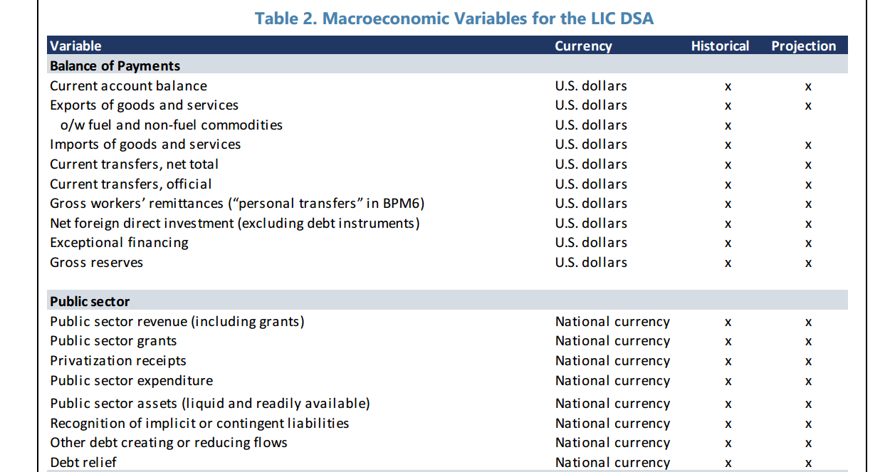

Slide 44
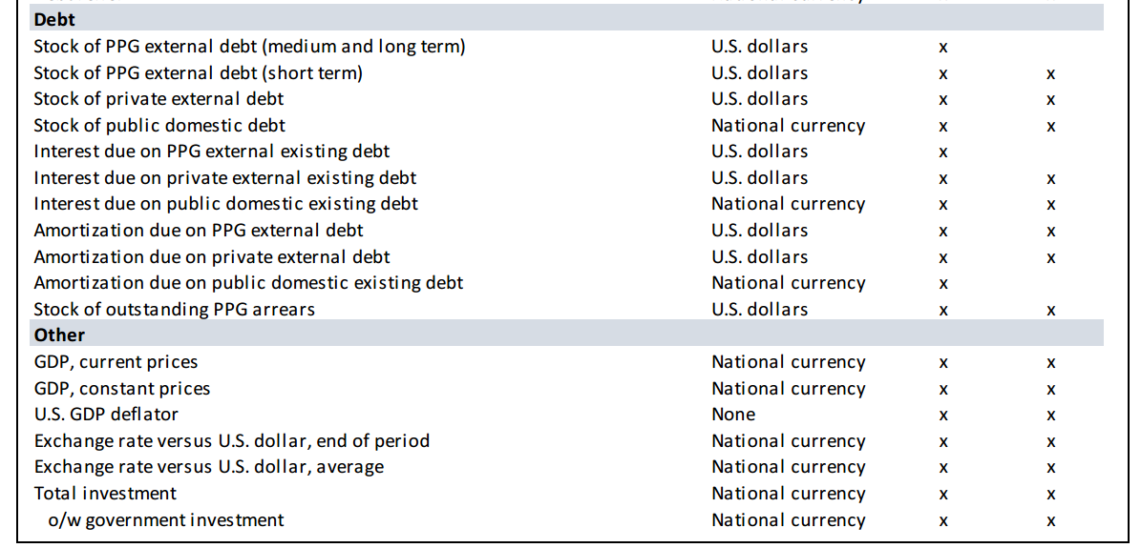

Slide 45
Contribution from real interest rate
Contribution from real GDP growth
Contribution from real exchange rate depreciation
- p Primary deficit
η Other identified flows and residual
Notes:
Explain each term of the decomposition as well as the intuition of the impact on the change in the debt ratio. i.e. for example the higher the average real interest rate to be paid, the more likely it is that this component will account of the change in the debt to GDP ratio.

Slide 46
Realism of
assumptions and projections
Determinants of debt dynamics
  3 vintages of debt dynamics: current, past year(5yrs) , forecasts (5yrs ahead).
  Are there any breakdown in the determinants of debts dynamics.
  Analyses of past forecast errors: contribution of each factor.
  Contribution of errors to unexpected changes and revision.
Are the projected drivers of growth likely to materialize? What were their respective contribution in the past?
  Low/high contribution of growth/interest differential in past debt accumulation?
  Prediction of the real exchange rate should be tighten to realistic assumptions on the current account balance.
  Realism of fiscal adjustment.

Slide 47
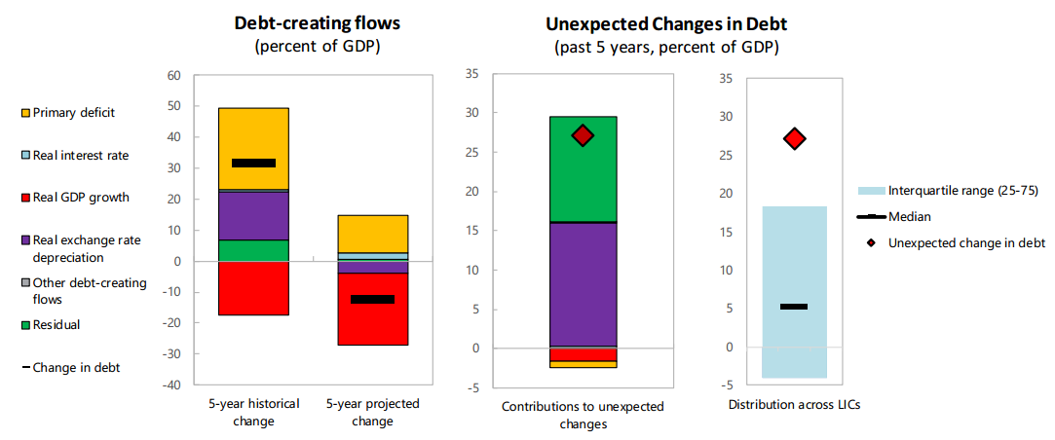
Example

Slide 48
EXTERNAL DEBT
AND CONTINGENT LIABILITIES
External Debt > Definition
  Gross TOTAL external debt =
  PPG (public and publicly guaranteed)
  + PNG (publicly non-guaranteed)
  + short-term debt (public and private)
Contingent Liabilities > Definition
  Explicit =
  Guarantees for borrowing (local gvts, private entities, sectoral : agriculture, SME).
  State insurance schemes (crop, flood insurances).
  Implicit = Defaults (local gvts, private entities) + Bank failures +
  Liabilities clean-up in entities privatized +
  Failure of pension and social security funds

Slide 49
PPG TOTAL DEBT
Total Debt > Definition = External PPG + Domestic PPG
  Domestic PPG
  Payable in domestic currency
  May include arrears (wage, suppliers)
  Drivers : budget deficits, domestic interest rates and term structure

Slide 50
Indicative thresholds depend on the quality of policies and institutions (CI indicator)
 |  | Quality of policies and institutions
 |  | Weak CI<2.69 |  | Strong CI>3.05
Solvency ratio | NPV PPG external Debt/GDP | 30 | 40 | 55
 | NPV PPG external Debt/EXPORT | 140 | 180 | 240
 | NPV PPG TOTAL Debt/EXPORT | 35 | 55 | 70
Liquidity ratio | NPV PPG external Debt service/Exports | 10 | 15 | 21
 | NPV PPG external Debt service/revenue | 14 | 18 | 23
  When the CI is high enough (a country has a good capacity of debt management)
  It will be more able to absorb large shocks on external and public debts.
  Higher thresholds indicate that the Fund and WB tolerate higher ceilings (corresponding to larger shocks on debt).

Slide 51
STRESS TESTS
Very important
  Shocks customized (not general) to the countries’ situation and specificities.
  3 dimensions : Nature of shock, trigger (When? How long?), How to quantify the shock.

Slide 52
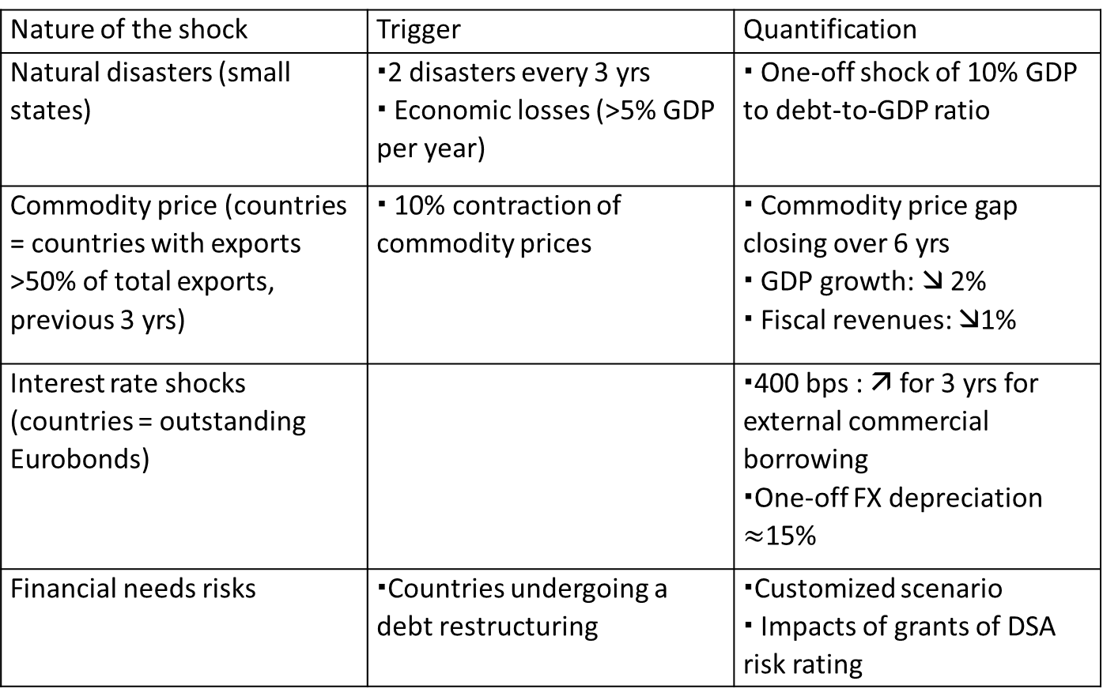
STRESS TESTS
Nature of the shock | Trigger | Quantification
Natural disasters (small states) | 2 disasters every 3 yrs Economic losses (>5% GDP per year) | One-off shock of 10% GDP to debt-to-GDP ratio
Commodity price (countries = countries with exports >50% of total exports, previous 3 yrs) | 10% contraction of commodity prices | Commodity price gap closing over 6 yrs GDP growth:  2% Fiscal revenues: 1%
Interest rate shocks (countries = outstanding Eurobonds)
Financial needs risks | Countries undergoing a debt restructuring | Customized scenario Impacts of grants of DSA risk rating

Slide 53
EXTERNAL RISK RATING
Low risk of debt distress
  None of Debt burden thresholds breached under the baseline scenario or stress tests.
Moderate risk of debt distress
  None of Debt burden thresholds breached under the baseline scenario and at least one is breached under the stress tests.
High risk of debt distress
  At least one of the debt burden threshold is breached under the baseline.

Slide 54
TOTAL DEBT
Low risk of debt distress
  PPG external has a low risk signal.
  Total PPG debt ratio below threshold under the baseline and stress tests.
Moderate risk of debt distress
  PPG external : moderate risk signal.
  OR PPG total : low risk + public stock debt threshold is breached under stress test.
High risk of debt distress
  PPG external OR total public debt breaches their threshold under the baseline scenario.

Slide 55
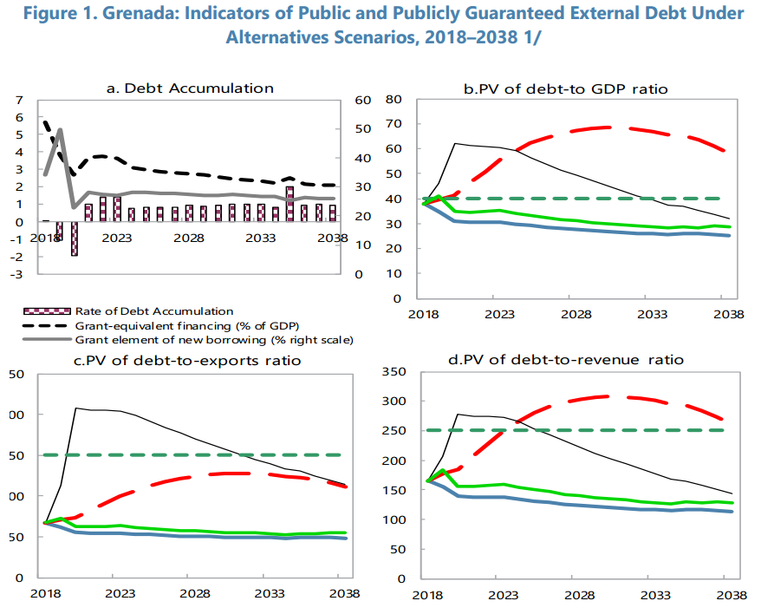

Slide 56
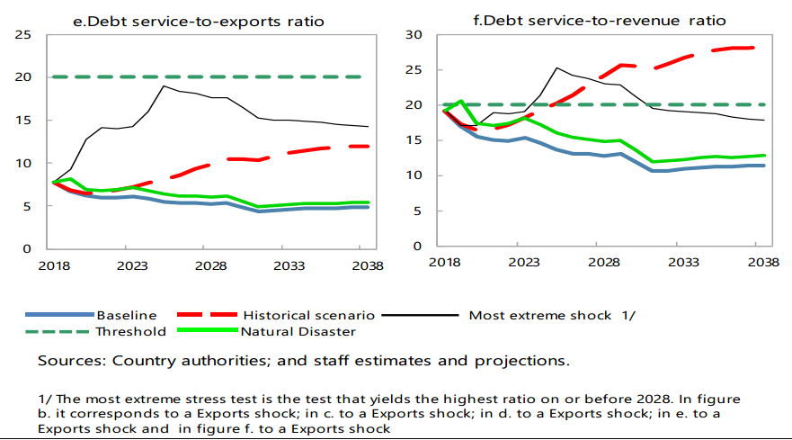

Slide 57
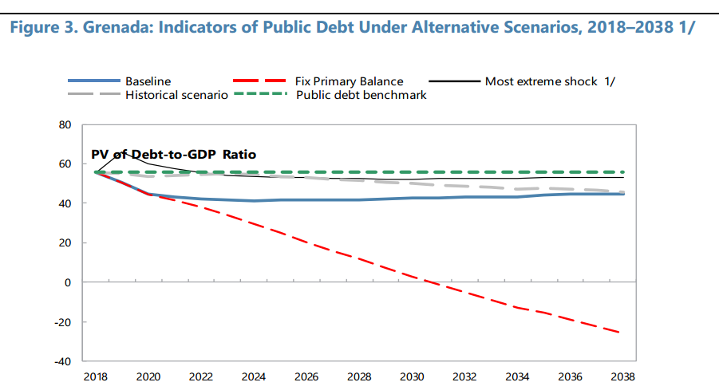

Slide 58
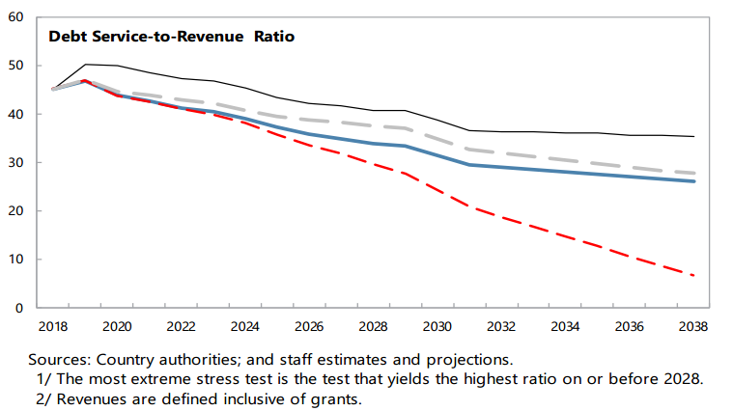

Slide 59
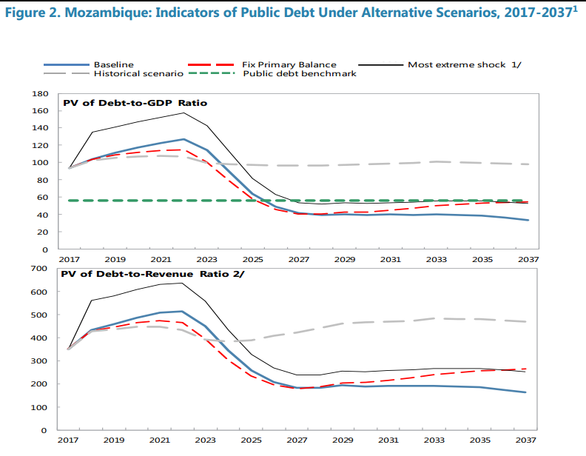

Slide 60
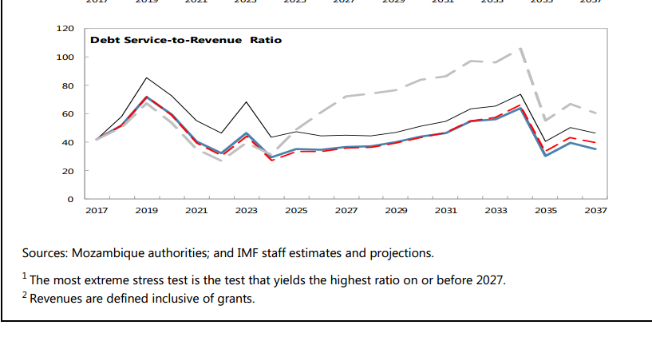

Slide 61
Outline
  What is debt sustainability?
  What is debt vulnerability ?
  The IMF/WB low-income countries DSF (2018)
  Debt limit policy (DLP 2015)

Slide 62
LIC-DSF used
to inform IMF and WB debt-limit policies
IMF and WB debt-limit policies
DSF
IMF DLP (2015)
Limits on debt accumulation in countries with Fund-supported programs
Results used
External DSA
IDA’s NCB policies
Limits on NCB in countries that receive IDA grants or that have benefited from MDRI
Public DSA

Slide 63
New IMF Debt limit policy (DLP 2015): Overview
  For countries that do not normally rely on concessional external financing
  For countries that normally rely on official concessional financing
  Judgments on debt vulnerabilities are informed by a set of tools provided within the DSF for market access countries (MAC-DSA).
  A heat map summarizes the risks to debt sustainability in the MAC-DSA. For example, heat map indicators flashing "red", i.e. exceeding their benchmarks under the baseline would signal significant debt vulnerabilities. In such circumstances, debt targets would take the form of limits on total public debt or targeted debt limits, taking into account country-specific circumstances.
  The assessment of debt vulnerabilities is informed by the low-income countries debt sustainability framework (LIC-DSF).
  An external risk of debt distress rating of "moderate", "high", or "in debt distress" would signal the presence of significant external public debt vulnerabilities.

Slide 64
New IMF Debt limit policy (DLP 2015): Overview
    The 2014 reform of the policy (Policy on Public Debt Limits in Fund-Supported Programs)—which became effective on June 30, 2015— is based on a set of robust principles guiding the use of public debt conditionality in Fund-supported arrangements.
    Key changes with respect to the 2009 policy include:
  The broadening of the policy to encompass all public debt rather than only external public debt (especially in countries having a market access).
  An integrated treatment of concessional and non-concessional external debt (initially, discussions were essentially on NCB).

Slide 65
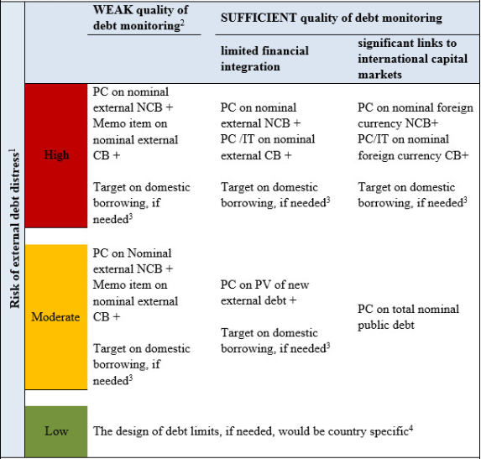
Debt limit policy:
ceilings on public external borrowing
    Three criteria:
  Risk of external debt distress (Low, Moderate, High)
  Quality of debt monitoring (weak, sufficient)
  Financial integration (limited, significant)

Slide 66
Debt limit policy:
ceilings on public external borrowing
    For countries in low risk of external debt distress
  Normally : No limit on external debt required
  But : if overall risk of debt distress shows significant risks related to domestic public debt  ceiling on domestic borrowing

Slide 67
Debt limit policy:
ceilings on public external borrowing
    For countries at moderate risk of external debt
  Debt conditionality would typically take the form of a limit on the present value of new external debt (NCB and CB).
  In addition: if overall risk of debt distress shows significant risks related to domestic public debt.
  Ceiling on domestic borrowing.

Slide 68
Debt limit policy:
ceilings on public external borrowing
    For countries at high risk of external debt
  Debt conditionality would mostly be set on the nominal levels of external debt.
  In addition: if overall risk of debt distress shows significant risks related to domestic public debt.
  Ceiling on domestic borrowing.

Slide 69
List of IDA-only and
PRGT-eligible Countries Subject to IMF/World Bank Group Debt Limits Conditionality (August 2018)

Slide 70
List of IDA-only and
PRGT-eligible Countries Subject to IMF/World Bank Group Debt Limits Conditionality (August 2018)

Slide 71
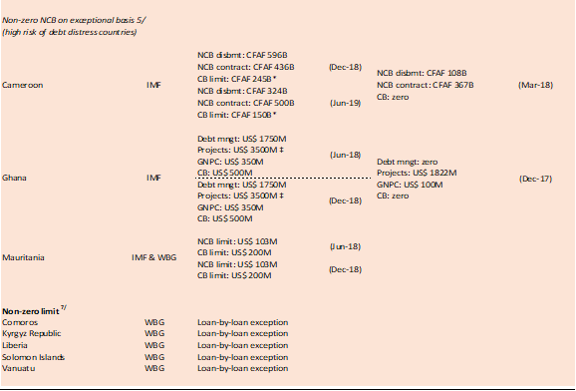
List of IDA-only and
PRGT-eligible Countries Subject to IMF/World Bank Group Debt Limits Conditionality (August 2018)

Slide 72
List of IDA-only and
PRGT-eligible Countries Subject to IMF/World Bank Group Debt Limits Conditionality (August 2018)

Slide 73
Thank you
for your attention

