Slide 1
European Union approach for DRM
Brussels, January 2019
Module 2
Domestic Revenue Mobilisation
Training funded by the European Union
DG TAXUD
Pierre Vandenberghe
Tax administration expert
Notes:
The notes included in this training material are a guide to the instructor and the participants and should not be construed as replacing any other texts.

Slide 2
Outline
Internal approach / Anti-tax avoidance package
EU external approach / EU list
Commission support on DRM to developing countries
Notes:
Introductions
Instructor
Name tents
- Objectives
Each participant, what would they like to get from this course?
Methods for course
Introducing DRM
Mexico to Addis
Collect More, Spend Better
EU commitment to DRM
Pre-course knowledge assessment -- this is to assess the knowledge that participants have when they come to the training programme and compare that with what they have at the completion of the training programme. This is not to SCORE or GRADE the participant.

Slide 3
1. EU internal approach – Which DG?
=> DG Taxud (tax & customs)
=> Structural reform support service (SRSS – under the SG)
=> DG Fisma (Accounting and financial reporting– CBCR)
=> DG COMP (state aid)
=> DG Justice (Anti money laundering & Counter terrorism)
=> DG ECFIN (economic and financial policy – European semester)
=> OLAF (Office de lutte anti-fraude, anti-fraud policy)

Slide 4
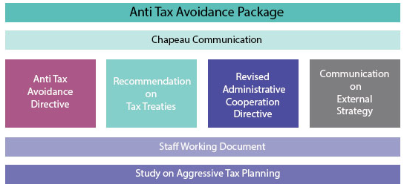
1 .EU Internal approach on fighting tax avoidance
Anti Tax avoidance package –ATAP- Janvier 2016
Notes:
See anti-avoidance directive https://ec.europa.eu/taxation_customs/business/company-tax/anti-tax-avoidance-package/anti-tax-avoidance-directive_en
Tax.
A hybrid mismatch arrangement is an arrangement:
Intended to secure a tax advantage within a multinational group
Resulting from a difference in tax treatment of the same financial instrument or entity between different jurisdictions.
Hybrid mismatch arrangements can arise both from hybrid financial instruments and from hybrid entities.

Slide 5
2. EU External approach - EU List
=> External Strategy for Effective Taxation ( ATAP January 2016)
=> Council Conclusions (May 2016)
- Endorsed the EU listing process set out in the External Strategy for Effective Taxation
- ECOFIN invited the EU Code of Conduct Group to start work on the common EU List by September 2016
- Asked for a first EU list of non-cooperative jurisdictions to be ready in 2017.
=> Member States driven process (Council: group Code of conduct)

Slide 6
2. The 3 steps of the EU listing
1: Scoreboard: a neutral scoreboard of indicators, to help determine the potential risk level of each third country's tax system in facilitating tax avoidance. Findings of the scoreboard to Member State experts in the Code of Conduct Group on business taxation in Council.
2: Screening: On the basis of the scoreboard results, Member States decide which third countries should be formally screened by the EU. The screening of third countries' tax good governance standards will be carried out by the Commission and the Code of Conduct Group. There will be a dialogue process with the countries in question, to allow them to react to any concerns raised or discuss deeper cooperation with the EU on tax matters.
3: Listing: Once the screening process is complete, third countries that refused to commit to improve their legal framework or to engage with the EU regarding tax good governance concerns should be put on the EU list.

Slide 7
2. The scoreboard
- the 28 Member States are excluded
- third country jurisdictions that already have a transparency agreement with the EU feature separately in the scoreboard. Currently, this covers Switzerland, Liechtenstein, Andorra, Monaco and San Marino.
- And finally, the 48 least developed countries (LDC) identified by the United Nations are also featured separately, in recognition of the particular constraints they face.
=> 160 jurisdictions in the scoreboard

Slide 8
2. Score board selection indictor’s
The selection indicators are obtained for all jurisdictions and grouped into three dimensions:
• Strength of economic ties with the EU
• Financial activity:
• Stability factors
(https://ec.europa.eu/taxation_customs/sites/taxation/files/2016-09-15_scoreboard-indicators.pdf)
=>92 jurisdictions finally screened to the 3 criterias

Slide 9
2. EU external approach
LISTING CRITERIA
Tax transparency
Fair taxation
Commitment to anti-BEPS measures
Notes:
BEPS : G20 initiative launched in 2012, implemented by OECD, 15 action points
See https://transferpricingasia.com/2017/03/09/15-action-points-beps-explained/
Will be seen at a later stage
CFC rules : Contrôle foreign cooperation

Slide 10

2. Criterion: Tax transparency
Committed to and started the legislative process to implement effectively the CRS with first exchanges in 2018 at the latest; and
Have arrangements in place to be able to exchange information with all MS, by the end of 2017, either by signing the MCAA or through bilateral agreements.
1.1
1.2
At least a "Largely Compliant" rating by the GF with respect to the OECD EOIR standard, with due regard to the fast track procedure.
1.2
Notes:
CRS : Common reporting standards

Slide 11
2. Criterion: Tax transparency
(for sovereign states) the jurisdiction should have either:
  Ratified, agreed to ratify, be in the process of ratifying, or committed to the entry into force, within a reasonable time frame, of the OECD MCMAA in Tax Matters (MAC), as amended, or
  A network of exchange arrangements in force by 31 December 2018 which is sufficiently broad to cover all MS, effectively allowing both EOIR and AEOI;
(for non-sovereign jurisdictions) the jurisdiction should have either:
  Participate in the MAC as amended, which is either already in force or expected to enter into force for them within a reasonable timeframe, or
  Have a network of exchange arrangements in force, or have taken the necessary steps to bring such exchange agreements into force within a reasonable timeframe, which is sufficiently broad to cover all MS, allowing both EOIR and AEOI.
1.3
Notes:
MCMAA : Multilateral Convention of Mutual Administrative Assistance)

Slide 12
2. Criterion: Tax transparency
Exception until 30 June 2019: Jurisdiction could be regarded as compliant on tax transparency, if it fulfils at least two of the criteria 1.1, 1.2 or 1.3
This exception does not apply to:
  Jurisdictions which are rated "Non-Compliant" on criterion 1.2; or
  Jurisdictions which have not obtained at least "Largely Compliant" rating on criterion 1.2 by 30 June 2018

Slide 13
2. Criterion: Fair taxation
The jurisdiction should have no preferential tax measures that could be regarded as harmful according to the criteria set out in the Resolution of the Council and the Representatives of the Governments of the MS, meeting within the Council of 1 December 1997 on a code of conduct for business taxation.
2.1
AND
2.2
The jurisdiction should not facilitate offshore structures or arrangements aimed at attracting profits which do not reflect real economic activity in the jurisdiction.
Criterion 2.2:
The Code of Conduct Group (Business Taxation) will assess 0% rate/ no-CIT jurisdictions applying "by analogy" the current "Code test" (Ecofin of 27 February)

Slide 14
2. EU list: Screening Process
The Code of Conduct Group (business Taxation) steered the screening process: MS expert panels set up
The Commission services assisted the Code of Conduct Group (technical preparatory work)
Stock taken of the work achieved by the GF and the OECD Inclusive Framework
Dialogue at technical level between MS experts and jurisdictions (questionnaires, meeting, conference calls)
Assessments sent to COCG and then to the ECOFIN Council

Slide 15
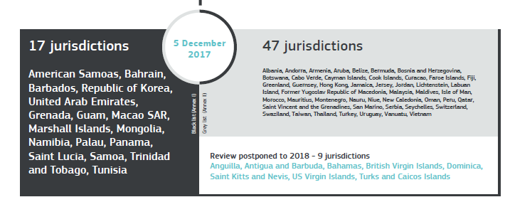
2. The common EU List

Slide 16
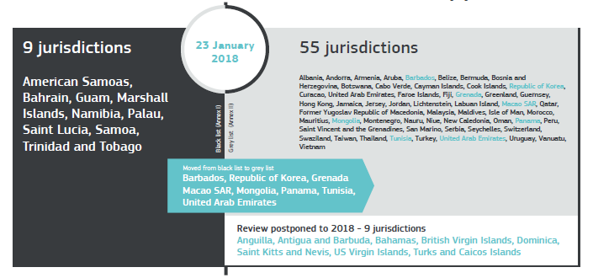
2. The common EU List: 1st update

Slide 17
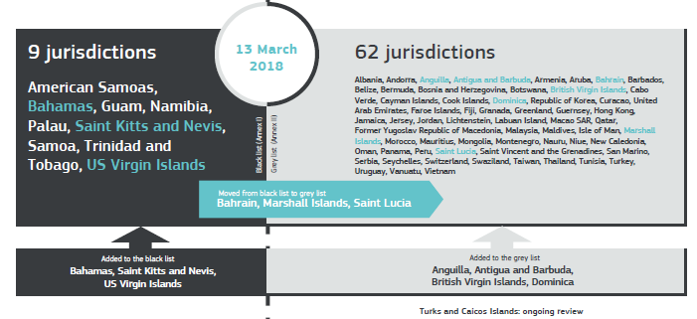
2. The common EU List: 2nd update

Slide 18
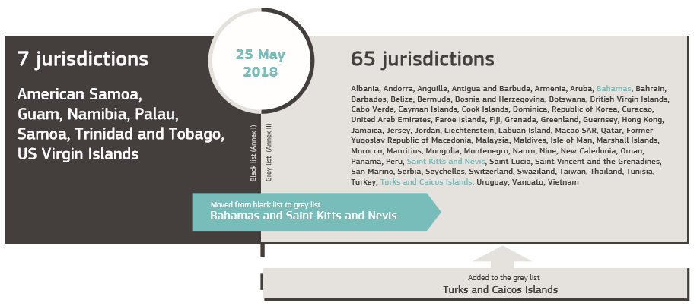
2. The common EU List: 3rd update

Slide 19
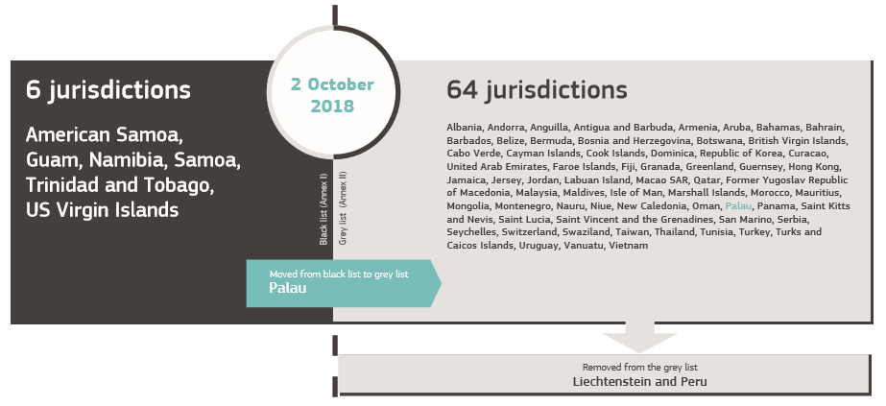
2. The common EU List: 4th update

Slide 20
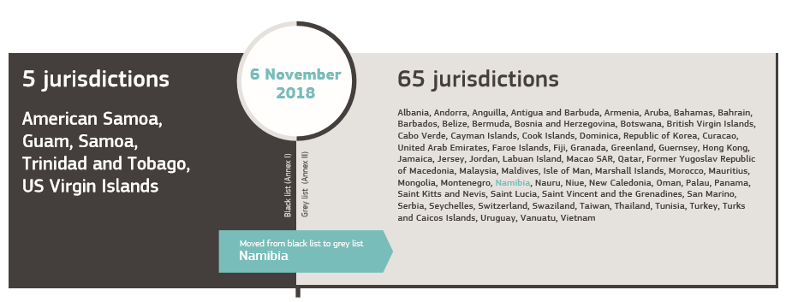
2. The common EU List: 5th update
https://ec.europa.eu/taxation_customs/sites/taxation/files/eu_list_update_06_11_2018_en.pdf

Slide 21
2. EU list: Consequences and next Steps
Consequences of being on the black list / Countermeasures
  Domestic and EU level (e.g. EU Funds)
  In the tax as well as in the non-tax area
  Reputational consequences
Dialogue and monitoring of commitments
Next steps :
Update of the list
Update of criteria
Notes:
Insert presentation Cambodia

Slide 22
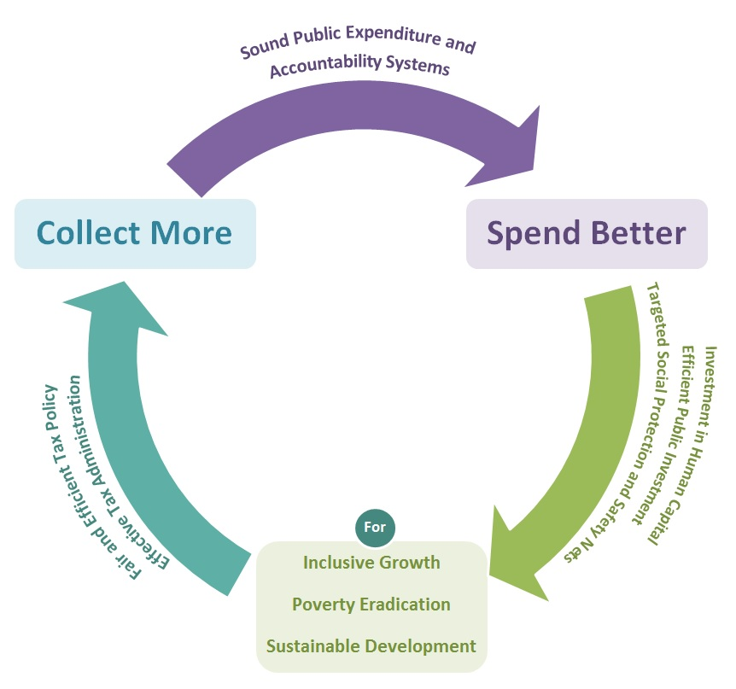
3. Commission support on DRM to developing countries
Staff working document (oct 2015)
Collect more – Spend better
https://ec.europa.eu/europeaid/sites/devco/files/swd-collect-more-spend-better.pdf

Slide 23
3. Supporting improvement on
Tax policy
  Focus on tax policies to close loopholes, broaden base, and fight “tax avoidance”
Tax compliance
  Difference between tax due under current tax policy and that actually collected.
  Focus on efficiency and effectiveness of tax administration, reinforcing voluntary compliance, good tax governance, and fighting evasion and illicit financial flows
=> Mix of political, administrative, and economic constraints
Notes:
An important European Commission document (2011) Tax and Development: Cooperating with Developing Countries on Promoting Good Governance in Tax Matters
SEC(2010)426 can be found at: http://eur-lex.europa.eu/legal-content/EN/TXT/PDF/?uri=CELEX:52010DC0163&from=EN.

Slide 24
3. EU ODA to DRM in figures
EU ODA support to DRM in 2015 (base line ATI):
Disbursements: € 34,3 M
Commitments: € 31,5 M
EU ODA support to DRM in 2016:
Disbursements: € 25,4M
Commitments: € 35,6M
https://www.addistaxinitiative.net/fr/

Slide 25
3. EU's support to global DRM initiatives
Addis Tax Initiative (ATI)
IMF thematic Funds (Revenue Mobilization, Management of Natural Resources Wealth, Tax Administration Diagnostic Assessment Tool, TADAT)
OECD Base Erosion and Profit Shifting (BEPS) Inclusive Framework
OECD Global forum on transparency and exchange of information on tax purposes
OECD revenue statistics (Africa, Asia-Pacific and Latin America)
Public Expenditure and Financial Accountability (PEFA) assessment
UN Committee of Experts on International Cooperation in Tax Matters
Extractive Industries Transparency Initiative (EITI)
Notes:
Supporting Capacity building and policy guidance with two IMF Topical Trust Funds
Topical Trust Fund on Managing Natural Resource Wealth (MNRW-TTF)
Tax Policy and Administration Topical Trust Fund (TPA- TTF)
Tax Administration Diagnostic Assessment Tool – newest tool in the toolkit
Regional and Global Forums on Tax Issues
Tripartite Initiative w/ WB and OECD on Transfer Pricing
BEPS: Base Erosion and Profit Shifting
Extractive Industry Transparency Initiative (EITI)
Illicit financial flows

Slide 26
EU support to regional DRM initiatives
EU regional programmes (e.g. on fiscal transition in West Africa)
IMF Regional Technical Assistance Centers (RTACs)
  Pacific Financial Technical Assistance Centre (PFTAC)
  South Asia Training and Technical Assistance Centre (SARTTAC)
  RTACs in Africa, Central America and the Caribbean
African Tax Administration Forum (ATAF / EU – GIZ Panafrican program ATAF/CABRI/AFROSAI/AFROPAC)
Cercle de reflexion et d’étude des dirigeants des administrations fiscales (CREDAF)

Slide 27
3. EU support to national DRM initiatives
Areas of support
Tax policy analysis and reform (e.g. in cooperation with IMF and World Bank)
Assessment of and capacity building to tax administrations (Tax Administration Diagnostic Assessment Tool assessments, TADAT)
Support to countering tax avoidance, tax evasion and illicit financial flows
Mid-term Revenue Strategy (MTRS)
Dedicated technical assistance program
Budget support program

Slide 28
3. DRM and Budget support : context
=> 2017 Budget support guidelines reflects the last international commitments on DRM (AAAA/SDG/ATI/EC)
= > Stocktaking of past experiences
=> European Court of Auditors – Recommendations on the use of Budget Support to improve DRM in Sub-Saharan Africa (Report 35/2016)
strengthen DRM assessments and risk analysis;
strengthen the use of DRM-specific disbursement conditions;
strengthen reporting on the use of budget support to improve DRM;
strengthen the policy dialogue component in DRM;
strengthen the use of capacity development in DRM;
evaluate the impact of budget support on the improvement in DRM.
=> Budget Support Guidelines 2017, p49 and annex 11

Slide 29
3. DRM in Budget Support eligibility criteria
Macroeconomic stability
=> Drop of revenues affects the macroeconomic stability
Public policy
=> Public Finance Management: DRM is part of PFM
Transparency and oversight
=> Information on DRM has to be available
Notes:
At least 3 out of 4 budget support eligibility criteria are linked to DRM
[There is 4 eligibility criteria for Budget support: 1- Macro eco stability / 2- PFM system /3- Transparency and oversight / 4 - Public policy

Slide 30
3. DRM in BS perfomance criteria
=> Ensure the political will both at political level (ministry) and technical level
=> Ensure access of source of information for verification
=> close dialogue with authorities and partners is crucial. Contributing to Technical assistance helps a lot.
=> NO ONE FIT FOR ALL, need to listen, understand and have close dialogue:
- with Tax authorities
- with partners to increase synergies and levy
- and with DEVCO A4 DRM section also !
Notes:
Through Budget support eligibility criteria, a high level dialogue on DRM is set up.
It’s even better to introduce one or two DRM performance indicator in BS program.
Need to ahve a close dilogue with authorithies to ensure it will have a positive effect.

Slide 31
3. DRM in accompanying measures
=> a well targeted TA will contribute to improve domestic revenue mobilisation
=> twinnings possibility between peers administration should also systematicaly explored
=> Keep in mind that IT equipment is not a guarantee of improved domestic revenue mobilisation
Notes:
See example :
VAT in Tanzania (ICTD) : Electronic Fiscal Device compliance is strongly associated with the customer’s perception of detection and penalty risks, and with the business operator’s perception of other businesses’ compliance behavior (https://opendocs.ids.ac.uk/opendocs/bitstream/handle/123456789/14093/ICTD_WP83.pdf?sequence=1&isAllowed=y)

Slide 32
3. DRM and dialogue
ECA report 35/2016
"Policy dialogue in the area of DRM was more focused when it was accompanied by specific conditions or indicators, since identifying, negotiating and, subsequently, monitoring these conditions necessitated extensive discussion with the partner countries.
However, difficult country circumstances meant that policy dialogue did not take place regularly. The Commission did not develop strategies for structuring its policy dialogue around concrete DRM issues including, for example, fixed priorities, objectives, interlocutors and dates."
Close, recurrent and documented dialogue is highly needed

Slide 33
Thanks a lot for your attention!
Any question?
Notes:
The lack of available data is a risk, which should be emphasized.

