Slide 1
How to engage?
Brussels, January 2019
Module 3
Domestic Revenue Mobilisation
Training funded by the European Union
Trainer: Pierre Vandenberghe
Tax administration expert..
Notes:
PLEASE PRINT OUT AS NOTE PAGE AND BRING TO CLASS.
The notes included in this training material are a guide to the instructor and the participants and should not be construed as replacing any other texts.

Slide 2
Outline
Medium term revenue strategy (MTRS)
Available data
Donor groups
Dialogue with administrations
Dialogue on policy strategy
Diagnostic tools
Choice of modality
Keeping the contact with HQ

Slide 3
Medium term revenue strategy (MTRS)
a high-level road map of the tax system reform over 4-6 years
country ownership and government commitment to its design and implementation is strong
wide consultation with the tax system’s stakeholders is desirable in its development, including to promote accountability of all concerned
Notes:
See documents on the USB Stick

Slide 4
Why designing a MTRS?
Tax priorities are too often driven by short-term considerations. Commitment to reforms over the medium term will help prioritize intermediate objectives.
Institution building in tax administration is complex and needs sustained effort over several years.
The legal framework requires timely change to support evolving policy and administration.
Successful reform requires continued commitment and trust among a wide range of stakeholders.
Provide a clearer picture of their likely revenues over a meaningful planning period, and taxpayers to have more certainty on how they will be treated and what the tax implications of their investment and other decisions will be.

Slide 5
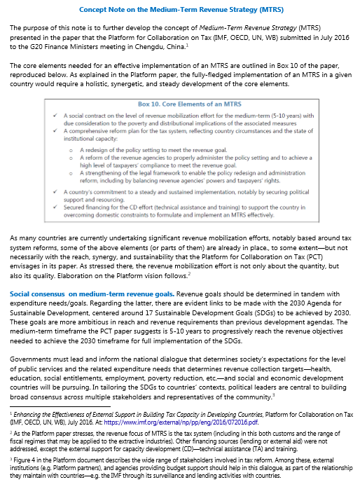

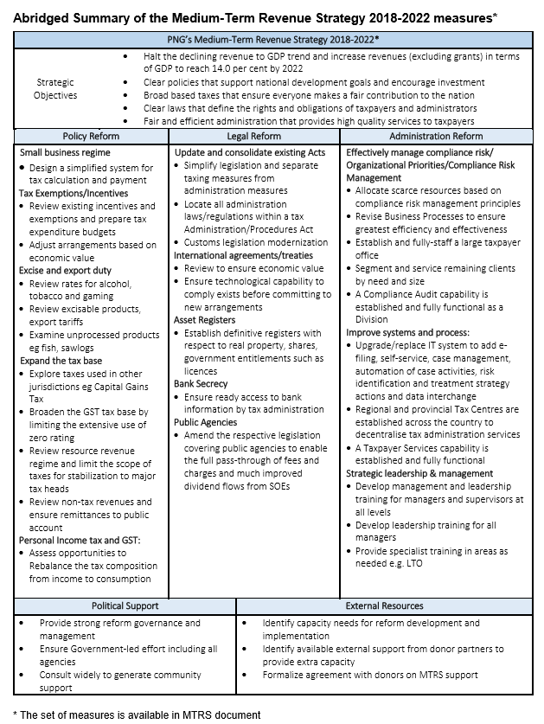

Slide 6
2. Availaible data
Source of data: Revenue administration
  Revenue administration website
  Revenue administration statistical service
Partners
  IMF
    IMF Data base
    Art IV reports
  Multi donors tools : RA-FIT, ISORA
  OECD / Revenue statistics initiative
  World bank / World development indicators

Slide 7
3. Donor groups
General donor group
Budget support donor group
Public finance management (PFM) group
Dedicated DRM group
Decentralisation group
➔ Involvement in donor group needed

Slide 8
4. Dialogue with administrations
Political level
➔ Prime minister / Ministry of finance
Technical level
➔ Revenue administration + relevant services (VAT…)
Notes:
Could be useful to have a Revenue administration organigramme to stress the need to find the good contact

Slide 9
5. Dialogue on policy strategy
Until now: no operational standard diagnostic tool. Still under development: Tax policy assessment framework (TPAF – IMF/OECD)
Dialogue however needed, not in a prescriptive manner, but to better understand and accompany.
Both at political and technical level.
➔ keep track record of this dialogue (shared report…)!

Slide 10
6. Diagnostics tools: PEFA
  3 indicators specifically dedicated to DRM
  PI 3 – Revenue outturn
  3-1 Aggregate revenue outturn
  3-2 Revenue composition outturn
  PI 19 – Revenue Administration
  19-1 Right and obligation for revenue measures
  19-2 Revenue risk management
  19-3 Revenue audit and investigation
  19-4 revenue arrears monitoring
  PI 20 - Accounting for revenue
  20-1 Information on revenue collections
  20-2 Transfer of revenue collections
  20-3 Revenue accounts reconciliation

Slide 11
6. Diagnostics tools: TADAT
A standardized assessment tool that can provide an objective view of the tax administration system and its strengths and weaknesses
Mirrored on the Public Expenditure and Financial Accountability (PEFA) tool
Does not assess special tax regimes such as for natural resources; nor does it assess customs administration
Better identification of the relative strengths and weaknesses in a tax administration system
Facilitating discussion towards a shared view of the tax administration's health among stakeholders
The EC supports the TADAT secretariat (access to assessments report even if not published)
Assessor has to be certified by TADAT secretariat (list on the TADAT website)
Possible to finance though Framework contract

Slide 12
Performance Outcome Areas—Core structure and desired outcomes
Tax administration is transparent in the conduct of its activities and accountable to the Government and the citizenry
All businesses, individuals and other entities, required to register, are included in the taxpayer database.
Database is complete, up-to-date and accurate
Risks to revenue and tax administration operations are identified and managed effectively
Tax revenue collections are fully accounted for, monitored against expectations, and analyzed to inform government revenue forecasting. Legitimate tax refunds are paid promptly
Taxpayers have the necessary information and support to voluntarily comply at a reasonable cost to them
Tax dispute resolution process is fair and independent, accessible to taxpayers, and effective in resolving disputes in a timely manner
Effective audit and verification programs deter taxpayers from reporting incomplete or inaccurate information in their tax declarations
Taxpayers file their declarations on time
Taxpayers pay their taxes in full and on time
http://www.tadat.org/files/TADAT_at_a_Glance_web.pdf

Slide 13
6. Diagnostic tools : EC Blueprints
Designed by EC for the purpose of the 2002 enlargement
Tax administration Fiscal blueprints
Customs administration : Customs blueprints

Slide 14
6. Other diagnostic tools
Tax policy assessment framework (TPAF- IMF/OECD)
Cross Border Diagnostic tool (CBDT OECD)
Not yet operational!

Slide 15
7. Choice of modality of support
Budget Support
Twinning
Partner administration with MS administration / peer partner (ex South-Africa with Malawi)
Technical assistance
Short term / Long term
Direct / Through partners (MS/IMF/WB…)
Diagnostic tool

Slide 16
7. Keeping in touch with HQ
Support to partner administration
=> DEVCO geo + DEVCO A4 (Stefan Agne / Anca-Maria Szigeti / Vincent Bigot)
=> DG NEAR A3 Javier Casanovas-Bernard / Damien Ruggeri
On EU Non cooperative jurisdiction
=> DEVCO geo + DEVCO A4 (Stefan Agne / Anca-Maria Szigeti ) / NEAR A3 (Javier Casanovas-Bernard / Damien Ruggeri)
+ DG TAXUD (Unit D1 - Company Taxation Initiatives: Marco Federici / Marco.FEDERICI@ec.europa.eu)
On AML/CT
=> DEVCO geo + DEVCO A4 (Stefan Agne / Vincent Bigot)
+ DG Justice (Unit B3: Financial crime: David Schwander / David.SCHWANDER@ec.europa.eu)

Slide 17
Thanks a lot for your attention!
Any question?

