Slide 1
Focus on direct tax,
Brussels, January 2019
Module 7
Domestic Revenue Mobilisation
Training funded by the European Union
Trainer: Pierre Vandenberghe
Tax administration expert
Notes:
PLEASE PRINT OUT AS NOTE PAGE AND BRING TO CLASS.
The notes included in this training material are a guide to the instructor and the participants and should not be construed as replacing any other texts.

Slide 2
Outline
Personal income tax (PIT)
Business/corporate income tax (CIT)
Property tax
Notes:
Introductions
Instructor
Name tents
- Objectives
Each participant, what would they like to get from this course?
Methods for course
Introducing DRM
Mexico to Addis
Collect More, Spend Better
EU commitment to DRM
Pre-course knowledge assessment -- this is to assess the knowledge that participants have when they come to the training programme and compare that with what they have at the completion of the training programme. This is not to SCORE or GRADE the participant.

Slide 3
1. Personnal income tax (PIT)
Three main systems in the World
1) The Comprehensive Income Tax (Global Income tax):
The Greek Temple
All sources of income (schedule) are aggregated to be taxed at a progressive rate.
2) The Dual (or semi-dual) Income Tax
Sources of income are taxed separately
The progressivity remains (or not) only on labor and business income
3) The Flat Tax
Unique tax rate for all the types of income.
In general very low amount of revenue collected from PIT in developing countries

Slide 4
2. Business income taxation
From the very small to the very large:
Profit tax:
- a multidimensional tax, which encompass physical person, self-employee (PIT)
- Can be progressive or proportional
-Corporations (CIT)
The definition of profit differs between and within countries
Tax base: all sales minus deductible costs
Types of incomes (sales, intellectual property revenue, etc.)
Deductible costs (purchases, wages, interests, etc.)
Notes:
What is a corporation ?

Slide 5
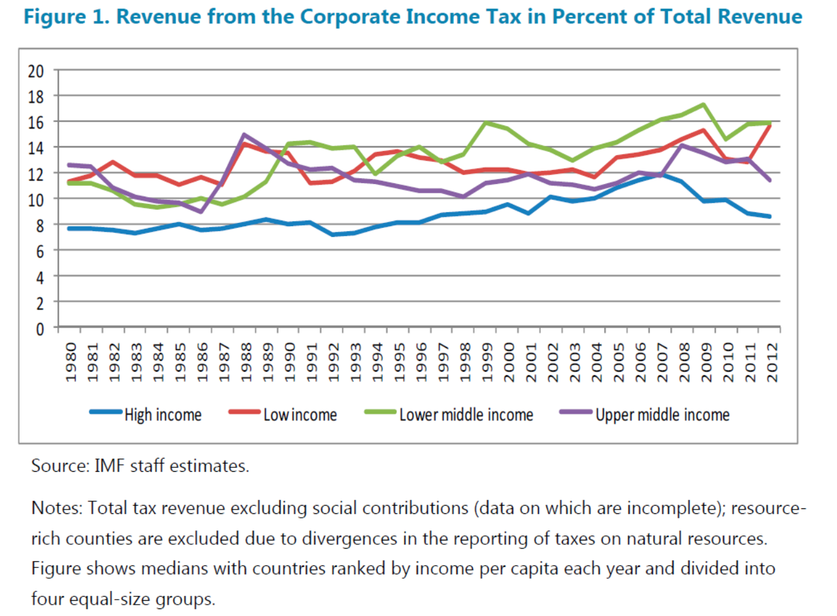
3. Corporate income tax (CIT)

Slide 6
2. Minimum taxation
A lot of developing countries have a minimum alternative tax for CIT or Profit tax purpose (losses or nil profit)
Two approaches
Turnover tax on turnover : 0.5 percent to 2 percent
Tax on assets (and/or imports)

Slide 7
3. Property tax
The missing tax in developing country
Tax on land and “fixed assets”
Fixed assets – immoveable assets

Slide 8
3. Property tax : pros and cons
PROS
Does not create economic distortions
Recurrent and usually stable
Hard to evade
Can help fiscal decentralisation
CONS
Traditional use of land
Political sensitivity

Slide 9
3. Property tax issues
Localisation
Assessment and valuation
Market value
Computer Assisted Mass Appraisal (CAMA) model
Taxable person
Who is the tax payer, who to tax ?
The simpler the better

Slide 10
3. Property tax : decentralisation
Issue of tax administration: which level agency/administration is responsible for:
Elaborating the rules for assessments / rates
Assess and control the tax
Collect the tax
Incentising dedicated employee working on that topic

Slide 11
Thanks a lot for your attention!
Any question?
Notes:
.

