Slide 1
International issues Brussels, January 2019
Module 8
Domestic Revenue Mobilisation
Training funded by the European Union
Trainer: Pierre Vandenberghe
Tax administration expert
Notes:
PLEASE PRINT OUT AS NOTE PAGE AND BRING TO CLASS.
The notes included in this training material are a guide to the instructor and the participants and should not be construed as replacing any other texts.

Slide 2
Outline
Aggressive tax planning
Tax treaty
Price manipulation
Transfer pricing
Debt shifting
Capital Gain Taxation
Tax ruling abuse
Solutions/recommendations
Fighting Illicit financial flow: exchange of information
Fighting money laundering
Notes:
Introductions
Instructor
Name tents
- Objectives
Each participant, what would they like to get from this course?
Methods for course
Introducing DRM
Mexico to Addis
Collect More, Spend Better
EU commitment to DRM
Pre-course knowledge assessment -- this is to assess the knowledge that participants have when they come to the training programme and compare that with what they have at the completion of the training programme. This is not to SCORE or GRADE the participant.

Slide 3
Aggressive tax planning
Economic integration
Multinational Enterprises (MNEs)
Foreign Direct Investment (FDI)
trade, transactions, movement of capital
about 2/3 of all cIncrease of crossboarder ross border transactions take place between businesses belonging to a multi-national group
Lack of means for tax administration to easily inquiry abroad
Financial Crisis in 2008
Public debt, tax revenue
Scandals
Google, Starbuck, Amazon, Ikea…
Panama Papers, Swissleaks, Luxleaks…
G20 reply:
Mandate OECD to develop measure to monitor Base Erosion and Profit Shifting (BEPS Action plan)
Mandate OECD Global forum on transparency and exchange of information to improve exchange of information between tax administration

Slide 4
1. Aggressive tax planning
MNE are crucial in developing countries
Why will a MNE invest in a country?
- Domestic demand: Mobile phone
- Natural resources, infrastructures: Mining, Oil, Building sector
- Reducing production costs: Exportations (textile industry, car manufacturing…)
Developing countries are often combining weaknesses
- Political involvement in investment decision
- Technical level not in the lead combine to : Inadequate national tax laws (Tax incentives approach, Tax Agreements, Exchange of information, lack of comparable)
- Few HR dedicated to international issues
=> The main determinant of investment is not taxation
=> Despite huge FDI and high growth rate, revenue collection is still low

Slide 5
1. Aggressive tax planning
Goals?
Decreasing taxable profit in high (standard) tax rate country.
Mechanisms?
Tax treaties (treaty shopping)
Minimising turnover (price manipulation, hedging contracts)
Transfer pricing: increasing production/administrative costs
Debt-shifting: increasing financial costs
All the economic sectors are concerned.

Slide 6
1. Aggressive tax planning
Tax planning conditions:
MNEs are active in the country.
The country has ratified Double Tax Agreements (DTAs)
Existence of tax heaven, which weakens the global tax system.
Tax heaven? No legal definition
Tax planning= the consequence of competition
Race to the Bottom

Slide 7
2. Tax Agreements / Treaties
Aims
- Protection of taxpayers against double taxation and improving international investment.
- Sharing the taxing power between countries on international transactions
Principles
- Source country (where capital is allocated) has the power to tax.
- Residence country (where capital’s owners are located) has the power to tax.
- Issue: defining Permanent Establishment.
Treaty shopping
- From non-double taxation to double non taxation

Slide 8
2. DTA: OECD versus UN
OECD model:
Capital exporting countries keep the final power to tax.
The OECD Model preserves a greater share to the “residence State”, the country of the investor, trader, etc.
UN model (revised in 2011)
The UN Model preserves a greater share of tax revenue to the “source State”, the country where investment or other activity takes place.
The UN Model is deemed developing countries more taxing rights on income generated by foreign investments in these countries.
Notes:
Alignment ongoing

Slide 9
3. Price manipulation
Minimising the sales price
Concerned sectors
=> Extractive industry, exporting sectors.
Goal
=> Decreasing CIT, mining royalties, government oil share
Reducing reported turnover
=> Hedging contract between a subsidiary located in a standard tax rate country and a subsidiary in a tax heaven.
=> Selling the produced good below its market value.

Slide 10
4. Transfer Pricing
Transfer pricing is necessary for MNEs management
Not bad in itself
Issue:
- Abusive practices of transfer pricing
- Over-estimating costs in standard tax rate country towards low tax rate country or tax heaven.
- Fictitious costs
Example : management fees, licenses and copyrights, use of brands, all services, sometimes purchases
Any cost may be artificially manipulated. Example: Miller in Ghana

Slide 11
Notes:
Source: ActionAid, 2010, Calling time: why SABMiller should stop dodging taxes in Africa, Report.
https://www.actionaid.org.uk/sites/default/files/doc_lib/calling_time_on_tax_avoidance.pdf

Slide 12
5. Debt-shifting
Intra-group lending
- Thin capitalization in standard tax rate country
- While the subsidiary in a developing country borrows to another subsidiary located in a tax haven.
=> Interests payments are CIT deductible in the developing country and become non-taxable income in tax haven.
One of the motive of capital flights.
Need for thin capitalization rules
Notes:
Thin capitalisation is a general issue, not only for MNEs

Slide 13
6. Capital Gain Taxation
Indirect transfer of assets (mining, oil, mobile phone licence)
Avoiding taxation through the sales
Example: Vodafone Case in India

Slide 14
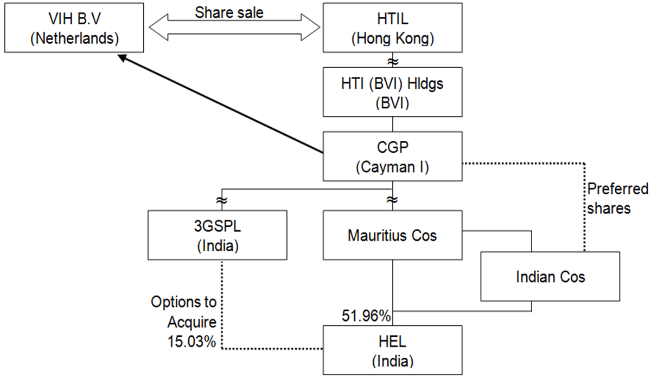
Vodafone vs India

Slide 15
7. Tax ruling abuse
Tax ruling
Public ruling = how tax legislation will be applied
Private ruling = Request of interpretation of a specific situation regarding taxes (the administration is bound).
Tax ruling abuse
A bargaining on tax law interpretation between the taxpayer and the tax administration
- The complexity of tax laws
- Issue of ring-fencing of the advantages
The case of Luxembourg: How to look as a standard country and behave as a tax heaven?
- Lux-Leaks scandal / SOCFIN

Slide 16
8. Solutions/recommendations
General recommendation
Transparency
The publication of tax reports
Country by country Report (CBCR) initiative
Examples: Banking sector in EU and WAEMU
Political sensitive: Tax secrecy
Support civil society initiative on DRM
Withholding tax regime
DTAs limit the efficiency of withholding taxes.
Reviewing DTAs towards multilateral treaties
Example: Mongolia and Netherlands

Slide 17
8. Solutions/recommendations
OECD Base erosion and profit shifting (BEPS) action plan
BEPS package (15 actions) (endorsed by G20 – Nov 2015)
Action 1 – Address the tax challenge of the digital economy
Action 2 –Neutralise the effects of Hybrid mismatch arrangements
Action 3 – Strenghten Controlled foreign corporation (CFC) rules
Action 4 – Limit base erosion via interest deductions and other financial payments
Action 5 – Counter harmful tax practices more efficiently, tacking into account transparency and substance
Action 6 – Prevent treaty abuse
Action 7 – Prevent the artificial avoidance of permanent establishment (PE) status
Action 8-10 – Assure that transfer pricing outcomes are in line with value creation
Action 11 – Measuring and monitoring BEPS
Action 12 – Require taxpayers to disclose their aggressive tax planning arrangements
Action 13 – Re-examine transfer pricing documentation
Action 14 – Make dispute resolution mechanisms more effective
Action 15 – Develop multilateral instrument
(in bold: the 4 BEPS minimum Standard for BEPS inclusive framework)

Slide 18
8. Solutions/recommendations
Commitment to OECD BEPS inclusive framework
G20 Nov 2015 requested to develop a BEPS Inclusive framework
“To monitor the implementation of the BEPS project globally, we call on the OECD to develop an inclusive framework by early 2016 with the involvement of interested non-G20 countries and jurisdictions which commit to implement the BEPS project, including developing economies, on an equal footing.”
Inclusive framework launched in July 2016
Commitment to
- Implementation the 4 BEPS minimum standards (see in bold previous slide)
- Gather data for the monitoring of the other aspects of implementation, including under BEPS Actions 1 (on the tax challenges of the digital economy) and 11 (on measuring and monitoring BEPS)
- Finalise the remaining technical work to address BEPS challenges
The inclusive framework provide further guidance on the standards and by develop toolkits for low income countries.
March 2018: BEPS Inclusive framework has 113 members

Slide 19
8. Solutions/recommendations
Improvement of transfer pricing legislation
- Documentation requirement
- Arm’s length principle
- Possibility to reassess the value of any transaction with related enterprises
- CFC rules reversing the onus of the proof
Important works done by OECD and UN: 5-6 guidelines to determine the right price of an intragroup transaction
- Comparable uncontrolled price method.
- Resale price method,
- Cost plus method,
- Transactional net margin method,
- Transactional profit split method.
=> Let some room to negotiation
Notes:
CFC = Controlled foreign enterprises

Slide 20
8. Solutions/recommendations
Thin Capitalization Rule : Limits the deduction of interests
Debt/Equity ratio
Related party debt or total debt
Deductible interests.
Earning stripping ratio
Deductible interest limited to a percentage of EBITDA or turnover.
Germany example.

Slide 21
9. Fighting IFF : Exchange of information
To improve fight against tax avoidance, tax fraud and tax evasion => need to crosscheck information
Incomes and bank accounts stated to the tax administration, as well as tax paid in and outside the country.
=> Tax administrations must easily receive data from each other, and be allowed to share the information they have on locals (if requested).
G20 Request to the OECD =>the Global Forum on Transparency and Exchange of Information on Tax Purposes has become the key international body to:
=>Develop standards on exchange of information
=>Implement it
Global forum has 153 Members (Oct 2018) (http://www.oecd.org/tax/transparency/about-the-global-forum/members/)
Lack of exchange of information in Africa = > Global Forum developed an Africa initiative to improve exchange of information in African countries (see “Yaounde declaration” on USB key)

Slide 22
9. Exchange of information
Exchange of information implementation is one of the EU NCJ listing criteria
The Commission supports Global Forum
- HQ financing
- West Africa regional financing through “Fiscal transition” program

Slide 23
9. Exchange of information : 2 standards
- Exchange of tax-relevant information on request only (the EOIR Standard).
=>The objective is to get this standard operational in all countries.
=> Peer reviews in 119 countries in 2017
- Automatic exchange of information on the financial accounts of non-residents (the AEOI Standard)
=> needs a more structured administration in terms of human and IT resource
=> over 100 countries and jurisdictions have committed to implementing the AEOI Standard

Slide 24
9. Exchange of info: Implementation
New members joining the Global forum have to engage in 3 steps:
=> Assessing the legal environment: current rules and regulatory framework making tax-relevant information available and empowering the tax administration; network of exchange of information agreement (Double taxation treaties, Tax information for exchange agreements – TIEAs)
=> Assess the way the regulatory framework is implemented, and creation of an "Exchange of information" unit within the tax administration.
=> Training of the relevant national auditors (in the tax administration, central bank, etc.).

Slide 25
9. Conventions or treaties with partner countries
Exchange of information between countries require the signing of numerous conventions or treaties with partner countries. To avoid time consuming negotiations with every single partner:
A standardized convention is proposed
=> the Convention on Mutual Administrative Assistance in Tax Matters (MAAC).
Once ratified, signatory countries will immediately have the opportunity to exchange information with all other MAAC signing partners (116 as of today).
- Countries participating in the AEOI will also need so sign the Multilateral Competent Authority Agreement (MCAA). 98 jurisdictions have signed it as of today. III

Slide 26
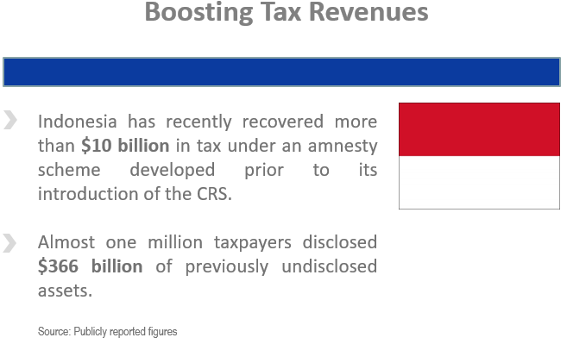
Example of achievement through Exchange of information implementation
Notes:
CRS – Common reporting standard

Slide 27
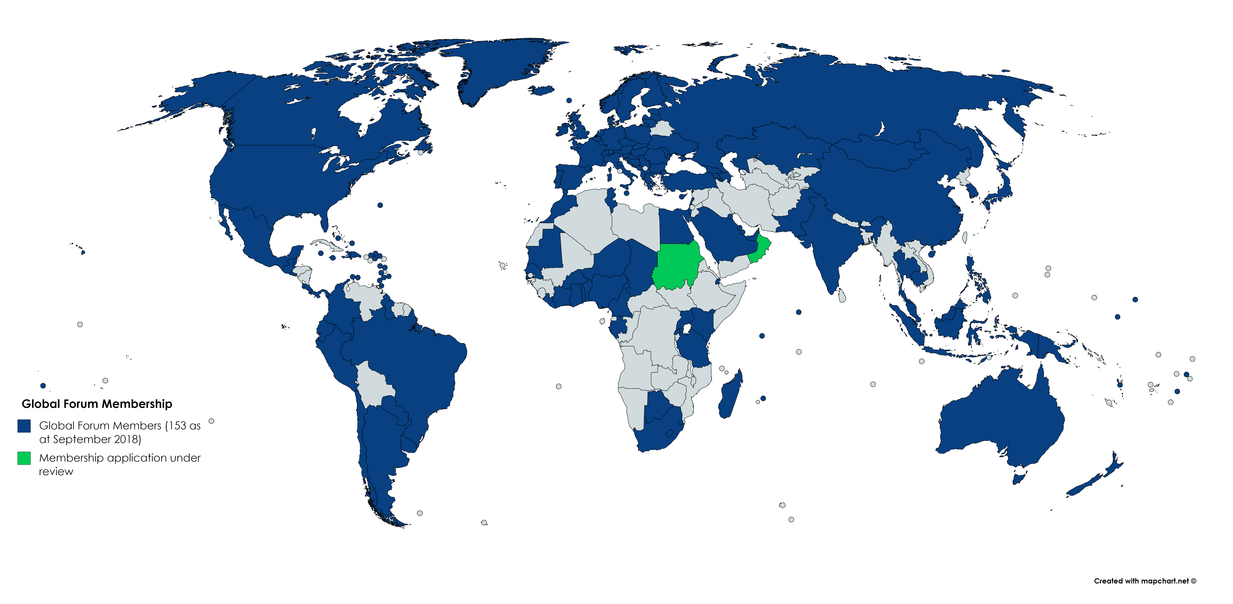
Global forum 153 members (+ 7 since September 2017)

Slide 28
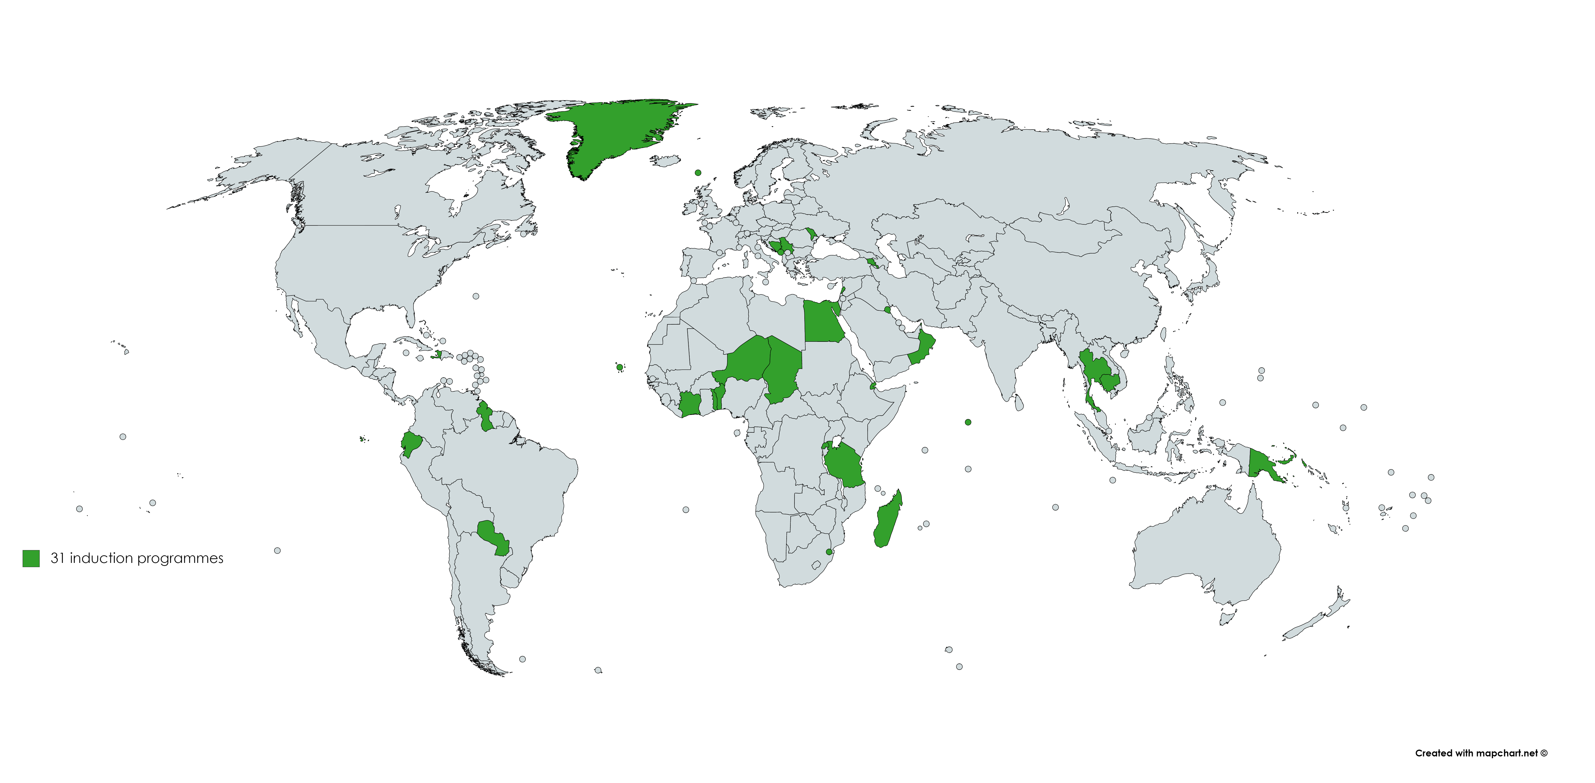
31 long term Induction programmes (EOIR, AEOI and MAC)

Slide 29
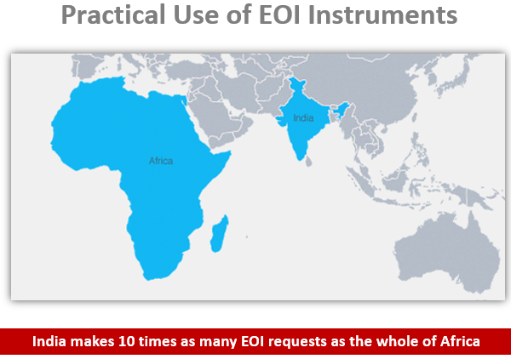
Notes:
Room for improvement, especially in Africa…

Slide 30
10. Fighting AML/CT
=> Financial Action Task Force (FATF)
- Global standard-setter for measures to combat ML and TF
- Intergovernmental body with 36 members (incl. COM)
- participation of over 180 countries through a global network of FATF-style regional bodies (e.g. CFATF, GAFILAT, APG)

Slide 31
10. Anti money laundering / Counter terrorism: task of Financial action task force
=> Adoption of FATF Recommendations on money laundering, terrorist financing and proliferation financing ("40 FATF Recommendations")
- AML/CFT policies
- Criminalisation of ML/TF, targeted financial sanctions and proliferation financing
- Preventative measures and supervision
- Transparency of beneficial ownership
- Powers of authorities and international cooperation
=> Peer evaluation (Mutual evaluation process by FATF/GAFILAT/CFATF)
- Technical compliance with standards
- Effectiveness of AML/CFT regime (Impact)
=> Identification of high risk countries (non-compliant)
- Black list ("Public statement")
- Grey list ("Compliance document)

Slide 32
10. FATF Listing process (grey list)
=> Poor evaluation report adopted ("mechanical criteria")
- DEVCO receives the updated list every 3 months
- Moment for technical assistance!
=> FATF Prioritisation criteria: material country or not?
=> Material country followed up by FATF:
- Observation period of 1 year (~1,5 year)
- Assessment of progress
- If no positive progress, imposition of an action plan agreed with the country
- Public listing on the compliance document
=> If not material: no FATF review but can be escalated later

Slide 33
10. AML/CT EU legislation
=> European framework built around the international FATF standards
=> Directive 2015/849 – “5th AML Directive"
=> Approach:
- ensure traceability of financial transactions
- Identification of clients (Customer due diligence measures - CDD)
=> Enhanced due diligence:
- As required by FATF recommendation (R19), enhanced vigilance to be applied towards high risk countries

Slide 34
10. EU list of high risk third countries
=> COM to identify third countries having strategic deficiencies in their AML/CFT regimes – based on Delegated Act (art 9)
=> Obliged entities need to apply enhanced CDD with clients established in those countries (art 18)
=> COM to consider FATF lists and assessments
=> 1st list adopted on 14 July 2016 (Regulation 2016/1675)
- Assessment in line with FATF lists
- EP rejected subsequent amending calling for a more ambitious approach
- COM developed its own methodology to assess on high risk countries

Slide 35
New EU approach on listing countries
=> FATF lists as a bottom line
=> EU autonomous assessment to complement it:
- Scoping out of 217 countries
- Planning and prioritisation
- Assessment: based on AMLD criteria
Analysing 8 key areas: criminalisation of ML/TF, CDD in the financial sector, CDD in non-financial sector, Beneficial ownership, sanctions, powers of authorities, international cooperation, targeted financial sanctions.
- Listing
- Follow-up with listed countries
=> First results by 2018 – role of technical assistance

Slide 36
Thanks a lot for your attention!
Any question?
Notes:
The lack of available data is a risk, which should be emphasized.

