Slide 1


DEAR Communication Plan

Slide 2
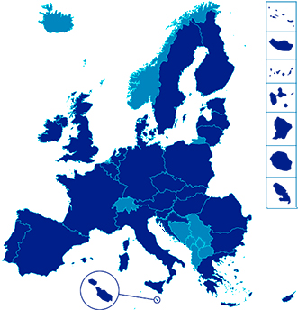
The rise of reactionary political groups
The Context
It’s time to boost the profile of DEAR, an EU-funded programme that listens and addresses European citizens’ concerns through hundreds of projects across the union.
Concerns over Climate Change
Worries about Migration
Young people – their role and means for shaping society
Notes:
EU involvement in DEAR is based on these two main principles:
Bringing an understanding of global issues to public is important, and development education and awareness raising can help achieve this objective.
The EU believes in the value of the DEAR programme, and annual amounts allocated to the programme have steadily grown, from 19 million EUR annually 10 years ago, to over 30 million EUR a year now.
At a time when budgets for development, and in particular for DEAR, are shrinking throughout Europe, continued and stable EU support to DEAR is a sign of EU's interest and investment in the sector.
DEAR is particularly relevant in the context of the new 2030 Agenda for Sustainable Development, given its universal focus.
2

Slide 3
Opportunity
Migration,
Climate Change
Youth
&
Building a Stronger Europe
EC,
Parliament,
& Council Priorities
DEAR
Priorities

Slide 4

The Change
Raise awareness of DEAR by showing how this EU-funded programme delivers results on issues that matter to EU citizens.
Notes:
4

Slide 5
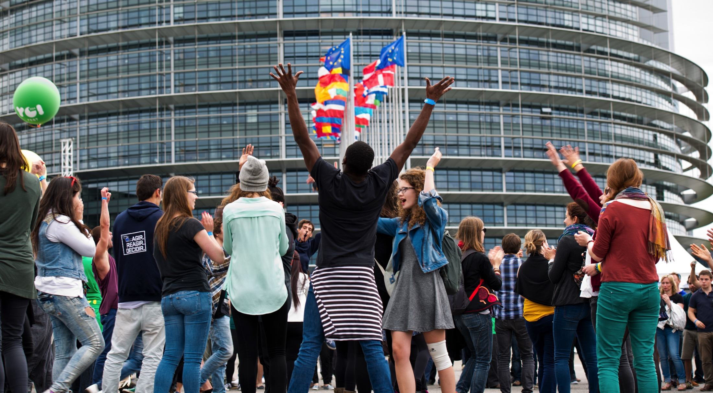
Audiences
Primary Audience:
EU Citizens
Secondary audiences:
MEPs
EC stakeholders
Member State governments, especially those with DEAR agencies/ programmes reached through the DEAR Multi-Stakeholder Group

Slide 6



Key Messages (1/3)
The DEAR Programme tackles global issues like climate change with informed local democratic action.
DEAR tackles global issues through local actions
A better life for everybody, everywhere
Global issues and local concerns hand-in-hand

Slide 7
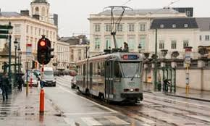
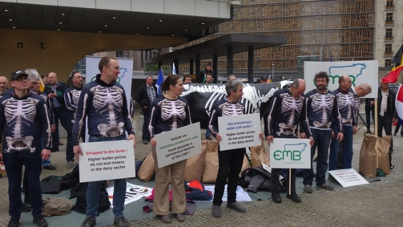
Key Messages (2/3)
The DEAR Programme raises awareness on issues of the day, like migration, in support of the European Fundamental Values.
Fundamental Values in action in the EU
DEAR brings EU Fundamental Values into our daily lives

Slide 8

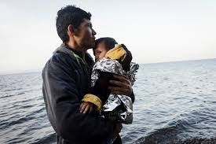
Key Messages (3/3)
The DEAR Programme is the only EU-supported global development programme focusing on EU citizens, including youths and the next generation of EU voters
Involving young Europeans on issues that matter to them
Supporting youth engagement on EU issues

Slide 9
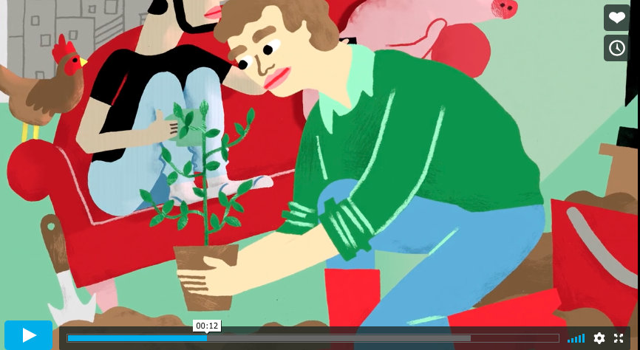
Products
Video
Leaflets & Brochures
Websitess
Events
Community building

Slide 10





Video: big investment = multiple use
Social Media
Events
Video
Websitess
Notes:
Note of caution on VIDEO: Before making a video, which is a big investment, you have to be sure that you have lots of channels to push it out on.
Also have to have good content – HJ’s Impact and Assessment report.
We’re also going to maximise our investment by using the video as a form of branding. We’ll strip out the assets and use them in leaflets, brochures and online. In info graphics and PPTs, etc
Still images with facts from the impact & assessment report for social media

Slide 11
Channels
Social Media
Events, meetings, presentations
Websites
Newsletters
Infopoints
Notes:
DEAR Programme not allowed social media channels of its own. But EC has established channels, which we can use and access.
250,00 followers of devco on FB, european commission has 150,000 on instagram
Invitations to events, presentations, meetings
Websites – C4D, but also europaid website, the EC’s intranet

Slide 12
Results
Act
Monitor
Review
Adjust
Plan

