Slide 1
2021 – 2027:
Commission proposal NDICI

Slide 2
External Heading Proposals
HEADING VI: Neighbourhood and the world | Amounts (billion euro)
Neighbourhood, Development and International Cooperation Instrument | 89.2
Instrument for Pre-accession assistance | 14.5
Humanitarian aid | 11
Common Foreign and Security Policy | 3
Overseas countries and territories including Greenland | 0.5
European Instrument for Nuclear Safety | 0.3
Other | 1.219
Margin | 3.283
Total | 123.002
European Peace Facility | 10.5

Slide 3
Operational issues/guiding principles
  Simplification - complex architecture
  Coherence – geographic approach preferred complemented by thematic for global or trans-regional initiatives
  Flexibility – financial and on substance: a policy-driven and enabling instrument (no artificial boundaries)
  Leverage and impact – e.g EFSD+

Slide 4

Pillars
Neighbourhood
Sub-Sahara Africa
Asia and Pacific
The Americas and the Caribbean
Thematic
Human Rights and Democracy
Civil Society Organisations
Stability and Peace
Global Challenges
Crisis Response and Conflict Prevention
Resilience and linking humanitarian and development actions
Foreign policy needs and priorities
Geographic
Rapid Response
Emerging challenges and priorities cushion
Geographic approach preferred; thematic programmes + rapid response complementary

Slide 5
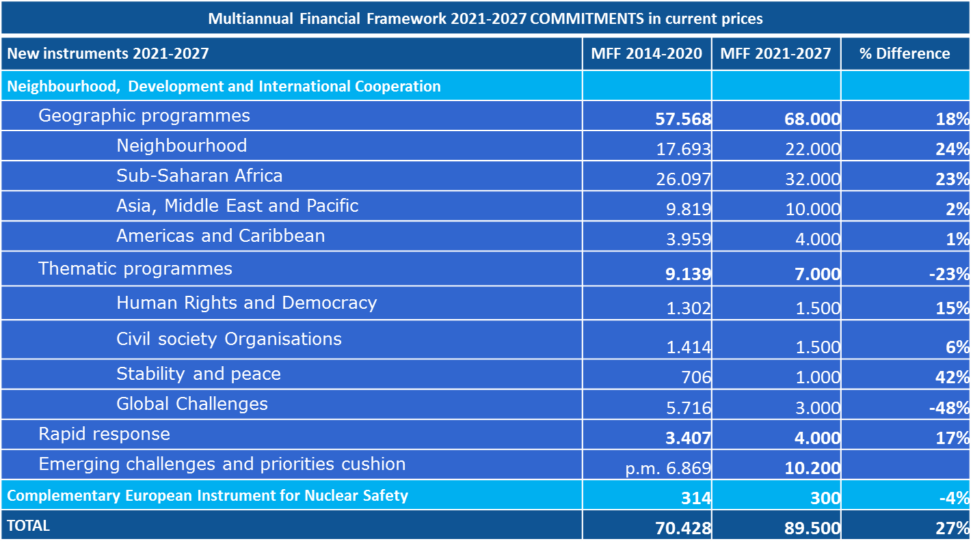
Budget (article 6)

Slide 6
Neighbourhood 2021-2027 in a nutshell
Neighbourhood integrated in an instrument covering most of the external actions (but excluding enlargement):
the Neighbourhood, Development and International Cooperation Instrument (NDICI)
NDICI:
  EDF budgetised
  Instrument both geographic and thematic
  EFSD +
  Horizontal provisions apply to other instruments (incl. IPA): replaces the CIR
Neighbourhood specificities preserved:
  Budget ring-fenced
  Cross Border Cooperation
  Specific objectives and strategic documents
  Specific allocation criteria and Performance-Based Mechanism (10%)

