Slide 1

Juergen Hohmann / Nadia Giske / Carina Staibano
SPaN Initiative
GUIDANCE PACKAGE
ON
SOCIAL PROTECTION
ACROSS THE HUMANITARIAN-DEVELOPMENT NEXUS
Presentation at the Thematic Seminar
22 January 2019, Paris

Slide 2
GUIDANCE PACKAGE on
SOCIAL PROTECTION
across the HUMANITARIAN-DEVELOPMENT NEXUS
Results from an inter-service initiative jointly led by three services of the European Commission DG’s DEVCO, ECHO and NEAR;
Aims at illustrating and providing practical guidance on how social protection can serve as an effective long-term response to protracted crises bridging the humanitarian - development divide;
Focusses on most challenging settings: fragile and conflict-affected countries; contexts of forced displacement;
Addresses: European Commission staff (EU Del, ECHO field offices, ECHO, DEVCO and NEAR operational desks), and also EU MS practitioners.

Slide 3
POLICY FRAMEWORK
OF THE GUIDANCE PACKAGE
The GP builds upon and substantiates the following policies in place:
2030 Agenda for Sustainable Development (2015)
Grand Bargain Commitments resulting from the World Humanitarian Summit (2016)
New York Declaration for Refugees and Migrants (2016)
New European Consensus on Development (2017)
Joint Communication on A Strategic Approach to Resilience in the EU's External Action
Council Conclusions on Operationalising the Humanitarian-Development Nexus of 19 May 2017
Communication on Lives in Dignity. From Aid-dependence to Self-reliance – Forced Displacement and Development (2016)
The Staff Handbook on “Operating in situations of conflict and fragility” (European Commission, 2015)
Commission Communication "Increasing the impact of EU Development Policy: an Agenda for Change“ (2011)

Slide 4
CONTENT OF THE
GUIDANCE PACKAGE
Policy material:
  Reference Document “Social Protection across
  the Humanitarian-Development Nexus”
  10 thematic, sectoral and contextual content notes
  11 country case studies
  Project Cycle Notes
  Think Pieces
Thematic seminar and Info-Points
Provides guidance for and creates synergies with
on-going initiatives relevant for social protection,
such as USP2030, the ISPA tools

Slide 5
REFERENCE DOCUMENT
ON
SOCIAL PROTECTION
ACROSS THE
HUMANITARIAN-DEVELOPMENT NEXUS

Slide 6
THE GUIDANCE PACKAGE
REFERENCE DOCUMENT
Refines the humanitarian-development nexus for social protection interventions
Specifically, this reference document aims to:
Articulate what is meant by working with social protection systems and approaches in crisis contexts;
Provide an overview of global experience and approaches to date;
Highlight specific challenges and suggest key criteria to inform decisions as to the most appropriate response option;
Provide guidance on key issues to consider when working with social protection in crisis contexts;
Highlight key features of social protection-related interventions in crisis contexts and offer practical tips;
Identify outstanding questions to inform future research.

Slide 7
THE GUIDANCE PACKAGE
REFERENCE DOCUMENT
Chapter 1 presents definitions, objectives and instruments of social protection, used in development and humanitarian action.
Chapter 2 synthesises opportunities, challenges and risks in using social protection (SP) approaches in crises.
Chapter 3 is about categorising the ways SP can be used in crises and provides a framework for assessing various response options.
Chapter 4 is about what EU/ECHO practitioners should be checking and promoting when engaging with partners on SP.
Chapter 5 highlights some research and operational questions that still need to be answered.
Chapter 6 contains a glossary of key terms used in this paper, a list of relevant policy commitments, two case studies of responses in different crisis contexts, and a selection of tools and resources.
Throughout the paper links to webinars, videos, initiatives, and background documents are provided:

Slide 8
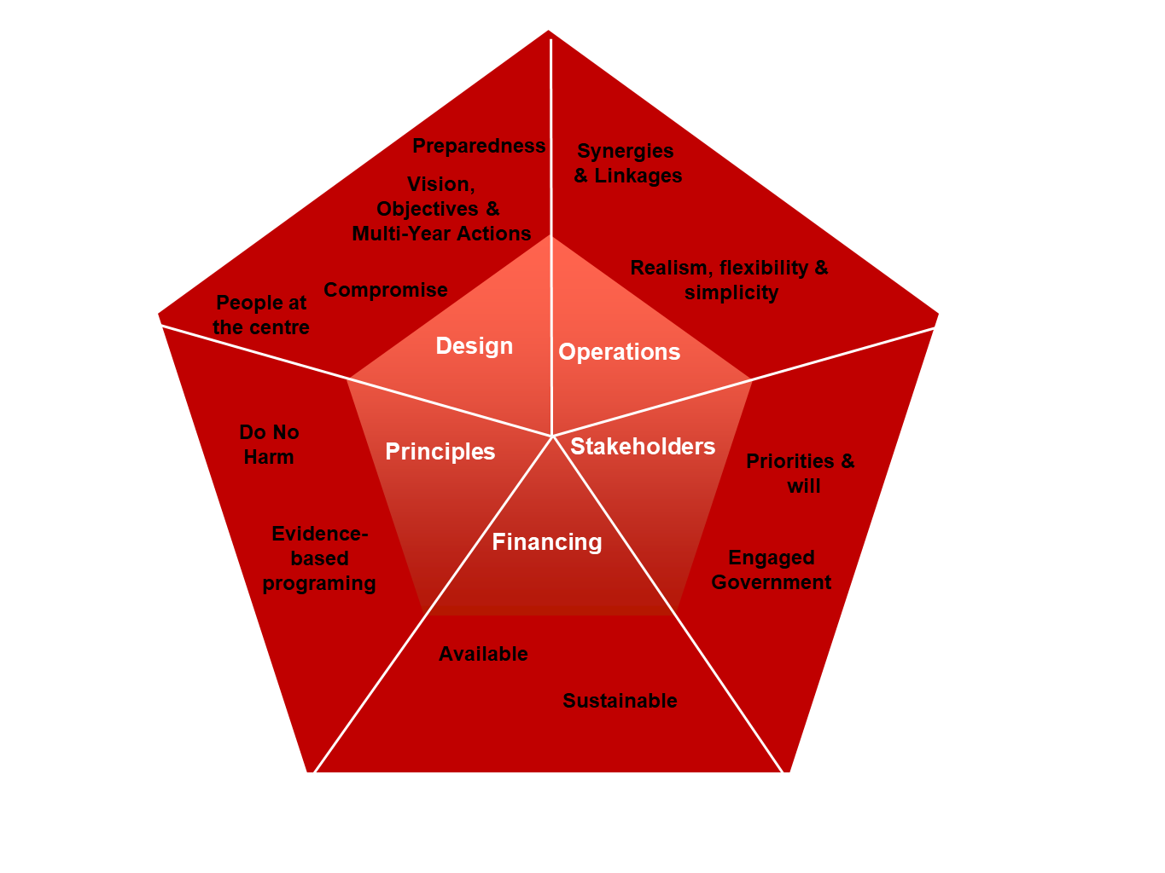
THE GUIDANCE PACKAGE
REFERENCE DOCUMENT
The Reference Document refines:
Rationale for working with social protection in crisis contexts
Frequency, severity, complexity & duration of crises has overburdened traditional systems;
Efficiency & impact gains from working with SP in different types of crises;
It is possible to work with all social protection instruments in crises settings;
Impacts are greater when SP linked to other services & programmes.
Key response features:
  Analysis:
  Conduct joint assessment in partnership with government to develop a common understanding, to clarify the risks;
  Design: Multi-year strategies & actions should be jointly developed with long and short-term objectives;
  Stakeholder priorities and incentives should be balanced according to political economy;
  Integrated financing (hum and dev funds) makes common programming a reality;
  Adherence to principles of engagement: requirement to Do No Harm; commitment to evidence-based programming;
  This generates a shared long-term vision and priority common goals for DG ECHO and DG DEVCO/DG NEAR to inform multi-year programming.

Slide 9
REFERENCE DOCUMENT
CHAPTER A -
SOCIAL PROTECTION AND HUMANITARIAN ACTION

Slide 10
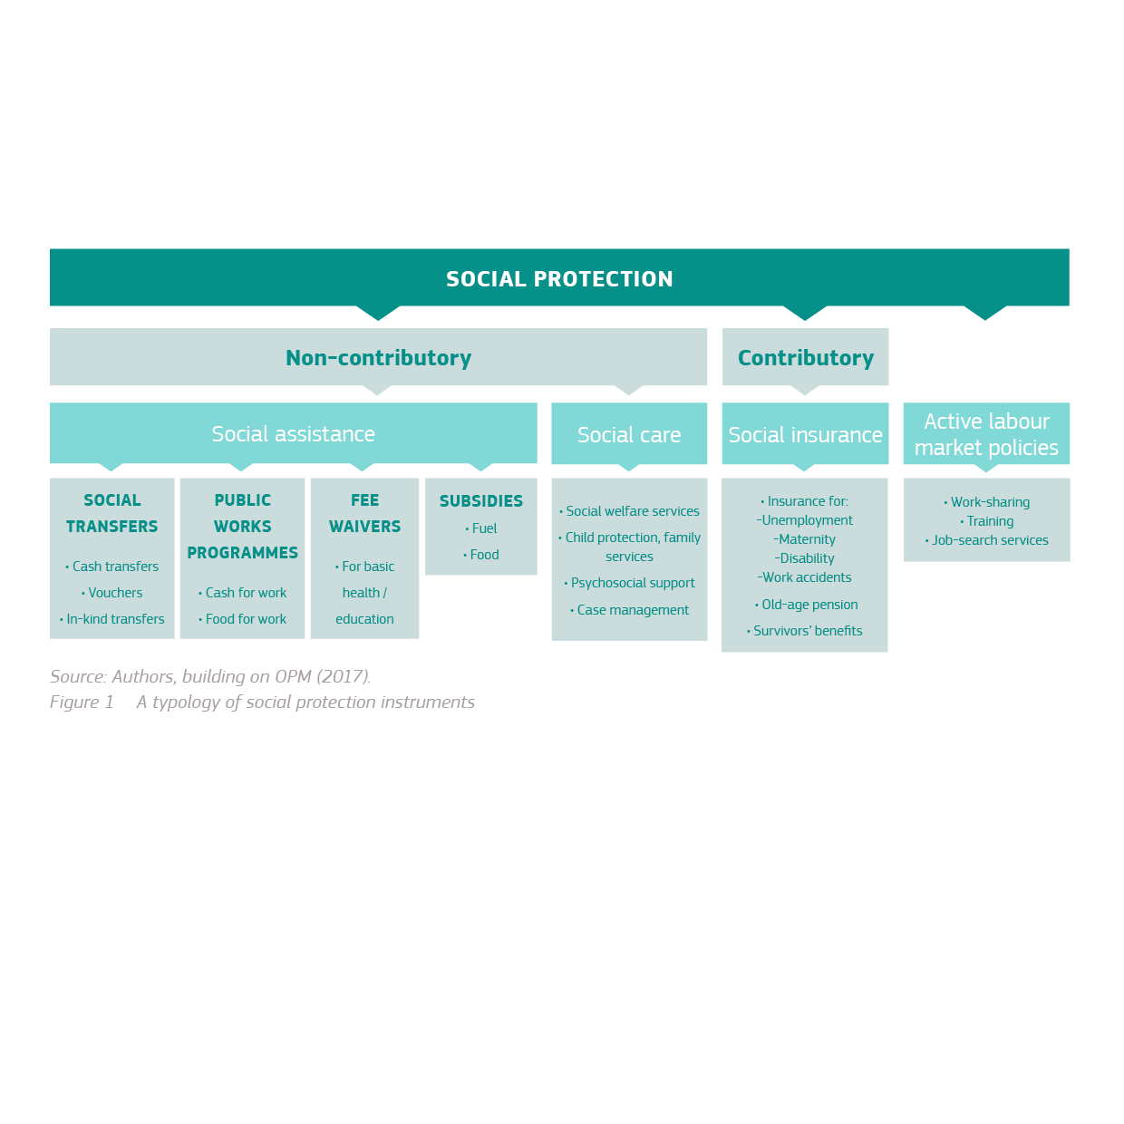
SOCIAL PROTECTION
AND HUMANITARIAN ACTION
SOCIAL PROTECTION - What is it and what are the instruments?
Social protection can be defined as a broad range of public, and sometimes private, instruments to tackle the challenges of poverty, vulnerability and social exclusion (European Commission 2015b). The Reference Document suggests the following typology of social protection instruments:

Slide 11
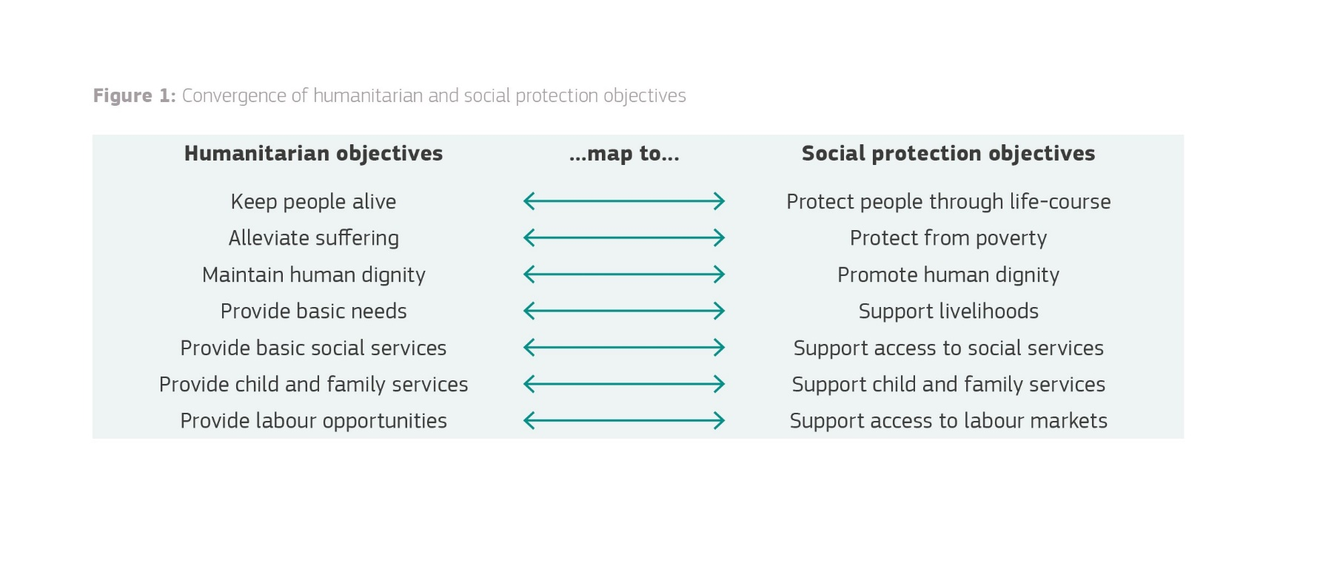
SOCIAL PROTECTION
AND HUMANITARIAN ACTION
COMPLEMENTARITIES AND CONVERGENCE OF HUMANITARIAN AND SOCIAL PROTECTION OBJECTIVES
To respond well to shocks that affect a large proportion of the population simultaneously there is increasing alignment of humanitarian and social protection objectives.
Many operational instruments used in crisis contexts are similar to those used in social protection.
Source: Authors, building on Cherrier et al. (2017b).

Slide 12
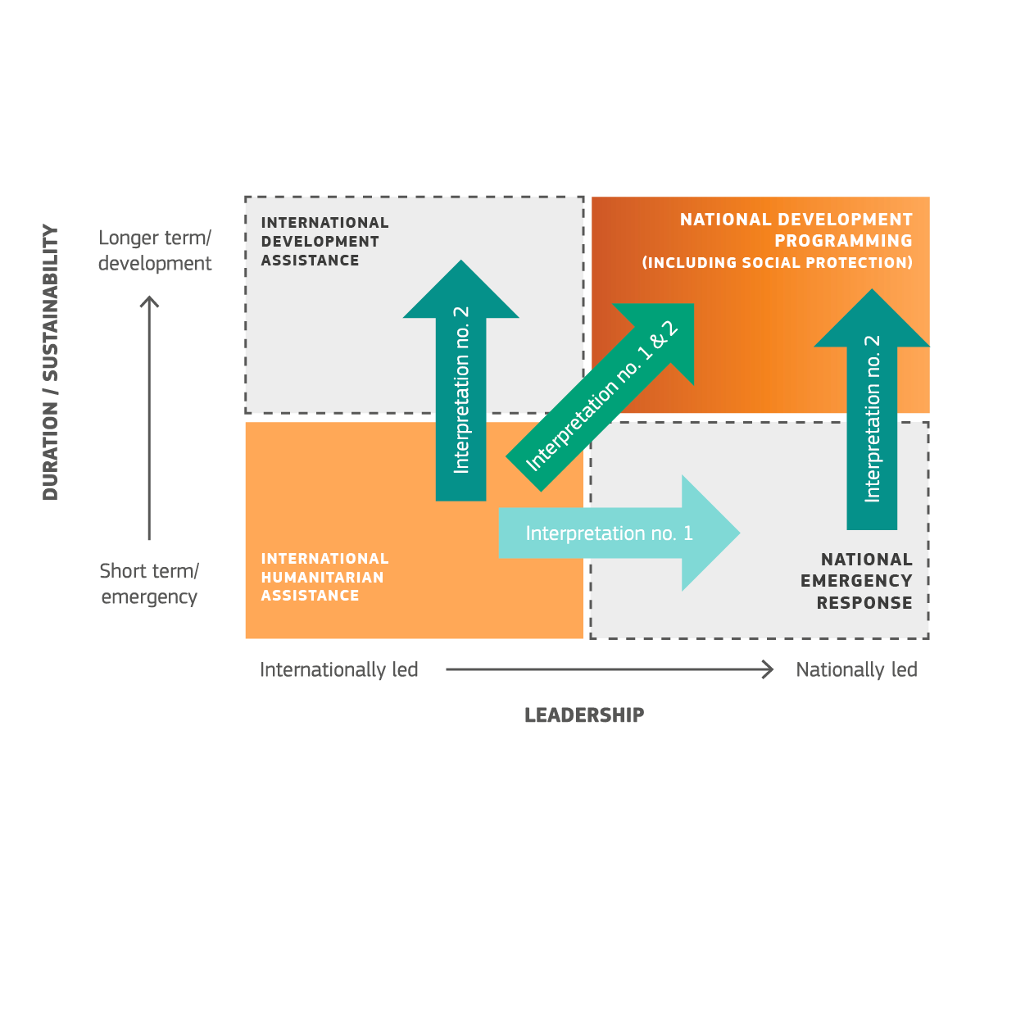
SOCIAL PROTECTION
AND HUMANITARIAN ACTION
Depending on the context,
bridging humanitarian assistance and social protection can be ensured in different ways,
as illustrated in this scheme:
Source: Source: Gentilini, Ugo / Laughton, Sarah / O’Brien, Clare (2018) Human(itarian) Capital?
Lessons on Better Connecting Humanitarian Assistance and Social Protection,
Social Protection & Jobs Discussion Paper No. 1802, WFP / WB.

Slide 13
SOCIAL PROTECTION
AND HUMANITARIAN ACTION
Approaches towards working with government are becoming less distinct.
The principle of independence does not necessarily preclude working with governments and the use of government systems.
Financing of social protection and financing for humanitarian responses have traditionally been separated, but there is scope to increase complementarity.

Slide 14
SOCIAL PROTECTION
AND HUMANITARIAN ACTION
Common ways in which social protection can help bridge the humanitarian-development divide, in
Periods of stability: building social protection programmes and systems that are resilient to fragility, conflict and displacement;
Periods of fragility, conflict or forced displacement: adapting existing social protection programmes and systems during periods of fragility, conflict or forced displacement which can respond to the needs of affected populations;
Crises: building new programmes that include design and operational features to facilitate the transition of the programme or caseload into social protection programmes that are more regular and predictable, with prospects of being sustained and ultimately nationally owned.

Slide 15
REFERENCE DOCUMENT
CHAPTER B –
WHY WORK WITH SOCIAL PROTECTION IN CRISIS CONTEXTS?

Slide 16
WHY WORK WITH
SOCIAL PROTECTION
IN CRISES CONTEXTS?
SOCIAL PROTECTION’S DEMONSTRATED IMPACT TOWARDS THE SDG’S
Impacts that social protection interventions can have across a range of outcomes including poverty, inequality, food security, education, and local economic growth.
These outcome areas are relevant to both development and humanitarian actors.
Social protection is a core policy tool for addressing major socio-economic challenges.

Slide 17
WHY WORK WITH
SOCIAL PROTECTION
IN CRISES CONTEXTS?
OPPORTUNITIES FOR BRINGING TOGETHER HUMANITARIAN RESPONSE AND SOCIAL PROTECTION IN CRISIS CONTEXTS
The number, severity, complexity and duration of recent crises have overburdened the traditional systems such that financing on the scale needed is not available. New, more flexible, comprehensive and predictable approaches are required.
There are significant efficiency, impact and sustainability gains to be made by working with social protection systems and approaches in crisis contexts.
Global and institutional commitments have been made to increase the use of social protection systems and approaches during crises, notably in protracted crisis contexts, to help bridge the humanitarian-development divide.
National governments, donor agencies, UN agencies and NGOs have generated significant and wide-ranging experience of working with social protection in crisis contexts over the past decade. This is an intense area of focus for both humanitarian and development actors.

Slide 18
WHY WORK WITH
SOCIAL PROTECTION
IN CRISES CONTEXTS?
GREAT POTENTIAL FOR SIGNIFICANT EFFICIENCY, IMPACT AND SUSTAINABILITY GAINS
National social protection systems and humanitarian programming coexist to varying degrees, depending on the context.
In this context, interest in ‘shock-responsive’ or ‘adaptive’ social protection has emerged in recent years.
Significant evidence confirms that reliable social protection schemes help improve resilience at individual and household levels.
Having a national social protection system in place can help reach disaster-affected households in a more timely and efficient manner than traditional humanitarian response.
There is growing interest in the role that social protection might play in influencing decisions to migrate in crisis contexts.

Slide 19
REFERENCE DOCUMENT
CHAPTER C –
WHAT DOES WORKING WITH SOCIAL PROTECTION IN CRISES CONTEXTS LOOK LIKE?

Slide 20
WHAT DOES WORKING
WITH SOCIAL PROTECTION
IN CRISIS CONTEXTS LOOK LIKE?
A WORKING TYPOLOGY OF APPROACHES TO DATE
Global experiences of working with social protection systems and approaches to respond to a crisis have recently been organised into a working typology.

Slide 21
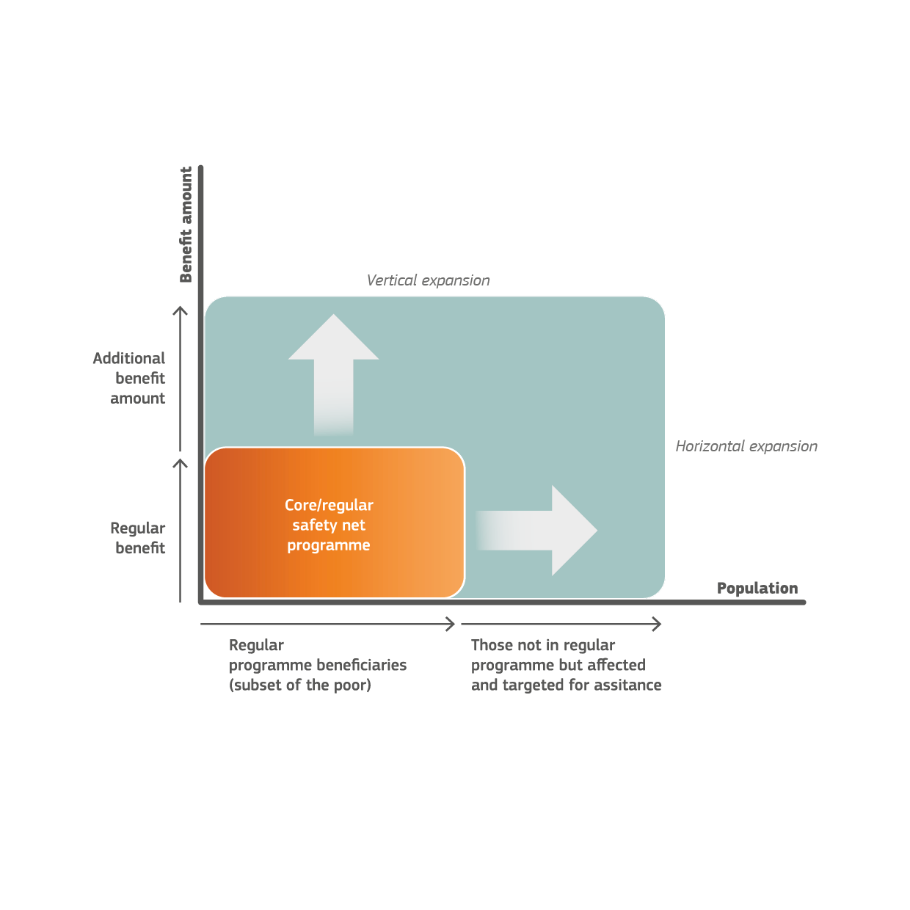
WHAT DOES WORKING
WITH SOCIAL PROTECTION
IN CRISIS CONTEXTS LOOK LIKE?
Programme Scalability to enable responsiveness
to shocks
Most experience to date of working with social protection in fragile, conflict and displacement settings is on working with social assistance (often cash based).
In all instances an assessment of options must be made against the anticipated benefits and risks of continuing with stand-alone humanitarian response.
Source: Gentilini, Ugo / Laughton, Sarah / O’Brien, Clare (2018) Human(itarian) Capital? Lessons on Better Connecting Humanitarian Assistance and Social Protection, Social Protection & Jobs Discussion Paper No. 1802, WFP / WB.

Slide 22
WHAT DOES WORKING
WITH SOCIAL PROTECTION
IN CRISIS CONTEXTS LOOK LIKE?
Depending on the context,
bridging humanitarian assistance and social protection can be ensured in different ways,
as illustrated in this scheme:
Source: Source: Gentilini, Ugo / Laughton, Sarah / O’Brien, Clare (2018) Human(itarian) Capital?
Lessons on Better Connecting Humanitarian Assistance and Social Protection,
Social Protection & Jobs Discussion Paper No. 1802, WFP / WB.

Slide 23
WHY WORK WITH
SOCIAL PROTECTION
IN CRISES CONTEXTS?
A response analysis tool is offered in the Reference Document and applied in the Case Studies on Somalia and Lebanon.
It is a work in progress and is intended to inform decision-making; it is not a decision tree. Depending on the context, different criteria or a different weighting of criteria may also be appropriate, which need to be adjusted to specific country cases at a specific time.

Slide 24
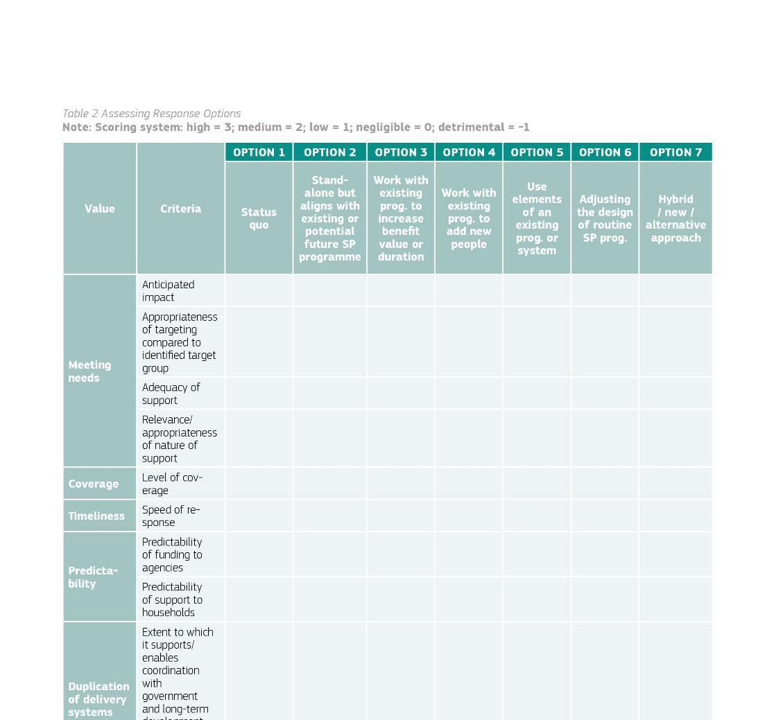
WHAT DOES WORKING
WITH SOCIAL PROTECTION
IN CRISIS CONTEXTS LOOK LIKE?
Presented example: Case study Lebanon
Scoring system:
High = 3 Great improvement
Medium = 2 Some improvement
Low = 1 Slight improvement
No change = 0 No change
Not applicable = n.a.
Source:
Authors, building on Bardach, E. (2012) and O’Brien et al. (2018c).
Response Options Matrix:
Optional Social Protection Options:
1 Stand-alone Hum. response no social protection
2 Shadow alignment align design with existing
nat. intervent./programmes
3 Vertical expansion increase value of benefits for
existing recipients
4 Horizontal expansion increase number of benefits
5 Piggybacking implement through existing infrastructure
6 Design Tweaks adjust design of existing SP
programmes
7 Hybrid / alternative approach

Slide 25

WHAT COMES NEXT
Analysing what works, in which contexts and why. Comparing social protection-focused interventions to standalone humanitarian responses. Assessing social protection instruments beyond social assistance. Understanding how political economy influences options and outcomes.
Reviewing the range of financial instruments available for common programming. Understanding whether and how social protection can address conflict and fragility and support state building.
Assessing how social protection affects decisions to migrate and to return.
Identify necessary further collective efforts to SPaN Guidance Package of for its intended purpose, keep it up-to-date for continuous implementation and further refinements (i.e. through the new GPGC programme on SP, through joint EU/EU MSs initiatives).
In the Communities of Practice on socialprotection.org and capacity4dev.eu
Discuss further what worked, why, and how?

