Slide 1
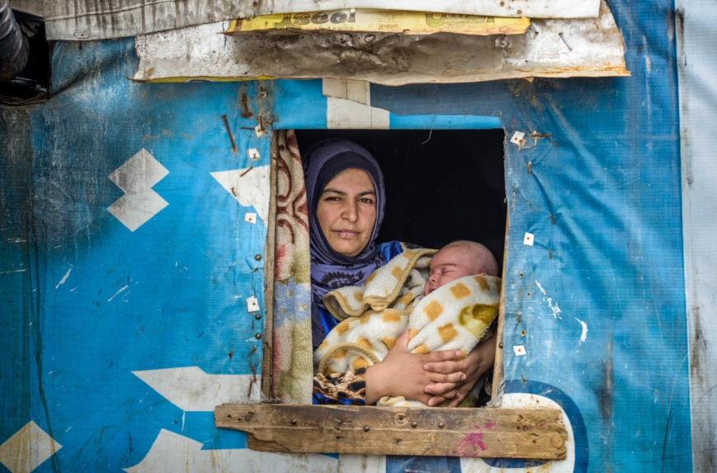
Bridging the gap between humanitarian and development assistance
for health and education
Elisabetta Aurino (Imperial College London) & Sara Giunti (independent consultant)
EU/EFTA Meeting on Social Protection in Development Cooperation
Paris, 23 January 2018

Slide 2
Why education and health in humanitarian settings?
In 2017, 201 million people in need of humanitarian aid
Humanitarian emergencies disrupt education and health services, as well as community ties and institutions
Long-lasting effects on health and education
  On the lifecourse (Akbulut-Yuksel 2008, 2014; Akresh & De Walque 2008)
  For the next generation (Akresh et al., 2017; Caruso & Miller 2015)
  With long-term consequences on a country’s social and economic development
Impact of crises not equitable
Meeting health and education needs in humanitarian crises is fundamental to achieve the SDG agenda
Notes:
resulting in decreased delivery and quality – also they break down community trust and networks that are key for health and education
: Children exposed to humanitarian crises have lower educational and health attainments in adulthood

Slide 3
The potential of SP for education and health in humanitarian settings
Pervasive -1.9 billion people worldwide (Alderman et al, 2018)
Positive impacts of social protection on education and health in non-humanitarian contexts (Drake et al., 2017; Baird et al., 2013; Taaffe et al., 2017; Hidrobo et al., 2018; Bastagli et al., 2016)
SP can be a sustainable tool to bridge the gap between humanitarian assistance and development
  School feeding has been scaled-up in emergencies (WFP 2013)
  Generalised food distribution largest component of humanitarian assistance globally (Harvey et al., 2010)
  Cash transfers increasingly used as a tool in emergencies (Roelen et al 2018)

Slide 4
Key evidence gaps
We know extremely little about the impact of social protection on education and health in humanitarian emergencies (Buvinić, Das Gupta, and Shemyakina, 2014; Doocy and Tappis, 2016, World Bank 2016)
Additional evidence gaps:
  Do educational and health effects of social protection in humanitarian settings vary by program type?
  Variation by gender and other vulnerable groups?
  Variation by type, intensity, scale and phase of the crisis?
  Cost-effectiveness?
Notes:
Add pics?

Slide 5
Evidence gap translates into lack of action!
Education and health are key pillars of humanitarian assistance together with food and shelter (UNESCO 2011)
However, only 6% of humanitarian assistance funding goes to educational programs
  Critical funding mismatch
Photo credit: Save the Children

Slide 6
This note:
Reviews the evidence (from academic and grey literature) on social protection for education and health in humanitarian settings
Emphasises innovative and promising practices
Highlights limitations and gaps

Slide 7
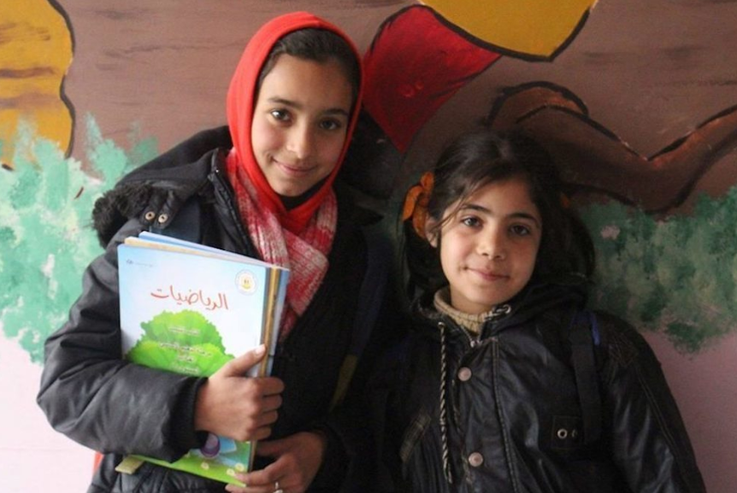
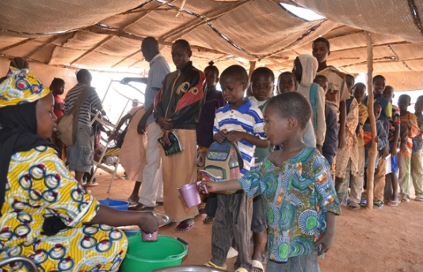
Education
Source: WFP/Daonda Guirou

Slide 8
Humanitarian settings amplify demand & supply barriers to SDG4
LEARNING ACHIEVEMENTS
SCHOOLING OUTCOMES
Enrolment
Attendance
Progression
Grade attainment
DEMAND-SIDE BARRIERS
SCHOOLING QUALITY CONSTRAINTS
PHYSICAL (e.g. cost of transport)
FINANCIAL (e.g. school fees, uniforms, books, poverty, time use)
INSECURITY AND FEAR OF VIOLENCE
BEHAVIOURAL (e.g. cultural norms or schooling)
INFRASTRUCTURES
TEACHERS (retention, quality and motivation)
EDUCATIONAL SUPPLIES
SOCIAL INSTITUTIONS
Notes:
Humanitarian crises amplify demand and supply-side barriers to education, hampering schooling and learning

Slide 9
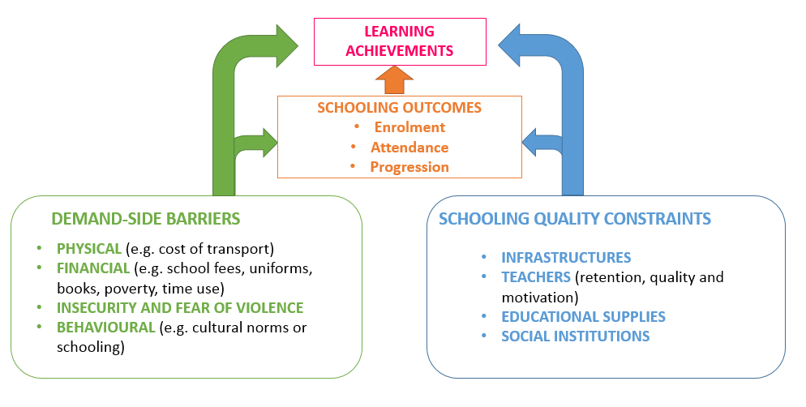
Cash transfers
Cash transfers
Unconditional & Conditional
Conditional
Cash plus

Slide 10
Cash transfers: Rigorous evidence base
 | Enrolment | Attendance | Grade attainment | Learning | School expenses
CCT Colombia (conflict) (Wald & Bozzoli 2011) | + | Not reported | Not reported | Not reported | Not reported
UCT Lebanon (Syrian refugees) (Lehmann & Masterson 2014) | + | Not reported | Not reported | Not reported | Not reported
CCT Lebanon (Syrian refugees) (De Hoop et al., 2018) | No effect (capacity constraints?) | + | Not reported | Not reported | +
UCT Jordan (Syrian refugees) (Ulrichs et al., 2018, qualitative evaluation) | + | + | Not reported | Not reported | +
Notes:
Overall,
CCT in Colombia increased enrolment more in conflict-affected areas than in non-conflict settings (Wald & Bozzoli 2011)
UCT to Syrian refugees in Lebanon increased enrolment to primary school by 6 p.p. Transfer mostly used to cover for transport costs (Lehmann & Masterson 2014)
CCT to Syrian refugees, with condition related to attendance. Transfers covered transport costs and offset a substantial part of income loss due to school attendance
No effect on enrolment (perhaps due to capacity constraints)
Increase in attendance by 20% over control group
Ulrichs et al. (2017): qualitative impact evaluation of UCT for Syrian refugees in Jordan
Most of the transfer spent on rent, but some positive effects on educational expenditures
Positive effect on enrolment and attendance
No evidence on cash-plus

Slide 11
School feeding
Provision of food (snack, meal or take-home ration) at school
375m children daily, for a global investment of US70 billion
SCHOOL MEALS

Slide 12

School feeding: Rigorous evidence base
 | Enrolment | Attendance | Grade attainment | Learning | School expenses
IDP camp in Northern Uganda (school meals and take-home rations) (Alderman et al,. 2012) | + | + | Not reported | Not reported | Not reported
Conflict in Mali (school meals) (Aurino et al., 2018) | + | + | + | Not reported | Not reported
Notes:
Overall,
CCT in Colombia increased enrolment more in conflict-affected areas than in non-conflict settings (Wald & Bozzoli 2011)
UCT to Syrian refugees in Lebanon increased enrolment to primary school by 6 p.p. Transfer mostly used to cover for transport costs (Lehmann & Masterson 2014)
CCT to Syrian refugees, with condition related to attendance. Transfers covered transport costs and offset a substantial part of income loss due to school attendance
No effect on enrolment (perhaps due to capacity constraints)
Increase in attendance by 20% over control group
Ulrichs et al. (2017): qualitative impact evaluation of UCT for Syrian refugees in Jordan
Most of the transfer spent on rent, but some positive effects on educational expenditures
Positive effect on enrolment and attendance
No evidence on cash-plus

Slide 13
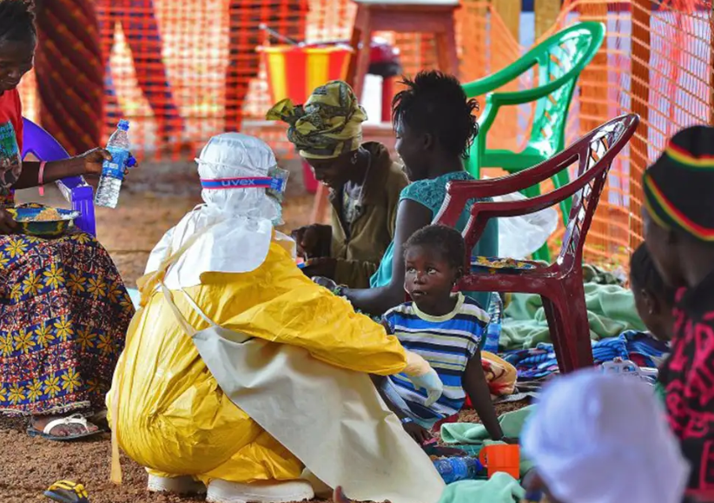
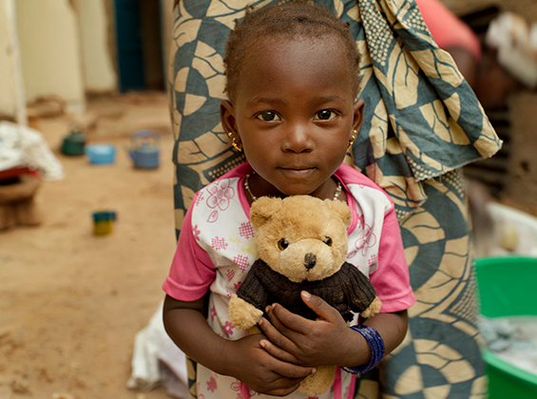
Health
Photo credit: The Independent, Muso

Slide 14
SP can address multidimensional determinants of health
Prenatal development
Early childhood
School-Age
Adulthood
Older age
Adolescence
HEALTH OUTCOMES OVER THE LIFECOURSE
DEMAND-SIDE BARRIERS
HEALTH CARE SYSTEMS
PHYSICAL (e.g. cost of transport)
FINANCIAL (e.g. users fees, drugs, poverty)
INSECURITY AND FEAR OF VIOLENCE
BEHAVIOURAL
EDUCATION
INTRA-HOUSEHOLD FACTORS
INFRASTRUCTURES
SKILLED HEALTH PERSONNEL (retention, quality and motivation)
DRUGS & VACCINES
SOCIAL INSTITUTIONS
POOR WATER AND SANITATION, DISEASE ENVIRONMENT
Examples of SP:
Cash transfers (CCT and UCT), cash plus
User fees exemptions
Health & social insurance (e.g. maternity, disability, etc)
Food assistance & Food for work/cash
Income support
Examples of SP:
Health services
Case management
Community services
Health prevention and promotion campaigns
Notes:
Humanitarian crises amplify demand and supply-side barriers to education, hampering schooling and learning

Slide 15
Evidence base
Recent systematic review highlighted the scarcity and overall low quality of interventions focusing on health in humanitarian settings (Blanchet et al 2017)
  Most studies focusing on acute malnutrition among young children or communicable diseases
  Many and persistent evidence gaps
No evidence of social protection on vulnerable groups such as adolescents
Dearth of evidence on cash transfers or vouchers
  In terms of cash transfers and vouchers, overwhelming majority of evidence relates to food security and nutrition
Evidence on food assistance programs also mostly refer to nutrition and food insecurity

Slide 16
To sum up: evidence gaps
EDUCATION
Effects on Learning?
Early childhood education and secondary school?
HEALTH
Effects on most dimensions?
  Non-communicable disease
  Sexual and reproductive health, including gender-based violence
  Nutrition for school-age and adolescents
Effects from cash, vouchers and food assistance?
CROSS-CUTTING GAPS
Effects by gender, age and vulnerable groups
Differences in impact by transfer modality, including cash plus
Differences in impact by type of crisis, phase and intensity
Cost-effectiveness of different types of interventions
More evidence on quality or program implementation

Slide 17
Programmatic highlights and tools
Targeting and delivery through national systems if they exist (scale-up and scale-out)
  Education and health can give strong signals of state presence
  Schools can be used as multi-sectoral platforms (e.g. school meals, vaccinations, mental health)
  Afternoon shifts and use of existing systems for delivery of cash (e.g. Syrian refugees)
Adapt modalities to context-specific needs
  Giving out cash may not work if social and behavioural constraints
Transfers cannot substitute for availability and quality of services
Recognise trade-offs and complementarities across sectors and programs
  Overcome fragmentation and verticalisation for comprehensive programs
  Joint programming
Consider innovative forms of delivering health and education in crises
Embed M&E in programs

Slide 18
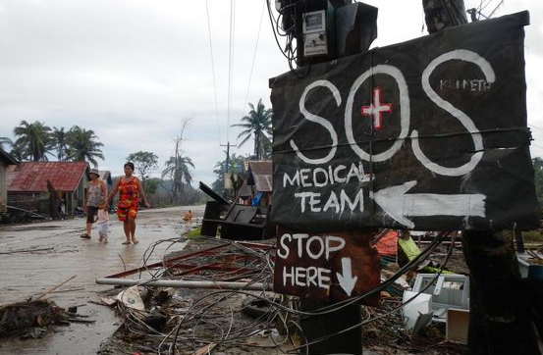
Main challenges
Coordination
Financial gaps
Safety, security and mobility
Quality of program implementation
Research ethics
Photo credit: Medico international

Slide 19
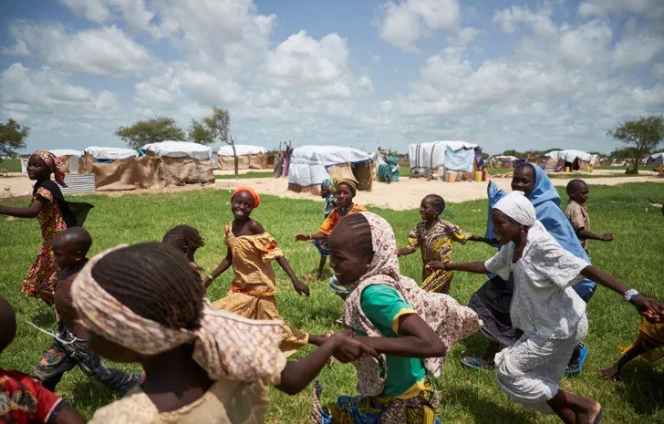

Thank you!
Questions?
e.aurino@imperial.ac.uk
@ElisabettAurino
Photo credit: @UNICEF/UN029108/Phelps

Slide 20
Good practices: Targeting and delivery through national systems
Schools can be used to deliver services across sectors:
psychosocial support programs preventing and reducing post-traumatic stress disorder (PTSD) in Israel, Burundi, Palestine, Croatia and Uganda.
School-based mental health interventions for depression among adolescents exposed to conflict-related violence in two camps for internally displaced persons in northern Uganda.
School-delivered water and sanitation program during the conflict in Mali.

Slide 21
Good practices: M&E
Integrated approaches to data and information management:
1) provide guidance for designing vertical and horizontal expansion of on-going social protection when a crisis occurs.
Aurino et al. (2018): https://blogs.unicef.org/evidence-for-action/administrative-data-missed-opportunity-for-learning-and-research-in-humanitarian-emergencies/
The Single Registry in Kenya: http://socialprotection.or.ke/single-registry
2) tackle the key evidence gap on social protection for health and education, improving cost-effectiveness of future interventions.

