Slide 1
SPaN for Food Security and Nutrition
Abi Masefield 23/01/2019

Slide 2
STRUCTURE
Understanding Food Insecurity and Malnutrition through a Nexus Lens
Setting the Scene
International Commitments and EU Policies
What Does the Evidence Tell Us?
What Does Experience Suggest?
Are there Promising Practices?
Are there useful Guidance and Tools?
Ten Points to Keep in Mind?

Slide 3
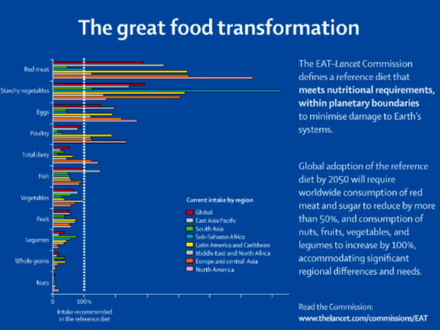
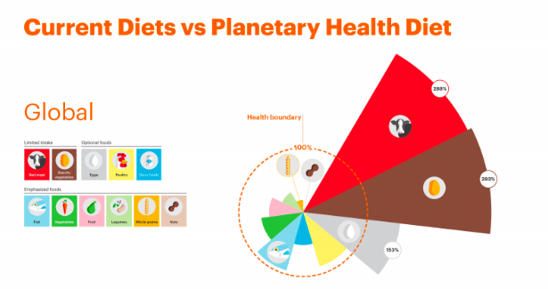
1. Setting the Scene…
SDG 2 set out a vision for sustainable solutions to end all forms of hunger and malnutrition by 2030;
Unfortunately not only is the global food system failing to live up to its responsibilities – our broken food system appears to be driving a rapid worsening of the situation.
Whether we look to the 2018 SOFI, the 2018 Global Report on Food Crises or the 2018 Global Nutrition Report, the evidence of continuing deterioration seems to be confirmed.
The good news is that we may be starting to recognize the increasing relevance of the term ‘Crises’ for us all as highlighted by the recent EAT / Lancet Commission for instance. It is now being acknowledged that malnutrition is the new norm – and this this had to change.
It is no coincidence that the health and nutrition of the population is now reflected in the health of the planet. Our food system is the single largest driver of the global environmental crisis. The crisis is systemic and therefore there are growing calls for a ‘Great Food Transformation’
Notes:
We know from the 2018 State of Food Security and Nutrition Report (SOFI) that the number of people with insufficient food (currently 821 million) is on the rise, while around 500 million live in countries affected by fragility, conflict and violence. It is estimated that the majority of the 151 million stunted children under five may live in conflict affected countries;
The 2018 SOFI report also focused on the implications of climate variability and extremes as a key driver behind the rise in global hunger and one of the leading causes of severe food crises;
The 2018 Global Report on Food Crises found that 124 million people across 51 countries (an 11% increase since the previous year) face crisis levels of acute food insecurity requiring urgent humanitarian action.
The 2018 Global Nutrition Report confirms that the burden of malnutrition across the world remains unacceptably high, and progress unacceptably slow. Malnutrition is responsible for more ill health than any other cause. At least one third of the global population experience at least one form of malnutrition, and this is rising year on year.
Nutrition inequalities are increasingly evident, with education and socio-economic background having a strong correlation with all forms of malnutrition (and their co-existence in the same communities, households and individuals) whether child stunting and wasting, micronutrient deficiencies or overweight and obesity.
As different forms of malnutrition continue to compound one another, they impose unacceptably high costs on individuals, families and nations, undermining life chances, productivity and labour market outcomes. These in turn contribute to reinforcing existing social inequalities and resulting instability.
At the same time, tackling the problem of malnutrition among the urban population (an ever growing majority) gives rise to new challenges, with nutrition related inequalities often even more apparent than among rural populations (further exacerbating instability) and food safety issues an increasing concern.
Obese people have poorer job prospects compared to normal-weight people, they are less likely to be employed and have more difficulty re-entering the labour market. Obese people are less productive at work due to more sick days and fewer worked hours, and they earn about 10% less than non-obese people. (OECD/EU, 2016)

Slide 4
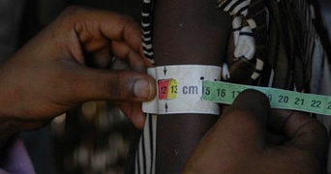
2. Understanding Food Insecurity and Malnutrition through a Nexus Lens
It is important to have a good grasp of the terminology in order to understand both the ‘diagnosis’ and the ‘cure’
As the H-D nexus agenda has evolved, so too has thinking about the different forms of food insecurity and malnutrition that exist, in particular:
how they can be measured (especially in challenging contexts)
what different indicators can tell us about the main drivers of the crisis
their interconnections
Historically, efforts to tackle malnutrition have adopted a ‘siloed’ approach with the treatment of wasting understood as a legitimate ‘emergency’ response and the prevention of stunting as a development priority. This is now starting to change…
The provision of adequate nutrition in early life (particularly the first ‘1000 days’ from conception until a child reaches two) should be considered crucial both in terms of saving lives and advancing the rights of children to realise their full potential. Currently 8% of all children under five are wasted and 22% stunted. Primary driver of this is poverty, inequality and deprivation.

Slide 5
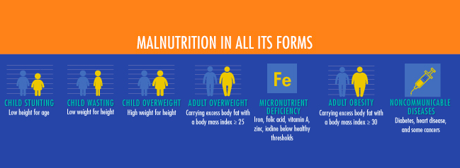
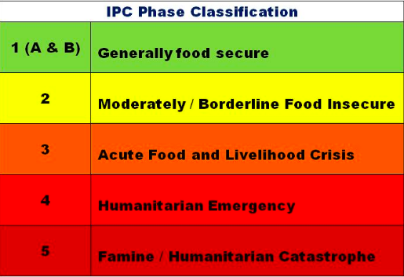
What are we talking about?
Hunger
Food insecurity (as experienced)
Acute Food Insecurity
Famine
Chronic Food Insecurity
Undernourishment
Undernutrition
Malnutrition
Stunting (or ‘chronic malnutrition’ (severe or moderate)
Wasting (or ‘acute malnutrition’ (severe or moderate)
Micronutrient deficiencies
Overweight and obesity
Non communicable diseases
Notes:
As with poverty….
It should be recognised that the number of ‘hungry’ people indicated by the ‘undernourishment’ indicator should not be equated either:
- with the number of people that may be defined as ‘food insecure’ or without the right to adequate food and nutrition which may be significantly higher; nor
- with the number of people that may be defined as having one or more forms of undernutrition.
In recent years, specific criteria have been agreed upon by the international humanitarian community for determining if a food crisis should be considered a famine. But given the range and complexity of food emergencies, the way in which famines, or potential famines, are discussed can still be quite unclear.
In declaring famines, the UN follows the Integrated Food Security Phase Classification (IPC) – you find all details in the IPC guidelines here, and the more general IPC Manual.
The IPC lays out thresholds across three dimensions of outcomes, all of which must be evidenced in order for a famine to be declared in a certain area:
Food consumption and livelihood change: At least one in five households faces an extreme lack of food, as evidenced by insufficient food consumption (in terms of quantity and/or quality) and by the coping strategies employed by or available to households (e.g. the extent to which assets like livestock or seed may have been sold off)
Nutritional status: More than 30% of the population is suffering from 'wasting' (being below 2 standard deviations below the median weight for a given height in the reference population)
Mortality (due to inadequate food consumption)⁶: At least two people out of every 10,000 and at least four children under five out of every 10,000 are dying per day.⁷
A few things are worth noting about this definition. Firstly, these thresholds represent only the most severe rank of the IPC food insecurity classification. The system ranges from Phase 1 to Phase 5, with 5 corresponding to a famine situation. Lower phases of food insecurity are categorized by lower thresholds in each of the three dimensions above.
Secondly, it is important to see that such thresholds are a measure of intensity rather than magnitude⁸. That is to say, rather than trying to capture the absolute number of people in a certain situation of food insecurity, it looks at proportions within given geographic areas.

Slide 6
Understanding the complex interaction of basic, underlying and immediate causes
Understanding and responding to the complex interaction of factors driving all forms of malnutrition in both rural and urban communities necessitates a multi-sectoral and context specific perspective.
This is essential to ensure a systematic analysis of diverse issues such as: agri-systems, incomes, diets, water and sanitation, women’s empowerment, infant and young child feeding and universal access to basic services (paying special attention to access by young children, adolescents and pregnant women).
UNICEF Conceptual Framework for the Causes of Malnutrition 1990
Notes:
Poverty, food insecurity and malnutrition share many of the same structural drivers and social protection comprises a set of policies and programmes that can address many of these economic, environmental and social vulnerabilities.
The widely respected UNICEF conceptual framework for understanding the determinants of malnutrition provides a crucial starting point for understanding potential pathways of impact (adequate diet, care and a healthy environment) and the corresponding theory of change with regard to opportunities presented by social protection.

Slide 7
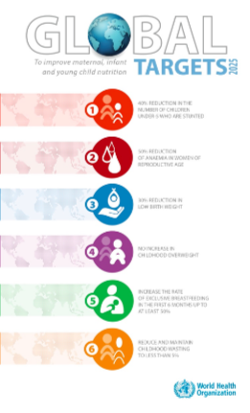
3. Food Security and Nutrition: International Commitments and EU Policies
SDG-2 By 2030 Zero Hunger and End Malnutrition in all its forms
World Health Assembly Targets (2025)
UN Decade of Action on Nutrition
2010 EU Policy Framework on Food Security
2013 EU Communication and Action Plan on Maternal and Child Nutrition
2013 ECHO Policy Framework for Humanitarian Food Assistance
2013 ECHO Thematic Policy Document Addressing Undernutrition in Emergencies

Slide 8
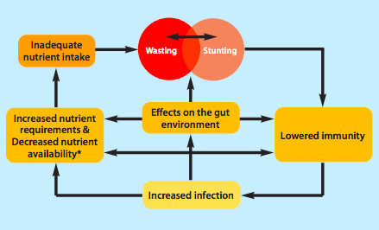
4a. What does the Evidence tell Us? Stunting, wasting and their interrelationship?
A child with severe wasting is 12 times more likely to die than a non-wasted or stunted child), but the majority of wasted children do not live in ‘emergencies’ as conventionally defined;
The evidence on persistent wasting indicates that food insecurity may often not be the main or only driver, but also other factors related to public health and ensuring adequate care practices, (associated in turn with the presence of environmental enteropathy pathogens);
Seasonality can play a significant role in deteriorating nutrition
Severe stunting is now understood to be associated with a higher risk of mortality than moderate wasting, suggesting that stunting reduction should be viewed as a legitimate goal in humanitarian and protracted crises;
Child stunting and wasting impact on each other and share common risk factors as well as common consequences.
A significant proportion of children are concurrently wasted and stunted. Being concurrently wasted and stunted is now understood to amplify the risk of death to levels comparable with children who have the most severe form of wasting.
Recent evidence suggests that episodes of wasting negatively affect linear growth and therefore undermine child growth and development in the long term. Analysis suggests that levels of wasting peak first, followed two to three months later by a peak in stunting.
Wasting, Stunting and the Cycle of Infection (WaSTTIG, 2018)
Notes:
While wasting tends to be associated with emergency contexts (due to the fact that a child with severe wasting is 12 times more likely to die than a non-wasted or stunted child), and stunting by contrast is generally regarded as an indicator of structural poverty, in fact the majority of wasted children do not live in emergencies, but rather situations associated with protracted crisis and / or extreme poverty with the emergency threshold of above 15% GAM repeatedly exceeded over several years or even decades ;
The evidence on persistent wasting indicates that food insecurity may often not be the main driver, but rather other factors related to public health and ensuring adequate care practices, associated in turn with the presence of environmental enteropathy pathogens;
Seasonality can play a significant role in deteriorating nutrition as there are generally periods in the year where food may be more difficult to access (often referred to as the ‘lean’ season) and the disease burden is higher (often coincides with the ‘wet’ season);
Severe stunting is now understood to be associated with a higher risk of mortality than moderate wasting, suggesting that stunting reduction should be viewed as a legitimate goal in humanitarian and protracted crises; and,
Child stunting and wasting impact on each other and share common risk factors as well as common consequences, with a significant proportion of children being concurrently wasted and stunted;
Recent evidence suggests that episodes of wasting negatively affect linear growth and therefore undermine child growth and development in the long term. This can be seen by the fact that South Asia alone is home to 50% of the world’s wasted children.
Analysis suggests that levels of wasting peak first, followed two to three months later by a peak in stunting.
Being concurrently wasted and stunted is now understood to amplify the risk of death to levels comparable with children who have the most severe form of wasting.
T. Khara and C. Dolan. 2014. Technical briefing paper: Associations between wasting and stunting, policy, programming and research implications. Oxford, UK, Emergency Nutrition Network.

Slide 9
4b. What Does the Evidence Tell Us? Impact of Transfers on Food Security and Nutrition
STRONG EVIDENCE: Cash transfers generally (in both development and humanitarian contexts) have a positive effect on resources to enhance food security and diet as well as health
MORE LIMITED AND MIXED EVIDENCE: On children’s dietary intake and nutrition (as measured by anthropometric indicators) and particularly so in humanitarian contexts.
ETHIOPIA: Evidence of nutrition impact arising from PSNP generally been disappointing (issues relating to targeting, low size of transfers and the involvement of a physical labour requirement, other structural problems relating to WASH and access to essential services etc.
PAKISTAN: Compelling evidence that both wasting and stunting were significantly reduced as a result of cash based assistance. The size of the reduction corresponded directly to the size of the cash transfer.
GENERAL CHALLENGES: Challenges facing efforts to generate evidence reflect multiple factors, including quality of programme design and capacities to deliver, research complexities associated with the context specific challenges presented by different crises as well as the fungible nature of cash and the implications for attribution. Evidence from more stable contexts cannot always be straightforwardly generalised to humanitarian contexts.
GAPS in UNDERSTANDING: There are many. A key gap relates to women’s empowerment which is particularly crucial in terms of mediating the relationship between cash transfers and care as well as equitable access to an adequate diet, essential services etc.
Notes:
There is strong evidence that cash transfers generally (in both development and humanitarian contexts) have a positive effect on resources to enhance food security and diet as well as health (for example increased preventative healthcare visits and improved access to WASH facilities, and even improved mental health).
However, the research base remains more limited, and the evidence mixed for children’s dietary intake and nutrition (as measured by anthropometric indicators) and this particularly so in humanitarian contexts. The challenges encountered in seeking to generate conclusive evidence, can be understood as reflecting the significance of multiple factors, including quality of programme design and capacities to deliver, as well as the research complexities associated with the context specific challenges presented by different crises as well as the fungible nature of cash and the implications for attribution.
In Ethiopia, the evidence of nutrition impact arising from the Productive Safety Net Programme has generally been disappointing, potentially as a result of issues relating to targeting, low size of transfers and the involvement of a physical labour requirement, while other structural problems relating to WASH and access to essential services also remain.
Nevertheless, an EU supported research initiative in areas of Pakistan impacted by crises found compelling evidence that both wasting and stunting were significantly reduced as a result of cash based assistance and moreover that the size of the reduction corresponded directly to the size of the cash transfer.
While the provision of cash or vouchers directly to those in need accounts for a rapidly increasing proportion of humanitarian assistance, it is important that the options for cash based assistance be supported by research. Evidence from more stable contexts cannot always be straightforwardly generalised to humanitarian contexts.
While the relation between caregiving and nutrition is known to be strong, there is so far little evidence of impact of CTs on caregivers’ behaviours and this should be considered a research priority. In particular, existing evidence suggests that women’s empowerment is particularly crucial in terms of mediating the relationship between cash transfers and care as well as equitable access to an adequate diet, essential services etc.
Other priority areas identified for further research include cash transfer programming outcomes across the nexus among urban populations, as well as the potential implications for social protection in protracted crises of increasing overweight and obesity associated with widespread NCDs among the poor in developing countries.

Slide 10
5. What is Experience Suggesting?
Size and duration of cash transfers
Integration with other interventions
Experience with conditionalities and targeting
Identifying institutional / capacity related challenges
Experiences with promotion of a rights based approach
Recognising the significance of breastfeeding for food security and nutrition in time of crisis
Coordinated monitoring, evaluation and learning
Addressing fears regarding misuse of cash transfers
Notes:
Key Experiences to Date
The Note identifies eight areas of emerging experience on the basis of their strategic significance for approaching social protection across the nexus in order to enhance food security and nutrition related outcomes:

Slide 11
6. Where are the Promising Practices?
System strengthening and capacity development
The added value of a regional initiative to support nutrition sensitive social protection
Harnessing the budget support modality in support of rights based, nutrition sensitive and shock responsive social protection
The ‘cash-plus’ approach
Strengthening knowledge and national information systems for nutrition
Promoting the ‘localisation’ agenda and the significance of community based support
Advancing gender equality and women’s empowerment via social protection for enhanced food security and nutrition
Strengthening systems to provide maternity allowance and increasing the focus on breastfeeding
Notes:
Promising and Innovative Practices
Building on the various challenges highlighted by recent experience, the Note presents eight promising and innovative practices and innovations to inspire decision making and inform processes across the programming cycle:

Slide 12
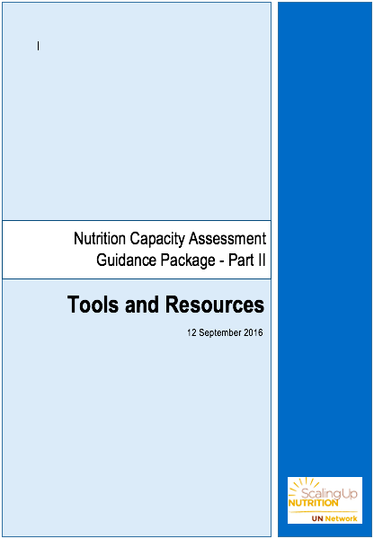
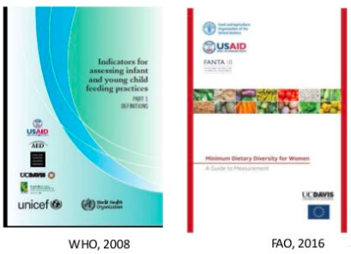
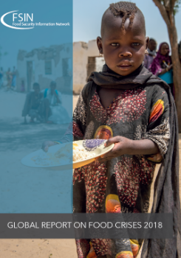
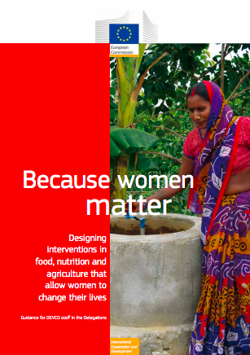
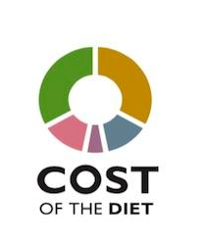
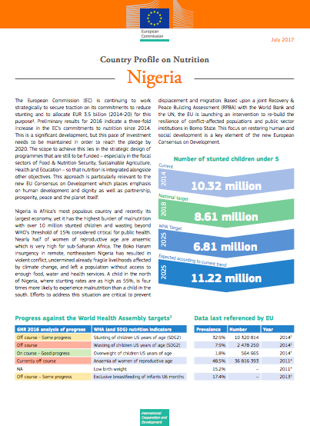
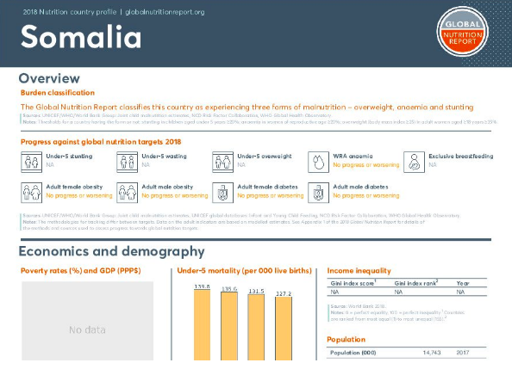
7. Useful Guidance and Tools?
Notes:
An extensive and ever increasing range of guidance and tools relating and relevant to SPaN for food security and nutrition exists as indicated by the selection of highlighted links and reviews provided in Section Nine of this Note.
The Cost of Diet (CotD) software, developed by Save the Children, analyzes the amount, combination, and cost of local foods needed to provide families with a nutritious diet. The software uses linear programming to find optimal combinations of available foods that meet energy, macronutrient, and micronutrient needs. With this new release, CotD has been completely re-written into a more stable program, and is available for use free of charge. Save the Children has used the software in Bangladesh and in Myanmar, for example to assist with measuring impacts of the 2009 food price crisis and with determining cash transfer amounts in a cash-for-work program. In addition to the software, several guidance documents are available, as well as an online forum to discuss and troubleshoot.

Slide 13
8. TEN POINTS: To Keep in Mind
Recognise complexity but maintain clarity
Abandon the siloed approach to stunting and wasting
Harness cash based assistance to lay the foundations for rights based social protection systems
Use existing tools to strengthen the evidence – policy connection
Identify opportunities to use social protection to protect and promote breastfeeding across the nexus
Avoid a narrow approach to ‘nutrition sensitive’ social protection
Build on promising experience with ‘Cash-Plus’ approach
Integrate investment in system strengthening and capacity development from the start
Make optimal use of Budget Support modalities
Coordinate support for regional initiatives to accelerate policy priorities, national commitment, cross country learning and capacity development
Notes:
Building risk-informed, shock responsive and nutrition sensitive social protection systems is increasingly recognised as a crucial and strategic component of efforts to strengthen the humanitarian development nexus within the framework of Agenda 2030 and associated commitment to end hunger and all forms of malnutrition.
On the basis of reviewing existing evidence, experience and promising practice, the following points can be born in mind for improved food security and nutrition when operationalising social protection policies and programmes across the nexus:
1. Greater clarity of focus in the face of complexity: The causes and far reaching consequences of food insecurity and multiple forms of malnutrition are complex and interconnected, whether in contexts of crises or ‘normal’ times. It is therefore extremely important to be clear on the various terminology and definitions associated with food security and nutrition as this has important implications for programming and understanding the evidence in terms of outcomes and impact;
2. Moving beyond a ‘siloed’ approach to stunting and wasting: The recent shifts in understanding the ongoing persistence, severity of risks and complex interrelationship with regard to stunting and wasting has profound implications for social protection in terms of its potential to support the transformation of a historically ‘siloed’ approach alongside building systems for the treatment of severe wasting into national health systems, while ensuring an increased focus on tackling stunting as a legitimate objective in protracted crises;
WHAT DOES THIS MEAN FOR HUMANITARIANS: Ensure greater attention to child stunting in humanitarian crises: While child wasting has been conventionally been given far greater priority in humanitarian crises than child stunting, it is increasingly recognised that high levels of child stunting can persist in areas of protracted crisis, while hard earned gains in stunting reduction are at risk of being eroded. Furthermore, being stunted carries a significant mortality risk, especially when a child is severely stunted, or when stunting and wasting exist concurrently. This has fundamental and potentially transformatory implications for strategic approach adopted in crises. (multi-annual approach, greater investment in basic and underlying causes etc.
WHAT DOES THIS MEAN FOR DEVELOPMENT ACTORS: Increase attention to both prevention and treatment of wasting across the development agenda: Based on the growing awareness that much of the child wasting in the world persists as a result of structural factors rather than crises per se and that both child stunting and wasting impact upon and interact with the other, tackling wasting through national systems for service delivery (addressing both prevention and treatment) is a key priority;
3. Cash based assistance can lay the foundations for rights based social protection systems: Flexible, regular, predictable and scalable social protection systems can support a more dynamic and adaptable response to crises as they evolve. Cash based assistance is inherently ‘multi-purpose’ and on the basis of the widespread structural poverty and livelihood insecurities that underpin chronic food insecurity and persistent malnutrition (both in humanitarian crises and in ‘normal’ times), can be considered both a prerequisite and a catalyst for enabling and facilitating the multiple changes in behaviour and access to services necessitated for lasting progress. In this way, social protection programmes can contribute both to the immediate realization of the fundamental right of everyone to be free from hunger and malnutrition and to the progressive realization of the right to food and good nutrition;
4. Promote the coordinated utilisation of existing tools to link evidence with policy making: Both humanitarian and development actors should work together to make more effective use of available tools and research priorities to better understand the relative significance of various causal factors in specific contexts, as well as to identify and measure crucial issues such as the gap between existing diet-related expenditure and that required to ensure that basic nutrition requirement are met. In particular, building on experience and promising practice to ensure greater attention to programming for greater gender equality and women’s empowerment is a key priority
5. Social protection can be harnessed to protection and promote breastfeeding across the nexus: Given the tremendous significance for saving millions of lives and enhancing the food security and nutritional status of millions more children, (in turn having profound inter-generational implications), a crucial opportunity for partnership across the humanitarian – development nexus relates to harnessing social protection (together with a range of complementary actions) to support the protection and promotion of breastfeeding;
6. The need to avoid an overly narrow approach to ‘nutrition-sensitive’ social protection: Coherence across the nexus in support of nutrition sensitive approaches to social protection is crucial, but an overly prescriptive interpretation of what this means in practice (such as a primary emphasis on the incorporation of nutrition-specific interventions) should be avoided. In particular, the inherent logic of narrowly targeted and conditional transfer based programmes which have been frequently branded as models of ‘nutrition-sensitive’ social protection, requires a fundamental rethink based on the growing body of causal analysis and evidence of impact generated in specific contexts. (A systematic guiding framework is presented in Annex Seven). Systematically tracking wealth and gender disaggregated indicators at outcome level (such as exclusive breastfeeding, minimum dietary diversity and the adequate diets of young children for instance) should be considered the crucial hallmark of genuine nutrition sensitivity;
7. Building on promising experience with the Cash Plus approach: The use and scale up of the Cash+ approach can be considered a response priority in protracted crises for example to support livelihood resilience at the same time as ensuring that essential needs for food are met (as well as other essential requirements for good nutrition such as water, sanitation and hygiene, access to basic services etc.). This should be done without the imposition of hard conditionalities, although this could still leave room for the adoption of either a ‘single standalone programme’ or ‘complementary programme’ model.
8. The neglect of investment in system strengthening and capacity development is a false economy: While the focus on rapid response and immediate impact has historically taken precedence in addressing needs in the context of a crisis situation, the potential for tension with system strengthening and capacity development must be addressed. This can be achieved by ensuring a simultaneous focus on partnership with national stakeholders around models for sustainable and inclusive delivery and the corresponding investment in institution building for good governance and the promotion of a rights based approach. Working with national stakeholders to undertake a comprehensive Capacity Assessment for Nutrition (drawing on recent tools and guidance for such an exercise) can be an important first step towards the development of an agreed roadmap for investment. Strengthening national information systems for food security and nutrition should be approached as an integral component of such support. Neglecting such opportunities is a false economy, undermining impact in the longer term;
9. Make optimal use of Budget Support Modalities for supporting SPaN and Localisation: Harnessing the Budget Support modality (also referred to as Sector Reform Contracts) to reinforce national governments’ policy commitments for example towards rationalised, universal ‘life-cycle’ schemes (such as maternity allowance or child cash grants - whether framed as social protection, or in the context of national multi-sectoral action plans for nutrition) should be considered as a key objective by EU Delegations (and where possible in partnership with Member States). This modality also brings with it strategic opportunities to promote a ‘Localisation’ agenda by way of putting a spot light on sub-national delivery mechanisms and improved results at all levels, as well as highlighting the significance of strengthening civil society’s role in enhanced accountability.
10. Coordinate backing for regional initiatives to accelerate national commitment: Where possible, entry points for supporting regional initiatives promoting social protection across the nexus should be identified and acted upon to promote the role of intergovernmental structures and mechanisms to ensure strong commitment and policy visibility around linking humanitarian and development approaches for accelerating food security and nutrition related outcomes
Invest now in analysis of the implications of profound shifts related to urbanisation and the ‘double burden’: It is estimated that 68% of the global population will be urban by 2050 with the greatest acceleration in Africa and Asia. The soaring prevalence of overweight, obesity and NCDs (with three quarters of NCD deaths in low and middle income countries), as well as the alarming increase in the prevalence of all forms of malnutrition among urban populations (the double burden), also has significant implications for social protection across the nexus. Almost three quarters of all NCD deaths (28 million people) and the majority of premature deaths (82%) occur in low- and middle-income countries and the onset and persistence of crises can lead to an acute exacerbation or a life-threatening deterioration in the health of people with NCDs.

Slide 14
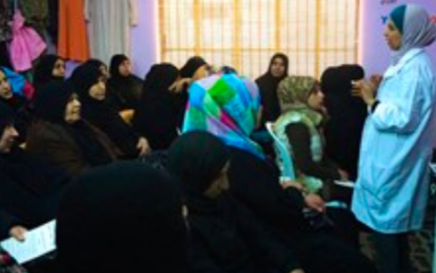
Urbanisation and the Double Burden
The soaring prevalence of overweight, obesity and NCDs as well as the alarming increase in the prevalence of all forms of malnutrition among urban populations (the double burden), also has significant implications for social protection across the nexus.
Almost three quarters of all NCD deaths (28 million people) and the majority of premature deaths (82%) occur in low- and middle-income countries and the onset and persistence of crises can lead to an acute exacerbation or a life-threatening deterioration in the health of people with NCDs.
Notes:
Two Key Challenges:
Invest now in analysis of the implications of profound shifts related to urbanisation and the ‘double burden’: It is estimated that 68% of the global population will be urban by 2050 with the greatest acceleration in Africa and Asia. The soaring prevalence of overweight, obesity and NCDs as well as the alarming increase in the prevalence of all forms of malnutrition among urban populations (the double burden), also has significant implications for social protection across the nexus. Almost three quarters of all NCD deaths (28 million people) and the majority of premature deaths (82%) occur in low- and middle-income countries and the onset and persistence of crises can lead to an acute exacerbation or a life-threatening deterioration in the health of people with NCDs.

Slide 15
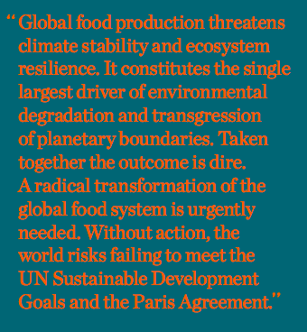
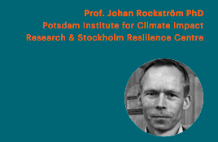
EAT LANCET COMMISSION: FOOD IN THE ANTHROPOCENE….
Thinking through the role of SPaN in the Great Food Transformation:
Notes:
Our Food in the Anthropocene: Healthy Diets From Sustainable Food Systems Introduction #foodcanfixit
The issue of dietary quality is strategically positioned at the interface between food security, nutritional status and the sustainability of our food systems. When global norms for a nutritionally adequate diet are compared to global data on actual agricultural production, it is clear that there is a significant overproduction of grains, fats and sugars while there is a significant shortfall in production of fruits, vegetables and protein as compared to nutritional needs. It is estimated by the EAT / Lancet Commission that dietary changes from current diets to healthy diets would avert around 11 million deaths every year. The good news is that re-orienting agricultural priorities from producing high quantities of food, to producing more nutritious and biodiversity-enhancing food offers a win-win situation.
Bahadur et al, 2018https://journals.plos.org/plosone/article?id=10.1371/journal.pone.0205683
Defined as having appropriate caloric intake, a diversity of plant-based foods, low amounts of animal source foods, unsaturated rather than saturated fats and small amounts of refined grains, highly processed foods and added sugars (EAT/Lancet, 2019)
Without action, the world risks failing to meet the UN Sustainable Development Goals (SDGs) and the Paris Agreement, and today’s children will inherit a planet that has been severely degraded and where much of the population will increasingly suffer from malnutrition and preventable disease.
the Commission proposes boundaries that global food production should stay within to decrease the risk of irreversible and potentially catastrophic shifts in the Earth system.
Achieving a sustainable food system that can deliver healthy diets for a growing population presents formidable challenges.
The Commission’s aim was to identify a set of actions that meet the scientific targets for healthy diets and sustainable food production, which will allow for a transition of the global food system to within the safe operating space.
The analysis shows that staying within the safe operating space for food systems requires a combination of substantial shifts toward mostly plant-based dietary patterns, dramatic reductions in food losses and waste, and major improvements in food production practices.
Humanity has never before set out to radically change the food system at the scale or speed envisaged by the Commission. There are no “silver bullet” solutions to the problems.
The data are both sufficient and strong enough to warrant immediate action. Delaying action will only increase the likelihood of serious, even disastrous, consequences. It is clear too that a Great Food Transformation will not occur without widespread multi-sector, multi-level action, which must be guided by scientific targets.
Co-chaired by Prof. Walter Willett and Prof. Johan Rockström, the EAT-Lancet Commission brought together 19 Commissioners and 18 co-authors from 16 countries in various fields including human health, agriculture, political science and environmental sustainability.
There is important work to be done to highlight linkage between GFT and SPaN
Five Strategies for a Great Food Transformation:
Strategy 1 Seek international and national commitment to shift toward healthy diets: The scientific targets set out by this Commission provide guidance for the necessary shift, recommending increased consumption of plant-based foods – including fruits, vegetables, nuts, seeds and whole grains – while in many settings substantially limiting animal source foods. This concerted commitment can be achieved by making healthy foods more available, accessible and affordable in place of unhealthier alternatives, improving information and food marketing, investing in public health information and sustainability education, implementing food-based dietary guidelines, and using health care services to deliver dietary advice and interventions.

Slide 16
THANK YOU

