Slide 1
ECHO DEVCO NEXUS ACTION PLAN :
STRATEGIC ACTION AREAS FOR 2018-2021
A. Forced displacement
B. Under-nutrition

Slide 2

Republic of Sudan
Social and Financial Protection for UHC
Dcember, 2018
Notes:
الصورة يتم تغييرها لتتناسب مع الموضوع

Slide 3

Background
A social type of health insurance established in 1995.
At first, started as mandatory to formal sectors employees and voluntary to informal sectors members.
The recently (2016) endorsed Act, the registration is obligatory to all Sudan-residents ( citizens, foreigners, refugees )
NHIF is now the main public health insurance institution throughout the country
The NHIF Act 2016, affirms that the NHIF as single purchaser of health services
The NHIF has been taking the challenge to achieve UHC by the end of 2020

Slide 4
Main characteristics of NHIF
Mandatory SHI to all Sudan residents
Centralized planning and decentralized implementation at state level.
Family based enrolment.
Gate keeper based system
Nationalized Health insurance card (works every where)
No cost sharing except 25% co-insurance in pharmaceutical bills

Slide 5
Benefit Package (BP)
Current NHIF’s BP is a comprehensive provided to all subscribers, and it includes :
  PHC services ( All components except vaccination & nutrition, covered by MoH)
  Secondary Health Care services ( all components)
  Limited tertiary health care services (Subsidizations).

Slide 6
Health service coverage
By December 2018
Total number of health service providers reached 3,022
Medicines outlets reached 2,583

Slide 7

The Premiums
No | Socioeconomic group | Enrolment unit | Contribution/ Month
1 | Civil Servants | Family | 10% of basic salary
2 | Private Sector employees | Family | 10% of basic salary
3 | Self-employed | Family | 100 SDG
4 | Poor Families | Family | 138 SDG
5 | Pensioners | Family | 100 SDG
6 | Students | Person | 10 SDG

Slide 8
Population coverage
By December 2018
Coverage reached 64.4%
25.3 million people are covered

Slide 9
Coverage of the poor people
By December 2018
Coverage reached 85%
15.5 million poor people are covered

Slide 10
Key Challenges in Financing Capacity
Overcoming fragmentation in healthcare financing funds
To be financially sustainable under following conditions:
  Modest contributions
  Escalating cost of health services
  on-going economic shocks
To generate more revenues to cover the benefit package (premiums adjustments, introduction of earmark taxation, investments, …etc.)
Investment and Actuarial reserve

Slide 11
key Challenges in Population Coverage
In terms of Population Coverage we have to expand the Umbrella to cover:
  The rest of vulnerable groups (Poor, IDPs, Returnees, ….)
  To complete the self-employed sector
  To enroll the entire private sector
  Foreigners and Refugees

Slide 12
Efforts to cover the Rest of vulnerable groups
The rest of vulnerable groups;
  Poor families= 700,000
  IDPs = 2 Millions
  Returnees= 2Millions
  To work in collaboration with Health sector partners to provide the health services for them through health insurance cards
  To split the health system Functions and work on one single robust system

Slide 13
Successful on going partnership with NGOs in population coverage
Save the Children 1,500 families
Sanad foundation 10,000 families
Alriada Organization 17,000 orphans
Islamic Aid organization 15,000 families
UNHCR 10,000 Refugees

Slide 14
Detailed Plan
National Health Insurance Fund (NHIF) NHIF GOVERNANCE PROJECT
21th of Jan. 2019
NHIF-DG Office

Slide 15





The Program results areas
NHIF governance arrangements and Organizational structure are modernized
NHIF enterprise resource planning and information system are upgraded and improved to provide necessary data for reporting and policy development.
Improve of quality and process management and development of human resource competencies.
Develop of new provider payment mechanism and support of improved delivery of quality health care services.
Health program of EU-financed partners are strengthened and supported in Khartoum, Eastern states and Darfur, to expand the health insurance coverage

Slide 16


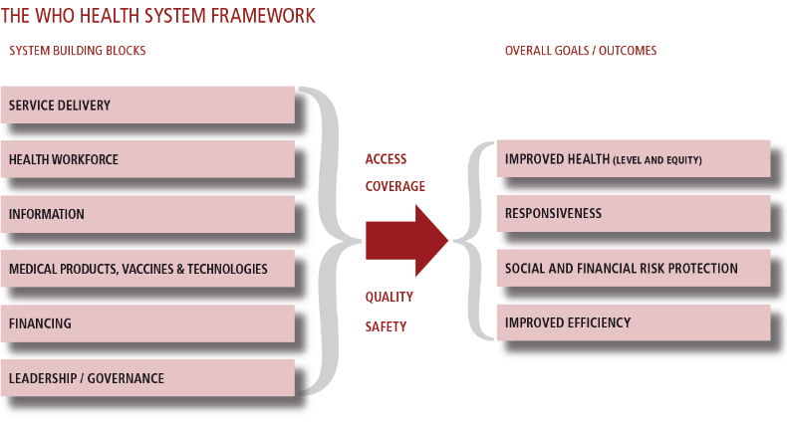
Health in the Humanitarian-Development Nexus in Sudan
IMC – Concern in West Darfur
Action “Strengthening Resilience for IDPs, Returnees and Host Communities in West Darfur”, EUTF 05 - HoA - SD - 12 EUR 7.000.000
IMC : Strengthening Resilience for IDPs, Returnees and Host Communities in Al Geneina, Beida, Sirba and Kerenik Localities – West Darfur, EUR 4,717,200,
Concern Worldwide (CWW) Strengthening Resilience for IDPs, Returnees and Host Communities in Kulbus and Jebel Moon Localities – West Darfur, EUR 2,220,800, 01/04/2017 to 31/03/2020.
Figure 1: HUMANITARIAN vs. DEVELOPMENT principles
nexus
Figure 2: From HUMANITARIAN to DEVELOPMENT approaches in health
SYSTEMS BUILDING
SYSTEMS STRENGTHENING
nexus
PROVISION OF HUMANITARIAN ASSISTANCE TO THOSE MOST IN NEED IN ORDER TO REDUCE EXCESS MORTALITY
NEW ELEMENTS IN THE CONTRACTS of IMC and CONCERN agreed in a joint workshop
Strengthening of Locality Health System: some infrastructure, equipment, capacity development
Medicines Supply through the National Medical Supplies Fund NMSF, no parallel NGO supply
Support to National Health Financing Policies, National Health Insurance Fund NHIF, insurance cards coverage among the poor, accreditation of health facilities
Coordination with the State Ministry of Health and Alignment to National Policies and Strategies

