Slide 1
Risk-Informed and Shock-Responsive Social Protection
ECHO’s experience in Asia
SOCIAL PROTECTION
ACROSS THE HUMANITARIAN-DEVELOPMENT NEXUS
WEDNESDAY, 23 JANUARY 2019, SESSION 6 – SPaN at country level
World Café with (interactive) presentations of country experiences
Sylvie MONTEMBAULT, Global & Regional DRR/ Resilience Coordinator
Directorate-General for European Civil Protection and Humanitarian Aid Operations (DG-ECHO)

Slide 2
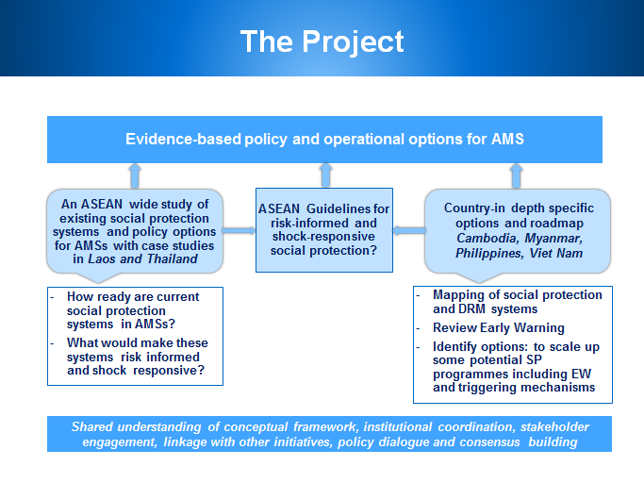







Strengthening the Capacity of ASEAN Member States to Develop Risk-Informed and Shock-Responsive Social Protection

Slide 3
What is Risk-informed and Shock-responsive Social Protection?
Adapting regular social protection systems and integrating disaster risk management systems to help cope with localized stresses and large scale shocks
  Contributes to and requires close links to all stages of the DRM cycle
  Allows social protection to complement other emergency response efforts with rapid scale up
  Over time and with maturity of systems, social protection can be used around the risk cycle to build resilience

Slide 4
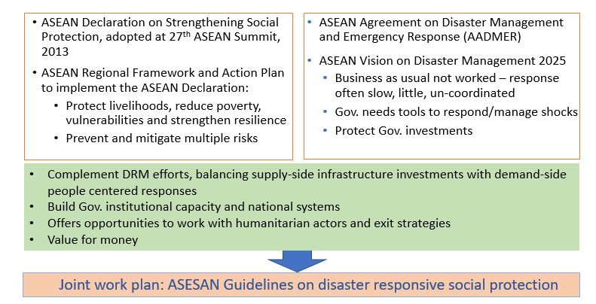
The ASEAN context
Why it is important? 1
Notes:
the later the response, the worse the longer term impacts are on livelihoods and development
AMS have made significant development progress – but we are always only one shock away from progress being wiped out
Emergencies typically focused on saving lives – an SRSP approach can help protect and save livelihoods as well as lives
By introducing adaptations to existing programs, Gov has more options to manage shocks better
In making investments in protecting households and sequencing programs, it demands that we invest in national systems and programs
Allows humanitarian actors to know how and when they can leave, confident that ‘their’ caseloads will still be reached and humanitarian principles wont be compromised
Ultimately, it is a most effective way of providing support and building resilience of poor households. An early response to shocks, using existing social protection programs can save enormous amounts of money - every US$1 spent on safety nets results in net benefits (savings) of US$2.3 and every US$1 spent on resilience programming results in net benefits (savings) of US$3.3.
a dollar invested in early warning systems can save USD 2-14 of avoided losses (Rogers and Tsirkunov, 2010)

Slide 5
Why it is important? 2
3 main global weaknesses in our response to disasters
  Decision-making processes too slow to respond and often with duplication in tasks and responsibilities
  Joint Preparedness planning not well developed and needs political will to turn commitments into action
  The current financing models for response are outdated, and available financing limited

Slide 6
Why it is important? 3
Early response protects human capital
Early response saves money
  Various studies show clear economic gains from early response
  Every $1 invested in early response and social transfers = up to $3.3 in humanitarian response

Slide 7
Opportunities For Annual Savings
Country Comparators | Annual gain ($ Million) Predictable Cash Transfers | Annual gain ($ Million) Resilience Building | Annual gain ($ Million) DRSP
Cambodia | 250 | 92 | 546
Lao People's Democratic Republic | 90 | 52 | 277
Philippines | 1,800 | 1,410 | 6,610
Thailand | 480 | 800 | 1,580
Viet Nam | 220 | 272 | 980
Notes:
WORLD BANK’S 2016 REPORT, UNBREAKABLE

Slide 8
El Nino Drought
2015-16
$1
$3
How to trigger early scale up of existing SP programs?
Credible El Nino Forecast
Anecdotal EW
Anecdotal EW
Anecdotal EW
Problem widely recognized
Formal Declaration of Emergency
Humanitarian Operations
Begin
July/Aug 2015
October
2015
February
2016
March
2016
March/April 2016
May
2016
November
Early Response Opportunity

Slide 9





5 common ways to adapt social protection
How can SP be disaster responsive?
Vertical Expansion
Increase the value or duration of benefit for existing recipients
Horizontal Expansion
Increase the number
of beneficiaries flexibility
In the event crisis
Piggybacking
Use an existing programme’s infrastructure
Alignment
Humanitarian system runs parallel to social protection programme
Tweaks
Adjust programme design

Slide 10
What does it require?
    Social protection delivery systems
      especially targeting and payment systems - to be functioning
    Close links to preparedness, early warning and emergency response
      especially linking disaster risk information systems to SP information systems
    Institutional arrangements
      especially coordination mechanisms
    Financing to be readily available and accessible when needed
Notes:
What do the lessons from Phils and elsewhere say about how can we introduce SRSP?

Slide 11
Building Blocks
Notes:
Flexible delivery systems are the tools and processes that the programme uses to quickly and easily provide ex ante and ex post support to beneficiaries in risk-prone areas.
Socio-economic and disaster risk and vulnerability information systems can play an important role in helping to identify which households should be targeted after a shock and where. When combined with early warning systems, they can also be used to model the impact of shocks on households of different wealth groups/quintiles - and therefore be used to predict and plan appropriate programmatic responses to future events. The information systems can also be used to develop either automatic or subjective ‘triggers’ for when funds can be released, so that responses can be phased for different magnitude responses.
Mobilizing funds after a disaster strikes can slow down the response time, leaving vulnerable people without sufficient support at a time when they need it the most. Layering risks (separating risks into tiers) through different financing instruments means introducing instruments that finance responses for differing magnitudes of risk operated at different administrative levels. This is different from mobilizing money for the regular program – it should be earmarked money that can be used in the event of a certain event. Ideally it should be developed as part of a broader DRF strategy, although can be
A robust risk-informed, shock responsive social protection system requires that DRM and social protection structures, processes and institutions work together to maximize their impact and avoid duplication of interventions. There are likely to be other emergency response efforts alongside risk-informed, shock responsive social protection programmes which all require coordination to work effectively.

Slide 12

Coordination & capacity
Some of the learnings…
Most AMS have DRM frameworks/laws/plans in place
Most AMS have adopted international DRM frameworks (Sendai Framework )
International bodies can promote coordination and knowledge sharing (ASEAN Secretariat).
In some cases SP has a DRM mandate (e.g. Philippines, Thailand, Vietnam) – it is a starting point for DRSP!
Lack of an explicit mandate doesn’t necessarily impede a role in shock response

Slide 13
Coordination & capacity
Some of the learnings…
Challenges with the implementation and enforcement of DRM legislation
Challenges with mainstreaming DRM
Substantial coverage gaps in social assistance
Overall limited coordination between DRM and SP
In Philippines and Laos PDR the mandates for DRM and SP lie with the same department
Notes:
The Philippines has an unusual institutional set-up, in that the same government agency has a
lead role in the coordination of social protection, DRRM and humanitarian response. This is
recognized to offer opportunity for integrated thinking and programming on shock-responsive social
protection (Bowen 2015;DSWD, UNICEF, Pers. Comm.).The
LAOS: mandates for disaster response and social protection both lie with the Department of Social Welfare in MoLSW

Slide 14

Information systems
Some of the learnings…
Ongoing development of SP information systems in various countries
Overall limited levels of SP data integration, low coverage and challenges in terms of ‘data quality’
Most countries have Early Warning Systems in place
No experiences of EWS triggering automatic responses in the region

Slide 15
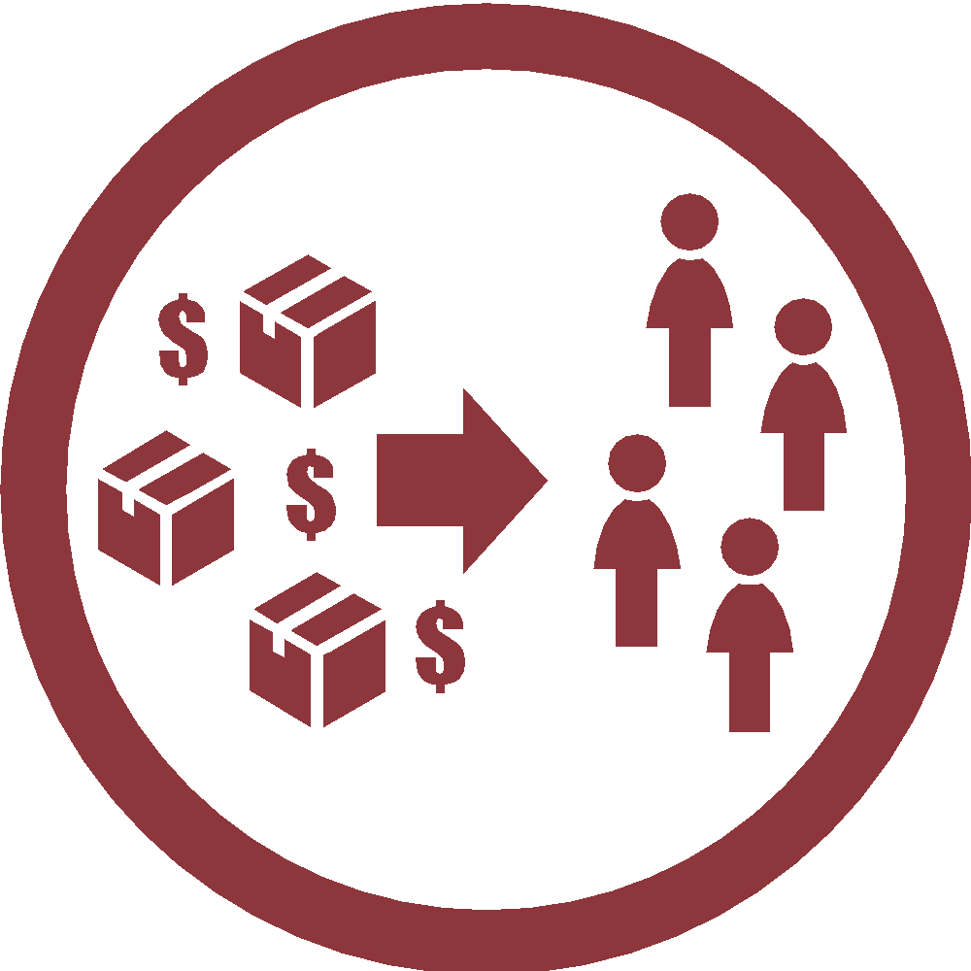
Delivery systems
Some of the learnings…
SP targeting mechanisms have been largely designed with objectives different from capturing the effects of sudden crises
This doesn’t mean that can’t be used in shock response
Flagship programmes in Indonesia, Thailand, Singapore, Malaysia, and the Philippines are poverty targeted. Others rely on universal and/or geographical targeting
Use in shock response depends on the correlation between the eligibility criteria and the effects of the shock.

Slide 16
Delivery systems
Some of the learnings…
Electronic payment systems are increasingly being introduced in contributory and non-contributory SP schemes in the region (e.g. Thailand’s SP payment are mostly electronic).
However, there are still large-scale schemes that transfer benefits manually (Indonesia, Vietnam, Myanmar)
Global experiences show that manual mechanisms can also be used to respond to shocks

Slide 17

Financial mechanisms
Some of the learnings…
Budget lines for DRM exist in most countries, though funding adequacy varies
Existing public financial management procedures can be cumbersome/rigid (Thailand and Laos)
Very few countries have contingency credit lines (e.g. Philippines – World Bank’s CAT-DDO)
Commitments to channel resources to the poor/vulnerable after a shock are missing
Humanitarian Aid is an important source of ex-post financing for some countries
The World Bank is working with Lao PDR, Cambodia and Myanmar, and the Government of Japan, on the development of the Southeast Asia Disaster Risk Insurance Facility, a regional catastrophe risk pool
Notes:
Strategy
Market-based instruments
Risk transfer for assets (property or agricultural insurance) and for budget management (parametric insurance)
Contingent credit
Financial instruments that provide liquidity immediately after a shocks
Budgetary instruments
Reserve funds, contingency budgets, budget reallocations

Slide 18
State of Play for country in Asia
OPM 2016-2017: Pakistan, The Philippines
EU case studies 2018: Nepal, The Philippines
FAO project 2018: ASEAN (region), Cambodia, Myanmar, The Philippines, Vietnam
• ASEAN regional study on shock responsive social protection (WFP), ASEAN guidelines on disaster responsive social protection (FAO), Policy brief of regional study (WFP)
• Roadmap for Establishing a Risk-Informed &Shock-Responsive social protection system in the Philippines (FAO); in Cambodia (FAO); in Myanmar (UNICEF)
• Policy brief for Philippines (FAO); for Cambodia (FAO); for Myanmar (UNICEF); for Vietnam (ILO) done in August
ERC – WFP 2018-2019: Bangladesh: TOR and consultant identified; Afghanistan?

Slide 19
The 4 priorities of ECHO DRR Strategy in Asia
Shock responsive service provision and social protection
Forecast based early actions
Disaster preparedness in urban settings
Emergency preparedness for response

Slide 20
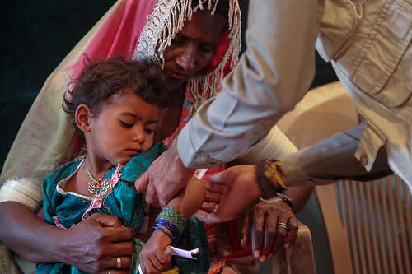
Risk-informed and shock-responsive basic service provision and social protection

Slide 21
Fostering a more efficient and effective vehicle for delivering emergency assistance
(i) the relative predictability of shocks in a number of countries in the region (crises occur every year with severity and geographic variations)
(ii) the existence of functioning basic services and social protection systems
=> it is critical to further use the existing systems to embed humanitarian response
=> where external humanitarian aid is likely to be requested, this may include Cash preparedness programme, to support the shift from prepositioning essential goods (such as food) to data, such as a unified registry of vulnerable households or an inventory of possible payment networks
Notes:
Shock responsive social protection: building up on the findings of the scoping work of the UN and under the umbrella of AADMER, continue supporting the ASEAN strengthening resilience through social protection policy and help developing the shock responsiveness feature in selected country with capacity building and technical support for social protection

Slide 22
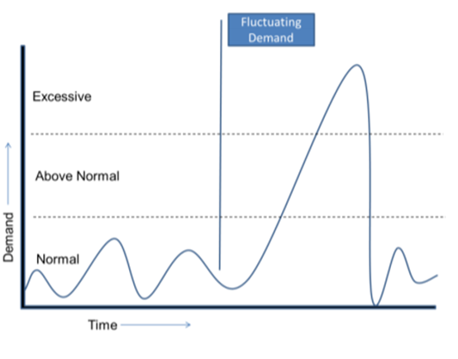
Shock responsiveness
Education System
From School Based DRR - SBDRR, Safe School Initiative, etc. to Education Continuity and Education in Emergencies
Health/ Nutrition service provision (CMAM surge)
Social Protection Systems
Adapting social protection system for humanitarian responses (expansion, piggy backing, alignment, etc.)
Notes:
The surge Model
Refers to the expansion and contraction of a system (human resources, materials/ commodities, assets, finances, management) in response to a spike in Demand
The system may be a basic service such as health, education, water or safety-net programme. It may equally be commercial such as a livestock trade, maize or food value chain.

Slide 23

Thank you!

