Slide 1
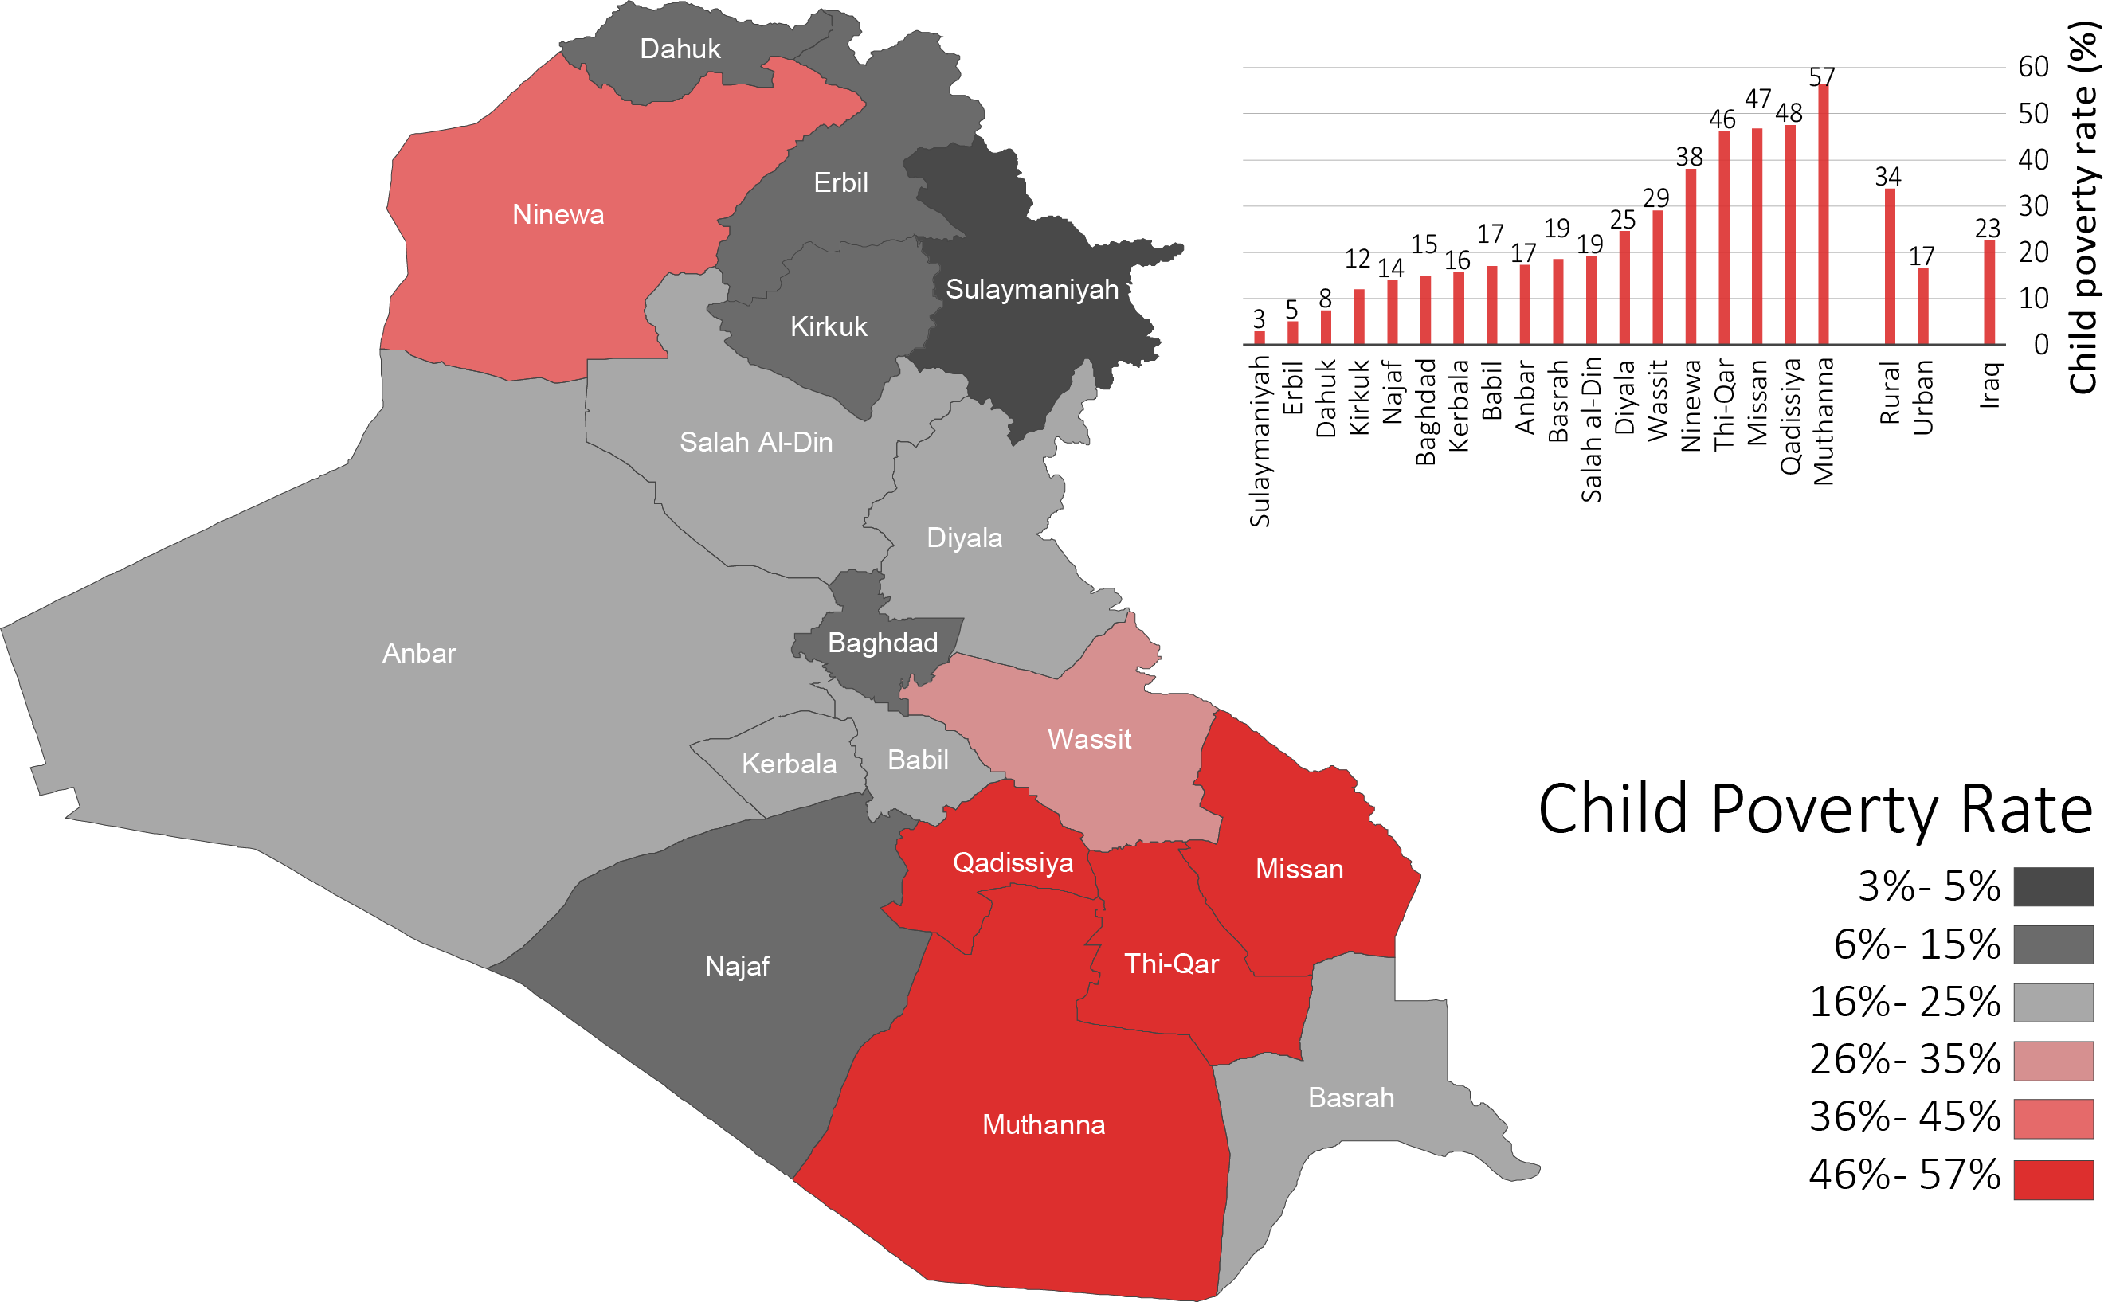
Proportion of children living in poverty 2012

Slide 4
Social protection benefits in Iraq (2012)
 | Coverage | % of budget
Health Universal free access to essential health care
Education Free universal access to education
Food Security Public Distribution System
Pensions State Pension System, Social Security System
Cash transfers
100%
4.9%
100%
6.4%
96%
4.2%
22%
6.5%
10%
0.3%
Social Safety Net (SSN; Poverty Targeted (PMT)
Disability pensions
Unemployment benefits
Emergency payments

Slide 5
Development humanitarian nexus in Iraq
Agriculture
Environment
Economic diversification
Decentralisation/ governance
Jobs and livelihoods
Reform
(Social, economic and political)
IDPs and Returns
Reconciliation and stabilization
Elections
Rights
Gender/ marginalization
Youth
Health & Education
De-radicalisation
Climate change
Population census
Social security/ safety-nets
-Restoration of services (Ed. Health, WASH, Infrastructure)
-Recovery/Revitalisation
-Cash for work (PDS, cash transfers)
-Rule of law and security,
Protection
Humanitarian assistance; Protection of minorities;
Peaceful coexistence;
Social Inclusion.

Slide 6
Social Protection – development and humanitarian nexus
Some challenges:
- Fragmentation within Government
Humanitarian actors had set-up parallel system even when Government had capacity
Government used PMT based targeting and humanitarian used vulnerability index etc.
Different payment mechanisms
Lack of coordination

