Slide 1
Budget Support
Module 1
Core Concepts
(introduction)

Slide 2
Outline Module 1
Objectives of Budget Support
Three types of contract
Fundamental values and rights-based approach
Intervention logic
Complementary measures
Support to BS governance

Slide 3
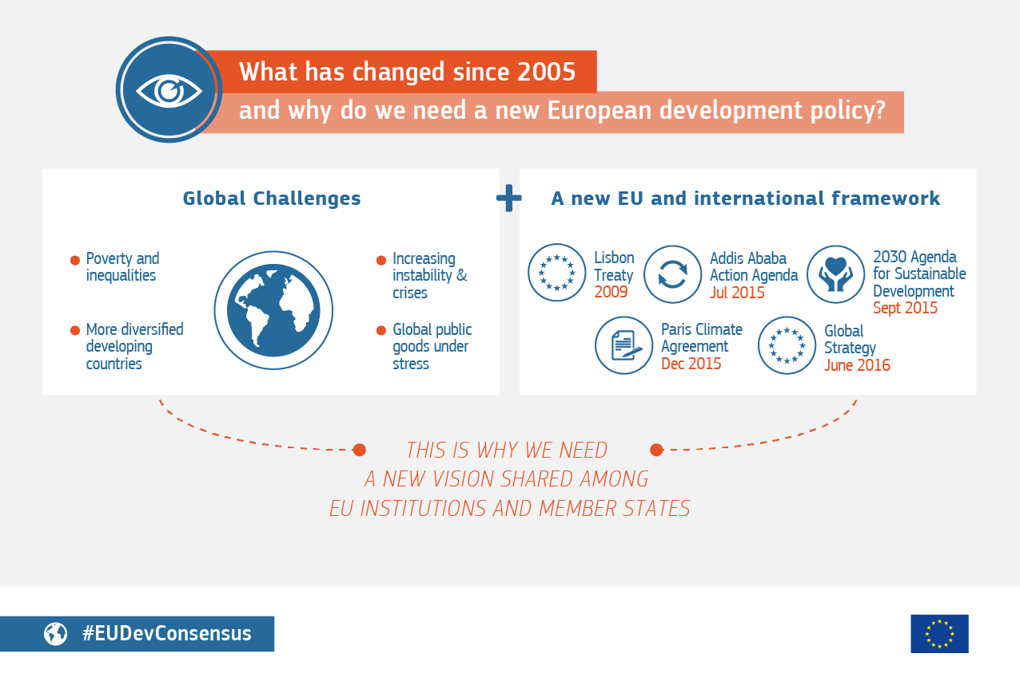
European Consensus on Development 2017
Joint programming, joint actions, but also
“The EU and its MS must be united in diversity, using a variety of experiences and approaches”
Notes:
Poverty reduction remains the primary objective
Target on LDCs (mainly Africa) and on situations of fragility
EU and its MS make use of different and complementary modalities (project aid, sector programme support, budget support) and modes of aid delivery (incl. twinning, technical assistance and capacity building)
Aligned to (i) 2030 Agenda for Sustainable Development (ii) Sendai Risk Reduction Framework on Disaster (iii) Paris Agreement on Climate Change.
Signed in July 2017: a shared vision and framework for action for development cooperation for the European Union and the Member States. It aligns the Union’s development policy with the 2030 Agenda for Sustainable Development.
It integrates the economic, social and environmental dimensions of sustainable development

Slide 4
Rationale
Budget Support is to address 5 challenges (‘vectors of change’):
  Improving PFM, macroeconomic stability, sustainable and inclusive growth and the fight against corruption and fraud
  Promoting sector reforms and improving sector service delivery
  State-building in fragile states, and addressing development challenges of SIDS and OCTs
  Improving domestic revenue mobilisation (and reducing dependency on aid)
  Promoting human rights, democratic values, peaceful societies, and gender equality
Com (2011) 638/2; Guidelines 2017
Notes:
Note: stress that the rationale stems from the 2011 Communication
Source: The Future Approach to EU Budget Support to Third Countries. Communication from the Commission to the European Parliament, the Council, the European Economic and Social Committee and the Committee of the Regions. Com(2011)638/2
NB Possibility to go quickly on this slide or to elaborate.
The communication proposes, 1° to develop a modern approach to BS, 2° to strengthen EU coordination, 3° to improve design and implementation
1° Developing a modern approach
Building on success: high degree of predictability, emphasis on national ownership of dvpt strategies, result oriented disbursements and performance related tranches. Continued dynamic approach to eligibility criteria , and strengthened assessment of progress and monitoring.
Contractual partnerships to build/consolidate democracies, pursue sustainable and inclusive growth and reduce poverty ➔ promote fundamental values (SDG-C); improve macro/financial stability and management (SDG-C); promote sector reforms & better services delivery (SRPC); SRBC in fragile states; reduce aid dependency & improve resources mobilisation.
2° EU coordinated approach: move towards « single EU SDG-C”; act together to increase critical mass & leverage; be supportive of wider donor coordination and country-led coordination. Practically: share assessments, diagnostics, eligibility conditions; harmonise risk assessment tools; perform joint assessment; carry out high level political dialogue; jointly communicate to local stakeholders BS disbursements and compliance with conditions.

Slide 5
General objectives of EU Budget Support
  Eradication of poverty and reduction of inequality (primary objective)
  Promotion of sustainable, inclusive economic growth and job creation
  Consolidation of democracies and peaceful societies and promotion of gender equality
  Sectoral impacts
Notes:
Sectoral impacts is new in the objectives….this is at the request of many countries having just SRCs, as well as to accommodate ENI / IPA where the main objective is not poverty alleviation
Job creation and promotion of gender equality are also addition made in the 2017 Guidelines
Primary objective of Art 208 of the Treaty on the Functioning of the European Union (TFEU) for development cooperation is poverty reduction and eradication (Guidelines p.15)
P 10 of guidelines. Note that the objectives are broader defined, aimed at incorporating also the ENI and IPA objectives.
Promotion of democracy is also one of the three fundamental values (see later on).
In case of State Resilience Building Contracts, one of the specific objectives is “transition towards democratic governance”, which is presumably a stage preceding “consolidation of democracy”.
Sectoral impacts have been added as compared to 2012 Guidelines (ENI / IPA).

Slide 6

Notes:
Not a blank cheque

Slide 7
EU approach to Budget Support
Policy
Dialogue
BS is a financial assistance modality:
It is about finance and incentives to deliver more effective support to national and sector policies
It involves:
  Financial transfers
  Policy Dialogue
  Performance assessment
  Capacity development
Progress / Performance assessment
Capacity development
Financial transfers

Slide 8
FLOW OF FUNDS
Partner country’s Central Bank
Tax &
non tax revenues (incl. financing)
EC External
Assistance €
Foreign Exchange Reserves (€)
Treasury Account
Conditions for
disbursement
Budget implementation through the partner country's PFM System, subject to its previous positive eligibility assessment
Notes:
Attention: animated slide: First illustrate the total chain of flow of money (to complement the explanation of the previous slide): from EC to Central Bank if disbursement conditions pre-agreed with Govt are satisfied, then transfer by CB to National Treasury at exchange rate agreed in Financing Agreement. The BS money thus goes into the National treasury account exactly in the same way as any other fiscal and non fiscal revenues. It is totally fungible. It is executed using national budgetary procedures.
It is important to underline here that the responsibility of the Commission is limited to verifying that (i) the conditions for fund disbursement have been respected and (ii) the funds transferred in forex to the Central Bank have been transferred to the National Treasury of the partner country at the XR specified in the FA. The EC’s responsibility goes no further: this is where the EC’s ‘fiduciary responsibility’ stops. (this is in contrast to project aid where the EC’s fiduciary responsibility is total). The reason is because BS is disbursed against prior (general) conditions of eligibility (ie stable macro situation, sector policy commitment, and a commitment to a credible and appropriate programme to strengthen PFM systems) and, for the Variable Tranche, against specific conditions related to prior performance. In short, BS is disbursed because of what has already been achieved by the partner government and not with the purpose of ensuring that specific projects or programmes are implemented. Once resources are transferred, they no longer belong to the EC and therefore do not need to be overseen or audited by the EC.
However, the EC retain responsibility for ensuring positive developmental outcomes/ results. They therefore must ensure firstly that BS resources are actually transferred into the Treasury Account (and not to other public sector accounts or to the private sector). Secondly, they must ensure that the budget implementation process occurs in conformity with national legislation and in a manner consistent with the national strategy. For this reason, there is an ongoing dialogue over the process of budget execution and over the quality of results achieved.

Slide 9

DONOR’s DILEMMA: Fungibility
Photo: Willem Cornelissen 2012
Notes:
This is a donor’s dilemma: both fungibility and fiduciary risk are at the side of the donor. Fungibility is no concern to the partner country.
Various water flows feed the water fall ( compare domestic revenues and various BS donors). Once flown into the main river, the origin of the water can not be traced any longer (= fungibility). While falling into the main river some on the water evaporates (exchange rate due to reconversions), while after the fall some of the water deviates from the main stream (see right bottom; that may represent mis-appropriation or corruption. It is beyond the donor’s direct control.

Slide 10
THE HAPPY POLITICIAN
Debt
Expenditure
The Happy Politician
TAXES
Notes:
Politicians promise to do more (with public money) while paying less taxes. On top they promise to control or reduce the public debt. Is that possible?
In fact it is, but only in countries that count with abundant natural resources that can be exploited (non tax revenues, like royalties)

Slide 11
GOVERNMENT FISCAL CONSTRAINT EQUATION
G^{K}+ G^{R} + r(D) = T + GRANTS + Δ(D)
G^{K} – Capital Expenditure
G^{R} – Recurrent Expenditure
r(D) – Interest payments on Debt
T – Domestic Resources (Tax and Non-Tax Revenues)
Δ(D) – Borrowing (change in the stock of Debt)
Notes:
The equation shows the various potential effects of budget support (grants): it may enable more expenditure (both investment and operational), but also lead to downward pressure on tax revenues or on (external) borrowing. The latter is positive. It also shows the dilemma of sustainability in case the grants are high.

Slide 12
Two principles for the specific objectives of a BS contract
  Formulation of specific objectives to be based on two principles:
  Alignment and harmonisation
  Consistency with EU external action policy (2017 Consensus and EU enlargement and neighborhood policies)
  Specific objectives should also reflect the key challenges addressed by the operation
      Specific objectives to be specified by
      type of contracts
Notes:
See section 2.3 and Annex 2 of the Guidelines
BS Guidelines state also that alignment implies harmonisation and coordination (H&C) with other aligned donors. However, in most cases H&C plays a much more central role than just being a kind of result from alignment. A coordinated and harmonised approach of donors is important for limiting transaction costs and avoiding confusion, inefficiencies and inconsistencies. Preferably BS programmes are joint programmes and based on a sector programme support (a coordinated and harmonised approach).
Because of their nature, various elements/issues of the Development Challenges are difficult to be translated into specific objectives.

Slide 13
Outline Module 1
Objectives of Budget Support
Three types of contract
Fundamental values and rights-based approach
Intervention logic
Complementary measures
Support to BS governance

Slide 14

The three types of BS contracts:
Sustainable Development Goals Contract
Sector Reform
Performance Contract
State and Resilience Building Contract
SDG-C
SRPC
SRBC
  Supports partner countries to implement their national development policies and strategies, based on fundamental values such as human rights.
  Supports sector reforms and improved service delivery.
  Supports legislative and regulatory approximation and/or policy convergence process with the EU (ENI/IPA) (the Union’s standards, policies and practices)
  Used in situations of fragility and transition, also to build up state and societal resilience.
  To help partner countries to improve financial capability of Govt to restore peace and macro-economic stability and to ensure vital state functions and deliver basic services
  To be based on forward looking political commitment and on institutional reforms.
  Requires a stronger political and policy dialogue.
  Support to the attainment of the SDGs.
  Supports higher-level strategic development objectives.
  Adherence to Fundamental Values as pre-condition.
  Emphasis on equitable access and quality of public service delivery.
Notes:
SDG-C is the previous General Budget Support - GBS (2006) and Good Governance and Development Contract – GGDC (2012)
SRPC is the previous Sector Budget Support – SBS (2006) and Sector Reform Contract – SRC (2012)
The SRBC was introduced in the 2012 Guidelines as State Building Contract - SBS

Slide 15


Slide 16
Since 2017 in SRBC:
  More flexibility and broader concept (societal resilience) than previous SBC (State Building Contract)
  SRBC can be of a longer duration (> 2 years)
  National level SRBC can be combined with (sector) SRPC, if and when a sector policy is in place
Notes:
EXERCISE OPTION (for example when time is too short to do the spider diagram exercise)
Duration: about 20 minutes
• Discuss in small groups (or just your neighbour) 3 differences and 3 common points of BS and project approach.
• Can you identify three advantages of BS over project support? And disadvantages?
• 10 min reflection/discussion/ buzz & 10-15 min plenary
EXERCISE OPTION: EITHER INSTEAD OF, OR IN ADDITION TO THE SPIDER DIAGRAM EXERCISE:
On portfolio approach (module 1)
Under which contextual setting would you consider that the best approach for the EU support would be:
To provide one or several project(s)
To provide budget support (a Sector Performance Reform Contract)
To participate to a basket fund
In your view can these different approaches be combined?
Should, could, blending be envisaged? How would it fit into the sector support?

Slide 17
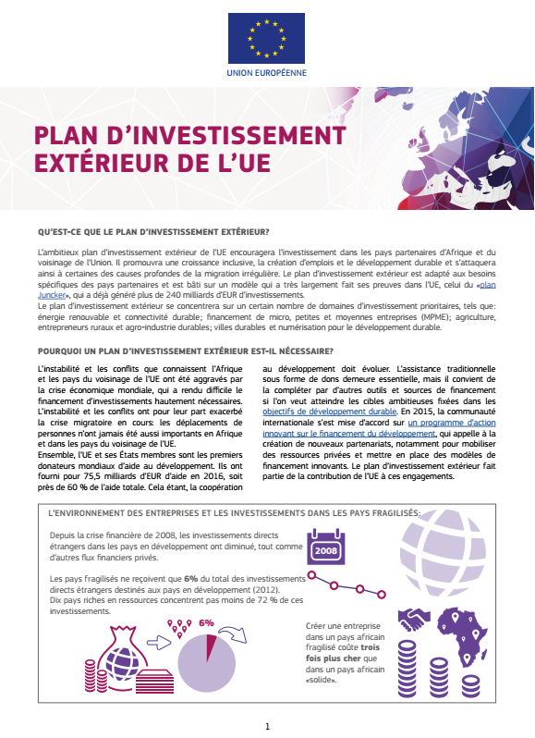
Also public - private funding
  BS linked to private / public investment climate
  Focus on Africa and ENI: EU External Investment Plan

Slide 18
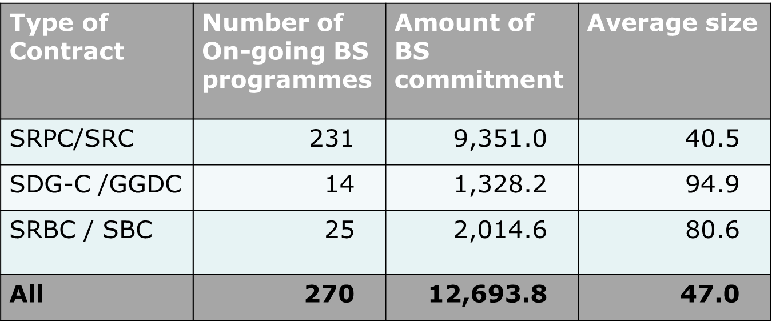
Budget support as per 31st Dec 2017
Average size of the BS contracts per type (in millions of Euros)
SRPC = 86% = 74% of commitments
SDG-C = 5%
SRBC = 9%
In % of number: increasingly SRPC. Average size reduced slightly since 2014

Slide 19
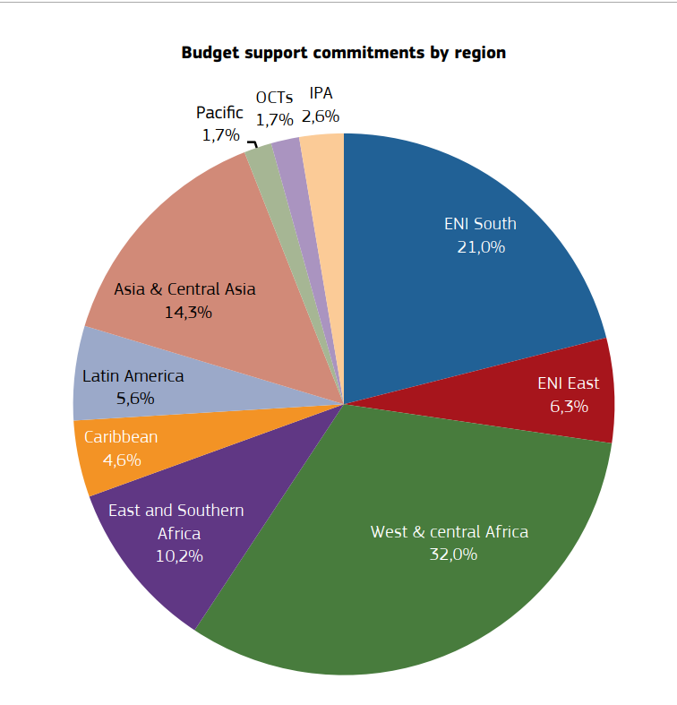
Source: Budget Support, Trends and Results 2018. European Commission
Notes:
BUZZ OPTION: (somewhere near slide 8-11, but prior to the presentation of the three types of contract; the subject of fundamental values has not been discussed yet at this stage, but most participants may know what is referred to; in case of many ‘starters’ the question of fundamental values can be left out)
On three types of BS contracts
Technically the three types of EU BS contracts are exactly the same: “A transfer of financial resources of an external financing agency to the National Treasury of a partner country, following the respect by the latter of agreed conditions for payment”.
Therefore, why the distinction between three types contracts, and why should they differ with regards to the respect of the fundamental values?

Slide 20
Thank you
for your attention

