Slide 1
Budget Support
Module 4
Design
(Action Document)

Slide 2
OUtline Module 5
The EU cycle of BS Contracts
The Action Document
The Action Document in fragile states
How much budget support?
Notes:
In this section, and in the next one on policy dialogue, key points for implementation are regrouped, coming explicitly or implictiely from different parts of the guidelines and the annexes.
Key message of this section:
Implementation is done in the context of the new governance mechanisms
Monitoring is a continuous process, of which the policy dialogue is a key component.
Capacity development needs must be assessed conctinuously as they are a major constraint to the achievements of the objectives of the government policy and the BS programme supporting it.

Slide 3
EU Cycle of operations
EU External Action Policy
Partner Government Policy
Multiannual Indicative programme, Single Support Framework, Indicative Strategy Paper: focal sectors
Preparation
of next BS
Programming/ Strategic Planning
Final Report and Evaluation: focus on joint evaluations
Evaluation & follow-up
Strategic Steering Committee (DEVCO) –Country Annual Action Plan, including BS
Disbursement process Monitoring, dialogue, assessment of conditions
Implementation
Identification
RMF + FV assessment
(for SDG-C only)
Opinion on disbursements when applicable
Strategic guidance choice of BS modality, contract type, design, policy dialogue
Formulation
Finalisation of TAPs (indicators)
QRG: AD & supp. documents
Budget Support Steering Committee (DEVCO) or Financial Assistance Steering Committee (NEAR): Continuous political and policy steer of BS programmes
Notes:
This is a reminder…

Slide 4
The context analysis at the centre: a continuous and iterative process
Results achieved versus what was planned. Final Report incl. analysis of the reasons for possible ‘gaps’
Overall national policy
Choice of overall objectives/results
Harmonization and synchronization
Choice of sectors
Identification of “global goods”
Closure
Programming
Proposed objectives & results
Proposed scale and form
Status of 4 eligibility criteria
Prior actions & supporting measures
Preliminary design & implementation proposals
Main risks & next steps
Disbursement upon proven performance and progress
Identification
Country context analysis
Public Policy Analysis
Stakeholders analysis
Political economy analysis
Implementation
Formulation
Continuous monitoring:
Verify IL, contract timeliness, conditions, factors affecting performance
Identify corrective measures, undertake PD, amend FA if needed
RMF
Finalize intervention logic, budget & calendar, stakeholders, donor coordination, implementing modalities (disbursement criteria, CD, PD, M&E, domestic accountability, …), C&V
RMF + FA
Annexes
Notes:
EU Programming cycle: putting context analysis at the centre
See Sections 5.2.5 (identification), 5.4 (formulation) and 5.7 (monitoring and final report) as well the Instructions for AD template
1. Identification: preliminary proposal with XX in box and accompanied by the latest validated RMF. The purpose of identification is to define an appropriate basis for the formulation/design of an action, in accordance with the relevant MIP. Whatever the aid modality, identification requires a thorough understanding of the context through mapping and analysis of sector and other relevant policies, institutions and stakeholders with the goal of focusing on the priority areas and/or problems to be addressed.
2. Formulation leads to the preparation of the AD and of the relevant annexes to the FA. Main activity here is to complete (if necessary) the context analysis and the indicative list of indicators, etc (box)
Draft AD, when transmitted by the EU Delegation to Headquarters, should be accompanied by the latest validated RMF and the relevant supplementary assessments. It should also include the annexes to the FA (which spell out in detail the general/specific disbursement conditions and the performance indicators attached to variable tranches).
After approval by the geographic director, the contract is submitted for approval to the relevant Committee of EU Member States for each instrument, before the European Commission takes a financing decision. The FA including relevant annexes will be signed with the partner country after the financing decision and forms the legal agreement with the partner country.
3. Implementation: requires verifying regularly the provisions of the FA to ensure the success of the contract and at anticipate any factor that could derail its implementation. Corrective measures, reinforced policy dialogue and, when needed, amendments to the FA, could then be enforced well ahead of payment:
4. Closure: Following the last budget support disbursement, a brief final report needs to be prepared by the delegation and submitted to headquarters. These final reviews are meant to remain internal, to assess the results achieved during the implementation of the contract and to draw lessons for future contracts. They are also used for communication and visibility. Should be sent to HQ within 3 months of last disbursement.
CD: capacity development
PD: policy dialogue
C&V: communication and visibility
FA: financing agreement

Slide 5
outline Module 5
The EU cycle of BS Contract
The Action Document
The Action Document in fragile states
How much budget support?

Slide 6
Box 7: aid modalities and their categories
Two aid modalities
Aid modality options are selected during identification and decided upon during formulation
BUDGET SUPPORT
(BS)
Both types have common features:
Context analysis
Risk analysis
Lessons learned
Policy dialogue
(Support to) Capacity Development
Results
See also: training on Budget Support and on LFA
PROJECT MODALITY (PM)
! There is only one Action Document template for both aid modalities

Slide 7
BS Preparation process (SIMPLIFICATION)
  Action Document + annexes
ACTION DOCUMENT
POLICY DIALOGUE
  Preparation of 2 supplementary documents
  (PFM and transparency; policy assessment)
  Design of the Budget Support Programme
  Including complementary measures
Assessment of four eligibility criteria:
  Relevant and credible national or sector development strategy
  Stability oriented macro-economic policy
  Relevant and credible PFM reform programme
  Publication of the budget (transparency and oversight of the budget)
Preparation of Sector Planning Document
(IPA II countries only when no sector strategy exists)
Notes:
Action Document are submitted with 2 supplementary documents instead of 4 (PFM & Transparency report + Public policy).
Macro-economic stability in AD narrative + table.
PFM and Budget Transparency/Oversight in one simplified document.
All BS AD follow the same format (BS guidelines section 5.4):
Rationale, objectives and expected benefits of the budget support contract constitute the key elements of the strategic framework;
Assessment of country context and budget support eligibility, summarising the main issues and results of the assessment of the four eligibility criteria;
Risk Management covers the main issues identified in the risk management framework focusing on a description of the major risks and mitigating measures;
Design of the contract covers the implementation issues, including the expected benefits and results, budget and indicative disbursement calendar, stakeholders and donor coordination, performance monitoring, criteria for disbursement, complementary measures (in particular for capacity development), domestic accountability, and crosscutting objectives particularly in relation to gender, the rights-based approach, and the environment; and
Evaluation and audit, communication and visibility.

Slide 8
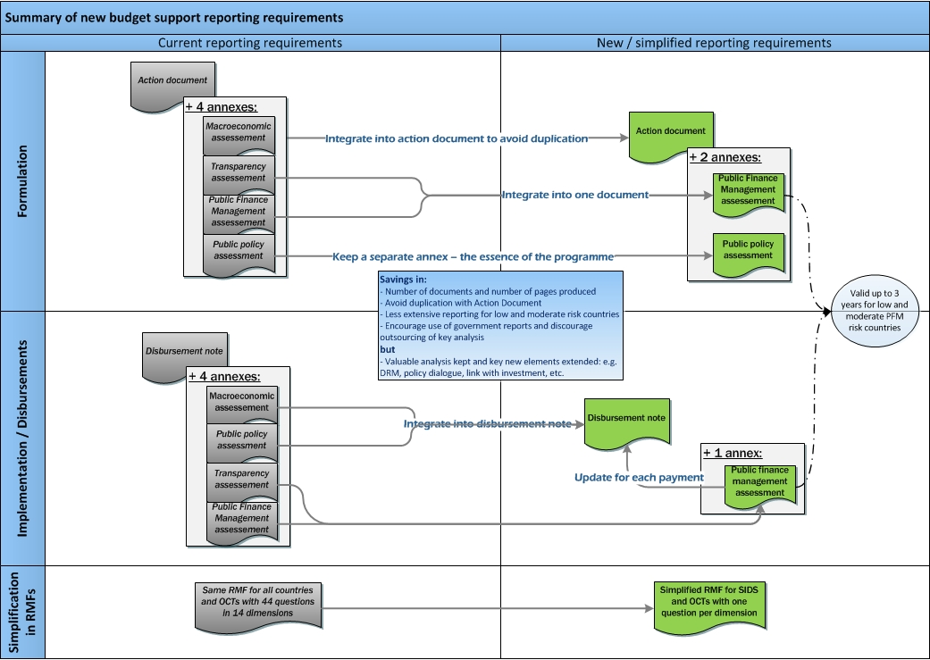
Simplification of reporting requirements
Notes:
Note: The top-part is about Formulation. Do not dwell on implementation, since that will come afterwards.

Slide 9
The role of Government Institutions
Line Min.
NAO/ ..
MoF
Key institutions involved and roles in preparing budget support
Policy
definition
Programming
PFM Reform Strategy:
Design and Implementation
Coordination within administration and with donors
Alignment with cooperation (accession) strategy
Coordination of reform effort with other PFM institutions (SAI, Parliamentary Committee) and line ministries
Policy
dialogue
Monitoring link to IPA sub-committees
Coordination through SWG with donors, strong monitoring and reporting
Fulfil the agreed policy implementation within specified timeframe:
  A dynamic interpretation of each eligibility criterion
  The fulfilment of agreed indicators for performance tranches

Slide 10
From AD to FA: Annexes / TAPs
  The latest validated Risk Management Framework
  Public Policy
  Indicative list of indicators
  Macro-economic stability
  Public Finance Management
  Budget transparency and oversight
  Fundamental Values assessment (SDG-Cs only)
  Annex 1: Performance indicators for disbursement
  Annex 2: Disbursement arrangements and time table
  Annex 3: Intervention Logic Table
  Assessment of cross-cutting issues
  Donor Matrix (optional)
Notes:
For the different steps, see the AD Instruction document

Slide 11
outline Module 5
The EU cycle of Operations
The Action Document
The Action Document in fragile states
How much budget support?
Notes:
In this section, and in the next one on policy dialogue, key points for implementation are regrouped, coming explicitly or implictiely from different parts of the guidelines and the annexes.
Key message of this section:
Implementation is done in the context of the new governance mechanisms
Monitoring is a continuous process, of which the policy dialogue is a key component.
Capacity development needs must be assessed conctinuously as they are a major constraint to the achievements of the objectives of the government policy and the BS programme supporting it.

Slide 12
Situations of conflict and fragility
Possible policy responses that can be supported by EU
  Investing in economic, social and political inclusion
  Supporting meaningful dialogue with citizens and across social groups
  Developing or reforming the security and justice systems
Security issues
chronic violence, illegal trafficking
Capacity issues
low capacity to deliver services
  Developing capacity to deliver services
  Investing in the business climate (incl. the judiciary)
  Increasing domestic revenue mobilisation
Legitimacy issues
weak legitimacy (violation of agreed rules)
  Supporting civil society and the media
  Supporting the complete electoral cycle and political parties
  Holistic and sequenced approach:
  Focus on humanitarian assistance and security
  Establish the basis for legitimate politics
Multiple issues

Slide 13
Roadmap to a SRBC
Assessment of the fragility situation.
Identification of the objectives of the transition process.
Government commitment to objectives and democratisation.
Assessment of eligibility according to specific circumstances and capacity constraints.
Forward looking assessment of risks and expected results.
Identification of other international support and coordination.
Specific design features (short engagement, large base tranche, simple realistic output indicators).
Elaboration of the roadmap itself.

Slide 14
Design of SRBC: an accelerated process
No identification step required
  1. Preparation of the road map:
  Preliminary analysis of the eligibility (or further steps needed to become eligible)
  Define the role of the different actors in the process
  Chart the identification/formulation phases, including timetable
  To be shared with the authorities and partners
  2. Formulation of the Action Document
  3. Systematic involvement of BSSC (in all steps)
Notes:
See section 3 of the same Annex 9.
The simplification to the roadmap is not entirely new, but gets more emphasis.
It is not required to consult QSG1, but one is free to do so. If the SRBC is an anwer to an inmediate problem, say an earthquake, it could be quicker to skip QSG1, but if SRBC is the answer to a more structural problem, it is better to go through QSG1.

Slide 15
SRBC: a coordinated package
to address the underlying causes of fragility
Specific objectives SRBC
  Used in situations of fragility and transition > to build up state and societal resilience.
  To help partner countries to improve financial capability of Govt to restore peace and macro-economic stability and to ensure vital state functions and deliver basic services.
  To be based on forward looking political commitment and on institutional reforms.
  Requires a stronger political and policy dialogue.
Financial Transfers
Policy Dialogue
Capacity Building
  Amount : to be discussed with IMF.
  Disbursement profile in line with cash flow needs.
  Predictability of aid flows.
  Focus on
  National responses to fragility and instability factors.
  Ownership of policies and management systems.
  Macroeconomic Governance.
  Institutional capacity.
  Support to:
  PFM.
  Public administration reform.
  BS implementation.
  One disbursement a year
  As far as possible: in the first half of the budget year
  1st Y: single fixed tranche
  2d Y: VT usually not more than 30%
  Continuous process
  Coordinated with donors
  Based on a close monitoring of BS program and on evolution of the political, economic and social situation
  Variety of support: TA, twinning, IT equipment
  Scale to be set according to needs.
Notes:
Once more: arguments are slightly different in the case of SRBC. This has to be considered as a complex set of considerations.
The short term is focus is at the functioning of the state; the underlying focus is at the structural causes of fragility. In case these find their origin in societal tensions, the process is long. The first resilience steps can be taken with SRBC support; but the support should be considered over a longer period of time.

Slide 16
Ouline Module 5
The EU cycle of Operations
The Action Document
The Action Document in fragile states
How much budget support?
Notes:
In this section, and in the next one on policy dialogue, key points for implementation are regrouped, coming explicitly or implictiely from different parts of the guidelines and the annexes.
Key message of this section:
Implementation is done in the context of the new governance mechanisms
Monitoring is a continuous process, of which the policy dialogue is a key component.
Capacity development needs must be assessed conctinuously as they are a major constraint to the achievements of the objectives of the government policy and the BS programme supporting it.

Slide 17
How much budget support?
  Decision to be based on broad qualitative assessment of:
  Financing needs of the partner country at national and sector level (MTFF/MTEF)
  Commitment of partner country to allocate national budget resources in line with country national/sector reform strategy objective and to follow standard national budget procedures
  Effectiveness, value for money and impact of specific added value of BS as regards enhancing the achievement of PC’s policy objectives and on indicators covering relations with the government, human resource capacity, and financial leverage
  Track record and absorption capacity of previous BS operations and effectiveness of reaching agreed objectives of previous BS contracts
  Results orientation in the PC’s national/sector policy including monitoring system
Notes:
Note: Part of the budget support can be absorbed, but not spent in the budget…absorbtion i.e. in not contracting new loans for financing, or additions to the reserves.
Section 5.2.2:
Financing takes into account the PC’s current and projected levels of domestic revenues, expenditures, fiscal deficit and financial needs, including aid (and budget support) dependency, and the country's own stated preferences for choice or mix of assistance modalities. The greater its current and projected reliance on budget support, and the stronger its own preferences for budget support, the larger the share of the programme would be provided as budget support.
Allocation according to policy priorities this should consider both the process of budget formulation, and its outcome in terms of budget allocations in line with development strategies and objectives and execution rates. The greater the confidence in both the process and outcome of the partner country's budget allocation system, the greater the share of the country programme that can be provided as budget support.
Effectiveness, VFM and impact assess potential impact of BS relative to other modalities, on policy objectives and on indicators covering relations with the government, human resource capacity, and financial leverage. The greater the impact, the larger the share to be provided as budget support. Similarly, the stronger the quality of policies and institutions in partner countries (likely to impact positively on aid effectiveness), the larger the share to be provided as budget support.
Track record and absorption capacity of past disbursements and how effectively agreed objectives were achieved with budget support contracts: the greater the rate and timeliness of previous disbursements of both fixed and variable tranches, the greater the share of the country programme that can be provided as budget support.
Result orientation in the partner country's national/sector policy including a monitoring system: the stronger the monitoring system and the greater the willingness of the partner country to be held accountable for key reforms and outcomes in budget support contracts, the greater the share of the country programme should be provided as budget support.

Slide 18
Thank you
for your attention

