Slide 1
Budget support
Module 9
Disbursement
Notes:
NOTE TO THE TRAINER: This module is aimed as back-up to the exercise on disbursement. The exercise should be done prior to the presentation of this module. For the exercise, you may indicate the participants to have a look at this print of this module in their folder. No need to present this module.
This presentation covers page 34-35 of the BS Guidelines Part II (Tools and methods) as well as Annex 3 (pp78-82).

Slide 2
Outline Module 9
The disbursement process
Disbursement template
Notes:
In this section, and in the next one on policy dialogue, key points for implementation are regrouped, coming explicitly or implictiely from different parts of the guidelines and the annexes.
Key message of this section:
Implementation is done in the context of the new governance mechanisms
Monitoring is a continuous process, of which the policy dialogue is a key component.
Capacity development needs must be assessed conctinuously as they are a major constraint to the achievements of the objectives of the government policy and the BS programme supporting it.

Slide 3
EU Cycle of operations
Reminder
EU External Action Policy
Partner Government Policy
Multiannual Indicative programme, Single Support Framework, Indicative Strategy Paper: focal sectors
Preparation
of next BS
Programming/ Strategic Planning
Final Report and Evaluation: focus on joint evaluations
Evaluation & follow-up
Strategic Steering Committee (DEVCO) –Country Annual Action Plan, including BS
Disbursement process Monitoring, dialogue, assessment of conditions
Implementation
Identification
RMF + FV assessment
(for SDG-C only)
Opinion on disbursements when applicable
Strategic guidance choice of BS modality, contract type, design, policy dialogue
Formulation
Finalisation of TAPs (indicators)
QRG: AD & supp. documents
Budget Support Steering Committee (DEVCO) or Financial Assistance Steering Committee (NEAR): Continuous political and policy steer of BS programmes
Notes:
This is just a reminder, the module starts really on the next slide

Slide 4
BS Disbursement
LEGAL BASIS:
Financing Agreement, including amendments, riders
Annexes
(Technical and Administrative Provisions)
Consult:
Guidelines section 5.6
Disbursement template of September 2017
Note on BS processes in NEAR of Sept 2017 or Note on DEVCO BS internal arrangements of Sept 2017
Programming/ Strategic Planning
Evaluation & follow-up
Decision process for tranche release: Monitoring and dialogue, assessment of payment conditions
Identification
Implementation
Formulation
Opinion on disbursements when applicable
Budget Support Steering Committee (DEVCO) or Financial Assistance Steering Committee (NEAR): Continuous political and policy steer of BS programmes
Notes:
Concentrate this module on the last but one step (see : the note on BS processes in NEAR of Sept 2017, the note on DEVCO BS internal arrangements of Sept 2017, the disbursement template note of Sept 2017 and for more background the Guidelines (see below)
7. Implementation with M&E, dialogue, assessment of conditions and again role of BSSC/FAST on disbursements
Underline that this stage of preparation of a budget support payment file is typically an iterative process and can take months to compile. NB: in cases where external assistance will be necessary to analyse the achievements against the indicators, this should be contracted within 6 months of the signature of the Financing Agreement.
Refer to the ongoing monitoring arrangements and to:
Section 4.4.4 of the BS guidelines for the determination of the VT payments (inclusive process led by the government and based on country's monitoring framework, whereby performance results are also subject to stakeholder consultations, are made publicly available and feed into domestic accountability mechanisms … etc.)
Section 5.6 on implementation and disbursement: ‘Regular monitoring and dialogue will be key elements of all budget support contracts, and should generally follow the structure and principles laid down in chapters 3 and 4 as well as in sections 5.2, and 6.6. It is important to promote domestic ownership and accountability, strengthen team working within EU Delegations and across all budget support providers, and pay attention to appropriate communication and visibility activities.’
This module is about the steps and arrangements for disbursements

Slide 5
Disbursement process
Partner country
Request for tranche release & engage in dialogue with EUD
EU Delegation
Engage in dialogue with national authorities, analyse tranche release request, assess tranche release and prepare a disbursement file. Submit clear recommendation
DEVCO / NEAR
Geographical services prepare file for approval by the relevant Director; check by DEVCO/NEAR A4 BS Support Unit and thematic units; potentially involving BSSC/FAST
Geographical Director approves (or not) payment and conveys key messages to be taken up in dialogue
EU Delegation
HOD provides authorising officer visa and letter with key messages to be taken up in dialogue
Verification of payments (incl. exchange rate verification)
Notes:
Five steps as described in guidelines section 5.6. We’ll be looking at these steps, at whom is involved within each category, what is required and when.
Reminder: Timeliness of payment is critical, and every effort should be made to adhere to the indicative disbursement timetable set out in the Financing Agreement and/or disbursement schedule agreed subsequently between the partner country and its budget support partners. This may require the Delegation to be proactive in soliciting the request from the partner country well ahead of the due payment date, and for all parties to respect agreed approval times.

Slide 6
WHO is involved in the process > partner
  Line Ministries (in particular in case of SRPC, preparation of sector policy update, sector performance and sector indicators)
  Ministry of Finance (Budget preparation and execution – Treasury, macroeconomic and fiscal policies and PFM reforms)
  National Authorising Officer/ Ministry of European Integration / Ministry of Finance… (coordination and preparation of disbursement request file and of request letter)
  Agencies and other stakeholders (if relevant)
  Preparation of the disbursement request
  BS eligibility assessment
  Formal disbursement request letter
Notes:
The process = the process of compiling the disbursement file

Slide 7
WHO is involved in the process? > EU Delegation
  Economic Section (dialogue with the Ministry of Finance, macro/fiscal policies analysis, PFM reforms dialogue and analysis, sector specific economic analysis)
  Sector Sections (sector dialogue, sector policy analysis, targets for sector indicators)
  Contract & Finance (account for transfer, contract, invoice, forecasts)
  Head of Co-operation, Political officer (if and when required)
  Head of Delegation (recommendation for disbursement)
  Analysis of disbursement request (positive or negative)
  Visa circuit
  Head of Delegation conclusion on eligibility criteria (HoD recommendation for disbursement or non-disbursement)
  After approval: disbursement decision letter to NAO/MEI…
Notes:
Insist on the fact that now it is the EUD which does all the analysis, the questionning with the authorities etc, and basically assesses the amount of the tranche and makes the decision even though the decision is then to be approved by the geographical director in HQ

Slide 8
WHO is involved in the process?
> Geographic Directorate (DG DEVCO or DG NEAR)
  DEVCO/NEAR unit in charge of BS, macroeconomic governance and PFM
  Relevant Thematic units including horizontal aspects such as Fundamental values
  EEAS geographic directorate for political opportunity to disburse (not for IPA)
  ECFIN for the macroeconomic situation (ENI & IPA only)
  BSSC/FAST only when required
  All relevant documents from EUD shared with geographical and thematic units and EEAS
  Geographical Unit: Verification of EUD analysis and preparation of a dossier for Approval
  Submission to BSSC or not : depending on risk levels
  Geo Director approval and note to Delegation or postponement and request for additional information or action from NAO or Ministry
Notes:
Refer to earlier slide for the BSSC/FAST: they intervene only for those files which have been specified in the RMF validation process as requiring closer scrutiny. Also typically, the commitment and disbursement proposals, particularly in high risk environments, or the proposals to delay disbursement or suspend budget support in a country, are discussed at BSSC.

Slide 9
WHO may be involved in the process after the payment or indirectly?
  European Court of Auditors and European Parliament
  External audit in partner country (Supreme Audit Institute)
  Member States
  Civil society (both in the EU and partner country)

Slide 10
WHEN to prepare a disbursement file?
  Assessment stage
  Keep record and relevant reports throughout the Implementation of the BS contract
  Preparation of the disbursement request (possible several exchanges between PC, the Delegation and HQ).
  Analysis of the request from PC by the Delegation.
  Verification of EU Delegation analysis by HQ and preparation of a dossier for approval.
Regular monitoring of the timetable in the Financing Agreement, TAPs and (other) Annexes
Notes:
See Financing Agreement
Continuously (BS is not just a cash transfer – there are general and specific objectives, activities to be implemented, policy dialogue)
During implementation unforeseen issues may arise
Time for a rider?
Working on several disbursements at the same time

Slide 11
HOW to prepare a disbursement file?
  Assessment of General Conditions for continued eligibility
  Assessment of conditions
  Continued eligibility
  Targets for variable tranches
  Sources of verification as indicated in the Financing Agreement
  Calculations

Slide 12
WHICH documents to insert in a disbursement file
  Cover Letter
  Analysis and evidence of continued eligibility and targets achieved for the indicators of the variable tranche
  Amount requested
  Proof of transfer previous disbursement (exchange rate) (if not done before)
  Validity of bank account
Partner Country
Formal request from the Government
Template covering:
  Introduction, including conclusion on proposed disbursement
  Review of eligibility criteria and conclusions
  Update of policy dialogue
  Annexes
EU
Delegation
Notes:
Usually the proof of transfer to the Treasury account (made by the Central Bank) and the exchange rate used is forwarded to the Delegation (and forwarded to HQ) immediately after the deposit. If not, the evidence of the exchange rate used shoud be added to the documentation for the request for release of the next transfer.

Slide 13
Outline Module 9
The disbursement file
Disbursement template

Slide 14
Template
Distinguish between first disbursement and subsequent ones:
  First: complete unless formulation concluded less than 6 months ago
  Subsequent: update on eligibility
Template is comprised of:
  Introduction: summary including changes since previous assessment, country/sector context and RMF risk situation, eligibility and conclusion with proposed disbursement
  Review of eligibility criteria and update of policy dialogue
  Annexes:
  Government disbursement request
  PFM (incl DRM) and Transparency Report
  Latest validated RMF
  Sources of information
Notes:
No new eligibility assessment is required for a first disbursement if the formulation assessment was concluded less than 6 months ago, and if there are no major changes which could affect eligibility. Such a provision would need to be included in the FA

Slide 15
Logic in the template
  The policy review is followed directly by the assessment of VT indicators (direct link between policy, support (BS) and performance).
  The macroeconomic eligibility (table) reflects main indicators directly related to (financial) stability: revenues, lending, debt and current account balance
Notes:
REFER TO TEMPLATE

Slide 16
Template:
Involves:
  Domestic Resource mobilisation.
  Relation to investments (incl. private investment).
  Decentralisation (if applicable).
  Communication and visibility.
  (Not necessarily, but eventually) report on policy dialogue.
Involves less annexes:
  For low/moderate PFM risk countries, the PFM and Transparency report is normally valid for 3 year, but the PFM monitoring table is updated annually.
  For countries with a low or moderate PFM risk profile: update in template (valid for 3 years).
  No annexes required for eligibility analysis

Slide 17
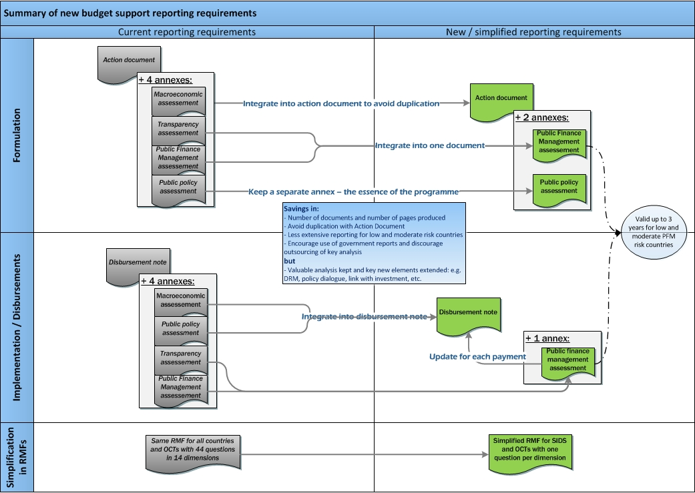
Simplification of reporting requirements

Slide 18
Thank you
for your attention

