Slide 1
Budget support
Module 10
Reporting and evaluation
Notes:
See sections 6.2 and 6.3, Section 5.4 and annex 8 of the Guidelines

Slide 2
Outline Module 10
  Final report on budget operation
  Evaluation of budget support
  Synthesis of country evaluations
  Audit

Slide 3
EU Cycle of operations
Reminder
EU External Action Policy
Partner Government Policy
Multiannual Indicative programme, Single Support Framework, Indicative Strategy Paper: focal sectors
Preparation
of next BS
Programming/ Strategic Planning
Final Report and Evaluation: focus on joint evaluations
Evaluation & follow-up
Strategic Steering Committee (DEVCO) –Country Annual Action Plan, including BS
Disbursement process Monitoring, dialogue, assessment of conditions
Implementation
Identification
RMF + FV assessment
(for SDG-C only)
Opinion on disbursements when applicable
Strategic guidance choice of BS modality, contract type, design, policy dialogue
Formulation
Finalisation of TAPs (indicators)
QRG: AD & supp. documents
Budget Support Steering Committee (DEVCO) or Financial Assistance Steering Committee (NEAR): Continuous political and policy steer of BS programmes
Notes:
This is just a reminder, the module starts really on the next slide

Slide 4
Final report
  Not a formal evaluation
  Internal document
  To be submitted within 3 months after last disbursement
  Special template (4-5 pages)
Notes:
Section 5.7 Monitoring
Final reviews are meant to remain internal and provide an input to future contracts
They are not a formal evaluation.

Slide 5
Five key questions
  What are the key country/sector results (outcome, induced output) [1 page]
  How BS contributed to these results (direct outputs) [½ page]
  What changed and how much the EU paid [½ page]
  What we learnt [½ page]
  What the indicators of the variable tranches tell us [1 or 2 pages, table ]
Notes:
NOTE: THESE KEY QUESTIONS ARE ALSO IMPLICIT FOR THE DISBURSEMENT FILE

Slide 6
Template: the operation in a nutshell
Title | Same title as in Financing Agreement
CRIS number | 20XX-XXX/XXX | Type: |  | GDDC/SDG-C ,SRPC, SRBC | DAC Code: | XXXXX
Period | Month/Year of first disbursement – Month/Year of last disbursement
General objectives | Summarize the general objectives (chapter 3.1, Action Document)
 | 1-
 | 2-
Specific objectives | Summarize the specific objectives (chapter 3.1, Action Document)
 | 1-
 | 2-
 | 3-
Commitments only budget support, incl. amendments | Total = XX M€ - Fixed = XX M€ - Variable = XX M€ |  | Disbursements only budget support, incl. amendments |  | Total = XX M€ - Fixed = XX M€ - Variable = XX M€
Complementary Support | Split by main beneficiaries or topics (e.g. court of auditors, tax collection, etc.) with management mode and amount (commitment & payments in million €)
Contact point at DEL | One or two names who may be contacted for follow-up by DEVCO/NEAR HQs
Notes:
Please always indicate the date at which the document has been drafted!

Slide 7
Outline Module 10
  Final report on budget operation
  Evaluation of budget support
  Synthesis of country evaluations
  Audit

Slide 8
Two types of evaluation
  Programme evaluation of budget support.
  Strategic evaluation of budget support.

Slide 9
Programme evaluation
  For one or two BS operations, focus on EU support; every 3-5 year.
  Under Framework Contract.
  Simplified approach (output and outcome).
  In FA a financial provision for the programme evaluation.

Slide 10
Strategic Evaluation
  Relatively long period : 7 to 10 years.
  Donor independent, preferably joint evaluation.
  Managed and funded by DG DEVCO / DG NEAR Evaluation services.
  Focus on impact.
Notes:
Preferably joint evaluation…in practice, there are less BS providers

Slide 11
A Comprehensive
Evaluation Framework
GOVERNMENT POLICY & SPENDING ACTIONS (STRATEGY)
Inputs to Government policy & spending actions
BS input
Direct Outputs
Induced Outputs
Outcomes
Impacts
Funds
Conditions / indicators
Capacity development
Policy Dialogue.
Improvement in the relationship between external assistance and the national budget and policy processes.
Improved public policies, public sector institutions, public spending and public service delivery.
Positive responses by beneficiaries to government policy management and service delivery.
Sustainable Growth & Poverty Reduction,
Stability.
EXTERNAL FACTORS, CONTEXT FEATURES
AND FEED BACK PROCESSES
Notes:
See Guidelines, p.22. The comprehensive Evaluation Framework has been developed in collaboration with the OECD

Slide 12
See p. 22
Guidelines
Notes:
Based on intervention logic of BS: hypothesised sequence of effects.
Central notion: BS is a contribution to the implementation of the policy and spending actions of a partner government.
The Comprehensive Evaluation Framework (CEF) consists of five levels: See page ?? of BS Guidelines.
Many external (non-BS) factors determine induced output, outcome and impact.
Broad assessment of outcomes and impact of government policies needed.
Specific CEF needed for a joint BS programme See page ?? of the BS Guidelines

Slide 13
A Comprehensive
Evaluation Methodology
  A harmonized 3 step approach:
    An evaluation of the input, outputs and induced outputs of budget support
    An assessment of the outcomes and impacts targeted by the govt. Policy / strategy / expenditure
    An exploration of whether there is a linkage between:
The budget support
induced outputs
The determining factors of outcomes/impacts formulated as BS objectives

Slide 14
Step 1: Evaluation of the chain from inputs to induced outputs of the BS
Government strategy
Impacts | Sustainable and inclusive growth Poverty reduction |  | Budget Support
Outcomes | Positive responses by service users and economic actors to government policy management and service delivery
Outputs | Execution of the budget Monitoring of results Improved macro-economic management Improved public services Etc. | Induced outputs | Improved macro-economic management Improved public services Strengthened PFM Improved policy formulation Strengthened public sector institutions, Etc
Inputs | National and sector policies Budgetary resources Human resources Institutional structures Strategies and operational programmes | Outputs | More aid provided through the budget More funds available for discretionary spending Increased predictability of disbursement of external funds Policy dialogue, conditionalities, TA and capacity building better coordinated and more conducive for government strategies Improved harmonisation and alignment Reduced transaction costs
 |  | Inputs | Transfer of funds to the national Treasury and disbursement conditions Policy dialogue and performance indicators Capacity building and TA
STEP 1

Slide 15
Step 2: Evaluation of the results and impacts and assessment of the contributions of Government policies and spending
Government strategy
Impacts | Sustainable and inclusive growth Poverty reduction |  | Budget Support
Outcomes | Positive responses by service users and economic actors to government policy management and service delivery
Outputs | Execution of the budget Monitoring of results Improved macro-economic management Improved public services Etc. | Induced outputs | Improved macro-economic management Improved public services Strengthened PFM Improved policy formulation Strengthened public sector institutions, Etc
Inputs | National and sector policies Budgetary resources Human resources Institutional structures Strategies and operational programmes | Outputs | More aid provided through the budget More funds available for discretionary spending Increased predictability of disbursement of external funds Policy dialogue, conditionalities, TA and capacity building better coordinated and more conducive for government strategies Improved harmonisation and alignment Reduced transaction costs
 |  | Inputs | Transfer of funds to the national Treasury and disbursement conditions Policy dialogue and performance indicators Capacity building and TA
STEP 2

Slide 16
Step 3: Exploration of the links between the BS and the results and impacts of the Government action
Government strategy
Impacts | Sustainable and inclusive growth Poverty reduction |  | Budget Support
Outcomes | Positive responses by service users and economic actors to government policy management and service delivery
Outputs | Execution of the budget Monitoring of results Improved macro-economic management Improved public services Etc. | Induced outputs | Improved macro-economic management Improved public services Strengthened PFM Improved policy formulation Strengthened public sector institutions, Etc
Inputs | National and sector policies Budgetary resources Human resources Institutional structures Strategies and operational programmes | Outputs | More aid provided through the budget More funds available for discretionary spending Increased predictability of disbursement of external funds Policy dialogue, conditionalities, TA and capacity building better coordinated and more conducive for government strategies Improved harmonisation and alignment Reduced transaction costs
 |  | Inputs | Transfer of funds to the national Treasury and disbursement conditions Policy dialogue and performance indicators Capacity building and TA
STEP 3

Slide 17
Outline Module 10
  Final report on budget operation
  Evaluation of budget support
  Synthesis of country evaluations
  Audit

Slide 18
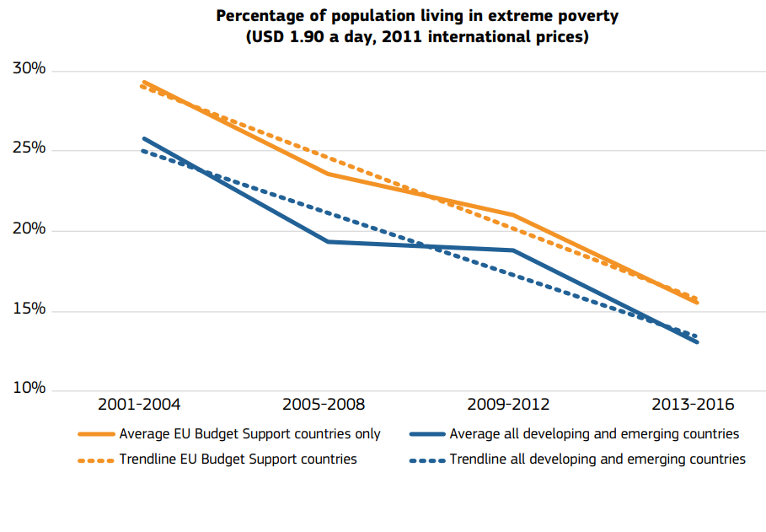
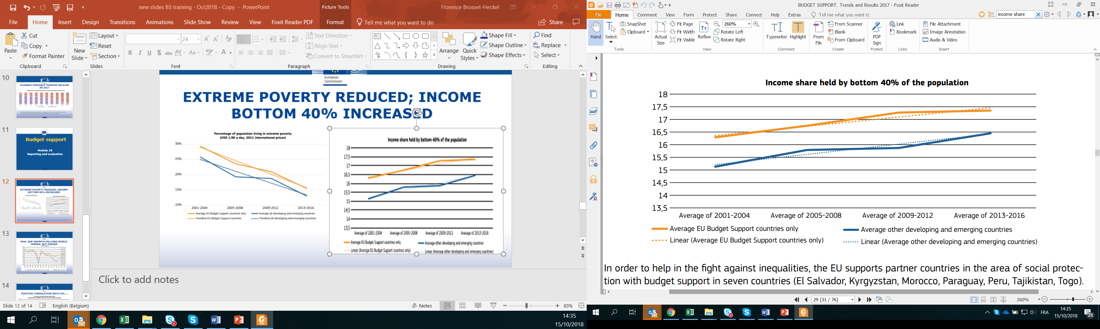
Extreme poverty reduced; income bottom 40% increased
Source: Budget Support, Trends and Results 2018. European Commission
Notes:
Low income BS recipient countries were less affected by the financial crisis than others;
BS recipient countries have lower fiscal deficits;
BS recipient countries have lower debt levels;
BS recipient countries have increased domestic revenue generation (but non-BS countries did so as well);
BS recipient countries have a higher current account deficit (higher imports).

Slide 19
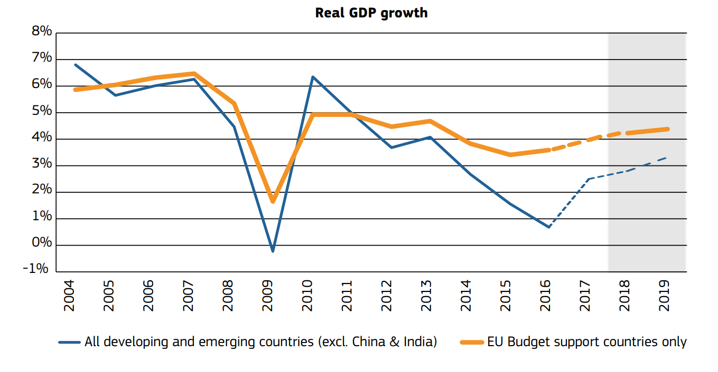
Real GDP growth follows world trends, but higher
Source: Budget Support, Trends and Results 2018. European Commission

Slide 20
Positive correlation with CPI…..
Notes:
The positive correlation with CPI could mean

Slide 21
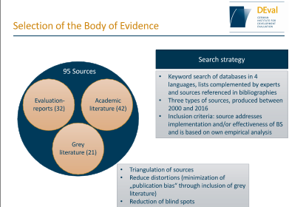
DEval Systematic literature review 2017/18

Slide 22
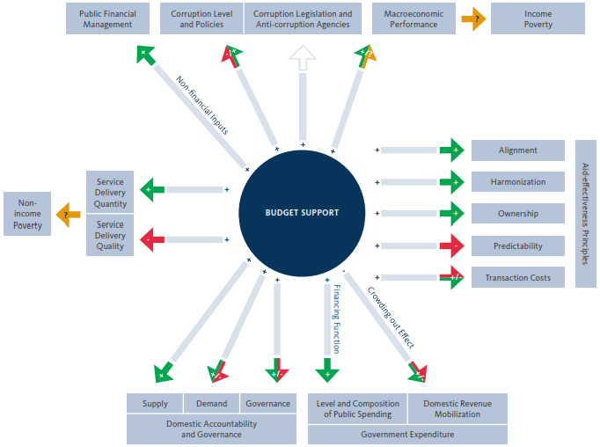


Qualitative
Content Analysis and Synthesis
Source: own

Slide 23
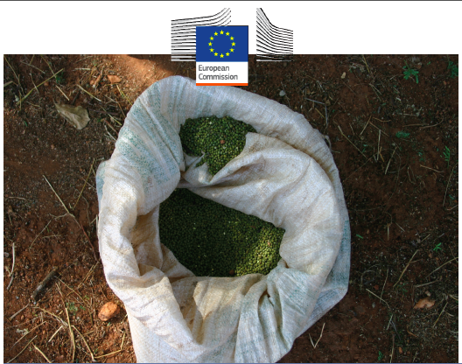
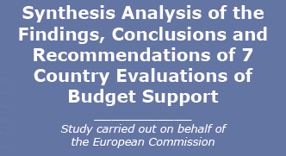
Notes:
These slides only if there is time to fill.
But reports are old now…so better skip.

Slide 24
Overall Conclusions
  Expansion of social service utilisation has been the principal outcome achieved.
  PFM systems and governance improved.
  In MICs, important reforms linked to market deregulation, tariff reduction and insertion in the international economy.
  Money can’t buy reform: budget support funding is not correlated with policy leverage.

Slide 25
Synthesis BS Evaluations
  Nurture strategic problem-solving dialogue
  The design, disbursement conditions and management processes should focus on strategic problem solving and policy orientation.
  The scope of dialogue should be consistent with the capacity of the partner government and development partners alike.
  Separate the forward-thinking dialogue from the “auditing” for disbursement decisions.
Synthesis of Budget Support Evaluations (2014) Volume 1: Synthesis Analysis of Findings, Conclusions & Recommendations of seven country evaluations
http://capacity4dev.ec.europa.eu/sites/default/files/file/17/02/2015_-_1338/synthesis_of_bs_evaluations_final-9_dec_b_volume_one.docx

Slide 26
Outline Module 10
  Final report on budget operation
  Evaluation of budget support
  Synthesis of country evaluation
  Audit

Slide 27
Audit of BS operations
Audit of BS operation:
can that be done? How?
  National Supreme Audit Institution
  Verification by EU of deposit in Treasury Account
  Complementary activities audited by EU
  In case of targeted BS: audit of corresponding budget lines (payment ex-post)
Notes:
Strengthening of SAI, as well as internal audit and control institutions usually forms part of the BS policy dialogue and capacity development components
In the case of targeted budget support, where funds are intended to finance a specific and agreed set of budget lines, an audit is required to verify the amount of eligible expenditure which has been made in those budget lines. The budget support payment is made ex-post to reimburse the eligible expenditure in line with the audit findings .

Slide 28
European Court of Auditors
Carries out
the audit of EU finances
European
Court of Auditors is EU’s independent external auditor
Acts as the independent guardian of the financial interests of the citizens of the Union
Contributes to improving EU financial management
Promotes accountability and transparency

Slide 29
Types of audits
Selected audits (special reports)
Financial audit
Compliance audit
Performance audit
Reliability
of the accounts
Legality and regularity of transactions
Soundness of
financial management
Obtain evidence on the extent to which transactions, assets and liabilities have been completely, correctly and accurately entered in the accounting records and presented in the financial statements.
Obtain evidence on the extent to which EU revenue and spending operations have been carried out in accordance with contractual and legal requirements and are correctly and accurately calculated.
Obtain evidence on the extent to which EU funds have been used economically, efficiently and effectively, and provide value for money.
Statement of assurance (annual reports)

Slide 30
What ECA expects from Budget Support disbursement files
  Clear conclusions on eligibility criteria.
  Disbursement according to FA (timing/amount/conditions).
  Correct calculation of the variable tranche.
  Documentation showing that conditions/indicators were met (Financing Agreement: sources of verification).
  Proof of payment.
  Exchange rate used as defined in Financing Agreement.
  Documentation showing which rate was used + the source of the rate.
Notes:
What ECA expect from files in general:
Signed versions of documents (Financing Agreement, Service contract etc.)
All pages of a document (including annexes)
Dated documentation
Signature with clarification + title
Scanned documents (pdf) in ”readable” format
If there are calculations, preferably in excel

Slide 31
Thank you
for your attention

