Slide 1
Combining satellite imagery with traditional evaluation techniques
The evaluation of the IFAD’s Agricultural Support Project in Georgia Brussels, February 04, 2019
Giancarlo Pini
WFP VAM
IFAD-WFP Joint Climate Analysis Partnership
giancarlo.pini@wfp.org
Dustin Gilbreath
Deputy Research Director
CRRC-Georgia
dustin@crrccenters.org

Slide 2
Organization of the talk
Country context
The Agricultural Support Project
Uses of Geo-spatial data within the evaluation
Lessons learned, potential extensions, and future work

Slide 3
Georgia: Country context
2 wars of secession in 1990-1991
Civil war in 1990-1991
August 2008 war (breaks out in South Ossetia, extends to Abkhazia)
~250,000 internally displaced people (~7% of population)
Right of return not happening, and slow moving ethnic cleansing particularly in Abkhazia.
Quasi-frozen conflict, however people on the administrative boundary line face regular issues (e.g. abductions, cattle theft, and a moving boundary line).

Slide 5
Agricultural Support Project
Challenges of undertaking evaluation in the country context
- Restricted mobility in some areas of the country (occupied areas)
Data limitations
Solution
Geospatial analysis
Sampling
Analysis

Slide 6
Agricultural Support Project
Developmental objectives
Increase assets & incomes among rural poor.
Remove infrastructural bottlenecks.
Project interventions
Rehabilitation of irrigation canals
Bridges for livestock movement
Drinking water infrastructure
Leasing products for agricultural businesses

Slide 7
Objective and approach of evaluation
Objective of impact evaluation
Measure the economic changes in the lives of project beneficiaries using inter alia income and changes in agricultural production as indicators
Approach
Ex-post quasi-experimental method

Slide 8
Use of geospatial data for sampling
Challenge
No random assignment of treatments at the individual or cluster level;
Lack of adequate baseline data.
Solution: Match on cluster level demographic and geo-spatial characteristics for the infrastructure component, prior to intervention:
NDVI
Gender balance of adults in communities
Ethnic minority community
Adult population size
Average elevation
Distance to a primary road
Distance to a secondary road
Distance to a tertiary road
Distance from a regional center
Area of the district
Koppen climate classification
Population density
Propensity scores

Slide 9
Use of geospatial data for sampling
Comparison of cluster level balance with matched versus random selection of control clusters:
Minimum p-value:
Random sample: p= 0.004107**
Matched sample: p=0.14894
Number of significant differences at cluster (community) level:
Random sample: 3 variables (6 tests)
Matched sample: 0

Slide 10
Topline survey results
Irrigation communities→ Increased amount of irrigated land, but no increase in agricultural incomes.
Bridge communities → Null results all around.
Drinking water communities → Slight decrease in amount of time getting drinking water, but otherwise null results.
Leasing indirect beneficiaries → Statistically and substantively significant increases in agricultural incomes.

Slide 11
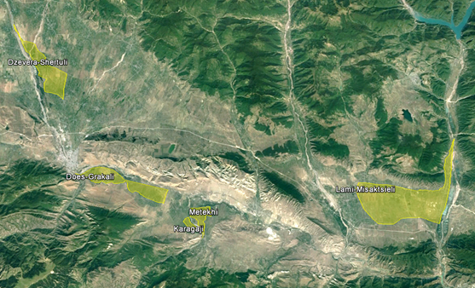
Use of geospatial data for analysis
Project Area: Five irrigation schemes that were rehabilitated as part of project intervention.
Farm plots split into three sizes:
small (< 2ha),
medium (2-10ha)
large (> 10ha)
to better understand the effect on different types of farmers

Slide 12
Use of geospatial data for analysis
The idea was to have two different and independent sources for evaluating the project impact.
The goal was to define and test an operational and statistically reliable methodology using free EO data that could be run in parallel with field survey.
The focus was to estimate the magnitude & significance of difference in vegetation development (NDVI) based on temporal variations (project baseline 2013 and endline 2016).

Slide 13
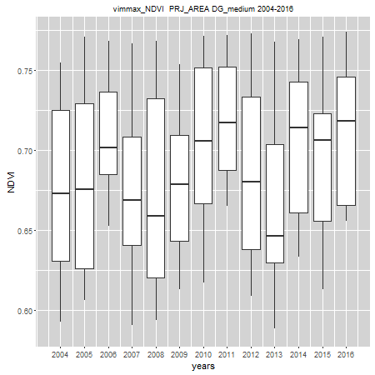
Use of geospatial data for analysis
We cannot just evaluate the change in the project area because NDVI variations between before and after the intervention could be due to :
the intervention itself;
the seasonal weather conditions in the period preceding the observation;
the stage of development of the vegetation at those particular times;
……
Solutions????

Slide 14
Use of geospatial data for analysis
The rationale is that project interventions will cause a different pattern of change from before to after the treatment compared, in the same moment, with similar areas not treated by the project.
Selection of non-treated sites based on:
Similar land cover;
Geographic proximity;
Not subjected to intervention;
Randomly selected.

Slide 15
Use of geospatial data for analysis
The methodology applied is derived from the “Before/After Control/Impact ‘BACI’ contrast presented in a recent research paper*.
Data: Analysis performed using 250-m NASA MODIS NDVI product (8 days) from 2004 to 2016 (Free)
Project Area: Five irrigation schemes. Farm plots split into three sizes: small (< 2ha), medium (2-10ha) large (> 10ha) - to understand better the effect on different types of farmers.
*M.Meroni et al. - Remote sensing monitoring of land restoration interventions in semi-arid environments with a before–after control-impact statistical design
International Journal of Applied Earth Observation and Geoinformation, 2017

Slide 16
Use of geospatial data for analysis
Methodology – in a nutshell
Unsupervised classification (KMeans cluster analysis) to classify area according to different vegetation development patterns.
Assess pixel similarity in treated (T) and non-treated (NT) areas
Similarity s = 1–RMSE. Pixels with a similarity smaller than 0.9 were discarded.
Random extraction of NDVI from all valid pixels belonging to the T and NT areas for the period before and after the intervention.

Slide 17
Use of geospatial data for analysis
Methodology – in a nutshell
The impact of the intervention is evaluated by the change between T and NT before and after the intervention.
BACI contrast = ( µNT_{a} − µNT_{b} ) − ( µT_{a} − µT_{b} )
where µ is the site-specific spatial NDVI mean; NT_{a}, T_{a} stand respectively for non-treated area and treated area at endline (after); NT_{b} and T_{b} stand respectively for non-treated area and treated area at baseline (before).

Slide 18
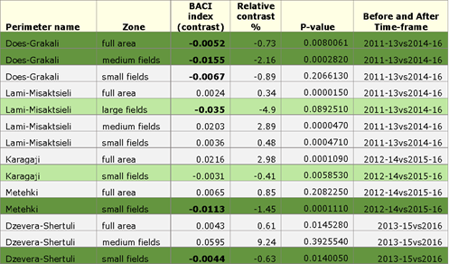
Use of geospatial data for analysis
Negative BACI contrasts (in bold) - Positive impact
Green background is used to highlight negative BACI contrasts that are significant at the 0.05 P-value
Light green background is used to highlight negative BACI contrasts that are very close to significant 0.05 P-value
Grey background indicates a non-significant/no BACI effect.
Positive impact has been detected in 7 out of 14 area samples but only 4 with significant 0.05 P-value.
In three of the five schemes, small plots in treatment areas performed better than similar plots in non-treatment areas.
Results of ground surveys confirmed the positive impact on the small plots.

Slide 19
Use of geospatial data for analysis
Lessons Learned
Preparation is the key:
Exact delineation boundary for project's area;
Pre-assessing the accuracy of treatment area maps through discussions with project staff.
A well-designed georeferenced field survey is essential to explain the confounding factors (e.g. crop rotation, crop change, etc.).
Complex environment (anthropized irrigated area) led to challenges in explaining whether the change is related to difference of vegetation greenness or due to “human” factors.
Need to better integrate the EO analysis in the I&E procedures.
Great potentialities coming from newly available EO data.

Slide 20
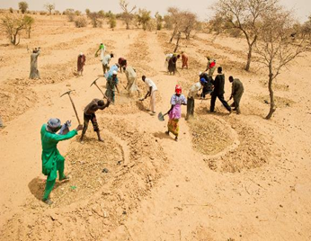
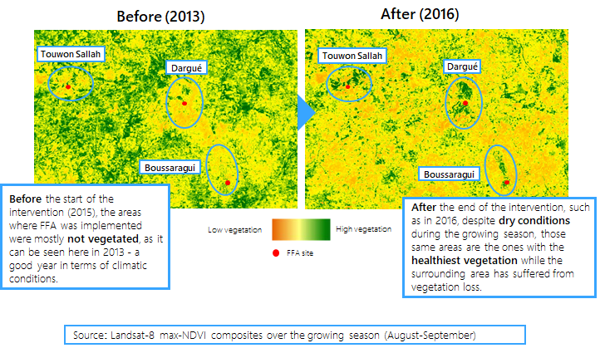
Use of geospatial data for analysis
Options
Less sophisticated options easier to develop (M&E)

Slide 21
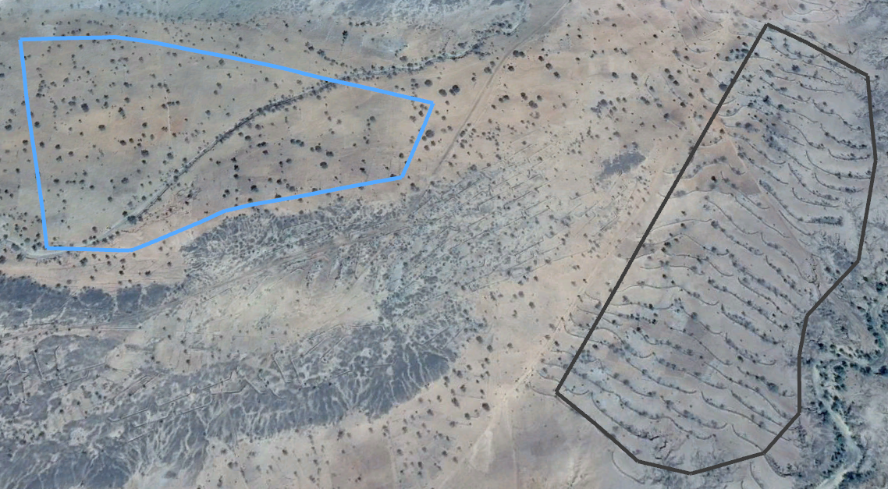
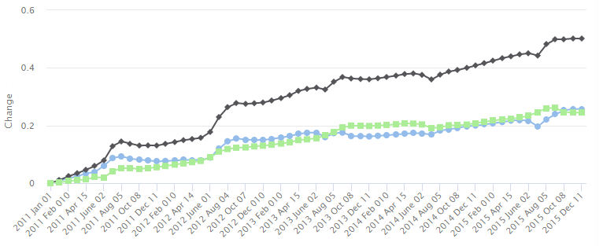
Use of geospatial data for analysis
Options
Less sophisticated options easier to develop (M&E)
project start
intervention
project start
difference
control

Slide 22
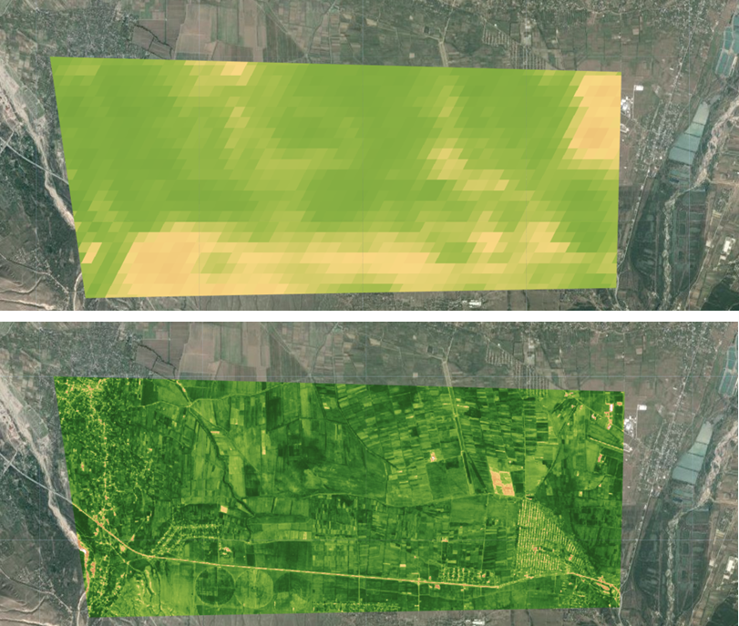
Use of geospatial data for analysis
Game
Changer
HOW I HAVE SEEN NASA MODIS: 250 mt/8 days
PRO
High spatial resolution
High temporal resolution
Free
CONS
Short time series (mid 2015)
Heavy processing
Large storage capacity
….cloud solutions!!!
HOW I AM SEEING NOW ESA Sentinel 2: 10 mt/5 days

Slide 23
Uses of geo-spatial the project inspired for us, but we didn’t use
Multi-level models incorporating cluster level data
More stable estimates, better controlled models
Synthetic controls applications of geo-spatial data

Slide 24
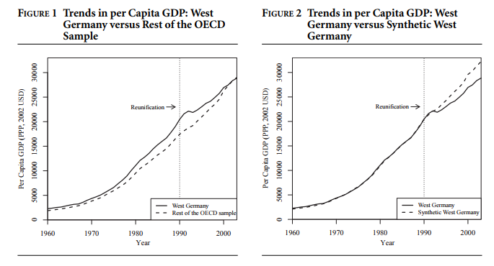
Some notes on synthetic controls using geo-spatial
What is a synthetic controls model and what do you need?
(Abadie, Diamond, and Hainmueller, 2015)

Slide 25
Some notes on synthetic controls using geo-spatial
How could this model be used with geo-spatial data?
Outcome variables a good geographer can get from a satellite or other geo-spatial means:
Night lights (a reasonable proxy for income, though problems exist at the unit level)
NDVI
Many more that I’m not aware of, because I’m not a geographer
Covariates that a good geographer can get from a satellite or other geo-spatial means:
Distance from a primary, secondary, or tertiary road (access to markets);
Altitude
Climate classification
Distance from a conflict line
Distance from an international border

Slide 26
Some notes on synthetic controls using geo-spatial
Other variables that you can often get in time series, but are not necessarily geo-spatial:
Population (from a countries list of electoral precincts)
Gender balance (if the country’s voter list is public)
Education level (if the census is available at the cluster level)
Ethnicity/language spoken (if the census is available at the cluster level)

Slide 27
Some notes on synthetic controls using geo-spatial
What are the implications: Survey-less evaluation
You can get a reasonable estimate of economic impact without doing a survey
You can get a reasonable estimate of whether something happened or not without doing a survey
You don’t necessarily have to be on the ground, potentially leading to quick, good enough impact evaluation;
You can get access to hard to access places including conflict affected areas.
Improvement on existing geo-spatial methods

Slide 28
Applications in other contexts
Geo-spatial data can be used for matched sampling in a wide-variety of situations
Which communities are at risk of losing members to the conflict in Syria and Iraq?
Did a civic education program actually get kids to engage local government on the budget?
Besides trying to find your comparison group communities, you can also find other outcomes of interest
What is the impact of building roads on economic development?

Slide 29
Lessons learned, applications, and things we thought of afterwards that might be valuable for others
Improved control group selection through matched sampling using geo-spatial data rather than sampling a random control group in post-hoc, quasi-experimental settings
Multi-level modeling to control for environmental factors makes sense (more stable estimates, in an environment where estimation is difficult)
Synthetic controls modeling would be a step up over the hand selection of control groups in the BACI
Synthetic controls modeling generally deserves a great deal of additional attention with geo-spatial data, because it has the potential to remove the need to do on the ground surveys;
The methods we used in this evaluation have the potential to be used in a wide variety of contexts.

