Slide 1
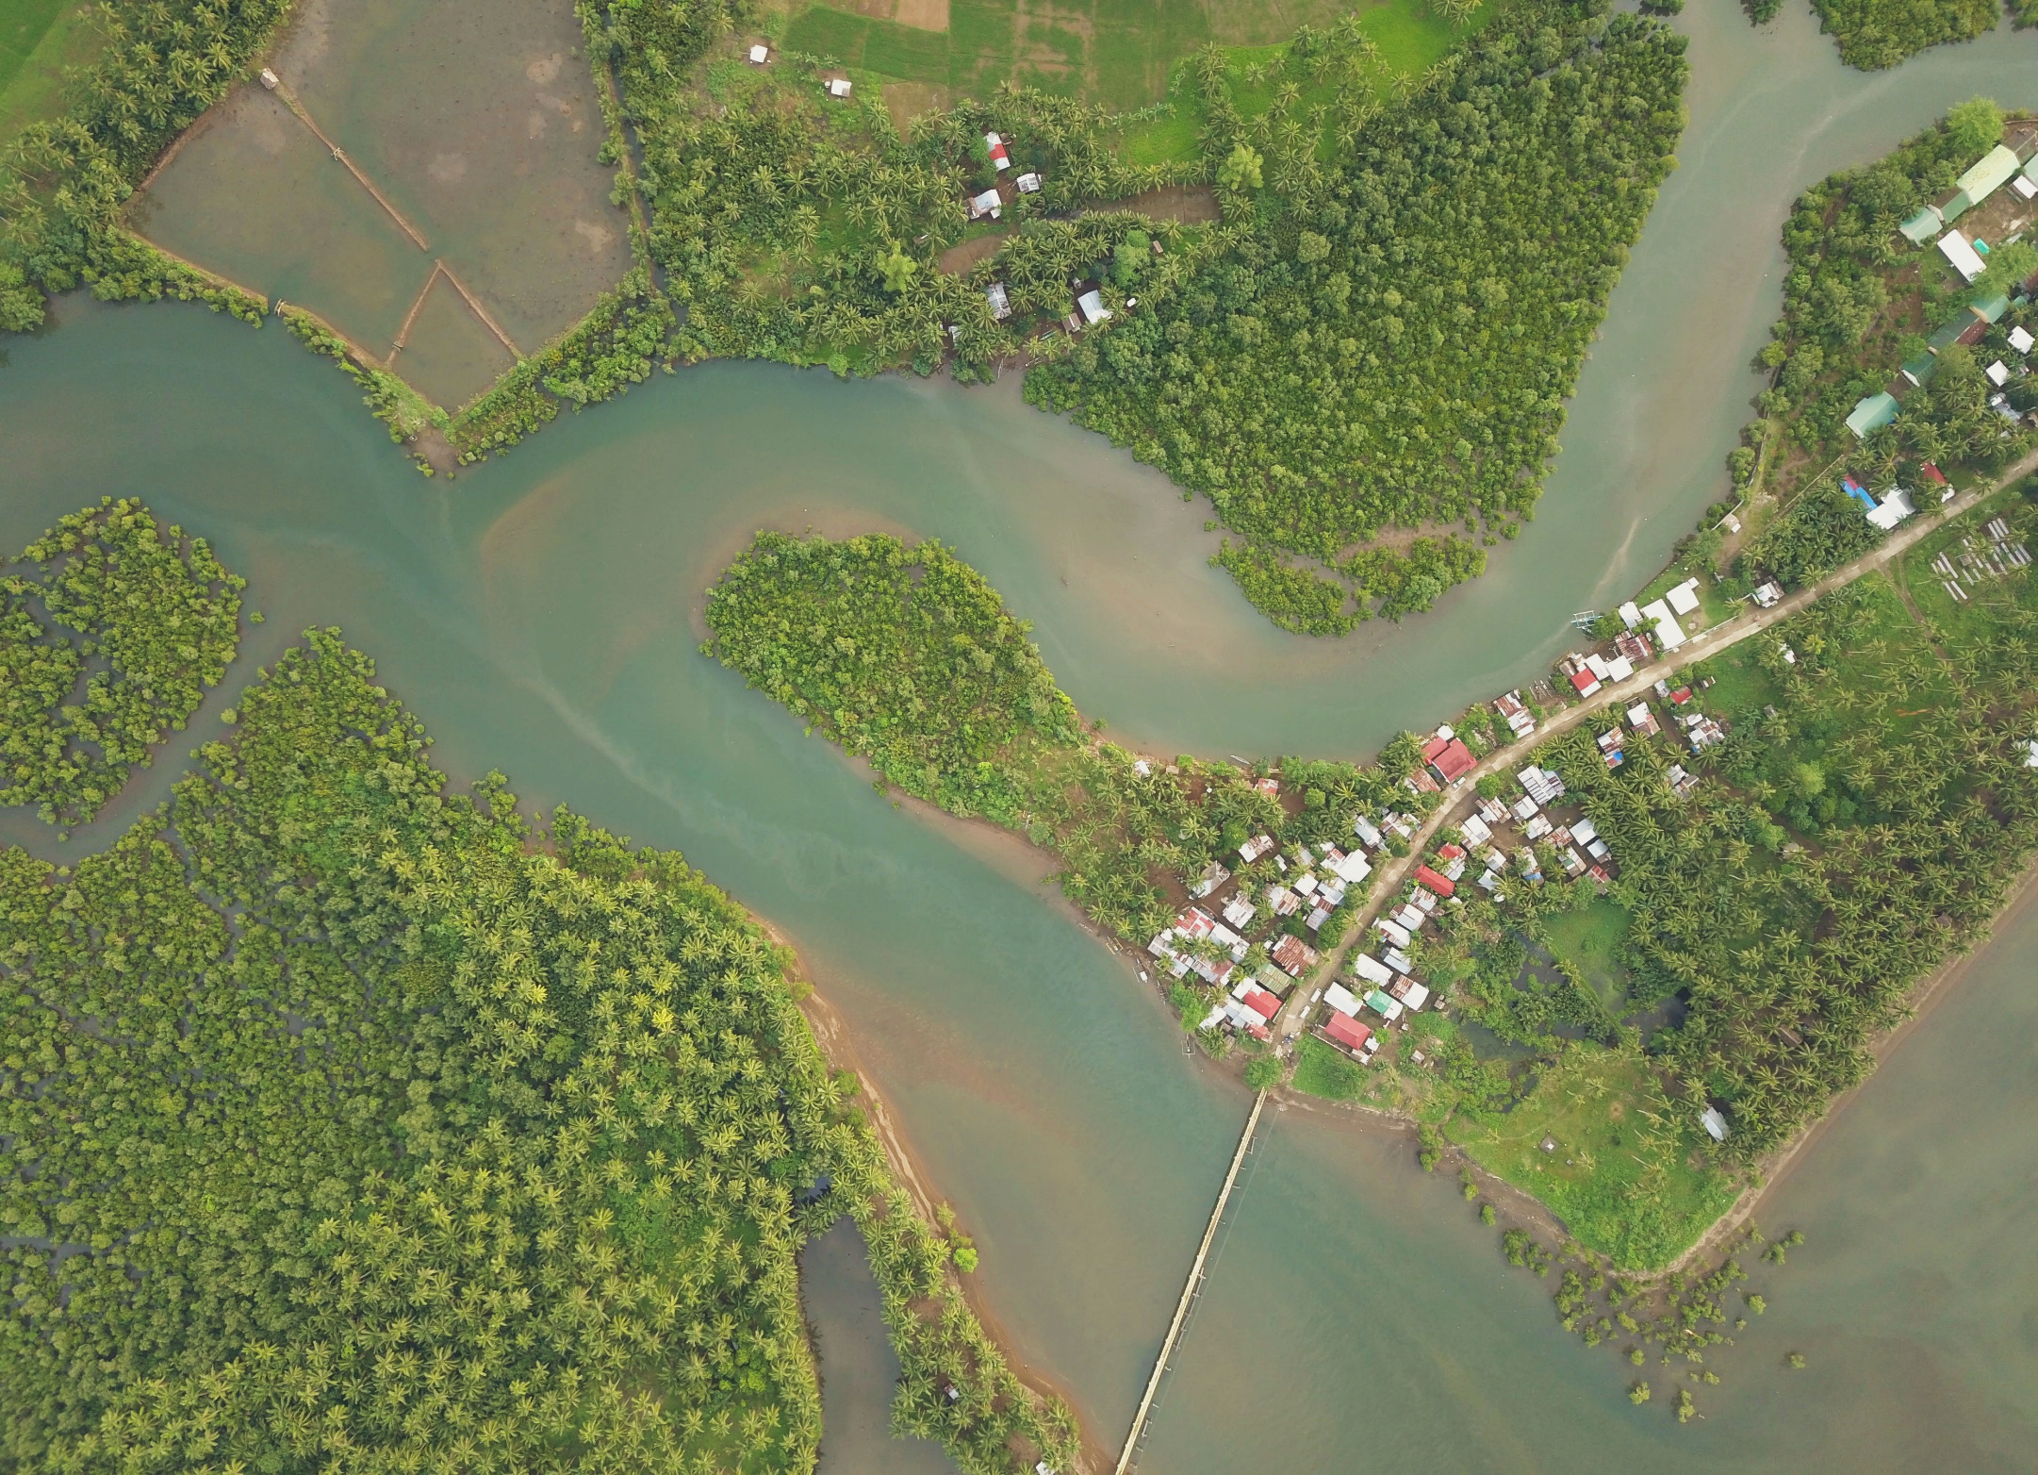
Improving international development evaluation through geospatial data analysis Lessons learned from DEval‘s enhanced land-use planning evaluation
Evaluation Support Service: Cycle of Lunch Time Conferences
DG DEVCO – Brussels, 12 March 2019
Dr. Malte Lech
Independent Evaluator /
Former DEval Evaluator

Slide 2
Evaluation from the bird‘s-eye view
Surge in interest (and application) of geospatial data and methods in development evaluation
Important driver of ‘geo-advocacy‘: AidDATA – Geospatial Impact Evaluation (GIE):
Often cheaper than RCTs
Offer flexible approaches to programs or projects
Ability to apply to concluded projects
Geo-integration into mixed-method evaluation designs
Spatial subsampling of qualitative interviews
https://www.aiddata.org/methods/geospatial-impact-evaluation-methodology
Notes:
The application of geospatial data and analysis in development evaluation experienced a substantial surge interest. Today many organizations are already utilize geospatial methods to improve their evaluations or to even carry some which were not possible to do before.
AidData at Williams and Mary one of the important players in the geo-advocacy have summarized some of the advantages on their website.
Often cheaper than RCTs
More flexible towards both programs and projects as well as
More flexible towards already concluded projects due to the availability of historic data
(given than outcome data is available and interventions show a sufficent degree of spatial variation or spatial dimension)
At DEval we can generally support these statements. Geospatial methods being used there integrated into mixed methods evaluations of strategic programs of the German Ministry for Economic Cooperation and development.
In today’s talk, I would like to give you a short overview about what has previously been done in terms of geospatial data in evaluations, and what are the current projects as well as their outlook.

Slide 3
Key questions
What is the current state of applying geospatial data and methods in evaluation?
How did we utilize geospatial data in DEval‘s Philippine land-use planning impact evaluation?
Typhoon Yolanda
Policy Diffusion
How can remote-sensing data and analysis enrich evaluations?
Notes:
I would like to split the remainder of my talk into:
Experiences and lessons learned during our previous impact evaluation surrounding comprehensive land use planning in the Philippines (where geospatial data and methods served to overcome certain challenges)
The to be concluded project on integrating remote sensing data with evaluation data, which was added as a short top-up after finalizing the Philippine evaluation.

Slide 4
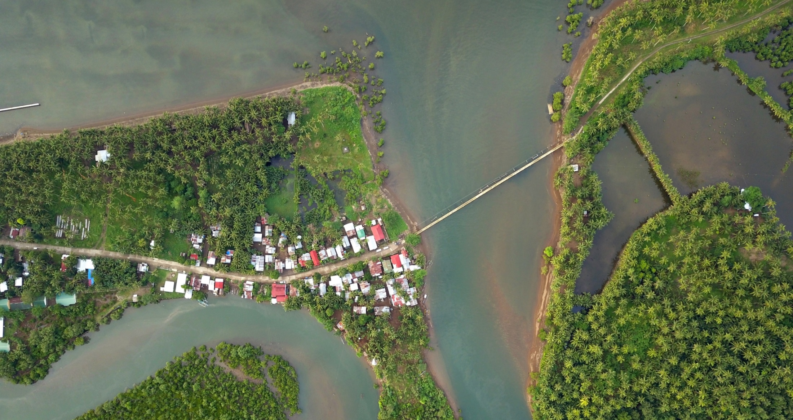
“How did we utilize geospatial data in DEval‘s Philippine land-use planning impact evaluation? ”
Enhanced comprehensive land-use planning in the Philippines

Slide 5
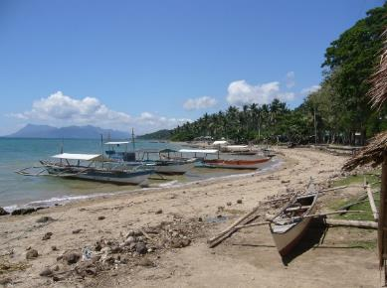
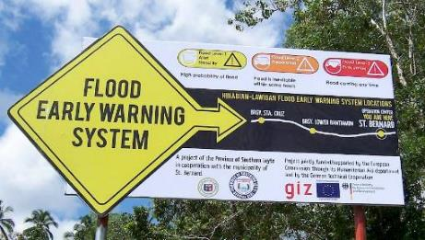
Land Use Planning Impact Evaluation at DEval: SIMPLE intervention
Sustainable Integrated Management and Planning for Local Government Ecosystems (SIMPLE)
Component project of Environment and Rural Development program (EnRD)
Duration: 2006 - 2015
Regional scope: Visayas Region, Philippines
SIMPLE consists of:
descriptions of well-tried processes and instruments for the management of land use
Training components / ‘writeshops‘ / GIS support
Institutionalized support infrastructure (resource centers)
Notes:
DEval was assigned to implement an impact evaluation of the SIMPLE component project as part of the GIZ‘s Environmental and Rural Development Program.
SIMPLE „Sustainable integrated Sustainable Integrated Management and Planning for Local Government Ecosystems” aimed to increase the Philippine planning administration’s capacity to engange in comprehensive land use and development planning in the relatively impoverished Visayas Region in the Philippines. Land Use Planning was fragmented, characterized by inconsistencies and vested interest of political actors. Exposure to natural disasters required in addition a strong disaster risk management component.
The GIZ implemented trainings, workshops, writeshops to increase planning officer capacities to development comprehensive land use plans, that covered the whole municipal territory “from ridge-to-reef” as well as all ecosystems and integrated information from village-level (barangay-level) planning, which is mostly project development for health, livelihood and infrastructure.
SIMPLE integrates and combines these information from sectoral agencies, develops a status quo and prospective land use plans and zoning ordinance to have a tool for the future development of municipal territories: Land use, in the logic of SIMPLE is then: more resource friendly, sustainable, more fair and transparent and enhances the living condition of the population affected.

Slide 6
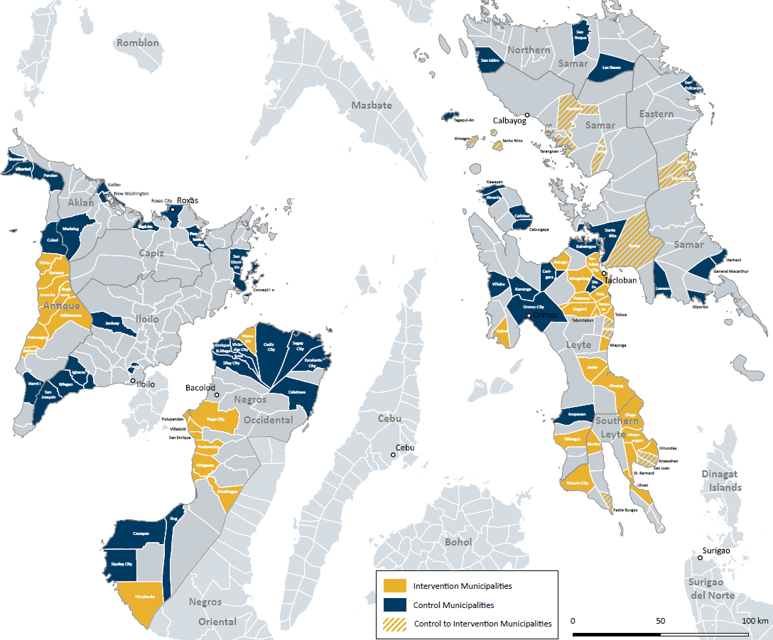
Impact evaluation
‘Baseline‘ data collection in 2012
3,000 households
300 villages
100 municipalities
‘Endline‘ data collection in 2016
Quasi-experimental design
Propensity score matching
Notes:
When we started the evaluation we approached it like any other impact evaluation.
3,000 HH
300 villages
100 municipalities
We had a ‚baseline‘ dataset, develop the endline dataset, quasi-experimental design and propensity-score-matching…

Slide 7
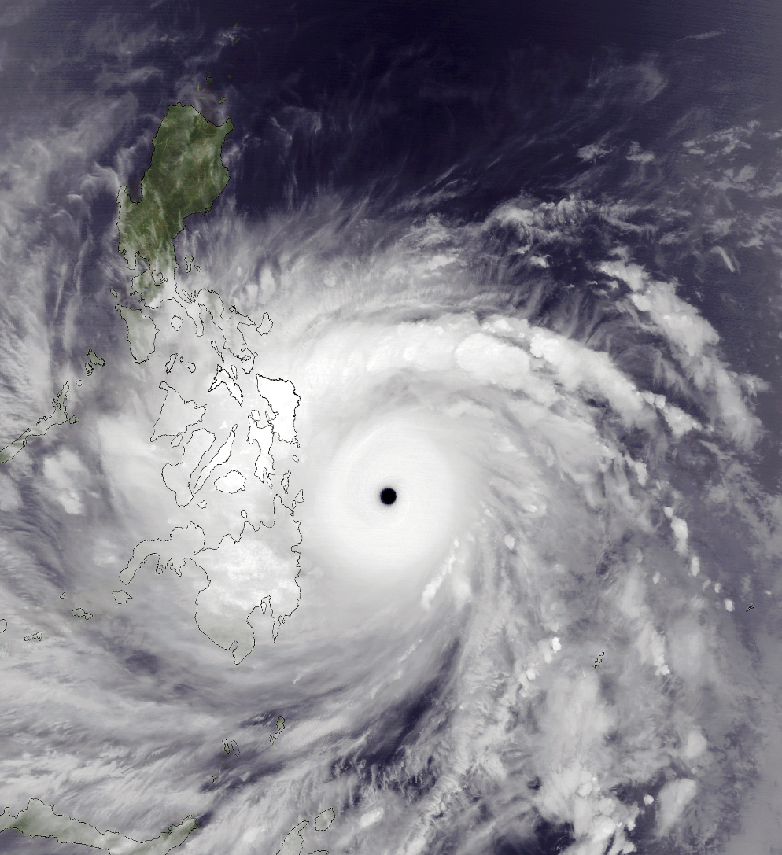
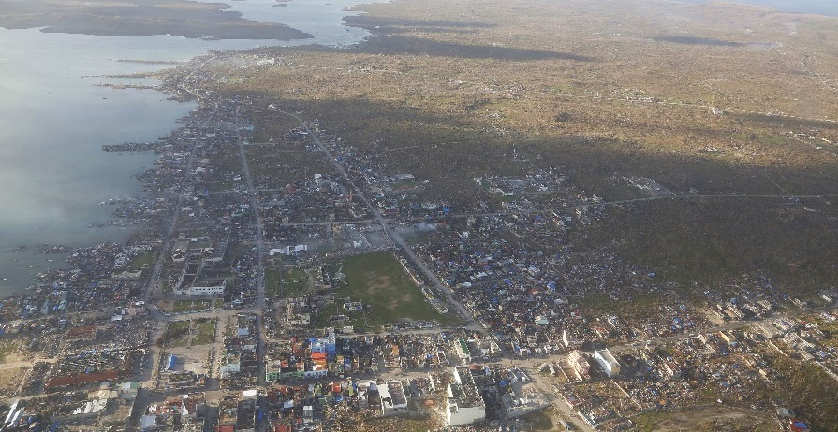
Typhoon Yolanda
Typhoon Haiyan (Yolanda)
6,343 confirmed casualties *
1,058 people missing *
Followed by tremendous international aid and donor support
* National Disaster Risk Reduction and Management Council (NDRRMC) 2013 – Final Report Effects of Typhoon "Yolanda" (Haiyan)
Notes:
But when we started looking more into the details, that is when the complexities started:
Typhoon Haiyan (locally called Yolanda) devastated the evaluation region in November 2013.
Besides horrendous casuaties and loss of life, devastating economic damage and traumatic experience for the affected population, we encountered problems for out evaluation.
Following the super typhoon international aid surged in the region. A flock of donor organizations we to the region and did all kind of supporting measures which ranged from donating food, to rebuilding intrastructure.
Right in the middle of this, is our (small) internvetion that is now part of this huge pile of support and we are facing the problem of differentiating outcomes and impacts of our Intervention with a multitude of competeting projects.

Slide 8
Typhoon Yolanda
Challenge
Little comprehensive data about exposure of survey area / Difficulty to evaluate the reported impact
Varying quality of self-assessment of interviewed people (overestimation)
Approach
Approximation of typhoon exposure based on geographically referenced meteorological model data
GFS (Global Forecast System) numerical meteorological model run by NCEP:
Wind speed
Wind direction
GFS
(Global Forecast System): Operational numerical meteorological model.
Data prepared and collected by ERDDAP:
Wind Speed
Wind Direction
Calculation of mean peak-wind speed over survey area / time
GIS mapping
Merging with primary survey data
Notes:
Approach for the problems associated with Typhoon Yolanda:
We had relatively little comparative data how our municipalities were affected by the typhoon and secondary statistics just focussing on self-reported affectedness proved not to be sufficient.
What we did was use the GFS (Global Forecasting System) weather forecast model to acquire data about wind vectors at surface level during the period of the typhoon. Plotting the data in GIS and calculating area means we were able to identify those areas affected by typhoon speed winds. Combinted with wind direction and coastal exposition of our municipalities were were getting a clearer picture of affectedness.
Note: this approach never aimed to be a scientifically precise measurement or an environmental model of impact, but an approximation to be able to control for severity of impacts for this evaluation (feasability).

Slide 9
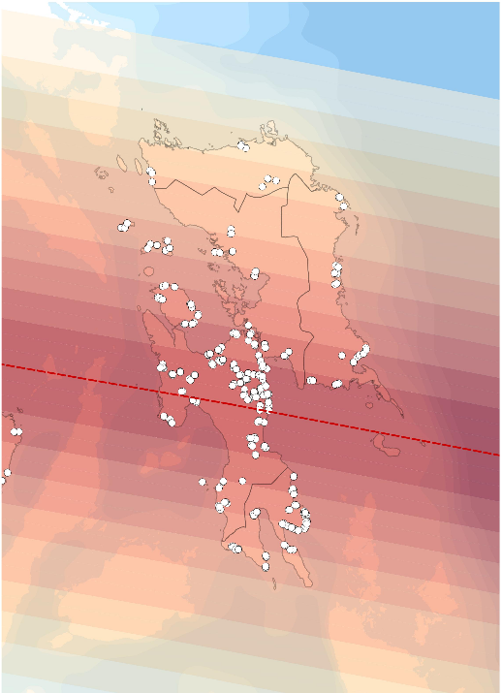
Typhoon Yolanda
Advantages
Assessment of municipal and HHs exposure to the typhoon‘s impacts
Utilization as variable for statistical matching procedure
Drawbacks
Requires prior knowledge about specific local conditions (storm surges)
Spatial resolution remains relatively coarse
Notes:
We were able to use and integrate the meteorological information with existing survey data and estimate the affectedness of HHs but also villages and municipalities of the typhoon. This information was used to inform the statistical matching procedure for harmonizing intervention and control group but later also to calculate specific effects of the most affected municipalites and villages.
The major drawback we were facing was that we still needed local knowledge as the storm was only one of two major factors that led to the tremendous casualities in the region. The other being the storm surges, which were largely depednent by the combination of wind speed and coastal exposition as well as local geography. Our affectedness variable did encompass these location specific effects that could not solely be extrated from the meteorological model.
Another drawback was: The spatial resolution of the moteorological model remained relatively corse. Sufficient for the statistical estimation but detailled enough to separate on a 100m grid level.

Slide 10
Policy diffusion
Challenge
Did the intervention also affect non-treated municipalities? (spillover effects)
Personnel from control municipalities might interact with treated personnel: “Unintended” spillover.
Approach
Calculate distance matrix and spillover of outcomes: Integration into data analysis
Basis for distance matrix: Google Maps API - Driving distance
Controlling for spatial autocorrelation of outcomes
Outcome and geographic area
Definition and refinement of distance (weight) matrix
Calculation and detection of spatial autocorrelation (Moran’s I)
Accounting for diffusion in statistical data analysis
Notes:
A second question we were interested in was associated to factors of policy diffusion. Diffusion effects, such as intended or unintended spillovers of intervention outcomes, can be quite important and desireable in development assistance. Untreated villages obtain development benefits is highly desireable and so is it in the case of our capacity development intervention. Our intervention did not taking place in a laboratory-like setting but „treated actors are moving and interacting freely – hence the thought that treatment effects might spill over to potentially neighboring municipalities as planners, for instanec might interact during meetins or exchange ideas.
Hence, we decided to calculate a spatial regression model to approximate diffusion between treated and untreated municipalities. (spatial autocorrelation of impacts.) All analysis in this spatial econometric approach are dependent upon a solid distance matrix – meaning the developed network of interconnecting entities.
Outcome variable: Did training materials reach untreated municipalities? To calculate a distance matrix we relied on the Google Maps Routing API and calculated a weight matrix based on travel distances. Reason: The very diverse geography of the Phillippines, where ridge to reef might mean 2000m difference in altitude in a few kilometers, we relied on road network distance.

Slide 11
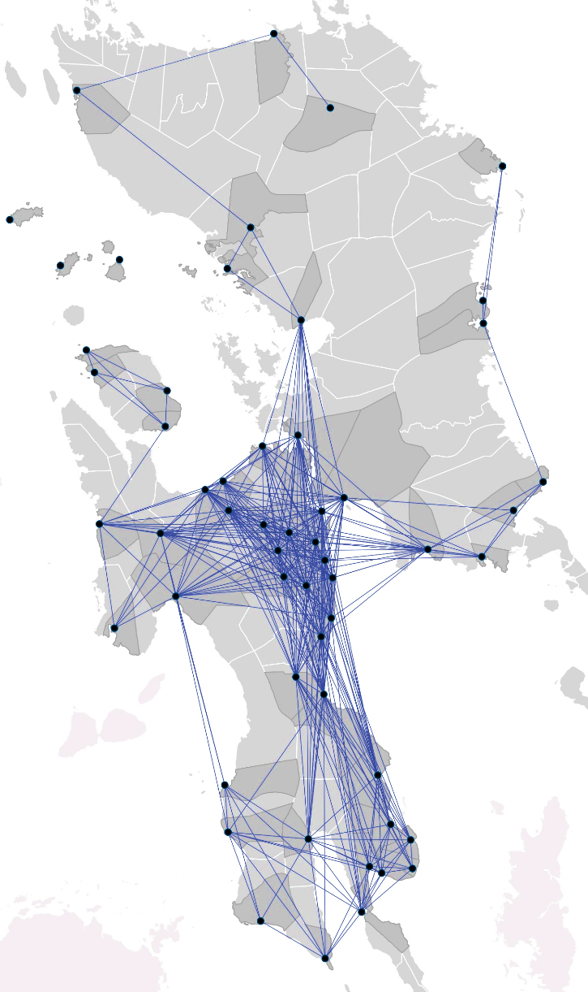
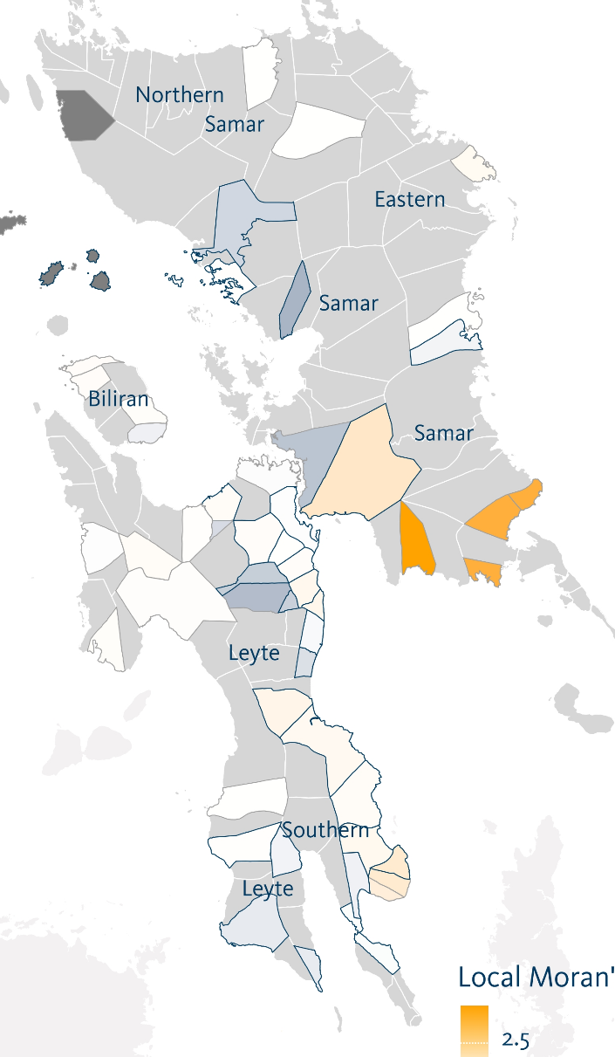
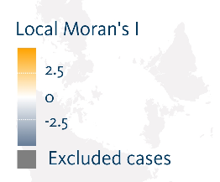
Policy diffusion
Results
Analysis revealed signifcant levels of policy diffusion
Several clubs of municipalities with high internal interaction
Drawbacks
Limitations of using Google Maps API for free: 100,000 request daily
Alternative: free routing API
Notes:
We used geocoded data for municipal halls and then experimented with Google Maps Distance API to calculate proximity based on travel times in the Google Maps Road Network (which is… good enough in the Philippines, not perfect though). The given scale of out analysis let us use the easiest API use, that did not require payment for accessing the. For larger analysis this would have been the case. However, we did have to split up our request due to the lmitation of daily request by Google. Free routing API, for instance from Open Street Map, would be an alternative here.
Using this, we found only slight effects of policy diffusion between treatment and control municipalities and were able to control for this in the following analysis. Several „clubs“ of local municipalities showed high degree of spillover.

Slide 12
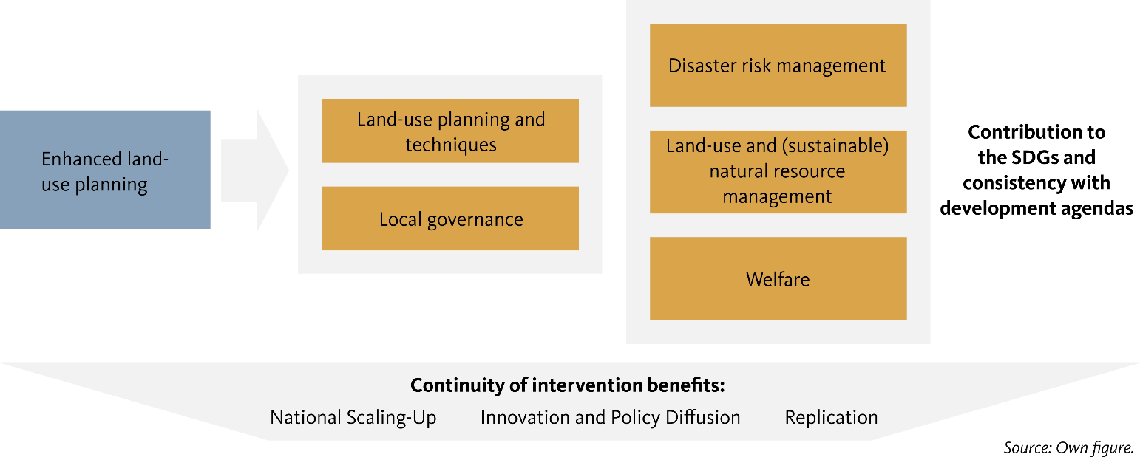
Findings: Impact evaluation
Evaluation findings
The SIMPLE intervention was able to improve land-use planning technique and partly contributed to improved natural resource management as well as municipal disaster risk management.
Little socio-economic long-term impacts and partly contradictory impacts on local governance.
Notes:
To conclude the first part, some general findings out the enhanced land use planning intervention:
We found that:
The intervetion did have a positive effect on capacity development and the improvement of land use planning capacities.
Limited positive effects on land-use and natural resource management as well as disaster risk management
No measurebale effect on long-term development objectives such as welfare.
The perception of local governance did not sytematically improve but in some cases even led to adverse effects (decrease in trust and perceived performance) => We further investigated these findings and concluded that improved transparency and awareness for public policy did increase the visibility of corrupt practices and politicizes decision-making.
The national-scaling up of the appraoch can be considered successful.

Slide 13
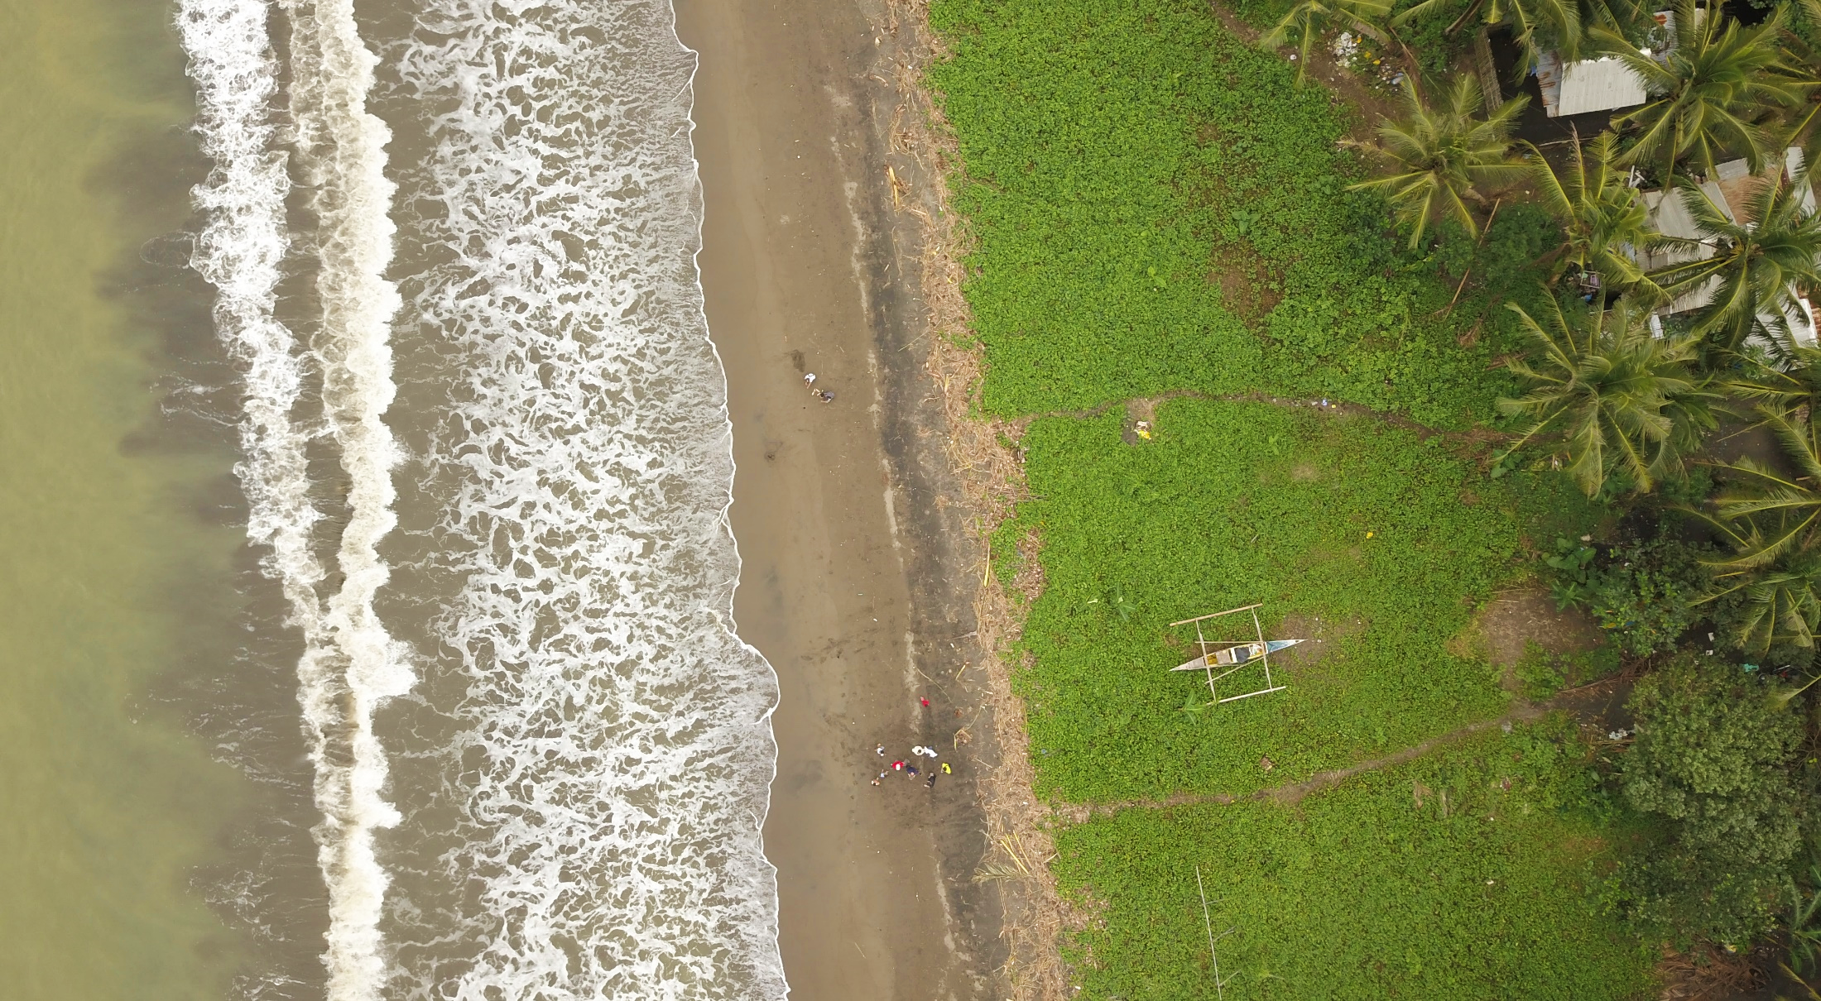
“How can remote-sensing data and analysis can enrich evaluations? ”
Using remote sensing images to measure disaster recovery and preparedness
Notes:
Now I would to come to part two: The small methodological study we added on the previous evaluation, to assess the potential to use very high-resolution remote sensing imagery to answer evaluative questions.
This part is based on a cooperation with the Faculty for Geo-Information Science and Earth Observation at the University of Twente, The Netherlands.

Slide 14
Using high-resolution remote sensing data to measure disaster resilience
Cooperation with Faculty of Geo-information Science and Earth Observation at the University of Twente (ITC)
Goal: Develop a methodological approach for machine-learning supported land-use and land-cover classification system based on very high resolution (VHR) RS data.
Commercial data:
WorldView 2 and 3 (Satellite Imaging Corporation, 2018a)
GeoEye 2 (Lockheed Martin Space Systems, 2018)
Pleiades (Satellite Imaging Corporation, 2018b)
Visual & near infrared spectrum (NIR) / up to 0.5m ground resolution (panchromatic)
Very high resolution remote sensing data
Proxies:
Transportation
Health
Agriculture
Economy
Classification of visual proxies using machine-learning algorithms
Time-series change detection / Functional assessment
Notes:
The goals was to assess how remote sensing imagery can be used to answer certain evaluation questions. Here we focused on the field of disaster risk management, as the colleagues at ITC we already concerned with a project in the Greater Tacloban Area: We pooled resources to obtain commercially available RS data (spatial resolution up to 50cm ground resolution for panchromatic images: WordView, Pleiades, GeoEye)
ITC implemented machine learning-based classification (Both classic classification algorithms based on Support Vector Machines, as well as more sophisticated approaches based on Gradiant Boosting Method), to semi-automatically classify land-cover and land use across 18 villages in 7 municipalities. We also experimented with CNN Convolutional Neural Network approaches but they did not systematically perform better than the other mentioned algorithms
Since, remote sensing data is available at several points in time (4-time steps), a precise change detection of visual changes is possible. This analysis then allows for assess changes in settlement systems but also the environment over longer time-frames. The detailed approach will subsequently allow the measurement and assessment of gradual changes, which are hard to grasp given established evaluation methods.
Thematic question: How did villages and municipalites in the Greater Tacloban Area recover from Typhoon Yolanda, what differences can be observed and how can these difference be explained using existing survey data (obtained in the Philippine evaluation).

Slide 15
Proxies used for the recovery assessment
Proxy | Proxy Name | Description of measurement | Approximation of socio-economic dimension
1 | Buildings | The area covered by buildings. Changes in this measure permit estimating damage and reconstruction of buildings | Economic loss in property and economic recovery
2 | Proportion of built-up area | Area covered by buildings expressed as proportion | Measure of the level of urbanization
3 | Impervious surface | Changes in this measure permit computing debris covering the surface | Debris as obstacle for economic business operations
4 | Large-scale industry | Measurement of buildings associated with large scale-industry | Indicator of industrial capacity and local labor market
5 | Vehicles | Count number of vehicles | Economic activity
6 | Boats | Count number of boats | Level of economic activity in fishery sector
7 | Arable land | Measure of the area that can be used for agricultural production | Use of agriculture for livelihood recovery
8 | Proportion vegetated area | Area covered by vegetation expressed as proportion | Measure of access to natural resources
9 | Roof material | Measure of the texture and color of roofs | Roof material is associated with housing quality and income level of occupants. It may be used as indicator of slum areas and presence of poverty.
Notes:
For the classification a catalogue of detectable proxies was developed based on the state-of-the-art discussion in remote sensing.
However, not all proxies deemed useful for out analysis (for instance, the color of roofing material was abandoned after ground truthing showed that they did not yield in useable results).

Slide 16
Proxies used for the recovery assessment
Proxy | Proxy Name | Description of measurement | Approximation of socio-economic dimension
1 | Buildings | The area covered by buildings. Changes in this measure permit estimating damage and reconstruction of buildings | Economic loss in property and economic recovery
2 | Proportion of built-up area | Area covered by buildings expressed as proportion | Measure of the level of urbanization
3 | Impervious surface | Changes in this measure permit computing debris covering the surface | Debris as obstacle for economic business operations
4 | Large-scale industry | Measurement of buildings associated with large scale-industry | Indicator of industrial capacity and local labor market
5 | Vehicles | Count number of vehicles | Economic activity
6 | Boats | Count number of boats | Level of economic activity in fishery sector
7 | Arable land | Measure of the area that can be used for agricultural production | Use of agriculture for livelihood recovery
8 | Proportion vegetated area | Area covered by vegetation expressed as proportion | Measure of access to natural resources
9 | Roof material | Measure of the texture and color of roofs | Roof material is associated with housing quality and income level of occupants. It may be used as indicator of slum areas and presence of poverty.
Notes:
We thus relied on Buildings, the proportion of buit-up area, impervious surface as well as large-scale industry to approximate socio-economic recovery.

Slide 17
Example of land-use classification
Barangay 69: Tacloban City
Original image before disaster (T0)Z
Land Cover / Land Use classification before disaster (T0)
Land Cover / Land Use classification directly after disaster (T1)
…
Notes:
Here I would like to demonstrate briefly how thes classification „looks“ like because sometimes it is a little hard to image the process:
The visual area (here one village within Tacloban City) is classified and trained using the ML classification algorithm. This is done over four time periods; then differences in land-use and land cover as well as other proxies are calculated and merged with existing survey data.

Slide 18
Findings: Recovery performance in land-use class “formal buildings“ and “industry”
Findings:
Barangays recovered best:
Presence of strong local government
Provided with reconstruction support by the national government
Provided with external funds by international NGOs
German development support: limited effect on recovery performance
Strong recovery during the first 2 years
Substantially slower recover effects for later years
Limitations:
Limited sample size (N= 20 barangays)
Relatively small region focus (Greater Tacloban Area)
Notes:
The analysis, despite the small sample size showed:
Disaster extent primarily influenced by exogenous effects and socio-economic effects
National as well as international reconstruction support explained higher recovery performance
We observed only a limited effect of German development support (technical support) on recovery performance.
Generally and not surprising: Reconstruction pace was strongest in the first two years after the typhoon, then slowed down substantially.
Limitations exist given the small sample sizes and the narrow regional focus: We treated the analysis mainly as a prove of concept. The concept and appraoch will be used on the upcoming Deval evaluation on climate change adaptation measures and then focus more on factors associated with recovering of the agricultural system. Dr. Raphael Nawrotzki at DEval will be in charge of the implemetaion of the second project phase.

Slide 19
Challenges
Scale versus Scope
Alignment of remote sensing (RS) and survey data crucial
Large area in RS / Small sample proportion in survey data => Attrition problems
Cloud coverage / cloud shadow (tropic / sub-tropic areas)
Costs
Commercial RS data can be quite costly:
25 – 35US-$ / km²
Example: Brussels 32.6km² (800 – 1,200 US-$) * no. observation periods
Larger evaluation areas / scaterred treatment sites
Technical aspects
Data availability (cloud coverage / temporal compareability)
Computing requirements
Notes:
We also used the project as a learning environment and yes we made some (sometimes painful) experiences as this application was new to us at DEVal:
Scale versus Scope. We learned that it is extremely important to think from the beginning about aligning survey and remote sensing data. A large coverage in RS sensing, especially with high resolution data, can cover only limited areas compared to survey methods. This can lead to inconsistencies and attrition problems. Secondly, cloud coverage and shwdow in data can substantially harm land use classification and lead to region dropouts of data (this is highly problematic in small sample situations)
Cost: High resolution data is highly costly: For example we had to calculate between 25-35USD for km² archived data. The geographic extent needs to be multiplied by the desired number of survey periods for change detection.

Slide 20
Take-away message
Growing use of geospatial analysis highlights potential of the approach
Requires solid preparation and precise workflow / No ‘quick-and-dirty‘ tool
Flexible and can offer insights that might be hard (or harder to gain) with traditional evaluation methodology
Cannot and will not make existing methodology obsolete
Biggest potential: Integration into mixed-method evaluation designs / Increasing the degree of automating geo data analysis processes
Notes:
With that being said, I would like to conclude my presentation with some take-away messages I have prepared:
- We learned that geospatial analysis is being increasingly used evaluation. Ist wide use nowadays underlines its potentials to improve development evaluation.
However: Geospatial analysis is neither easy not a quick-and-dirty tool: it requires certain technical competencies, solid preparation and a precise and workflow.
It is flexible and can offer insights into hard or harder to reach areas and topics using existing evaluation methodology
BUT: It cannot and will not make existing methods obsolete. At Deval we see the biggest opportunities in mixed-method evaluation designs and in the increase of automation of geo-analytical processes.

Slide 21
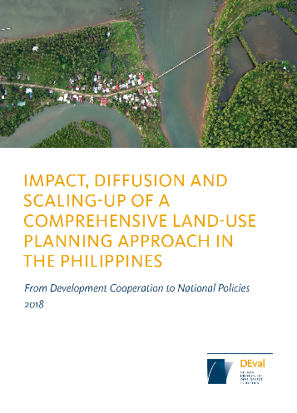
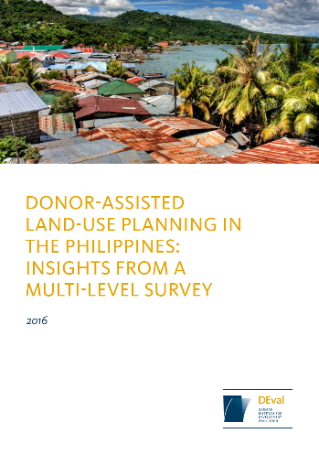
Would you like to learn more?
upcoming
Policy Briefs on Remote Sensing Analysis also coming soon!
www.deval.org

Slide 22
Thank you for your attention!
Dr. Malte Lech
Mail: malte.lech@gmail.com
Phone: +49 1575 4008006
Dr. Raphael Nawrotzski
Mail: raphael.nawrotzki@DEval.org
Phone: +49 228 336907 969

Slide 23
Source of Pictures / Images:
Slide 5: Gesellschaft für Internationale Zusammenarbeit (GIZ)
Slide7: (Left) Public Domain Images, Wikimedia Commons
https://en.wikipedia.org/wiki/Typhoon_Haiyan#/media/File:Haiyan_Nov_7_2013_1345Z.png
Slide 7: (Right) Lance Cpl. Luis Rodriguez - Public Domain Image
https://en.wikipedia.org/wiki/Typhoon_Haiyan#/media/File:Operation_Damayan_131118-M-LT992-019.jpg
Title Slide, Slide 4 and Slide 13, Slide 22 Julian Barth (Kigali Film), 2018
http://www.kigali-films.de/julian-barth/
--- All other pictures, images & graphics are the author‘s own work and can be used under Creative Commons - CC BY 4.0 ---

