Slide 1
Copernicus: full, free and open EO data and information
Catharina Bamps and Ola Nordbeck – DG GROW
12 March 2019, Brussels

Slide 2
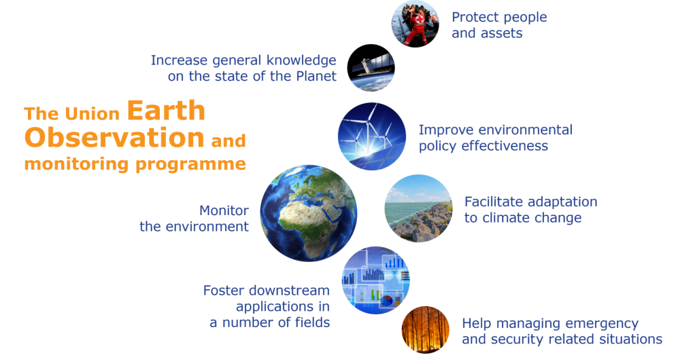
COPERNICUS IN BRIEF
The Copernicus programme : European Union’s revolutionary Earth Observation and Monitoring programme:
To monitor the Earth, its environment and ecosystems
To ensure its citizens are prepared and protected for crises, security risks and natural or man-made disasters

Slide 3
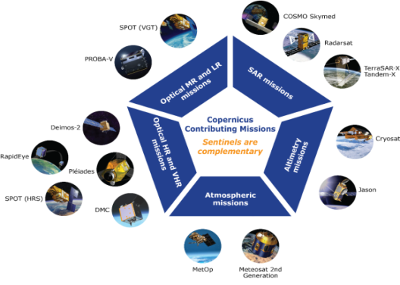
COPERNICUS : an enabling programme
6 Copernicus core services
use Earth Observation data and in situ data to deliver information products
Contributing missions
added-value products
Sentinels

Slide 4
COPERNICUS IN BRIEF
Copernicus is a European Union Programme, aimed at providing worldwide Earth Observation data and EO-based information products about our planet at the disposal of citizens, public authorities and policy makers, scientists, entrepreneurs and businesses on a full, free and open basis
http://copernicus.eu/data-access :
Access Hubs: https://www.copernicus.eu/en/access-data/conventional-data-access-hubs
Sentinel Data: https://scihub.copernicus.eu/
Services data and information : land, atmosphere, emergency, marine, climate and security
+ https://services-portfolios.copernicus.eu
Data and Information Access Services (DIAS): 5 cloud-based platforms to facilitate integration of Copernicus data and info without the need to download or invest in heavy processing and storage facilities;
https://www.copernicus.eu/en/access-data/dias
Comparison functionalities 5 DIAS: https://www.youtube.com/watch?v=cvP2xqiMOh4

Slide 5
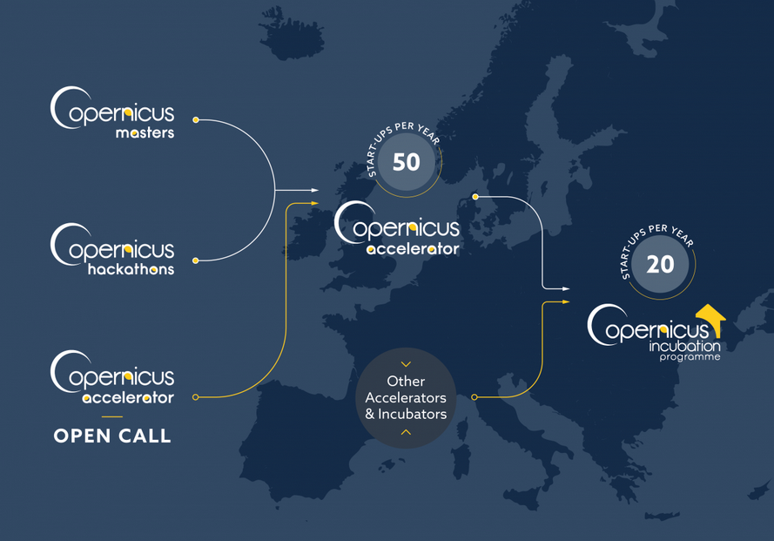
COPERNICUS IN BRIEF
Is a tool for economic development and a driver for the digital economy
Copernicus market report 2019 Copernicus start-up programme

Slide 6
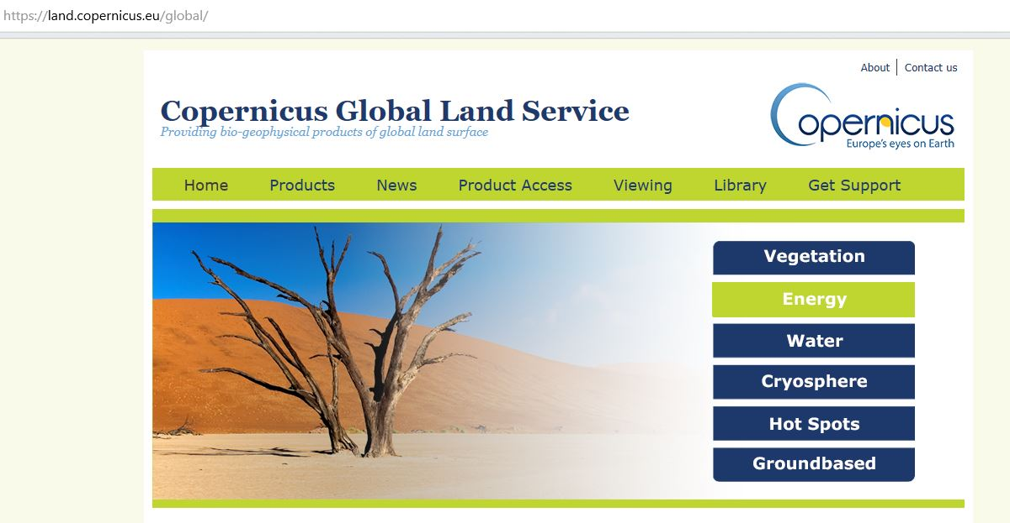
GLOBAL LAND Systematic Monitoring variables
Ten daily frequency / Delivery timeliness 3 days
Resolution from 1km to 300m and 100m
Current Portfolio of 27 products
Notes:
The exhaustive list of the products, around 30 variables are produced for the whole globe, every ten days and at a resolution of 300 meters for mots of them
This is done, as said, to monitor activities with a global dimension
6

Slide 7
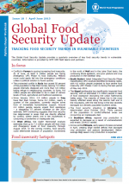
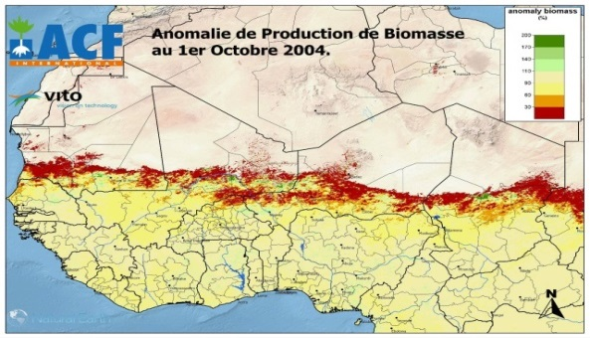
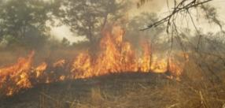
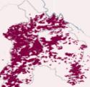
GLOBAL LAND Systematic Monitoring applications
Climate change
Carbon flux forecast
Agriculture
Crop monitoring
Yield forecasting
Biomass conditions
Monitoring extreme events
Droughts
Frost conditions
Heat waves
Hydrology
Water management
River discharge
Fire ecology
Monitoring of fires and burned areas on a daily basis
Development of indices of fire management and efficiency
Bulletins developed at national and PA level
Notes:
Here are the main applications : crop monitoring bulletins produced at national or continental level, drought monitoring, water monitoring, yield forecast …
7

Slide 8
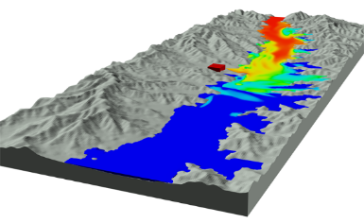
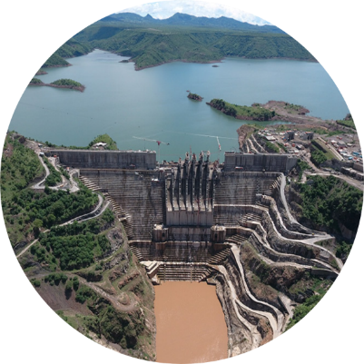
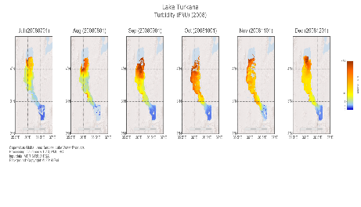
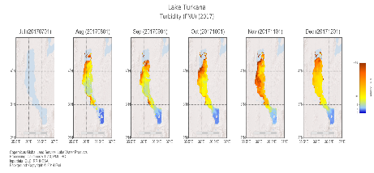
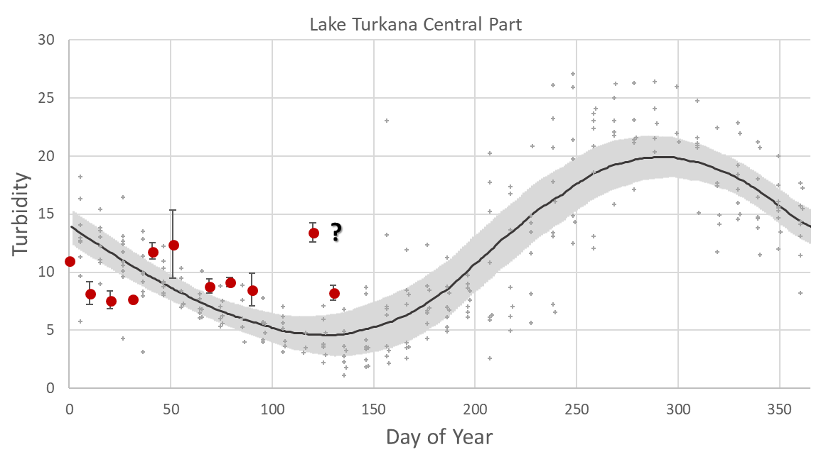
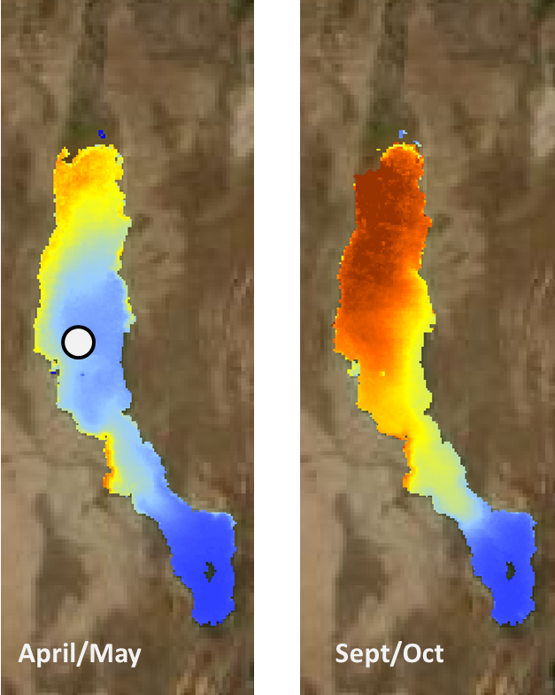
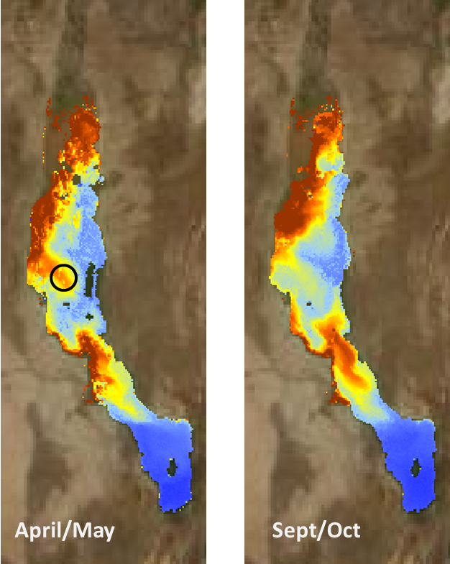
Users Water level and quality monitoring - Lake Turkana
Gibe III dam on the Omo River is Africa´s biggest dam (since 2016), will make possible large-scale commercial irrigation schemes in the Lower Omo
Potential impacts:
Lake Turkana´s ecology (captured nutrients could no more feed the lake)
Risk on indigenous fishery
Urgency to establish effective monitoring
Knowledge of upstream/downstream water resources (Hydrologic models)
Knowledge of ecosystem to estimate environmental and societal impacts
Operational monitoring (optimization, monitoring…etc)
Water Level
Snow Water Equivalent
Discharge (in situ)
Rain
Source: FLOW-3D
Gibe III Hydropower Plant on the Omo river in Ethiopia
Turbidity of Lake Turkana before (2008) and after (2017)the construction of the Gilgel Gibe III Dam
Water Level
Lake Water Quality/temperature
Archive Turbidity data over 10 years, seasonal trends
NRT Turbidity data
Near Real Time data:
Water Level
Lake Water Quality/Temperature
Area of water bodies
Discharge from local model
Lake Turkana, Kenya
Notes:
Example : the monitoring of the water level and water quality of lake Turkana in Kenya following the construction of the GIBE III Dam in Ethiopia, this has a clear impact on the turbidity and the water level of the Kenyan lake which is in a unique biodiversity environment
8

Slide 9
Drought assessment

Slide 10
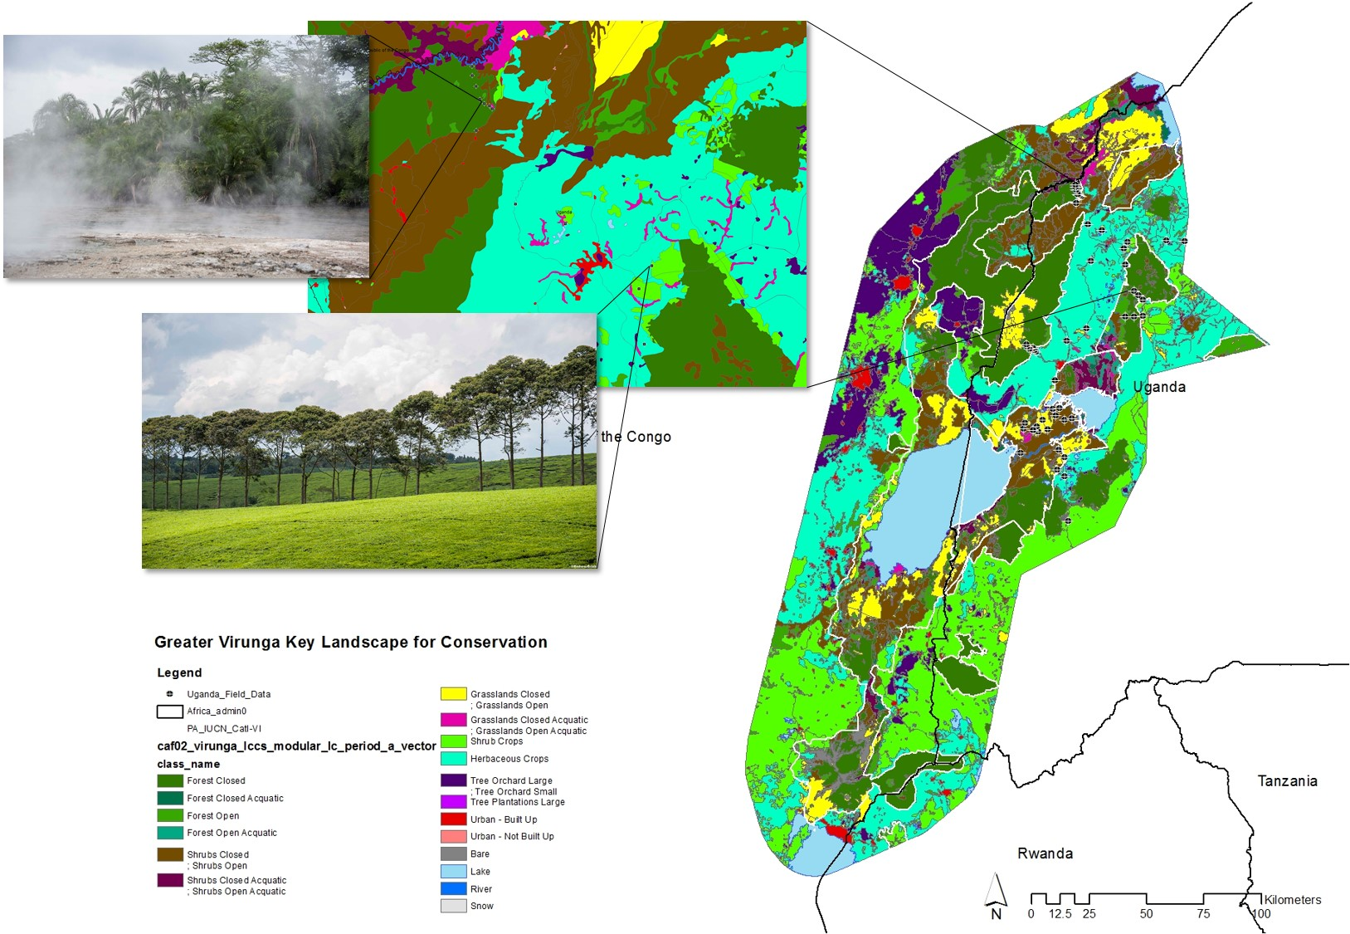
GLOBAL LAND Hot Spot component
Provide detailed land cover information on specific areas of interest for EU outside the European Union, particularly in the domain of the sustainable management of natural resources.
Africa : Areas of interest defined in collaboration with DG DEVCO to support EU Biodiversity Strategy in Africa.
Asia : EU funded project in collaboration with GIZ and Portuguese Coop. in Timor-Leste.
Notes:
The second component is a high resolution component providing detailed information on specific areas of interest, to support EU strategy (here the biodiversity strategy in Africa) or development project in the field. This activity is based on request from DG’s, MS or International institutions supported by the EU.

Slide 11
Land cover/use monitoring, deforestation, REDD+ (Reducing Emissions from Deforestation and Forest Degradation) etc.
https://land.copernicus.eu/imagery-in-situ/global-image-mosaics/
https://apps.sentinel-hub.com/mosaic-hub/#/
Sentinel 2 Global Mosaics (S2GM) – analysis ready data
Sentinel 2B (image source: ESA)
Notes:
To facilitate the uptake of the satellite data, we have also set up a tool which produce cloud free mosaics of data. It is currently based on Sentinel 2 data. The tool was initialy designed to support countries in their REDD plus process.
An example of the result, the different images that you see on the back are combined to create a cloud free image of the whole area, this tools is available on line

Slide 12
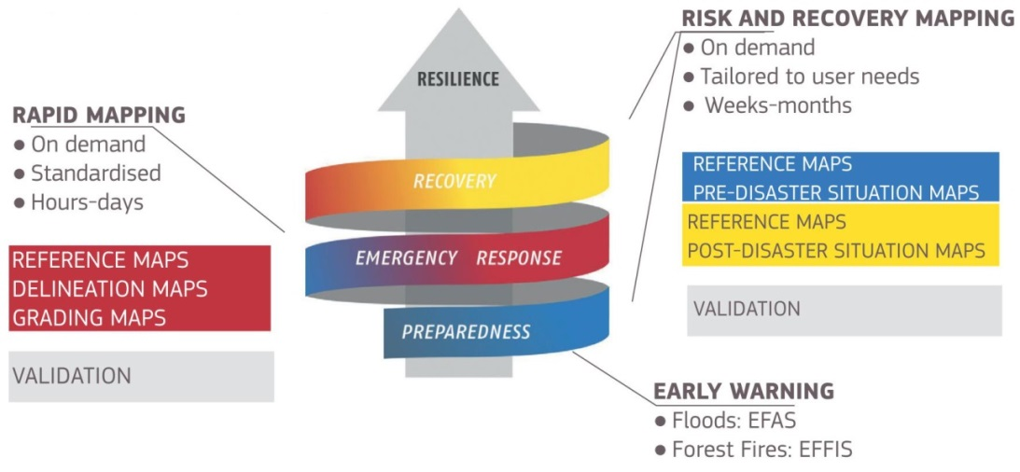
Emergency Management Service
Operational since 2012 (research project prior to 2012)
Addressing natural & man-made disasters globally
Supports all phases of the disaster management cycle (during, before, after):
Warnings & risk assessments for floods and forest fires
Information on the impact of natural and man-made disasters

Slide 13
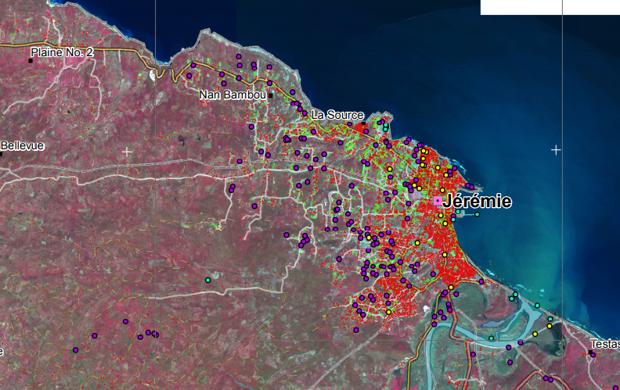
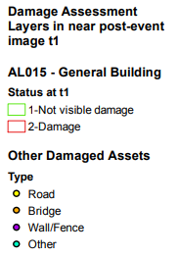
Risk & Recovery Mapping - Examples
EMSN050: Post-Mathew Damage Assessment and Monitoring of Recovery Activities in the South Region of Haiti (EMSN050)
Products for risk assessment & disaster risk reduction
Purpose: to provide a general reference content to support activities of administration in reconstruction work of damage caused by Cyclone Matthew (October 2016) over two areas of interest containing the cities of Jérémie and Les Cayes, Haiti and to understand vulnerabilities during the recovery period.
Results are presented in tables containing, between other indicators, damage to assets, statistics at each monitoring interval, reconstruction progress rates, grouped by administrative boundary of interest (i.e.: sub-commune)
Product 1: Reference map
Product 2: Land Use Land Cover map
Product 3: Damage Assessment Map
Product 4: Monitoring of Reconstruction Activities Map
Product 5: Identification of IDP camps Map in three time stages
Product 6: Monitoring of Evolution IDP camps t1-t3 Map
http://emergency.copernicus.eu/EMSN050
Notes:
Maps qualitatively marked, no significant figure to show

Slide 14
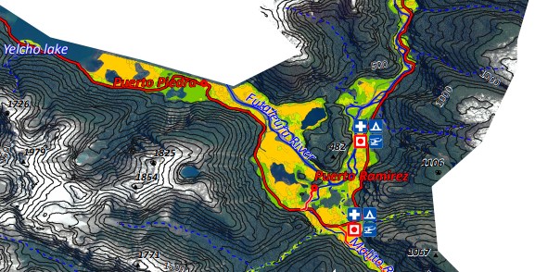
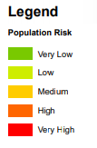
Risk & Recovery Mapping - Examples
Flood Risk mapping, Southern Chile (EMSN053)
Products for risk assessment & disaster risk reduction
The activation focuses on two flood disaster management levels.
The first refers to post‐disaster situation analysis concerning the impact of intense rain (16 December 2017) over the Villa Santa Lucia, in the commune of Chaitén, Chile (CL).
The second refers to the efficient support of flood risk management activities and planning of prevention, protection and preparedness measures through accounting for the area characteristics.
Product 1: Reference Mapping
Product 2: Land Use/ Cover Mapping
Product 3: Delineation of the Flood/ Mudslide area
Product 4: Flood Risk Assessment – Population at risk
Product 5: Flood Risk Assessment – Assets (POIs) & Transportation at Risk(AOI-02)
http://emergency.copernicus.eu/EMSN053
Notes:
Risk assessment showed:
1249 people in areas designated as high risk of flooding
0.25km² of built up areas at high or very high risk of flooding

Slide 15
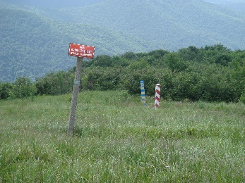
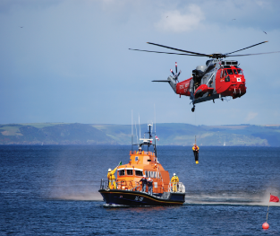
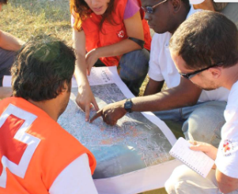
Security Service
Border Surveillance
Maritime Surveillance
Support to EU External Action
Coastal monitoring
Pre-frontier monitoring
Reference mapping
Maritime surveillance of an area of interest
Vessel detection
Vessel tracking and reporting
Vessel anomaly detection
Road network status assessment
Conflict damage assessment
Critical infrastructure analysis
Reference map
Support to evacuation plans
Crisis situation map
Border map
Camp analysis

Slide 16
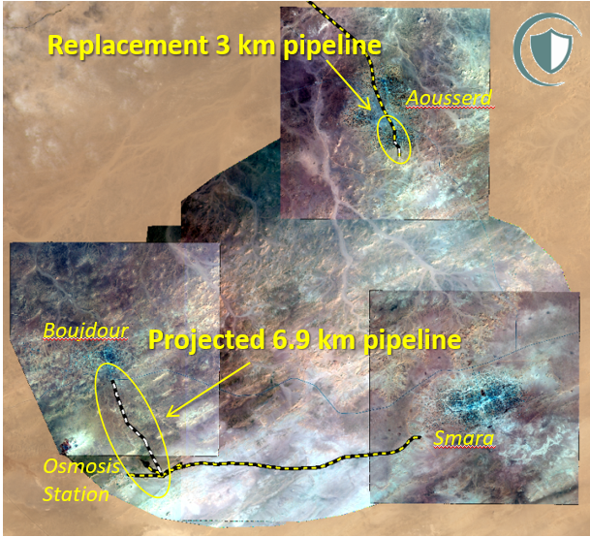
Previous Examples - Copernicus SEA Service
WHERE:
Sahrawi refugee camps in Algiers. 2 locations:
Downtown Aousserd
Smara osmosis plant
WHY:
Monitor progress of two projects of pipeline construction.
Replacement of 3 km of pipeline between the centre of Ausserd centre and two metallic tanks outside Ausserd.
Construction of 6,9 km of pipeline from Smara Osmosis Station to Boujdour Camp.
Identification of the exact relation between the 3 kms and the 6,9 kms.

Slide 17
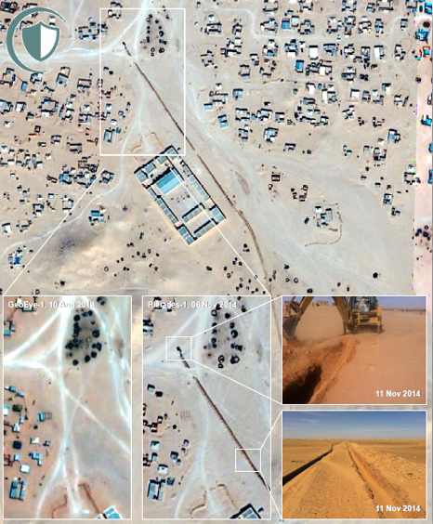
Previous Examples - Copernicus SEA Service
HOW
Very High Resolution data allows to identify the footprint of construction activities, such as trenches and construction equipment.
Change detection techniques allow to determine the dates on which activities are taking place.

Slide 18
Thank you
50+ Copernicus webinars on Youtube:
https://www.copernicus.eu/en/media/videos
https://rus-training.eu : research and user support for Sentinel core products - on-line free-access platform to promote the uptake of Copernicus data

