Slide 1



JOINT PROGRAMMING FOCAL POINTS MEETING
BRUSSELS, 15 MARCH 2019

Slide 2
Joint Programming
The joint planning of development cooperation and external action by the EU and Member States development/external action partners working in a partner country. It is a voluntary, flexible and tailored process designed and driven by European partners at country level.
Joint analysis
Joint response
Joint results framework
Notes:
EEAS

Slide 3
Global Strategy for the EU's Foreign and Security Policy
A Joined-up Union
A more prosperous Union calls for greater coordination between the EU and MS, the EIB and the private sector. We must become more joined-up across internal and external policies
A Credible Union
Engage responsibly with the world. Our credibility vital: hinges on our unity, achievements, effectiveness and consistency of policies. It requires investing in all dimensions of Foreign Policy (energy diplomacy, cultural diplomacy and economic diplomacy).
A Responsive Union
We will pursue greater information sharing and joint reporting, joint analysis and response between MS embassies, EU Delegations, Commission services, EU Special Representatives and CSDP missions.
We aim to develop stronger links between humanitarian, development, migration, trade, investment […] through joint risk analysis, and multiannual programming and financing.
Notes:
EEAS

Slide 4
2016 Council Conclusions on Stepping-up Joint Programming
“The Council stresses the opportunity of expanding Joint Programming including in fragile situations and conflict-affected countries, as well as in prevention or post-conflict contexts. […] The Council also invites the Commission services and the EEAS to consider ways in which Joint Programming can accompany countries in transition to higher income levels, as part of a wider relationship going beyond external assistance.

Slide 5
2017 new European Consensus on Development
Working Better Together
“At country level, the EU and its Member States will enhance Joint Programming in development cooperation to increase their collective impact by bringing together their resources and capacities. […] should be promoted and strengthened, while being kept voluntary, flexible, inclusive, and tailored to the country context, and allow for the replacement of EU and Member States programming documents with EU Joint Programming documents.”
“Joint monitoring and results frameworks will be core elements of the joint response to maintain momentum, inform dialogue and enhance mutual accountability.”
“Joint implementation can involve various financial modalities such as, co-financing and delegated cooperation, as well as non-financial means of implementation.”
Notes:
EEAS

Slide 6
Newest policy framework
Council Conclusions for a revised EU International Cooperation and Development Results Framework
10. The Council welcomes the revised EU Results Framework as a tool to facilitate joint follow-up and reporting by EU and Member States. In addition, the Council encourages the Commission services, the EEAS and Member States to further promote the use of joint results frameworks to facilitate joint programming, joint implementation and policy dialogues between the EU, Member States and stakeholders in partner countries.
Notes:
EEAS

Slide 7
2018 OECD Peer Review on EU development cooperation
Recommendation:
The EU and its member states should continuously expand and refine implementation of their joint programming strategy, including by reinforcing partner country ownership and strengthening results-based approaches, in support of the 2030 Agenda and the SDGs.
Analysis:
For joint programming to fully deliver on its promise, close monitoring, adaptation and partner country leadership are needed.
As the EU and its member states continue plans to further develop and support flexible joint programming approaches, emphasis should be placed on monitoring their effectiveness […] on resulting in better information sharing, closer alignment of budget cycles and more joined-up or delegated implementation.
Notes:
EEAS

Slide 8
Evolution of Joint Programming
EU & MS collectively contribute to implementing the policy commitments made at global and EU level
Effort and commitment by EU & MS necessary in countries where partners have recognised Joint Programming's potential to become the preferred approach
Consolidate and expand JP in fragile & and conflict countries, in prevention/post-conflict contexts, as well as accompany PCs in transition to higher income levels
JP process evolves to include strategic issues, such as migration, climate change, fragility, security and democracy
Notes:
EEAS

Slide 9
Global State of Play of Joint Programming (March 2019)
20 (+6)
17
COUNTRIES IN THE PROCESS OF JOINT PROGRAMMING (JOINT ANALYSIS OR ROADMAP)
Joint Analysis: Armenia, Belarus, Benin*, Georgia, Morocco*, Niger, Zambia
19
7
COUNTRIES EXPLORING JOINT PROGRAMMING POTENTIAL (FEASIBILITY/SCOPING EXERCISE)
Joint Monitoring / Results Framework
Bolivia, Burkina Faso, Cambodia, Comoros, Ethiopia, Ghana, Kenya, Laos, Nicaragua, Palestine, Senegal
Replacement
FR in Comoros, FR in Kenya, EU in Laos, DE and FR in Mali, EU in Palestine, EU in Senegal
JOINT PROGRAMMING DOCUMENTS
Afghanistan, Algeria, Angola, Bangladesh, Chad, Guinea Conakry, Iraq, Jordan, Kyrgyzstan, Liberia, Libya, Malawi, Myanmar, Somalia, Tajikistan, Tanzania, Ukraine, Uzbekistan, Yemen
Bolivia (2017-2020), Burkina Faso (2017-2021)*, Cambodia (2014-2018/2019-2020), Central African Republic (2017-2021)*, Comoros (2015-2020), Egypt (2017-2020), Ethiopia (2017-2020)*, Ghana (2017-2020), Guatemala (2014-2020), Honduras (2018-2022)*, Ivory Coast (2017-2020), Kenya (2018-2022), Laos (2016-2020), Moldova (2017-2020), Nicaragua (2018-2020), Palestine (2017-2020), Senegal (2018-2023), Togo (2014-2020), Tunisia (2017-2020)*, Uganda (2015-2019)
Old: Chad (2014-2017)**, Mali (2014-2018)**, Myanmar (2014-2016)**, Namibia (2014-2017), Paraguay (2014-2018), Rwanda (2014-2018)
Roadmap: Azerbaijan, Burundi*, Cameroon, El Salvador, Haiti, Lebanon, Madagascar*, Mali, Mozambique*, Nepal, Pakistan
11
JP ACTIVE IN 37
56 Active countries
*drafts **working towards a 2nd joint programming document
Notes:
EEAS

Slide 10
REPORTING FROM EU DELEGATIONS:
JP GOOD PRACTICES IN 2018
Joint Programming documents enabled more frequent meetings among Europeans, better integration of policies (GAP) and closer monitoring and linking of European interventions
  Kenya, Burkina Faso, Nicaragua, Georgia, Bolivia, Madagascar
In the absence of bilateral development funds, Joint Programming process sustains an identifiable European presence/group in-country
  Nepal, Kenya, Tajikistan
Joint Programming’s flexibility allows for tailored approaches by the European group taking the form of joint visions (common objectives and values), or thematic joint work (economic diplomacy, investment focus), or joint messages (sectoral work), or a joint front towards government (joint, united European stance)
  Thailand/Indonesia/Malaysia, Malawi, Lebanon, Burundi, Cambodia, Sudan
Notes:
DEVCO
HoMs report from 2016…..visibility and leverage

Slide 11
REPORTING FROM EU DELEGATIONS:
KEY MESSAGES FROM 2018
Lighter joint programming processes, esp. when few EU MS present or in fragile contexts
  Focus on joint vision or selected sectors can be better starting points
Thematic programming and diverse instruments can be an obstacle for JP
  Identification and formulation work at HQ to be more coordinated
The scope of joint programming to be understood as meaning “working together” at country level, ie in graduated countries where donors scale back aid
  JP to be linked better to EU priorities at country level and to better communicate the scope/added-value for different countries (neighbourhood, MICs)
  Linking JP process to work of European financial institutions
Joint (conflict) analyses in fragile contexts have added-value
HQ support via guidelines, human resources, technical support help move the process forward
Notes:
DEVCO
Broad themes: (i) programming cycles, (ii) local conditions (staff, resources, transaction costs), (iii) IFIs importance in relation to MS in some partner countries, (iv) diverse approaches in crises contexts by EU and MS
Partner governments: (i) in some cases, limited interest in donor coordination or questionable development strategy, (ii) better outreach to Govs to demonstrate added-value, (iii) absence of single national focal point for coordination/proliferation of counterparts
EU/MS: (i) many instruments (regional, thematic), (ii) difficulties to allocate leads/DoL among Europeans, (iii) new policies/tools and how to link with JP
Fragility: (i) limited capacities available in fragile countries, ending up working in silos, (ii) migration/security and how it influences JP

Slide 12

LAOS
MID-TERM REPORT OF THE JPD
SEPTEMBER 2018
Notes:
DEVCO

Slide 13
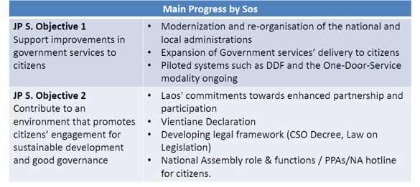
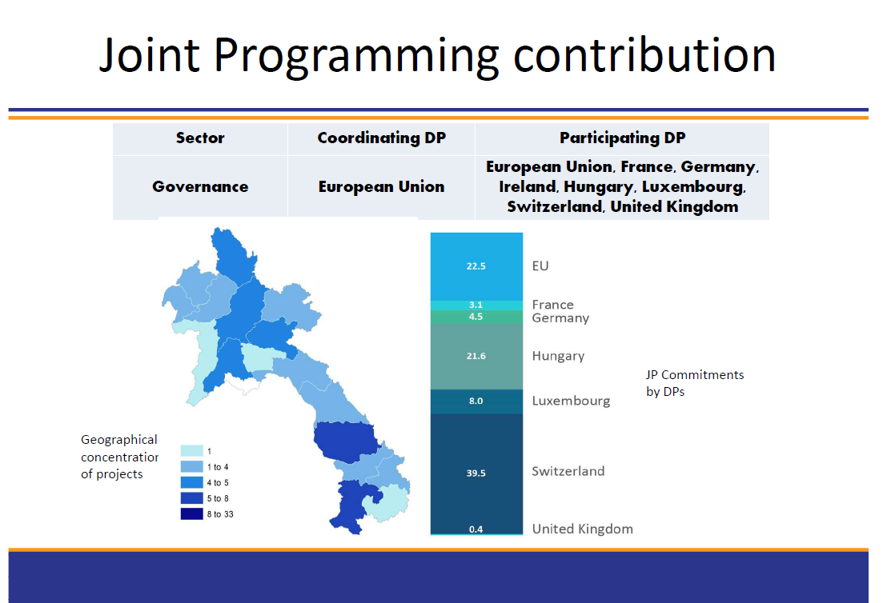
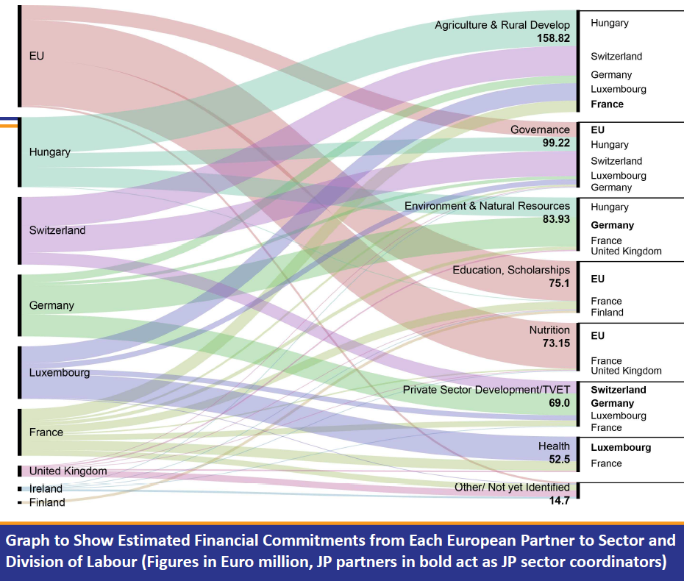
Notes:
DEVCO

Slide 14
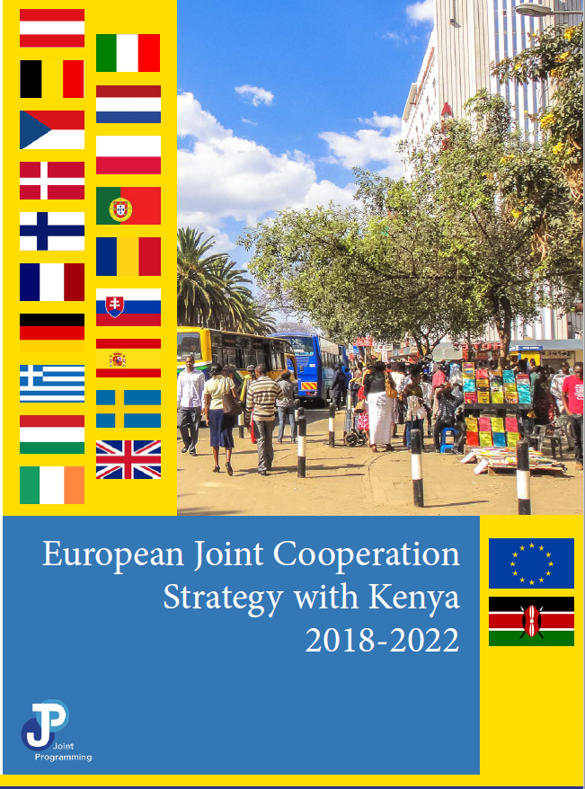
KENYA
LAUNCH EVENT OF ART.8 AND JOINT COOPERATION STRATEGY
12 NOVEMBER 2018
Notes:
DEVCO

Slide 15
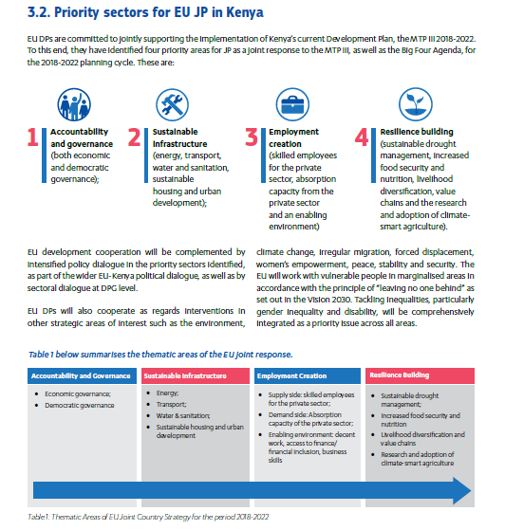
Notes:
DEVCO
Kenya: 4 outcome areas – 30 selected results
Accountability and Governance – 14
Infra- 8
Employment 5
Resilience 3
Links to SDG targets and goals : use of national monitoring systems – will also look at UNDAF monitoring..
1st DC counsellors meeting – review of actions together : ambition to find opportunities for policy dialogue as a European group with the Government

Slide 16

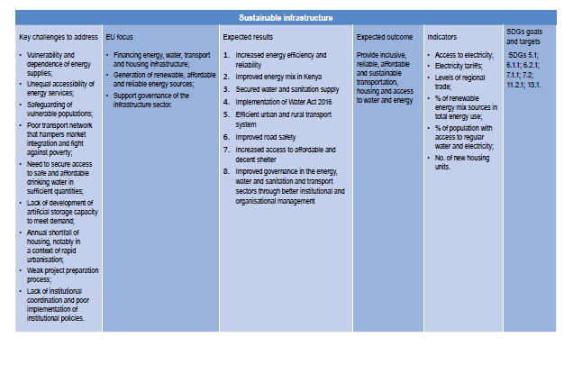
Notes:
DEVCO

Slide 17

SENEGAL
LAUNCH EVENT OF JOINT COOPERATION STRATEGY
07 DECEMBER 2018
Notes:
DEVCO

Slide 18
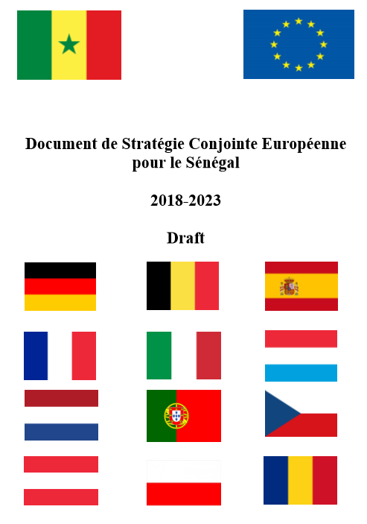
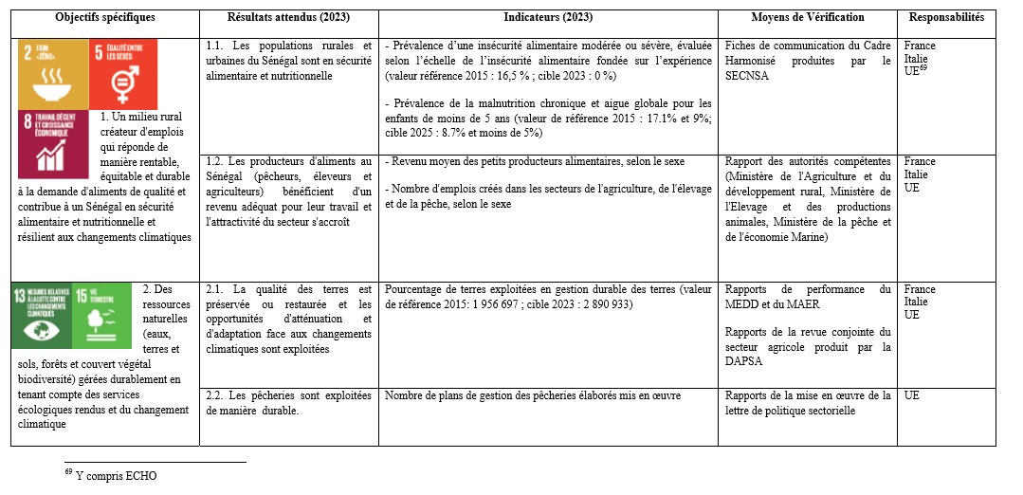
Notes:
DEVCO
Senegal: 2017 EU replacement
9 thematic leads identified in JP process- EU lead
Each lead developed logframe for thematic area of JP with inclusive consultation process (beyond EU group)
Joint annual reviews planned
SDGs linked to each of the 25 specific objectives
82 indicators (disaggregation + targets)
Government data + international reports and data used
EU contribution includes ECHO

Slide 19
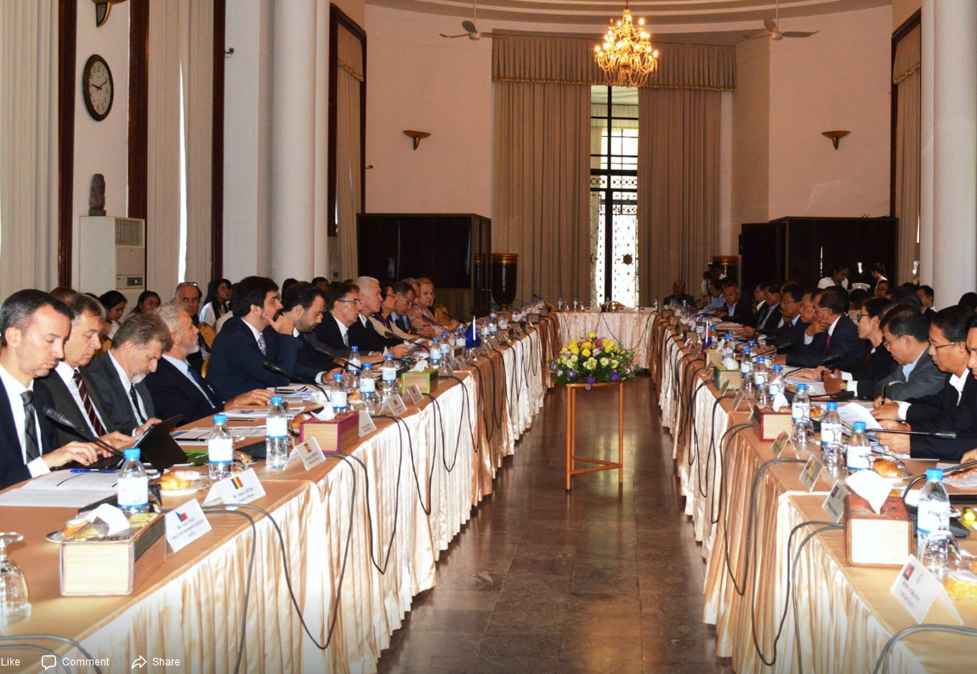
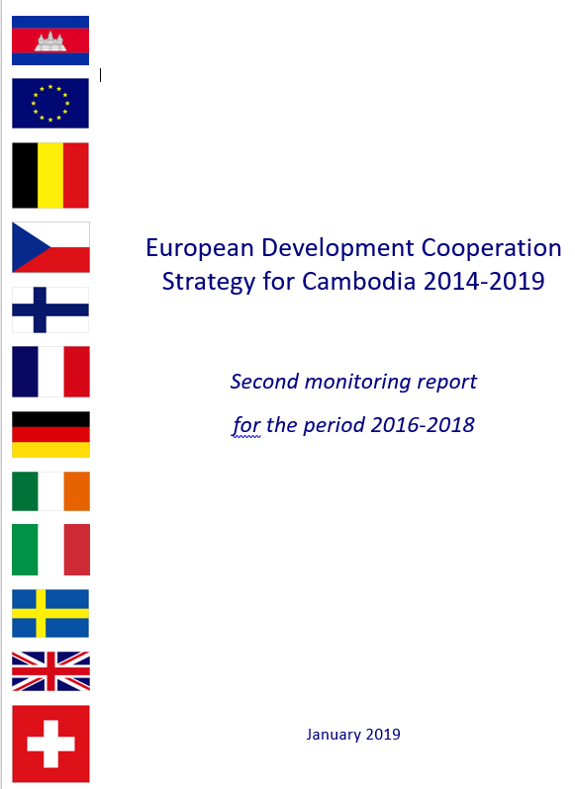
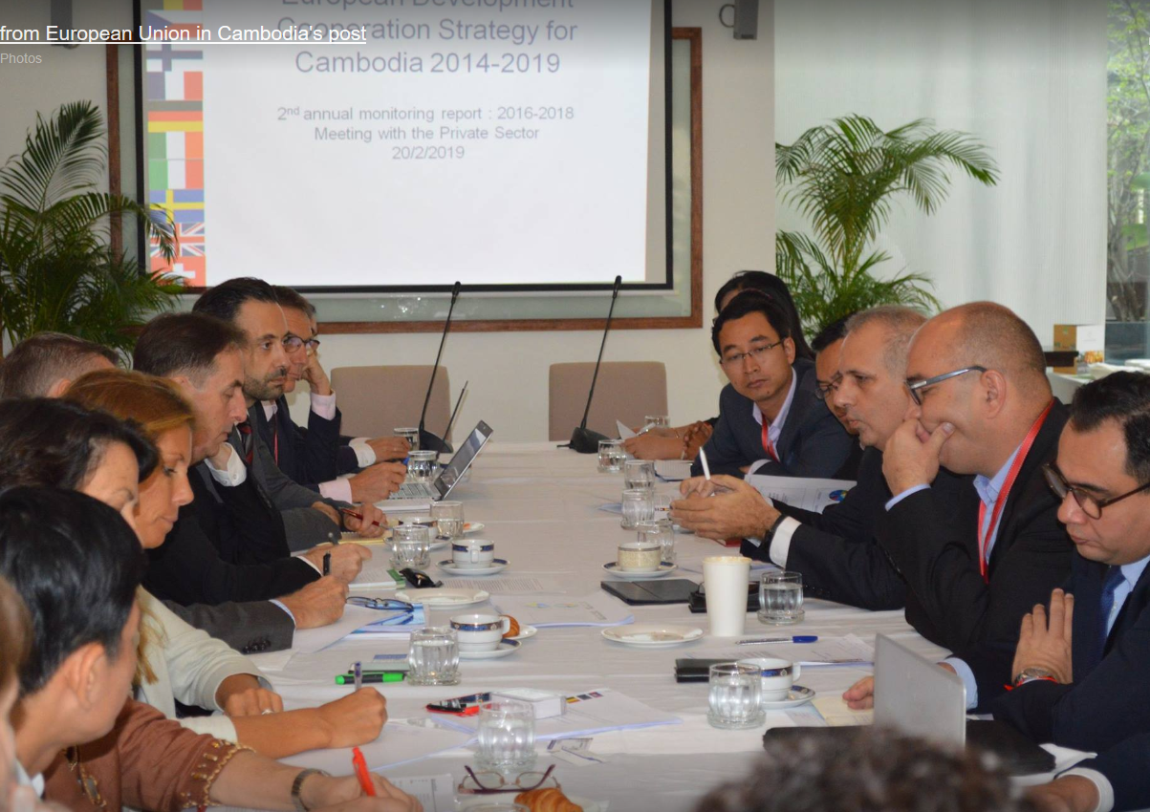
CAMBODIA
2nd MONITORING REPORT
Notes:
DEVCO

Slide 20
European Joint Programming Workshop
29 November 2018 - Jericho - Jericho Resort Village
Attendance: 13 EUMS (AT, BE, DE, DK, ES, FI, FR, IE, IT, NL, PL, SE, UK) + CH + EU offices (EUREP, EUPOL COPPS) + HQ reps (AT, EEAS, NEAR)
KEY MESSAGES
Communication is key (internal)
  Share with each other information on planning processes, programming options, policy dialogues, constraints, challenges, opportunities
  Understand how your actions may affect the position of others
  Convey common messages to other administrative branches (HQ, Tel Aviv missions etc.)
Actions inspire (be realistic about timetables and deliverables)
Leverage is attainable
  Give HoMs clear and concise common messages
  put together a common calendar/plan of opportunities
  use material that is already available to support messages
  focus on areas where there is already European consensus
HQ support is vital and needs to be increased if Joint Programming is to succeed
Notes:
NEAR
Key Messages
Communication is key (internal)
Have the reflex to share with each other information on planning processes, programming options, policy dialogues, constraints, challenges, opportunities
Ensure you have up-to-date information from other active donors before embarking on programming and policy dialogue
Understand how your actions may affect the position of others
Be clear on the purpose of meetings and leave space in them for discussion
Meet regularly with counterparts in political/cooperation section, including joint HoCs-HoPs meetings.
Convey common messages to other administrative branches (HQ, Tel Aviv missions etc.)
Actions inspire
Be realistic and focus on what is achievable within a tangible timeframe
Focus joint discussions on concrete action
Better leverage is attainable
Give HoMs clear and concise common messages to deliver to PA counterparts
Put together a common calendar/plan of opportunities to deliver key messages, based on European national days, Palestinian holidays and International days.
Use material that is already available to support messages (European Joint Strategy, Council Conclusions, new Consensus on Development, EU Global Strategy, UN Resolutions, etc.).
Focus on areas where there is already European consensus
HQ support is vital and needs to be increased if Joint Programming is to succeed.

Slide 21
PALESTINE VIDEO
Notes:
NEAR

Slide 22
Joint implementation
Work to expand Twinning and TAIEX
Based on the successful model from the enlargement and neighbourhood context, expansion to cover development countries.
* Reference in EU-Africa Alliance
Responsible services:
NEAR.C3 - Institution Building, TAIEX, Twinning Unit
DEVCO.A2 - Working Better Together team
Notes:
DEVCO

Slide 23
TWINNING | TAIEX
EU instrument for institutional cooperation between Public Administrations of EU Member States and of beneficiary or partner countries | Peer-to-peer technical assistance and policy-support from EU Member States to neighbouring countries (now also development countries)
Brings together public sector expertise with the aim of achieving concrete mandatory operational results through peer-to-peer activities | Targets central public administrations, judiciary and law enforcement authorities, parliaments and their civil servants, representatives of social partners, trade unions and employers’ associations
Medium to long-term institutional relationship | Provides three main types of short-term activities: - study visits; - expert missions; - workshops (single or multi-beneficiary)
It is funded from the EU budget and jointly implemented by the EU Member States and the partners It is policy-driven | Demand-driven (TAIEX Classic) or activated by the EU (TAIEX Strategic)
Notes:
DEVCO

Slide 24
Joint Implementation study with the PN
Study to assess added-value of joint implementation modalities
Case-studies:
Morocco – AECID+BC – TVET - ENI
Cambodia – SIDA+EU – PFM - Budget Support
Regional (LAC) - FIIAPP+E.F. – Human/Social Development - EuroSocial+
Senegal – AFD+LuxDev – Economic development – Budget Support
Cameroon/CAR – GIZ+SNV – Economic development and governance - Trust Funds
Togo – AFD+KfW+EU Blending – Electricity
Thematic (Climate Change) – GIZ, FIIAPP, AECID, AFD, EF - Euroclima
Report by mid-2019, incl. draft guidelines for joint implementation for field staff
Notes:
DEVCO:
AECID (Spain): Agencia Espanola de Cooperacion Internacional Para el Desarrollo
BC (UK): British Council
SIDA (Sweden): Swedish International Development Cooperation Agency
FIIAPP (Spain): Fundacion Internacional y Para Iberoamericana de Administracion y Politicas
EF (France): Expertise France, currently in the process of integrating in the AFD Group
AFD (France): Agence Française de Développement
LuxDev (Luxembourg): Luxembourg Development SA
GIZ (Germany): Deutsche Gesellschaft für internationale Zusammenarbeit GmbH
SNV (the Netherlands): Stichting Nederlandse Ontwikkelingsorganisatie
KfW (Germany): Kreditanstalt für Wiederaufbau

Slide 25
Mali joint mission (November 2018)
EU (EEAS, DEVCO) + 11 Member States BE, CZ, DE, DK, ES, FI, FR, IT, LUX, NL, SE + Switzerland
Large number of meetings:
  Malian Finance Minister and Foreign Minister
  EU CDSP mission/Barkhane operation
  UN, WB, IMF
  CSOs, local organisations, private sector
Commitment to pursue a joint programming process and produce a joint strategic document by mid-2019 that is flexible and able to respond to changes in the political/security/development context
Having HQ/Capitals and country-based colleagues together was a useful dynamic and highlighted the need for increased interactions, strategic guidance and support from HQ
Notes:
DEVCO

Slide 26
Global Learning Event on Joint Programming December 2018
Key takeaways:
Joint Programming evolves: from development effectiveness to a tool for external actions and policy dialogue
Strengthened policy commitments
Replacement should be a choice for all European partners, but if not feasible, this should not prevent the Joint Programming process to go ahead
Joint Programming as an inclusive process more rather than one product
A more strategic and political dimension to be reflected in the JP documents
Keep the JP process as a living process with reviews and monitoring
JP to help address inefficiencies in coordination questions in the multiple and diverse fora and meetings
Notes:
DEVCO

