Slide 1



JOINT PROGRAMMING FOCAL POINTS MEETING
BRUSSELS, 15 MARCH 2019

Slide 2
(I) Joint Programming Guidance
(II) Joint Programming Studies
(III) Communicating on Joint Programming
SESSION 4: JP knowledge management
(JP Guidance, studies and communication)
Notes:
NEAR

Slide 3
Joint Programming Guidance
Annex 6 possible update
Notes:
NEAR
First part.
To discuss replacement and incorporate updates on the annex IV of the Joint Programming Guidance.
Annex 6 of the guidance was drafted with information dating from 2016, and was slightly updated in 2017. It needs refreshment, therefore MS invited to send discuss changes.
Portugal has sent an update on its priority countries (added Guiné-Bissau, São Tomé e Príncipe)

Slide 4
The 4 questions of Annex VI
Do Member States and the EU consider it possible to replace bilateral programming documents with JP documents?
What are Member States and EU’s core requirements for Joint Programming Documents to replace bilateral documents (or otherwise requirements of bilateral strategies)?
With whom do Member States and the EU consult regards programming?
What is the legal status of Members States and EU’s bilateral programming document?
Session 4
Notes:
NEAR
Annex VI presents detailed information of where MS stand with regard to
(i) possibility of replacing programming documents with joint ones,
(ii) consultations carried out for programming,
(iii) minimum requirements in a JP document, with or without replacement,
(iv) and information on MS legal status of programming documents

Slide 5
Do Member States and the EU consider it possible to replace bilateral programming documents with JP documents?
Status | Member States/EU
No, replacement not possible (for the time being) – 18 MS | Austria, Belgium, Bulgaria, Czechia (not for the time being), Denmark, Estonia, Finland, Hungary, Ireland, Lithuania, Luxembourg (near future yes), Poland, Portugal, Romania, Slovakia, Slovenia, Spain, UK,
Yes, replacement possible – 6 MS | France, Germany (Mali), Greece, Italy, Netherlands (intends replacement in Palestine and Ethiopia), Sweden, EU (Laos, Palestine, Senegal).
No information received – 3 MS | Croatia, Cyprus, Malta
JP documents will help the country to identify its own priorities – 1 MS | Latvia
Session 4
Notes:
NEAR
On the first question
No, replacement not possible (for the time being) – 18 MS
Yes, replacement possible – 6 MS
No information received – 3 MS
JP documents will help the country to identify its own priorities – 1 MS
→ In some cases this information is contradictory and possibly update will be needed, as some countries keep programming documents in the form of programming have informed us that they have individual relations with partner countries

Slide 6
Why considering replacement?
Joint programming documents may increase in the coming period
A single vision, approach and eventually document will make our collective commitment and presence more visible
Avoid country based staff having to invest in multiple programming processes wherever possible.
Session 4
Notes:
NEAR
Joint programming documents may increase in the coming period
A single vision, approach and eventually document will make our collective commitment and presence more visible
Avoid country-based staff having to invest in multiple programming processes wherever possible.
For example, we are very encouraged by Sweden’s statement that when the EU replaces its bilateral programming document with a Joint Programming Document Sweden will consider undertaking replacement.
What do the Council Conclusions (May 2016) say on replacement?
5. Joint Programming should be promoted and strengthened, while being kept voluntary, flexible, inclusive, and tailored to the country context, and allow for the replacement of EU and Member States Programming documents with EU Joint Programming documents. In countries where Joint Programming has yet to start, the Council calls on the Commission services and the EEAS to assess the potential with Member States missions for Joint Programming and for developing a roadmap. Partner country engagement, appropriation and ownership are essential for this process. Joint Programming should be led by the partner country’s development strategy.

Slide 7
What are Member States and EU’s core requirements for Joint Programming Documents to replace bilateral documents (or otherwise requirements of bilateral strategies)?
The most common requirements include:
  Definition of Priority Sectors (14 MS)
  Indicative allocations per donor (14 MS)
  Results Monitoring Framework (9 MS)
Session 4
Notes:
NEAR
Data based on the analysis of the information provided by MS in Q2 in annex 6 of the JP Guidance.
Priority Sectors (14 MS)
Indicative allocations (14 MS)
Results Monitoring Framework (9 MS)
# MS having certain requirements:
Lessons learnt 3
Theory of Change analysis 3
Objectives/Common Results Framework for Development Cooperation 6
Policy priorities alignment (to MS) 4
Priority sectors defined 14
Specific objectives and expected results defined 3
Indicative allocations (financial framework, sector indicative allocations) 14
Results monitoring framework 9
Context analysis 7
Risk assessment 5
Progrmame management administraton arrangemets 1
Division of labour 3

Slide 8
With whom do Member States and the EU consult regards programming?
The most common MS consultation happens with:
  Government of the partner country (17 MS)
  Civil Society Organisations in the partner country (11 MS)
  Other donors active in the partner country (10 MS)
Session 4
Notes:
NEAR
Civil Society Organisations in the partner country (12 MS)
Government of the partner country 1(8 MS)
Other donors active in the partner country (10 MS)
stakeholders (MS) 5
CSOs 11
NGOs 7
Ministries ( MS) 5
Parliement (MS) 1
Ministries (parter) 3
Political actors (partner) 1
Government/Administration (partner) 17
Multilateral organisations 2
other donors active 10
programme partners 4
government stakeholders (parter) 1
private sector 6
Academia 1

Slide 9
What is the legal status of Members States and EU’s bilateral programming document?
Status | Member States/EU
Not legally binding – 13 MS | Austria, Estonia, France, Germany, Greece, Hungary, Ireland, Luxembourg, Netherlands, Portugal, Romania, Slovakia, Spain, EU
Legally binding – 5 MS | Belgium, Finland, Italy, Slovenia, Sweden,
Others – 4 MS | Bulgaria, Denmark, Poland, Latvia (binding strategy),
No information received – 5 MS | Croatia, Cyprus, Lithuania, Malta, UK
Session 4
Notes:
NEAR

Slide 10
Any updates?
New questions to add to the JP Guidance to help knowing what other MS do?
Session 4
Notes:
NEAR

Slide 11
Joint Programming Studies (II)
Joint Programming in conflict and fragile states
Joint Programming in middle-income countries
Joint Programming and SDG
1
2
3
Notes:
NEAR

Slide 12
JP in conflict and fragile states
Recommendations:
Consider a joint conflict/situational/shared risks analysis as a first step
Develop a light joint strategy / vision/ joined-up approach that can contribute to the medium to long-term aspiration of a Joint Programming process
  Resilience as a core focus of the strategy
  Consider ‘security’ as a cross-cutting issue
  Consider using specific joint actions as pilot approaches to draw lessons
  Limit strategy to few key sectors, results, indicators
  Allow for regular reviews
  Consider whether the strategy should be labelled as confidential
  When no NDP exists, allow alternatives (SDG, sectoral focus, subnational plans) for aligning of the strategy
  Start with the “willing” European donors
  Taking into account the high turnover of staff in fragile states, use the joint strategy as a basis for handover
  Keep Heads of Mission and HQ involved in the JP process
Session 4
Notes:
DEVCO
Consider a joint conflict/situational/shared risks analysis as a first step
Develop a light joint strategy / vision/ joined-up approach that can contribute to the medium to long-term aspiration of a Joint Programming process
Resilience as a core focus of the strategy
Consider ‘security’ as a cross-cutting issue
Consider using specific joint actions as pilot approaches to draw lessons
Limit strategy to few key sectors, results, indicators
Allow for regular reviews
Consider whether the strategy should be labelled as confidential
When no NDP exists, allow alternatives (SDG, sectoral focus, subnational plans) for aligning of the strategy
Start with the “willing” European donors
Taking into account the high turnover of staff in fragile states, use the joint strategy as a basis for handover
Keep Heads of Mission and HQ involved in the JP process

Slide 13
JP in Middle-income countries
Recommendations:
Politics matter most and size of envelope matters less and less
Joint Programming has to adjust to include tools beyond traditional approaches to development :
    relationship-building and exchange of knowhow
    invest in relationship-building amongst peers
Guarantee that JP is relevant to policy in partner countries:
    beyond development priorities, looking into political interests
    who is the EU partnering with
    check cross-cutting issues and SDG where they fit
JP is an opportunity to better link programming to high-level strategy:
    joint strategy to include focus on improving dialogue and partnership; include strategies for coalition building with national stakeholders
Session 4
Notes:
DEVCO
Politics matter most and size of envelope matters less and less
Joint Programming has to adjust to include tools beyond traditional approaches to development :
cooperation tools that use relationship-building and exchange of knowhow
Cooperation needs to invest in relationship-building amongst peers (twinning and triangular cooperation)
Guarantee that JP is relevant to policy in partner countries:
go beyond purely development priorities and look into political interests (ie manifestos, Parliament debates)
who is the EU partnering with in country
check cross-cutting issues and SDG where they fit
JP is an opportunity to better link programming to high-level strategy:
- all components of the joint strategy should include focus on improving dialogue and partnership; include strategies for coalition building with national stakeholders

Slide 14
JP and SDGs
Recommendations:
Ensuring linkages between national priorities and SDGs within the Joint Strategy
JP and SDG monitoring/ follow-up
EU policy dialogue influence on national SDG progress
JP and its effect on joint implementation
Session 4
Notes:
DEVCO
Ensuring linkages between national priorities and SDGs within the Joint Strategy
Possible actions: organise joint data field missions; option to introduce a web-based ‘SDG Data Tool’; map existing SDG and data collection capacity; use planned reviews to integrate SDG; take into account the UN SDG gap analysis; use SDG indicators as performance indicators (check for means of verification when selecting indicators)
JP and SDG monitoring/ follow-up
Possible actions: centre JP discussions around SDG progress; act as an EU/European group when reaching out to SDG Secretariats/Units of partner countries; link JP discussions to VNR process
EU policy dialogue influence on national SDG progress
Possible actions: undertake a joint stakeholder and SDG entry point analysis by identifying key influencers; discuss joint (EU JP group and UN) messaging around SDG progress; supporting local “SDG transformers” (e.g. civil society, private sector)
JP and its effect on joint implementation
Possible actions: use a pilot (cross-sector ideally) case study to start a multi-stakeholder partnerships; JP to explicitly identify cross-sector financial and non-financial joint implementation

Slide 15


Communicating on Joint Programming (III)
Session 4
Notes:
DEVCO

Slide 16
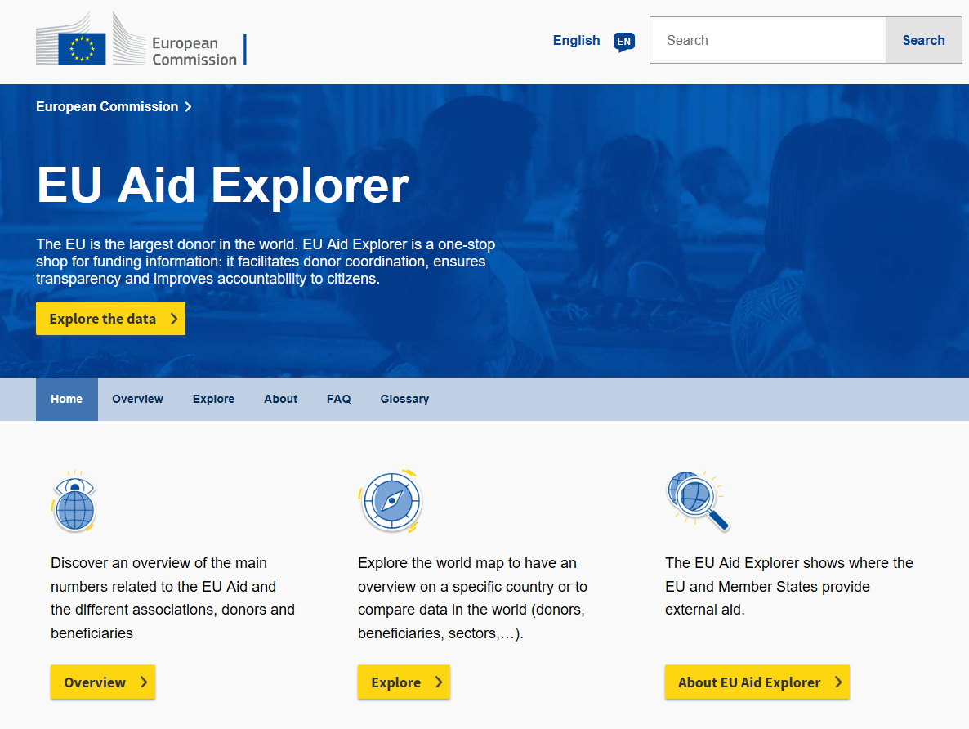
Session 4
Notes:
DEVCO

Slide 17
EU Aid Explorer : the added-value
Aid transparency
One-shop stop to access data supporting the work of governments, researchers, CSOs and the public
Important for internal work
  Geographic and thematic desk officers
  Heads of Delegation and Cooperation to analyse aid activities in their countries and lead the coordination
  Programming purposes, as a rich source of development financing
  To track progress via reporting on targeted SDGs and results
Covers EU and MS
Session 4
Notes:
DEVCO
Importance of aid transparency
One-stop shop for development and humanitarian data
Rich and accurate aid data support work of governments, researchers, CSOs and the public in general
Important for internal work
For example, for intra-EU:
- Geographic and thematic desk officers;
- Heads of Delegation and Cooperation to analyse aid activities in their countries and lead the coordination;
- Programming purposes, as a rich source of development financing;
- To track progress via reporting on targeted SDGs and results
Covers EU and Member States
Uses both OECD DAC data (looking at past data) and IATI (looking both current and past data)
.

Slide 18
Training: “Joint Programming: Better Impact through Working Together”
In Brussels, on 12 April 2019
Open to Commission and Member States staff.
Topics to be discussed:
  The added value of working in a joined-up manner at country level
  How Joint Programming processes can be taken forward
  What is possible within the main building blocks of Joint Programming
  How Joint Programming delivers on the 2030 Agenda and SDGs
Session 4
Notes:
DEVCO
Open to HQ to colleagues from the "Relex family" (ECHO, TRADE, FPI, ECFIN, EEAS and IPA staff working in HQ) and for Member States staff.
Objectives
The added value of working in a joined-up manner at country level;
How Joint Programming processes can be taken forward drawing on key building blocks, each of which can deliver added value to programming, implementation and policy dialogue in partner countries;
What is possible within the main building blocks of Joint Programming (joint analysis, joint response, joint results frameworks) and have an overview of current good practice including joint policy dialogue, joint implementation and joint visibility initiatives.
How Joint Programming delivers on the 2030 Agenda and SDGs by working better together.

