Slide 1
From island creoles to global creoles
Penda choppy (University of Seychelles)
upf lecture, umeÅ, May 2018

Slide 2
the frog under the coconut shell
Growing up in Seychelles, the word ‘creole’ has come to represent everything that describes my identity:
Language (from patois to first language)
Music (appropriations and transformations)
Food (fusion of 3 continents)
Culture (melting pot)
Creole people (metissage – physiognomy and cultural practices)
National identity… (multicultural origins – one nation)
This definition was extended to other island nations in the Indian Ocean and Caribbean (or American mainland) which shared the same historical and socio-cultural patterns as the Seychellois. The medium of expression for this creole solidarity was the Seychelles Creole Festival, through which Victoria, the capital, has come to be known as ‘the capital of the creole world’.

Slide 3
about seychelles
Seychelles, island republic in the western Indian Ocean, comprising about 115 islands, with lush tropical vegetation, beautiful beaches, and a wide variety of marine life. Situated between latitudes 4° and 11° S and longitudes 46° and 56° E, the major islands of Seychelles are located about 1,000 miles (1,600 km) east of Kenya and about 700 miles (1,100 km) northeast of Madagascar. The capital, Victoria, is situated on the island of Mahé. Population, about 90,000.

Slide 4
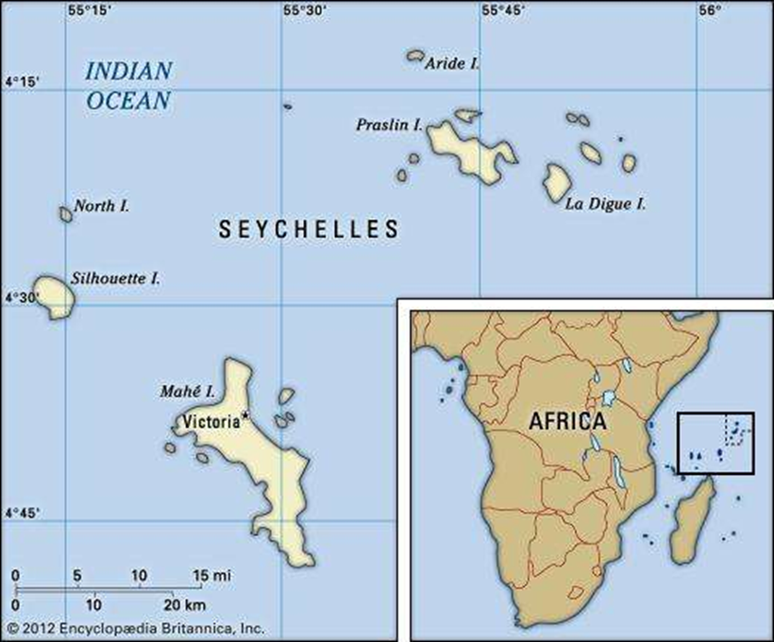

Slide 5
Brief history
1741 - the Governor of Mauritius (then called Île de France) sent Lazare Picault to explore the islands.
1756 – French claimed possession
1770 – arrival of first settlers
1814 – ceded to Britain under Treaty of Paris
1903 – ceased being administered by Mauritius – became Crown Colony
1861 to 1874 – dumping of liberated slaves by British soldiers
19th century – Chinese and Indian settlements
1976 – Independence (1st Republic)
1977 – Coup d'état (2nd Republic)
1993 – Multiparty Democracy (3rd Republic)

Slide 6
the 17th century slave trade as the progenitor of new world creolization.
Creoles from the Indian Ocean and the Caribbean have for a long time been described in literature as culturally hybrid populations, as a result of 17th century colonialism and slavery.
Root of ‘creole’ → Latin ‘creare’ (to create) (Cashmore 2004: 94).
Robin Cohen qualifies this as ‘to create anew’, in the ‘New World’ (2007). E.g. Spanish term criollo, which described the children of Spanish colonizers born in the New World.
The French transformed the word to ‘créole’ and, Jolivet(1982, 1993) argued that it become synonymous with any white person born in the colonies.
However, the racially exclusive definition, which confined the term to whites, had been challenged as early as 1722 when in a 4-volume travelogue by a French missionary, Father Labat, a distinction was drawn between ‘Créole slaves’ and ‘traded slaves’ (Jolivet 1982).

Slide 7
the 17th century slave trade as the progenitor of new world creolization: The case of Seychelles
If any Creole society is a melting pot of races, none could be more so than the Seychellois nation where créolité means a total mixture of races: a society where slave descendants have mixed with the white plantation families or with the Indian and Chinese merchant class.
For example, regarding interbreeding between whites and blacks, expressly forbidden by the Code Noir’s Article 5, Pierre Hangard set an early example by marrying a Malagasy woman, producing the first legitimate coloured children (Deryck Scarr, 2000).
Scarr establishes the fact that since 1766, Paris had decreed that ‘all blacks were slaves, and their progeny indelibly tainted and barred from entering the ruling white class.’ Since this applied to all French colonies, ‘proponents of the view that Seychelles uniquely differed would have had to explain how the white people of the Mascareigne Islands came to identify themselves as ‘Seychellois’ and call blacks ‘Creoles’ […].

Slide 8
who is creole? sharing an identity with the whole world
The continued evolution of new cultural forms in ‘New World’ creole societies has established a definite creole "genre" in popular culture that has come to be recognized as a brand, worldwide. For example, creole food, creole music, creole styles are recognizable brands associated with creole societies like Louisiana, the Seychelles, Reunion, Martinique, etc.
However, more and more, creoles who have no other identity than this one, have come to realize that they must share this identity with practically the whole world, since as a result of globalization and the recent acceleration of migration, the metropoles of the world are becoming centres of creolization in the sense of mixing, hybridity etc.
Robin Cohen, for example, sees creolization as the selection of particular elements by communities or individuals, from incoming or inherited cultures, and the endowment of new meanings to these elements that are different from those they possessed in the original cultures, and then creatively merging these to create new varieties that supersede the prior forms (Cohen, 2007).

Slide 9
the location of creolization
With the advent of immigration from the Global South, Is Cohen’s description what is happening in Europe?
Or should the term creolization be reserved for a particular historical and sociocultural situation resulting from plantation slavery?
In other words, is creolization a global or localized phenomenon?

Slide 10
creole manifesto: we are what we create
In Bernabé, Chamoiseau and Confiant’s discussion of identity in In Praise of Creoleness, they proclaim a double sense of identity as Caribbean Creoles in that they affiliate themselves with other Caribbean peoples, from a geopolitical standpoint, and with other Creole peoples in the Indian Ocean, for example, from an anthropological standpoint.
Neither Europeans, nor Africans, nor Asians, we proclaim ourselves Creoles. This will be for us an interior attitude-better, a vigilance, or even better, a sort of mental envelope in the middle of which our world will be built in full consciousness of the outer world.
‘Creoleness is the interactional or transactional aggregate of Caribbean, European, African, Asian, and Levantine cultural elements, united on the same soil by the yoke of history’.

Slide 11
creole manifesto: we are what we create
There can be no real opening to the world without a prerequisite and absolute apprehension of what we are.
Once our interior vision is applied, once our Creoleness is placed at the center of our creativity, we will be able to re-examine our existence, to perceive in it the mechanisms of alienation, and, above all, to grasp its beauty.
The Creole literature we are elaborating takes it as a principle that there is nothing petty, poor, useless, vulgar, or unworthy of a literary project in our world. We are part and parcel of our world. We want, thanks to Creoleness, to name each thing in it, and to declare it beautiful. To perceive the human grandeur of the djobeurs.T o grasp the depth of life in Morne Pichevin. To understand the vegetable markets. To elucidate the functioning of the tale tellers. To accept again without any judgment our "dorlis," our "zombis," our "chouval-twa-pat,"soukliyan."To adopt the language of our towns, of our cities.

Slide 12
creole manifesto: we are what we create
Our history is a braid of histories. We had a taste of all kinds of languages, all kinds of idioms. Afraid of this uncomfortable muddle, we tried in vain to anchor it in mythical shores (exterior vision, Africa, Europe, and still today, India or America), to find shelter in the closed normality of millennial cultures, ignoring that we were the anticipation of the relations of cultures, of the future world whose signs are already showing.
In multiracial societies, such as ours, it seems urgent to quit using the traditional raciological distinctions and to start again designating the people of our countries, regardless of their complexion, by the only suitable word: Creole…
Let it take part of the emergence, here and there, of verticalities which would maintain their Creole identity and elucidate it at the same time, opening thus for us the routes of the world and of freedom.
Creoleness is an annihilation of false universality, of monolingualism, and of purity.
Glissant (in Stoddard and Cornwall: 1999: 349) asked whether we should favour ‘An identity that would not be the projection of a unique and sectarian root, but of what we call a rhizome, a root with a multiplicity of extensions in all direction? Not killing what is around it, as a unique root would, but establishing communication and relation?

Slide 13
hannerz & world assimilation
It is not only anthropologists who talk about "flows" these days. Rather, the term has become transdisciplinary, a way of referring to things not staying in their places, to mobility and expansion of many kinds, to globalization along many dimensions ( Flows, Boundaries & Hybrids… 1997).
Ralph Linton´s (1936: 326-327) classic, ”100 % American” : A "solid American citizen" goes through his morning routines, and as Linton follows him around, it turns out that hardly an object he uses is actually of American origin as a cultural invention; it is from India, Germany, China, the near East, and so forth. Yet as he considers the accounts of foreign troubles in his morning newspaper, the man thanks "a Hebrew deity in an Indo-European language that he is 100 percent American."

Slide 14
Creolization and Cultural Globalization: The Soft
Sounds of Fugitive Power
ROBIN COHEN (2007)
By accepting the idea and reality that cultural boundaries are fuzzy and indeterminate and embracing the notion of ‘travelling cultures’, hybridization and creolization have become potential subversive concepts.
They are subversive of race and ethnicity because they point to the existence and growing numbers of people of mixed heritage.
They are subversive of territorial and language-based notions of nationalism.
They are subversive, thirdly, of religious fundamentalisms as they stress the syncretic nature of belief systems rather than their supposedly divine origins. Even as religious leaders stress purity, consistency and adherence to strict doctrine, hybridized and creolized practices present anomalies in social behaviour and belief systems.

Slide 15
maintaining authenticity: fear of the invading hordes
The concepts of ‘nation’ and ‘culture’ means that communities and governments are very much preoccupied today, with identifying and maintaining cultural authenticity. In this sense, the globalization phenomenon is often considered a threat because it is seen as homogenizing and standardizing cultures, thus depriving nations of authentic uniqueness.
Globalists often caution against this turning into radicalism:
As the culture concept becomes increasingly popular in wider circles, there is again a strong tendency to focus attention on culture only as a group marker. In "identity politics", in debates over multiculturalism, in many contexts of "cultural studies", it becomes primarily a basis of group formation and mobilization, usually involving ascriptive memberships. Or, on the other hand, it turns into a tool of social exclusion, on the part of dominant majorities. There may be a preoccupation with cultural autonomy and the defense of a cultural heritage for its own sake, yet frequently this rhetoric of culture is closely linked to power and material resources as well. (Hannerz, 1997)
On an economic plane, one can argue on the other hand, that globalization is in fact increasing diversity of culture through improved consumer access to markets (e.g. tourism, art & décor, food…).

Slide 16
maintaining authenticity: fear of the invading hordes the case of the Seychelles
The clash of the modern and the traditional (music, food, dance…)
Language shift: keeping SC authentic
Tourism and cultural impact (e.g. hotel/agency decors, hospitality rituals [leis], intr. carnival…)
Religion: An authentic Seychellois follows the Roman Catholic calendar? (expressions of wariness re the observation of Kavadi and Friday Mosque)
Fear of ‘the Indians taking over like in Mauritius – the ‘Malbar Syndrome’ (Indians have a tendency to maintain their own communities instead of merging with the local population in the Seychellois melting pot tradition)

Slide 17
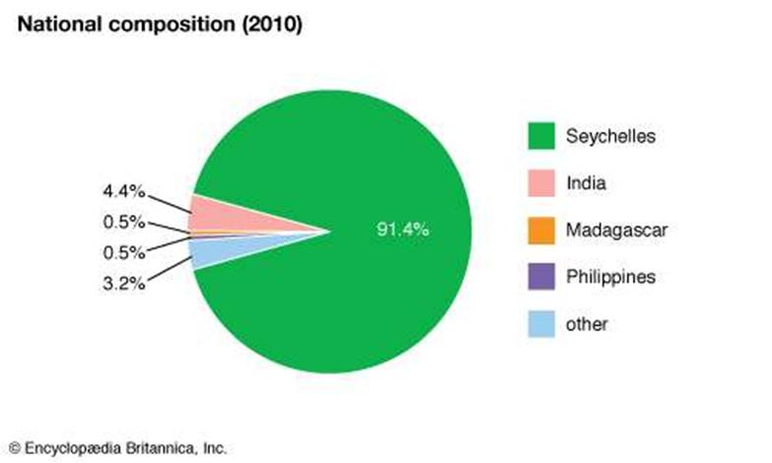

Slide 18
new definitions of creoleness
To be a Creole is no longer a mimetic, derivative stance. Rather it describes a position interposed between two or more cultures, selectively appropriating some elements, rejecting others, and creating new possibilities that transgress and supersede parent cultures, which themselves are increasingly recognised as fluid. If this is indeed happening we need to recast much traditional social theory concerning race and ethnic relations, multiculturalism, nation-state formation and the like – for we can no longer assume the stability and continuing force of the ethnic segments that supposedly make up nation-states. (Cohen, 2007)

Slide 19
the inevitability of globalization and creolization
Gobalization started with travel and voyages of discovery (e.g. Marco Polo’s travels across Europe and the Asian continent – spice trade). The European voyages of discovery which led to the Triangular Trade and the creation of the New World, unleashed a historical wave of creolization through globalization which then ricocheted back to the Old World in the mass migration of creoles from the colonies. (‘If you bring ant-infested faggots to your yard, you can expect the visit of lizards.’ (Achebe)
The current wave of migrations across Europe, though man-made, might be described as ‘force majeure’. This is leading to what Cohen describes as ‘mobile, transnational groups, themselves undergoing ‘everyday cosmopolitanism’, while dominant, formerly monochromatic, cultures are becoming criss-crossed and sometimes deeply subverted by hybridisation and creolization.
Cohen also says that accepting the force of hybridity and creolization is also to accept that humankind is refashioning the basic building blocks of organised cultures and societies in a fundamental and wide-ranging way.

Slide 20
conclusion: salman rushdie’s ‘bit of this and that’
As Rushdie (1991: 394) himself says of The Satanic Verses:
  Those who oppose the novel most vociferously today are of the opinion that intermingling with different cultures will inevitably weaken and ruin their own. I am of the opposite opinion. The Satanic Verses celebrate hybridity, impurity, intermingling, the transformation that comes of new and unexpected combinations of human beings, cultures, ideas, politics, movies, songs. It rejoices in mongrelization and fears the absolutism of the Pure. Mélange, hotchpotch, a bit of this and a bit of that is how newness enters the world. It is the great possibility that mass migration gives the world, and I have tried to embrace it. (Cohen, 2007)
  In Hannerz’s theory of social organization and cultural process, the world keeps on turning. Cultural diversity will not be absorbed in a single and uniform global order. Creolization is a never-ending process, and cultural innovation is inevitable. (Cohen, 2007)

