Slide 1
Using ICTs in Evaluations in Fragility, Conflict and Violence with a focus on mobile phone/tablets
Hur Hassnain
Evaluator
Board Member at IDEAS
Twitter: @hurhassnain

Slide 2
Agenda
Evaluation using Mobiles / Tablets in FCVs
What is the FCV context?
Challenges of evaluation in FCV contexts
Why ICTs in FCV contexts
Using mobile / tablets for data collection
Collecting feedback
Closing the evaluation learning loop
10 key take aways
IDEAS and EvalFCV TIG

Slide 3
What is fragility?
OECD defines fragility as the combination of exposure to risk and insufficient coping capacity of the state, system and/or communities to manage, absorb or mitigate those risks. Fragility can lead to negative outcomes including violence, the breakdown of institutions, displacement, humanitarian crises or other emergencies (States of Fragility report, 2016:22).
G7+ defines “[A] state of fragility can be understood as a period of time during nationhood when sustainable socio-economic development requires greater emphasis on complementary peacebuilding and State-building activities such as building inclusive political settlements, security, justice, jobs, good management of resources, and accountable and fair service delivery”.

Slide 4
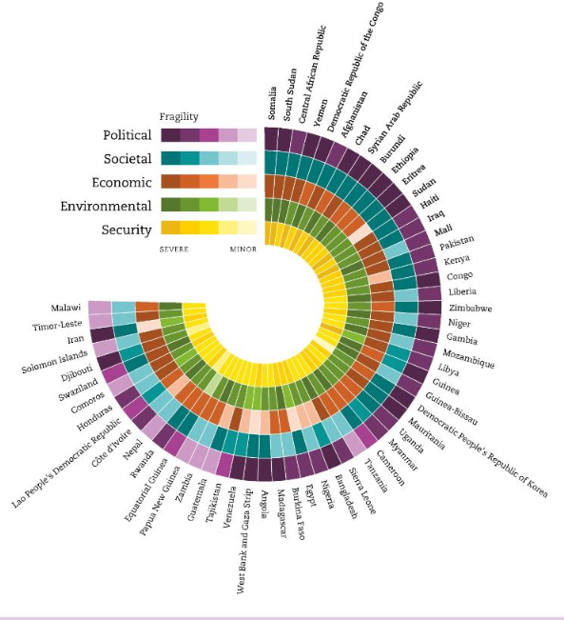
OECD FRAGILITY FRAMEWORK 2018

Slide 5
What is the context we are talking about

Slide 6
What is the context we are talking about:
The Cynefin framework
Complex
Knowable
Setting up health services – assess, plan, implement, review, re-plan.
Building hospitals – follow the blueprint.
Chaotic
Known
.. in complex emergencies – just try something sensible, if it works, do more of it.
Treating diseases – use the right dose.
Source: Dave Snowden - www.cognitive-edge.com/library/more/video/introduction-to-the-cynefin-framework/

Slide 7
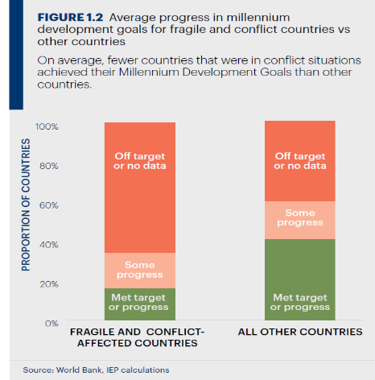
Link between FCV and Development
“Without peace there is no development, and without development there is no peace”
Jan Eliasson,
UN Deputy Secretary General
2012–2016

Slide 8
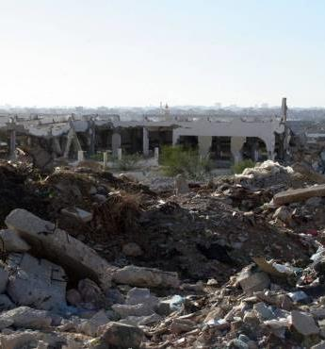
Challenges of Evaluation in FCV Contexts
Defining How Change Happens
Weak theoretical foundations – evidence base
Risk of violence
Transitional nature/fluidity
Measuring fragility
What standard/criteria to use
Limitations of face-to-face-meetings/FGDs in FCVs
Trust: No one is neutral
How to adapt to the changing context
Understanding and distinguishing between the nuances of fragile situations: crises, fragility and conflict
Learning - What works today may not work tomorrow – also culture of sharing learning?

Slide 9
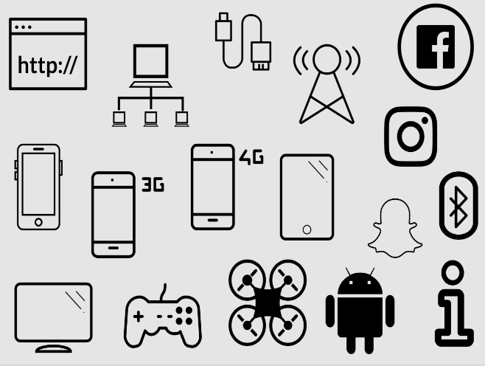
So What now – How can ICT help?
Prevent from face to face meetings in a violent conflict
Rapid and real time monitoring
Triangulation (sound, pic, videos, data points)
Tracking progress more systematically (aggregation, sharing)
Cost saving
Replacing papers
Eliminates manual data entry
Capacity and collaboration
Interest in new ways of doing things
Though ICTs bring huge potential, they also carry new risks.

Slide 10
Notes:
2014

Slide 11
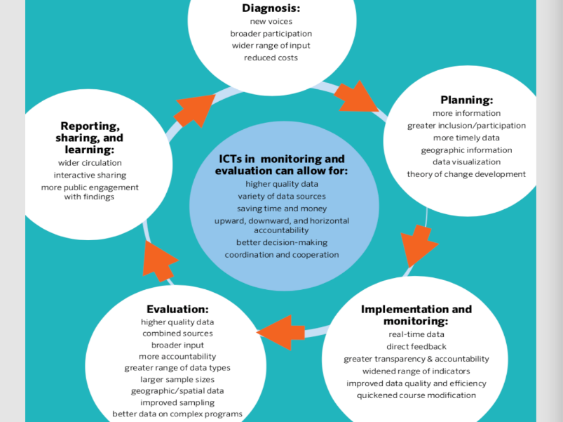

Slide 12
Key Learning
Growing use, sparse evidence
Emerging areas need exploring
New challenges arising
M&E basics vs. shiny tools
Really need to consider risks

Slide 13
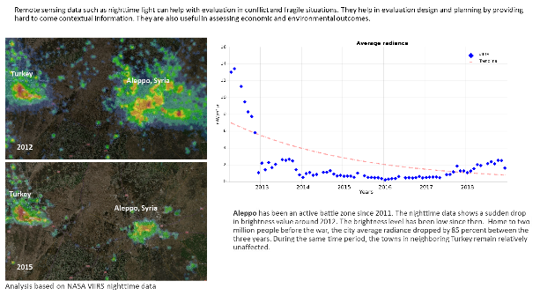
Take context and technology as the starting point
Take context as the starting point
Understand the conflict - What triggers violence
Un/friendly government
Gender and conflict and technology
Invest time in creating a trusting environment before & during data collection to avoid problems or biased answers.
Eliminate risk to staff and locals
Invest time in training of enumerators
Plan and budget for back-ups
Digital risks and privacy concerns
Password protected
Select software that offers digital privacy features
GPS enabled/disabled, Offline mode
Automatic data saving
Only collect personal data / GPS if it is needed
Nature of the project
Literacy, languague and movements
Coordination with other agencies
Prepared by Anupam Anand

Slide 14
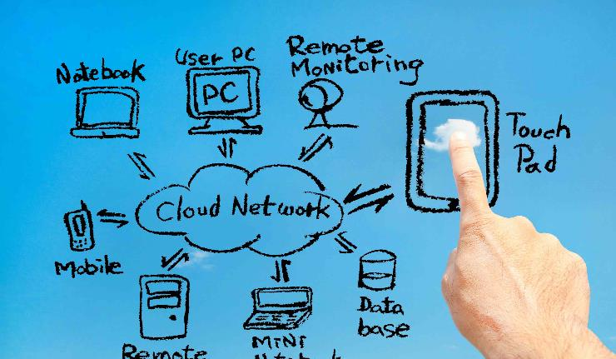
Mobile / Tablets in FCV Contexts
How can they be used:
Digital data collection – risks?
Location tracking
Mobile phone based feedback mechanisms – risks?
Broadcasting
Social media
Closing the learning loop

Slide 15
Digital data collection using mobile/tablets
Pros
The increasing access and use of Mobile phones
Tablets almost look like papers
Time and resource saving for data entry
Limited human errors
Enumerators or self-reporting
Cons
Can be off-putting to survey takers
Can raise alarm bells in FCV contexts
Cost
BYOD can cause privacy risks
Can hasten shift to quantitative

Slide 17
ASSUMPTIVE SURVEYS

Slide 18
what’s your
STORY?

Slide 19
Bipole
The situation in my story happens
Rarely
Daily

Slide 20
Tripole
Leadership style at our organisation is:
Authoritarian
Democratic
Tripole
Laissez-faire

Slide 21
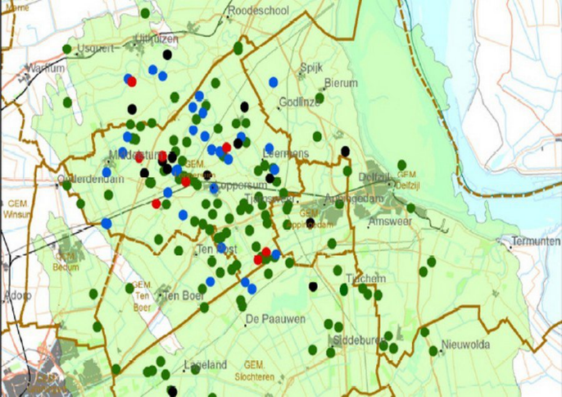
Picture Pointer
Where did your story occur?

Slide 22
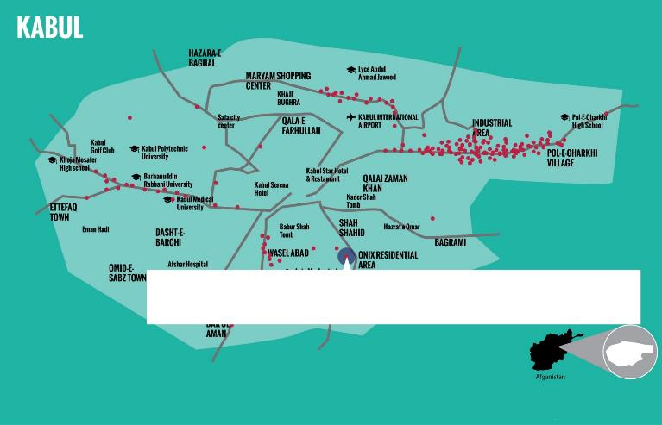
Which area did you avoid in the event of the story:

Slide 23
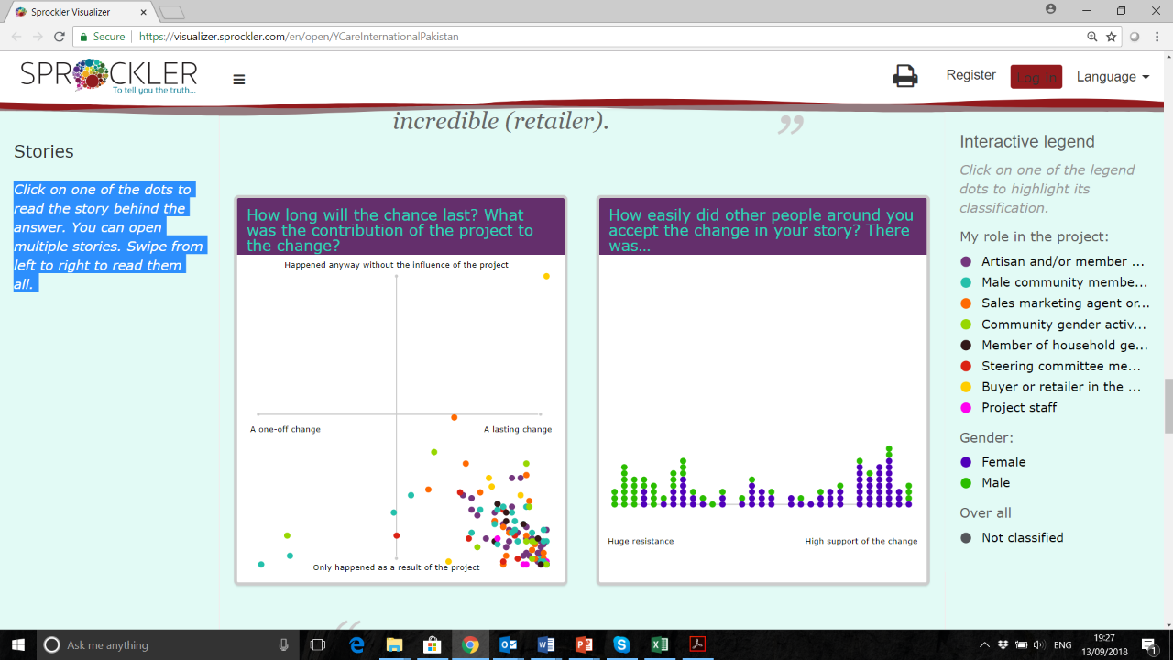
Sprockler
https://visualizer.sprockler.com/en/open/YCareInternationalPakistan
Click HERE

Slide 24
Children’s perceived level of safety in their household, schools and in communities

Slide 25
How children advocated for change

Slide 26
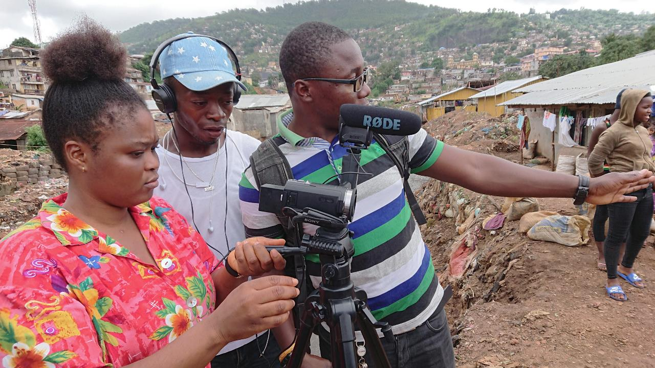
Participatory Video Most Significant Change in Sierra Leone

Slide 27
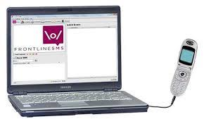
Feedback and Complaints Mechanism ICTs for adaptive learning
Pros:
Reach out for regular feedback
No need to visit
Closing the loop
Cons:
Phone access/coverage
Vs. face to face
Trust?
Elite capture/Exclusion of most vulnerable

Slide 28
Text based Feedback Mechanism
Challenging the gender based harmful norms and practices
Giving the power back to the people
“We feel the ownership of the project by directly monitoring it regularly and reporting if we found the skill center is opened late.” Shared by Steering Committee President, “the response is also quite spontaneous.”
“I am illiterate and felt confused when project team gave me cell phone to report for orders received and market visits. I never had a phone before.” Saleemat, the Sales and Marketing Agent shared, “but it was very easy method they trained me.”

Slide 29
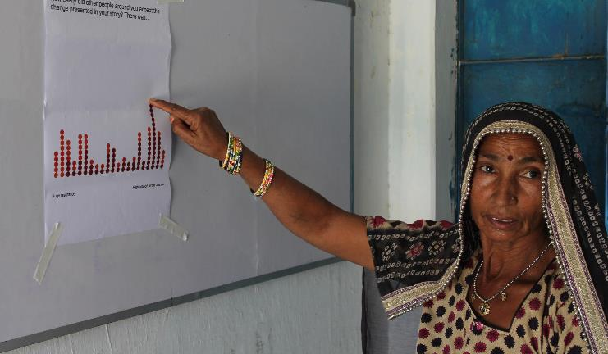
How to close the evaluation learning loop and learn from it?
‘This validation workshop was special, since it was the first time after a survey that the evaluation team shared the results with us’.
Online interactive Sprockler Report
Evaluation Report
Video
Blogposts– Stitching-up Poverty
Podcasts

Slide 30
10 Key Take Aways
Safety and Security - Though ICTs bring huge potential, they also carry a number of new risks.
Conduct a risk assessment and think about unintended consequences. Are we creating risk for anyone? Is the potential benefit worth it?
Awareness - Include community and data subjects in the process so people know why data is being gathered using technology.
Privacy – Study the privacy policies of the service providers, government data collection and storage regulations. While speaking to respondents always take consents.
Invest in building acceptance - Invest time in creating a trusting environment before & during data collection to avoid problems or biased answers.
Training - Train the enumerators on how to engage with the platform, deal with the language issues and seek assistance when required.
Also, training on conflict and gender sensitivity and make sure they understand the purpose of the data collection.
Triangulate - To avoid selection and other bias from using ICTs, use participatory and mixed methods
Analysis - Get feedback from enumerators and partners after the data collection and involve them in the analysis of the data.
Validation - Wherever possible get back to the respondents and try to make sense of the data with them.
Identify innovative ways of validating and disseminating the information
Coordinate and collaborate with others - Where possible use data from other sources (e.g., National Statistical Offices, other agencies, donors, academia, the UN)
Logistics – Beware of additional infrastructure and logistical support
Backup plan – What to do if ICT doesn’t function

Slide 31
IDEAS
Global Development Evaluation Association – membership based
Bi-annual Evaluation Conferences
Publications
Partnering in evaluation – (SDG 17)
National, regional and global
Professionalisation
We need to agree as a profession on competencies, ethics, skills and norms and standards if we are to contribute consistently and credibly for evaluating SDGs.
International Evaluation Academy
Thematic Interest Groups (TIGs)
EvalFCV

Slide 32
Evaluation for Transformative Change: Bringing experiences of the Global South to the Global North
IDEAS Global Assembly, Prague, Czech Republic
30 September-4 October 2019
Six work streams are currently being prepared.
Evaluation for Transformative Change, with involvement of the International Fund for Agricultural Development (IFAD), the Global Environment Facility (GEF), the Climate Investment Funds (CIF), the Green Climate Fund (GCF) and the SDG Transformations Forum, coordinated by the ITIG Climate Change, building on the various research and evaluation initiatives that have been engaged with the topic in support of the call to action in the 2030 Agenda.
Evaluating environment and development, presented as the Third International Conference on Evaluating Environment and Development and promoted by the The Independent Evaluation Office (IEO) of the Global Environment Facility (GEF) and Earth-Eval.
Transition Experiences and best practices in the use of evaluation for systemic changes, coordinated by The Czech Evaluation Society.
Evaluation in contexts of Fragility, Conflict and Violence, with involvement of EvalPartners and a range of Voluntary Organisation for Professional Evaluation (VOPE) partners such as PEA and CES, under the coordination of the EvalFCV ITIG.
Evaluation on Gender and Equity, coordinated by the Gender and Equity Focused Evaluation ITIG, in partnership with EvalGender, EvalPartners and other groups.
Professionalisation, combining various partners and initiatives regarding evaluation criteria, an International Evaluation Academy, skills and competencies, approaches, methods and tools and a revision of the IDEAS Code of Ethics.

Slide 33
Thanks Please feel free to write to: hurhassnain@hotmail.com Twitter: @hurhassnain

