Slide 1
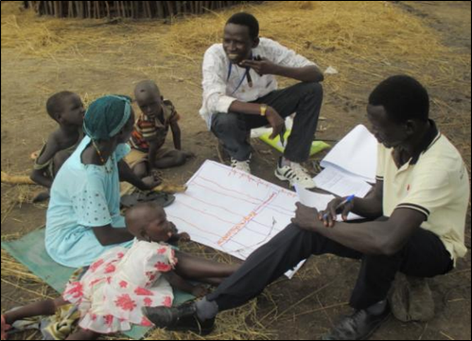
Evaluation methods for consulting affected populations in ‘hard to reach’ areas: learning by doing
Margie Buchanan-Smith

Slide 2
Outline
Role of an evaluability assessment
Common challenges in consulting the affected population in ‘hard-to-reach’ areas
3 case study examples: consulting the affected population to evaluate impact in Somalia, South Sudan & Sudan (Darfur), using qualitative methods & PRA
An overview of methods to consult the affected population in hard-to-reach areas
Learning by doing:
  the advantages of qualitative methods
  planning and preparation
  implementation

Slide 3
Role of an evaluability assessment – when constrained access is foreseen
What is an evaluability assessment?
a descriptive and analytic process to produce a reasoned basis for proceeding with an evaluation or not
opportunity to assess the feasibility of consulting with the affected population
  if the answer is yes to an evaluation, to ensure steps/ actions are taken to facilitate a credible evaluation process; to inform the TOR
  if the answer is ‘no’ what other options can be considered eg a reflective learning workshop with staff, peer learning across agencies, or more limited evaluative activity
  eg MSF in Syria: challenge to obtain primary data on outcomes and consult with the affected population -> recommendation to focus on process and activity rather than results, and rely on secondary data
Notes:
MSF example **

Slide 4
Evaluability assessment: key questions to ask
Assessing the feasibility of consulting the affected population.
Key questions:
What are the main risks that the evaluation faces eg operational risks, financial risks, protection risks?
What are the implications of these risks for the evaluators having access to affected populations?
What secondary and other data are available to the evaluators if they cannot gain access to the affected population?
What other options are available to the evaluators to gain access to the affected population?
How will this affect the credibility of the evaluation?

Slide 5
Different methods of consultation
Section13.3
Method | Pros | Cons
Focus groups & group interviews | Good for consulting a particular group Good for open-ended discussion | Controlling the size & composition of the group Requires skilled facilitation
Community meetings | Uses existing structures Can involve large numbers | May be dominated by certain individuals or groups Disaggregation of responses difficult
Individual & household interviews | Easier to ask sensitive issues Can be more in-depth Can be illustrative | More time-consuming Cannot make generalisations from a small sample
Semi-structured key informant interviews | May provide a good overview, & insights that can be followed up in group or individual interviews | Need to be aware of ‘gate-keepers’, and potential bias of key informants
Formal surveys | Provide comparable data-sets & may be easier to generalise Quantitative data convincing to decision-makers | Time-consuming & expensive if resources are limited May not be feasible in conflict environments
Notes:
Table 4 of Guide on p.46

Slide 6
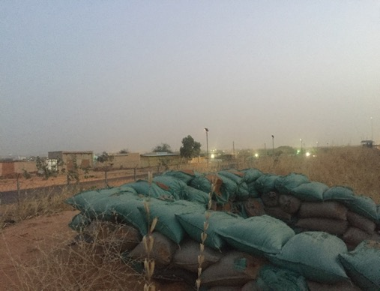
Common challenges in consulting the affected population in ‘hard to reach’ areas
Insecurity and therefore lack of access
But also:
Lack of baseline data, so high dependence
on recall
Suspicion: gaining trust of the affected population
Protection issues associated with data collection

Slide 7
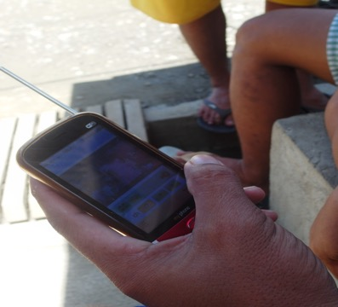
Example 1: Evaluation of FAO programme, Somalia
Methods used to deal with constrained access
Interviewing local key informants in a safe environment (NB inevitable bias)
Phone interviews (again, beware of bias)
Fieldwork in a ‘semi-accessible’ location,
using a range of qualitative methods, including PRA

Slide 8
Examples of PRA methods
Section14.4
Technique | Description | Potential use
Calendar | Diagram that shows changes over time | Seasonal calendar could show periods of greatest food insecurity
Timeline | Timeline of events | 2 timelines: of the crisis, and of humanitarian assistance
Proportional Piling | 100 beans or stones, divided up proportionately | Relative significance of sources of livelihood
Ranking | Ranking of different items | To compare how a group valued different types of humanitarian assistance
Transect walk | Walk through a village with key informants/ small group and ask about what is observed | Differential impact of a natural disater on different areas/ groups of people
Venn diagrams | Circles representing different categories | To show institutions and their relative significance in response

Slide 9
Somalia evaluation: 4 weeks fieldwork on impact of Cash-For-Work
1 international team leader and 4 local researchers: team leader had no access to villages but local researchers did
Investment in training (4 days)
Qualitative participatory methods, using PRA
Snowball technique: information collected iteratively over 1 month period
Flexibility and adaptation were key
Triangulation: photographic and audio recordings, phone surveys etc
3 PRA tools: social and resource mapping, well-being and targeting analysis, income expenditure and coping matrix
Also semi-structured interviews and ranking

Slide 10
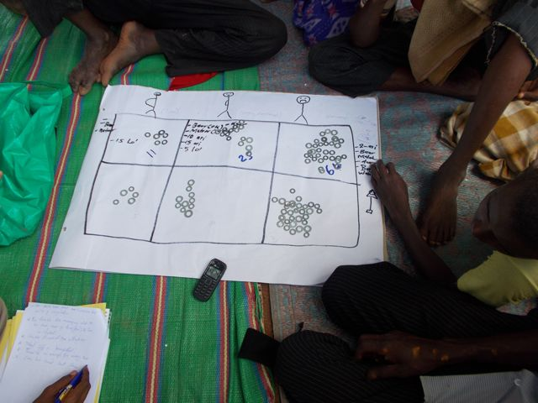

Slide 11
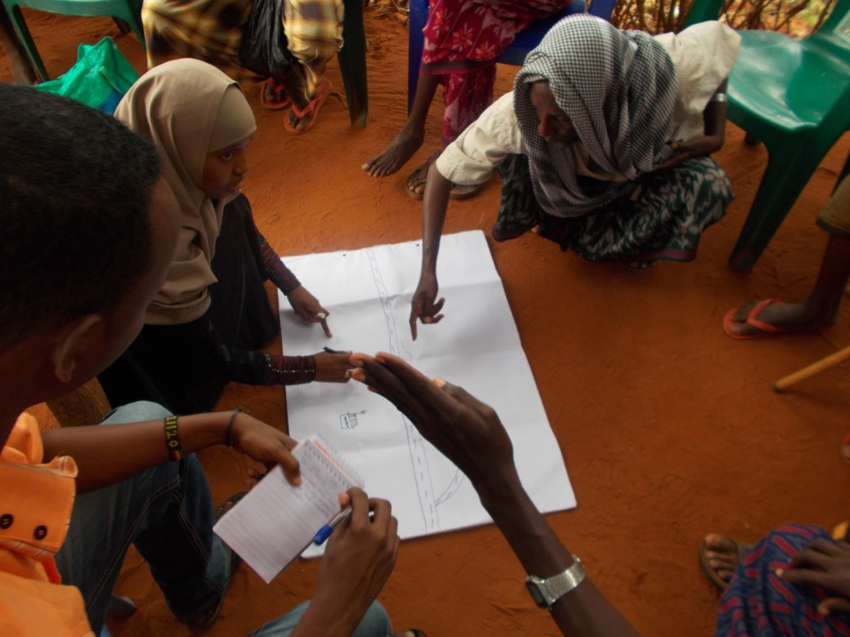

Slide 12
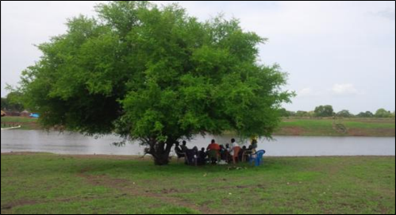
Example 2: South Sudan Participatory Impact Assessment of FAO’s distribution of emergency livelihood kits in South Sudan
Carried out in advance, by the evaluation department: 3 sub-teams and a number of enumerators over 2 to 3 months
Recruitment of team: with relevant experience; to ensure access; gender balance
Investment in training (10 days): Face to face ‘classic’ training on PRA:
review & refinement of the methodology through testing in training
Purposive sampling: government and opposition-controlled areas;
different agro-ecological zones; areas in different IPC classifications

Slide 13
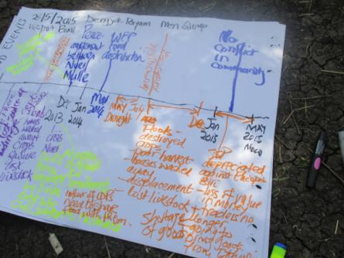
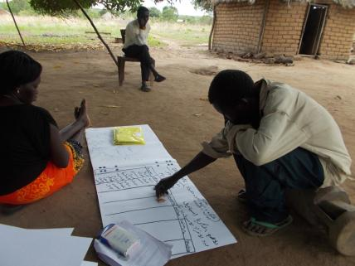
Example 2: South Sudan contd.
Qualitative participatory methods, using PRA:
  Maps to quickly understand the development context and the issues;
  Timeline to reconstruct a baseline and change over time;
  Venn Diagrams to explore the relationships, actors and dynamics;
  Household economy matrix to understand the incomes, expenditures and
  coping strategies of households;
Use:
  as a basis for the 2016 planning of FAO response activities
  (with corrective action)
  as the principal source of data at the results level for the main evaluation

Slide 14
Example 3: Darfur assessment of impact of food aid on livelihoods
Lack of baseline data: so dependent on recall
Recruitment of team: hand-picked; with relevant experience and high skill levels; from the region
Purposive sampling: different livelihood zones;
ethnic groups; experience of conflict;
urban & rural
Qualitative methods: key informant interviews,
group interviews, PRA

Slide 15
Example 3: Darfur contd.
PRA methods:
  Timelines: to capture history of conflict in particular communities and timing of humanitarian assistance
  Proportional piling eg sources of livelihood and how they
  have changed
Importance of triangulation: between focus groups,
between key informants
Ethical considerations: protection; right not to
participate

Slide 16
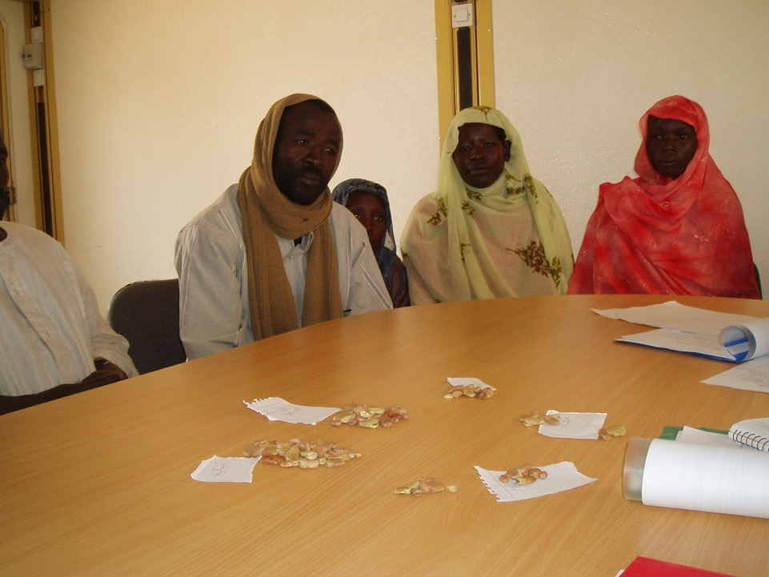

Slide 17
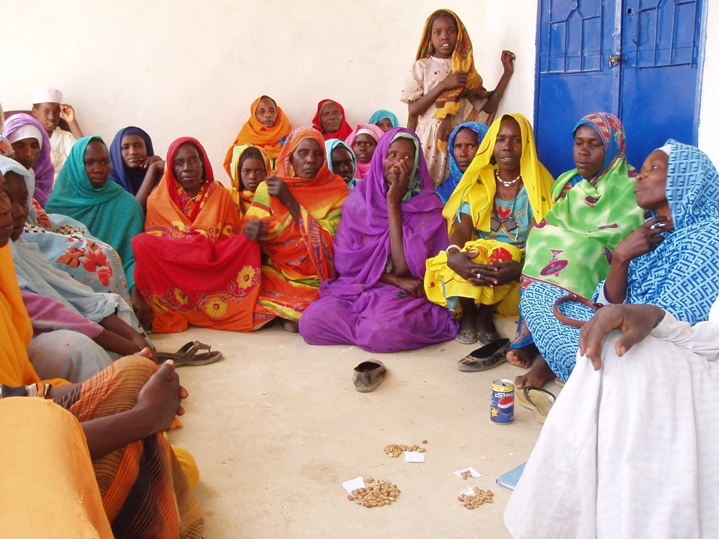

Slide 18
Examples of data collected and analysed using PRA(proportional piling) in group interviews

Slide 19
An overview of ways of consulting the affected population in hard-to-reach areas
Ways of overcoming constrained access | How to use the method | Potential pitfalls
Use local evaluators to carry out interviews | Plan for training and analysis workshops eg Darfur, South Sudan Could record interviews eg Somalia | Is it safe for local evaluators? Can they be objective?
Carry out surveys online, by phone or SMS | Useful for straightforward questions eg when assistance was received. Hotlines | Beware of bias eg self-selection bias, mobile phone ownership bias
Interview affected people in accessible locations | Find out if/ request affected people to come to more accessible locations eg market towns eg Somalia case | Beware of bias eg if only men can travel safely eg Somalia
Remote observation | Satellite imagery to check infrastructure Affected people take photos/ videos | Tells you about physical landscape but little about how it is being used
Crowd-sourced data eg Twitter, Facebook | To look at usage of particular facilities | Beware of bias eg young people more likely to use social media
Other?
Section 15.3

Slide 20
Advantages of qualitative methods
In hard-to-reach areas, because:
  Insecurity and restricted access mean you must be flexible and creative
  Statistical sampling is not feasible
  Time and other resources are limited
But also, where:
  You are exploring cause and effect
  There is no baseline data and you need to rely on recall
  You want flexibility and openness in pursuing ideas, issues, opinions
  You need in-depth insights into the ‘intangibles’ eg behaviour/ attitude change, decision-making etc
NB: Qualitative methods are not a ‘cop-out’:
    Usually require less people but higher skill levels
    Require rigour in design, implementation, triangulation and analysis
    Must be well-described in the final report

Slide 21
Consulting affected people in ‘hard-to reach areas’: learning by doing
Take time to plan and prepare:
  If necessary, to carry out an evaluability assessment
  To determine the requirements of team members
  To recruit national staff with appropriate skills
  To design the approach and methods
  To consider ethical issues eg protection
Have a team totally dedicated to consulting the affected population
Purposive sampling frame is key, based on deep local knowledge
Invest in training: often also an opportunity to pilot the methods

Slide 22
Learning by doing contd.
Build in an iterative process of analysis, and ensure teams are regularly feeding back to each other and to the coordinator during fieldwork
May require longer period in the field than in most evaluations – don’t rush
Flexibility essential: unpredictable and fluid context
In evaluation report:
  be clear about limitations and constraints and how this has affected the evaluation findings
  beware of generalisations to groups and areas not visited
  if the evaluation cannot be conclusive in its findings, consider presenting hypotheses based on uncertain findings, and ask the evaluation team to identify areas for further investigation
BE CREATIVE, and RIGOROUS!

