Slide 1
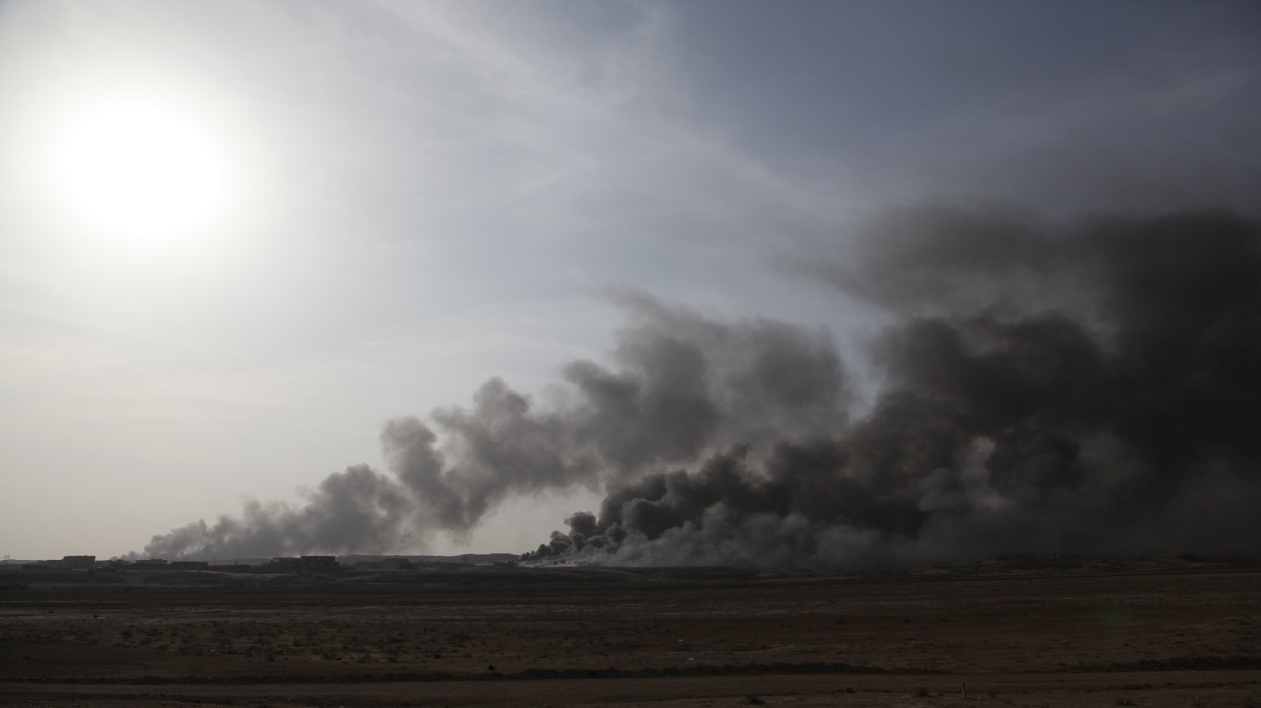

F.Dupaquier
April 2019
HARD-TO-REACH
Concept and evaluation preparation
© FrontView

Slide 2
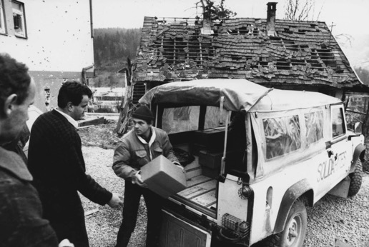
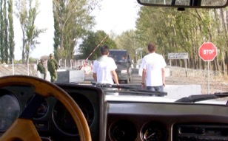
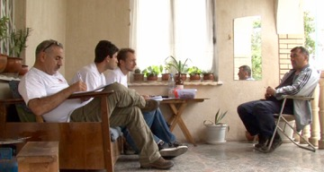
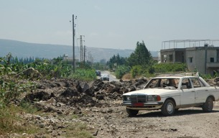
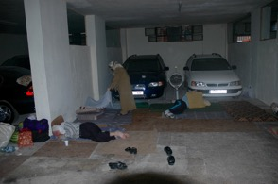
Introduction
Access: common issue in humanitarian action
© Solidarités
Bosnia war
© FrontView
Access to the Russian army buffer zone - Georgia/South Ossetia, August 2008
Need assessment in conflict affected situations: first teams at the frontline of access issues.
© FrontView
From Tyr to South Lebanon border- Air strikes - Lebanon July 2006

Slide 3
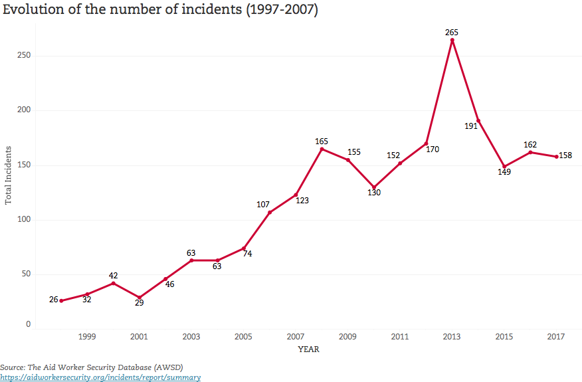
Increase of security issues for aid worker ?
Remote evaluation and program management = more regular modus operandi.
Project’s evaluations improvements + M&E better professionalism = Understanding, Programming, Accountability, Knowledge / new technical competencies / less access knowledge
M&E = laboratory to understand and measure contexts and projects in Hard-to-Reach.

Slide 4
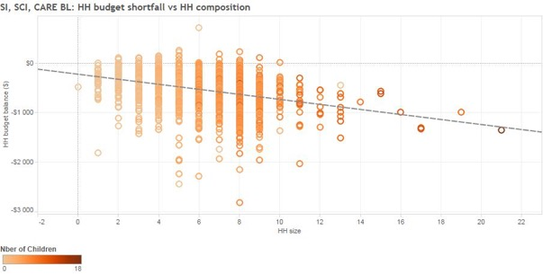
“Hard-to-Reach”, innovative methods and technics as respect of basic concepts.
Need of the necessary security and field knowledge to analyse the level of access (access is often more important than what we think) and identify the risks.
Work with efficiency and usefulness: is it necessary (to what level) to improve the operational response and for accountability purposes?
Ex: Realtime-permanent quantitative data collection in Lebanon=data unused and fcollected or no clear operational objectives. Basic tendencies not taken into account because of respondent trust issues.
IN HARD-TO-REACH YOU WILL NEED TRUST

Slide 5
Need of preparation and of a feasibility/evaluability study
Adjustment of the methodology: good quality is often better than bad quantity.
And at the end:
YOU CANT ALWAYS GET WHAT YOU WANT
So
DO WITH WHAT YOU (can) GET.

Slide 6
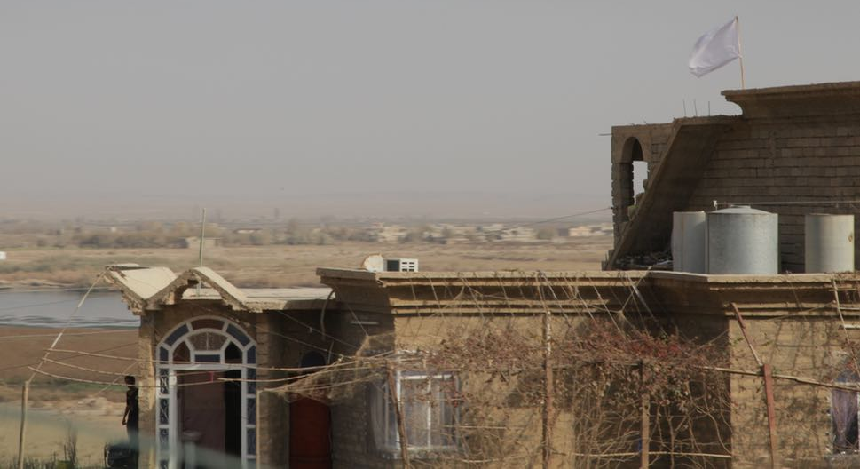
Concepts
Population/groups versus areas
Centrality of protection approach to include marginalized populations
Definition of Hard to reach population
Populations which are specifically difficult to reach, for security reasons, permission issues, or because of their particular characteristics, in order to get information on their vulnerability and for whom there are restrictions to provide direct humanitarian support and to evaluate the quality of the services brought.
Frontline with ISIS, Tigris river - Mosul battle - Iraq October 2016
© FrontView

Slide 7
Hard to Reach evaluations
Entail:
A precise context analysis and security assessment
Specific security and protection measures
Anticipation of logistic, administrative and implementation constraints
Often a local evaluation partner/team identified & trained,
or recruitment of team members sometimes remotely.
Alternative technics explored and used for triangulation.

Slide 8
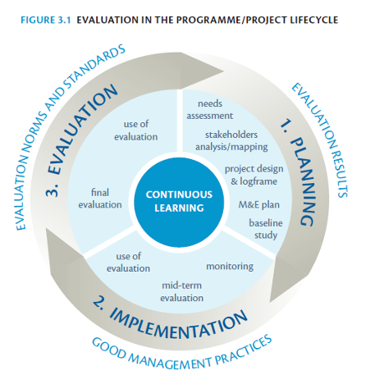
Evaluation in the project cycle
WHAT IS ACCEPTABLE DEPENDING OF WHAT YOU WANT TO DO WITH IT?
Is it worth conducting it and is it efficient in terms of:
Decision making process
Accountability

Slide 9
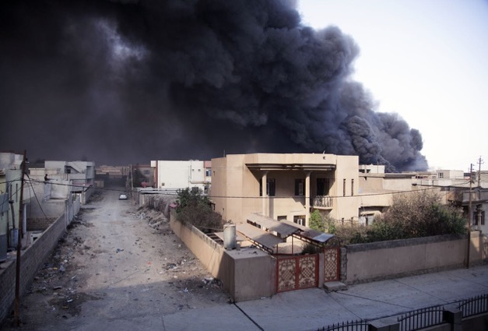
Security issues: defining the risk
Context and conflict analysis
Conflict profile
Conflict causes and triggers
Conflict actors (dividers/spoilers & connectors/stabilizers)
Conflict dynamics (trends & opportunity)
Do it yourself or find sources
Ex: ACAPS secondary data review - Difficulty to find sources - CAR 2014
Desk review is not enough,
So always:
NETWORK AND TRIANGULATE
Ex: Need assessment, military sources from Kurdish and French special forces- Mosul battle - Iraq, October 2016.
© FrontView

Slide 10
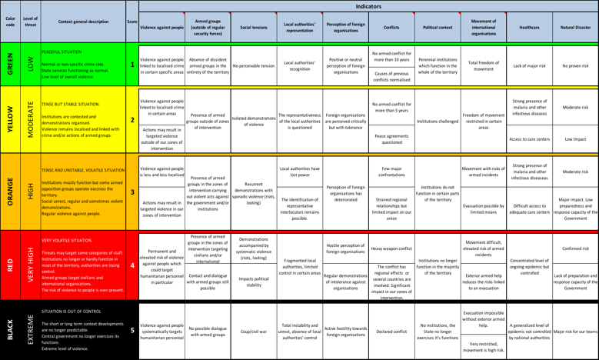
Security analysis: authorize and anticipate
Managing your own security
PROCEDURES HAVE TO BE RESPECTED
- Positive risk/benefit?
- Feasibility?
- Will the information collected be relevant or is there any limitation?

Slide 11
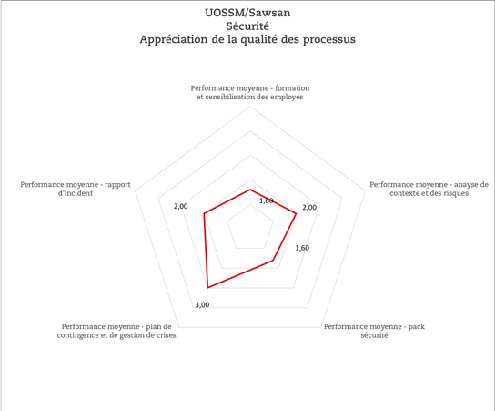
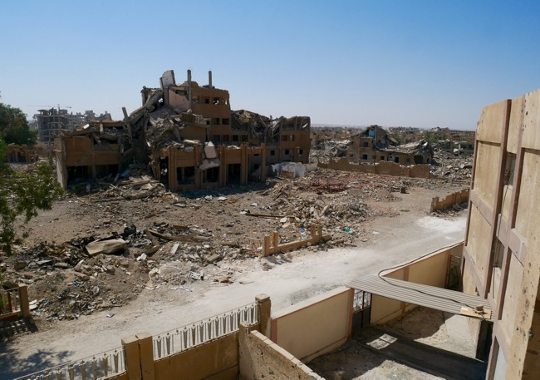
Depending on other organisations’ procedures : security vetting
Ex: Project evaluation - European MoFA - different partners, different levels of security - Syria October 2018.
Confusion between visibility/security and communication= conflict sensitivity issues
© FrontView

Slide 12
Specific protection issues: conflict sensitivity and risks for the targeted population
IN HARD TO REACH CENTRALITY OF PROTECTION APPROACH IS A REQUIREMENT
Conflict sensitive evaluation
Population’s expectations
Sensitivities around question asked
Team profile: perception of the people doing the evaluation
Having enumerators being part of the community
Advantages | Disadvantages (conflict sensitive)
- Identifying respondents’ sensitivities/understandings. - Designing questions, identification of mistakes. - Field and community knowledge - Etc. | - Partiality bias (assessing needs of a part of the community) - Feeling of knowledge, understanding bias (can answer instead of the people) - Etc.

Slide 13
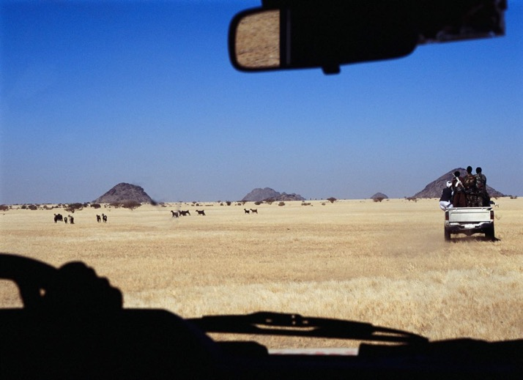
Charities/NGOs affiliated with armed groups
Ex: Beja congress vs Beja Relief Organisation-East Sudan, Eritrea 2005
© FrontView

Slide 14
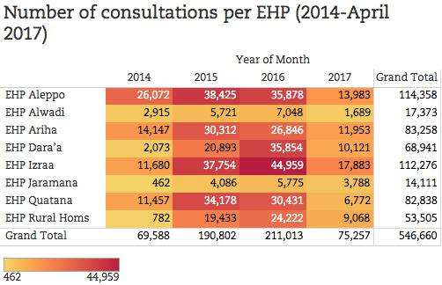
Confidentiality, data protection and ethical considerations
Ex: Syria and sensitive data (threat on the family, desertion from GoS army issues, reprisals risks, land property issues, etc.)
Access to confidential database = need rules to get the necessary data without sensitive ones..
Source profiling
Gender, age, religion and ethnicity etc.
Visibility and communication strategy (security & protection)
HARD TO REACH: Low profil / partner identified
Ex: Syria, project evaluation, 2018.
Mix up of visibility and communication: conflict and rumours appearance.

Slide 15
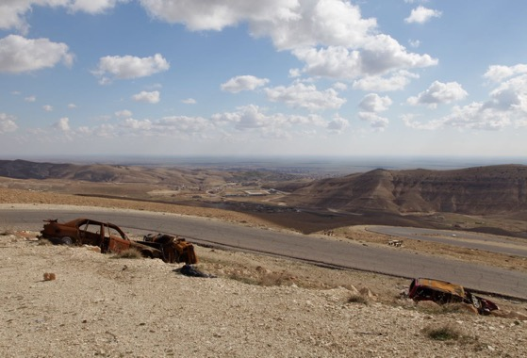
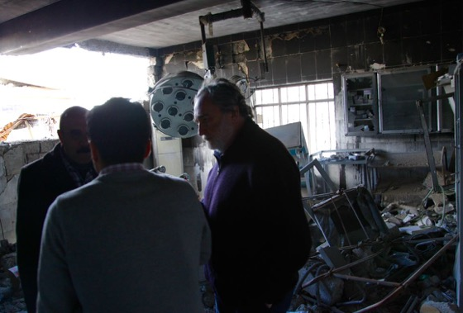
Preparation: key of success
Anticipate specific evaluation constraints
Administrative
Ex: Irak, Sinjar 2015 - Agreement from the Assayesh (Kurdish security forces)
Bring the necessary papers
© FrontView
© FrontView

Slide 16
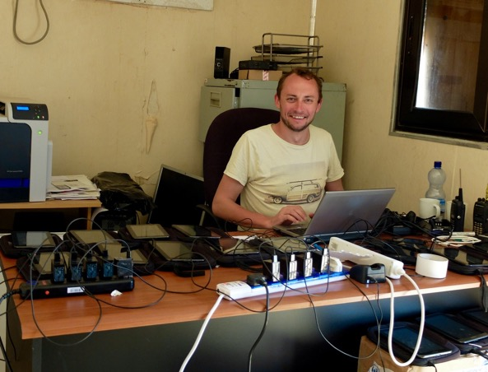
Logistic constraints
Transport
Equipment (software) selection, maintenance and follow up
Climate
Communication
Electricity and Internet etc.
Ex: Baseline and impact evaluations, Dollo Ado, Ethiopia, 2015
Bring the necessary equipement
And
BE PREPARE TO CHANGE YOUR PLAN
© FrontView

Slide 17
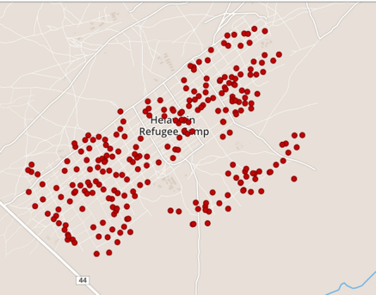
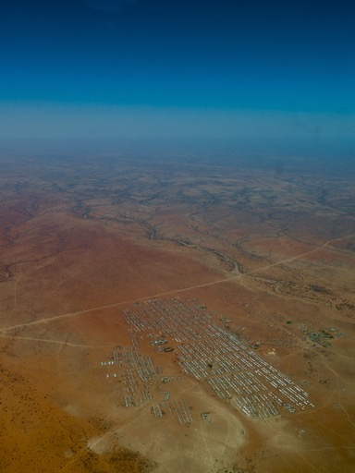
Evaluation sources and location profile
Ex: Baseline and impact evaluations, Dollo Ado, Ethiopia, 2015
Sample selection and representativeness problems:
High level of non-respondents
In camp population profile under representation
Problems of sampling selection and density of population in the camps
Etc.
© FrontView

Slide 18
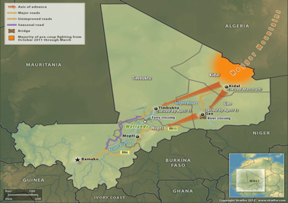
Selection of your implementing partner
Local private actor vs LNGO
Advantage |  | Disadvantage
Private actor | NGO | Private actor | NGO
Reactive Objectives’ focussed Professional /technical skills Etc. | Committed Experienced Capacity building driven Etc. | Information monopolization Profit focused Humanitarian values issue Etc. | Neutrality issue Deadline considerations and capacities Etc.
Ex: Mali 2012 (need assessment) & Burkina Faso 2015 (baseline)= l ocal NGO
Northwest Syria (project evaluation/third party monitoring) & impact evaluation Ethiopia 2015 = private company

Slide 19
Partner Vetting / Due Diligence
Risk Management Matrix
Description of risk | Probability (Certain / Likely / Moderate / Unlikely / Rare) | Significance & Mitigation (H= High/ M=Medium / L= Low risk)
Key programmatic documents are lost/missing/unavailable | To be determined with ___ and ___ | M | Check for availability or references in secondary data sources
Stakeholders may provide inaccurate/conflicting inputs | To be determined with ___ and ___ | M | Strong focus on triangulation of evidence from multiple sources
Visit to ___ office in ___ is not possible due to political or security reasons | To be determined with ___ and ___ | L | To be determined
Etc…

Slide 20
Conflict sensitivity issues
Ex: Conflict Sensitivity Evaluation (beneficiary selection process), opposition held areas, Syria march 2018 (NES, Northwest, South-central)
Report extract:
“An interviewed (…) employee in Syria was mentioning the worries linked to the stoppage beginning of 2018 of Southern Front salaries from the Military Operations Command in Amman. This event has pushed military groups to fund new local “social” entities that are able to catch funds. This places greater pressure on independent NGOs and could become a threat for humanitarian means predation especially when speaking of CBI”
Hard-to-Reach areas: People being part of the community have access and are able to work.
There are so important questions to address on the identity of the local researchers:
- What are their characteristics (ethnicity, religion, gender etc.) ?
- What are their relationships and interests with the local authorities, the local economic fabric and businesses, the armed groups?
- Are they subject to specific pressures or harassments?
- What are the security issues they have to face?
Etc.
NEED OF MITIGATION MEASURES: triangulation, combination of technics for data collection etc.

Slide 21
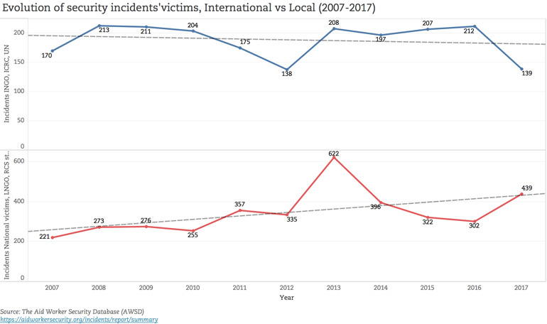
There is a transfer of risk from international to local who have often lower security procedures and higher insecurity acceptance.
YOUR PARTNERS ARE AT RISK

Slide 22
Training and testing plan
To be adjusted considering the level of knowledge and experience.
Supervisors and managers training
HUMANITARIAN PRINCIPLE
SECURITY
USE OF MOBILE DEVICES
PLANNING AND METHODOLOGY
Etc.
Ex: Baseline evaluation, Sahel region, Burkina Faso, 2015
Enumerators training
INFORMATION/DATA COLLECTION PRINCIPLES AND TECHNICS (including good practices)
EVALUATION OBJECTIVES, EXPECTED OUTPUTS/OUTCOMES)
METHODOLOGY
QUESTIONNAIRE DISCUSSION AND WORKSHOP: ROLE PLAY
Testing

Slide 23
Communication and information on the evaluation (acceptance)
Public/targeting warning.
Presentation of the evaluation with possibility to give clarification (who is the interviewee and the agency it represents, reasons for the survey, overview of the interview process, time needed etc.): downward accountability.
Participation involvement / consent (anonymous, voluntary, no compensation, no benefits to respondent etc.).
HARD-TO-REACH
ANTICIPATION NEEDED LINKED WITH EVALUATION VISIBILITY, SECURITY AND PROTECTION ISSUES

Slide 24
F.Dupaquier
April 2019
THANK YOU
© FrontView

