Slide 1
Working Better Together for the Implementation of the 2030 Agenda
Training on Joint Programming

Slide 2
The most important slide of the day!
Joint Programming is now the model for European Cooperation Global Strategy & New Consensus
  Supporting the 2030 Agenda & SDGs
  Working Better Together
  The ‘preferred approach’ to cooperation
  ‘Voluntary, flexible and inclusive’ (country tailored)
  Working ‘beyond aid’ to address global challenges
Shared Vision, Common Action. EU Global Strategy for Foreign and Security Policy (June 2016), pp 49-50
New European Consensus on Development: Our World, Our Dignity, Our Future, (May 2017), para 75

Slide 3
Today’s objectives
For you
  Enhance understanding of JP as a useful and relevant approach
  Identify entry-points to support Agenda 2030 implementation through JP
  Acquire skills and insights to advance the Working Better Together commitment
For us
  Understand your implementation challenges and future knowledge/learning needs

Slide 4
What we will cover today
  The context for Working Better Together
  JP as a response to changing context & global challenges
  Understanding the JP mandate, content & added-value
  Tools and approaches for JP & Working Better Together
  Experience at country level: discussion & questions
  Getting ready to work better together
  Conclusion & wrap-up

Slide 5
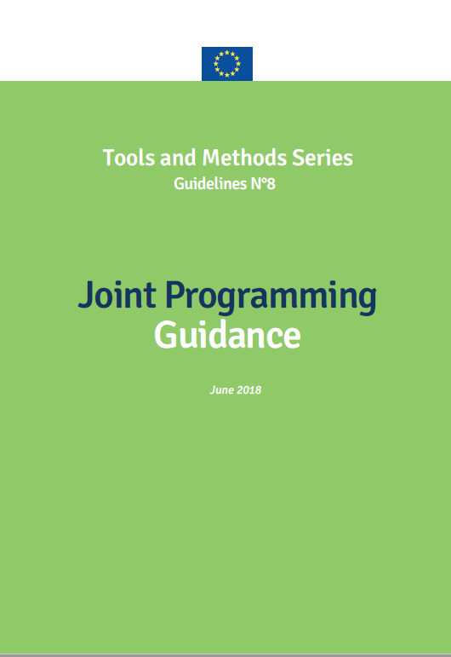
JP Guidance
  What is Joint Programming (JP)?
  Getting started on JP
  Joint analysis
  Joint response
  Joint results framework
  Tools and approaches
      Division of labour
      Stakeholder consultation
      Policy dialogue
  Visibility
  Fragile states
  Broadening the scope

Slide 6
Introductions
  Write on a card what you think JP is
  Come to the front, state your name and where you are from
  Put your card on the flip chart

Slide 7
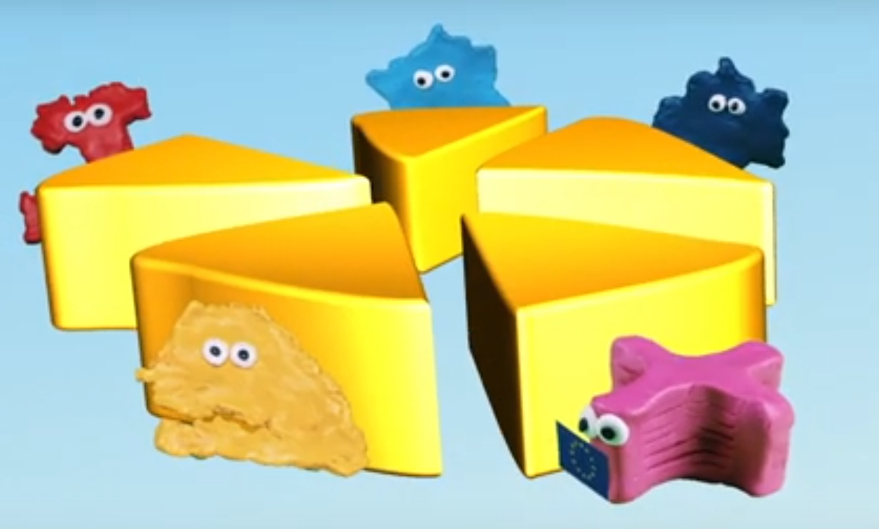
And an introduction from our friends in the field …
Notes:
https://www.youtube.com/watch?v=Ak0A8ELXcts&list=PL0NKSZy4-2Da-YBHX2mST6KgLhWxXqWGW

