Slide 1
The context for Working Better Together Building on what we know Training on Joint Programming

Slide 2
What is Joint Programming?
A commitment to “working better together”
Combines development & external action
“adaptable and responsive to changing needs, crises and priorities”
“voluntary, flexible, inclusive, and tailored to the country context”
Beyond programming: implementation & results
The Global Strategy on the EU’s Foreign and Security Policy (2016)
New European Consensus on Development (May 2017)

Slide 3
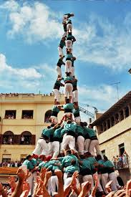
Why Joint Programming?
A problem shared is a problem halved…
Reaching new heights…
Working with European and national partners we can tackle shared problems more effectively.

Slide 4
ODA: Visibility Influence Impact
Total ODA
$200 bn
(2017)
The EU disbursed total ODA of USD 18.8 billion in 2017 (10% of total)
20 other EU MS contributed a further combined USD 60+ billion
Combined EU/MS ODA represents 40% of the global total

Slide 5
Where are the policy commitments?
New European Consensus on Development - Our world, our dignity, our future (2017)
A Global Strategy for the European Union’s Foreign and Security Policy (2016)
Council Conclusions on Stepping-up Joint Programming (2016)
Busan Global Partnership on Development Effectiveness (2011) (Ownership; A focus on Results; Partnerships for Development; Transparency and shared responsibility).
Paris Declaration on aid effectiveness (2005)

Slide 6
EU Global Strategy implementation:
Moving towards a joined-up external action / Joined-up Union
“Joint programming in development must be further enhanced. New fields of our joined-up external action include energy diplomacy, cultural diplomacy and economic diplomacy. A more prosperous Union calls for greater coordination between the EU and Member States, the EIB and the private sector. We must become more joined-up across internal and external policies.”
Joint Communication: A Strategic Approach to Resilience in the EU's external action:
"[…] the resilient approach should be taken into account in joint programming processes with MS, which will be further encouraged"

Slide 7
European Consensus on Development
The “European Consensus on Development frames the implementation of the 2030 Agenda in partnership with all developing countries … The EU and its Member States … will implement the 2030 Agenda across all internal and external policies in a comprehensive and strategic approach … Within this overarching framework, a coherent and coordinated approach to EU external action will be important for the successful implementation of the 2030 Agenda globally.”
New European Consensus on Development: Our World, Our Dignity, Our Future, (May 2017), pp 3-5

Slide 8
EC proposal for the NDICI
ARTICLE 10 (general programming) | Joint programming shall be the preferred approach for country programming
ARTICLE 12 (geographic programming) | 12.3: Multi-annual Indicative Programmes shall be built on: A national or regional strategy in the form of a development plan […] accepted by the Commission […] A framework document laying down the Union policy towards the concerned partner or partners, including a joint document between the Union and MS A joint document between the Union and the concerned partner […] setting out common priorities
ARTICLE 12 | […] where possible, Joint Programming document shall replace the Union’s and member states programming documents

Slide 9
Value of Working Better Together, at country level (survey + other practitioners):
Information - and data sharing
More visibility and impact - a single «EU branding» for high quality (and quantity) support
Speaking with one voice: Policy and political dialogue
Less fragmentation and reduced transaction costs (in the long-run!) – Division of Labour.
Intensifies & formalizes financial (energy, WASH) + cross-sector (nutrition) implementation (nutrition)+ non-financial JI

Slide 10
Country perspectives (1)
Notes:
https://www.youtube.com/watch?v=uMUrDn-jKLQ&list=PL0NKSZy4-2Da-YBHX2mST6KgLhWxXqWGW&index=3

Slide 11
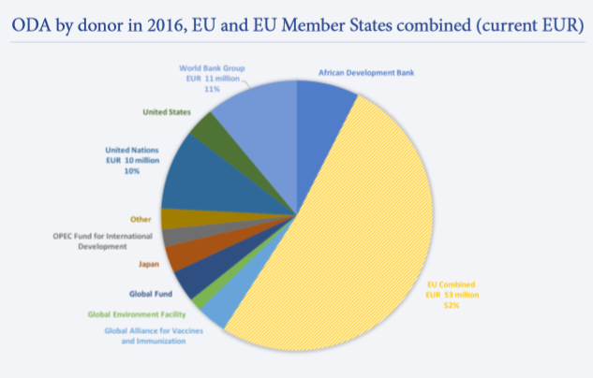
Does size matter?
Congo (Brazzaville)
8 EU/MS partners (out of 13 donors)
EU/MS = 52% of total ODA
EU Combined = EUR 53 million

Slide 12
Does size matter?
Congo (Brazzaville) 2,8 % of revenue

Slide 13
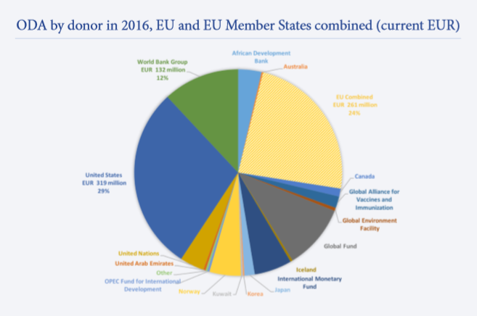
Does size matter?
Malawi
6 EU/MS partner (out of 24 donors)
EU/MS = 24% of total ODA
EU combined = EUR 261 million

Slide 14
Does size matter?
Malawi EU combined 26 % of revenue
Notes:
.

Slide 15
Main messages
There is a high-level policy commitment to Working Better Together
JP is the ‘preferred approach’ to EU programming: working towards the 2030 Agenda and the SDGs
Money matters, but partnerships matter too.

Slide 16
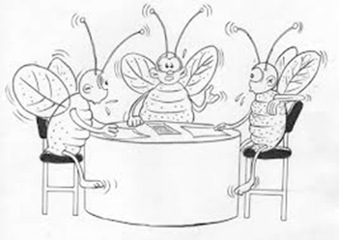
Group discussion
Based on your own experience and what you have learned this morning, reflect on the challenges and opportunities of a joint approach:
What is the concrete added-value of a joined-up approach?
What have been the main stumbling blocks to working better together?
Work at your tables to discuss and share your experiences of a joint approach or JP. If you have major questions arising from your discussion please write them down and we will attempt to answer them as we go through the day.

