Slide 1
  Group work: Getting ready for Joint Programming
  Training on Joint Programming

Slide 2
A summary of JP lessons learnt
1. The value in WBT is principally related to policy coherence
A consensus on priorities (negotiated with partner government)
A shared vision and objectives
A joint strategy approach which support joint results framework
Good practices in collaboration
2. Raise EU profile in country
Beyond programmes: towards policy and political dialogue on EU values.
Beyond aid: trade and foreign policy issues (migration, democracy, human rights, fragility, climate).
Leverage new partnerships (private sector, civ-soc, change agents)
3. Flexibility = “best fit” = relevance to context → SDG results
Process is key → inclusive, build momentum, institutionalise JP

Slide 3
Good Practices in Collaboration (Artists)
1. A strong transparent project lead open to new ideas
2. A shared vision
3. Everybody has a role; no duplication; encourage alternative perspectives/ creative thinking
4. Constant feedback in managing the work flow
5. Regular meetings focused on problem solving
6. Verbal communication – email for decisions
7. Focus on results that are fun
8. Build a group of champions.

Slide 4
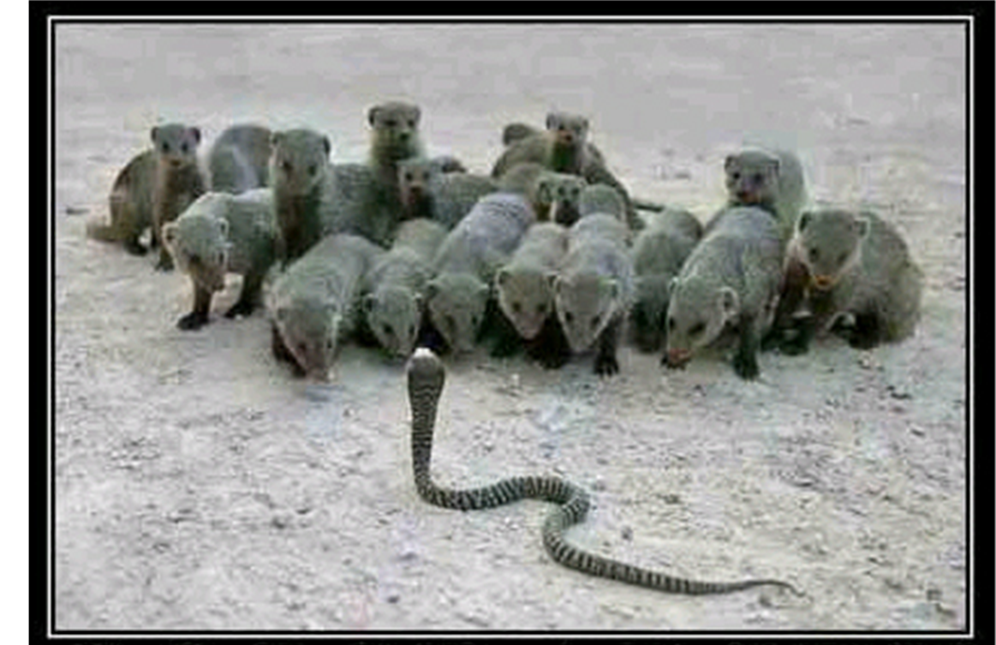
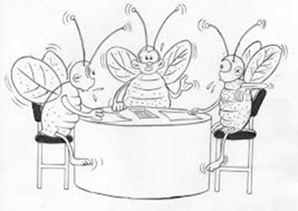
Group work
Use the handout to organise yourselves
Consult the facilitator where necessary
Use the questions to motivate discussion (no obligation)
Come back in one hour with a 5 minute presentation
Remember…
…be a mongoose.
…or a bee.
…or whatever.

Slide 5
Objective: focus on next steps to use JP as the ‘preferred approach’ to implementing the SDGs
See you in 1 hour!

Slide 6
Feedback to questions
Motivation
Why is your group considering (or rejecting) JP? What would be your JP’s principal focus or objective? What are the concrete benefits (or disadvantages) that JP is expected to bring?
Partnering
What kind of issues and relationship dynamics are important in preparing a scoping study or joint analysis?
What kind of support – and resistance – did you encounter? What strategies were employed to reach a final decision?
Tools and preparation strategy
What tools, approaches and partnerships can be used to move forward? Can the SDGs be used for leverage, consensus-building or finding an entry-point?
Which areas/issues can be used to build consensus? Is it better to begin with a common agenda (as a platform for further engagement) or to be comprehensive?

