Slide 1
  Learning from the JP experience
  Training on Joint Programming

Slide 2
Global State of Play of Joint Programming (March 2019)
20 (+6)
17
COUNTRIES IN THE PROCESS OF JOINT PROGRAMMING (JOINT ANALYSIS OR ROADMAP)
Joint Analysis: Armenia, Belarus, Benin*, Georgia, Morocco*, Niger, Zambia
19
7
COUNTRIES EXPLORING JOINT PROGRAMMING POTENTIAL (FEASIBILITY/SCOPING EXERCISE)
Joint Monitoring / Results Framework
Bolivia, Burkina Faso, Cambodia, Comoros, Ethiopia, Ghana, Kenya, Laos, Nicaragua, Palestine, Senegal
Replacement
FR in Comoros, FR in Kenya, EU in Laos, DE and FR in Mali, EU in Palestine, EU in Senegal
JOINT PROGRAMMING DOCUMENTS
Afghanistan, Algeria, Angola, Bangladesh, Chad, Guinea Conakry, Iraq, Jordan, Kyrgyzstan, Liberia, Libya, Malawi, Myanmar, Somalia, Tajikistan, Tanzania, Ukraine, Uzbekistan, Yemen
Bolivia (2017-2020), Burkina Faso (2017-2021)*, Cambodia (2014-2018/2019-2020), Central African Republic (2017-2021)*, Comoros (2015-2020), Egypt (2017-2020), Ethiopia (2017-2020)*, Ghana (2017-2020), Guatemala (2014-2020), Honduras (2018-2022)*, Ivory Coast (2017-2020), Kenya (2018-2022), Laos (2016-2020), Moldova (2017-2020), Nicaragua (2018-2020), Palestine (2017-2020), Senegal (2018-2023), Togo (2014-2020), Tunisia (2017-2020)*, Uganda (2015-2019)
Old: Chad (2014-2017)**, Mali (2014-2018)**, Myanmar (2014-2016)**, Namibia (2014-2017), Paraguay (2014-2018), Rwanda (2014-2018)
Roadmap: Azerbaijan, Burundi*, Cameroon, El Salvador, Haiti, Lebanon, Madagascar*, Mali, Mozambique*, Nepal, Pakistan
11
JP ACTIVE IN 37
56 Active countries
*drafts **working towards a 2nd joint programming document

Slide 3
A common vision and a higher EU profile
Independent evaluation and OECD Peer Review find:
Shared vision and coherent policy add value but need to be part of a clearer intervention logic
Potential for greater impact by joining-up development work, a reform focus & politically strategic interventions
“Expand and refine implementation” of JP:
Extend the scope & reinforce partner country ownership
Process matters: strengthen results-based focus & approaches
SDGs as opportunity to bring coherence (financing, policy dialogue, prioritisation & partnering)
Evaluation of EU Joint Programming process of development cooperation (2011-2015)
OECD Development Cooperation Peer Review of European Union 2018

Slide 4
Working better means working smarter (EAMR reports 2018)
Joint programming is:
A catalyst for trust-building, deeper dialogue & policy cohesion – beyond program/ project implementation.
Opportunity for promoting shared European values more strategically.
Value added of working together in difficult political contexts: A way to pool risks to explore new areas for engagement.

Slide 5
Global learning event: Messages for EU+ MS HQ
Make JP and SDGs part of our DNA
Communicate the “preferred approach” to MS more effectively & strategically
HQ programming to become more JP & SDG-aligned
Operationalise commitments to improved JP process & support
Foster informal dialogue (EU and MS) across sector and geographic desks
Promote regional/country workshops & trainings
Provide support tools (operationalise the JP tracker)
Promote joint missions & retreats
JP Global Learning Event, Cambodia, 4-6 December 2018

Slide 6
Global learning event: Country-level reflections
  Quality of process institutionalises momentum & flexibility
  Joint analysis is a key step (and reoccurring)
    Clarify the vision, the scope & the added-value
    Strategic and political dimensions
    Identify drivers & mitigate risks
    Agree objectives & entry-points
  Incentives & motivation (EU/MS staff and counterparts)
  MICs and LIC/LDC emphasise different issues
    Success more likely where clear priorities/plans in place
    Political traction a precondition for SDG engagement
    Monitoring systems are under strain
  Lighter processes (when few MS or in fragile contexts)
JP Global Learning Event, Cambodia, 4-6 December 2018

Slide 7
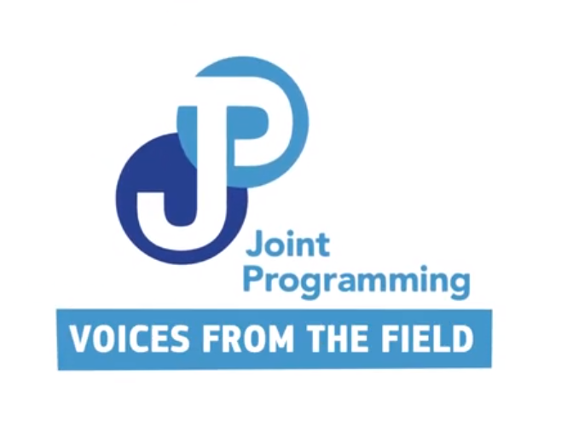
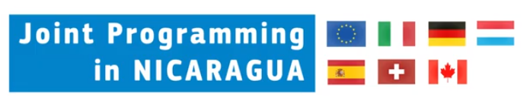
Country perspectives (4)
Notes:
https://www.youtube.com/watch?v=07j_-D0Z7Eo&list=PL0NKSZy4-2Da-YBHX2mST6KgLhWxXqWGW&index=2

Slide 8
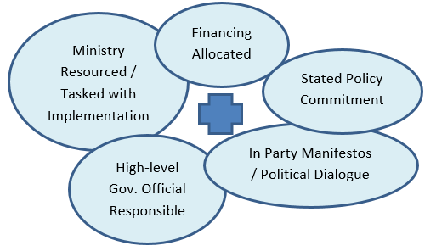
Greater impact through improving relevance

Slide 9
Let’s hear from an expert!

Slide 10
Joint Programming in Cambodia
Trauma in society
Rapid poverty reduction + strong growth
Democracy
Consolidation of power + economic roles
State Building
Different models from region
Scoping
Visibility: grant donor
Support aid architecture
Decision
Use political platform
EU leads
Monitoring
Report for dialogue
Government, Civil Society, Private sector, Parliament
Definition of results
Joint implementation
Be constructive

Slide 11
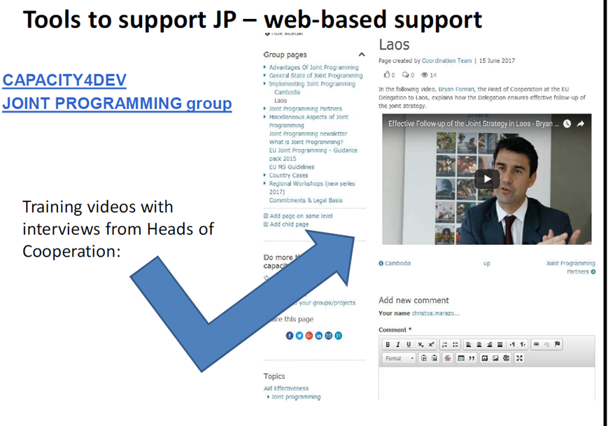
Tools to support JP
JP Guidance
JP Tracker / EU aid explorer
Capacity4Dev
  Aid and Development Effectiveness
  Joint programming
  Political economy
  Financial instruments (budget support etc)
DEVCO Academy (online learning, country videos)
Trainings, e.g. on Policy Dialogue
ODA info systems (OECD, IATI)

Slide 12
Country studies & resources
See the reading list in your folder!
JP core documents and policy documents
  JP Guidance
  Global Strategy, Consensus on Development, Stepping Up JP
  JP thematic studies (MIC, Fragile states, SDGs)
Capacity4Dev access (country/thematic studies and videos)
  Videos
  Case studies (mid-2019) Morocco (TVET), Cambodia (PFM), Senegal (Economic Development & Budget Support), Cameroon/CAR (Governance ), Lebanon (Wat-San)
Agenda 2030 & the SDGs – tools & data
Fragility and crisis situations – good practice notes

Slide 13
Main messages
  Be politically smart and versatile: look at the big policy picture
  Use SDGs as an advocacy & policy ‘dialogue’ entry-point
  The process drives & institutionalises the product
  Work more with partner governments to support country priorities & build capacity
  Many tools available – tailor to country context
  Be prepared to innovate
  Share experiences and lessons

