Slide 1
Budget Support
Module 3
Risk Management Framework
Notes:
This presentation covers chapters 2 and section 5.1. of the BS Guidelines

Slide 2
outline Module 3
Risk Management
Risk Management Framework
Notes:
Bringing everything together to feed into the RMF

Slide 3
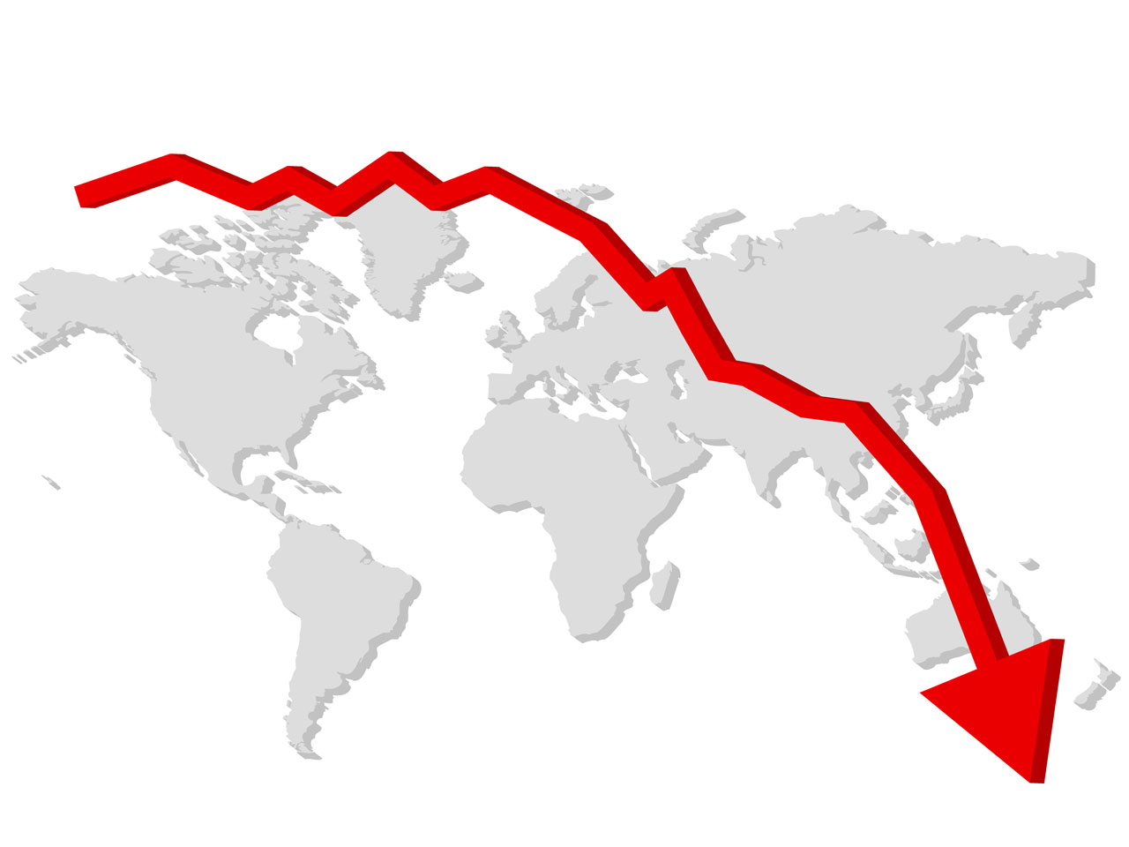
Three types of risk: external, inherent and behaviour risk
Risk : « Any event or issue that could occur and adversely impact the achievement of the Commission’s political, strategic and operation objective. Lost opportunities are also a risk ».
External risks: from outside the system: world economic outlook; climate; political unrest
Notes:
See Guidelines p 37 and Annexes 5,6 and 7 of 2017 Guidelines. Definition risk on p.38
See: Risk Management in the Commission, Implementation Guide. Version updated in November 2015 (2016 edition).

Slide 4
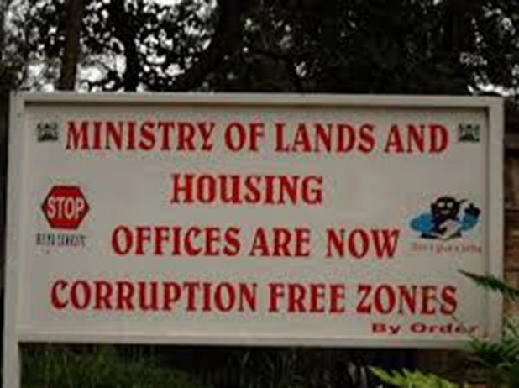
External, inherent and behaviour risk
  (2) Inherent risks: risks from within the system (omissions in oversight, weaknesses in control, lack of credibility)
  (3) Behavioural risks: deliberate misappropriation, fraud, abuse of power (social appreciation, adherence to the rule of law)

Slide 5
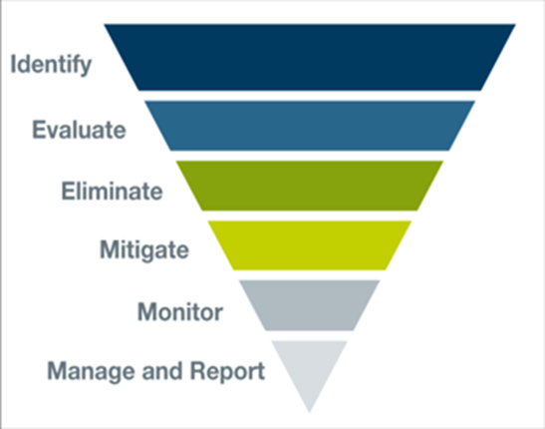
What is risk management?
  Risk management is a continuous, proactive and systematic process of assessing, mitigating, and monitoring risks.
  Risk assessment: an input into BS programme cycle: during identification, formulation, implementation and evaluation.
Notes:
RMF is an early warning system. But not an eligibility criterion!

Slide 6
outline Module 3
Risk Management
Risk Management Framework
Notes:
Bringing everything together to feed into the RMF

Slide 7
Main functions of the RMF
RMF provides basis for decision making process by:
  Identifying specific risks (risk level) linked to the provision of BS (or cost of non-intervention)
  Identifying mitigating measures and risk responses (risk strategy)
  Informing Budget Support policy dialogue
  Monitoring the identified risk and mitigating measures during implementation
  Identification of changes over time: improvement / deterioration

Slide 8
How to assess risks
RISK MANAGEMENT FRAMEWORK
Notes:
The risk categories are the five column headers.
Under each risk category the various risk dimensions corresponding to that category.
This slide shows the categories and the dimensions that are covered in the risk management framework template.
Specific case: for OCT only 4 of the categories need to be assessed since political risks do not need to be assessed.
NEW: SIDS and OCTs only at dimension level!

Slide 9
Occurrence and impact
Frequency, likelihood of occurrence
                Impact
Impact
Notes:
Relation between occurrence and impact. A risk may occur frequently, but without serious impact; or the other way around: it may occur in exceptional cases only and have a lot of impact.

Slide 10
Risk level | Systems and institutional structures in place | Impact in case of occurrence
Low | Are strong enough to make occurrence unlikely | Limited on objectives
Moderate | Should prevent occurrence but monitoring is necessary | Would delay attainment or partial achievement of the objectives
Substantial | Are not sufficiently robust to guard against key risks | Would disrupt the programme or the achievement of the objectives
High | Are too weak to prevent the occurrence of risk | Would result in a (quasi-) failure. Results will not be achieved

Slide 11
RMF components (2019 VERSION)
  A Risk Questionnaire: Risk identification and mitigating measures. 48 questions with distinction between
  structural weaknesses to rate the risk level and calculate overall risk – 4 categories low/moderate/substantial/high
  risk outlook for next 12 months to highlight trends not sufficient yet to raise/lower the risk level or events that might materialise and could alter that rating next year – 3 options negative/neutral/positive (can also about opportunities!)
  A Risk Profile: Summary for decision-makers
      One RMF for all contracts.
      Sector specific risks can be differentiated
Notes:
The focus is on risks that can have a negative impact on the achievement of budget support objectives.
The assessment is done using a template which consists of 2 parts;
(Simplification: There is no risk register anymore (has been merged with the questionnaire)
For SIDs and OCT only the 14 dimenions (OCTs 10, since the political risk category is not assessed)

Slide 12
2017 : UPDATE
  Differentiation for developmental risks per sector (for SRPCs)
  PFM: adapted to new 2016 PEFA Measurement Framework (both old and new PEFA-indicators)
  Simplification of the RMF questionnaire for some selected SIDS (14 questions only covering each dimension); and OCT (10 dimensions). Simplified RMF Excel sheet available
Notes:
OCTs: the political dimension is not assessed, so 10 dimensions

Slide 13
2019 : UPDATE
  Differentiation between risk level (structural weaknesses) and risk outlook (next 12 months)
  Further emphasis on investment climate and business environment: one new sub-category within developmental risks (2 new questions) + one new question within political risks/rule of law (legal framework) + one new question within PFM risks (public investment management)
  Sharper questions on public policies, environmental/climate change, public administration reforms (one new question) within developmental risks
  2 questions on macroeconomic policies merged into one
Notes:
OCTs: the political dimension is not assessed, so 10 dimensions

Slide 14
Annual update RMF
  End of year update: presentation Jan/Feb: one RMF for all BS operations
  Update during the year in case of change to substantial or high
  Internal EU tool; concerns may be shared (i.e. with MS); the assessment is not public
  Joint (government, DPs) search for mitigation factors
  Mitigation activities can be performed by anyone (Government, DPs, EU)
      At the end: decision about risk acceptance or risk avoidance
Notes:
The RMF is updated once a year, submitted to DEVCO and EEAS for validation and submission to the BSSC; except when new circumstances lead to a deterioration in at least one of the risk categories to substantial or high. In that case a new RMF should be submitted as soon as possible.
In principle, end of year elaboration; submission in January; feed-back and consolidation in February

Slide 15
Importance of the RMF and role of the BSSC/FAST
EUDs prepare an updated RMF once a year
RMF completed submitted to BSSC or FAST for validation
Identification of risk levels in five categories
Validation of risk levels
Proposal by
Geographical Director
BSSC/FAST agrees list of operations for which payments are to be submitted for guidance during the year
Typically, substantial or high risk level in one or several of the 5 risk categories means disbursement files are submitted to BSSC/FAST for strategic guidance
Notes:
This is the normal routine but remind the participants that:
‘During the course of the year, the EUD monitors the developments in the country. Where a risk level increases from low/moderate to substantial/high, the EU Delegations shall notify HQ. The Geographical Director is responsible for discussing the change with the relevant services and submitting an updated RMF to the FAST for validation ‘
➔ RMF is really central in deciding what level of scrutiny the disbursement will be subjected to and the amount of additional documentation and analysis is to be provided (for ‘what’ treated in later slides)

Slide 16
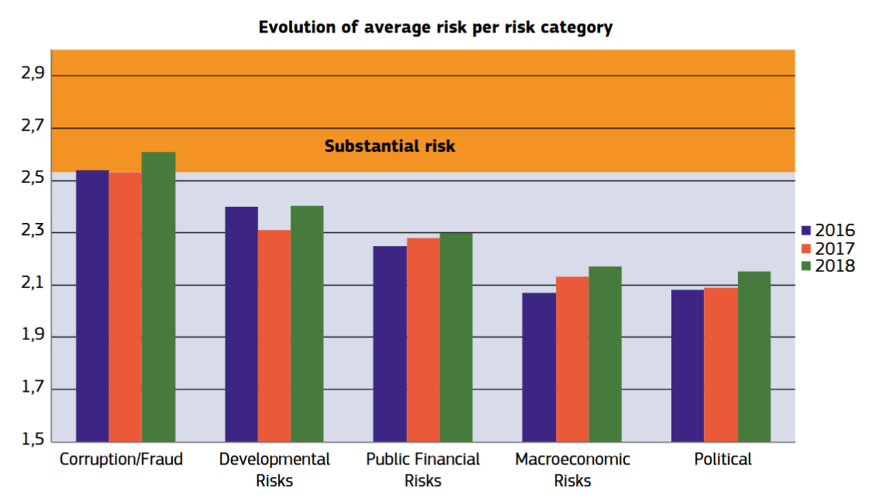
Average risk by category, 2016-2018
Of all substantial or high risk situations, 28% is corruption and fraud; 23% developmental, and 16% PFM.
Source: Bidget Support Trends and Results, 2017 and 2018

Slide 17
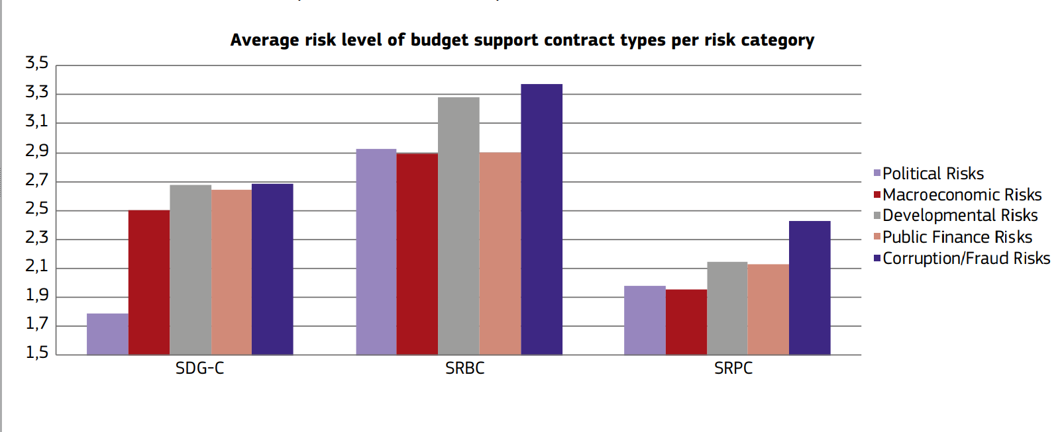
Average risk by type of contract
Source: Budget Support, Trends and Results 2018. European Commission

Slide 18
Risk level implications
  If the risk level for a risk dimension is substantial or high :
  Definition and implementation of clear and comprehensive action plan
  Satisfactory progress is required during implementation
  If the political risk is substantial or high in case of a SGD-C:
  Comprehensive action plan and policy dialogue (gradual and proportional)

Slide 19
Examples of mitigation measures
  Analyses and surveys (e.g. PEFA, PETS, PER…; political economy or drivers of change analysis)
  Capacity development and technical cooperation
  Enhancing transparency, accountability, participation in budget process
  Policy dialogue
  Performance indicators of the variable tranches (but without jeopardizing predictability)
  Requirements: specific controls, legislation changes
  Further adaptations regarding the design of a budget support programme
  Proactive communication strategies (i.e. public acceptance of reforms)

Slide 20
Thank you
for your attention

