Slide 1
Towards Sustainable Development –
Greening EU Development Cooperation
Module 1:
Mainstreaming and its policy basis
Notes:
A. Intervention logic as theory of change - LFA here
B. Phases (start with exercise )
Programming
Identification and Formulation
Implementation
Completion/Closure and Follow up
C. Important choices to be made during the phases of development actions (exercise on stakeholder analysis and choice of partners – force field diagram)
Aid modalities as one choice to make
D. Stakeholder analysis (light)
E. Policy dialogue (light)

Slide 2

MAINSTREAMING
A long-term, iterative process aimed at:
  transforming ideas
  transforming policies, resource allocations and practices
in order to:
  promote desired developmental outcomes
  and support integrated solutions to
  human problems

Slide 3
Environmental integration in EU development policy
EU founding Treaties and policies
Regulations and guidelines that govern EU development cooperation
Multilateral agreements and development agenda
Notes:
Expansion
http://www.climat.be/files/8513/8479/2884/Mette_Quinn_European_Commission.pdf
Examples:
Groupwork / discussion

Slide 4

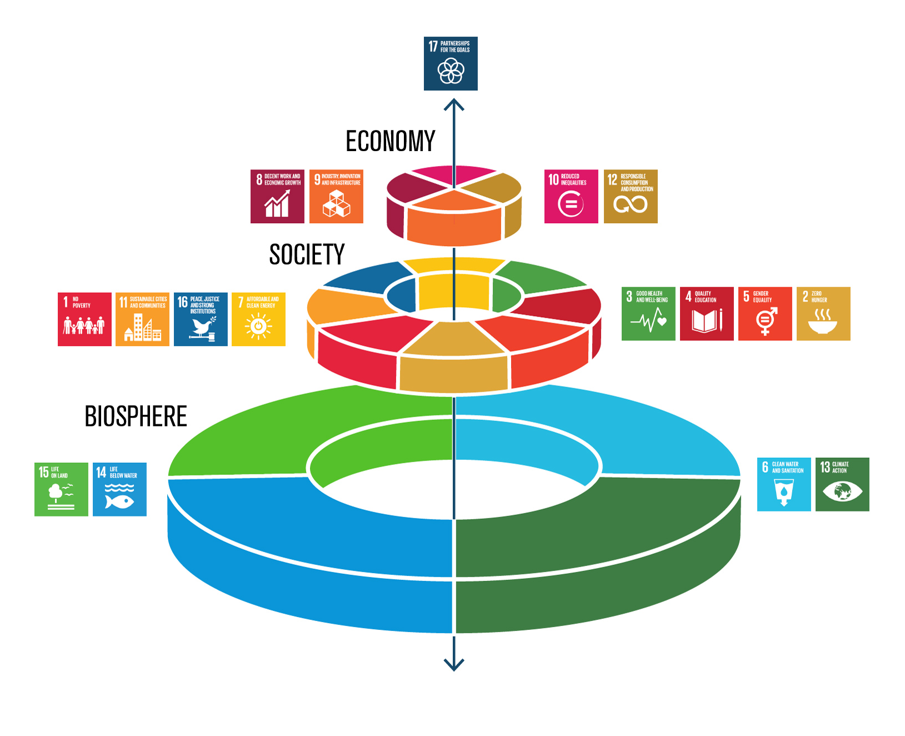

Slide 5
Rio conventions
Notes:
A chlorofluorocarbon (CFC) is an organic compound that contains only carbon, chlorine, and fluorine, produced as a volatile derivative of methane, ethane, and propane.

Slide 6

Convention on Biological Diversity
COP13 (2016) Decision XIII/3
”urges Parties…to strengthen their efforts to mainstream conservation and sustainable use of biodiversity within and across various sectors, including agriculture, forestry, fisheries and aquaculture, and tourism at all levels and scales…"
”Encourages Parties…to develop coherent and comprehensive policy frameworks that integrate biodiversity across sectors... "
COP14 (2018) Decision 14/3
Promotes mainstreaming of biodiversity in the energy and mining, infrastructure, manufacturing and processing sectors
Makes a proposal for a Long-term Strategic Approach to Mainstreaming Biodiversity

Slide 7

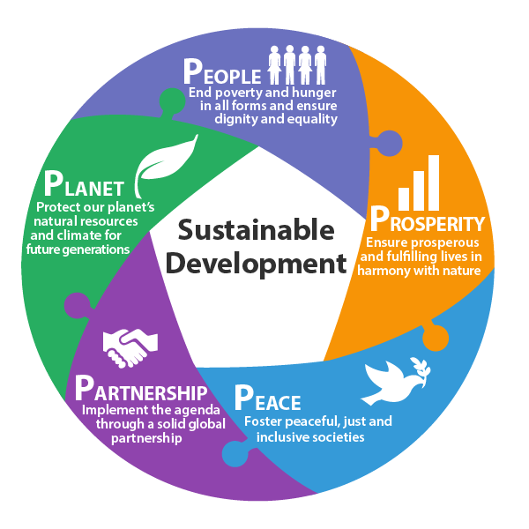
Emphasises implementation of Agenda 2030 and the Paris Agreement
Promotes integration of environment and climate change in all development cooperation sectors
Promotes resource use efficiency, sustainable consumption and production, uncoupling of economic growth from environmental degradation
Promotes integration of environment in policy dialogue
Supports implementation of NDCs
Promotes clean energy, sustainable agriculture, IWRM, resilient infrastructure, green and circular economy...
Notes:
Within the definition of “Disaster Risk Reduction” of UNISDR (2009), wise management of land and the environment are explicitly mentioned as a way of reducing factor of risk.
CDN Contribuciones Determinadas Nacionales
Gestión Integrada de Recursos Hídricos (GIRH)
In the Hyogo Framework for Action 2005 – 2015, an expected outcome is “The substantial reduction of disaster losses, in lives and in the social, economic and environmental assets of communities and countries”, and priorities for action include “sustainable ecosystems and environmental management”.
This illustrates the strong link between environment quality and reducing disaster risk . Included in slide notes

Slide 8


Financial commitments
Dedicate at least 20% of EU budget (2014-2020) to climate-related actions
20%
Double financial flows to biodiversity in developing countries by 2015 and up to 2020
>332 M€/yr
More ambitious commitments expected for 2021-2027!!

Slide 9










How to achieve mainstreaming?
DEDICATED PROGRAMMES
Global Climate Change Alliance
Switch to Green
Biodiversity for Life
FLEGT
Geographical programmes
INTEGRATION
Agriculture & Food Security
Private Sector Development
Water & Sanitation
Infrastructure & Transport
Energy

Slide 10
Where do contributions to biodiversity come from?

Slide 11
Where do contributions to climate action come from?

Slide 12
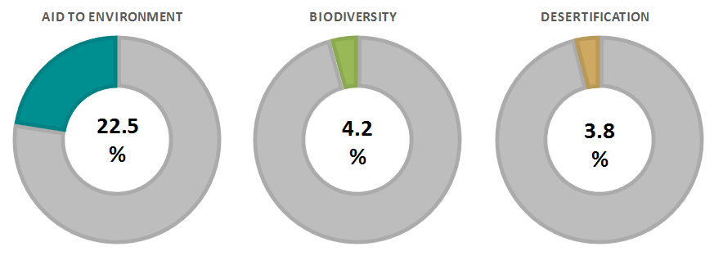
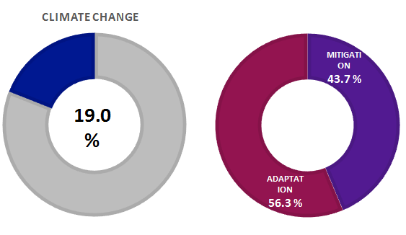
DEVCO commitments 2014-2017

Slide 13
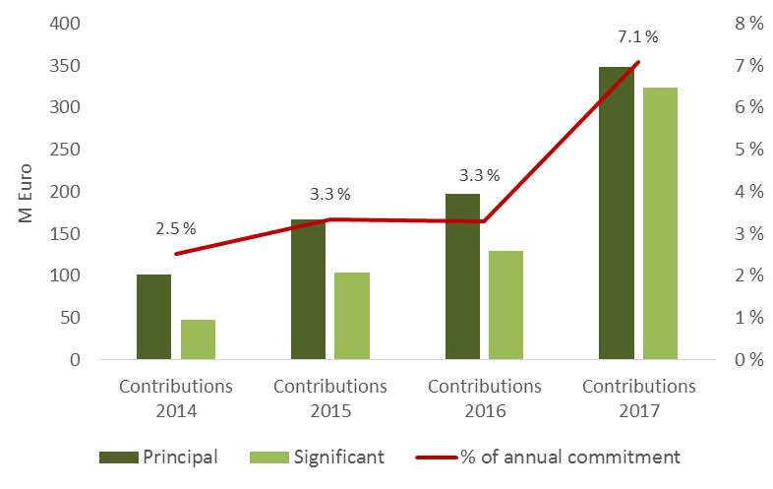
Financial flows to biodiversity

Slide 14
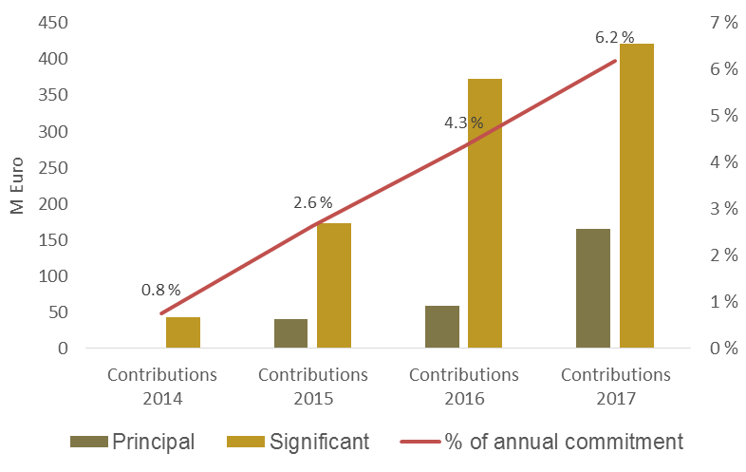
Financial flows to desertification

Slide 15
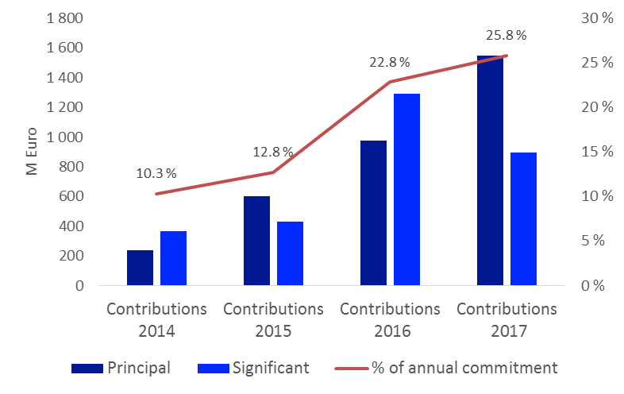
Financial flows to climate change

Slide 16
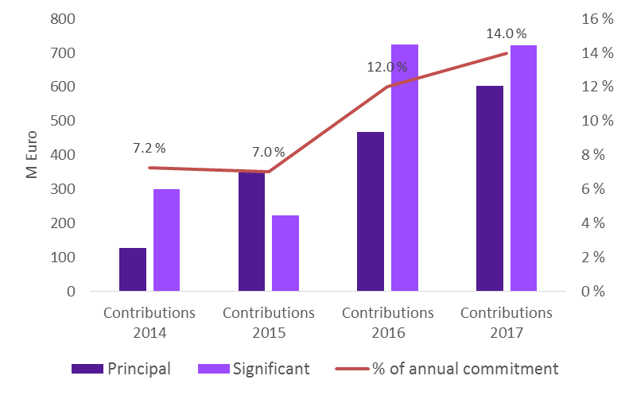
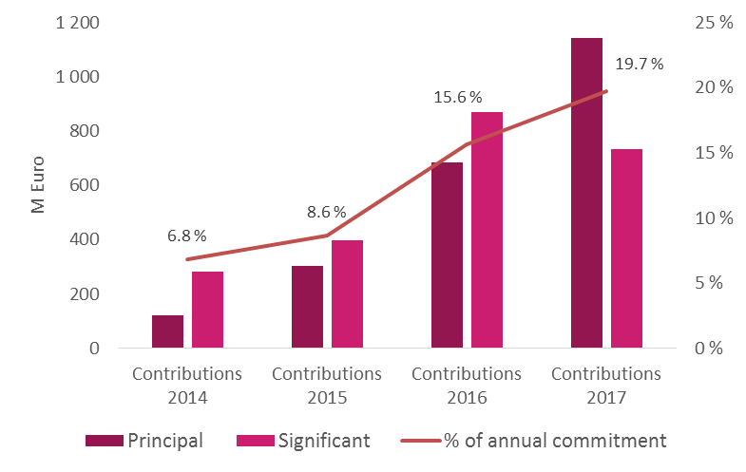
Financial flows to climate change mitigation/adaptation

Slide 17
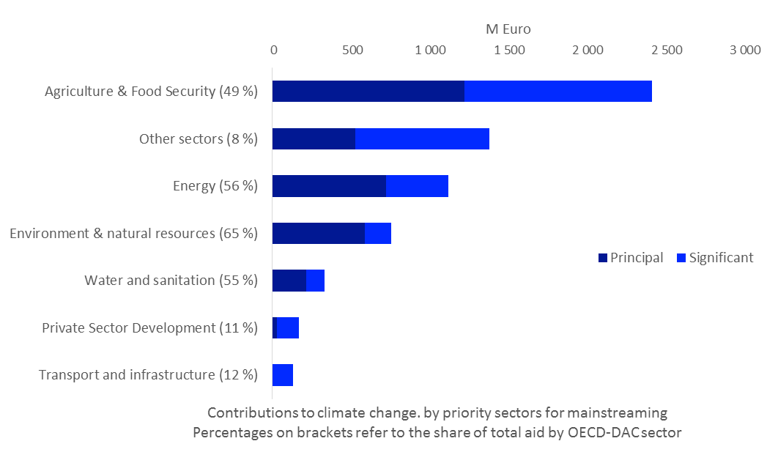
Contributions to climate relevant action (2014-2017)

Slide 18
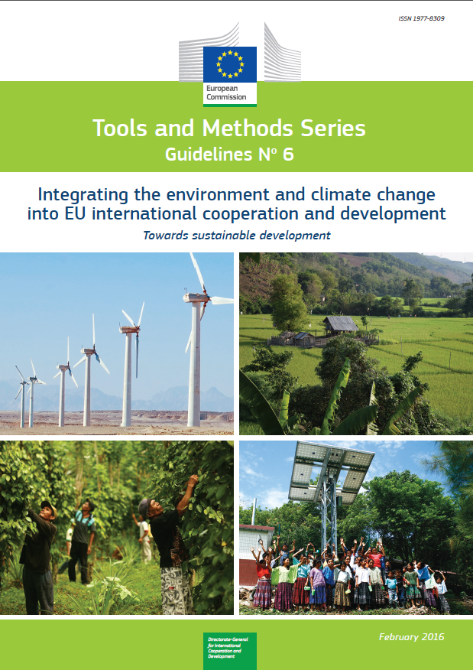
Purpose and background
The case for environment and climate change mainstreaming
Mainstreaming in practice
Annexes
  SDGs and targets relevant to mainstreaming
  ToR for a CEP
  Environment and climate risk screening
  Guidance for integration in formulation
  SEA ToR
  EIA ToR
  Monitoring and indicators
  Rio and aid to environment markers
  ToR for a CRA

Slide 19
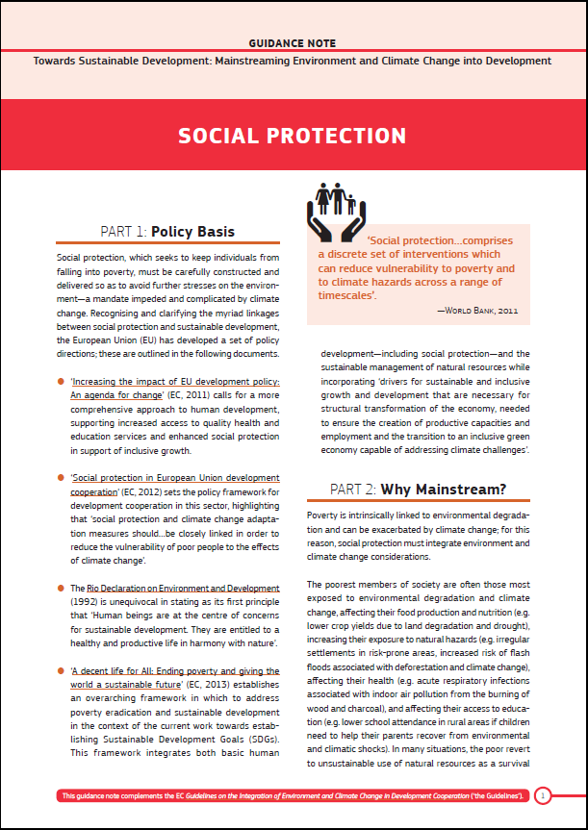
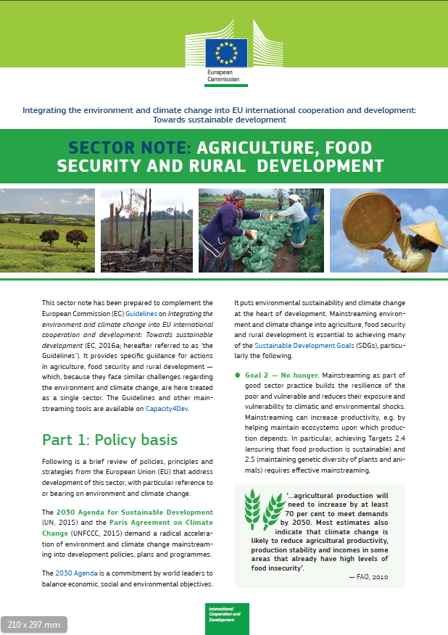
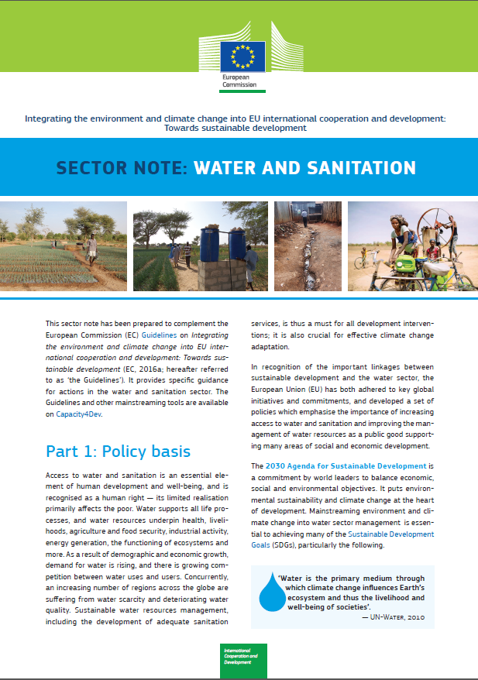
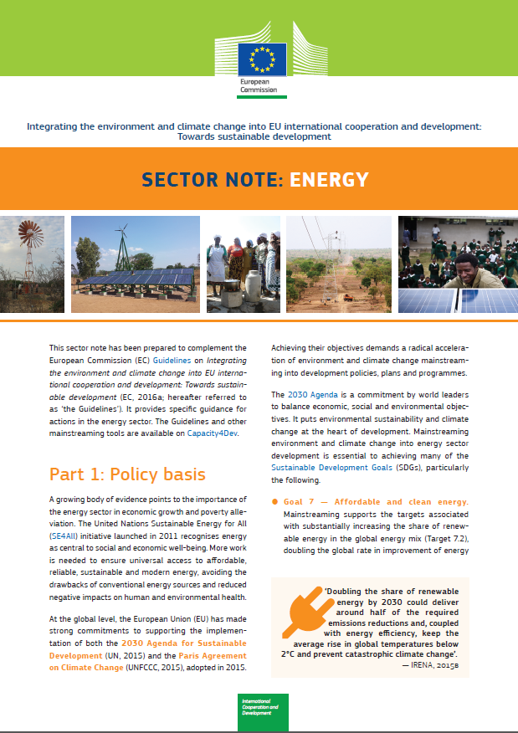
Sector Notes

