Slide 1
Towards Sustainable Development – Greening EU Development Cooperation
Module 3a:
Entry points for mainstreaming in the cycle of operations
Notes:
A. Intervention logic as theory of change - LFA here
B. Phases (start with exercise )
Programming
Identification and Formulation
Implementation
Completion/Closure and Follow up
C. Important choices to be made during the phases of development actions (exercise on stakeholder analysis and choice of partners – force field diagram)
Aid modalities as one choice to make
D. Stakeholder analysis (light)
E. Policy dialogue (light)

Slide 2
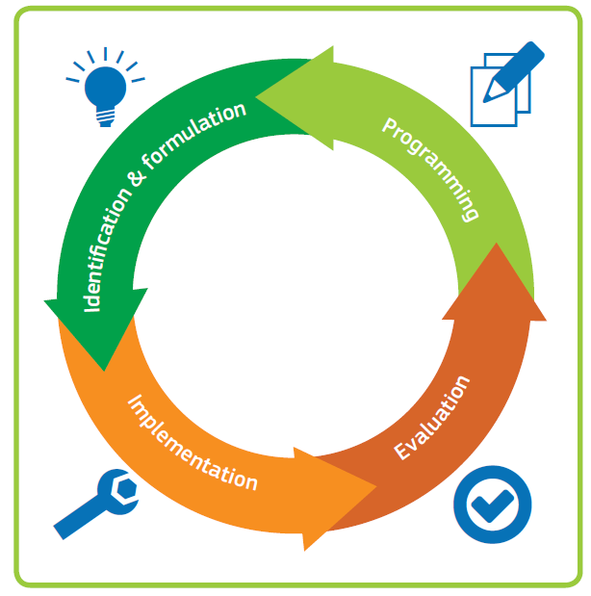
Environment and climate risk screening
Strategic Environmental Assessment (SEA)
Country Environmental Profile (CEP)
Environmental Impact Assessment (EIA)
Climate Risk Assessment (CRA)
Identification/formulation studies
Policy dialogue
Mid term evaluations
Budget support eligibility assessment
Final evaluations
Environmental Management Plan (EMP)
Climate Risk Management Plan (CRMP)
Performance indicators
Monitoring missions
ROM
Notes:
Implementation – is the forgotten phase

