Slide 1
Towards Sustainable Development –
Greening EU Development Cooperation
Module 3b:
EIA, EMP and CRA

Slide 2
Environmental Impact Assessment

Slide 3
Environmental Impact Assessment
“the process of identifying, predicting, evaluating and mitigating the bio- physical, social, and other relevant effects of development proposals prior to major decisions being taken and commitments made.”
– IAIA (International Association for Impact Assessment)
Notes:
is also to ensure that the public are given early and effective opportunities to participate in the decision making procedures.
Environmental Impact Assessment should not be a barrier to growth and is to be applied to a proportion of projects, where env’l impacts are likely.

Slide 4
Key objectives of EIA
Ensure environmental considerations are explicitly addressed and incorporated into the decision-making process
Anticipate and avoid, minimise and offset the adverse significant biophysical, social and other relevant effects of development proposals
Protect the productivity and capacity of natural systems and the ecological processes which maintain their functions
Promote development that is sustainable and optimises resource use and management opportunities.
(IAIA)

Slide 5
Key aspects around EIA
Widely established world-wide Applicable to projects with potential significant adverse impacts on the environment
Decision-informing in development consent
Traditionally impact-centered
Often also addresses socio-economic impacts (ESIA)

Slide 6
EIA principles
Early
Transparent
Participatory
Independent
Rigorous
Objective
Clear

Slide 7
EIA regulatory framework
Use of national systems – unless not up to standard
EIA Directive (2011/92/EU amended by 2014/52/EU)
Aarhus Convention
Kiev Protocol (to the Espoo Convention)
Performance Standards of Financial Institutions (relevant for blending)

Slide 8
EIA Process
Public Participation
Screening
Positive lists
Scoping
Participatory
Assessment
Different techniques
Screening criteria
Mainly quantitative
Beyond compliance
Inter-disciplinary
Define ‘mitigation measures’ – Mitigation Hierarchy
Avoid, minimise impact
Calculate residual impact
Maximise positive impacts
Prepare Environmental Management Plan
Public enquiry
Formal, additional to other opportunities
Decision
Go
Monitoring
Control and verification
Key aspects, methodologies, approach
Implementation / follow-up of EMP
No-go
Conditional
Notes:
Purpose of screening:
Identify those projects or activities that may cause potential significant impacts
Identify special conditions/analyses that may be required by international funding bodies
Categorize the project as one where:
Full-Scale EIA required
Some further environmental analysis required
No further environmental analysis required

Slide 9
Key contents to highlight
Non-technical summary
Analysis of alternatives (including baseline scenario)
Cumulative impacts
Addressing climate vulnerability
Impacts associated to vulnerability to major accidents and/or disasters
All phases of the project
Associated developments
Transboundary consultations

Slide 10
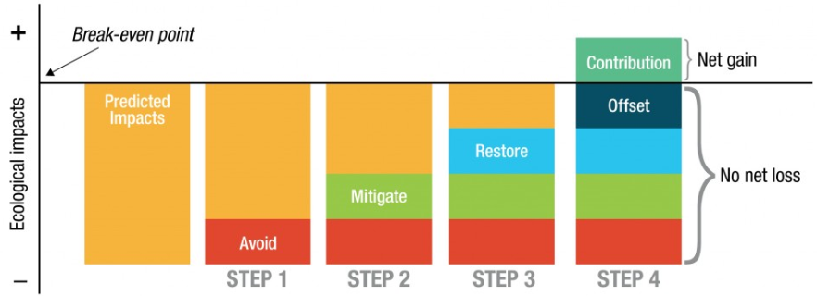
EIA and biodiversity: the "mitigation" hierarchy

Slide 11
Environmental Management Plan
Details for the implementation and monitoring of impact mitigation measures
    What? Who? When? How much?
  Must be reflected in contractual documents
Link to monitoring and evaluation

Slide 12
Common shortcomings in EIA systems
‘Catch-all’ approaches
Limited participation
Manipulation of data
‘Salami-slicing’
Unclear/un-precise
Little or no follow-up

Slide 13
Climate Risk Assessment

Slide 14

Climate Risk Assessment
Ex ante assessment
To reduce the project’s vulnerability to climate change
To reduce climate damage by preventive measures
To optimise positive impacts
Through technical/scientific studies and stakeholder consultations

Slide 15
Climate-proofing infrastructure
Example
What are the characteristics of the weather events for the given return period expected under climate change?
Probability (%)
Return period for design

Slide 16
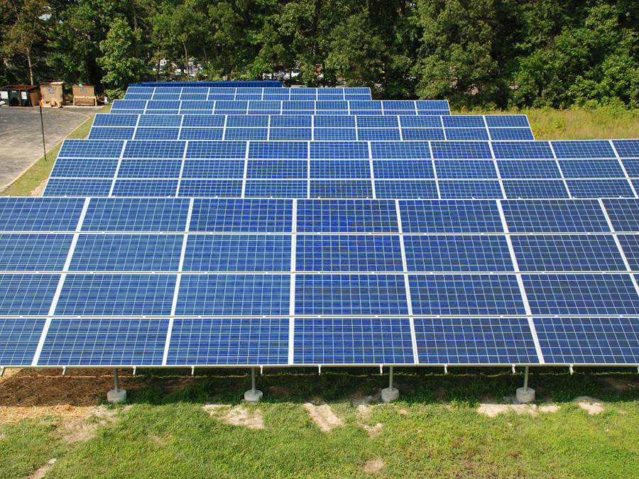
Example
Anguilla Solar PV project
1 MW grid-connected, ground mounted Solar PV Project
EIB Required a
Climate Vulnerability Assessment
WIND PV Plant most sensitive to wind
Data show wind gusts up to 140 mph
Could damage system components
Corrected for CC: projected gusts of 155 mph
Other data: increase in Category 4 and 5 hurricanes
Thus, design for the above 1 in 150 year events

