Slide 1
Towards Sustainable Development –
Greening EU Development Cooperation
Module 5: Strategic Environmental Assessment (SEA)

Slide 2
Origins of SEA
Originates jointly with EIA processes in 1969, in the US, but starts gaining prominence only in the 1990’s
Arises out of recognition of the limitations of project-level EIA – need to incorporate environmental considerations from early planning stages
Need to inform strategic decisions about their potential environmental consequences

Slide 3
Tiering approach
Policies
Plans
Programmes
National
Projects
Impact assessment
Sectoral
Impact assessment
Regional
Local

Slide 4
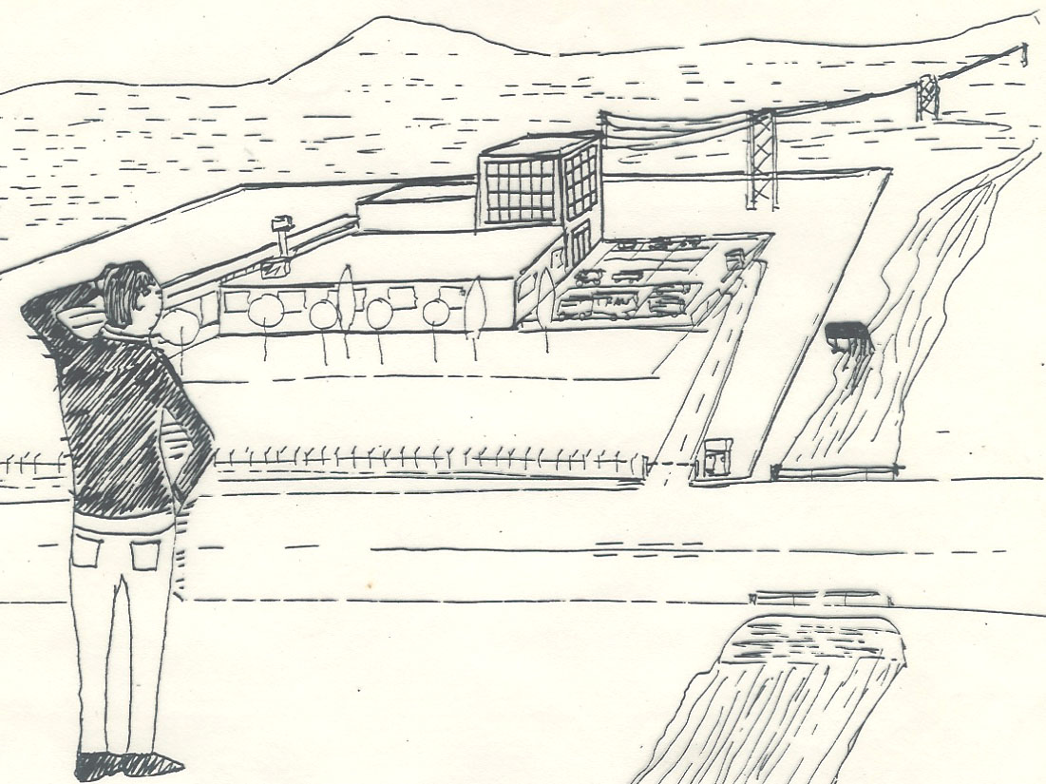
EIA: we know what we want to assess
Partidário (2007)

Slide 5
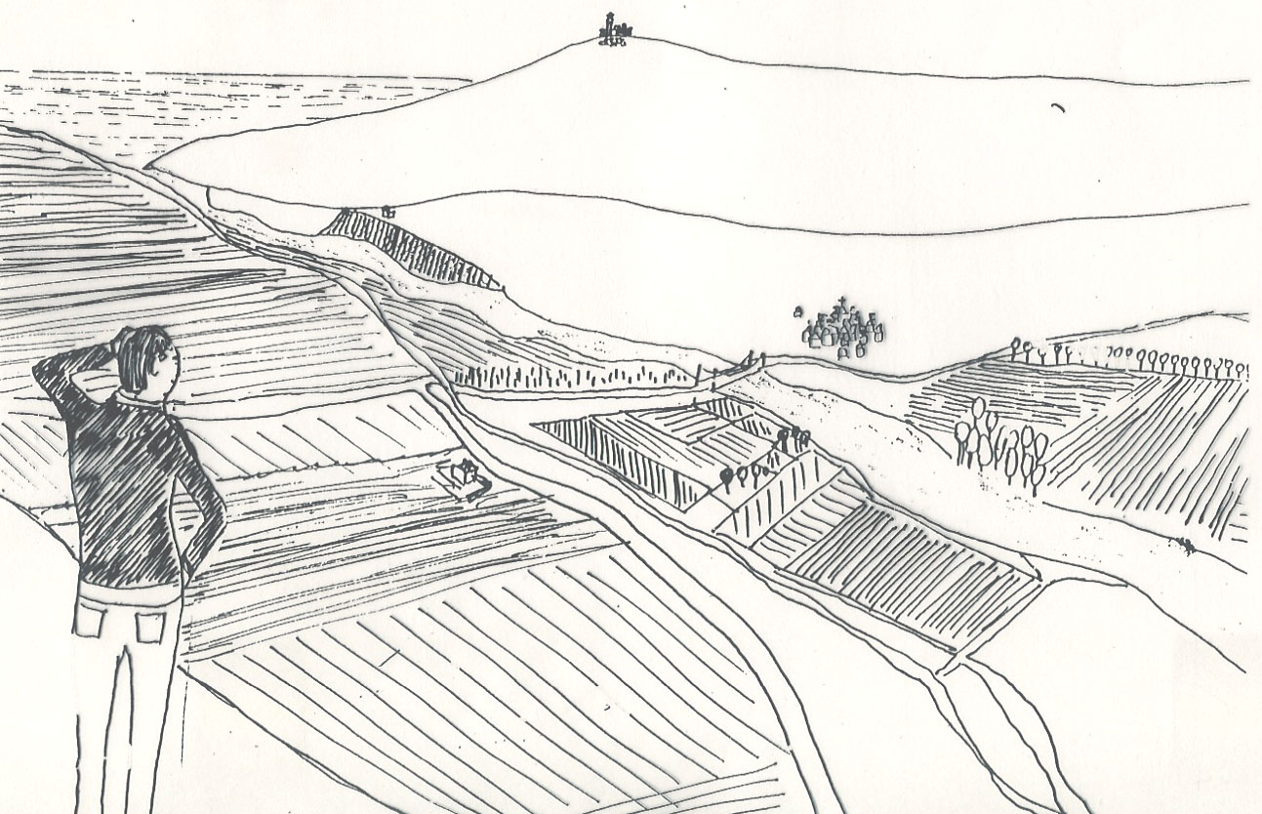
SEA: we have an idea of what we want, but don’t know exactly what will be done
Partidário (2007)

Slide 6
EIA vs SEA – Key differences
EIA | SEA
Project-level | Policies, plans & programmes
Focus on informing development consent authorisation process | Focus on enhancing policy-making/planning process
Relatively standard approach | Different approaches available
Widely adopted in legal systems | Few countries have legal system
Quantitative analyses dominate | Qualitative analyses dominate
Analyses alternatives within a project | Analyses alternatives to achieve strategic objectives

Slide 7
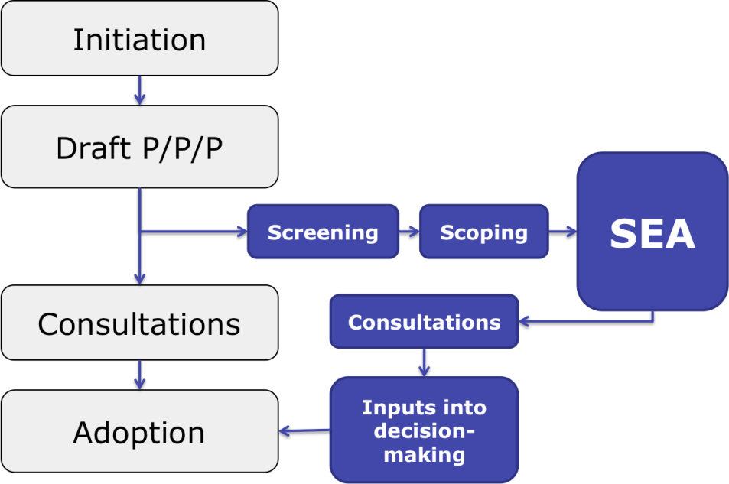
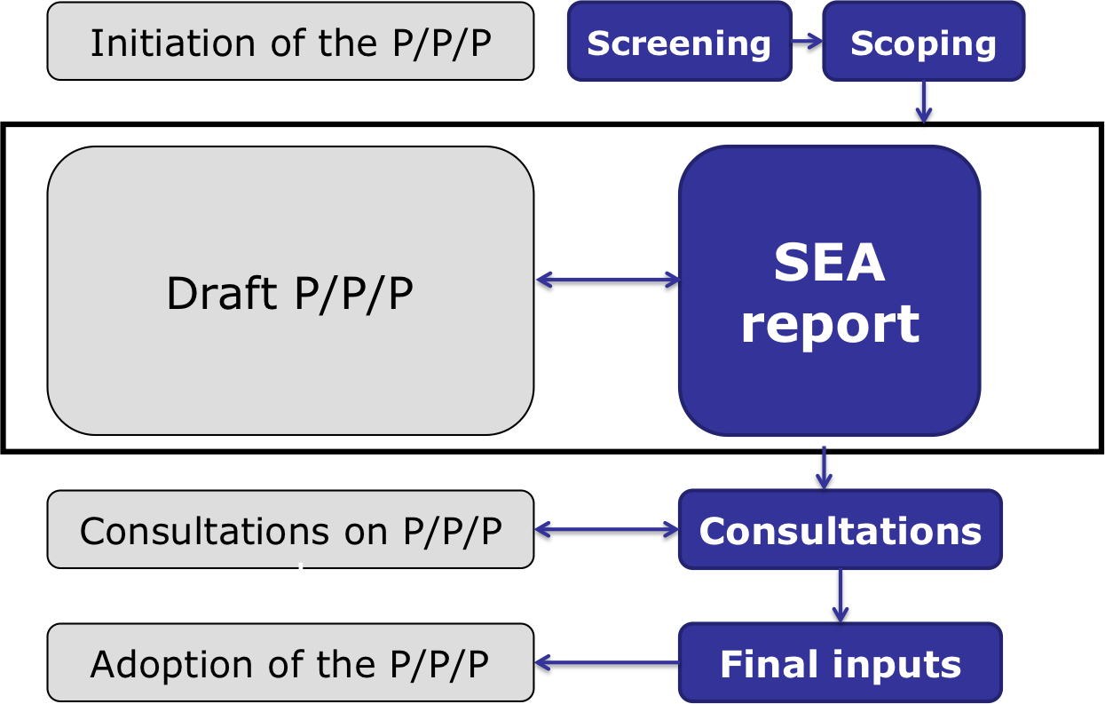
Approaches to SEA
Based on draft PPP vs in parallel to PPP elaboration vs fully integrated
Adapted from: GTZ (nd)

Slide 8
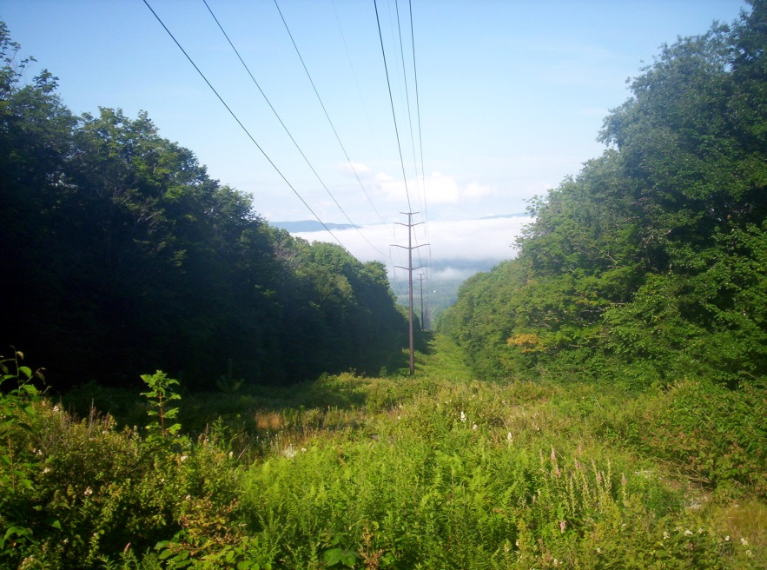
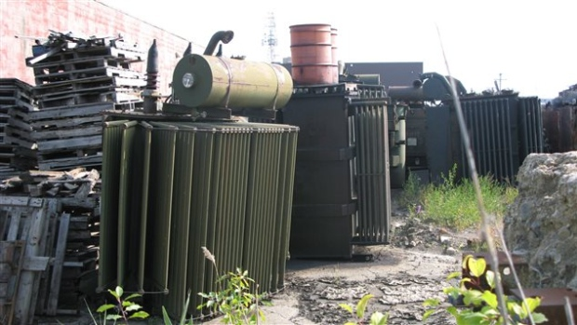

DEVCO’s approach to SEA
Common to most SEA systems:
What are the likely environmental consequences of implementing the policy/plan/programme?
© GCCA/Catherine Paul

Slide 9
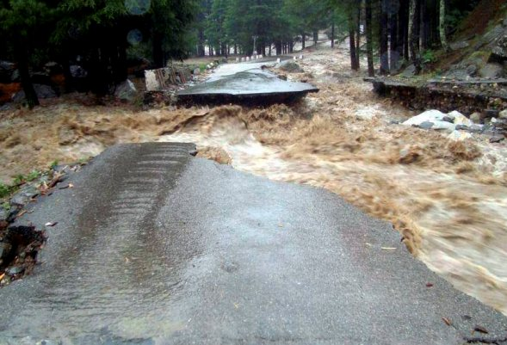
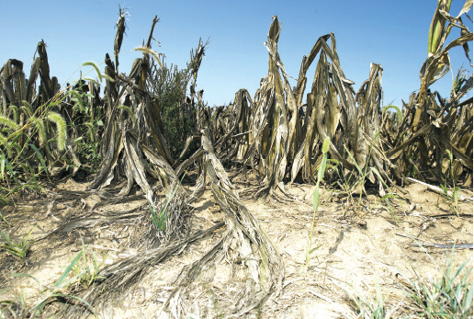
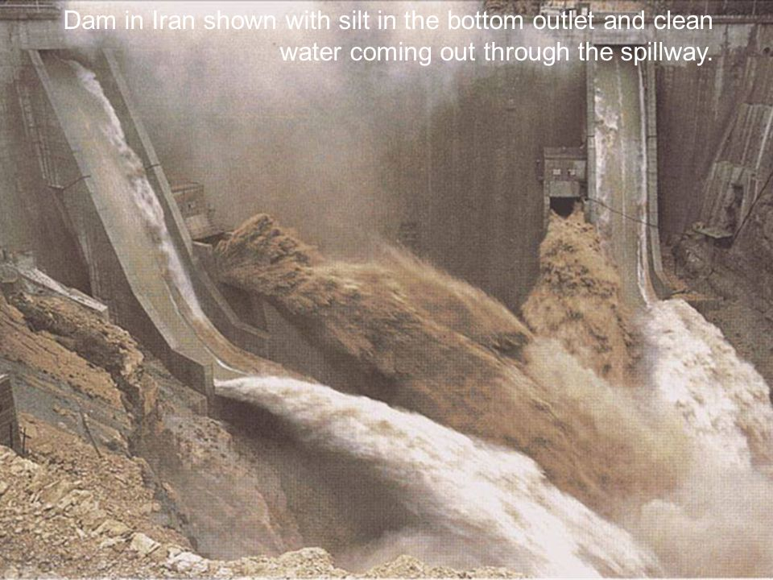
DEVCO’s approach to SEA
Also addressed in EU development cooperation approach:
Are the environmental threats faced by the sector taken being addressed? Are the potential effects of climate change on the sector taken into account? On the proposed actions?
© GCCA/Catherine Paul

Slide 10
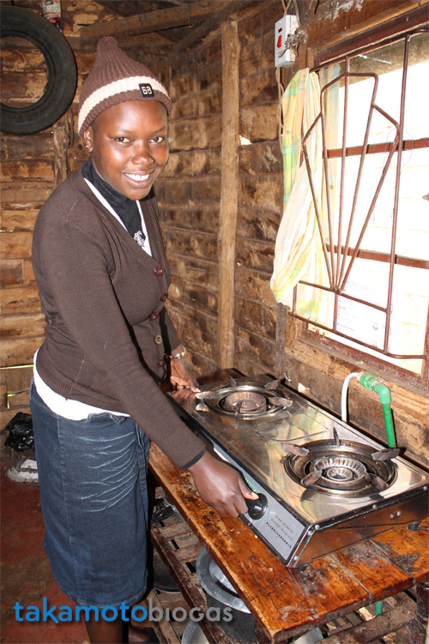
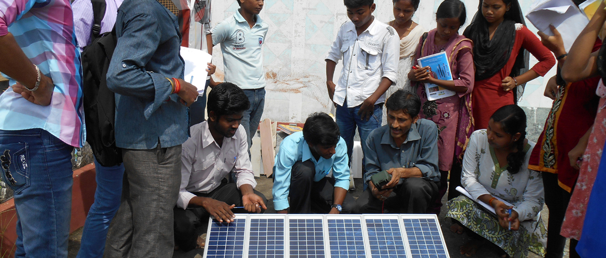
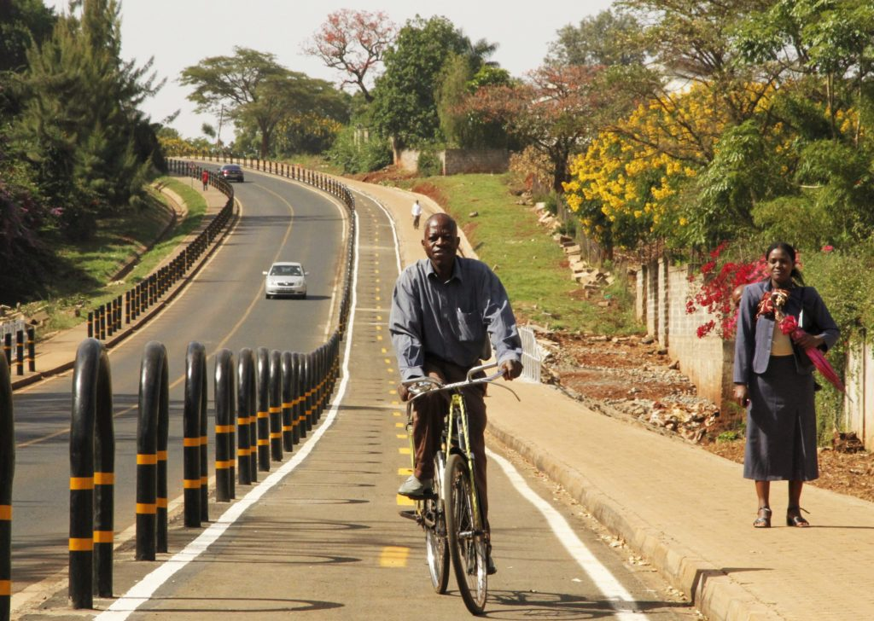
DEVCO’s approach to SEA
Also addressed in EU development cooperation approach:
Are there opportunities to enhance:
  Environmental sustainability?
  Low carbon development?
  Climate resilient development?
© GCCA/Catherine Paul

Slide 11
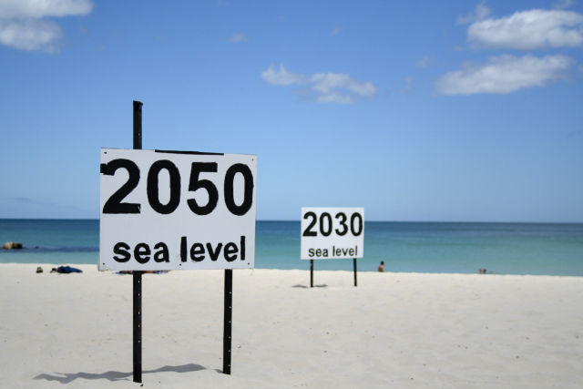
SEA and climate change
Strategic planning: medium- to long-term
Climate change becomes fundamental

Slide 12
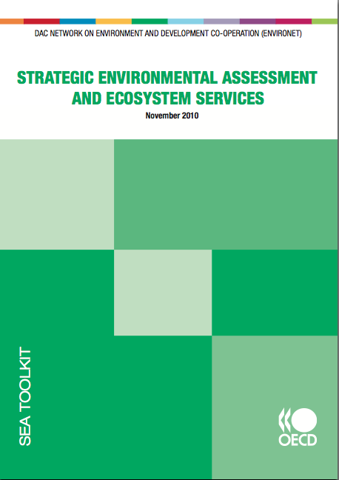
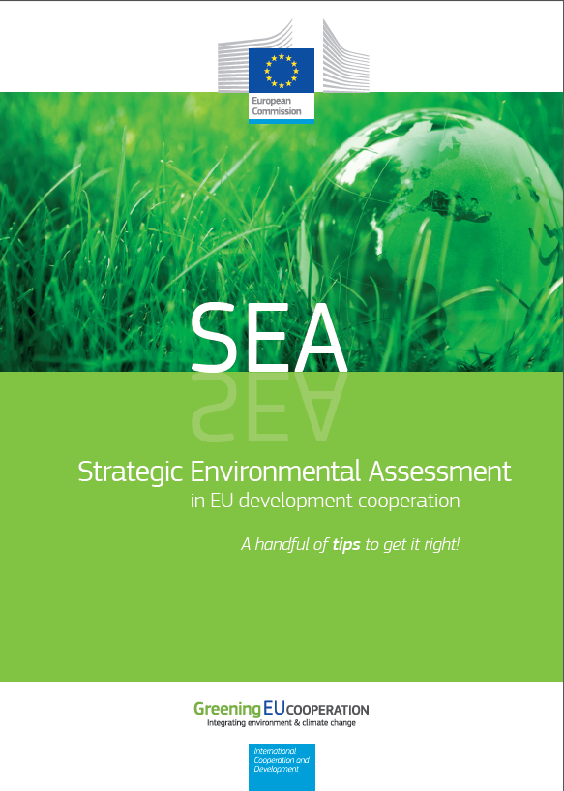
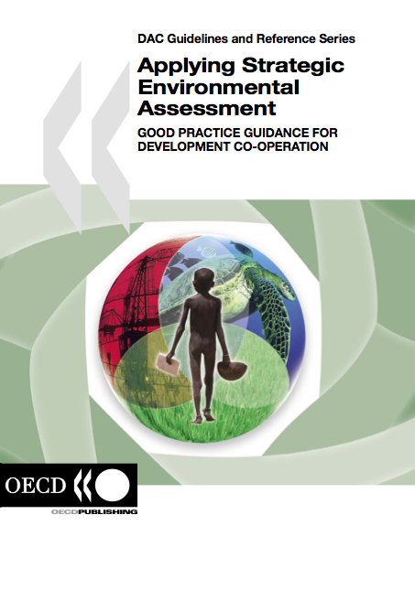
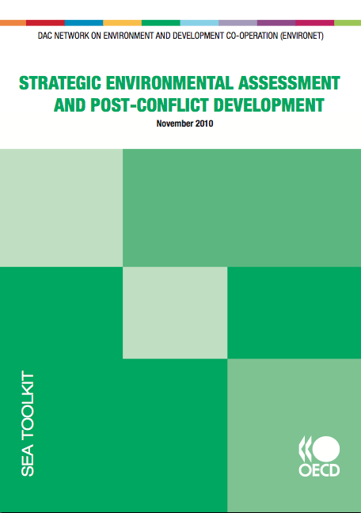
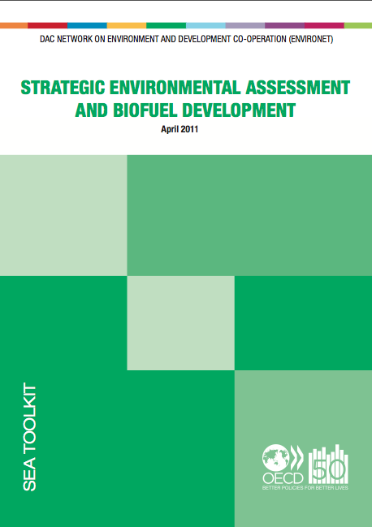

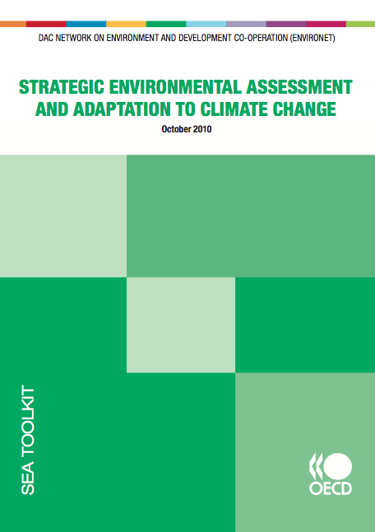
Guidelines for SEA

Slide 13
SEA in EU development cooperation
1
When providing budget support or comprehensive sector-wide support
Ensure national/sectoral strategies supported are environmentally sustainable and climate resilient (e.g. in BS eligibility criteria)
Inform policy dialogue on sector-related environmental and climate change aspects
Inform formulation: identify opportunities to promote environmentally sustainable, climate resilient and low carbon options
Provide inputs to national partners to enhance environmental sustainability and climate resilience of their policies and strategies
Inform the selection of performance indicators that capture key environmental and climate-related concerns
Build awareness and capacities of national stakeholders on key sector-related environmental and climate-related aspects

Slide 14

1
When providing budget support or comprehensive sector-wide support
SEA Recommendations
To the EU Delegation
To the partner government
To address through policy dialogue
Improve formulation of EU support programme
Improve sector strategy
© GCCA/Catherine Paul

Slide 15
SEA in EU development cooperation
2
When supporting national/sectoral policy-making and planning processes
Integrate SEA as an integral component of the policy-making/planning process…
to ensure policies, plans and strategies respond to environmental and climate change challenges and opportunities
Builds awareness and capacities of national stakeholders on key sector-related environmental and climate-related aspects

Slide 16
SEA in EU development cooperation
In all cases…
Build a common understanding on the SEA approach
Identify clear entry points of the SEA in the relevant policy-making and planning processes
Ensure ownership of the SEA process by national partners
Agree on how the SEA findings will be discussed and implemented
Develop SEA capacities
Disseminate benefits and good practices

Slide 18
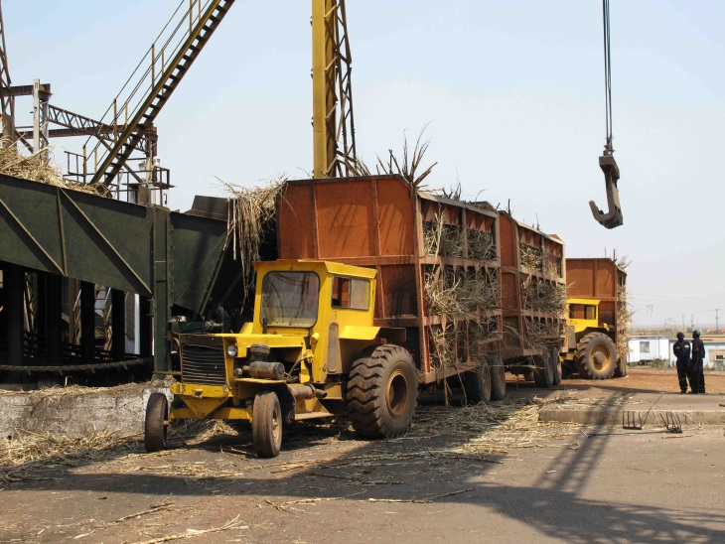
SEA of Zambia’s sugar adaptation strategy – addressing potential impacts
Example
Introduction of new industrial sector: ethanol distilling
Potential impacts: vinasse management
Addressing risks at a strategic level: strengthening capacities of the environmental protection agency

Slide 19
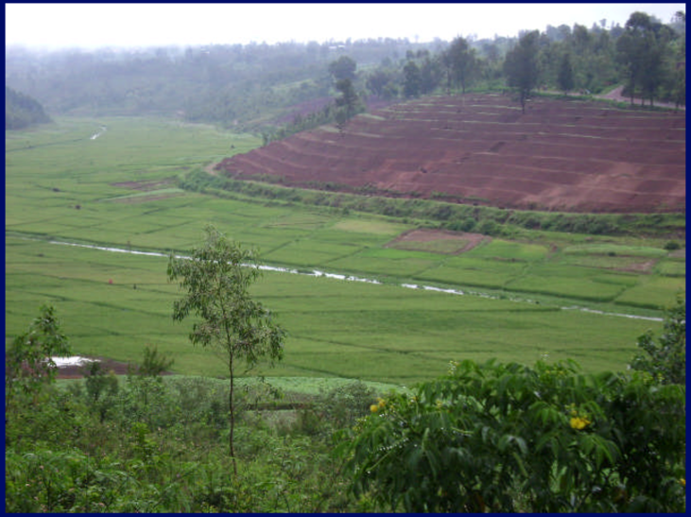
SEA of Rwanda’s agriculture sector strategy – seizing opportunities
Example
Recommendations on soil & water conservation and soil acidity informed the 11th EDF – e.g. performance targets on agro-forestry, reduction of soil acidity in areas of public investment…
SEA is reference for design of feeder roads development policy and strategy.
Findings on soil nutrient management informed GoR’s review of inputs subsidy scheme and recommendations for pest and disease management to be promoted.

Slide 20
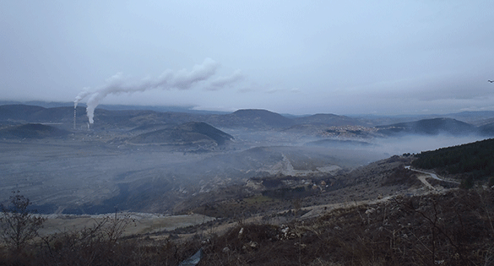
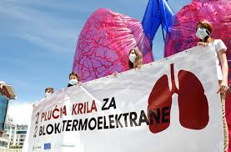
SEA of Montenegro’s climate change strategy – enabling opportunities
Example
Potential contribution to air quality and improved health: co-generation from thermal power plant / reduced burning of coal in households
Key issues: how to ensure positive contributions would materialise?
http://bankwatch.org/our-work/projects/pljevlja-ii-lignite-power-plant-montenegro
http://etnar.net/two-lungs-for-two-blocks-of-thermal-power-plant/

