Slide 1


Support from HQ

Slide 2






Resources
Environment & Climate Change integration Guidelines
Sector Notes
Other publications
© GCCA/Catherine Paul

Slide 3
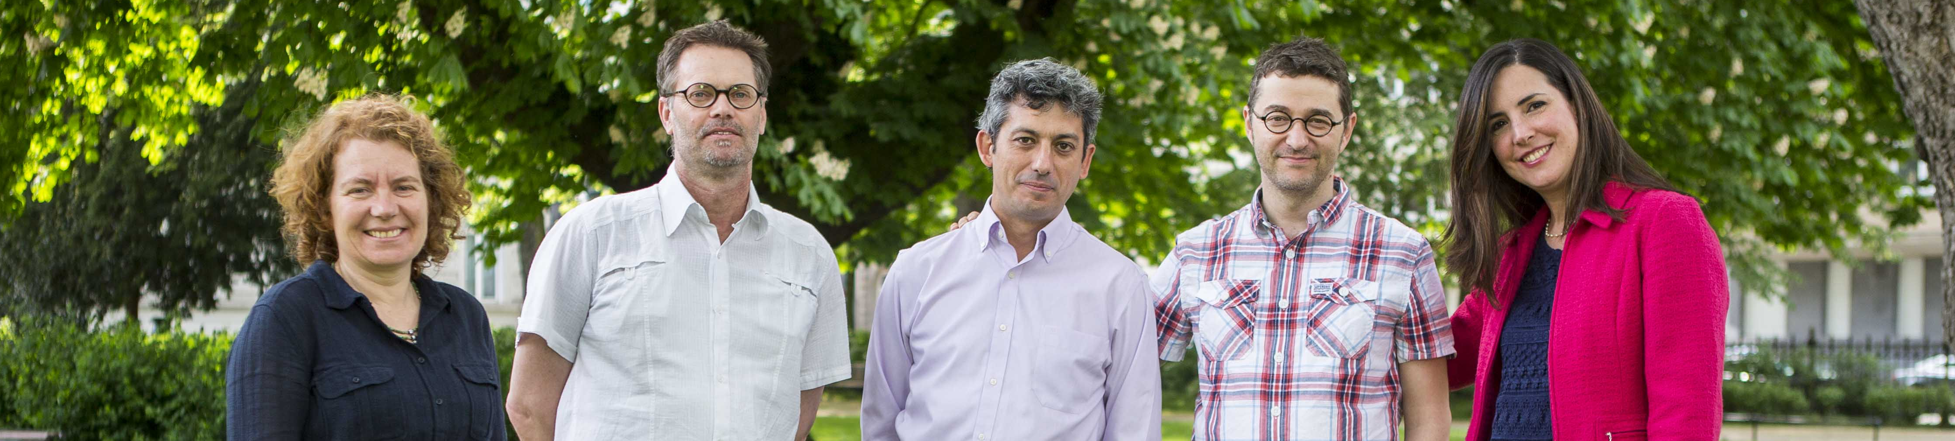
Mainstreaming facility
Technical (Communication) Expert
Mrs. Patricia Rodriguez
Team Leader
Mr. Egger Topper
Technical Expert
Mrs. Raffaella Sardi
Deputy Team leader,
Technical Expert
Mr. Juan Palerm
Technical Expert
Mr. Geraldo Carreiro
Notes:
Core team of 5 experts providing a three full-time equivalent input into the Facility
Pool of non-key experts

Slide 4

Support available from:
DEVCO C2
DEVCO C6
Mailbox: EuropeAid-C2-MAINSTREAMING@ec.europa.eu
JOIN Capacity4Dev:
http://capacity4dev.ec.europa.eu/public-environment-climate/
© GCCA/Catherine Paul

Slide 5


Use of human resources
Thank you!

