Slide 1
Policy Dialogue on Environment and Climat Change
Module 1:
Policy Dialogue:
Tool for promoting change
Why? Who? What? How?
Brussels, 23 May 2019
Thomas Theisohn (thomas.theisohn@gmail.com)
Notes:
Background
Policy dialogue is not new: delegations have been doing it during operations designs and management, and beyond operations
New guidance seeks to build on experience and clarify EUDs roles
Achieving a more strategic, structured, pro-active and documented policy dialogue: international commitments (Aid effectiveness) and EU policies (Agenda for Change & Budget Support communications)
Key principle = flexibility: adapted to country/sector situation

Slide 2
Structure of Module 1
Overview
Who? - PEOPLE
Stakeholders, political economy, …
How? - PROCESS
Entry points, time and space, quality of engagement
1
2
3
4
5
6
Why?
Rationale, instrument for change, …
What? - PROBLEM
Objectives, assumptions, problem solving, …
Groupwork

Slide 3
Session 1:
Policy Dialogue on Environment & CC: Tool for promoting change
Introduction and overview
Module 1: Why? Who? What? How?
Group work
Debriefing in plenary
Session 2:
Role-Play: “Programming dialogue in Uqbar”
1. Preparatory meeting within constituency
2. Programming dialogue between the 4 constituencies
Debriefing in plenary
Conclusions
Module 1:
Rationale, challenges and potential
of a structured approach
to Policy Dialogue
Session 3:
Preparing policy dialogue on Environment & CC
Connecting some dots from the role play
Module 2: Strategic approach to policy dialogue
Group exercise: Imagine you were Head of Cooperation …
Debriefing in plenary
Session 4:
Take-Aways, HQ issues and Lessons
Debriefing in plenary (cont.)
Discussion with HQ colleagues
Wrap-up and closing
DEVCO Environment Week 2018, Brussels, 17 October 2018
Thomas Theisohn (thomas.theisohn@gmail.com)
Notes:
Background
Policy dialogue is not new: delegations have been doing it during operations designs and management, and beyond operations
New guidance seeks to build on experience and clarify EUDs roles
Achieving a more strategic, structured, pro-active and documented policy dialogue: international commitments (Aid effectiveness) and EU policies (Agenda for Change & Budget Support communications)
Key principle = flexibility: adapted to country/sector situation

Slide 4
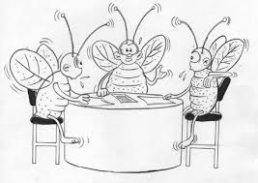
Policy Dialogue in practice
Module 1:
Rationale, challenges and potential
of a structured approach
to Policy Dialogue
Coffee
Lunch
WIFI
Documents
…
DEVCO Environment Week 2018, Brussels, 17 October 2018
Thomas Theisohn (thomas.theisohn@gmail.com)
Notes:
Background
Policy dialogue is not new: delegations have been doing it during operations designs and management, and beyond operations
New guidance seeks to build on experience and clarify EUDs roles
Achieving a more strategic, structured, pro-active and documented policy dialogue: international commitments (Aid effectiveness) and EU policies (Agenda for Change & Budget Support communications)
Key principle = flexibility: adapted to country/sector situation

Slide 5
Structure of Module 1
Overview
Who? - PEOPLE
Stakeholders, political economy, …
How? - PROCESS
Entry points, time and space, quality of engagement
1
2
3
4
5
6
Why?
Rationale, instrument for change, …
What? - PROBLEM
Objectives, assumptions, problem solving, …
Groupwork

Slide 6
Policy dialogue to be accurately integrated in the Action Document
“4. Description of the action (max. 3 pages,)
4.1 Overall objective, specific objective(s), expected outputs and indicative activities
< For project modality, list all expected results: Overall objective (expected impact), specific objective(s) (expected outcome(s)), and expected outputs (if defined at this stage) – in line with the results chain of the Logframe Matrix in Appendix.
<List here the main indicative activities. Where possible, these activities should be grouped per expected outputs.)>
For Budget Support modality
< In case of budget support, consider both budget support and complementary support >
please list all expected results:
Overall objective : the expected impact of the policy supported through BS,
specific objective(s) : the expected outcome(s) of the policy supported through BS,
the induced outputs of the policy supported through BS
the direct outputs of the budget support contract (indicatively one for each input: financial transfers, policy dialogue, performance, capacity development)
Please refer to the guidance provided in Chapter 2.3.3 and Annex 2 of the Budget Support Guidelines (2017). This results chain should be reflected in the Intervention Logic under section 4.3.of the Action Document as well as in the summary of Intervention Logic in Annex 1. >
< For budget support, present the main inputs (budget support, performance assessment, policy dialogue and, when appropriate, complementary support). >” (AD template 2018)
4.2. Intervention logic
“... Explain briefly how the financial transfers together with policy dialogue, performance assessment and capacity development is expected to contribute effectively to improved outputs, outcomes and ultimately impact.”
(AD instructions 2018)
Source: Action Document Instructions

Slide 7
What is Policy Dialogue?
ESSENTIAL activity (under Budget Support) and CRUCIAL (for other interventions)
It is expected to CONTRIBUTE to the objectives of BS & other interventions
Used to MITIGATE some of the RISKS
COHERENT and in line with the AGREED OBJECTIVES
Adaptation of Annex 13, Budget Support Guidelines 2017
Cross-cutting themes are crucial !

Slide 8
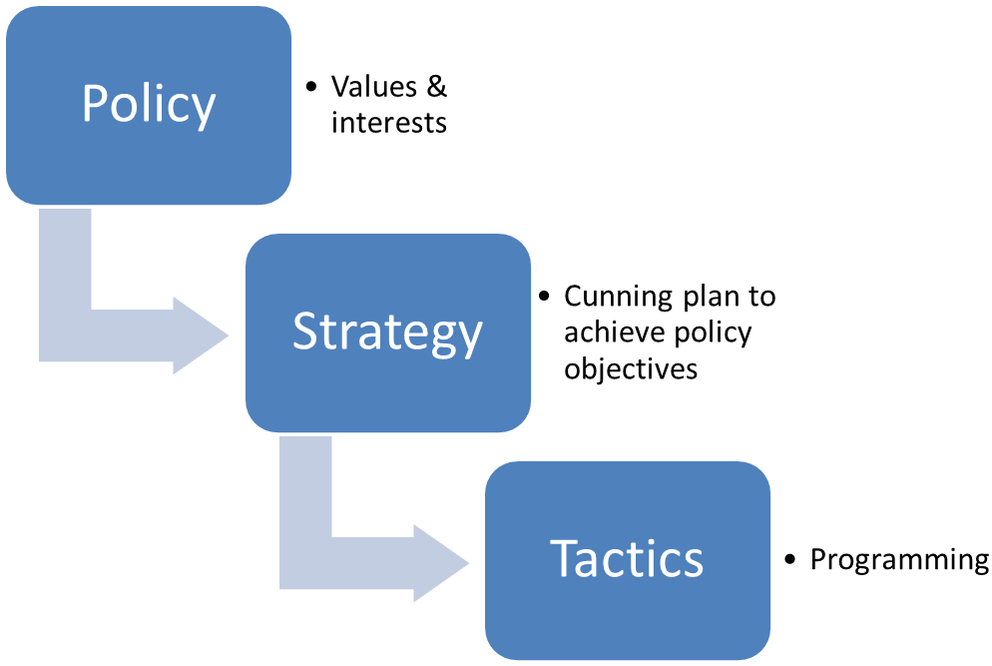
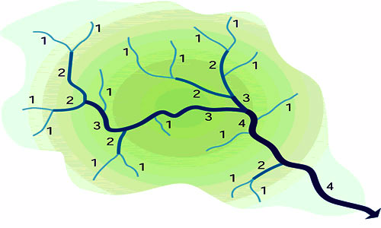
Policy dialogue is an
’open and inclusive dialogue on development policies’.
Accra Agenda for Action (Section 13)
Policy Dialogue
“Policy dialogue is a process of communicating and negotiating values in a landscape of power and knowledge imbalances”
AUSAID 2013
Policy Dialogue
Situational Analysis
Multiple policy streams across sectors
Source: AUSAID 2013 Thinking and Working Politically AN EVALUATION OF POLICY DIALOGUE IN AUSAID
Notes:
Differentiating ‘policy’ from ‘strategy’ and ‘tactics’
We think it is important to differentiate ‘policy’ from ‘strategy’ and ‘tactics’ (Figure 1).
‘Policy’, we are saying, is fundamentally the expression of the values that an organisation holds to be important in delivering its mandate. In the context of government and public services, policy is inherently political. Administrations—such as a partner government department or AusAID itself—deliver on the policies established (or the values expressed) by ministers.
‘Strategy’ can be seen as the ‘cunning plan’ to achieve stated higher-level policy objectives. Strategy is about how an organisation organises its presence, efforts and resources, and its ways of working, such that they represent the right thing in the right place at the right time to contribute most efficiently and effectively to reaching its goals. Strategy will involve a consideration of the mix and focus of the aid program, and the types of aid that should be employed, where and when. That is, the ‘how’ of the aid program, or the Delivery Strategy in AusAID’s Country Strategy Architecture.
‘Tactics’ are the programming decisions made in operationalising a strategy. They are the choices made about inputs and activities—for example the deployment of technical assistance or the allocation or reallocation of assets and resources, to achieve the required results efficiently and effectively.
This concept derives in part from: D. Nabarro, Special Representative of the UN Secretary General, personal communication.
AUSAID 2013 Evaluation of Policy Dialogue

Slide 9
Two types of dialogue may be distinguished:
Political dialogue, which in line with the Lisbon Treaty or other legal bases covers all EU external policies be they development, neighbourhood or enlargement, foreign and security, or migration policies.
Policy dialogue (PD) covers the specific sectors of EU cooperation and supports the partner country's efforts to achieve the objectives laid down in their strategies.
Annex 13, Budget Support Guidelines 2017
« Dialogue politique » – « Dialogue sur les politiques »
Partnership Instruments / Dialogue facilities
Notes:
A broader explanation of the difference between Political and Policy dialogue will be given in the slide 25.

Slide 10
Policy dialogue is continuous, dynamic,
multidimensional, non-linear, purposeful exchange …
… between:
»…In relation with partner countries, the EU and its Member States will put renewed emphasis on country ownership, partnership and dialogue, in order to contribute to greater effectiveness…
They will promote open government dialogues with all stakeholders during the decision-making, planning, implementation and review stages.”
European Consensus (2017)
Intra/ Inter DP
Donor-Country
Domestic stakeholders
(“Democratic Space”)
… at multiple levels:
Global/Regional/national/sub-national levels
Technical and strategic levels
Formal and informal
Content focus and depth
Intra-EU and intra DEVCO dialogue!
… and evolving over time !

Slide 11
JGF GPFAM JS CQQD
An example of a cognitive bias

Slide 12
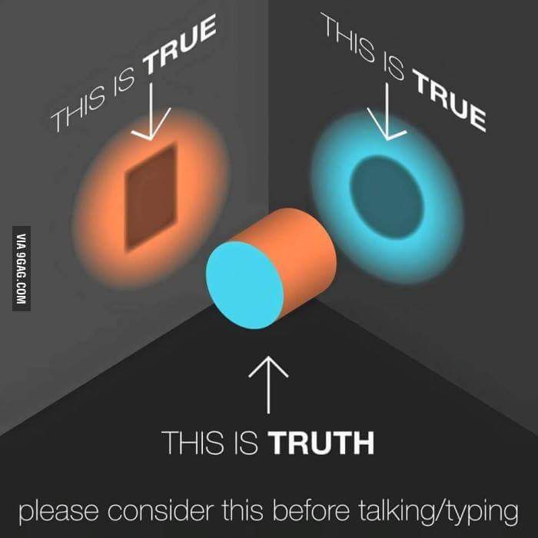
Principles for engaging in Policy Dialogue
Realism
Alignment
Trust/transparency
Inclusive Dialogue
Respectful
Constructive
Committed
Responsive
Iterative
There may be more valid perspectives !

Slide 13
“We should have talked about it!”
Assumptions (Instructive examples)
Reform related risks are adequately managed
Stakeholders share a common understanding of reform priorities and direction
Political feasibility of reforms is duly taken into account
Implementation is adequately sequenced and proceeds at a reasonable pace
Expectations are adequately managed
Reform momentum is sustained
Local ownership principles are honoured through processes of validation by a wide cross-section of national stakeholders
Blueprint approaches are avoided
Plans and proposals are realistic and feasible and the ‘politics of implementation’ is duly taken into account
Resources are made available by the Government to support the rollout of reforms
A viable interface between bottom up approaches and top down reforms is created
Broader public sector reforms do not hinder sector-wide reform processes
Source: Drawn from EU Health Sector Support Programme, Libia
Assumptions are masters in disguise …

Slide 14
PPCM steps and continuity of policy dialogue
PROGRAMMING
IDENTIFICATION
FORMULATION
MONITORING
EVALUATION
IMPLEMENTATION
ACTION DOCUMENT
PROGRAMMING
EVALUATION
IDENTIFICATION
FORMULATION
MONITORING
POLICY DIALOGUE
STAKEHOLDER PARTICIPATION AND COALITION AROUND VISIBLE CHANGE PATHS
ANALYSIS, EVIDENCE, LESSONS, LEARNING
SEA as key instrument
Use purposefully!
Target for purpose!

Slide 15
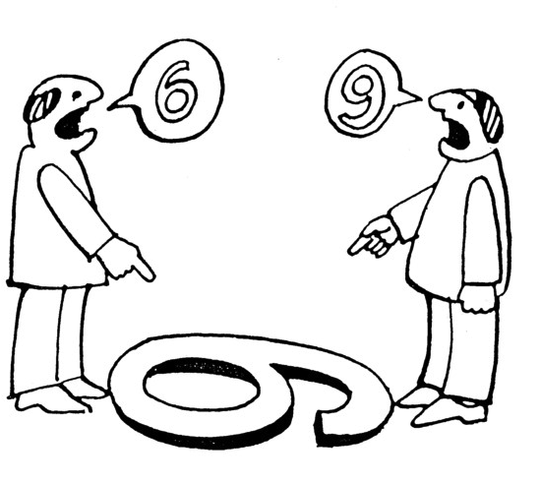
What challenges do you face with
Policy Dialogue on Environment?
Why?
From where do problems arise?
A key premise:
please, put yourself into the shoes of
your counterparts!

Slide 16
Risks of Dialogue Failure
PEOPLE | PROBLEM | PROCESS
No leadership Conducted with the “wrong” actors Flickering representation: stakeholders scope and mandate Mindsets, Stereotypes, lack of trust Lack of technical expertise Interests and power (also on the EU/donor side) | Partial coverage/ empty dialogue Issues not treated Lack of solid content and result-oriented focus Agenda controlled by interest/political priorities (hidden agenda) « Empty » Forum Venues non conducive: trust | Unclear/purposeless process Overall environment in partner countries Ad hoc organisation of PDs Trapped in over-formalised settings “Little leverage” -> little interest
The environment and climate change nexus adds complexity!

Slide 17
Structure of Module 1
Overview
Who? - PEOPLE
Stakeholders, political economy, …
How? - PROCESS
Entry points, time and space, quality of engagement
1
2
3
4
5
6
Why?
Rationale, instrument for change, …
What? - PROBLEM
Objectives, assumptions, problem solving, …
Groupwork

Slide 18
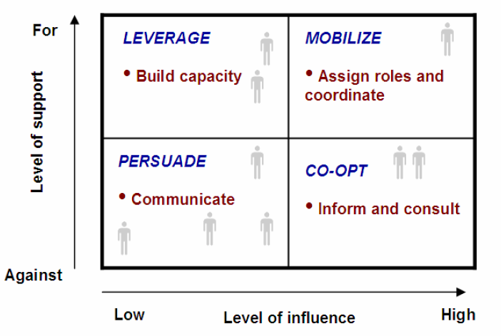
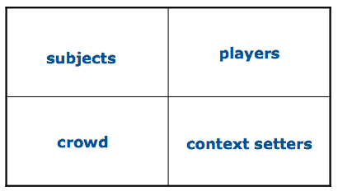
Policy Dialogue engages diverse stakeholders
High
“STAKEHOLDERS”
Political structures, government departments, organisations, groups, networks, coalitions, media and opinion leaders, individuals
“INTEREST”
Measures the degree of importance attached to the issue by the various stakeholders and how they are likely to be affected by it
“POWER”
Measures the influence stakeholders have and the degree to which they may help achieve or block the reform
Interest
e.g. Hydro dams in protected areas
Low
Low
High
Power
Different PEOPLE may need to be handled differently

Slide 19
EUD’s roles in engaging with the partner country
EU INSTITUTIONS
DG DEVCO
European External Action Service - EEAS
DG NEAR
Line DGs (DG TRADE, DG MARE, DG Env.,etc)
EUDs
PARTNER COUNTRY
MEMBER STATES
Notes:
NEW VERSION proposed

Slide 20
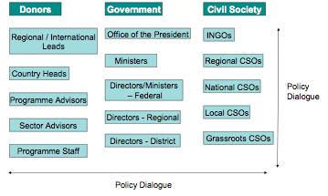
Understanding who makes policy helps identify opportunities
Representative model
Liberal democratic view
Rational actor model
Expert view
Bureaucratic politics model
Scepticism
Interest group model
Pressure and lobbying
Policy network model
Differentiated and disaggregated policy process
Third Sector and NGO advocates
NGOs represent ‘their’ clients
Elitist model
Decisions taken in a closed insider circle
Based on: John Wanna, John Butcher, Benoit Freyens, ‘Policy in Action’, 2010, p. 173
Review of Literature and International Practice in Policy Dialogue » July 2011 »
Whatever “model” may resonate with your context, in order to influence in a meaningful way, you need to identify who “calls the shots” or how decisions come about in space (where) and time (when).

Slide 21
Structure of Module 1
Overview
Who? - PEOPLE
Stakeholders, political economy, …
How? - PROCESS
Entry points, time and space, quality of engagement
1
2
3
4
5
6
Why?
Rationale, instrument for change, …
What? - PROBLEM
Objectives, assumptions, problem solving, …
Groupwork

Slide 22
Choices of policy instruments …
… depend on context
Political preferences: interventionist states may use fiscal policies and spending programmes more than regulatory instruments
History: how has typically been treated an issue in the past?
Capacity: Human resources, social capital, institutional framework
 | Direct | Indirect
Monetary | Provide | Tax
 | Purchase | Subsidise
Non-monetary | Prohibit | Inform
 | Require | Implore
Source: Norman Flynn: Public Sector Management
Role of perverse subsidies, e.g. differential between agriculture and industry leading to black market!
… may not imply large expenditure programmes
… can be supported through policy learning / offering alternatives
… should not be imposed!

Slide 23
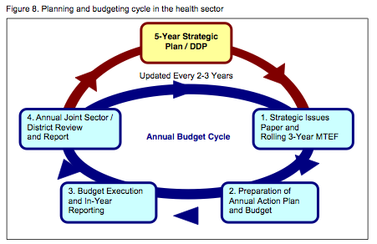
Policy Transmission & Budget
Difficult political decisions on resource collection and allocation
Repetitive budget cycle: policy formulation, analysis, execution, tracking, performance evaluation.
The budget is fundamental for accountability
Reality checks
How to make resources available for policies?
How to ensure budget execution enables implementation of policies?
How to improve the policy performance of governments through the budget cycle?
How to ensure room in annual budget for a new policy?
The budget is one of the main public sector instruments to achieve society’s goals:
It is a representation of government’s preferences and priorities.
Planning and budgeting in the Health Sector (Rwanda)
Notes:
How to reflect policies in budgets: this is the logical sequel to policy design and needs to be part of the policy dialogue. This requires an in-depth analysis of the public finance management systems, their capacity to translate policies and a historical analysis. PEFA report provide a sound basis to make this analysis along with more specific sector studies.
How to make sure there is room in the annual budget for any new policies?: the next logical step is to test the sustainability of the proposed policy (assuming it is pertinent). This requires testing hypothesis of how much will the policy costs and whether the government will be able to fund it in the future (after aid is no longer provided) and to fund the forward spending requirements.
This is a necessary reality check that is often eluded. This translates in PRSPs being “for donors”, budget “for Parliament” (and donors) and cash management for “real people”

Slide 24
PROGRAMMING
IDENTIFICATION
FORMULATION
MONITORING
EVALUATION
Allows reflection on the big picture, that should not be lost throughout the PPCM
Programming
OPPORTUNITIES
FOCUS OF PD
Assess areas that are likely to be regarded as assumptions
Discuss systemic blockages preventing progress
Explore critical building blocks of governance, e.g. access to information legislation
Introduce complementary / lateral issues that are relevant for the broader PD
Support budget analysis by CSOs
Ensure that evidence is packaged for uptake, e.g. briefs tailored for specific groups.
Connect Development Partners to effectively share evidence and data.
Effectively use evidence to ensure big issues are kept on the screen throughout PPCM
Assess mutual expectations and understanding of the needs and opportunities
Agree on the evidence and the gaps that need to be addressed through analysis and/or validate findings on the country situation
Interpret jointly findings from analysis!
Decide on areas of concentration in the Multiannual Indicative Programme: identify focal sectors and key priorities
Avoid duplications /determine absorption capacity
Discuss and learn lessons of past programming for future cooperation
Key outputs
The relevant stakeholders are identified along with the most appropriate platforms and communication channels
Relevant information guides the selection of focal and non-focal sectors
Communication channels are established to sources of information
Close coordination with the lead and like-minded development partners
Familiar with EU thematic and regional programmes and projects
National ownership consolidated and supported.
DEVCO Mainstreaming Guidelines (2016)

Slide 25
PROGRAMMING
IDENTIFICATION
FORMULATION
MONITORING
EVALUATION
PD should not jump to conclusions too quickly but genuinely explore options!
Identification
Focus of PD
OPPORTUNITIES
Key outputs
deepening and confirming the understanding of the political economy / drivers
confirming the relevant stakeholders and communication platforms
identifying and discussing policy options
mutual recognition of:
the importance of taking into account the economic costs
& inclusion of environmental and climate change considerations in sector policies, plans and budgeting systems;
monitoring environmental performance of the sector
options for mitigating negative environmental impacts
awareness, capacity and institutional constraints and opportunities.
DEVCO Mainstreaming Guidelines (2016)
Include salient analysis, e.g. in order to be ready for sector review process, in which stakeholders participate
Cover analysis that can be used as justifications in policy dialogue
Build change alliance around a shared vision and agree on a credible process
Frame preparatory missions well to allow for genuine exchange without overloading partners.
Help government with evidence gaps, even beyond the immediate scope of the envisaged intervention.
Bring in relevant stakeholders into PD.
Consider CD support as pertinent. (e.g. CSOs) This is the start of a multi-year engagement and change takes time.
Promote joined analysis for widely shared use over piecemeal and ad hoc studies
Jointly “digest” in-depth context assessment and problem analysis: macroeconomic, PFM, public policy analysis, actor mapping, PEA, CA, …
Explore diverse options for most effectively supporting reforms, assess pros and cons
Explore risks, resulting implications for the considered options, and possible mitigation action.
Agree on entry points for the support, incl. the approach (macro, sector or project)
Coordinate approach with partners on messages/ proposals to put forward.
Explore appropriate implementation modalities
Start identifying content and process aspects of future policy dialogue: issues, venues, …

Slide 26
PROGRAMMING
IDENTIFICATION
FORMULATION
MONITORING
EVALUATION
Defines the parameters for implementation, including the role of Policy Dialogue
Formulation
Focus of PD
OPPORTUNITIES
Key outputs
deepening and confirming the understanding of the political economy / drivers
confirming the relevant stakeholders and communication platforms
identifying and discussing policy options
mutual recognition of:
the importance of taking into account the economic costs
& inclusion of environmental and climate change considerations in sector policies, plans and budgeting systems;
monitoring environmental performance of the sector
options for mitigating negative environmental impacts
awareness, capacity and institutional constraints and opportunities.
DEVCO Mainstreaming Guidelines (2016)
Build proactively on identification advances in broadening and consolidating a change alliance, build a genuinely shared vision and a credible process.
Consider, including “shared vision and credible change process” as output in LFM. Both can be measured!
The AD leads to a contract and should be based on a genuine shared understanding. Formulation is the last opportunity to get it right.
Anticipate role of PD for working towards higher level results (coherence, sustainability, synergies, …)
Anticipate actions that can bridge the gap between AD and when Implementation starts, including through additional analysis, vetting of findings, targeted TA, …
Decide with other DPs to coordinate action, e.g. conditions / benchmarks for policy and enforcement for ensuring policy transmission and budget implementation
Facilitate finalisation of analysis and draw shared conclusion on parameters for choice and the design of the intervention
Establish agreement on the specific choice(s), including areas to be supported through specific activities, CD or disbursement conditionalities
Agree on PAF indicators and baselines to monitor implementation of reform and support action
Sequence issues for discussion during implementation: actors, forums, desired quality of dynamics (formal and informal dialogue)
Confirm the best fit approach and implementation modality

Slide 27
PROGRAMMING
IDENTIFICATION
FORMULATION
MONITORING
EVALUATION
Implementation
& Monitoring
Helps maintain a credible process and to regularly validate a shared vision
FOCUS OF PD
OPPORTUNITIES
Use and complement reviews to inform on the direction of change, reveal weaknesses and serve as a technical, independent basis for dialogue
Revalidate that the shared vision holds and that the quality of engagement is adequate.
Influence/discuss the implementation of reforms through constructively agreement on solutions.
Support risk management (informed by annual risk management framework reviews)
Coordination between relevant policy and political dialogues
Informs Performance Monitoring and is informed by the indicators. Monitoring feeds the dialogue with information
Continue to address relevant emerging issues of a problem solving nature.
Using government annual discussion on special reports / Feed those discussion forums with well tailored and packaged inputs
Expand policy dialogue spaces for CS actors, e.g. steering committees to reflect on broader policy
Take advantage of Technical Assistants (TA) appointed to the program to advice on oversight
Use monitoring missions or other activities to address knowledge gaps and persistently foster further alignment and harmonization
Well crafted TOR & engagement helps manage risks/address assumptions
Pay attention to broader policy issues beyond the sector, e.g. civil service reform / salaries, labour mobility, …
Key outputs
Deepening partnerships and mutual understanding … and learning from experience;
Bringing forward findings and information arising from ongoing monitoring
identifying new opportunities to … bring about transformative change
Agree on any necessary remedial measures
Opportunities can be identified; activities can then be reoriented (adjustments budget, schedule, logframe, performance assessment)
DEVCO Mainstreaming Guidelines (2016)

Slide 28
PROGRAMMING
IDENTIFICATION
FORMULATION
MONITORING
EVALUATION
Allows reflection on the small and the big picture, and identify fields for future CD
Evaluation & Audit
FOCUS OF PD
OPPORTUNITIES
Use evaluations to fill knowledge and evidence gaps
Implications of findings on results and impacts for on-going and new programmes
Promote effective joint action with other donors (e.g. joint evaluations or ideally sector wide assessments).
Ensure transparency, publication of evaluations and reporting results to a wider audience
Sharpen indicators and benchmarks as mutual accountability mechanism to support policy decisions.
Usually audit are about compliance, but there is no reason not to carry out value for money audits, to complement evaluations: mutual accountability mechanism that serve domestic accountability for both partners and reinforce SAIs
Agree on scope and opportunities of using planned evaluations beyond the standard set of assessments.
Explore with government (and other stakeholders as pertinent), how a given evaluation can be made more relevant. Evaluations offer opportunities for learning and traction for capacity development
Promote joint multi-partner evaluations or integration with broader sector assessments,
Organize Evaluation to improve country system for joint monitoring between government and DP and to promote gradual alignment to national evaluation systems.
Promote as useful involvement of beneficiaries and stakeholders in conceiving evaluations, in validating or testing findings, in possibly managing elements of evaluations (e.g. satisfaction surveys)
Key outputs
The results of the final evaluation should be discussed, and — where relevant — key messages should be integrated into the policy dialogue agenda and taken up with national partners.
Key messages are likely to be better understood when national partners have been actively involved in the evaluation.
DEVCO Mainstreaming Guidelines (2016)

Slide 29
Structure of Module 1
Overview
Who? - PEOPLE
Stakeholders, political economy, …
How? - PROCESS
Entry points, time and space, quality of engagement
1
2
3
4
5
6
Why?
Rationale, instrument for change, …
What? - PROBLEM
Objectives, assumptions, problem solving, …
Groupwork

Slide 30
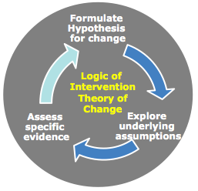
Policy dialogue and intervention logic (2/2)
The Intervention Logic
is a critical subject of Policy dialogue!...
…and Policy dialogue is an
is an important part of the Intervention Logic!
Intervention Logic
It is important, in the AD, to explain briefly how the financial transfer together with policy dialogue and possible complementary support is expected to contribute effectively to improved outputs, outcomes and ultimately impact.

Slide 31
Types of venues
Sector Working Groups | Technical issues, break down complex themes into smaller pieces =>agenda? Mandate?
Donor coordination (many forms, formal and informal) | Lead donors role and Division of Labour to become operational, preparatory to SWGs, hidden agendas made
Establish informal dialogue | Trust can only be built over time through genuine concern for others
Documentation | Concept notes, briefing, analysis, evaluations; usually joint work, published and accessible, possibly publicly presented
31

Slide 32
The Policy cycle and Entry points
Verify the problem
Help define the problem with neutral information & analysis (content)
Choose best fit modality to support change
& Dialogue to support implementation
E.g. Country environmenyal profile
Env. performance of sectors
Implementation, including M & E
Evaluation criteria
Indicator set to support policy dialogue & to test approaches (stakeholders preferences)
Designing and Implementing agreed policies is a Democratic Governance issue
Select preferred option
Identify alternative options
Help test options for sustainability & Assess capacity development requirements
Engage with stakeholders to broaden the dialogue, ensure credibility and scrutiny
Evaluate alternative options
Ensure forum exist to agree on “best fit” option
The next EU programming cycle starts soon!

Slide 33
Policy process: a compound of inter-dependent spaces
Fiscal Space
Policy Space
Political Space
Helping to create
fiscal space (financial aid)
Window of opportunity
“Reform space”
Support coalition building:
donor coordination & work with NSAs
Support capacity development (Technical Assistance,
Policy learning)
Facilitate agenda setting
neutral information and analysis
Mainstreaming effort should help convergence of spaces and enlarging the (evolving) window of opportunity.

Slide 34
Structure of Module 1
Overview
Who? - PEOPLE
Stakeholders, political economy, …
How? - PROCESS
Entry points, time and space, quality of engagement
1
2
3
4
5
6
Why?
Rationale, instrument for change, …
What? - PROBLEM
Objectives, assumptions, problem solving, …
Groupwork

Slide 35
Policy Dialogue in practice
Module 1:
Rationale, challenges and potential
of a structured approach
to Policy Dialogue
DEVCO Environment Week 2018, Brussels, 17 October 2018
Thomas Theisohn (thomas.theisohn@gmail.com)
Notes:
Background
Policy dialogue is not new: delegations have been doing it during operations designs and management, and beyond operations
New guidance seeks to build on experience and clarify EUDs roles
Achieving a more strategic, structured, pro-active and documented policy dialogue: international commitments (Aid effectiveness) and EU policies (Agenda for Change & Budget Support communications)
Key principle = flexibility: adapted to country/sector situation

