Slide 1

Policy Dialogue on
Environment and Climat Change
Module 2:
Preparing for a strategic approach
to policy dialogue
Brussels, 23 May 2019
Thomas Theisohn (thomas.theisohn@gmail.com)
Notes:
Background
Policy dialogue is not new: delegations have been doing it during operations designs and management, and beyond operations
New guidance seeks to build on experience and clarify EUDs roles
Achieving a more strategic, structured, pro-active and documented policy dialogue: international commitments (Aid effectiveness) and EU policies (Agenda for Change & Budget Support communications)
Key principle = flexibility: adapted to country/sector situation

Slide 2

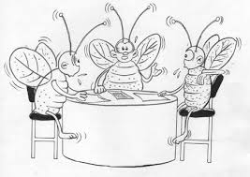
What would make an approach
to policy dialogue
on environment & climate change
more “structured” or “strategic”?

Slide 3
Structure of Module 2
Embedding PD in contextual evidence
Recording and reporting of dialogue
PD indicators
1
2
3
4
5
6
PD objectives & content
PD plan
Top tips for effective policy dialogue

Slide 4
Country Environmental Profile
“Three main tools are used to analyse in detail the relationships between a programme/project and environment and climate change:
Strategic Environmental Assessment (SEA), applicable to budget support and programmes/ projects that provide strategic-level support;
Environmental Impact Assessment (EIA), applicable to projects or specific investments;
Climate Risk Assessment (CRA), applicable to projects.”
DEVCO Mainstreaming Guidelines (2016)
Costing tools (Poverty-Environment Initiative)

Slide 5

Embedding PD in contextual evidence
Understanding the EU Perspective
  EU Policy agenda: DEVCO, NEAR, LINE DGs, EEAS
  International conventions & commitments
  Legal framework for EU Cooperation
  Priorities in country: programming response strategy
Understanding the country & sector context:
  Understanding the stakeholder landscape: stakeholder analysis, political economy (PEA): incentives and interests, drivers of change, capacity assessment (CA)
  Where and how policy is made: many elements influence policy making (e.g. role of the state, taxation, public expenditure…), existing venues, quality, formal and informal institutions and processes, dynamic factors, …
  Understand the reform space: fiscal, political, policy
  Assessments: Macroeconomic and Public Policy Analysis, PFM and Budget analysis, Eligibility assessments, Fundamental values assessment, Risk Management Framework,
  Previous experience in country/sector: can affect the level of understanding and trust
Learning throughout programme cycle management and on an ongoing basis !

Slide 6
Structure of Module 2
Embedding PD in contextual evidence
Recording and reporting of dialogue
PD indicators
1
2
3
4
5
6
PD objectives & content
PD plan
Top tips for effective policy dialogue

Slide 7
Synthesis from budget Support (BS) Evaluations:
Recommendations for the Way Forward (1/3)
Reinforce the partnership basis of budget support
• In order to facilitate effective donor-donor relations as the basis of effective donor- government relations, the number of donors, involved in GBS and SBS dialogue fora should be limited.
• Introduction of a clear division of labour between donors.
• Re-assert the fundamental importance of respect for the ownership of the policy agenda by the partner government.
• MoU for BS, so as to ensure that disbursements are only suspended when justified based upon the agreed provisions, processes and procedures.
• Where possible, seek to develop linkages between budget support operations and wider strategic cooperation frameworks
• The design of BS, its disbursement conditions and management processes should all have a strategic problem solving and policy oriented focus.
Synthesis of Budget Support Evaluations (2014) Volume 1: Synthesis Analysis of Findings, Conclusions & Recommendations of seven country evaluations
http://capacity4dev.ec.europa.eu/sites/default/files/file/17/02/2015_-_1338/synthesis_of_bs_evaluations_final-9_dec_b_volume_one.docx

Slide 8
Synthesis from budget Support (BS) Evaluations:
Recommendations for the Way Forward (2/3)
Nurture strategic problem-solving dialogue
• The design of budget support, its disbursement conditions and management processes should all have a strategic problem solving and policy oriented focus.
• Programme of research and evaluation work to strengthen continuously the analytical basis of the policy dialogue.
• Donors to strengthen their expertise in policy analysis and dialogue, including: division of labour, recruitment, placement and training of staff, share good practices across countries
• The overall scope of dialogue should be limited so as to be consistent with the capacity and expertise of the partner government
• A separation between the forward-thinking dialogue and the process of “auditing” progress to decide on disbursements
• Problem-solving discussion to include external ‘third-party’ stakeholders, such as academics or subject matter specialists
Synthesis of Budget Support Evaluations (2014) Volume 1: Synthesis Analysis of Findings, Conclusions & Recommendations of seven country evaluations
http://capacity4dev.ec.europa.eu/sites/default/files/file/17/02/2015_-_1338/synthesis_of_bs_evaluations_final-9_dec_b_volume_one.docx

Slide 9
Synthesis from budget Support (BS) Evaluations:
Recommendations for the Way Forward (3/3)
Maximise opportunities for promoting Social Accountability
• Access to the policy documents, progress reports and conclusions, emerging from the Budget Support policy dialogue.
• Deepening citizen engagement in the debates on public policies and public spending choices:
- Access to the documentation, progress reports and budgetary data produced through the Budget Support dialogue should be systematic and guaranteed, potentially through a dedicated internet portal;
- Support to CSOs in improving understanding of public budgets and public policy issues;
- Innovative channels to engage the private sector and civil society in the policy debates.
Solution seeking dialogue is not about doom but opportunities:
Going green & access to markets, resource efficiency, jobs, furture ...
Synthesis of Budget Support Evaluations (2014) Volume 1: Synthesis Analysis of Findings, Conclusions & Recommendations of seven country evaluations
http://capacity4dev.ec.europa.eu/sites/default/files/file/17/02/2015_-_1338/synthesis_of_bs_evaluations_final-9_dec_b_volume_one.docx

Slide 10
PD Content: What are the “Influencing” objectives? (long/short term)
FOCUS ON
✔ What is relevant, timely and adds value in context
✔ EU values and policy priorities
✔ Substance/solution finding where it matters
✔ Few selected issues (e.g. systemic bottlenecks)
✔ Connecting related policy dialogue streams
✔ What is discussable now. (Save for opportunities)
✔ Concertation & harmonization with DPs
✔ Broadening/deepening evidence & understanding
✔ Coherence, Risks, Sustainability etc.
AVOID
✖ Belabouring the evident and negative
✖ Myopic perspectives, sub-sectorial issues, operations
✖ Crowding out substance by focusing on administration
✖ Overloading & fragmenting: venues and issues
✖ Increasing Transaction cost
Focus may change with operations. PD should always remain relevant and add value!
Examples of “Influencing” objectives
Promoting progressive access to information legislation
Ensuring that national environmental indicators & targets abide by the SMART principles
Development of a strategy for improved green growth conditions
Establishing ground rules for Government and DP putting into practice Aid Effectiveness principles.
Inclusion of non-state and sub-national actors in justice sector working group
Rationalization of ad hoc evaluations through strategic environmental assessment
Diagnostic study on human resource management in the public sector

Slide 11
Structure of Module 2
Embedding PD in contextual evidence
Recording and reporting of dialogue
PD indicators
1
2
3
4
5
6
PD objectives & content
PD plan
Top tips for effective policy dialogue

Slide 12
Indicators: How would you measure progress and results of PD?
Measuring progress and results
Align and link into country processes.
Seek joint frameworks!
Results
Long term changes as results of capacity development
Outcomes that make a difference to people (demand side)
Process indicators / intermediate results
Indicators
cannot be limited to sector markers, such as SMART indicators.
Reflect stakeholders values, commitments and expectations (see RACER indicators)
Possible process indicators
Is there a shared vision and a credible process?
Clarified issues: technical reports and notes, briefings
Established stakeholders: mapping, participation log, commitment, capacity assessments
Structural elements: formal and informal fora established, minutes
Established practices: mandates and decision making rules, proceedings for managing debate and forums
Mutual trust & accountability: evaluations (joint), log of indicators and targets, assessments and decisions
Possible process indicators
for policy dialogue ?
The number of indicators and ‘trigger actions’ included within any Performance Assessment Framework should be government-determined, limited in number, and focused on results or reform actions of genuine strategic importance.
The number of indicators based on process actions or on output measures should be limited, with the primary focus placed on the targeting and tracking of outcomes.
Synthesis BS Support Evaluations

Slide 13
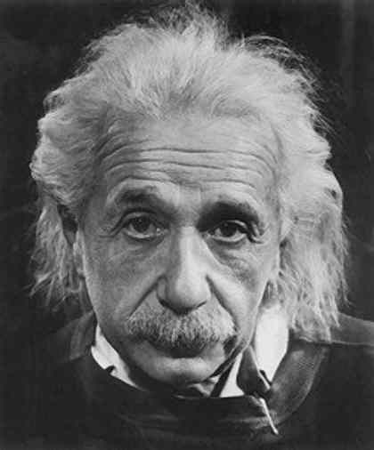
SMART Objectives and RACER Indicators
RACER
Relevant: the indicator should have a strong correlation with the objective that the programme/policy aims to achieve
Acceptable: the indicator must be easily understood and should be accepted by all stakeholders.
Credible: The indicators must be accessible to non-experts, unambiguous and easy to interpret.
Easy: it should be possible to collect the data with available resources, based on the principle of ‘proportionate analysis’ (appropriate scope and depth)
Robust: The indicators should be sensitive enough to monitor changes; therefore it is important to select them according to the time lag between the action and the expected change that points to current progress towards long-term or future improvements.
SMART
Specific
Measurable (verifiable)
Achievable (at an acceptable cost)
Relevant (considering what needs to be assessed)
Timebound (measurable within the timeframe of the project and with a specific frequency)
“Not everything that counts can be counted,
and not everything that can be counted counts.”
A. Einstein

Slide 14
Structure of Module 2
Embedding PD in contextual evidence
Recording and reporting of dialogue
PD indicators
1
2
3
4
5
6
PD objectives & content
PD plan
Top tips for effective policy dialogue

Slide 15
Elements of a Policy Dialogue Plan
What is our objective?
What do we want achieve and by when?
PROBLEM to be addressed
How would we make a difference?
How can we approach this?
INTERVENTION LOGIC Rationale
Who needs to lead, engage, be involved, informed, …? Their interests and influence? What is value to them?
PEOPLE
How do we organise it?
Preparation, process, agenda, logistics, …
PROCESS
What do we need?
Staff time, finance, facilitation support, research, …
MEANS
How do we know we are making progress?
Who needs to engage / know?
Monitoring, Indicators, benchmarks, credible process

Slide 16
Beginnings, middles, and ends of & possible steps for PD events
I. Start up: Issue Focusing and Convening
II. Management: Information Exchange and Discussion
III. Closure: Solution Seeking and Consensus Building
Organizing productive and respectful exchanges of information.
Pushing the parties to understand the positions and underlying interests of all stakeholders.
Helping the parties discover, clarify, or create the highest joint gains possible.
Appraising possible conflict.
Organizing leadership, sponsorship, and willingness to convene.
Gaining the participation of key stakeholders.
Designing a forum and a strategy.
Establishing protocol and forging working agreements on the issues to be addressed.
Assisting the parties in making informed choices.
Capturing agreements and helping ratify, memorialize, and prepare for implementation
Added
value
Uptake
Based on Peter S. Adler Kristi Parker Celico December 2003 http://www.beyondintractability.org/essay/policy-dialogue

Slide 17
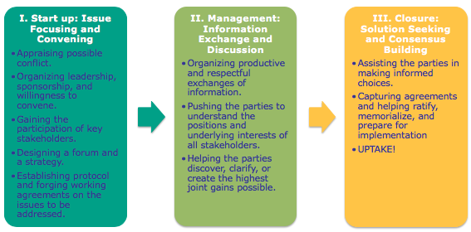
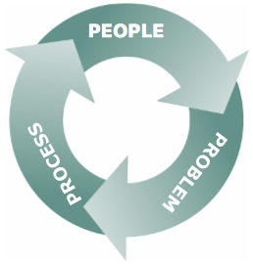
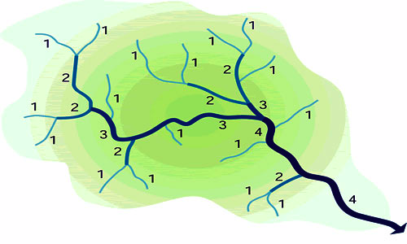
Differentiating opportunities and dialogue strategies?
Organise / Facilitate “dialogues”
Prepare for negotiation
Engage in spaces of others

Slide 18
DIALOGUES for SCOPING A GREEN ECONOMY (IIED TOOL 2013)
Step 1. Preparing the dialogue
Clarify the purpose and context for a dialogue. (awareness-raising and opinion-sharing / mapping green foundations / assessing particular green economy initiatives / strategy scoping )
Scoping meeting with the stakeholders
Commissioning a brief background paper (independently produced) to aid discussion, not foreclose it!
Step 2. Holding the dialogue
Agenda should offer the opportunity to work through • drivers • vision • precedents • models • players • follow-up
Hosting: If possible, an overarching authority
Participants: 25 - 50 participants, atmosphere of free debate, encourage shifting from entrenched positions
Chatham House Rule has proven effective
Timing: two to four days. Poss. local-level dialogues (Timeliness matters eg. part of the national development plan review.
Step 3. Writing up the dialogue
Independent and/or a representative group of participants.
reflect the agreed purpose , not foreclose further exploration, clarify the state of consensus or difference, and
postulate priority issues and options for consideration.
Step 4. Keeping the dialogue alive
moving into diagnosis and action and empowering stakeholders
e.g. platform for continued exchange, learning, experimentation, debate and assessment and to build momentum behind new policy ‘asks’; Action Learning Group for a Green Economy; South Africa’s Green Economy Accord is another means

Slide 19
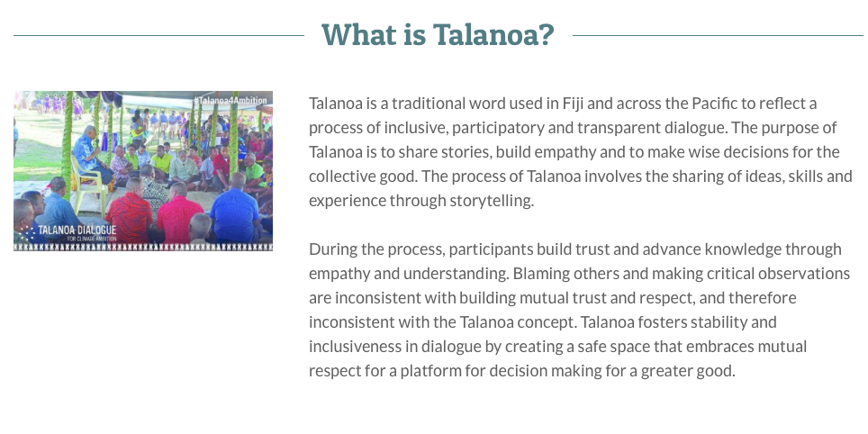
SEA Participatory Workshops: What then? Injecting findings in ongoing dialogue …

Slide 20
10 Essentials for preparing negotiation
PEOPLE
Interpersonal Relationship
Mandate
Stakeholders Map
Motivations, Interests and Positions
Solutions at the table
Criteria of Justification
Solutions away from the table (B.A.T.N.A)
Structure of meeting and agenda setting
Communication
Logistics
e.g.
Negotiating the implementation of conventions and their legal obligations
PROBLEM
PROCESS

Slide 21
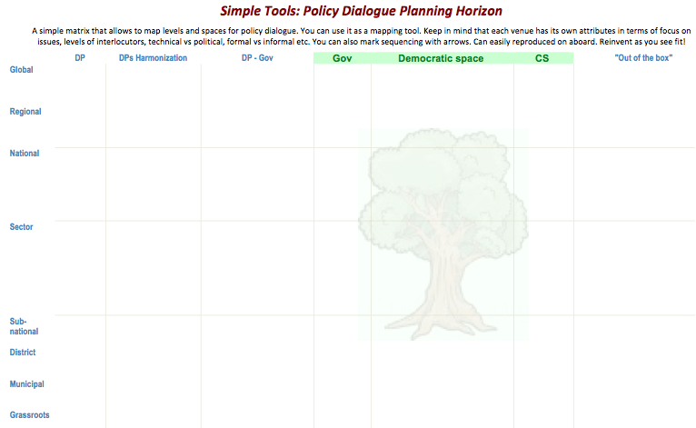

This tool allows you to differentiate the local, the national, the regional and the global level of your PD.
It also allows you to identify who you are developing a dialogue with: with other donors, with the government, with the civil society…
And also if your PD is technical or strategic, formal or informal, etc.
Engage where it adds value and advances reforms
incl. South – South dialogue
Technical and strategic levels
Formal and informal
Content focus and depth
… evolving over time !

Slide 22
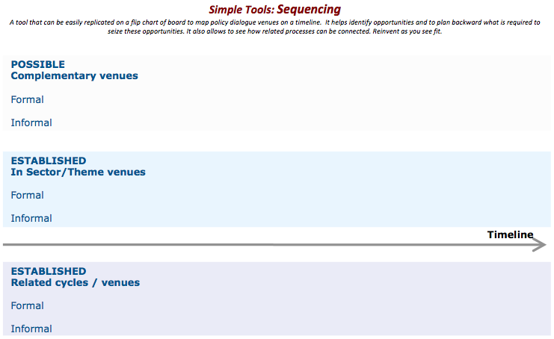
This tool helps you organise the sequence of your PD. What comes first.
And also differentiate the formal from the informal
Map and anticipate for
timely & “good fit” engagement
Simple instruments (PD tools) can help keep track and plan a policy dialogue strategy in space and time.

Slide 23
Structure of Module 2
Embedding PD in contextual evidence
Recording and reporting of dialogue
PD indicators
1
2
3
4
5
6
PD objectives & content
PD plan
Top tips for effective policy dialogue

Slide 24
Multiple places for record keeping ...
A multitude of documents contain relevant records
documenting the concept, objectives, key actors, framework, history and steps of the process:
concept notes, briefing notes, minutes, proceedings, agendas, correspondence, back-to-office reports, Aide Memoires, monitoring reports, assessments, etc.
How to structure and synthesize this?
An evolving policy dialogue plan: will capture what has happened and how progress is made
Structured log book of informal meetings: relating efforts of EUD to the process, logging positions explained and clarified, basis for negotiation and report
Regular analytical notes: state of play of each PD, bridges between types of PDs and between sector PDs
Minutes of formal joint review meetings: on agreements reached, progress, forward looking objectives and expected milestones.
Mechanisms for information sharing among all stakeholders as well as internally.
Established EUD instruments: Risk Management Framework, HoD disbursement file transmission note.
… need to come together somewhere to support structured policy dialogue!

Slide 25
Useful Rules in Record Keeping (1/2)
Be imaginative about how you (and others) record events, meetings and project activities. Use flip charts, ad hoc notes, logbooks, audiotapes, videotapes, photographs, cartoons or drawings – anything that will capture and communicate information more vividly
Be selective – only record information that is useful and relevant. Nobody ever wants to read pages and pages of what everyone said, rather it is more useful to provide information that prompts and reminds readers of key issues discussed and activities agreed or undertaken
Choose good record keepers– since record keeping is a highly skilled role, always allocate it to an experienced and confident colleague (not the most inexperienced, junior member of the team)
Source: Brokering Guidebook

Slide 26
Useful Rules in Record Keeping (2/2)
Disseminate information appropriately to meet the needs of different audiences including: partners; partner organisations; external donors; public officials; project staff and beneficiaries; media; reviewers and project evaluators; and other partnership practitioners
Remember to double-check that all partners (and other key stakeholders) are comfortable with the communications and record-keeping approaches
Take time to educate all those involved in the value of good record keeping to enhance the efficiency, effectiveness and impact of the partnership
Build storytelling skills with all those involved to help materials come alive since every bit of partnering activity – if one thinks of a partnership as a journey where those travelling together may have had to overcome insurmountable odds – is, after all, a story worth telling
Source: Brokering Guidebook

Slide 27
Structure of Module 2
Embedding PD in contextual evidence
Recording and reporting of dialogue
PD indicators
1
2
3
4
5
6
PD objectives & content
PD plan
Top tips for effective policy dialogue

Slide 28
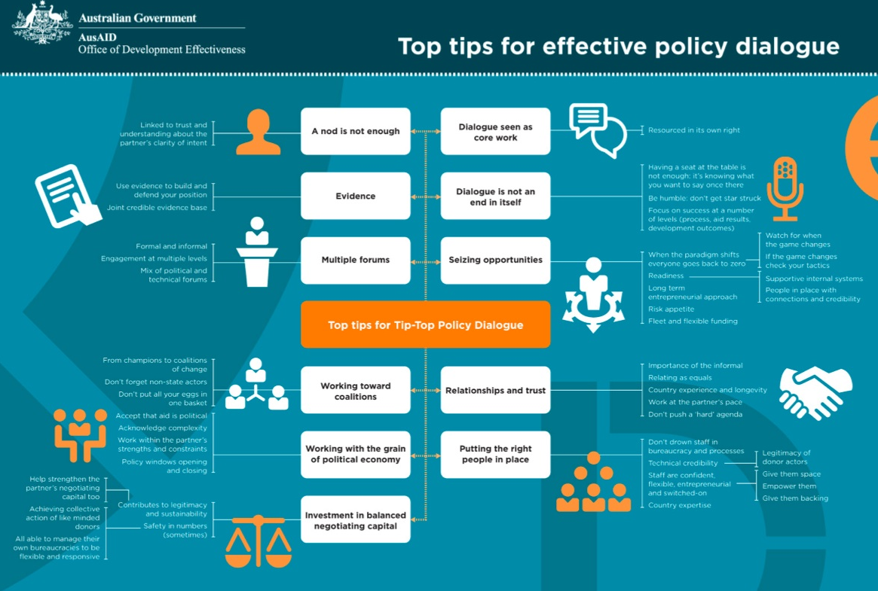

Slide 29
Some key points to take into account
Dialogue seen as a core work
Resourced in its own right
Dialogue is not an end in itself
Having a seat at the table is not enough; it’s knowing what you want to say once you’re there.
Focus on success at a number of level (process, aid results, development outcomes)
Seizing opportunities
When the paradigm shifts everyone goes back to zero
Readiness
Long term entrepreneurial approach
Inspired by Top tips for effective Policy Dialogue
AusAID -Office of Development Effectiveness
Relationships and trust
Importance of the informal - Relating as equals
Country experience and longevity
Work at the partner’s pace
Don’t push a ‘hard’ agenda
Putting the right people in place
Don’t drown staff in bureaucracy and processes
Technical credibility
Staff are confident, flexible, entrepreneurial and switched-on
Notes:
Apart from this new slide, we distribute a handout with all the information contained in the previous and unreadable picture from the Australian Government.

Slide 30
THE ESSENTIAL
before
THE OBVIOUS
Relationship | before | any other action
Preparation | before | Action
Process | before | Problem
Value creation | before | Value claiming
Creativity | before | Reality check
Search for information | before | Search for solution
Internal consensus | before | External meeting
Active listening | before | Active Speaking
Evaluation | before | Decision
Validating commitments | before | Adjourning

Slide 31
Policy Dialogue in practice
THANK YOU!
Module 1:
Rationale, challenges and potential
of a structured approach
to Policy Dialogue
DEVCO Environment Week 2018, Brussels, 17 October 2018
Thomas Theisohn (thomas.theisohn@gmail.com)
Notes:
Background
Policy dialogue is not new: delegations have been doing it during operations designs and management, and beyond operations
New guidance seeks to build on experience and clarify EUDs roles
Achieving a more strategic, structured, pro-active and documented policy dialogue: international commitments (Aid effectiveness) and EU policies (Agenda for Change & Budget Support communications)
Key principle = flexibility: adapted to country/sector situation

