Slide 1
INTRODUCTION TO
PUBLIC FINANCE MANAGEMENT
Module 4.1: Coding and classification

Slide 2

International standards and local requirements
Classification systems must follow international standards defined in the IMF Government Finance Statistics (GFS) manual.
Information on the Government Functions.
Budget management – administrative unit, line item, programmatic…
National Public Sector Accounting Standards.

Slide 3
Module outline
  Budget classifications
  Using budget classification systems and coding
  The Chart of Accounts

Slide 4
Budget classifications
A single data source for administering the budget and providing information for all financial reports.
  The budget should be presented in a format that reflects the most important classifications.
  The classification should be embedded in the government’s chart of accounts (the accounting classification) to ensure that every transaction can be reported in accordance with any of the classifications used.
  There is a need to know both the economic activities and the functions of government both for budget management and financial statistics.

Slide 5
Budget classifications
  Object – line-item or economic (inflows and outflows, including revenue):
  Purpose: budget management, compliance controls, fiscal management, reporting and analysis (deficit/surplus) e.g. IMF government statement of operations;
  International standard: IMF GFS.
  Organisation/Administrative – ministry, department, agency.
  Purpose: budget management, accountability;
  No international standard.

Slide 6
Budget classifications
  Function – functions of government spending
  Purpose: historical analysis, international comparison, policy formulation;
  International standard: IMF GFS and COFOG.
  Programme – programmatic breakdown of government spending:
  Purpose: planning, performance monitoring, accountability;
  No International standard.
  Other – e.g. fund, financing sources:
  Purpose: budget management, special needs, accountability.

Slide 7

Budget classifications
Economic - Government Finance Statistics (GFS)
Transactions affecting net worth i.e. revenue and expense.
Transactions in non-financial assets.
Transactions in financial assets and liabilities (financing).

Slide 8
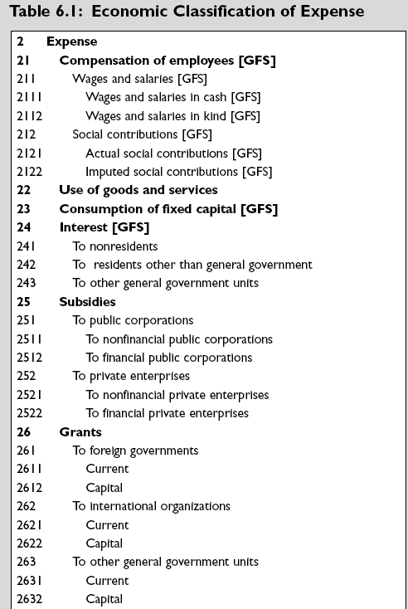
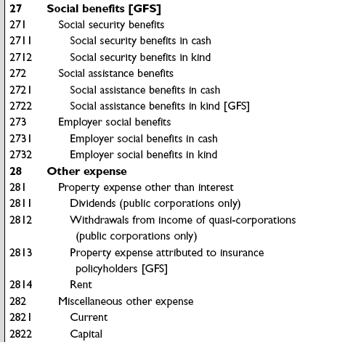
GFS Economic

Slide 9
Budget classifications
Economic/Revenue - Government Finance Statistics (GFS)
  Taxes are classified mainly according to the base on which they are levied.
  Grants are classified by the source from which the revenue is derived.
  Property income is classified by type of income.

Slide 10
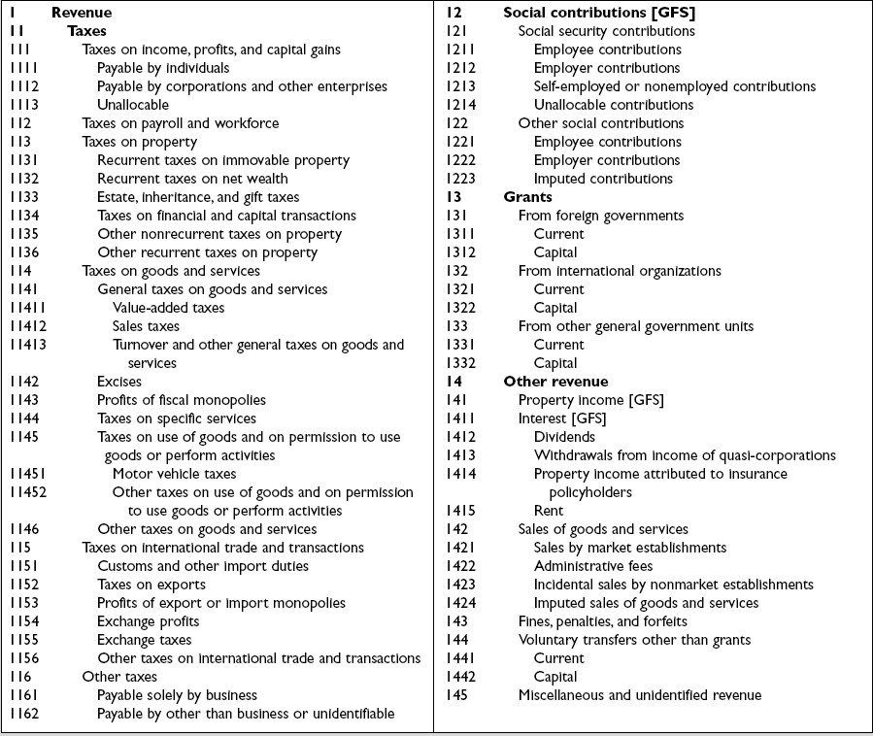
GFS Revenue

Slide 11
Budget classifications
The Classification of Functions of Government (COFOG) and IMF GFS
Classification by purpose;
Independent from the government structure;
Used for historical analysis, international comparison, policy formulation;
Three levels:
  Division: e.g. 4.Economic Affairs; 9.Education.
  Group: e.g. 4.2.Agriculture, Forestry, Fishing;
  9.2.Secondary Education.
  Class: e.g. 4.2.1Agriculture;
  9.2.1.Lower secondary education.

Slide 12
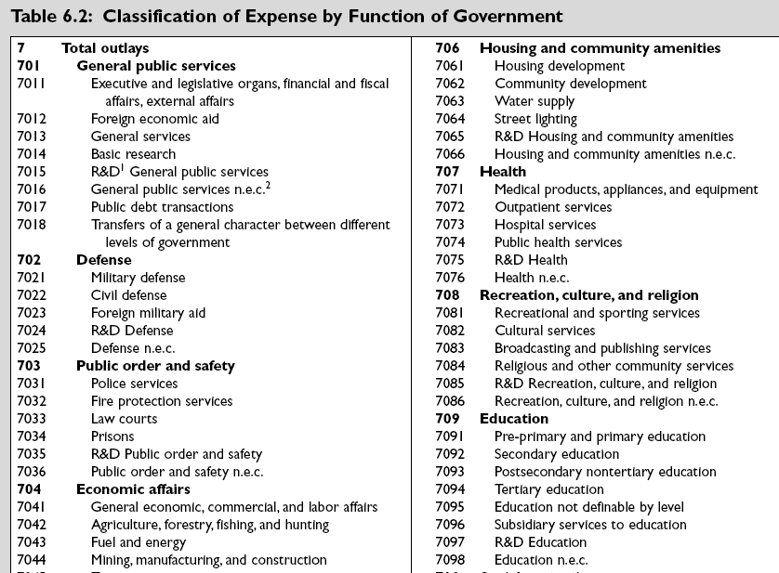
GFS/ COFOG
Function

Slide 13
Analysing the budget: COFOG x GFS Economic
Budget classifications

Slide 14
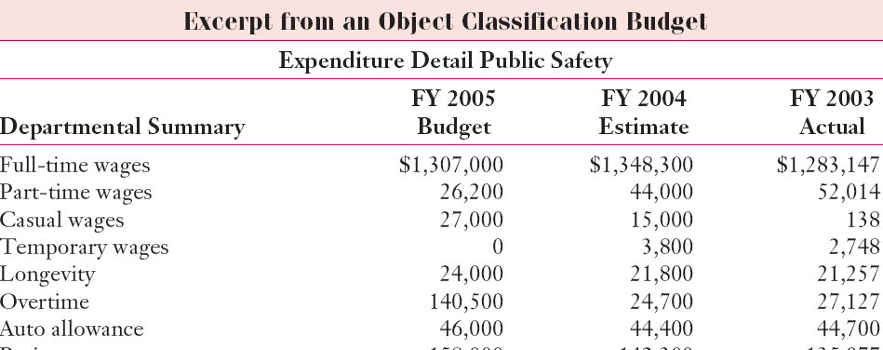
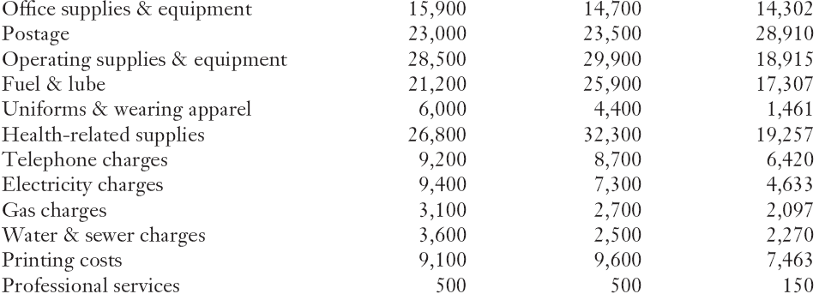
Analysing the budget

Slide 15
Budget classifications
The Programme as element of the budget classification system
Used for budget management, grouping spending against policy objectives, planning for results.
Generally, overheads administrative expenses are grouped into a ‘general administration programme’… often a catch all.
The Programme and the COFOG:
  The notions of Programme and Function can be confused,
  … COFOG is very broad international standard grouping while the Programme classification must take into account the country policy context and requirements for managing the budget!

Slide 16
Module outline
  Budget classifications
  Using budget classification systems and coding
  The Chart of Accounts

Slide 17
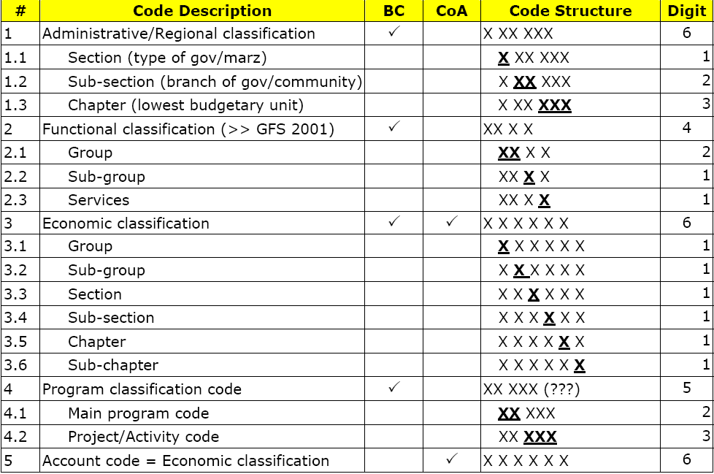
Budget System Law (Armenia):
Using the budget classification system
X XX XXX
Administrative
X XX X
Function
XXX XX
Programme
XXX XXX
Economic

Slide 18
Using the budget classification system
The coding system needs to allow for spare capacity (segments, digits) for future expansion such as new initiatives/programmes.

Slide 19
Module outline
  Budget classifications
  Using budget classification systems and coding
  The Chart of Accounts

Slide 20
The Chart of Accounts
Is used to classify financial transactions and events and prepare financial statements for reporting in accordance with national Public Sector Accounting Standards.
A move to the International Public Sector Accounting Standards (IPSAS) means a coding system to allow a greater range and level of detail than the traditional cash based systems.

Slide 21
The Chart of Accounts (Cash based)
The published accounts were traditionally the budget out-turn with a need for additional information on financial assets and liabilities.

Slide 22
The Chart of Accounts IPSAS (Accruals)
A move to IPSAS means a coding system to allow that information to be collated.
Major change in coding requirements to add non financial assets and liabilities (discussed in the Module on Accounting & Reporting) such as:
  Fixed assets:
    Premises, Plant and Equipment;
    Depreciation.
  Liabilities:
    Pensions.

Slide 23
Key messages
The budget classification system must suit the needs for reporting, accountability and budgetary control.
Whatever the budget approach it must include:
  administrative, economic and function classifications to allow reporting according to the GFS and COFOG standards.
  information for budget execution.
Information for Chart of Accounts:
  either cash assets/liabilities (cash based);
  or all assets/liabilities (accruals/IPSAS based).

