Slide 1
Stakeholders
for Social Protection across the
Humanitarian – Development Nexus (SPaN)
Professor Rachel Slater, Centre for International Development and Training
May 2019

Slide 2
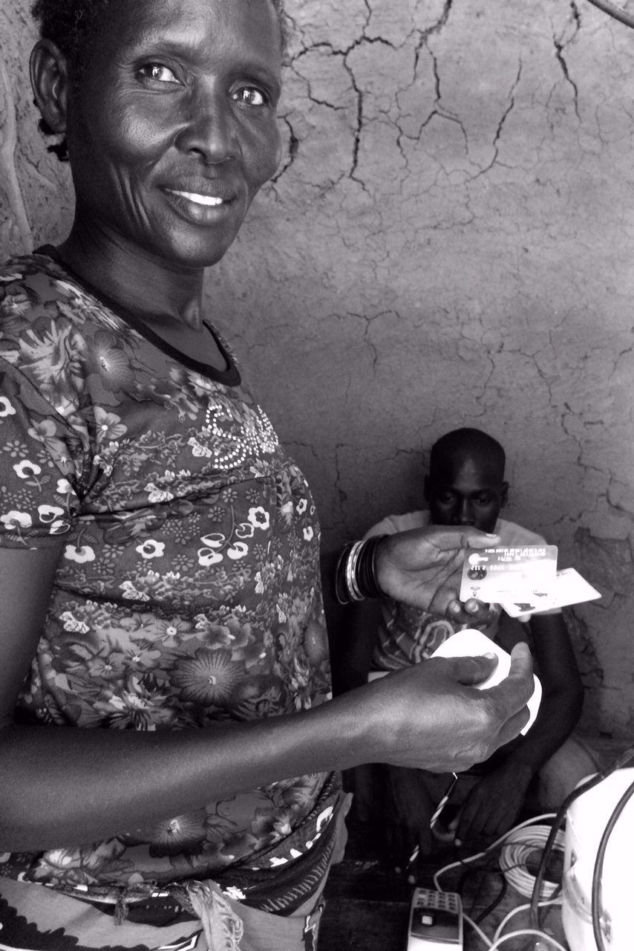
Outline
The issue
The challenges
Lessons and promising practices
Principles, recommendations and conclusions

Slide 3
The issue – stakeholders for SPaN
Global consensus but …
“not simply a technocratic process of bringing together humanitarian and development instruments but involves reconciling fundamental differences” (FAO, 2016)

Slide 4
The issue – stakeholders for SPaN
Stakeholder incentives
Competition for funding between humanitarian and development reduces incentives to cooperate and coordinate (especially ex ante)
Stakeholder capacity
Timelines differ, influence programme design and the configuration of stakeholders
Stakeholder ‘rule books’ and ‘modus operandi’
Government-owned, government-driven mantra difficult to align with neutrality and impartiality
Map of stakeholders not always clear (or may be predatory)

Slide 5
Humanitarian work
Government
Donor agency
Development work
Notes:
Lots of further layers

Slide 6
Humanitarian work
Government
Donor agency
Development work

Slide 7
Further layers (of complication)
NGOs
INGOs
CSOs / CBOs
Private sector
Clusters

Slide 8
Lessons and promising practices (1) – Defining ‘the cube’
Multiple configurations of stakeholders in different contexts
Type of emergency (e.g. rapid vs slow onset, # affected, short-term or protracted)
Needs (which clusters)
Existing capacities
Coordinating across a multiplicity of stakeholders
Mantra of coordination not underpinned by evidence of what effective or ineffective coordination looks like (we continue to talk to people who are the same as us!)
National governments at the centre – not just in principal but in practice
Working through parastatals where governments may be predatory
Support stewardship and regulation (especially post-conflict)

Slide 9
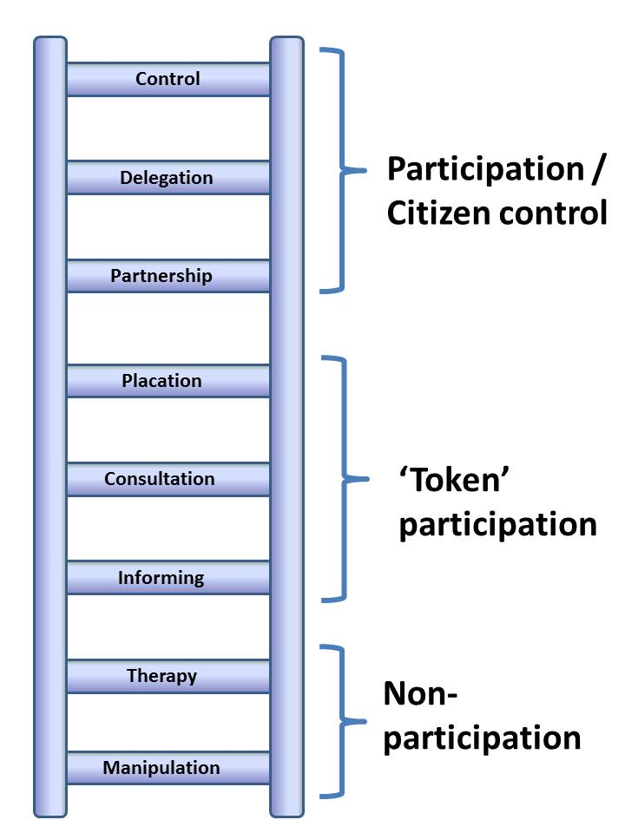
Lessons and promising practices (2) – bringing in non-donor and non-government actors
Involving citizens and CSOs – finding the right level of participation
Panel research in 5 conflict-affected countries (northern Sri Lanka, eastern DRC, northern Uganda, Nepal and NW Pakistan) shows the difference that evening ‘informing’ can make
Questions about whether

Slide 10
Lessons and promising practices (3): gender-sensitive approaches
Can social protection do a better job of ensuring gender aware responses in disasters?
Categorically programmes often target women and other disadvantaged or marginalised groups
Debate for categorical programmes – do they effectively reach disaster affected people and households?
Debate about targeting of disaster response and the exclusion of particular groups

Slide 11
Lessons and promising practices (3): gender-sensitive approaches
Debate for categorical targeted programmes over whether they effectively reach disaster affected people and households?
Concerns about targeting of disaster response and the exclusion of particular groups

Slide 12
Who would a cash transfer top up reach? Earthquake in 7 crisis hit districts, Nepal
Earthquake affected households
Households in SP prog
56.2%
(5.2%)
43.8%
Source: Slater et al 2018 based on 7 districts identified as most affected by earthquake in HRVS Wave 1 data

Slide 13
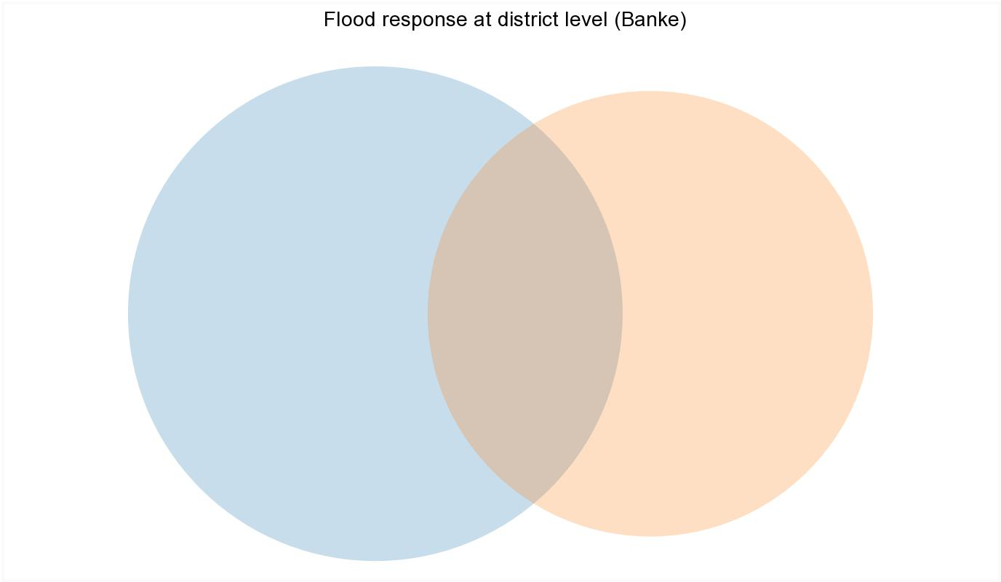
Who would an SP top-up reach?
Flood in Banke district, Nepal
Flood-affected households
Households in SP prog
33.3%
(78.7%)
66.7%
Source: Slater et al 2018 based on HRVS Wave 1 data

Slide 14
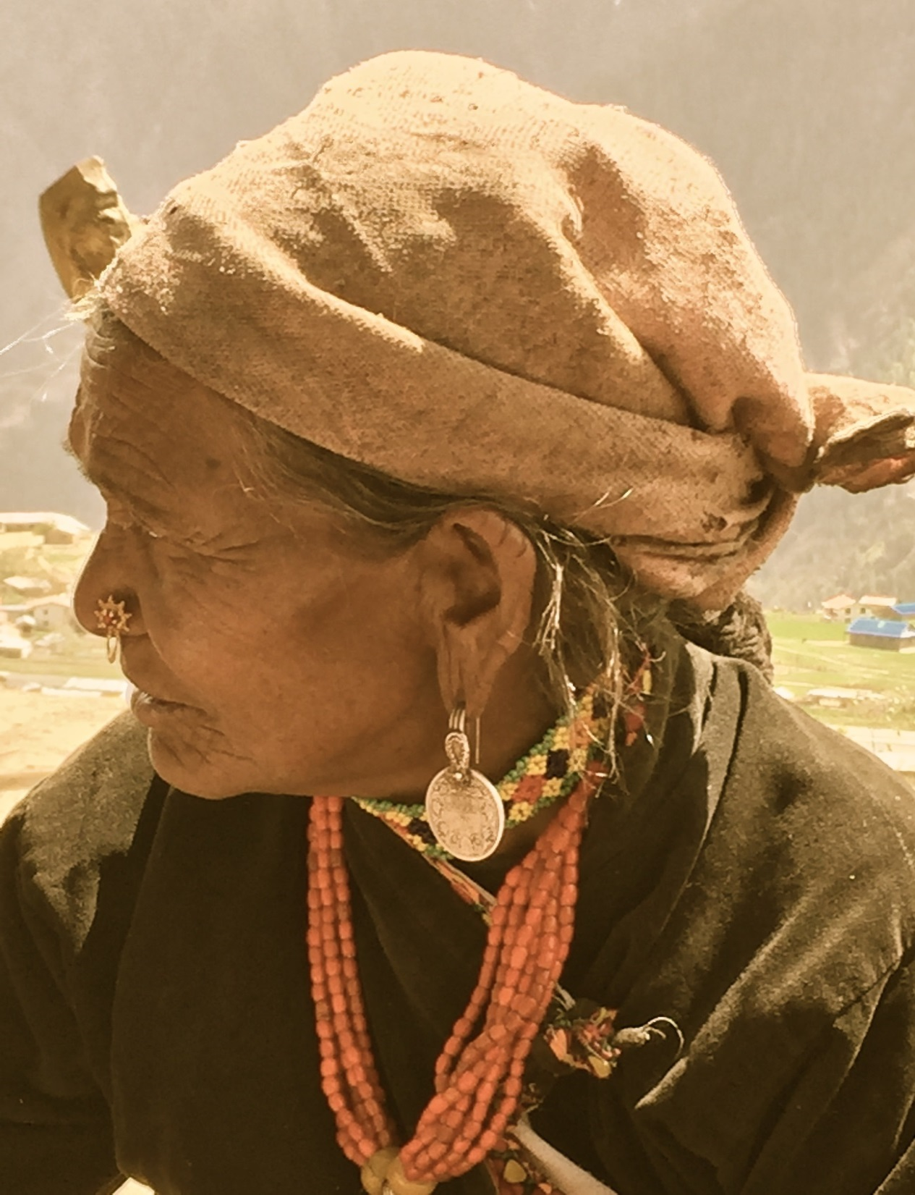
Even when the shock a is very widely experienced, top-ups via SP programmes will often exclude many shock-affected households: Social protection is not a substitute for shock response, but can be a complement to it – especially by reaching those who are otherwise excluded
pre-target vulnerable groups

Slide 15
Lessons and promising practices (3): gender-sensitive approaches
The engagement of stakeholders to ensure gender aware responses
UNISDR (2015) stresses the importance of participation: “engage with relevant stakeholders, including women, children and youth, persons with disabilities, poor people, migrants, indigenous peoples, volunteers, the community of practitioners and older persons in the design and implementation of policies, plans and standards.”
Women aren’t just victims – they are critical to effectively designing, managing and implementing disaster responses

Slide 16
Lessons and Promising Practices (4) – systems and foundations
Investing in systems in advance
Registries
Pre-positioning / contingency
Operational guidelines / SOPs in
governments’ DRM / SP guidelines
Delivering SPaN across borders
Integrated or parallel systems?
Harmonise (especially targeting and payment levels)

Slide 17
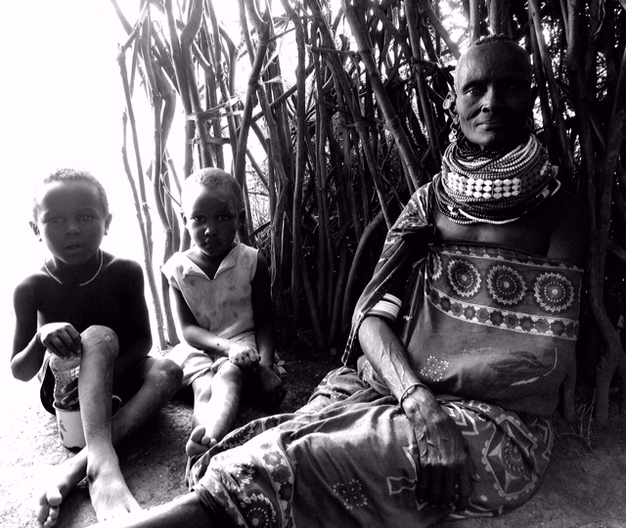
Knowledge gaps – striking the right balance:
between ex ante and ex post actions
Risk of the ‘tail wagging the dog’
between investing in advance and responding after
‘too much until it’s not enough’
Between parallel vs integrated systems
When is it appropriate to harmonise domestic and refugee systems?
Notes:
A minor or secondary part of something controlling or dominating the whole or the main part.

Slide 18
Principles, recommendations and conclusions: changing our perceptions and perspectives
No one-size-fits-all
Build on what is already there, rather than crowding out / creating parallel systems
Objectively assess the capabilities and limitations of all actors (and interrogate our perceptions about them)
Work towards capacity strengthening at national level (and ‘unlearn and relearn’ our perceptions and incentives in donor agencies)
Work towards shared long term goals, through establishing shared ways of working (SOPs) in the shorter term
Incorporate principles of adaptive programming into operations
Put the principles of non-competition among stakeholders centre stage in social protection
Document lessons (both successes and failures) and share knowledge
Navigate trade-offs (‘all good things don’t always go together’).

