Slide 1

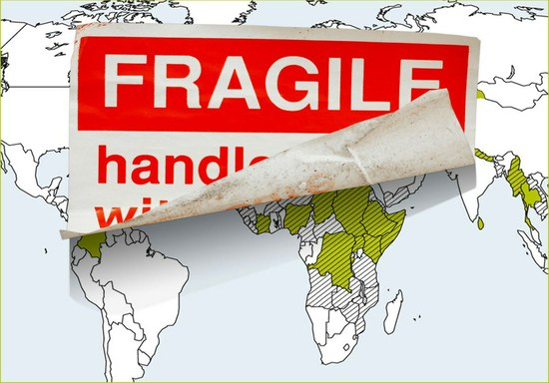
Working with Social Protection in Contexts of Fragility and Conflict
Georgia Rowe,
Independent Consultant

Slide 2
FRAGILE & CONFLICT
AFFECTED CONTEXTS
Many definitions & typologies
Call, 2010 offers…Security-Capacity- Legitimacy model
Fragile sub-national & transnational areas
Severity of deficits across each dimension helps shape response options
Three dimensions of fragility and country examples from 2010
Capacity Gap: Weak States
Bangladesh Malawi
Zimbabwe Equatorial Guinea
Legitimacy Gap: Repressive, Autocratic
Burundi East Timor Haiti
Uganda
Afghanistan
DRC
Iraq
Somalia Sudan
Turkmenistan
North Korea
Colombia, Guatemala, Tajikistan
Security Gap: War-Torn States
Source: EC, 2015, based on Call, 2010

Slide 3
INTERVENTION
FRAMEWORK
State and non-state social protection and humanitarian assistance
Assess and engage across five levels:
  Stakeholders & institutions
  Data and information systems
  Programme design
  Programme delivery systems
  Financing

Slide 4






PRINCIPLES
Do no harm
People at the centre
Build peace & resilience
Flexibility & simplicity
Strengthen national ownership
Generate evidence

Slide 5


PROMISING PRACTICES
Stakeholders & Institutions
Build strategic partnerships – in advance
Be flexible with policy instruments
Factor in different procedures & timelines
Strong leadership & clarity of process
Partner on low-risk actions to build trust
2. Data & Information Systems
Strengthen SP & DRM info. systems prior to crisis
Develop assessments to serve humanitarian and development actors
jointly develop scale-up triggers
Notes:
Understand the limitations and opportunities for decision making in each institution is fundamental for effective collaboration.

Slide 6

PROMISING PRACTICES
3. Programme Design
Joint context analysis inc. political economy
Consider social cohesion objectives
Compromise and trade-offs
Recognise historical barriers to access
Quick-wins
4. Delivery Systems
Delivery systems to support mobile populations & operate during crises
Use delivery systems as entry points for collaboration
Innovate for M&E
Notes:
Ensuring transparent programme processes and design features (such as eligibility criteria), basing design on existing community culture and norms and involving the community to the greatest extent possible in key design, delivery and monitoring processes may help foster social cohesion and promote a sense of community solidarity and collaboration. At a minimum it is likely to help avoid fostering social tension and unrest.
Build quick-wins into programme plans. Whilst building social protection systems takes decades building early wins into programme design can help build confidence among all actors (Lindborg, 2018). Examples include government capacity building initiatives or the short-term transition of some key functions (such as monitoring and evaluation) from non-state to state management.

Slide 7

PROMISING PRACTICES
5. Financing Instruments
Crises may generate additional financing offering window to develop new approaches
Pooled funds can spread risk and streamline admin. processes
Layer instruments to cover different sized risk

Slide 8
CONTEXTUAL GUIDANCE
  The nature of options and approaches will be influenced by at least 3 factors:
    Existing social protection context
    Stage of the crisis
    Fragility context

Slide 9

CONTEXTUAL GUIDANCE #1:
SOCIAL PROTECTION CONTEXT
Basic maturity: Align, Inform, Transition
Deliver hum. assistance to better meet SP needs of affected populations & help build future SP
Align existing or new humanitarian support
Design for scalability, sustainability & govt. delivery
Document humanitarian systems & engage with SP actors
Intermediate or advanced maturity: Utilize & Preserve
Adjust existing programmes, or elements, to reach affected populations. E.g. Design tweaks; Horizontal & vertical expansion; Piggy backing.
Support and preserve
All levels of maturity: Develop and Strengthen
Bring together humanitarian & development actors to build govt. capacity:
Relevant in protracted or post-conflict situations, with overlap between chronic & transient poor & vulnerable
Should* be integral to all SP engagement
Draw on existing social protection development resources
Notes:
Largely draws on OPM/O’Brien, SR-SP framework but with some adjustment for
Not mutually exclusive – in many contexts may be delivering a combination of approaches
Basic: Govt. SP may not exist, be suspended, or may be small scale and fragmented, limited coverage, weak policy & legislative framework, unclear institutional structures and mandates & weak delivery systems
Align, inform, transition: Can lead to short term efficiency savings if it helps reduce duplication within the human. system
In medium to longer term may build a more sustainable approach to emergency response with greater predictability, potential for scalability and possibly government transition.
Utilize and Preserve: government social protection shows reasonable levels of coverage and coherence, strong delivery systems and relatively clear institutional structures and mandates.
Develop and Strengthen: Applicable where it is possible and appropriate to work with the government and their programmes
*should, where possible and appropriate

Slide 10
Contextual Guidance #2:
Stage of Crisis
Crisis Stage | Actions (illustrative)
Pre-crisis | Develop & strengthen SP capacities and systems Pre-plan responses in line with the existing context Build relationships and inclusive dialogue;
In acute crisis | Activate existing contingency plans Identify primary objective for working with SP Frequent review & assessment…real-time mitigation actions.
Protracted crisis | Develop & strengthen SP capacities and systems & transition case-loads (as appropriate and feasible) Build shock-responsive features into existing programmes to address acute shocks on top of protracted crisis Sequential pathways between interventions, as needs change.
Post-crisis / long term recovery | Develop & strengthen SP capacities and systems & transition case-loads (as appropriate and feasible) Position SP where there’s political traction Understand & address structural, historical access constraints

Slide 11
CONTEXTUAL GUIDANCE #3:
FRAGILITY CONTEXT
Capacity Gap
Legitimacy Gap
Work through government systems if appropriate
But agree ‘red lines’
Identify mix of interventions at different levels
Consider engagement via EUD & common advocacy messages
Context analyses including political economy
Culturally appropriate, transparent, simple programming
Invest in front line delivery inc. accountability & communication
Invest in social protection for its own sake
Security Gap
Conflict sensitivity (and other DNH) analyses
Multi-component projects to spread risk
Select partners with access
Promote IT-supported approaches
Interventions for youth or ex-combatants

Slide 12
THANK YOU

