Slide 1
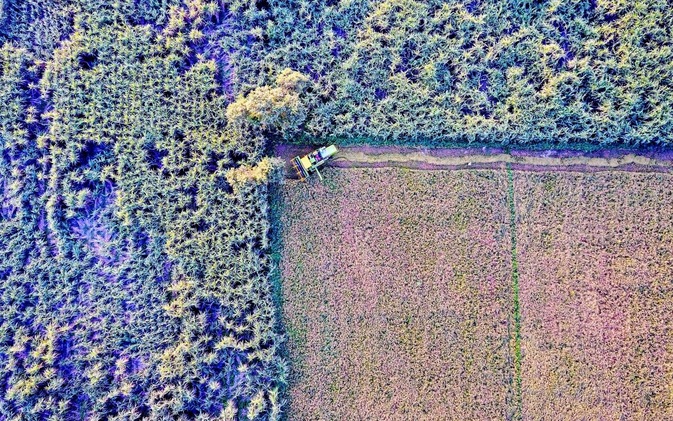

Bridging the Gap: Bigdata and Evaluation
Anupam Anand, PhD
Evaluation Officer
Independent Evaluation Office, Global Environment Facility
World Bank Group
Notes:
Who are we

Slide 2







25 Years
US$14.5 billion, and the leverage of US$75.4 billion
4,000 projects in 167 countries
18 implementing agencies
5 major environmental conventions
Established in 1992
Innovator and Catalyst
Unique Partnership
Financial Mechanism
The Global Environment Facility
Notes:
Established on the eve of the 1992 Rio Earth Summit
The GEF is…
A UNIQUE PARTNERSHIP of 18 agencies
A FINANCIAL MECHANISM for 5 major international environmental conventions:
AN INNOVATOR AND CATALYST that supports multi-stakeholder alliances to preserve threatened ecosystems on land and in the oceans, build greener cities, boost food security and promote clean energy for a more prosperous, climate-resilient world; leveraging $5.2 in additional financing for every $1 invested

Slide 3
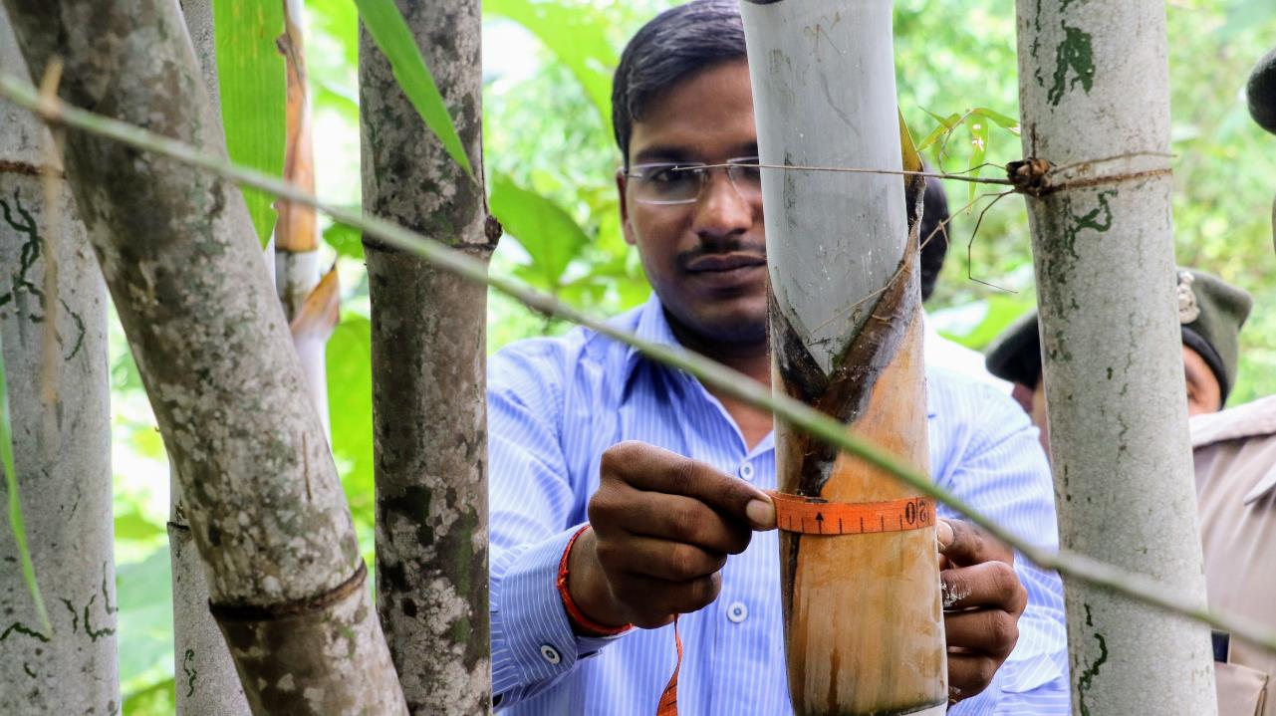
Notes:
Conventional measurement is often constrained by time and resources. However they tell us Why and How

Slide 4
Why do we need Geospatial methods in Evaluations?
Efficiency
Analysis at different scales
Aiding objectivity and transparency
Applicable to variety of evaluation methods
Helps deal with methodological challenges
Notes:
Efficiency: More bang for the buck in evaluation studies.
Analysis at Scales: Enables analysis at project, national and global scale. Also, enables looking at ecologically meaningful scales
Objectivity and transparency: Need objective evidence base for decision-making
Transparency: Reproducible and replicable evidence base
To deal with Methodological challenges in Evaluations: Counterfactual selection, Assessing factors influencing outcomes, Identifying drivers of degradation, estimating co-benefits generated, Compliment traditional methods, triangulation. It can also help with ex-ante evaluation wherein we can forecast the outcome under varied scenarios or causal pathways.
Why it’s challenging and why it’s not (Envtal outcome)

Slide 5
What it takes to integrate
1
Is it expensive ?
Is it technically challenging?
2
3
What is feasible to do with this approach ?

Slide 6
Questions we seek to answer through evaluation
Relevance of the intervention—is it in the right context?
Trends in performance and impacts going far back in time…even if we didn’t have baseline data?
Attribution: Did the intervention make a difference? –counterfactuals
Does the intervention deliver value for money?

Slide 7
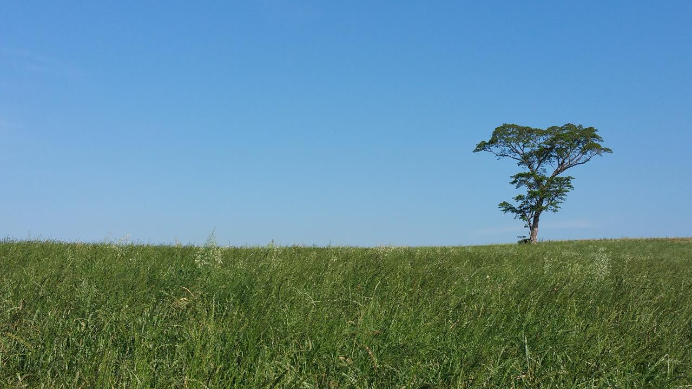
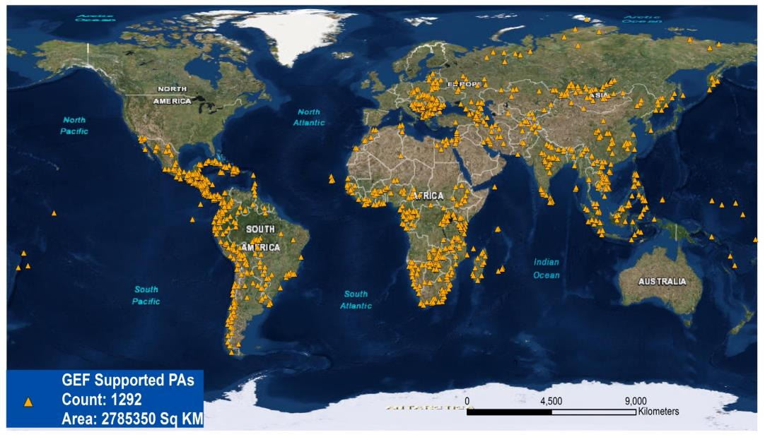
Biodiversity
Study the impact of GEF support to 1292 global protected areas across 147 countries.

Slide 8
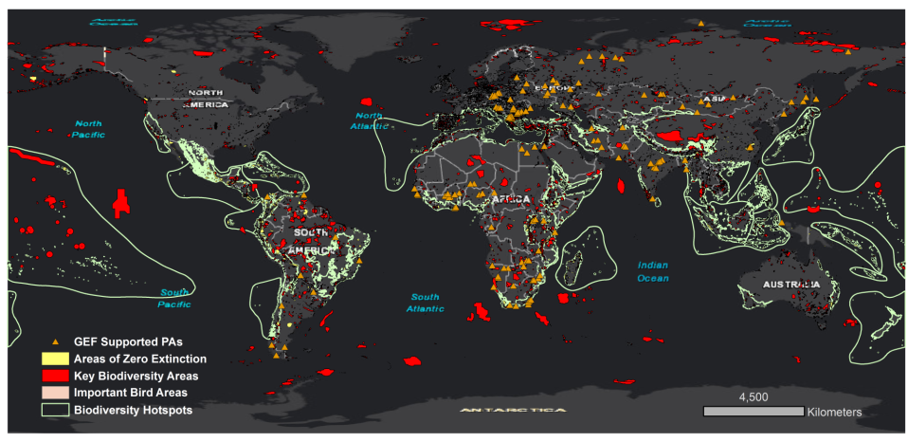
Biodiversity: Relevance
KEY BIODIVERSITY
AREAS, highest
scientific designation
of global biodiversity
significance

Slide 9
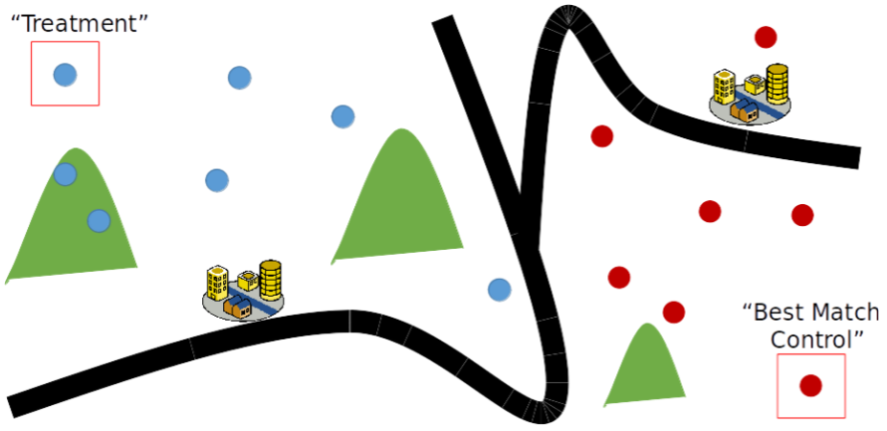
Impact: Counterfactual selection
Quasi-experimental method: Propensity Score Matching(PSM)
Variables that were used for matching were:
Forest Cover Percent (2000) and Forest Loss, Distance to Forest Edge, Elevation, Slope, Topographic Ruggedness Index, Land Use Suitability, Travel time to nearest major city, Distance to Road and Population Density
Notes:
Quasi experimental method leveraging geospatial and econometric analysis for counterfactual selection. In the top figure you can see how contextual variables such as distance from road, distance from cities, forest etc. was used to find a similar site for comparing the effect of treatment (interventions).

Slide 10
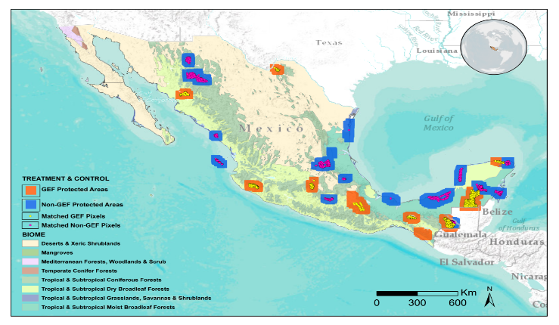
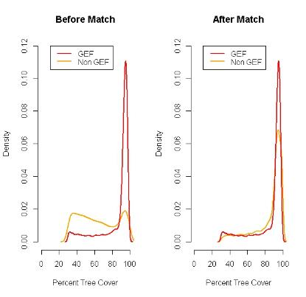
GEF-supported PAs have 23% less forest loss
scores for
non GEF
Control groups
scores for GEF treated groups
Probability
0
Propensity score p(x)
1
p (x) = Pr (T=1| X)
Attribution: Did the intervention cause the change?
Quasi-experimental evaluation design based on PSM
Notes:
-Difficult to find counterfactuals due to a lot of contextual variation within the PAs themselves, RCT doesn’t work
-This is where geospatial technologies could be useful for selecting "Treatment" and "Best match control" sites
-Variables that were used for matching were: Forest Cover Percent (2000) and Forest Loss, Distance to Forest Edge, Elevation, Slope, Topographic Ruggedness Index, Land Use Suitability, Travel time to nearest major city, Distance to Road and Population Density
We carried out this analysis for GEF supported PAs in Mexico because GEF’s has given long term support to these PAs. The conservation agencies in Mexico also have a rich database on GEF support which enabled this detailed study.
MAP: The GEF and Non-GEF sites in Mexico, PAs within the same ecoregions were compared. E.g. Mangroves with Mangroves
Right Top Figure: The pair of GEF and Non-GEF tree cover before matching analysis are not balanced and can’t be compared statistically. “Apples with Oranges analogy”. The figure after propensity score matching shows the samples are balanced(have similar distribution) and can be compared.
RESULT: GEF-funded PAs have 23% less forest loss than PAs not funded by GEF from 2001 to 2012.

Slide 11
Value for money analysis
Land degradation: Global
1
What works, where, why and under what conditions?
2
Factors associated with the outcomes

Slide 12
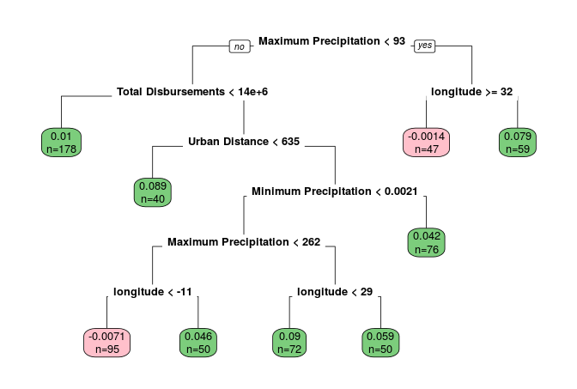
LAND DEGRADATION: What works
Machine learning and causal tree
Notes:
Top Figure: Machine learning, causal tree method for assessing factors influencing outcomes and impact. This method accounts for heterogeneity in the geographical distribution affecting the outcomes.

Slide 13
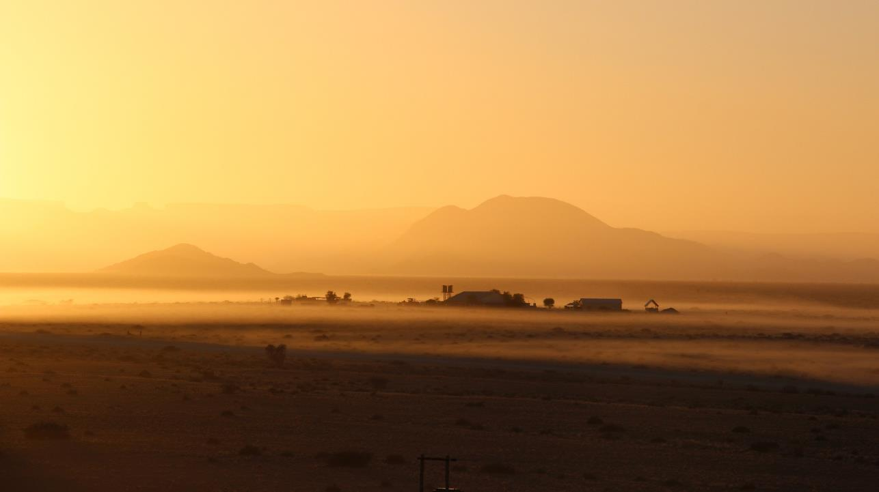
LAND DEGRADATION: what works …..
Lag time of
4.5 to 5.5 years for impacts to be observed
Access to electricity associated with higher impact
Higher impact observed in areas with poor initial conditions
Notes:
Measured on 3 UNCCD recommended indicators( Forest cover, vegetation productivity, and Forest fragmentation), we found that
1. The optimal results take 4.5-5.5 years after the project completion to be observable
2. Access to electricity was associated with higher impact. Might be due to the availability of better irrigation facilities and better infrastructure.
3. GEF impact was higher in areas with poor initial conditions. (Note: Results are based on Quasi-experimental analysis, which controlled for other factors)
Additional Factors not on this slide
1.In some projects access to roads also showed up as an important factor associated with positive outcomes
2.The LD projects closer to the cities showed better outcomes in terms of forest cover
3. Most of the LD projects were within 25 Km of a protected area

Slide 14
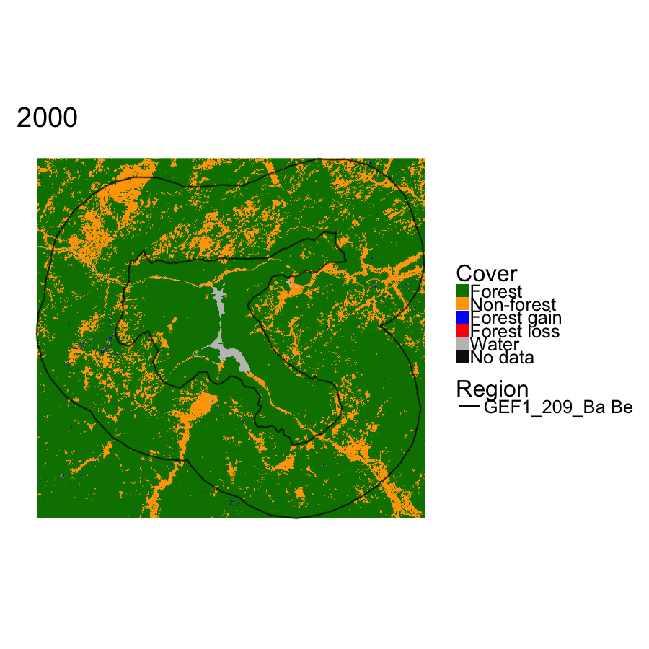
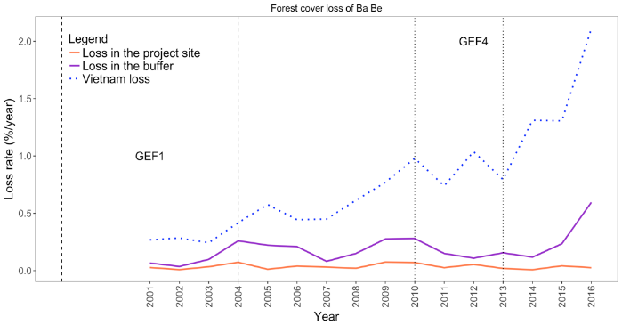
Ba Be: Sustainable Forest Management, Vietnam
SUSTAINABILITY
Forest cover loss
Loss rate (%/year)
2 %
Vietnam loss
0.55 %
Loss in the buffer
0.1 %
Loss in the project site
Sustainable outcome: Forest loss did not increase despite unprecedented increase in the buffer and at country level
Notes:
The forest loss in Ba-Be has not increased despite an unprecedented increase in the forest loss in the adjacent area and at the country level. The post project loss for the PA was 0.1 percent compared to 0.55 in the buffer area and 2 percent at the national level in 2016, 3 years after the project completion.

Slide 15

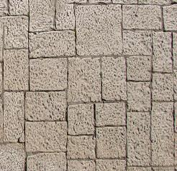

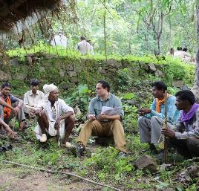
Challenges and Limitations
High computing power and technical skills needed
Uneven availability and accuracy of contextual variables across sites
Cannot always answer “how” and “why” questions
Need for field verification/ groundtruthing
Notes:
Challenges and Limitations
High computing power and technical skills needed
Uneven availability and accuracy of contextual variables, often vary widely across countries and sites
Cannot always answer “how” and “why” questions
Need for field verification/ groundtruthing

Slide 16
Triangulating Across Methods
Notes:
Getting to the Why and How?

Slide 17
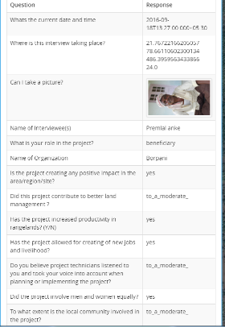
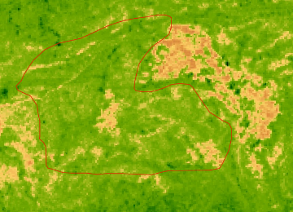
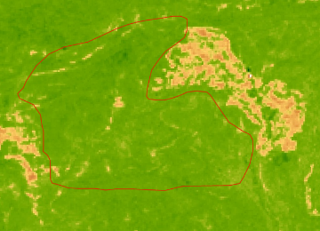

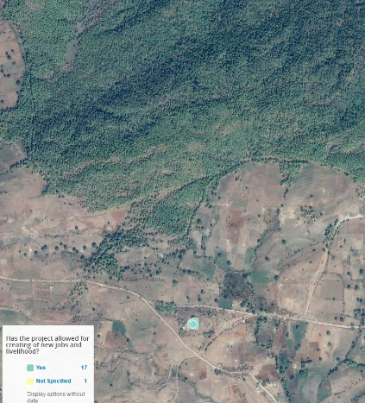
Time series analysis using Satellite data
India: SLEM PMIS 3472(2009-2015)
Beneficiary survey
Apr 2009
Apr 2015
Year
Bamboo Forest
Mixed methods and triangulation of findings
Qualitative methods
Case study
Field visits
Focused group interview
Stakeholders interview
Apr 2009
Village
Notes:
SLEM : GEF PMIS IDs 3472: Integrated Land Use Management to Combat Land Degradation in Madhya Pradesh. The main objective of the project was to restore bamboo forest by engaging with local communities We found that:
Vegetation has been improving since 2010. This was identified using daily MODIS NDVI observations.
The average vegetation index (NDVI) in 2015 increased about 10% from 2009.
Vegetation significantly improved inside the project area than outside.
In this case study we used smartphones to conduct the beneficiary survey on environmental and livelihood outcomes. We also collected the project boundary through GIS. The GIS data collected at the field site helped us conduct the satellite data analysis. Both these methods helped triangulate our findings from field work and the satellite data analysis. The field surveys helped answer the “Why” questions while the satellite data helped us to know “What”, “Where” and “How Much” of environmental change.

Slide 18

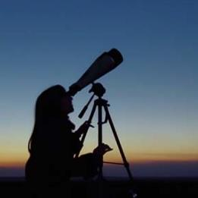


Lessons for the future
Use mixed approaches and methods
Approach evaluation as a dynamic learning process
Partner with
global institutions
Continue exploring
new methodologies and data sources
Notes:
Partner with global institutions with access to and infrastructure for using big data: GEF IEO has partnered with NASA, ESA,WRI,IUCN, Universities eg. For commodities we use WRI, Global Forest Watch(GEF is one of the core funding org.)
Used mixed approaches and methods
Use complementary tools and other sources of evaluative evidence to triangulate findings
Continue exploring use of new technology
drones, deep learning, internet of things, computational social science
Approach evaluation as a dynamic learning process
new data sets, approaches, issues will always emerge!

Slide 19
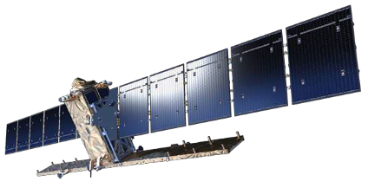
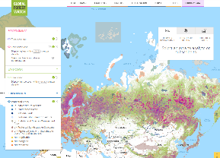
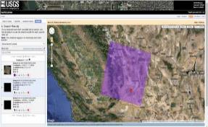
Resources
Interactive tools
http://www.globalforestwatch.org/ : GFW offers data, and tools for forests monitoring
https://global-surface-water.appspot.com/ : Global Surface Water
Data visualization and download
http://earthexplorer.usgs.gov : NASA-USGS EarthExplorer for raw data
https://scihub.copernicus.eu/ : Copernicus Open Access hub
Analytical tools(Open Access or Free)
http://www.qgis.org/en/site/ : QGIS
https://earthengine.google.com/ : Google Earth Engine(requires CODING)
https://www.google.com/earth/ :Google Earth Pro
Notes:
The list is not exhaustive. However, it is a good starting point.

Slide 20
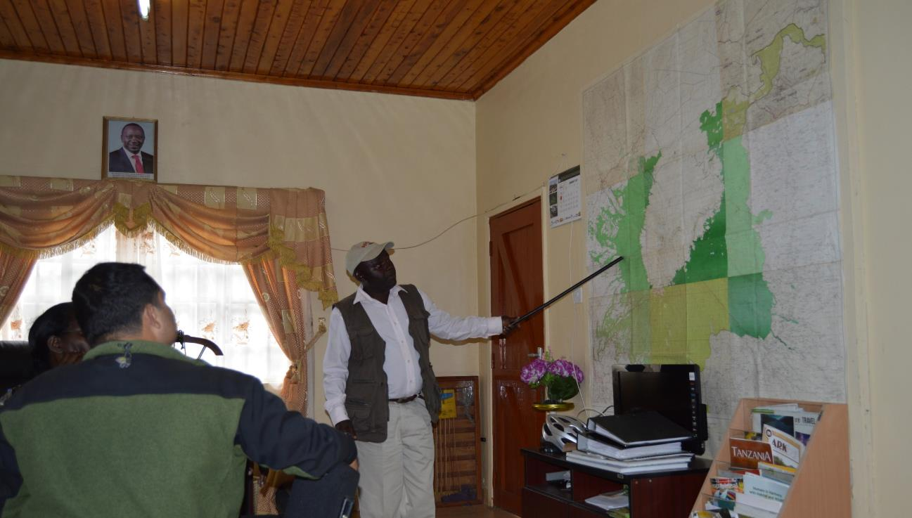
Thank you
aanand2@thegef.org
GEF-KWS-IFAD MKEPP, Kenya

Slide 21
• The main steps in the design and utilization of the different data science techniques in evaluations.
• The financial and technical resources required for the design, implementation and analysis of the respective studies
• How much time was required for the implementation of these studies and how did this compare requirements for traditional evaluation approaches?
• How were the different big data sources accessed and would these sources be easily accessible to other agencies (or is it necessary to have high level contacts with government agencies or the organizations that produce the data?)
• What was the value-added of using the big data? Were the additional costs and effort justified by the improved quality of the evaluation?
• What were the main challenges [methodological, resource considerations, organizational, political and cultural] in using these tools and techniques?
• What advice would the presenters give to other agencies considering the use of these tools and techniques?

