Slide 1
Deep insights with pragmatic approach to data collection
Cycle of conferences on evaluation in hard-to-reach areas
Daniela Uličná
6 June 2019

Slide 2
Briefly: Who we are?

Slide 4
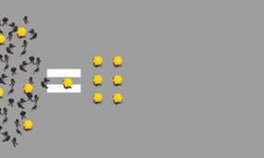
Public Division of Kantar
Research, data and analytics services
Behavioural insight, communications and digital consultancy
The Development Practice
Opinion, political and media advisory
Notes:
Globally, our work falls into four key practice areas: research, data and analytics; behavioural insight, communications and digital consultancy; the development practice; and opinion, political and media advisory.
One of the areas we specialise in here in the UK is behavioural insight, communications and digital consultancy, so we’re very exciting to be launching the UK Digital Hub, under the leadership of Dan Clay.
The Hub is designed to be a centre of excellence for digital research and consultancy across the group. It’s an opportunity to pull together what we and our clients are doing around the world, so we can share and advise each other as the pace of digitisation grows every quicker.
And that’s the topic for this morning: we’ll be looking at the opportunities that we see opening up for government as a result of the rise of the connected citizen. We’ll also be highlighting some questions that government will need to answer, and indeed that we expect to be addressing ourselves in the coming year.

Slide 5
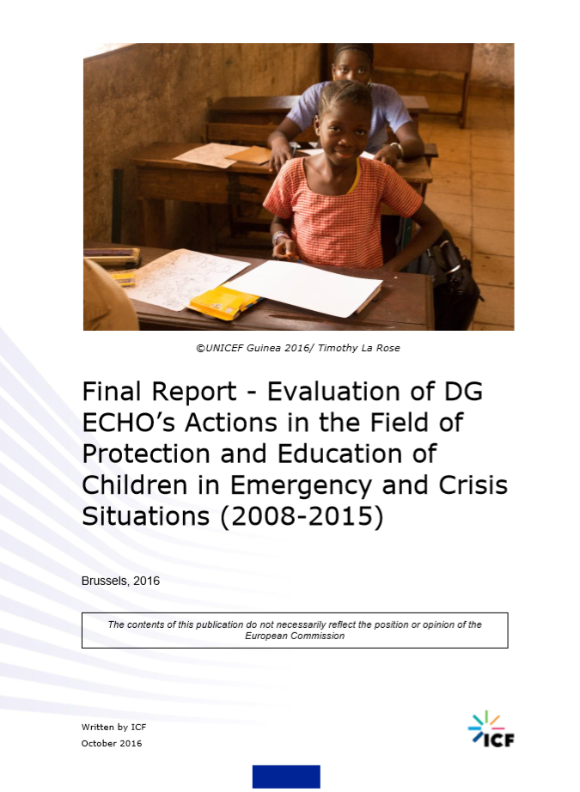
Evaluation of DG ECHO’s Children in emergency and crisis situations actions
Project led by ICF (2016)

Slide 6
The challenge
How to integrate the voices of beneficiaries without any opportunity to travel for fieldwork?
How to collect testimonies of children?
Photo by Antenna on Unsplash

Slide 7
Projective drawings collected by the local beneficiary organisations
Photo by Kelli Tungay on Unsplash

Slide 8
Summary
4 participating local partners
Save the Children
South Sudan
Children aged 10-17
Regional education project for refugee children and youth
Plan international
Uganda
Children aged 10-15
Child friendly space for refugee children in Adjumani district
UNICEF
Guinea
Children aged 10-16
Education support to mitigate effects of Ebola
International Red Cross - Tanzania
Children aged 4-7
Pre-school education project in Nyarugusu refugee camp
Source/base information here

Slide 9
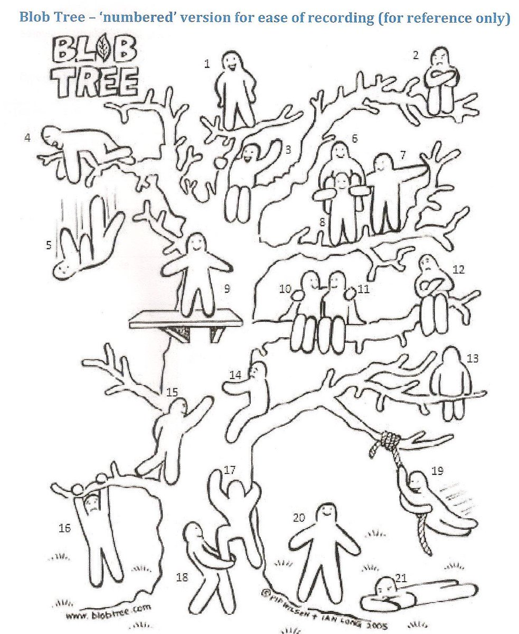
3 drawing exercises
Blob-tree – circle a figure which shows how you feel in <the environment that describes the project – school/ centre/ etc> . Circle twice a figure that shows how you feel outside.
Draw yourself doing an activity within the <the environment that describes the project – school/ centre/ etc>
Draw yourself before and after taking part in the project

Slide 10
What we collected
92 Completed Blob trees
92 drawings of child activities
30 Before and after drawings

Slide 11
How we organised the fieldwork
Recruit local partner organisations
Participation volunatry
Positive aspect: they really liked the idea
Briefing
Talk directly to persons who administer the exercise
Send a pack to the persons on the ground
Collect the drawings
Local contacts send scanned images
Physical material was picked up by a courier

Slide 12
What does the analysis enable us to discuss?
Positive and negative emotions that children associate with the project
Predominantly positive: Happiness, pride, excitement, feeling safe, support, nurture
In few cases negative: loneliness, fear, anxiety, anger
What is important for children in the projects
Friendships, socialisation, games and playing, learning and educational activities
How they see the project activities integrated in their daily routine and their lives
Children drew themselves walking to school (school bag, uniform as part of their identity)
Images of children receiving care to protect them from Ebola
Drawing their families as part of preparation for school

Slide 13
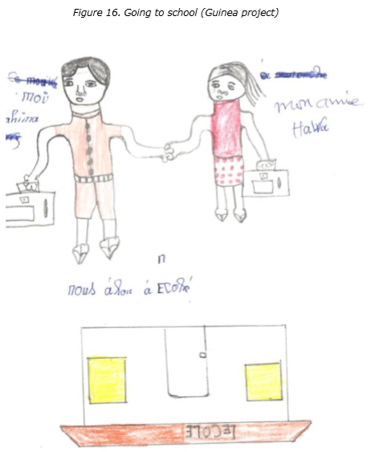
Going to school

Slide 14
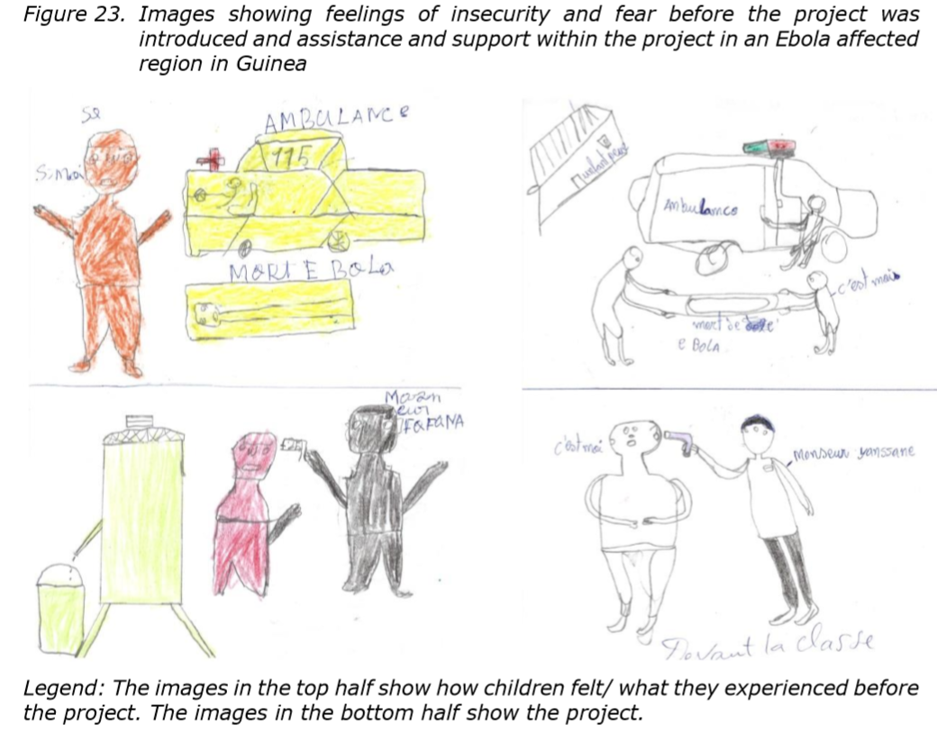
Receiving treatment

Slide 15
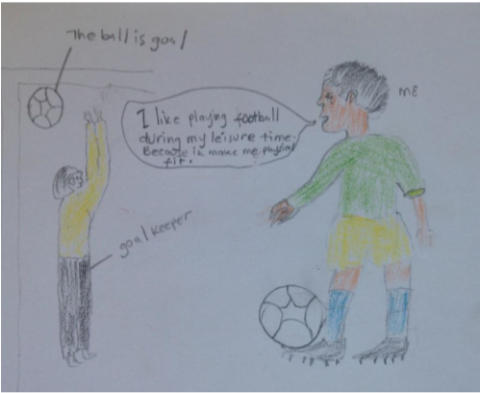
Playing

Slide 16
Advantages / disadvantages
Advantages
Disadvantages
Of collecting data through beneficiary organisations:
Buy in into the evaluation
Interest in evaluation findings
Lower costs for the evaluation assignment
For the organisations: new way of presenting their work
Of using drawings:
Easy to administer for local contacts
Deeper insight into emotions
Non-verbal evidence (show me rather than tell me)
Easies to communicate evaluation findings
Of collecting data through beneficiary organisations
Selection of organisations → requires committed partners
Little control over how the exercise is administered
Possible misunderstanding of instructions
Of using drawings:
Ideally the completed drawings would be a basis for an interview to get a complete picture and avoid misinterpretation

Slide 17
Other examples

Slide 18
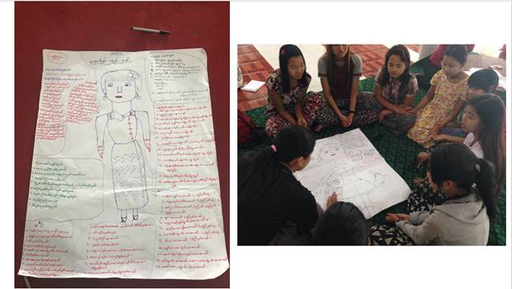
Other examples – ‘Being a girl in Myanmar’

Slide 19
Other examples – Perception of earthquake impact among children

Slide 20
On the issue of fieldwork in hard to reach areas
2 Minutes reads by Alexandra Cronberg – Kantar Research Methodologist
https://www.kantar.com/public/AF/our-thinking/public-empiricus-blog

Slide 21
Thank you
Daniela Ulicna
Daniela.Ulicna@kantar.com
0032 2 661 72 00
Kantar | Rue du Marais 49-51, 1000 Brussels, Belgium | www.kantar.com/public

