Slide 1
Introduction to the Dimensions of Digitalisation
Module 2.1:
Digitalisation & Development Cooperation
Notes:
Overall learning objective module 2: Understand the value digitalisation brings to development as well as challenges (deep dive: digital divide with focus on access and gender)

Slide 2
Agenda
Module 2.1: Digitalisation & Development Cooperation
  Initiatives & Strategies in DevCo
  Frameworks & Principles
  Tech4Good projects
  The private sector as "developer"
Notes:
Overall learning objetive module 2: Understand the value digitalisation brings to development as well as challenges (deep dive: digital divide with focus on access and gender)
Initiatives&Strategies: DevCo actors are developing roadmaps for their work at the intersection of digitalisation & DevCo=> Overview
Principles: Besides the strategic approach there are numerous guiding principles aiming to support the integration of digital approaches in DevCo
Tech4Good projects: How do digital projects look like? (Examples from Devco)
Private sector as developer: Numerous new players from the private sector such as large IT companies are engaging in developmental issues. What are the chances and risks of their engagement?

Slide 3





Digital Transformation affects all parts of our lives
It is also referred to as „Revolution”
affecting all areas of life and businesses
This also changes work and stakeholders of DevCo
CONSUMPTION
LIFE
PRODUCTION
WORK
DevCo
Notes:
Transition from Module 1
Message: The extent of the changes the digital transformation effects all dimensions of our lives. This also changes work and stakeholders of DevCo
Background:
Digitisation is not an end in itself for development policy. It can have a positive influence on developments in partner countries and spur development. But it can also hinder development or even have negative consequences for people in partner countries. It is precisely for this reason that dealing with digital change and its management is a development policy task. It will change the core areas of Development cooperation - education, health, rural development, good governance and sustainable economic development - and increasingly influence the path to achieving development policy goals.

Slide 4
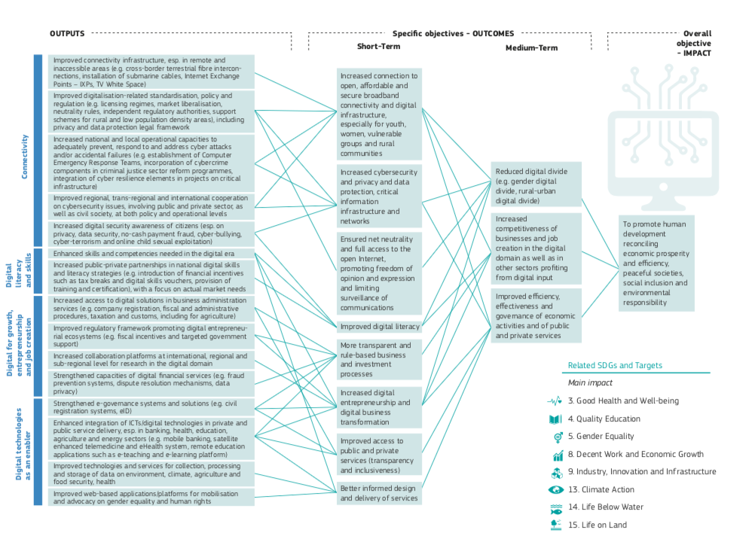
Digitalisation & DevCo
EU Results and Indicators for Development guidance for actions design
Improved regulatory framework promoting digital entrepreneurial ecosystems
Increased digital entrepreneurship and digital business transformation
Increased competitiveness of businesses and job creation in the digital domain as well as in other sectors
To promote human development reconciling economic prosperity and efficiency, peaceful societies, social inclusion and environmental responsibility
Table taken from EU Commission Document:
Results and Indicators for Development - Digitalisation
Notes:
Background:
The results chain (Digital for growth, entrepreneurship and job creation) examplifies how DevCo interventions can create “digital impacts“. The highligthed example on the right side exemplifies how an improved regulatory framework can enhance digital entrepreneurship and job creation and in the end promotes in the end contribute to human development and thereby tackling several challenges including the digital divide. (Digital entrepreneurship will be dealt with in detail in module 4)
EU Document: Results and Indicators for Development - Digitalisation

Slide 5
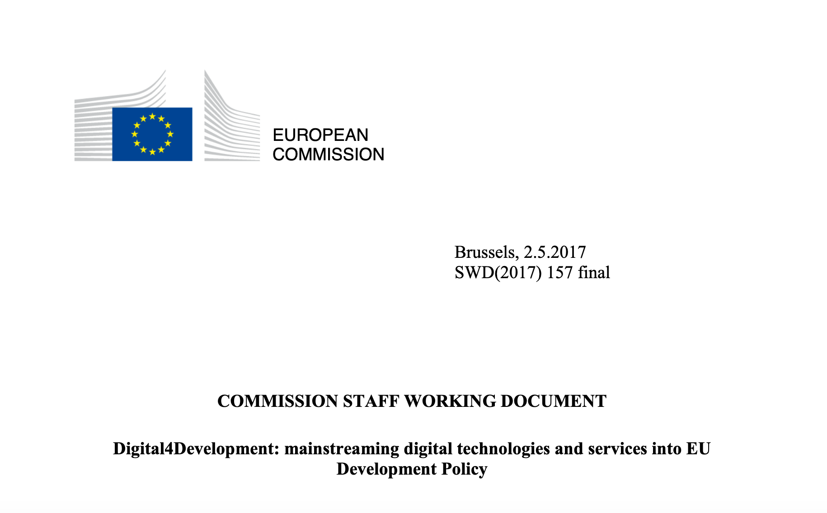

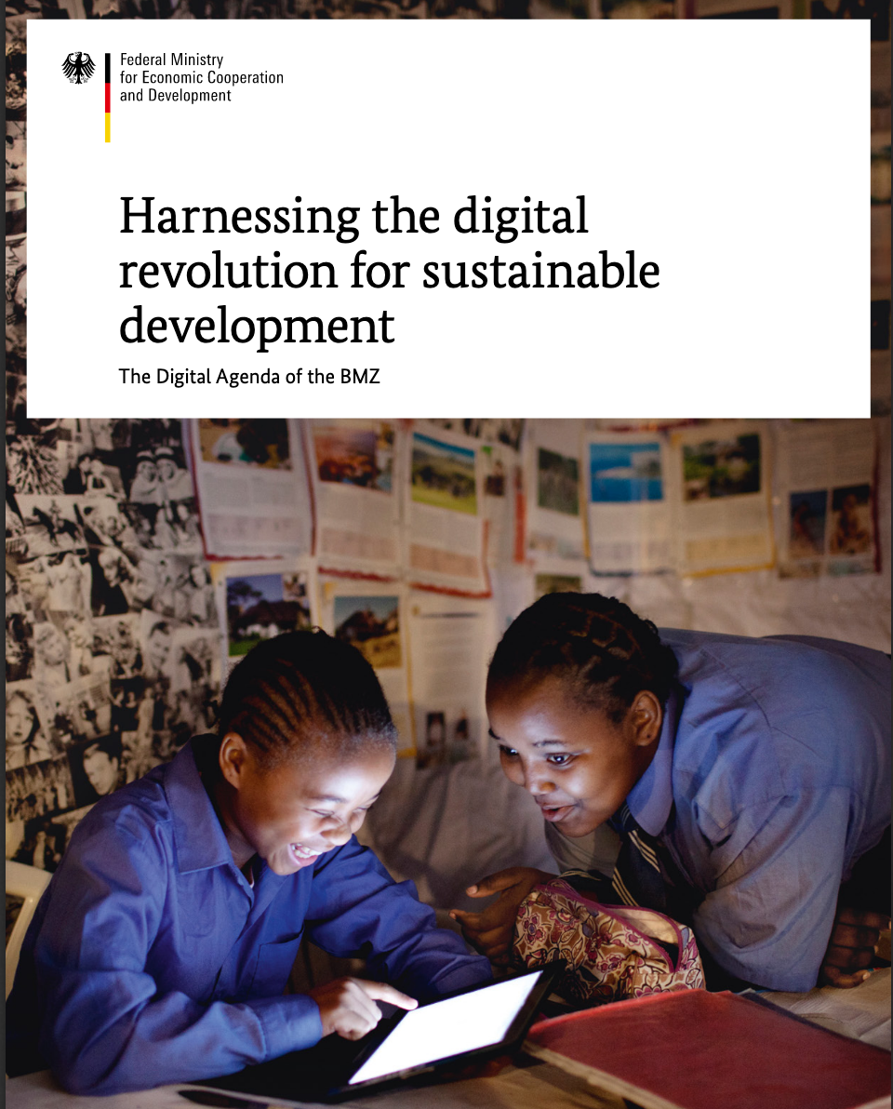
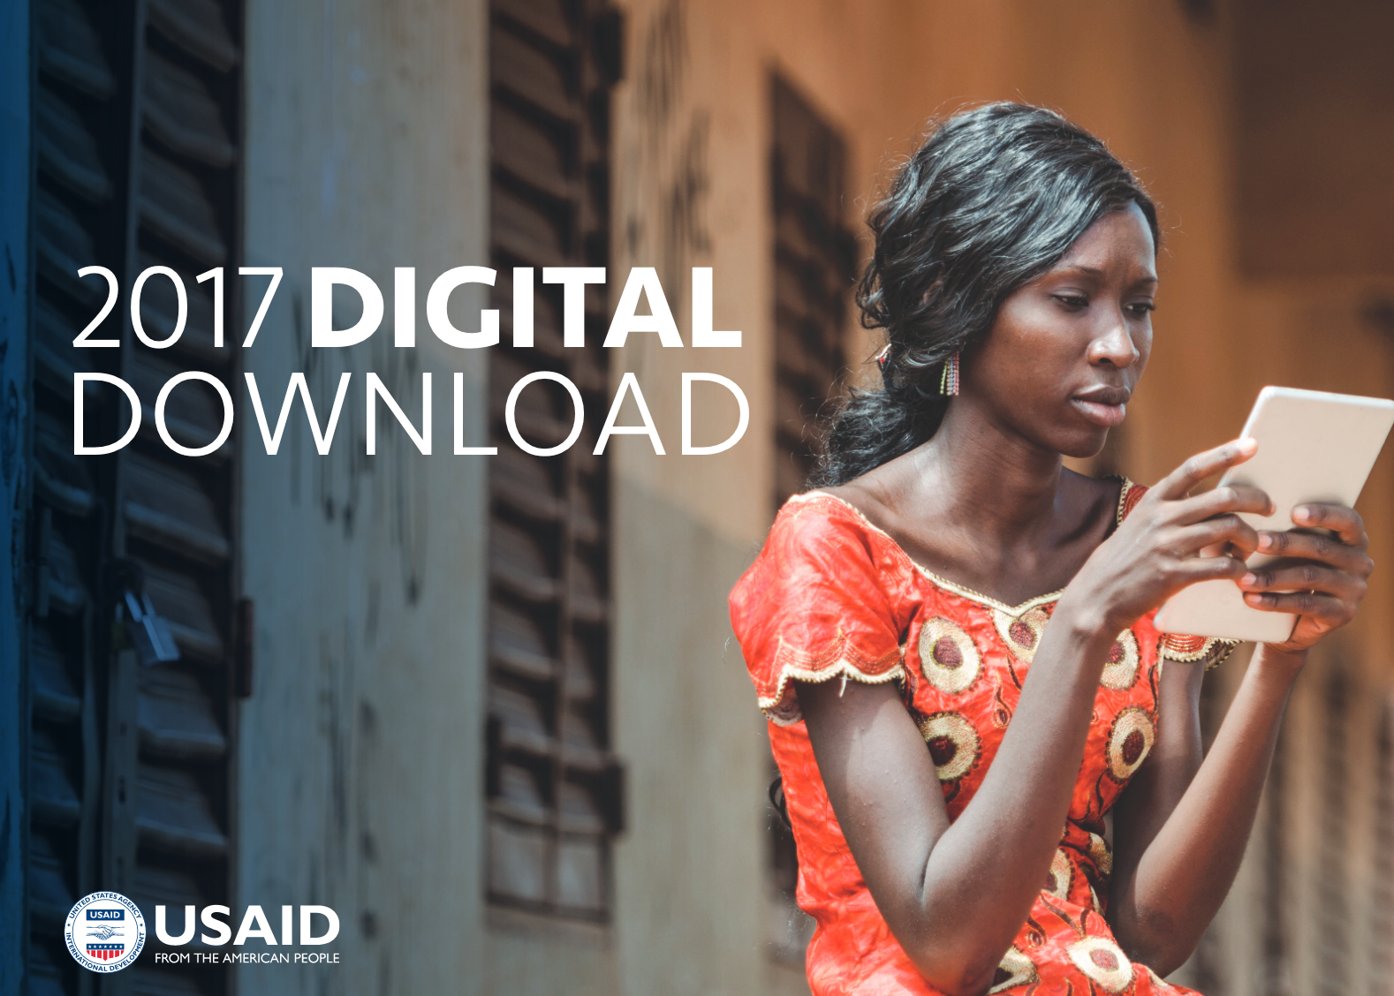
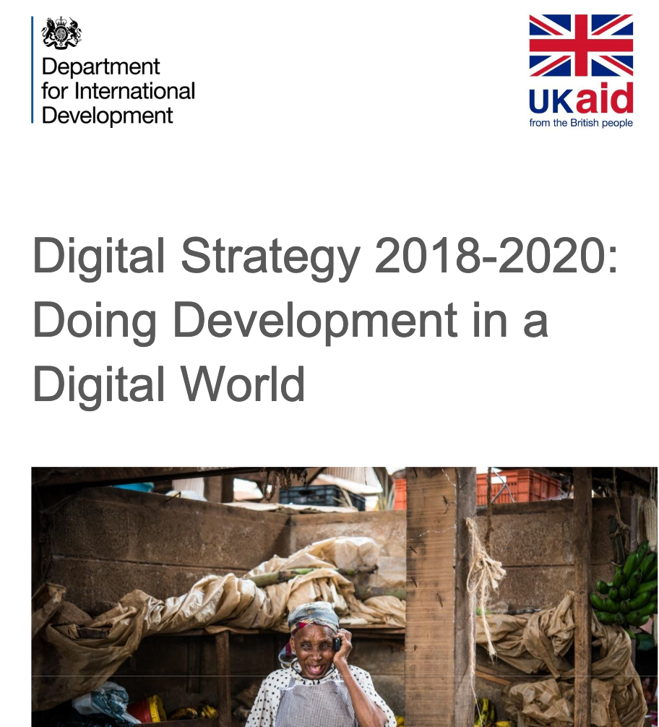
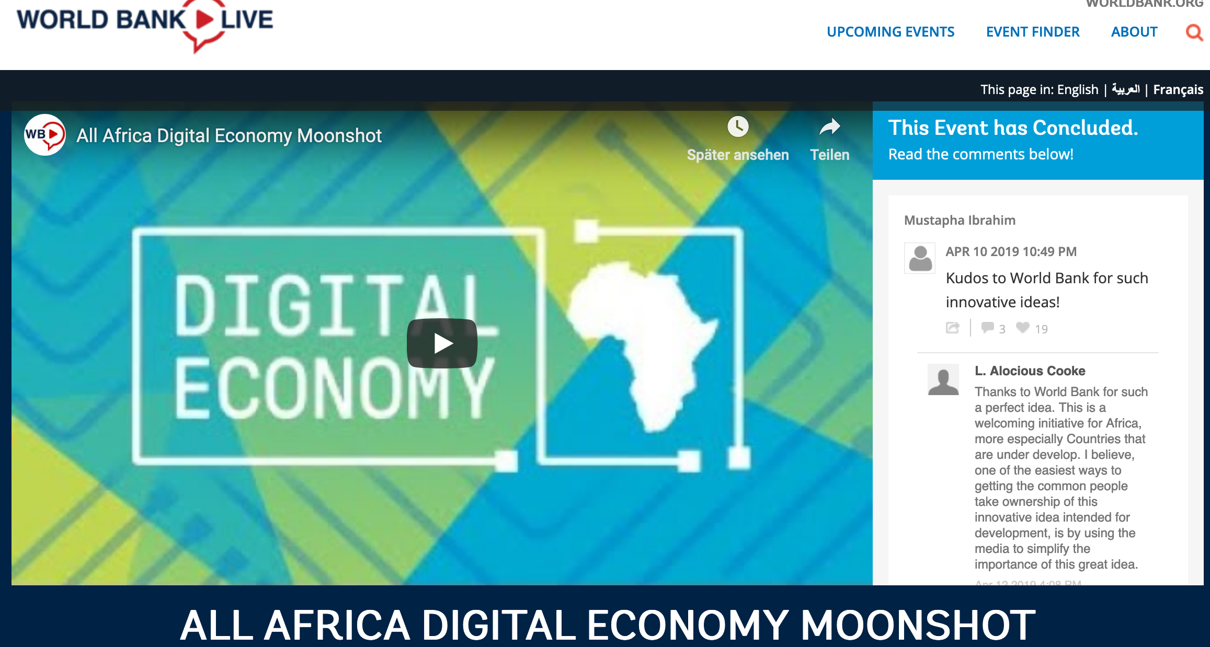
Initiatives & Strategies
DevCo is getting structured on digital topics as we speak
Most DevCo actors have developed specific digital strategies
Common vision: Promotion of inclusive and sustainable economic growth through digital development
Wide variety of instruments to achieve aims in the field of digital for development
Cooperations through donor alliances including private sector-based actors and multi-stakeholder approaches are quite common
Notes:
Key Message: DevCo is getting structured on digital topics. There is a global consensus on what the key areas are and all actors share a joint vision.
Background:
Most DevCo actors have developed specific digital strategies and share a common vision
Many emphasize the potential benefits of digital development in terms of promoting inclusive and sustainable economic growth. Meanwhile, it is less common to provide a clear vision or approach for the mitigation of potential downside risks, such as harmful concentration and monopoly, rising inequality, or state and corporate use of digital technologies to control rather than empower citizens.
Examples:
EU Digital4Development: 4 priority areas
Based on the Digital4Development agenda, digitalisation is mainstreamed into EU development policy across four main priority areas:
Promote access to affordable and secure broadband connectivity and to digital infrastructure, including the necessary regulatory reforms
Promote digital literacy and skills
Foster digital entrepreneurship and job creation
Promote the use of digital technologies as an enabler for sustainable development
EU/AU Digital Taskforce
The European Union-African Union Digital Economy Task Force (EU-AU DETF) provides a platform of partnership for the private sector, donors, international organisations, financial institutions and civil society based on a shared understanding of how an already fast evolving African digital transformation can achieve cross-border integration, and bring benefits to all citizens. During 6 months, the EU-AU DETF developed a shared vision, a set of common agreed principles and a list of policy recommendations and actions focusing on four main objectives.
i. Accelerating the achievement of universal access to affordable broadband.
ii. Guaranteeing essential skills for all, in education and Vocational Education and Training (VET), to
enable citizens to thrive in the digital age.
iii. Improving the business environment and facilitating access to finance and business support services
to boost digitally enabled entrepreneurship.
iv. Accelerating the adoption of eServices and the further development of the digital economy for
achieving the SDGs
African Development Bank
Although lacking a general framework for its interventions in the ICT sector, AfDB supports many African countries and regions in their efforts to formulate well-founded ICT strategies with a strong emphasis on ensuring conducive legal and regulatory frameworks and developing the required infrastructure
World Bank Moonshot initiative
Five principles proposed by the world bank to harness the digital business potential in Africa
1. Comprehensive: taking an ecosystem approach that looks at supply and demand and defies a narrow silo approach in defining the required elements and foundations for the digital economy.
2. Transformative: aiming at a very different scale of ambition, beyond incremental “islands”of success.
3. Inclusive: ensuring that the digital economy creates equal access to opportunities and dealing with the risks of exclusion.
4. Homegrown: basing expansion of the digital economy on Africa’s realities and unleashing the African spirit of enterprise to produce more homegrown digital content and solutions, while embracing what is good and relevant from outside the continent.
5. Collaborative: dealing with the digital economy requires a flexible “mindset,” requiring different types of collaboration among countries, sectors, and public and private players, as well as facilitation, retooling, and encouraging risk taking.
Wide variety of instruments to achieve aims in the field of digital for development
Donors have introduced a wide variety of instruments to achieve their aims in the field of digital for development. These include various tools to promote digital innovation and start-ups through incubators, grants, competitive awards etc. and the exchange of information via online platforms, webinars, toolkits, and the like. Indicator and index systems have been developed to measure the status and evolution of digital economies.
Cooperation through donor alliances including private sector-based actors and multi-stakeholder approaches are quite common
Cooperation through donor alliances including private sector-based actors and multi-stakeholder approaches are quite common. Many donors contribute to and participant in D4D-relevant fora such as the the WSIS Forum and the Internet Governance Forum.

Slide 6





Frameworks & Principles
ICT plays a role in the achievement of all of the SDGs
ICT is only named in the SDGs 4x explicitly
4.A.1 Proportion of schools with access to the Internet for pedagogical purposes
5.B.1 Proportion of individuals who own a mobile telephone, by sex
9.C Significantly increase access to information and communications technology and strive to provide universal and affordable access to the Internet in least developed countries by 2020.
8.2 Achieve higher levels of economic productivity through diversification, technological upgrading and innovation, including through a focus on high-value added and labour-intensive sectors.
...but play a significant role for all goals
Notes:
Key Message:
DevCo is also impacted by the digital transformation. There are guidelines and tools you can refer to.
Background:
The exponential spread and scale-up of digital technologies and services has profound global implications, creating opportunities for sustainable development and inclusive growth, but at the same time bringing with it new threats and challenges. On an international level several processes acknowledge these developments.
Although access to and deployment of information communication technology (ICT) are cited as specific targets in only four of the SDGs (4, 5, 9 and 17), ICT plays a role in the achievement of all of the SDGs
Reference back to digital strategie of DevCo actors: Donor support to SDG achievement through digital economies is quite diverse in terms of thematic focus, levels of funding, modes of delivery, conceptual approaches and expected results. Donors have dedicated a large part of their support to digital solutions in health (SDG 3), education (SDG 4), decent work and economic growth (SDG 8) and industry and infrastructure (SDG 9), while other areas appear to have attracted relatively little attention from donors.
Examples SDG/Digitalisation:
SDG 3 (good health and well-being) => better connectivity and e-health initiatives support access to health care and services as well as exchange of critical health-related information.
SDG 4 (Quality education) => Platforms and online learning courses, such as Massive Open Online Courses which are available for free as well as exchange via online social networks make it easy to learn independent from place and time (inclusion of marginalized groups)
SDG 5 (gender equality) => efforts on closing the gender digital divide; improve women’s access to technology, build relevant digital and other skills, and promote female leadership in the tech sector.
SDG 9 (industry, innovation and infrastructure)=> Efficient and affordable ICT infrastructure and services allow countries to participate in the digital economy and to increase their overall economic well-being and competitiveness
SDG 13 (climate action)=> The main areas where ICT can support are transportation and traffic management, buildings, services, manufacturing, agriculture, land use and satellite monitoring for weather forecasting and monitoring.
SDG 14 (life below water) => increasing scientific knowledge of oceans and marine life in support of
SDG 15 (life on land) => Through improved monitoring and reporting, ICT can play an integral role in the prevention of biodiversity loss and conservation and sustainable use of terrestrial ecosystems. Local sensors can deliver real-time updates, while satellite-based monitoring provides timely and accurate data on a global basis.
Examples for innovative approaches:
Transport/ICT:
In Sub-Saharan Africa, private sector’s investments experienced a shift from ICT infrastructure, with few but big projects, to energy infrastructure while interest in transport remains small. But urgent need for policy shift: A step change in future mobility patterns and multimodal transport is envisaged: information and communication technology (ICT) and the associated disruptive technologies are reshaping the landscape with major trends in autonomous driving, shared mobility, connectivity, and electrification.
ICT trends for urban transport: Real-time public transit information, Autonomous vehicles, Intelligent traffic signals, Integrated multimodal information, carsharing
WhereIsMyTransport
WhereIsMyTransport is a transport technology company that provides governments and transit operators with an open data platform for the integration of formal and informal transit data. This enables third-party apps to provide commuters with real-time transport information, it allows for more efficient planning and regulation of mass transit systems by local governments, and it also makes mass transportation more accessible, efficient and safe for the poor. The start-up is now seeking to expand to India, South East Asia and Latin America, having carried out data collection on the public transport system of Mexico’s capital, Mexico City, last year.
The intervention of the start-up supports a number of the UN Sustainable Development Goals including: Goal 1 (No Poverty), 8 (Decent Work and Economic Growth), 9 (Industry, Innovation and Infrastructure) and 11 (Sustainable Cities and Communities).
Gender/ICT:
UN Women is piloting the Buy from Women (BfW) platform under the Global Flagship Programme on Climate Smart Agriculture, to provide easier access to land, information, markets and finance for women farmers. Most available market platforms are developed based on the needs of buyers or companies that need to track their suppliers. But the design of Buy from Women is directly based on women farmers’ needs. It uses an open source ERP system (Enter-prise Resource Planning) developed for the farmers, covering multiple functions, and flexible to integrate third party apps. Pilots are based on value-chain-specific analysis to make sure their features integrate local needs and contexts. The platform plays a dual role: it allows women to access pertinent information (prices, inputs, financing) while helping them establish themselves as legitimate commercial entities with records (land/yields, track record of investments/repayments) to secure their financial future or access new markets.
Resources:
https://www.icafrica.org/fileadmin/documents/Annual_Meeting/2017/2017_Annual_Meeting_-_background_paper_FULL.pdf
https://globalinnovation.fund/investments/whereismytransport/
http://www.unwomen.org/-/media/headquarters/attachments/sections/library/publications/2019/innovation-for-gender-equality-en.pdf?la=en&vs=733

Slide 7
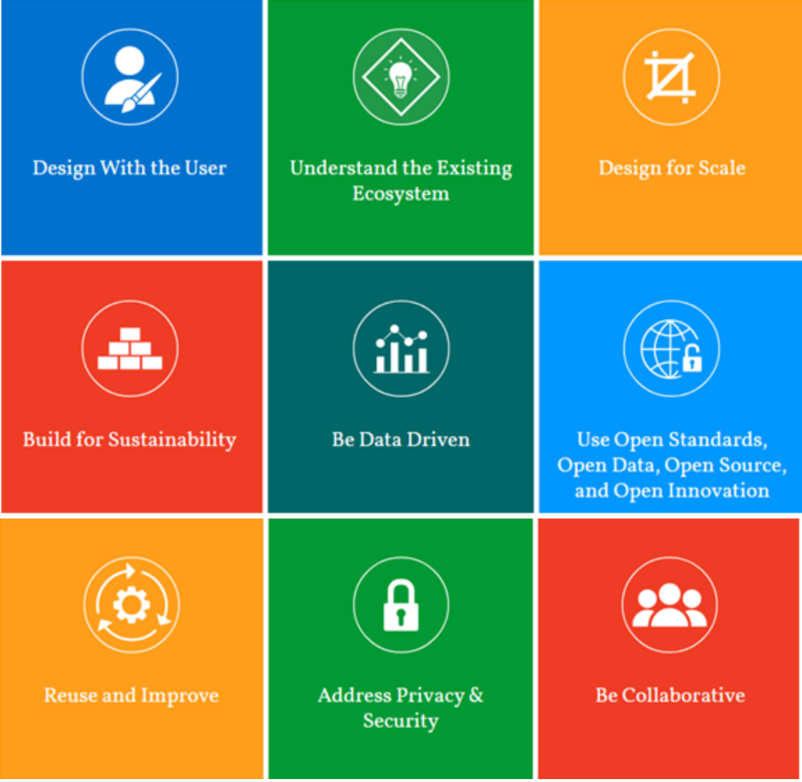
Frameworks & Principles
The Principles for Digital Development can help to ask the right questions
The Principles for Digital Development provide straightforward, intuitive guidance on how to choose and use appropriate technology to promote development objectives
Notes:
Background:
In the literature on digitalization for development practitioners a number of principles for the implementation of digital technologies in projects have been proposed. The most important initiative has emanated from a collaboration between several UN-agencies, the World Bank, development cooperation agencies and others for defining the „Principles for Digital Development“. The nine principles are guidelines to be followed by development projects in the implementation of digital technologies and are officially endorsed by over 50 organizations, including major development cooperation agencies like USAID, large NGOs like Oxfam and international organizations.
The Principles for Digital Development have been proven worthwhile in the conception, planning and implementation of digital projects in development cooperation. 9 Principles:
Design with the User
Understand the Existing Ecosystem
Design for Scale
Build for Sustainability
Be Data Driven
Use Open Standards, Open Data, Open Source, and Open Innovation
Reuse and Improve
Address Privacy and Security:
Be Collaborative
https://digitalprinciples.org

Slide 8

Frameworks & Principles
Discussion: The Principles for Digital Development in Practice
20 min
Context:
The government of Afghanistan wants to develop a customized management information system (MIS) that allows all staff to better track and manage health data of rural communities. While discussing the concept, the implementation team faced decisions, such as whether to buy or build a product and whether work should be outsourced or done in-house.
How do you make the suggested digital solution creates impact?
Discuss applying the Digital Principles!
Notes:
​Preparation:​
Hand out Digital Principles to each participant
Timing:
20min

Slide 9






Example: Failed Tech
OLPC: One Laptop Per Child
Actual production costs were more then 200$
No connection ports for local classrooms
Limited assistance with software issues
Lack of existing infrastructure including power supply and broadband connection
Ignored local contexts and broke the cardinal rule of program design by not focusing first on the end users of the laptops.
Notes:
Key Message:
The following examples show how digital transformation and new technologies are shaping development cooperation for good and for bad as well. Digital tools are means not end!
Background:
The Presenter shortly introduces the OLPC initiative and why it is considered a failure referring back to the digital principles which have not been considered in the project design (e.g. design with the user, understand the existing ecosystem)
Background:
The OLPC short for One Laptop Per Child also known as the “100$ Laptop” is an initiative intended to provide every child in the Global South with an inexpensive, robust and energy-saving laptop. These computers should be able to interconnect and thus create an educational network even in the remotest corners of the world. Was founded by MIT professor Nicholas Negroponte in 2005.
Why is it considered a failure?
The program originally aimed to produce at a price of $100 per laptop, but manufacturers often had to price them at $200 or more. Moreover 90% of the acqusition costs should have been funded by the receiving countries who had no money in the first place.
Lack of existing infrastructure including power supply and broadband connection.
The laptops also were criticized for:
lacking connection ports for classroom projectors,
limited troubleshooting assistance for software issues,
expensive replacement parts for hardware,
and being made with environmentally hazardous materials.
Ignored local contexts and broke the cardinal rule of program design by not focusing first on the end users of the laptops: Thus cultural issues also presented significant challenges. For example in Uruguay a national evaluation of the program after it launched revealed that only 21.5% of teachers reported using the laptops in class daily or near-daily, and 25% of the teachers reported using them less than once a week – reference Digital Principles.
Business Week’s Bruce Nussbaum suggested that OLPC would have been more successful if it had involved its aimed beneficiaries earlier in the planning. “It would have been far better to begin in the villages, spend time there and build from the bottom up.” Had teachers, parents, and students been consulted more in the research and planning stages before implementation, OLPC strategists may have been in a better position to tailor the program to needs at the local level. Public relations professionals should apply this type of design thinking that focuses on end users (i.e., key publics) in any kind of planning. Access to technology is perhaps the first concern, but any effective communication strategy also requires careful attention to social and cultural contexts.
Background information for possible questions:
One Laptop Per Child (OLPC) is a nonprofit founded by MIT professor Nicholas Negroponte in 2005

Slide 10

Example: Tech4Good
Life Saving Delivery by Drone (Zipline+Government of Rwanda)
©zipline
Notes:
Procedure:
The presenter clicks on the image. A small promotion video starts playing to illustrate the benefits of UAVs - unmanned aerial vehicles (also referred to as humanitarian drones/drones for good) for Development Cooperation (in this case, the e-health sector).
Background information for possible questions:
Drones, or unmanned aerial vehicles (UAV), are vehicles that fly either autonomously or by remote control. In a development cooperation context, drones could potentially prove useful for obtaining data and transporting certain types of load.
Role of the partners:
Rwanda: UPS (global supply chain and logistics expertise), GAVI public–private global health partnership (public health and vaccine knowledge), Zipline (expertise in last-mile delivery technology),
Zipline exemplifies how cargo drones greatly facilitate deliveries of aid to inaccessible areas. The following facts are generated by zipline:
Zipline provides daily deliveries across Rwanda and Ghana
500 deliveries/day: Capacity from each distribution center. This is up to one ton of medicine and blood products, daily.
30 Minutes: Average time from order placed to delivery. This was once a 5 hour round-trip truck drive for many hospitals.
80 km Service Radius: A single Zipline distribution center can provide instant medical access to millions. For large countries, Zipline builds a network of distribution centers.
1.8 kg Payload A single flight can deliver up to 3 units of blood. For larger orders, multiple drones are sent at the same time.
Dependable Zipline has designed redundant systems into our drone. The drone has two motors and if one stops working, the other kicks in. The same is true for the drone's power, communications, and navigation systems. Additionally, the drone has a parachute landing system as a backup to the backup.
Source: https://www.youtube.com/watch?v=OnDpE8uSb7M

Slide 11




Example: DEVCO
Digital approaches are already part of the DEVCO portfolio
Africa Connect: Support of the creation, development and use of regional education and research communication networks.
Policy and Regulation Initiative for Digital Africa (PRIDA): Aims to foster universally accessible and affordable broadband across the continent by facilitating efficient and harmonised spectrum utilisation.
Cyber Resilience for Development: Aims to increase the security and resilience of critical information infrastructure and networks supporting the adoption and implementation of a comprehensive set of policy, organisational, and technical measures that will increase their cybersecurity and preparedness.
The Multinational Trans-Saharan Backbone (TSB) Optical Fiber Project will lay optical fiber cables to interconnect Algeria, Niger, Nigeria and Chad
Notes:
Background:
AfricaConnect a programme facilitating the creation, development and use of regional education and research communication networks and high capacity internet connectivity with a gateway to global research collaboration. By facilitating access to much needed educational and research resources and enabling research collaboration, the action will support the digital transformation of those sectors and digital skills development.
Policy and Regulation Initiative for Digital Africa (PRIDA) aims to foster universally accessible and affordable broadband across the continent by facilitating efficient and harmonised spectrum utilisation; harmonising measurable policy, legal, regulatory frameworks; and strengthening the ability of African decision makers to actively participate in the global governance debate. (Total budget EUR 8 million; EU contribution EUR 7.5million)
The Cyber Resilience for Development, under: Protecting critical infrastructure envelope, aims to increase the security and resilience of critical information infrastructure and networks supporting the adoption and implementation of a comprehensive set of policy, organisational, and technical measures that will increase their cybersecurity and preparedness. (Total EU contribution: EUR 11 million)
The Multinational Trans-Saharan Backbone (TSB) Optical Fiber Project will lay optical fiber cables to interconnect Algeria, Niger, Nigeria and Chad (Total budget: EUR 78.5 million; EU contribution: EUR 29 million).

Slide 12


The private sector as developer
New players from the private sector are engaging in developmental issues
Facebook Diverse initiatives to connect the unconnected with projects like Freebasics: Facebook App + slimmed-down versions of other services (BBC, Wikipedia) Aquila solar-powered drone, which will be able to beam bandwidth down to users in remote areas | Google Supports the growth of start-up communities around the globe by providing them with technical training, mentoring, business tools and financial sponsorship Products and projects include Google Earth Engine, Google AI Impact Challenge, Google SOS Alerts
Notes:
Key Message:
The Digital4Development approach will not be implemented in isolation, but as part of overall development strategies involving also the private sector. Numerous new players from the private sector such as large IT companies are engaging in developmental issues. What are the chances and risks of their engagement?
Message:
Facebook for example provides with „Free Basics“ a set of service that can be access for free
With the selection, Facebook can manipulate markets and opinions
Innovation is hindered, as new services can‘t can access to customers as easy
Similar situation in Germany until recently: Spotify was zero rated on the T-Mobile network, giving it a huge advantage over the competition
Google
supports the growth of start-up communities around the globe by providing them with technical training, mentoring, business tools and financial sponsorship
Products and projects include Google Flu Trends, Google Earth Engine (Google Earth Engine is a cloud-based platform for planetary-scale geospatial analysis), Google AI Impact Challenge (The Google AI Impact Challenge gives Google.org grant funding to organisations that are using AI to address social and environmental challenges. Full Fact, Africa Check, Chequeado and the ODI will share $2 million over three years, as well as receiving coaching from Google’s AI experts and credits and consulting from Google Cloud) and Google SOS Alterts (Two years after their original introduction, Google is updating its SOS Alerts with more real-time information about areas affected by natural disasters, and new navigation warnings in Google Maps to help route you around danger. The changes will also show you more detailed visual information about earthquakes, hurricanes, and floods, with a visual overlay to show the impacted areas. For hurricanes, Google will attempt to forecast their route, and will display a crisis notification card in Google Maps if you’re near an affected area. Flood forecasts will show an overlay on a map of affected areas, along with information about severity. Finally, earthquakes will also get a crisis card, which will show you its epicenter, magnitude, and areas affected)

Slide 13


The private sector as developer
New players from the private sector are engaging in developmental issues
SAP Africa Code Week Pan-African digital skills initiative Since 2015 ACW has introduced over 1.8 million African youth to coding skills in multiple African countries Facilitates the integration of ICT education in the school curriculum for more than 28,000 teachers and educators across the continent. Supported by partners such as Google, UNESCO, BMZ | Microsoft 4Afrika Initiative Started in 2013, invests in start-ups, partners, small-to-medium enterprises, governments and youth on the African continent Projects include: 4Afrika Academy providing graduates and developers with in-demand digital skills and experience TV white spaces connectivity for schools, healthcare centres and businesses
Notes:
Background:
SAP Code Week
On a mission to empower 70 000 teachers and positively impact the lives of 2 million young Africans by 2020, Africa Code Week is supporting governments’ sustainable capacity building strategies. Every year between June and September, SAP funds a series of Train-the-Trainer (TTT) sessions to empower teachers with skills and teaching materials that drive the advance of digital skills in the school curriculum. As part of this year’s TTTs organized across 20 countries in the build-up to the 2018 edition, 500 teachers were trained in Ghana, 1,200 in Nigeria, 200 in Madagascar, and another 1,000 in Botswana.
For the third year in a row, Google is also supporting Africa Code Week as part of its own commitment to preparing 10 million people in Africa for tomorrow’s workplace. In 2018, Google is supporting 53 non-profit organisations across 11 countries to empower teachers and inspire an estimated 80 000 students through computer science and coding workshops.
4Africa Initiative
Our 4Afrika Academy is providing graduates and developers with in-demand digital skills and experience, securing full-time employment for 90% of our participants. 400 interns have been placed with 60 partners across 20 countries. 90% retention rate of interns.
More local start-ups, with the relevant financial and technical support, are now all using cloud-enabled technology to change the face of healthcare, agriculture, education, finance and government services on the continent. 64 Startups funded and 94 supported generating $5.1 million in reciprocal investments
Through TV white spaces connectivity pilots, we have connected schools, healthcare centers, universities and businesses to the internet for the first time. 15 Connectivity plots in 6 countries with $4.1 million from OPIC to expand Mawingu

Slide 14


Discussion
Will digital businesses spur development globally?
Numerous new players from the private sector such as large IT companies are engaging in developmental issues.
What are the chances and risks of their engagement?
Discuss considering the following aspects:
Privacy vs. Use of data
Market distortion vs. Innovation
Business expansion vs. Social impact
10 min
Notes:
Procedure:
The Presenter shortly introduces the exercise and starts a (max 10 min.) group discussion on the pro and cons of private sector actors engaging in developmental issues against the background of the examples from slides 12/13
Zero Rating could be introduced to trigger the discussion if necessary:
Background:
Zero rating offers allow free access to selected offers for free
This allows access to certain elements for many that could not afford any internet use otherwise (pro)
On the other hand this small piece of the internet becomes „THE“ internet for people (con)
Facebook for example provides with „Free Basics“ a set of service that can be access for free
With the selection, Facebook can manipulate markets and opinions
Innovation is hindered, as new services can‘t can access to customers as easy
Similar situation in Germany until recently: Spotify was zero rated on the T-Mobile network, giving it a huge advantage over the competition

