Slide 1
Introduction to the dimensions of digitalisation
Module 2.2:
The Digital Divide
Notes:
Overall learning objective module 2: Understand the value digitalisation brings to development as well as challenges (deep dive: digital divide with focus on access and gender)

Slide 2
Agenda
Module 2.2: The Digital Divide
Introduction and Status Quo: The digital divide
Deep Dive: Access
Deep Dive: Gender
Notes:
Overall learning goal module 2: Understand the value digitalisation brings to development as well as challenges (deep dive: digital divide with focus on access and gender)
Introduction: The digital divide
Focus: Access
Focus: Gender

Slide 3
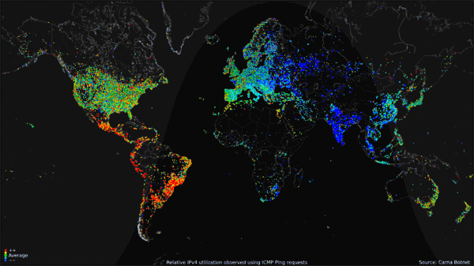
Notes:
Key message: The potentials of digitalisation are not accessible for everyone.
Procedure:
Ask participants to interpret the visualization
Ask for reasons of low internet use / adoption e.g. in Africa; The trainer captures the points on a flipchart
Reasons are to be discussed in the following section
Background:
Shown: World map of 24-hour relative average utilization of IPv4 addresses observed using ICMP ping requests as part of the Internet Census of 2012 (Carna Botnet), June - October 2012.^{[23]} Key: from red (high), to yellow, green (average), light blue, and dark blue (low). (Copied from Wikipedia, CC)

Slide 4








The Digital Divide(s)
Still ~3.5 billion people do not use the internet
A digital divide has formed
42% offline
57% online
No access
= no access to possibilities
= falling behind even further
access
= access to benefits
= faster development
Notes:
Background:
A Digital Divide is opening between users and non-users
Non users are excluded from the advantages of digitalisation (see 1.2) and
fall back behind those connected (generally those more developed anyways). This is due again to the advantages (access to knowledge, markets, faster development, etc.) connected regions and people have access to
Resources: Global Digital Report 2019 (https://wearesocial.com/blog/2019/01/digital-2019-global-internet-use-accelerates), ITU ICT Facts and Figures 2017 (newest available)
Definition: An internet user is someone who used the internet by any device and location within the last 3 months
Group work (optional – also included in slide 3)
Start with an exercise to make participants move. Create a matrix, or circles on the floor with masking tape or duct tape. One area is for non users from developing countries. Mark also other areas for instance non users from rural areas. Tell them that the class is a is a representation of the world. How many participants are the non-users from developing countries? How many are the non-users from western countries? Ask them to move to the assigned area. Calculate the ration. Don’t give them the answer yet. Write it down on paper. Presentation: Now use the slide to present the barriers to internet use. Now you can give them the correct answers: how many are the non-users from developing countries (in the room) brainstorming, ask participants what are the barriers to digitalisation? The trainer captures the points on a flipchart and then uses the PPT to add, clarify

Slide 5
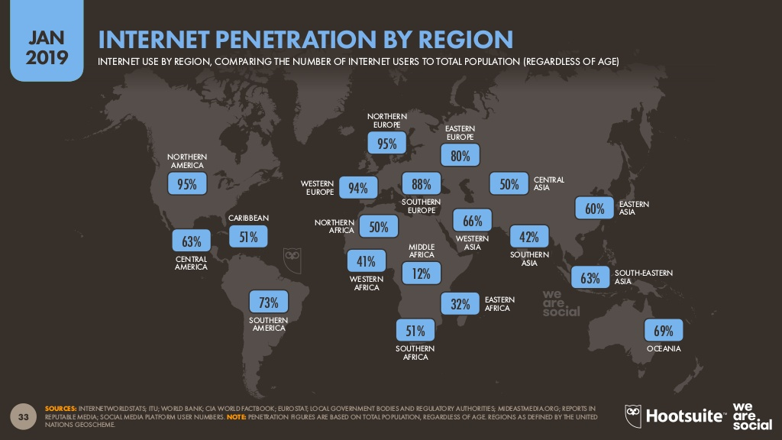
The Digital Divide(s) by region
Notes:
Background:
Visualisation of the Digital Divide between regions (global North vs. Global South)

Slide 6
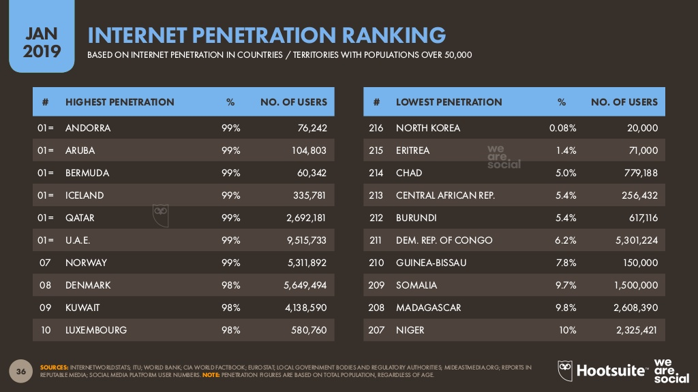
The Digital Divide(s) by selected countries
Notes:
Background:
Visualisation of Digital Divide between countries (global North vs. Global South)

Slide 7

The Digital Divide(s)
Several divides exist
The Digital Divide does not only form between countries, but also between regions and socio-economic groups of
the population. E.g.
Young vs. old
Rich vs. poor
Urban vs. rural
Male vs. female
Notes:
Procedure:
- Ask participants about their experience with internet access. Even at home (this living in rural areas)
Background:
- Topics Access rural / urban and Gender Divide are discussed in more detail in the following
90% of all non users live in developing countries
60% are living in rural areas, where network coverage is poor and expensive
58% are women
Age and wealth are further influencing factors increasing or lowering ones chances of access

Slide 8



The Digital Divide(s)
Barriers to internet use
Five barriers (As) to internet use have been identified – Digital Divide is „not binary“
Not only access to ICT and its cost presents a barrier to internet adoption
Capabilities, awareness or prejudices pose barriers as significant
Access / Availability
Is access to networks and devices in reach?
Awareness / Appetite
Are users aware of the value internet services bring them?
To overcome the digital divide, people need to be empowered with
Affordability
Can users afford the access available?
Ability
Do users have the necessary Skills / eLiteracy to use digital services?
Agency
Who has the self-efficacy to make use of the technology?
Notes:
Goals:
The audience is aware that the digital divide „is not binary“, but is the result of several hurdles
The audience has understood and will be able to remember the 5 As
The audiences is aware, that the Development Cooperation has to act accordingly:
Design projects according to the levels of access, ability etc. of their target group and area
Help overcome the digital divide
Background:
Dimensions according to Roberts (2017). Other models are similar, but name barriers differently.
Ability is also called Capabilities
Awareness = Motivation
The ITU ICT Development Index (IDI) can give an indication of how far developed countries are regarding digitalization. This can help designing programmes accordingly. It does use similar, but not the same dimensions.
Brainstorming Groupwork (Optional)
Ask participants what the barriers to digitalisation are. The trainer captures the points on a flipchart and may group them in different categories (access, affordability, ability, agency, awareness) and then uses the PPT clarify etc…
Resources: Roberts T, Hernandez K. Digital Access is not Binary: The 5’A’s of Technology Access in the Philippines. E J Info Sys Dev Countries. 2019;e12084. https://doi.org/10.1002/isd2.12084

Slide 9

The Digital Divide(s)
Barriers to internet use
ITUs „ICT Development Index“ (IDI): Other dimensions and also an evaluation of the digital development by country is providede by
Access / Availability
Is access to networks and devices in reach?
Awareness / Appetite
Are users aware of the value internet services bring them?
To overcome the digital divide, people need to be empowered with
Affordability
Can users afford the access available?
Ability
Do users have the necessary Skills / eLiteracy to use digital services?
Agency
Who has the self-efficacy to make use of the technology?
Notes:
Background:
Transition-slide. Access and Gender Digital Gap are looked at more specifically in the following sections

Slide 10

Deep Dive: Access

Slide 11

Focus on: Access
What are reasons for lack of Access?
What are the strategies to promote Access?
What role do policy-actors play?
10 min

Slide 12
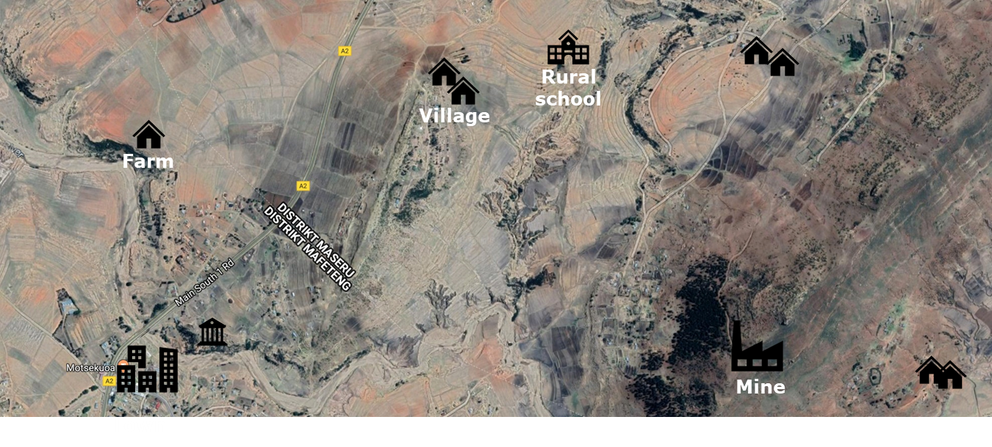
Focus on: Access
Connecting rural areas
Notes:
Procedure:
Shortly discuss with participants the situation governments and telecomunications companies are faced when connecting people, looking at the picture above and rural areas
Background Information:
Bringing Connectivity is expensive:
Wireline: CAPEX and OPEX for cables, digging the in, servers, energy
Wireless: CAPEX and OPEX for frequencies, towers, energy
Rural Areas are at a specific disadvantage
Cost: Great distances to be covered, lack of infrastructure (eneryg grid), hills, etc.
Revenue: low population density, low income population = low income potential to cover the high costs
Further Challenges in Developing Countries
National Infrastructure
No or low connectivity to global backbone (see cables) – landlocked countries have a disadvantage, as they are dependent on neighbouring countries
Lack of energy-grid
Market Regulation / policies
monopols or oligopols exist
Incumbants don‘t allow new entrants access to their infrastructure (need for regulation)
Licences for radio frequencies are too expensive (Germany received much criticism because of the high prices it achieved for UMTS frequencies in the 2000‘s. A success as it seems first. But this is said to be one of the reasons, why Germanys Mobile prices are quite high compared to other EU countries, as companies had to reearn those costs) – sensible management required by the ministries (of telecomunnication)

Slide 13

The Digital Divide(s)
Status Access
Isn‘t there network everywhere?
  90% of the global population live within the reach of a mobile broadband network (ITU 2019)
but:
  Bandwidth: Broadband = 3G
  Affordability: 11-25% (1-2% in global north)
  Reliability? Throughput?
Also: Specifics of internetuse in developing countries:
  Only 7% of households have fixed line broadband access
  Only 9.2% have a computer at home
Notes:
Background:
- More detailed look at the situation in Africa

Slide 14


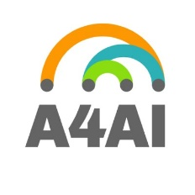

Focus on: Access
The market will take care of it!
Challenge: No or too costly access for many. Market does not cater to low profit areas.
Goals: Policy actors have recently recognized need to act and set ambitious goals
„Significantly increase access to information and communication technologies and strive to provide universal and affordable access to the Internet in least developed countries by 2020” (9.c)
Bridge the digital divide and provide broadband for all​ (15% of household in LDCs should have access to the internet) (Connect 2020 Agenda, Goal 2)
1GB of mobile internet is available for 2% or less of average monthly income (1 for 2 target)
Outlook:
SDG Goal 9.c will be missed by at least 20 years (According to A4AI)
Also the industry (GSMA) recognizes the rate of bringing people online is slowing. New approaches need to be identified if to brigde the divide.
Notes:
Background:
Access and affordability are sometimes hard to distinguich. As so often more availability of service and infrastructure (bandwidth) will decrease prices (economies of scale, etc.)
Status: Access: 90% live within the reach of a mobile broadband network (ITU 2019)
But: Quality? Bandwidth? Cost?
Affordability: 11-25% in developing countries, 1-2% in global north)

Slide 15
Focus on: Access
Approaches for Development Cooperation
Cost
High Costs (Fiber, 4G, Towers)
Complexity -: lack of skilled workers
Regulation:
Market
Frequencies
Infrastructure
Grid
Purchasing power
Regulation:
Market Regulation
Digital Dividend
Universal Service Funds (USF)
HCD
Technicians
Infrastructure
Sea Cables
Open Access Infrastructure
IXPs / Data Centers
Energy infrastructure
Cost
Voucher system
Tower sharing
Regulation:
Set legal environment for establishment of innovative technologies
Infrastructure
- Pilot new technologies
e.g. communal networks
Challenge
Development Cooperation now
Development Cooperation next

Slide 16




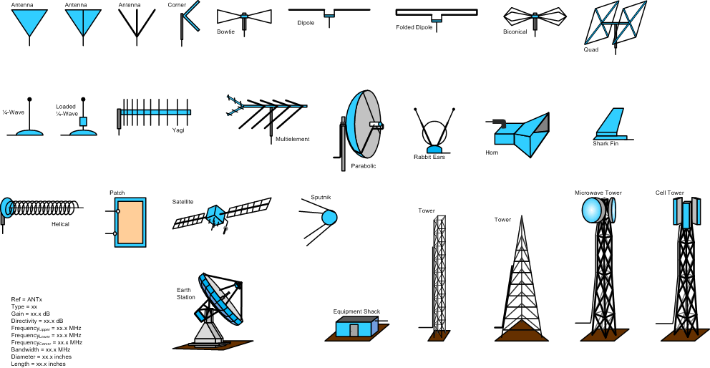


Focus on: Access
Technological Options
Pro: Less need for infrastruc-ture, can reach all areas
Con: Capacity? Business Model? Technical viability?
Challenges: Technology, regulation
Baloons, Drones
Pro: little ground infrastructure needed
Contra: Cost? Business Case? Space is full? Capacity?
Challenges: Business Case, Technology
Low Orbit Satellites
Mesh / Directional Radio
Pro: low cost, decentral communal networks
Contra: Challenging regulatory environment
Challenges: Regulation, access to infrastructure, lack of finance options, trust
Pro: proven technology
Contra: Frequency costs
Challenges: Business Case for Rural if quality access to be provided
3G / 4G (5G not rural option)
Fibreoptic Cable:
Best technological option, but too expensive to reach every village any time soon
Used for backbone network and backhaul in more urban areas
Notes:
Please refer to short Fraunhofer Study for insights (attached to training material):
“Connecting the Unconnected - Tackling the challenge of cost-effective broad band Internet in rural areas”, by Fraunhofer FIT (2019)

Slide 17
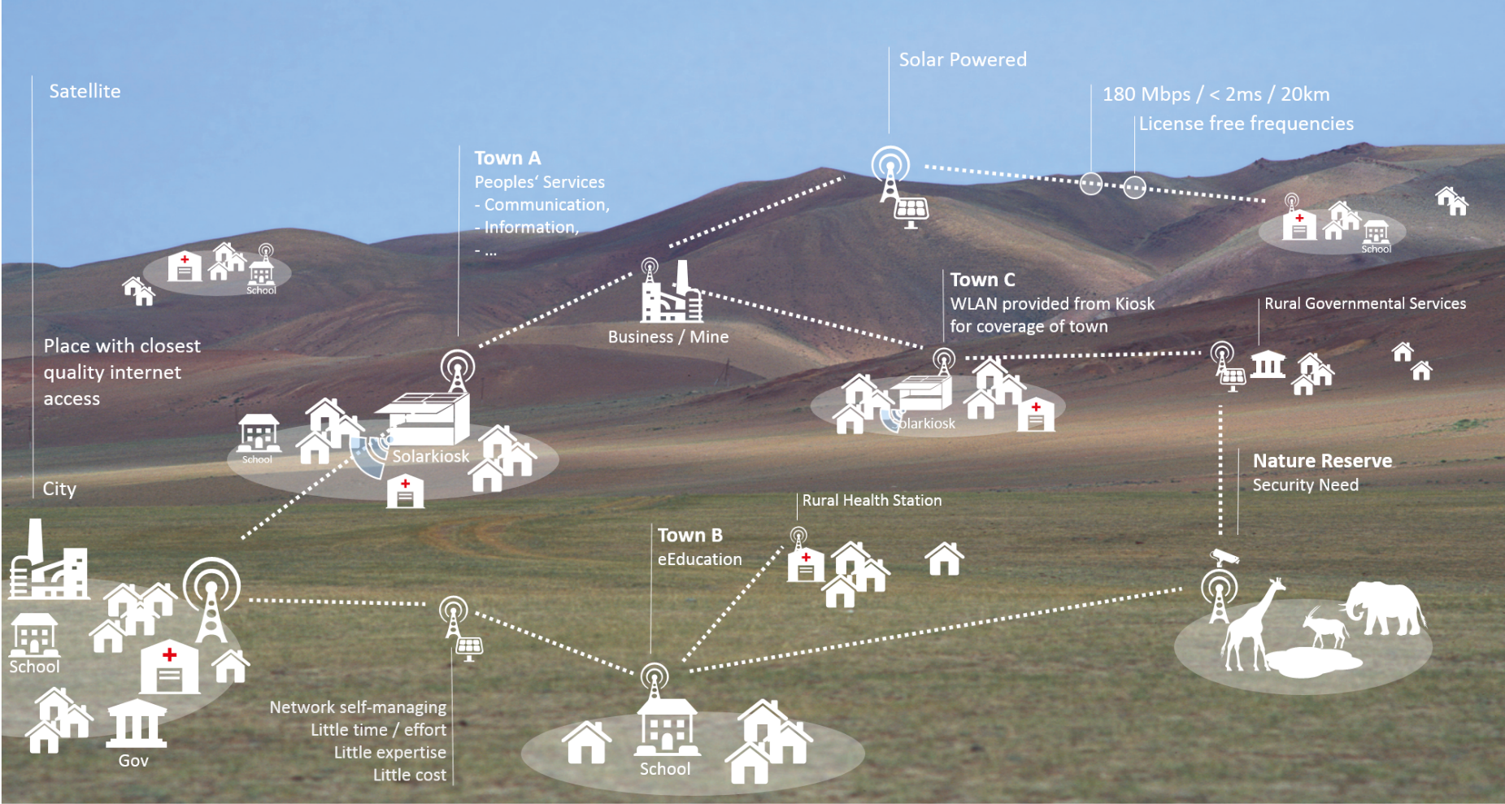
Case Study: Communal Networks
Notes:
Optional:
Please see
Fraunhofer (2019) Section 5.3
https://www.internetsociety.org/issues/community-networks/

Slide 18
Deep Dive: Gender

Slide 19

Focus: Gender Digital Divide
Introduction
Notes:
Key Message:
The gender digital divide limits the access of women and girls to technology and resources, their ability to gain critical skills, and their opportunities for leadership in the tech sector.
Description:
Video produced a part of Germany´s G20 presidency and the initiative #eSkills4Girls which was set up to support digital skills and employment opportunities for women and girls in developing countries (video presentation is optional, duration: approx. 5min)
Source: https://vimeo.com/215192520

Slide 20

Gender Digital Divide
True or false?
Ruth has set up a coding school for girls in Mombasa/Kenya that aims to bridge the gender gap of women. According to data from the International Telecommunication Union (ITU), the digital divide between men and women has closed at least slightly globally since 2013.
Amantya only learnt how to use computer when she was in university. UNESCO estimates that men are around two times more likely than women to have advanced ICT skills such as the ability to programme computers.
Ruth talks about job opportunities in the tech sector und the underrepresentation of women in the sector. Worldwide, women hold just 24% of computer science jobs.
According to Ana, socio-cultural factors such as parental support and female roles models also influence the decision to pursue a tech career. Portrayals of men as computer scientists and engineers in family films outnumber portrayals of women by 14.25 to 1.
Notes:
Description/Background:
True or false questions: Ask the participants by giving their answer by raising their hand to True or False
Appraisal question: Ask the participants to say the estimated number aloud in the plenum
Answers:
1) Ruth has set up a coding school for girls in Mombasa/Kenya that aims to bridge the gender gap of women. According to data from the International Telecommunication Union (ITU), the digital divide between men and women has closed at least slightly globally since 2013. FALSE
According to ITU data, the digital divide between men and women has even widened since 2013: Worldwide from 11% to 11.6% and from 29.9% to 32.9% in the LDCs with the largest gaps in parts of South Asia and sub-Saharan Africa. A study by the World Wide Web Foundation in 2015 shows that women are still almost 50% less likely than men to access the Internet. Although women are online, they are 30-50% less likely than men to use the Internet to increase their income or participate in public life.
2) Amantya only learnt how to use computer when she was in university. UNESCO estimates that men are around two times more likely than women to have advanced ICT skills such as the ability to program computers. FALSE
UNESCO estimates that men are around four times more likely than women to have advanced ICT skills such as the ability to programme computers (UNESCO. 2017. Global Education Monitoring Report 2017/8. Accountability in Education: Meeting Our Commitments. Paris, UNESCO)
3) Ruth talks about expanding jobs in the tech sector und the underrepresentation of women in the sector. Worldwide, women hold just 24% of computer science jobs. TRUE
In 1995, 37% of computer scientists were women. Today, it’s only 24%. If we do nothing, in ten years the number of women in computing will decrease to just 22%.
4) According to Ana, socio-cultural factors such as parental support and female roles models also influence the decision to pursue a tech career. Portrayals of men as computer scientists and engineers in family films outnumber portrayals of women by 14.25 to 1. TRUE (Accenture: Cracking the gender code, 2016)

Slide 21
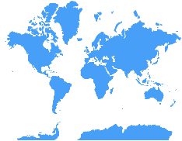
The Gender Digital Divide
The divide is a global phenomenon albeit with different manifestations
Europe: Number of female graduates in ICT-related subjects decreases since 2011.
Europe: Women in ICT earn 19% less than men.
OECD: At 15 years of age: only 0.5% of girls wish to become ICT professionals, compared to 5% of boys
Developing countries: Many women are unsure or unaware of the potential of communications services to benefit their lives.
Developing countries: Limited access to high-quality formal ICT education
Closing the global gender leadership gap could generate up to a 0.6% increase in global GDP
Notes:
Background:
The so called gender digital divide is a global phenomenon albeit with different manifestations across regions and even within countries: In developed countries women face systematic underrepresentation in the tech sector, pay gaps and glass ceiling effects in career advancement. Whereas in developing countries, women have to deal with limited access, lack of skills and often deeply rooted socio-cultural barriers and stereotypes.
But in the end, it all sums up to the common challenge of increasing women´s participation as key for an inclusive economy and development. Closing the global gender leadership gap could generate up to a 0.6% increase in global GDP
Europe:
Fewer women are interested in participating in the digital sector, be it higher education, jobs or entrepreneurship. The Commission's study Women in the digital age (2018) confirms this trend with only 24 out of every 1000 female tertiary graduates having an ICT related subject - of which only six go on to work in the digital sector. The study's findings show a decrease in this number when compared to 2011. And once in the IT sector women earn 19% less than men.
Examples for differences in motivation for ICT-career and education pathways: OECD: At 15 years of age: only 0.5% of girls wish to become ICT professionals, compared to 5% of boys
Developing countries: Limited access to high-quality formal ICT-education especially affects women and hinders their full participation in the digital economy. Often women are unaware or unsure of communication services to benefit their lifes (eg. Financial services, eCommerce solutions etc.)
Source: EQUALS (2019): Taking Stock: Data and evidence on gender digital equality

Slide 22
Barriers to Gender Digital Equality
Gender gaps cut across three interrelated dimensions: ICT access, skills and leadership
ICT access & use
ICT skills
ICT leadership
Girls and women have significantly less access to secondary and tertiary education and thus fewer opportunities to acquire digital skills.
Eventually, women’s leadership and representation in the technology sector remains low across different dimensions of ICT employment, entrepreneurship, and policymaking.
Basic digital access is a necessary but not sufficient condition for women to meaningfully use ICTs.
It is important to overcome the barriers because being online increases access to information, education and economic and political participation.
Notes:
Beware: This is a very simplicistic representation of the different layers of the gender digital divide. It does not cover the interdependecies between the different dimensions and is only to be taken as general overview of the main topics.
Background:
Gender gaps cut across three interrelated dimensions: ICT access, skills and leadership
The digital divide is not only a matter of matter of access to infrastructure and adequate frameworks, it is also a matter of digital skills. Today, having digital skills, and having personnel with ICT qualifications, is something required in all sectors of the economy, not only in the ICT sector. Digital skills and knowledge of digital technologies enable women to shape their own digital future – as learners, as users, as employees, as entrepreneurs, and as leaders. With women having lesser educational opportunities, they also have lesser chances of acquiring digital skills eventually leading to an enrolment in ICT-related studies and careers and leadership in ICT-related sectors and policymaking.
There are large regional variations: some countries are close to parity or have even reversed the gender gap on some indicators, while others still have persistent gaps. Individual countries can have both large and small gaps, depending on the indicator being measured. Interpreting the gaps requires careful and contextualised analysis.
It is important to overcome the barriers because being online increases access to information, education and economic and political participation.
In the next slides, we will have a closer look at each of the dimensions and discuss the causes for the gender digital divide.

Slide 23
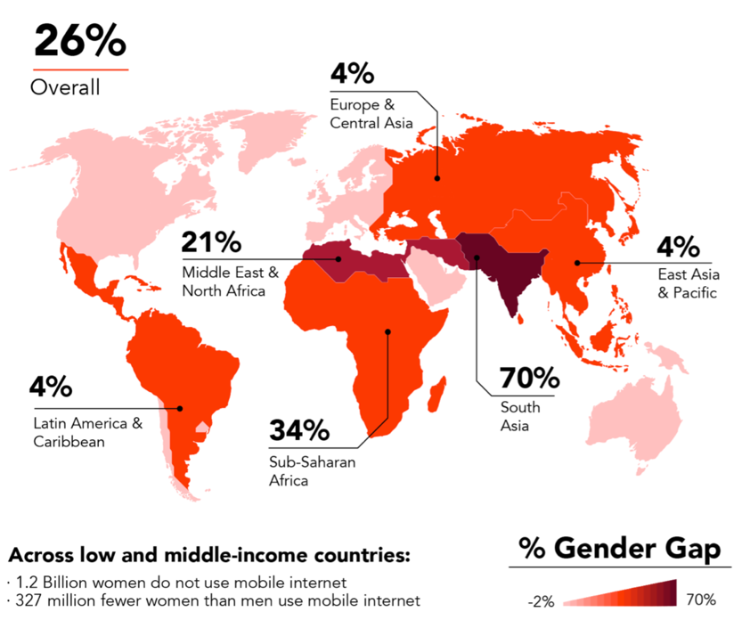
Gender Digital Divide
Access is not enough
ICT access & use
Source: GSMA Mobile Gender Gap Report 2018
Lower access to resources and a lack of financial means (affordability) disproportionally affects women and girls and limits their ability to access the internet.
Discrimination and marginalization due to cultural, economic and social barriers further restricts internet use.
On average, women are 26% less likely to use mobile internet
Notes:
Background:
The Gender gap represents the difference between the internet use rates for males and females relative to the internet use rate for males, expressed as a percentage.
The lack of access to affordable and reliable technologies and services disproportionally affects women and girls in developing countries due to lower access to resources, lack of financial means (affordability) as well as discrimination and marginalization due to cultural, economic and social barriers.
But: Access is not enough: Once online, there may be noticeable differences in usage patterns between men and women.
There is growing recognition that basic access to ICTs is not enough to empower women.
For both mobile and internet use, the gender digital divide widens as the technology gets more sophisticated and expensive (Highet, 2017; Deen-Swarray et al., 2012).
The gender gap does not end at mobile phone ownership but increases when we look at usage patterns, especially for more transformational services. (Transition to next slide/topic skills)
Cultural factors stretch across access, skills and leadership. They act as barriers to digital technologies and are difficult to address, deeply entrenched, and often so subtle that it is hard to recognize their impact. Examples of such barriers are for example, the prioritization of boys’ education over that of girls’ or women’s fear of the Internet because they believe content may be inappropriate, offensive or harmful to them.
Background (additional stats):
While the internet is increasingly being accessed over mobile devices, data on use of mobile internet is not one of the indicators that ITU regularly collates. The private sector is taking the lead in measuring the gender gap in this area: the GSMA conducts surveys across different countries; it creates models to estimate the gender digital gap in mobile internet use, even in countries where a survey was not conducted.
GSMA’s Mobile Gender Gap Report 2018 notes that on average, women are 26% less likely to use mobile internet than men.
The report also notes regional differences across low- and middle-income countries, ranging as high as 70% in South Asia to as low as 4% in East Asia & Pacific and Latin America & Caribbean.
Source: EQUALS (2019): Taking Stock: Data and evidence on gender digital equality; I´d blush if I could (2019)

Slide 24
Gender Digital Divide
Women lack digital skills and confidence needed to engage with digital technologies
ICT skills
In many countries, girls have poorer access to education than boys and, as a result, more are illiterate.
Limited literacy leads on to lack of digital skills and lack of confidence, reducing women’s ability to take advantage of online resources and pursue a career in ICT-related fields.
Women are 25% less likely than men to know how to leverage ICT for basic purposes
Notes:
Background:
Women lack digital skills and confidence needed to engage with digital technologies
Digital Skills are the literacy of the 21st century and key for employment and participation in the digital world
The higher the education level of women and girls the more likely they are to use ICT. Girls need to learn, from primary school onwards, how to use technology competently, to interpret and understand digital content and assess its credibility, and to create, research, and communicate with appropriate tools.
But: in many countries, girls have poorer access to education than boys and, as a result, more are illiterate. In developing countries, lack of educational opportunities is one of the root causes of the problem: girls and women have significantly less access to secondary and tertiary education and thus fewer opportunities to acquire the skills they need. The gap is apparent from the lowest skill proficiency levels, such as using apps on a mobile phone, to the most advanced skills like coding computer software to support the analysis of large data sets.
Limited literacy leads on to lack of digital skills and lack of confidence, reducing women’s ability to take advantage of online resources and pursue a career in ICT-related fields.
In many national contexts, men are four times more likely than women to have advanced ICT skills such as the ability to program computers, and similar divides are apparent for basic tasks such as using email or a spreadsheet. Girls in secondary education also tend to have lower self-efficacy and interests in studying STEM subjects as well as lower aspirations for STEM careers. AT this point also the lack of female role models from the tech sector kicks.
These skills gaps carry serious repercussions for employment. Leading consulting companies estimate that 90% of all future jobs will have a digital component. Despite this, the number of women choosing to pursue technology studies and careers has been declining globally since the 1980s. On average, women constitute less than 35% of ICT and related professions. This means, the key technologies of the future (e.g. in Artificial intelligence, Robotics, Virtual Reality) are developed out of an extremely homogenous community. In the hyped AI sector this so called “white guy” problem is even more obvious: According to a 2018 study by the World Economic Forum, 78% of AI ​​experts are male, a gender gap three times larger than that in other industries.
Examples: Mostly female-voiced virtual assistants or discriminating job recruiting mechanisms are just two examples for manifestations of patriarchal stereotypes based upon AI. This is why addressing the shortage of women in digital workforce is not only an economic need, but it is also a matter of equality given the predicted influence of AI and other key technologies on economies and societies as a whole.
Additional stats:
Only 35% of women major in STEM subjects at higher education; within STEM majors, they tend to study natural sciences more than applied sciences related to ICT
“Boys only” associations of computing influence all stages of a girl’s journey en route to a career, but they have relatively more influence on younger girls
Source: EQUALS (2019): Taking Stock: Data and evidence on gender digital equality; I´d blush if I could (2019)

Slide 25
Gender Digital Divide
Increasing women’s representation in the ICT sector has ethical and economic benefits
ICT leadership
The case for gender equality in technology leadership is usually presented as either an ethical argument or a business argument.
Low proportions of women in leadership means that women’s ability to have decision-making impact within ICT employment, entrepreneurship, and policymaking is limited.
Economic benefits: More inclusiveness could help to address industry skills shortages and has organisational benefits.
Women in ICT tend to be in junior and support rather than managerial roles
Notes:
Background:
Increasing women’s representation in the ICT sector has ethical and economic benefits
The case for gender equality in technology leadership is usually presented either as an ethical argument or a business argument. From the ethical perspective, advocates note that in the digital age, technology jobs usually command more power, prestige and higher pay. They are also more influential in driving economic development and producing the systems and tools that shape people's lives.
Low proportions of women in leadership means that women's ability to have decision-making impact within the industry is limited. This argument aligns with the UN’s Sustainable Development Goals, several of which advocate gender equality in the labour force.
There are also economic arguments: Scholars argue that diversity leads to organisational benefits such as improved financial health and returns on investment, higher staff productivity, a healthier workforce and more creative problem-solving. Some studies found a correlation between diversity in tech company workforces and higher revenues, profits and market value. They estimated that closing the global gender leadership gap could generate up to 0.6% increase in global GDP.
Additional stats:
Women in ICT tend to be in junior and support rather than managerial roles
Within the ICT industry as well as in academia, data is sparse, but indications are that women tend to be in junior and support rather than managerial roles. Where women have made inroads into management, they are often in staff positions, rather than the line positions which constitute the main pathway to executive roles. These trends appear to be repeating in the new industries developing around artificial intelligence
Although gains have been made, women’s representation remains low across different dimensions of ICT employment, entrepreneurship, and policymaking
On average, women constitute less than 35% of ICT and related professions. However, there is wide variation by country and by ICT sub-sector, ranging from as low as 2% to as high as 60%.
Evidence from North America and Europe indicates that women leave science and engineering jobs at higher rates than men.
Moreover, in terms of career advancement, at all levels of leadership (lower management, upper management, executive boards) and across diverse types of institutions (industry and academic), available evidence indicates that men outnumber women.
Source: EQUALS (2019): Taking Stock: Data and evidence on gender digital equality; I´d blush if I could (2019)

Slide 26
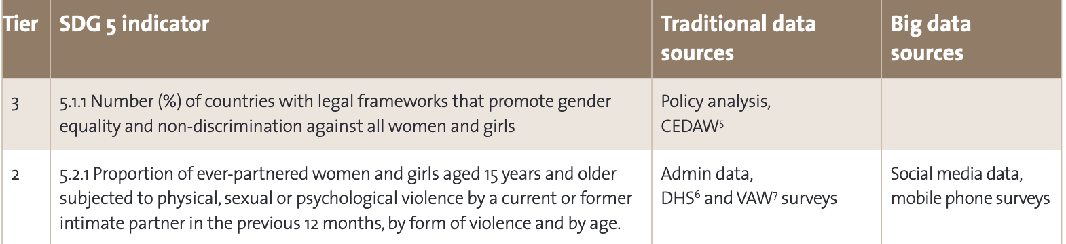
Gender Digital Divide
Without data equality there is no gender equality
The lack of (reliable) sex-disaggregated statistical data is a serious problem for the formulation of activities to overcome the gender digital divide
Reasons: Lack of prioritization of gender equality in data collection, lack of resources, no internationally accepted standards, irregular collection of data
New forms of data generation and analysis present opportunities for improved programming and implementation and for closing the gender data gap
Source: UN Women 2018, Gender Equality and Big Data
Notes:
Background:
Without data equality there is no gender equality
Our ability to assess where we stand currently in relation to access and use of the internet, and to measure progress toward achieving SDG targets related to ICT and gender equality is further constrained by the lack of reliable data. Critial is the lack of disaggregated data essential to assess the unevenness of internet access and use, particularly for the Global South, where inequality is greatest.
A fundamental challenge for the formulation of measures to overcome the gender digital divide is the lack of sex-disaggregated statistical data, due both to the lack of prioritisation of gender equality in data collection and to a lack of resources for data collection and analysis.
Reasons: Lack of prioritization of gender equality in data collection, lack for resources, no internationally accepted standards, irregular collection
According to a 2018 UN Women study, only three of the 14 proposed indicators for monitoring SDG 5 have internationally accepted measurement standards for which most countries also regularly collect data (Tier I indicators). Of the remaining 11 indicators, five have internationally accepted standards, but data collection by most countries is largely irregular. For the remaining six, international standards do not yet exist and most countries do not collect data on a regular basis.
New forms of data generation (e.g. via mobile phones and the Internet of things but also social media and citizen-generated data) and analysis present opportunities (but also risks with regards to privacy) for improved programming and implementation and for closing the gender data gap.
Example from UN Women report on Gender Equality and Big Data: Shows gender-related indicators in the 2030 Agenda could benefit from new data analytics; here: alternative data sources for the collection of data for violence against women.
There is an abundance of data innovation projects, e.g. from Data2X and Global Pulse institute: UN Global Pulse collaborated with Data2X and the University of Leiden to develop and prototype a tool to infer the sex of users. Using open source software, the sex-disaggregation tool automates the process of looking up public information from Twitter profiles by analysing user-names from a built-in database of predefined names (from sources such as official statistics) that contain gender information. As in most cases user name is insufficient to discern sex, the tool also analyses profile photos, using face recognition software. UN Global Pulse used the tool to improve an existing real-time online dashboard showing the volume of tweets around priority topics related to SDGs. The tool was tested on more than 50 million Twitter accounts.

Slide 27








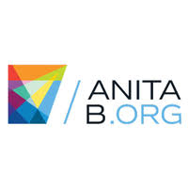
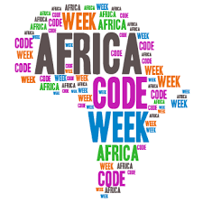

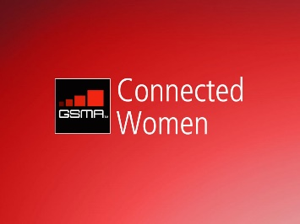


Gender Digital Divide
Many stakeholders advocate for closing the gender digital divide
Activities
Networking
Awareness Raising
Mentoring
Funding
Advocacy
Training
Capacity Building
Notes:
Background:
Never before have there been as many movements for women in tech as there were in recent years and entrepreneurs, policy makers and activists worldwide advocate for the empowerment of women in technology. Digital skills and knowledge of digital technologies are key to provide access to information and to give women a voice online and offline. To this end, women develop innovative platforms which strengthen participation and women’s rights, support digital skills trainings for girls and young women at schools and universities and found start-ups enabling employment and future prospects.
The EQUALS Global Partnership conducted research to identify initiatives to bridge the gender digital divide. The research found 857 gender tech projects (as of May 2018), including 143 projects from 70 organizations in 56 countries that provide coding education for girls and women
The initiatives presented here stand representative for a variety of projects engaging in different fields (mentoring, funding, networking...) with the common goal of tackling the digital gender divide

Slide 28
Gender Digital Divide
EQUALS – Multistakeholder Initiative: Workstreams and Policy recommendations
Workstreams
Coalition on Access
Online Course, Connected Women Initiative
Facilitate digital skills learning alongside the whole educational pathway
Recommendations
Coalition on Digital Skills
Digital Skills Fund, Workshops for Policymakers
Embed ICT in formal education
Coalition on Leadership
Leadership Webinar Series, Women Network
Create safe spaces
Use Universal Access Funds
Research Group
Stocktaking and Case studies
Collect and use data
EQUALS aims to promote gender balance in the technology sector by championing equality of access, skills development and career opportunities for women and men alike.
Notes:
Background:
the Multi-stakeholder Partnership EQUALS - Global Partnership for Gender Equality in the Digital Age is a network of 90+ organizations, companies, UN agencies and research institutions – whose founding partners include the International Telecommunication Union (ITU), UN Women, International Trade Centre, GSMA, and United Nations University. a multi-stakeholder partnership to achieve gender equality in the digital age.
The steering committee consists of organisations like ITU, UN Women, BMZ, GSMA, Internet Society
The partner network (+90 organisations currently) consists of organisations like African Development Bank, Ernst & Young, OECD, Mozilla Foundation, SAP, UNITED NATIONS CONFERENCE ON TRADE AND DEVELOPMENT, World Bank and World Economic Forum
Partner roles:
Contribution to the EQUALS partnership can include:
Strengthening global data collection, reporting and sharing on tech gender equality issues;
Using big data to guide smart investments in women’s tech access, skills, roles;
Volunteering staff resources – technical, marketing, communication, research, etc.;
Joining an EQUALS Coalition to make progress and implement core activities; and
Donating or contributing work to scale-up the critical efforts of the EQUALS Global Partnership.
The EQUALS Access Coaltion
The Access Coalition led by the GSMA focuses on reducing the gender gap in internet access and use to empower women and reduce inequality. Through its activities the Access coalition aims to increase women’s access to and use of the internet in countries where targeted action has been taken by EQUALS partners and to share insights and evidence based case studies which provide examples of how to increase women’s access to and use of the internet.
Activities: The GSMA supports the Connected Women Commitment Initiative through which mobile operators have made formal commitments to increase the proportion of women in their mobile internet and/or mobile money customer base by 2020. Through this initiative, mobile operator partners have already reached millions of women, acquiring over 12 million new female mobile internet or mobile money customers since making their commitment.
The GSMA integrated the Broadband Commission Working Group on the Digital Gender Divide’s recommendations for governments into a practical training course for government officials and regulators. This “Women and Mobile: Bridging the Gender Gap” course is being delivered free of charge online and as a one-day face-to-face training course for policymakers on an ongoing basis
The EQUALS Skills Coalition (lead: UNESCO/BMZ) aims at ensuring that digital skills are taught to all children and girls in particular. The members work on improving the data base on women’s digital skills and develop principles for gender-inclusive digital trainings. The Digital Skills Fund supports grassroots initiatives in scaling their digital skills trainings. In the first call, 10 initiatives from Africa, Latin America and Asia received support. the so-called #eSkills4Policymakers Workshops, which are organised by the World Wide Web Foundation in cooperation with experts from civil society and organisations such as UNESCO and the African Development Bank (AfDB) with the support of BMZ. The central element of the policymaker workshops is not only to inform political decision-makers about topics such as gender-sensitive education policy. It is equally important to bring politicians into contact with women and girls, so that they can contribute their perspectives to political decision-making processes. First workshop took place in Mozambique in April 2019. More to follow.
The EQUALS Leadership Coalition (lead: International Trade Center, UN Women)
The EQUALS Leadership Coalition aims to address the barriers that prevent women from rising to the top of their chosen technology field. Coalition members from leading private and public sector organizations will strive to empower women as ICT leaders, creators, and entrepreneurs through a range of actions that leverage their global presence and build on their own success stories including:
​
Training and mentoring women to create tech businesses and readily assume leadership roles
Facilitating better access to finance and funding through venture capital opportunities, angel investors and impact investors
Identifying regulatory and policy barriers that are limiting women’s ability to access and monetize opportunities
Activities: Capacity-Building Course on “Business and Leadership for Women in the Technology Sector.” The course goal is to develop the leadership, knowledge and skills of women entrepreneurs and women working in the technology sector so that they can increase the competitiveness of their companies and motivate their own teams.​
Research Group:
Supporting the work of the three EQUALS Coalitions, the Research Group – led by the UN University Institute for Computing & Society – is fundamental to our emphasis on evidence-driven actions.
Composed of experts in information gathering and analysis, the group focuses on generating knowledge about the existence, causes and remedies for gender tech inequalities, and on motivating key stakeholder groups, including private sector companies, government departments, regulatory agencies, and academia, to collect and share gender-relevant data.
Activities: The report, Taking Stock: Data and Evidence on Gender Equality in Digital Access, Skills and Leadership, highlights the implications of persistent gaps across different facets of digital technologies. It also presents a compilation of case studies written by more than 25 leading experts and researchers that tell the story of how technology impacts women and girls in various contexts, including jobs and wages, security and privacy, cyber threats, and new technologies such as artificial intelligence (AI).
Recommendations (just a few examples):
Facilitate digital skills learning alongside the whole educational pathway: Increasing girls’ and women’s digital skills involves early, varied and sustained exposure to digital technologies.125 Interventions must not be limited to formal education settings but rather should reflect a multifaceted approach, enabling women and girls to acquire skills in a variety of formal and informal contexts – at home, in school, in their communities and in the workplace. In addition, because the digital divide cuts across age groups, solutions need to assume a lifelong learning orientation.
Embed ICT in formal education: One of the most notable gender trends in digital skills education in the formal sector is the sharp decline in girls’ interest that starts around the lower secondary levels and becomes more pronounced as education levels increase. One solution to this issue is to make technology classes mandatory at the secondary education level, to avoid the ‘secondary school trap’ that causes many girls to lose their interest in digital skills. A growing number of countries are making computer science a core subject and instituting graduation requirements that necessitate at least some ICT subjects.
Safe spaces: For adult women, informal learning may be the only pathway available to them for developing digital skills. Interventions targeted at adult women should take into account cultural norms as well as women’s domestic responsibilities. For instance, internet cafes and other ICT access hubs are often male-dominated spaces that are off-limits to women, or located far from women’s homes or in unsafe areas. Public access points that are female-friendly, such as specially-designed libraries, parks and community centres, are particularly important in these contexts.181 Governments might consider designating women-only spaces for internet access in these locations to further accommodate women’s needs.
Use universal access funds:
Governments may consider using universal service and access funds (USAFs) for investments in closing the digital skills gender gap. While these funds are usually used purely to extend networks and coverage, they can and should be reoriented towards skills training, as education – not wires and networks – is the major barrier in many communities. In Pakistan in 2015, for example, the national Universal Service Fund partnered with Microsoft and Bait-ul-Mal, a Pakistani social welfare organization, to launch a programme to train girls in ICT.242 As of spring 2018, the Ministry of IT had used USAFs to establish 226 computer labs for girls and provide training for over 100,000 girls and more than 200 teachers.243 At the 2018 Mobile World Congress, the Pakistan Universal Service Fund signed a memorandum of understanding with Huawei to further expand and improve the programme
Collect and use data:
Sex-disaggregated statistics about digital skills acquisition is thin in developed countries and non-existent in many developing countries, as is the longitudinal data needed to gain insights into trends.249 At the regional level, Europe and North America have the most robust data on ICT skills, followed by Asia, whereas Africa has the least. Many countries are still working to develop frameworks and methodologies to measure digital skills, and in some cases there is confusion regarding which government ministries are accountable.
Resources: https://docs.wixstatic.com/ugd/04bfff_06ba0716e0604f51a40b4474d4829ba8.pdf

