Slide 1
Introduction to the dimensions of digitalisation
Module 3.2:
Data Perspectives
Notes:
Overall learning objetive module 3: Data is the currency of the digital transformation and needs to be contextualized within layers of DevCo

Slide 2
Agenda
Module 3.2: Data perspectives
  Individuals and data
  Businesses and data
  Governments and data
  Data for Development
Notes:
Overall learning goal module 3.2: Data is being harnessed by different stakeholders. This comes with potentials and challenges.

Slide 3




Data from different perspectives Data use is valuable for individuals, businesses and governments
Individuals
Business
Governments
Data profile:
Generate bulk of the data
Rightful owners of data
Trade private data for goods & services in general without monetary benefits
Data profile:
Beneficiaries of the data revolution
Capitalize on data by processing and analysing it for business purposes
Data profile:
Accumulate vast amounts of information about citizens and businesses
Data insights can help improve citizen experience and accountability
Notes:
Key message:
Data use is valuable for individuals, businesses and governments.
Background:
The question that this data revolution then presents is - who will be the winners and losers as the data age takes off? To arrive at a credible and satisfactory answer, it is important to analyse the value of data from different perspectives, that of an individual, businesses and government. Each stakeholder has its own „data profile“. Starting with individuals, we will move throught the different perspectives and get to know the interests and challenges of each group in terms of data. Our discussions will also touch upon the interrelated fields of regulation, security and privacy.
Individuals
The individuals, who generate the bulk of the data, and are its rightful owners, end up sharing it, sometimes with explicit consent and many times with implied, but uninformed consent. Individuals trade their private data in the digital economy for more tailored choices - goods and services, free applications and software, but don’t reap any monetary benefits from this exercise.
Business
Businesses have been the greatest beneficiaries from this data revolution. They capitalize on data by processing and analysing it for business purposes
Governments
Governments are increasingly becoming data savvy and leveraging open data for improving quality of life of its citizens by better design and targeting of welfare schemes, data driven policies, and improving participative governance.

Slide 4
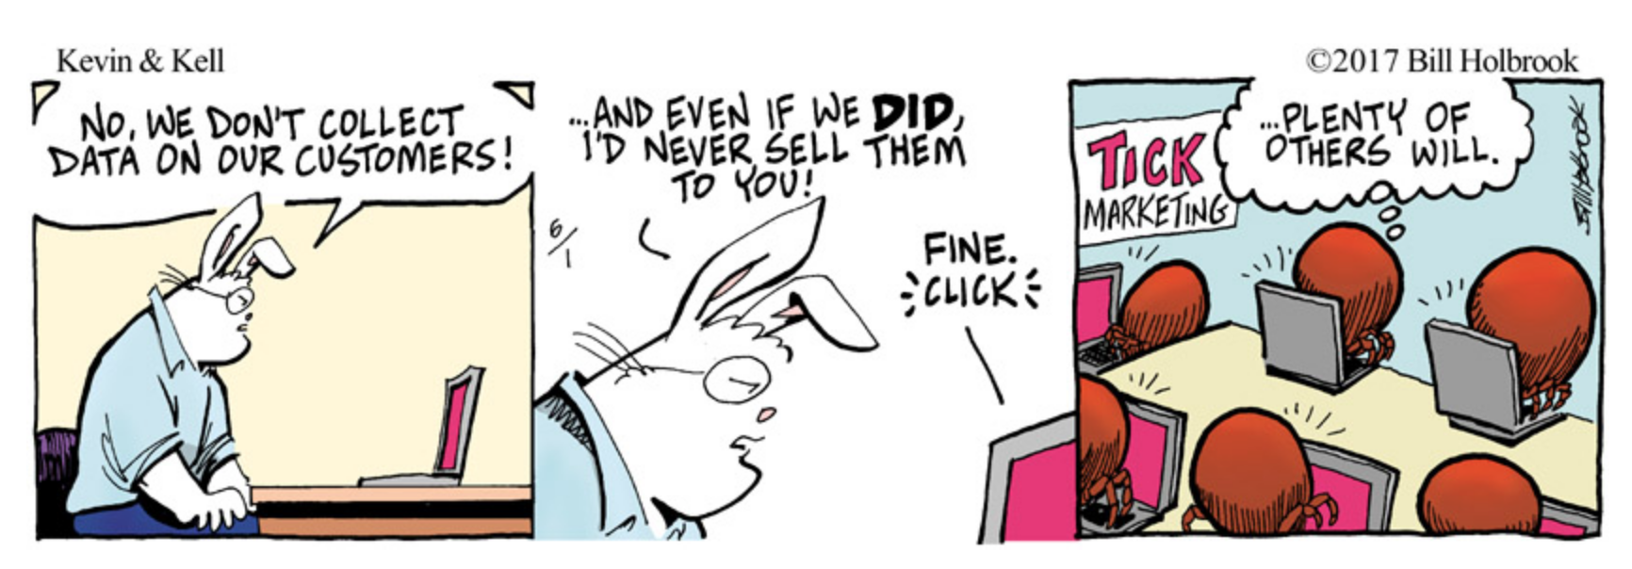
Data from different perspectives
Individuals and data
=> Data has a price tag but there is no monetary compensation for the data producers
Notes:
Background:
Individuals
Personal data is generated through an individual’s actions (such as making a payment using a credit card), through business processes that digitize analog data (such as medical histories), or through consequent machine response (such as call data records). Such data is now increasingly coming from use of the internet, wireless sensors, and the billions of mobile phones around the world. As the world gets more connected, more people are leaving a digital trail, wherever they go and whatever they do.
In his book Everybody Lies, Stephens-Davidowitz describes Google as “a digital truth serum” that knows all of our private thoughts and desires. Stephens-Davidowitz said when looking at sex, data offers a more accurate picture than discussions.
This data, which has become more voluminous and granular over time, piqued the interest of various organizations that saw the financial value embedded in it.
Based on these projections, one might wonder what kind of compensation the creators of this multibillion-dollar data can expect. As it stands, the answer is none at all. Individual users are at the bottom of a broken economy. The value that their data generate is being collected by third parties, and sold to whatever cash-rich organization is willing to purchase it.
Examples:
Facebook was reported to have asked hospitals, including Stanford University School of Medicine, to share and integrate patients' medical data with its own (the research project has since been put on hold).
Gay dating app Grindr was revealed to have shared customers' HIV status with two app-optimization companies.
An online personality test delivered data for President Donald Trump's targeted political advertising
The application of personal data for online advertising has skyrocketed, with the internet now surpassing television as the leading advertising channel. At a forecast US$237 billion in 2018, digital ads are expected to grow from 44 percent of global advertising revenues in 2018 to more than 50 percent by 2020 (Magna Global 2017).
Sources:
https://www.engadget.com/2018/09/04/who-controls-your-data/?guccounter=1&guce_referrer=aHR0cHM6Ly93d3cuZ29vZ2xlLmNvbS8&guce_referrer_sig=AQAAAMyLXphLKMBv85oPwZAVFyhl5uRB8HQiMitClqPDzwMovBhX2a7QATXNBTSD-JH3oSLb-ysLlZC7qikvYN0UJ4UakBLT6n-amb21QY2qIxjE2sWXok1pMwx0QRxQAUXpVS7WQ_ROy0XXAqGnFcn7uuzDfW-wwoVVPWbv75Qb7d2h
https://openknowledge.worldbank.org/handle/10986/30437
https://www.weforum.org/agenda/2014/10/digital-footprint-data-mining-internet/

Slide 5
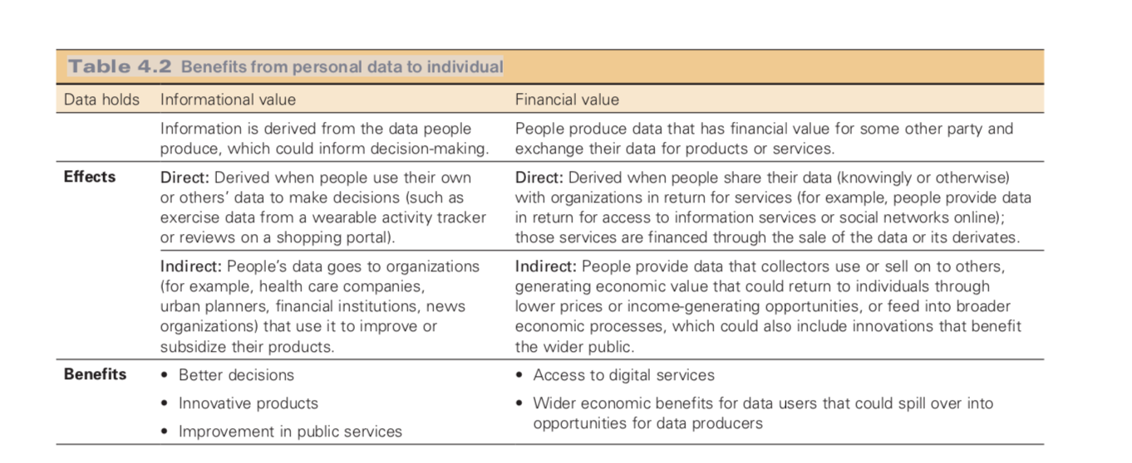
Data from different perspectives
Individuals and data
Data enables improved individual decision-making and more convenience when interacting with organizations
But there is also a price to pay: Potential loss of privacy, agency and control
Notes:
Data enables improved individual decision-making and more convenience when interacting with organizations and when using digital services
But there is also a price to pay: Potential loss of privacy, agency and control
The possible costs to the user of data collection include the loss of privacy, of agency, and of control. Such costs can undermine people’s trust in the organizations that collect, control, and use data. The recent controversies that broke out over data leaks compromising the privacy of personal data and the biases involved in the use of data to profile individuals have underscored the risks emerging in the new data-rich economy (see Cambridge Analytica scandal and so on)

Slide 6

Data from different perspectives
Individuals and data
Example: User paying the price?
Notes:
Example
Private Donors: In the past few years, it has been revealed that a large number of UK charities, at one time as many as one hundred, adopted a ‘Reciprocate’ scheme, where they shared with other charities their list of donors, including their names, addresses, and donation histories. They sent these supplemented lists to ‘wealth management’ companies, who would investigate a donor’s income, property values, lifestyle, and even friendship circles, and return to the charity an estimate of each donors’ wealth and disposable income. This allowed charities to identify those donors who should be given high priority to be ‘targeted’, as well as those most likely to leave money in their wills (‘legacy profiling’). Some charities even employed people to visit donors in care homes to persuade them to change their wills.
Much of this activity came to light during the investigation that followed the suicide of one donor, Olive Cooke, who leapt into the Avon gorge. A report into her death concluded that she had become “distressed and overwhelmed” by the huge number of requests for donations she received from charities. Twenty-four out of the ninety-nine charities with her details on file had passed them on to others.

Slide 7

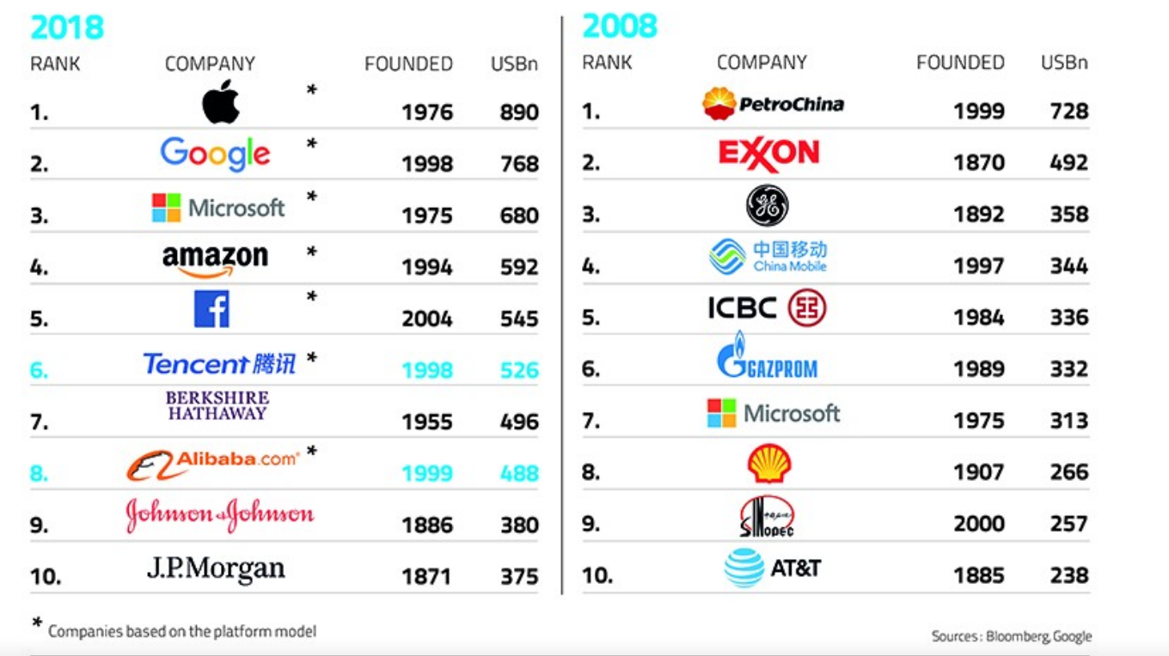
Data from different perspectives
Businesses and data
Economies are increasingly
data-powered (“data-driven value-chains”)
Data is now a critical corporate asset
Innovative data use can have disruptive effects for whole industries (“winner takes it all dynamics”) and enables new business models
An opportunity for developing markets
Notes:
Background:
Economies are increasingly data-powered:
The emergence of the data economy has stimulated development of new business models and is transforming many of the key functions of private sector firms, including product development, customer relation- ships, supply chains, and core enterprise functions such as marketing, human resources, and finance.
Data is now a critical corporate asset
Corporations have been the greatest beneficiaries from this data revolution. In 2008, oil and energy companies dominated the list of top six most valuable firms in the world, but in 2018, the list is dominated by data firms like Apple, Google, Facebook, Amazon and Microsoft. Platform companies and data-aggregators capitalize on individual data by selling to advertisement networks and marketers looking to target specific segments, influence buyer behaviour and make dynamic pricing decisions.
As trade is increasingly becoming digitalized, cross-border data flows are becoming more important for international transactions. Activities affected by digitalization go beyond online trading and supply chain coordination, to using information and communications technologies (ICTs) for the integration of a wider range of activities into single systems, thus making value chains increasingly data driven.
The network effects of digital platforms are creating a winner-takes it all dynamic in some markets.
Introducing new types of data sets (“orthogonal data”) can disrupt industries, and massive data integration capabilities can break through organizational and technological silos, enabling new insights and business models.
Examples:
Hyperscale digital platforms can match buyers and sellers in real time, transforming inefficient markets. Granular data can be used to personalize products and services—and, most intriguingly, health care. New analytical techniques can fuel discovery and innovation. Above all, data and analytics can enable faster and more evidence-based decision making. Systems enabled by machine learning can provide customer service, manage logistics, analyze medical records, or even write news stories.
For developing countries, it opens up new opportunities for convergence, including by leapfrogging intermediate infrastructures of the industrial age, drawing on the vast knowledge spillovers from the internet, taking advantage of the new markets offered by digital platforms and exploiting production possibilities enabled by digital technologies. In particular, digital infrastructure coupled with strong governance provides the means to launch micro-multinational firms from anywhere in the world, skirting the traditional coordination/missing market problems routinely faced by would-be entrepreneurs in less developed economies.

Slide 8


Data from different perspectives
Business and data
Exclusive ownership of data brings risks for open access and privacy
Market concentration of major digital firms and anti-competitive behaviour can accentuate polarization and can prevent competitors from reaping benefits
Data itself becomes a profitable target
Notes:
Background:
Risks private sector
Exclusive ownership of data could make access to essential data problematic. It would be important to identify open access business models that are attractive to the private sector to nudge them away from exclusive approaches. Examples are open source software, which is widely used by innovators. The same approach could work in data, but this needs more reflection.
Market concentration and anti-competive behaviour
Growing reliance on data (the “currency” for the platform economy, more details provided later), combined with strong network effects, can give companies that control the data considerable market power, raising the risk for market dominance and anti-competitive behavior. The tendency of major digital firms to acquire newcomers on the market and the considerable capital investment needed to develop a market leader position, preferably on an international scale, present considerable entry barriers for developing country companies to take full advantage of a data-driven economy.
Data itself becomes a profitable target
Corporations looking to mine data—for instance, transaction and customer information, results of product launches, and market information—create valuable intellectual property that is in itself an attractive target.

Slide 9
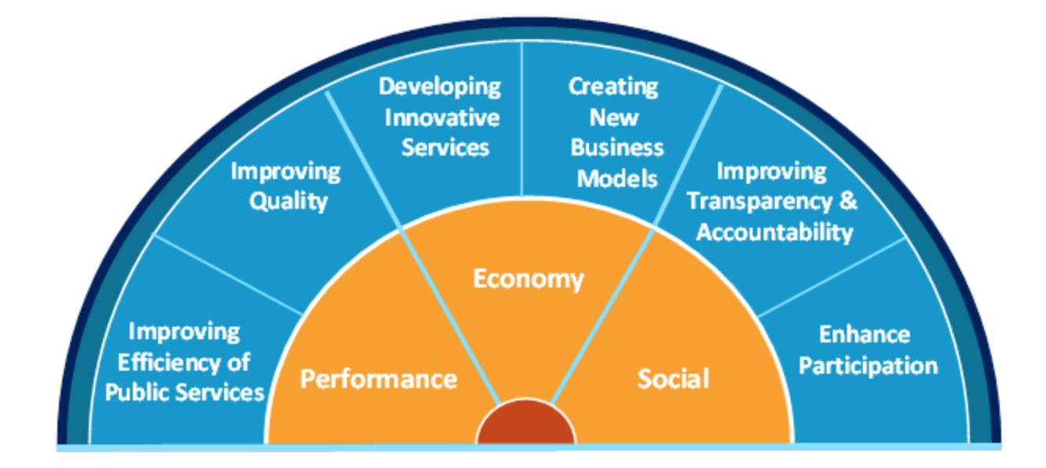
Data from different perspectives
Governments and data
=> Governments have the opportunity to become more “data driven” at all levels
Source: European Data Portal
Notes:
Key message: The public sector harnesses data for service provision
Background:
In the first generations of “e-government,” much of the emphasis was on channels—using web browsers, and more recently, mobile devices, to access government information and services and to perform transactions. In this period, data was often seen as just the payload of the transaction— information supplied by the citizen or the business to support the request for service and the information supplied by the government in return.
However as “e-government” has evolved into “digital government,” data is seen increasingly as a strategic asset with value lasting beyond a particular transaction and able to strategically transform the efficiency and effectiveness of government. Governments have the opportunity to become more “data driven” at all levels, from policy making through operational management and risk management to individual decision making
Providing, through “open data” and other programs, authoritative reference, geospatial, and other data to the national economy and society as a whole to improve transparency, to enable economic growth and business innovation, and to increase the engagement of citizens in the co-creation of public services. An example of this would be a National Spatial Data Infrastructure, or Digital Maps.
Differentatiation eGovernment/Open Data (Backup):
E-Government
E-Governance promotes dialogue between governments and civil society and private sector actors and
can improve political participation and accountability mechanisms. The efficiency of governments is increased, their creation more transparent and thus the development goal of "good governance" promoted. In contrast to Open Government, E-Government entails practical services and thereby the relation between government bodies and civil society for example: digitally supported submission of official documents (identity card, car registration, tax return) and network-based citizen consultations and feedback mechanisms.
Source:
World Development Report
Information and Communications for Development 2018 : Data-Driven Development
https://openknowledge.worldbank.org/handle/10986/30437

Slide 10
Data from different perspectives
Governments and data
Lack of technical capacity and incentive to
  interpret, analyse and disseminate open data
Cash-strapped agencies might support themselves by selling data
Outdated or poor- quality data might discourage demand
Manipulative data use
Implications for trust and confidence
=> But: There a still limitations to harnessing the value of data
Notes:
Background:
But: There a still limitations to harnessing the value of data for governments:
Lack of technical capacity and incentive to interpret, analyse and disseminate open data
Cash-strapped agencies might support themselves by selling data
Outdated or poor- quality data might discourage demand
Manipulative data use
Some countries evaluate their citizens' behavior on the basis of data that are generated in every-day-life. Bonus and malus points are attributed and may have an impact on a person's eligibility for government services.
Implications for trust and confidence in government
The collection and aggregation of “public” data found in open datasets and other databases can violate the privacy of individuals by painting a vivid picture of them without their consent or reasonable expectation
A government’s decision to make a particular dataset open has important implications for privacy as seemingly non-personal data can have characteristics or attributes that allow for an individual to be identified after the fact, even if that data had already been anonymized.
Businesses may use open data to inform analysis that advance their commercial interests. They may use this data to inform consumer profiling or geographic red-lining, a practice where services are strategically denied to people in specific areas based on the racial composition or socio-economic status of the area.

Slide 11
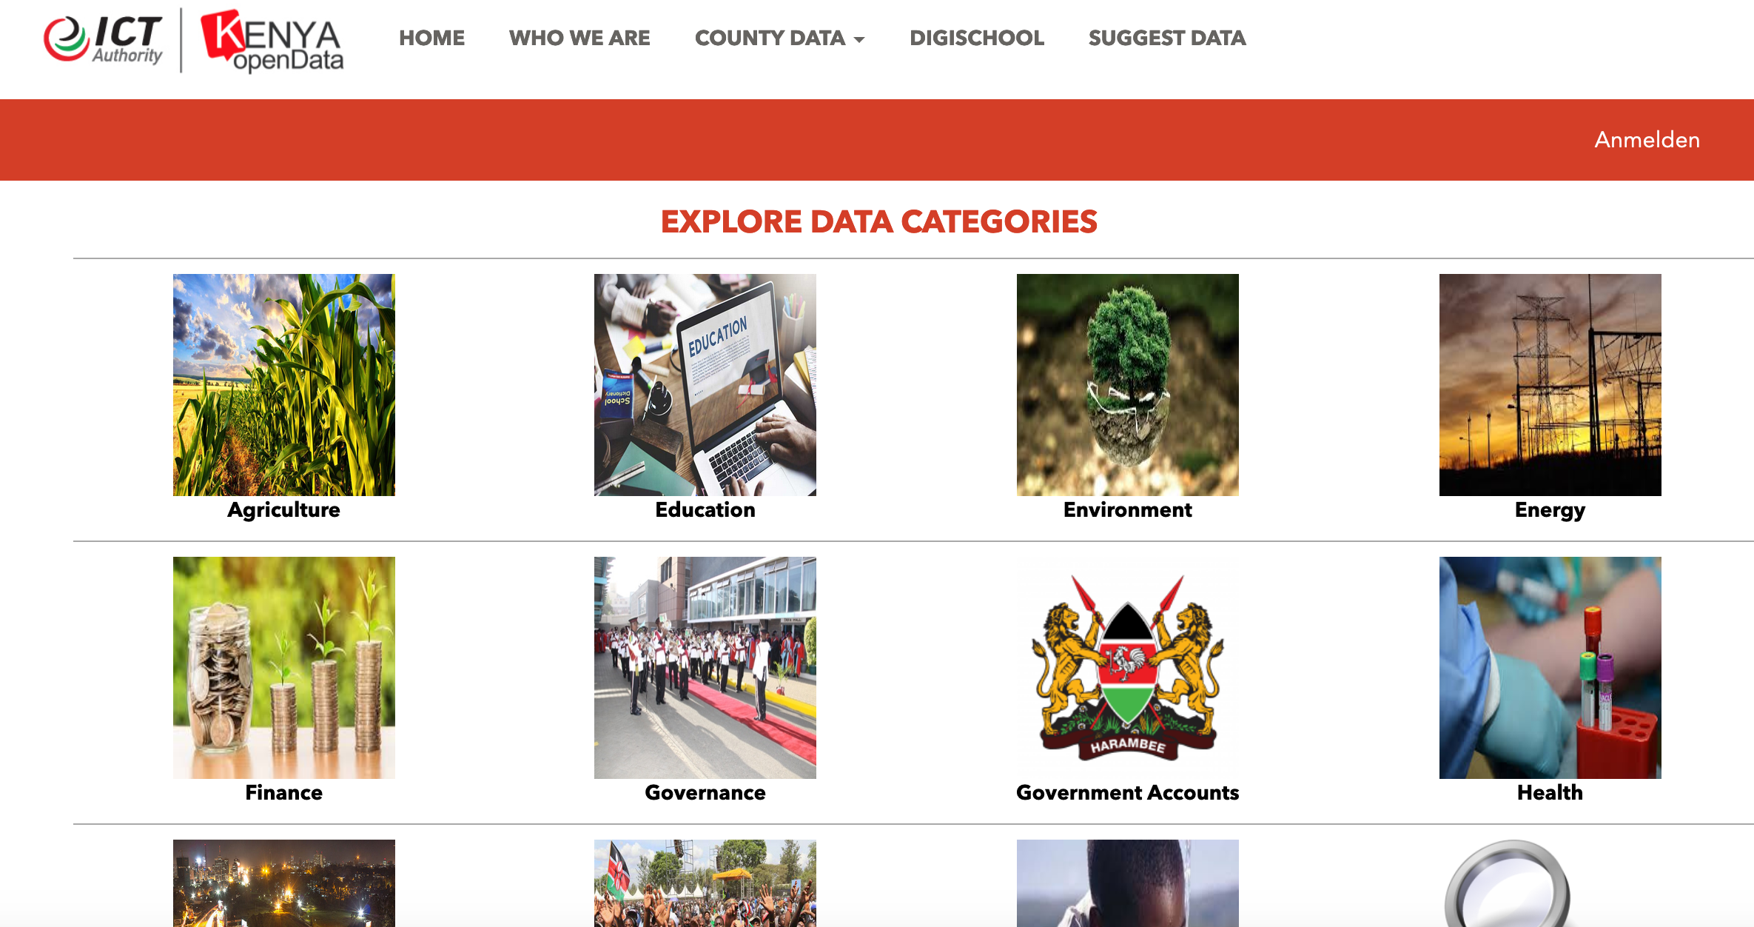

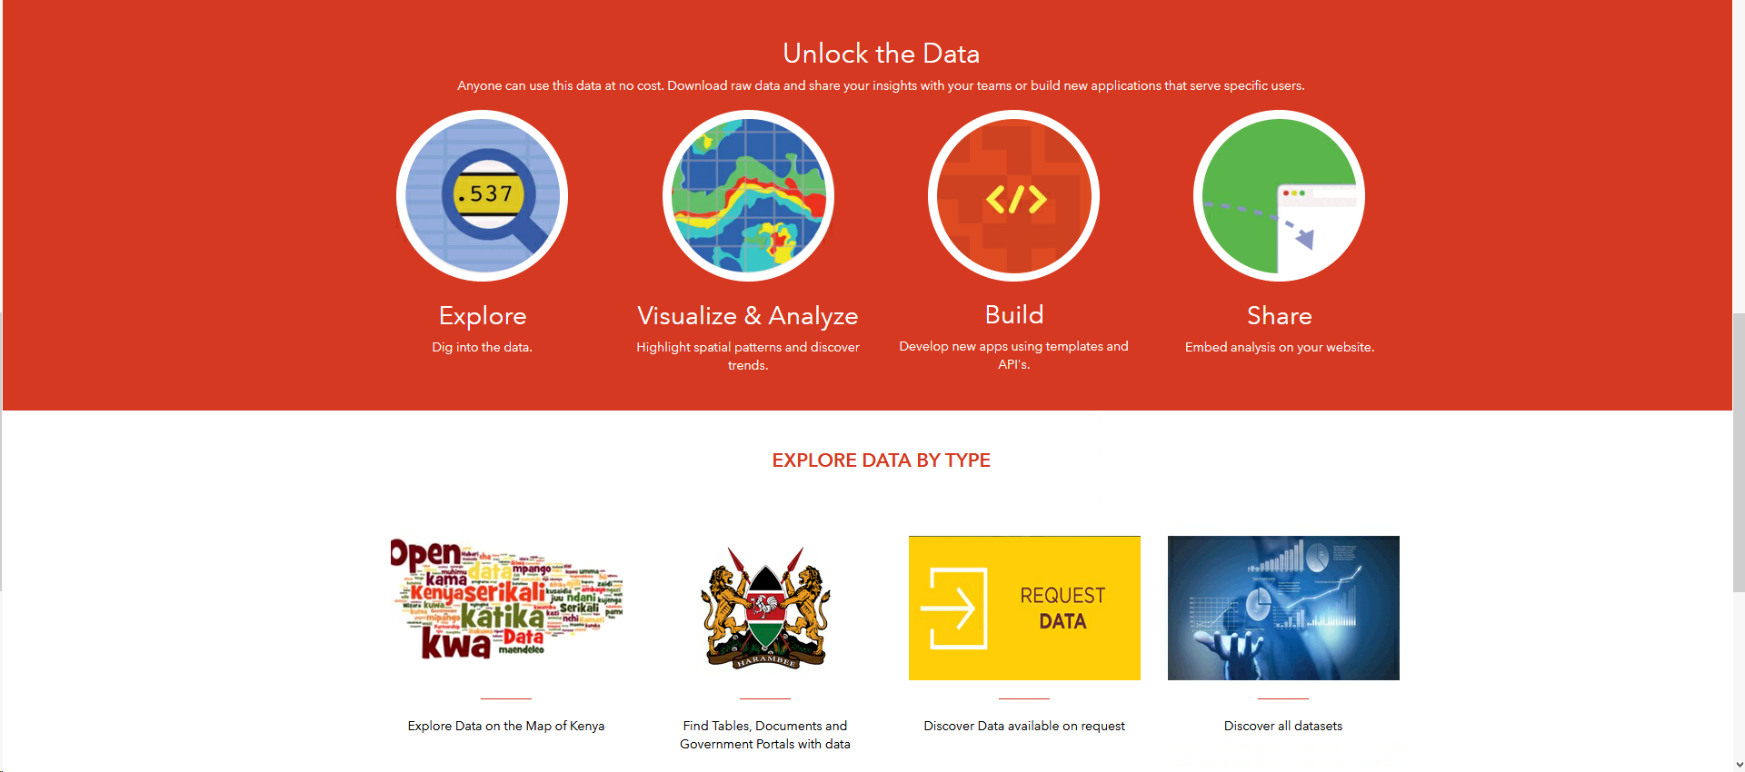

Data from different perspectives
Example: Kenyan Open Data Initiative
Multistakeholder initiative
Not only data collection but also application (20+ initiatives since 2011) and (political) actions
No data updates
Lack of legal and policy structures
Notes:
Key Message Module 3.2: Public sector harnesses data for service provision
Background:
Governments in Africa frequently have commitments to increase government transparency and release open data, but that these commitments are usually vague and lack high-level political backing.
There is almost no evidence of any documented national open data policies or strategies that articulate processes, responsibilities and timelines in the continent. Those few that are available have usually been in a draft stage for years and were never officially published, promoted, endorsed or formally adopted.
The number of governments in the region releasing their national data catalogues keeps increasing, with eight out of every 10 countries maintaining a reference catalogue of some kind. However, sometimes governments do not remain in control of their own data portals when third-party providers or other external partners manage them.
Government-run open data initiatives and teams are also becoming more frequent, for instance, in Morocco, Burkina Faso and, more recently, Mauritius. Still, those rarely have the human and budgetary resources to be sustainable over the long term and are generally too dependent on external development resources from international multilateral organisations, such as the World Bank or United Nations agencies. This dependency means that in a large number of cases, open data initiatives are discontinued when external resources are no longer available. That has been the case for Ghana on two occasions, and also in Kenya (described as example here)
The pioneering Kenyan Open Data Initiative shows both the promise and challenges of open data. Open data in Kenya was accelerated by its intent and commitment towards the Open Government Partnership (OGP) in 2011 (Open Government Partnership, 2011). This agreement was accompanied by the launch of Kenya Open Data Initiative (KODI) portal and a few use cases in the form of mobile applications that helped in demonstrating the potential value of open data to the public. This was made possible through the political, financial, and technical support of various stakeholders including The World Bank, private sector organisations such as the Nation Media Group and Standard Media Group, civil society groups, NGOs and academic institutions such as Strathmore University.
Kenya has since enacted a few enabling laws, which have assisted in resolving some of the bureaucracy. The Access to Information Act of 2016 (Kenya Access to Information Act, 2016) grants citizens the right to access public information or data held by a public entity. The Kenya Open Data Policy remains in draft stage and is necessary for stimulating and guiding the publication of government and non-government data that is of public interest, and deriving advantages from its use. Kenya’s OGD is mainly supplied by the Kenya ICT Authority through the Kenya Open Data Initiative (KODI) Portal and the Kenya National Bureau of Statistics (KNBS) through their data visualisation platform and the Kenya National Data Archive (KeNADA) portal, which contains a collection of KNBS survey datasets. The KODI portal contains an engagement mechanism, which allows ordinary citizens to make requests for inaccessible government datasets. Despite these efforts, only 31 out of 83 government agencies are releasing some of their datasets.
The Kenya Open Data policy is necessary for guaranteeing the supply of government data, and providing clear guidelines on the role of the various government agencies in supplying OGD. Despite the lack of some of the fundamental legal and policy structures, there have been more than twenty data-driven initiatives since the first launch of KODI in 2011
This example underscores the global need for sustained commitment to openness and for investment in high-quality data if the dream of a data revolution is to be realized. Countries can seek ways to discourage data hoarding, by adequately funding data holders and showing them that they can attain a higher profile by opening their data. Donors and the international community can support these actions through funding, capacity building, and ensuring that their own data are open.
Sidenote: Kenya is just preparing its first data protection law inspired by the EU’s General Data Protection Regulation
https://blog.mozilla.org/netpolicy/2019/01/02/kenya-considers-protection-of-privacy-and-personal-data/
Resources:
http://www.opendata.go.ke/
http://webfoundation.org/docs/2019/03/Africa-data-revolution-report.pdf

Slide 12
Data for Development
Unleashing the power of data- driven development for developing countries
People’s lives can benefit greatly when decisions are informed by relevant data that uncover hidden patterns, unexpected relationships, and market trends or reveal preferences.
Development cooperation can be a driver for increasing the availability of relevant data
Quality data is still scarce, especially in developing regions
!
!
Notes:
Background:
People’s lives can benefit greatly when decisions are informed by relevant data that uncover hidden patterns, unexpected relationships, and market trends or reveal preferences. For example, tracking genes associated with certain types of cancer or explaining the potential links of Neanderthal DNA with resistance to the common flu virus or Type II diabetes can help improve treatments.
Development cooperation can be a driver for increasing the availability of relevant data, by sharing information collected during projects (open data) or by including data components in projects and deploying relevant infrastructure
Challenges remain: Quality data is still scare, especially in developing regions
Further challenges: lack of sex-disaggregated data (refer back to gender digital divide module)
And governments often lack the resources to extract value from their data without private partners. the methodological and technical expertise required to implement big data projects is not evenly distributed across geographies and organizations
Additional information (on SDGs)
The 2030 Agenda explicitly calls for a data revolution for sustainable development
Six strategic areas of data for sustainable development: its dissemina-tion and use; coordination and strategic leadership; innovation and modernization of national statistical systems; strengthening of basic statistical activities and programmes; multi-stakeholder partnerships; and mobilizing resources and coordinating efforts for capacity building

Slide 13

Data for Development
Examples of innotive data use (UN Global Pulse)
Notes:
Video: UN Global Pulse, Big Data for Sustainable Development (duration approx. 3min)
Background:
The team from UN Global Pulse is working with UN partners to responsibly harness big data and artificial intelligence for development and humanitarian action
Source: https://www.youtube.com/watch?v=v-zGHqMyd7o

Slide 14




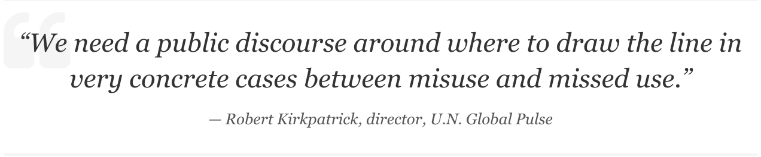
Data for Development
Discussion: Misuse or missed use?
15 min
+
=
?
What are your experiences with data for development?
How relevant are data approaches in your work context?
Where do you potentials and risks?
What can be done to prevent potential harms of sensitive data misuse?
Notes:
Procedure:
Ask participants to share their thoughts on innovative data use in development cooperation? How relevant are data approaches in their work context? What risks and potentials do they see? What can be done to prevent potential harms of sensitive data misuse?
Timing:
15min
Background:
In the video of UN Pulse, participants have seen a variety of examples for innovative data uses for sustainable development from analysis for social media to better coordinate disaster response to the analysis of social media for disease forecast.
Also, in data use we can see the duality of digitalisation:
Controversial example for discussion:
In February 2019, the UN World Food Programme announced a partnership with the algorithmic intelligence/data mining firm Palantir sparking a firestorm of criticism. WFP seeks to make the vast amount of data it generates accessible across the organization in order to streamline the delivery of food and cash, but data privacy activists say the partnership with the Silicon Valley-based company puts the recipients of WFP aid at risk.
Background:
Humanitarians have become increasingly reliant on digital data, and on third-party partnerships to collect and process it to create operational impact. But the ecosystem for doing this responsibly is missing: the policies, procedures, and capacities that ensure core principles, human rights standards, and data regulations govern these partnerships. bal development organizations partner with the private sector to unleash the power of their data to save lives, it is also imperative that they elevate privacy and information security to first-order priorities and partner with organizations whose values and business models are aligned with their humanitarian mission
Resources:
https://www.devex.com/news/opinion-the-wfp-and-palantir-controversy-should-be-a-wake-up-call-for-humanitarian-community-94307

Slide 15
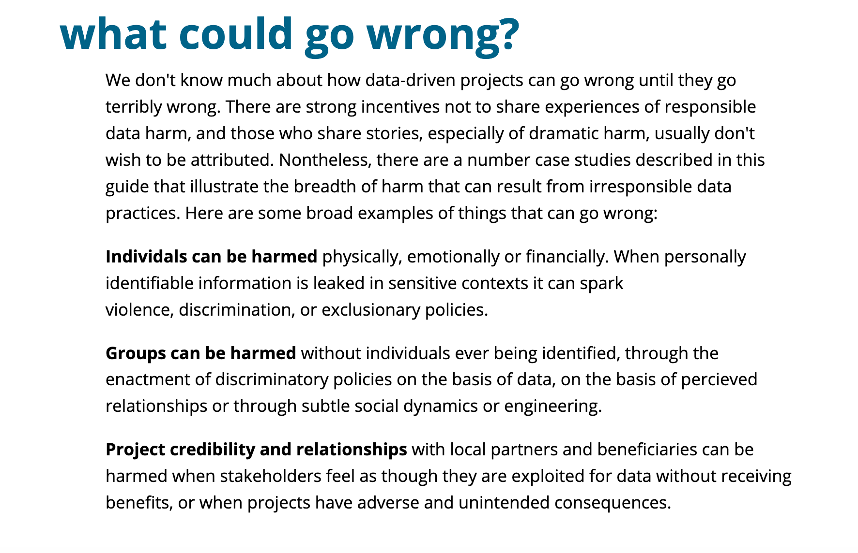
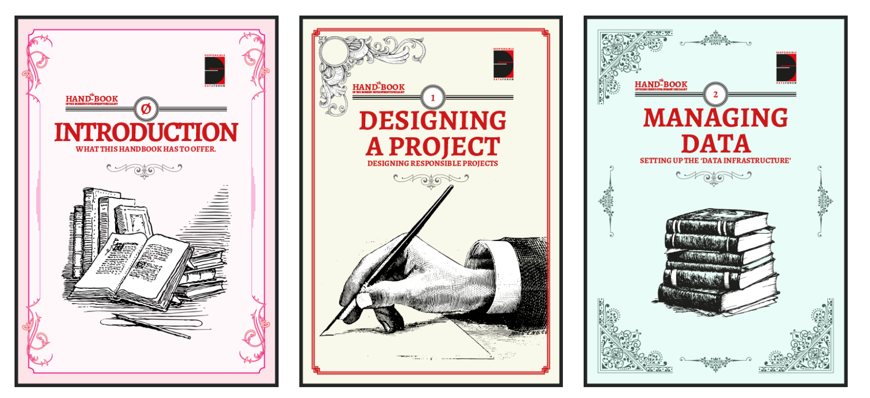
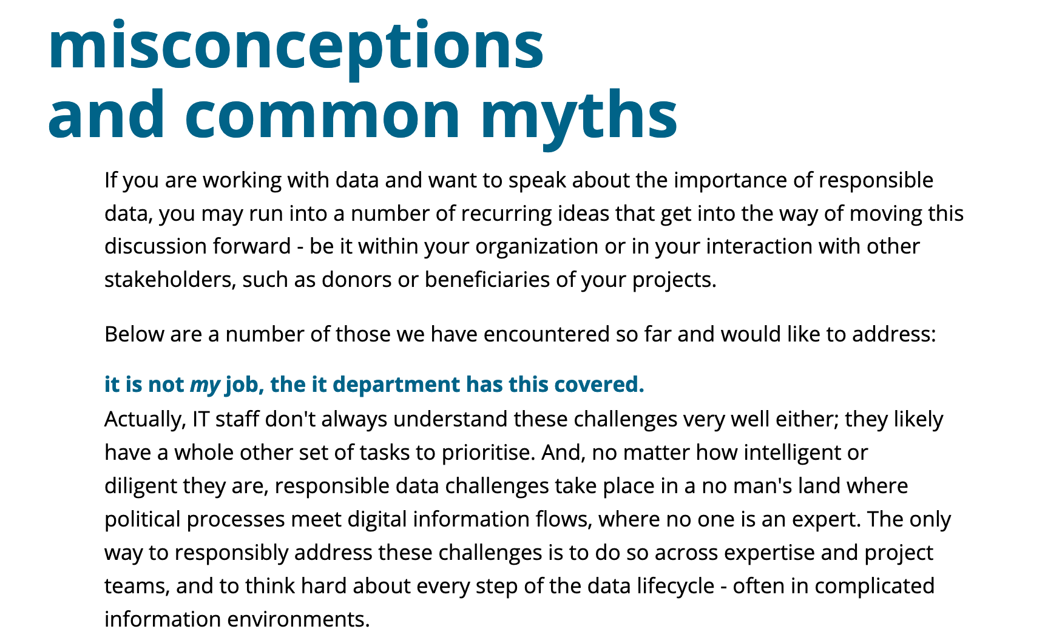
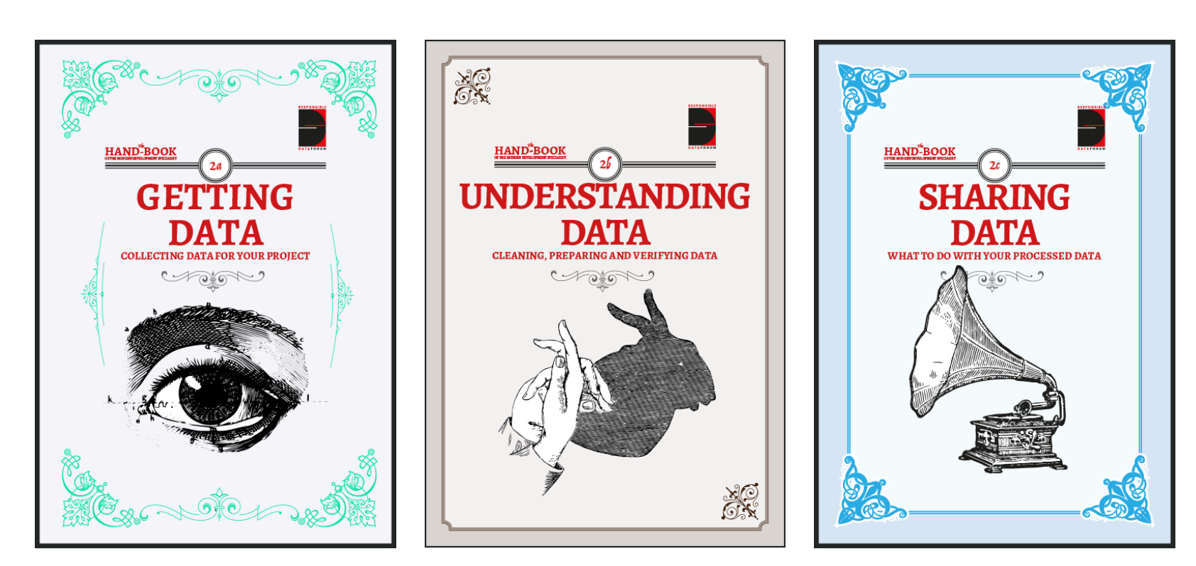
Dealing with Data
Helpful Guidance for Policymakers
The Hand-Book of the Modern Development Specialist (The Engine Room)
Notes:
Using data for social change work offers many opportunities, but it brings challenges, too. The RD community develops practical ways to deal with the unintended consequences of using data in social change work, establishes best practices, and shares approaches between leading thinkers and doers from different sectors. It has also published „The Hand-Book of the Modern Development Specialist“. Illustrated Guide to Responsible Data Usage, Manners & General Deportment.
About the Engine Room:
The responsible data community was first convened by The Engine Room, alongside a number of partners – most notably Aspiration Tech – who helped design and lead the first Responsible Data Forum kick-off event in 2014. Since then, diverse institutions and individuals have pioneered responsible data practice in their own work and within their communities. This decentralised effort has played a huge role in evolving key concepts and practices.
The Engine Room act as responsible data community stewards. This includes maintaining this site and moderating discussions on the mailing list. Various community partners set up responsible data events, organise calls and develop resources. You can find their work outlined below.
https://the-engine-room.github.io/responsible-data-handbook/

Slide 16

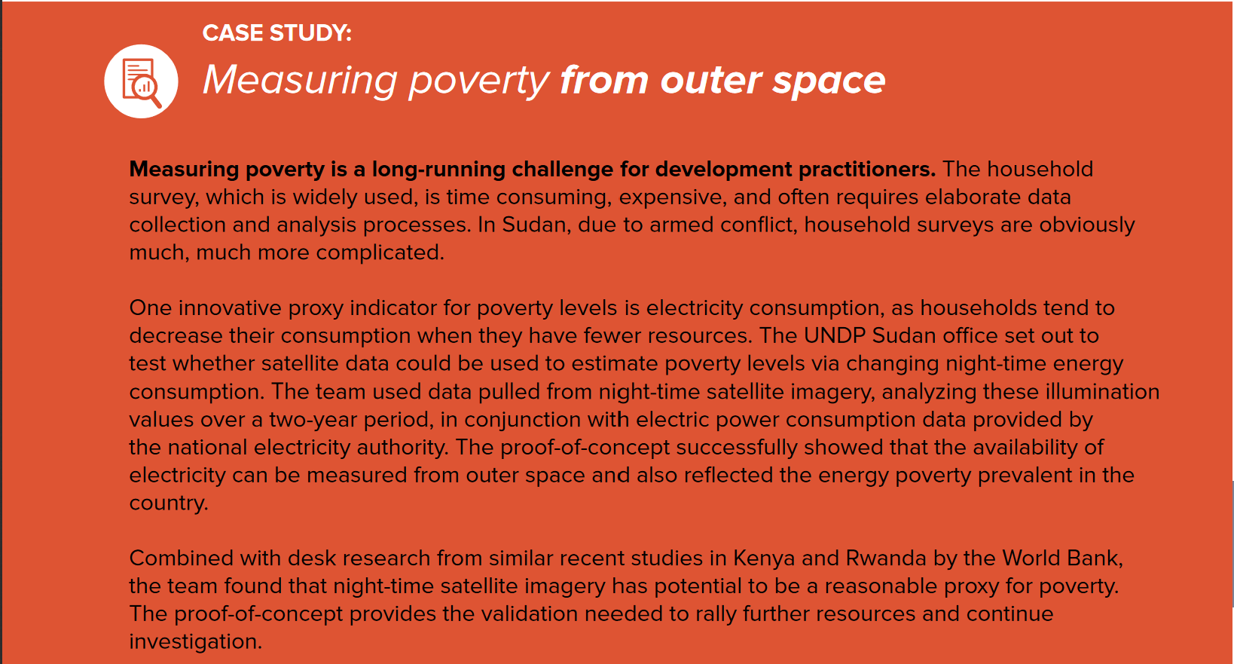
Example: Data Innovation for Sustainable Development
Source: UNDP (2016)
Notes:
Background:
Data innovation is the use of new or non-traditional data sources and methods to gain a more nuanced understanding of development challenges.
It often combines non-traditional with traditional sources of data, such as household surveys, to reframe issues and shed new light on seemingly intractable problems. New, or non-traditional data sources may include digital data derived from social media, web content, transaction data, GPS devices (see pp 19 for more). Because combining data sources can provide more complete, more timely, and/or more granular information about an issue, data innovation can open opportunities for more cost- effective interventions, as well as provide entirely new insights that may have been overlooked through traditional approaches
Further Examples to be found in: UNDP (2016): A GUIDE TO DATA INNOVATION FOR DEVELOPMENT FROM IDEA TO PROOF-OF-CONCEPT
Using night-time satellite imagery for poverty measurement
The UNDP Sudan office set out to test whether satellite data could be used to estimate poverty levels via changing night-time energy consumption. The team used data pulled from night-time satellite imagery, analyzing these illumination values over a two-year period, in conjunction with electric power consumption data provided by the national electricity authority. The proof-of-concept successfully showed that the availability of electricity can be measured from outer space and also reflected the energy poverty prevalent in the country
Weather Prediction models for farming
The challenge to farmers, and the lack of data, comes from unexpected shifts in rainfall and planting seasons. Most agricultural producers rely on historic data, which is increasingly unreliable in a shifting climate. Researcher in Egypt combined data from the sensors network Central Laboratory for Agricultural Climate, and local and international weather station data, a combination that (based on previous successes) proved to reveal insights for decision-makers in the area of water management.
Improvements of Disaster Response Systems
Natural disasters affect hundreds of millions of people worldwide every year. Emergency response efforts depend on the availability of timely information, such as the movement and communication behaviours of affected populations. As such, analysis of aggregated and anonymized Call Detail Records (CDRs) collected by mobile phone operators can reveal new, real-time insights about human behaviour during such critical events. By combining mobile phone activity data with remote sensing data it was possible to understand how people communicated during severe flooding in the Mexican state of Tabasco in 2009, in order to explore ways that mobile data can be used to improve disaster response. The representativeness of the research was validated by comparing the mobile data with official population census data.
Resources:
https://www.undp.org/content/dam/undp/library/innovation/UNGP_BigDataGuide2016_%20Web.pdf
BMZ ICT Toolkit Digitalization: https://www.bmz.de/en/zentrales_downloadarchiv/ikt/Toolkit-Digitalisation-Development-Education-Culture-Media.pdf

