Slide 1
Introduction to the dimensions of digitalisation
Module 3.2.2:
Deep Dive: Regulation of Data
Notes:
Overall learning objective module 3: Data is the currency of the digital transformation and needs to be contextualized within layers of DevCo

Slide 2
Agenda
Module 3.2.2: Deep Dive: Regulation of Data
Where do we stand?
Examples of data regulation
Regulatory implications for
  Individuals
  Businesses
  Governments
Notes:
Key message module 3.2.2.: There are many challenges that need to be considered when it comes to policy and regulatory implications

Slide 3

Deep Dive:
Regulation of Data

Slide 4







Data Regulation
Where do we stand?
The flow of data is by nature almost frictionless, regardless of national borders.
Once the internet connects us, data moves freely unless governments impose restrictions.
Notes:
Background:
The flow of data is by nature almost frictionless, regardless of national borders. Once the internet connects us, data moves freely unless governments impose restrictions.
But we need to be aware; Data exchange needs to be possible in a globalized economy. Todays fragmentation of protection laws make such integrations complex and costly.
Data Protection is not a national task
Rather than pursuing multiple initiatives, it would be preferable for global and regional organizations to concentrate on one unifying initiative or a smaller number of initiatives that are compatible across countries
Importantly for developing economies, the General Data Protection Regulation (which took effect in May 2018) applies to data on European Union citizens regardless of where data are stored or processed so that its law has in effect a global reach.
A number of countries have adopted similar approaches to the General Data Protection Regulation including Brazil, India, Japan and the Republic of Korea (🇧🇷 🇮🇳 🇯🇵 🇰🇷 ).
Coherent and internationally compatible national data protection regimes to facilitate cross-border trade will be ever-more important in the face of new technologies. More dialogue between all stakeholders is needed to achieve adequate protection.

Slide 5
Data Regulation
Where do we stand?
Underdeveloped and fragmented across countries
logic of economic justification for policies is not well established.​
Policy regime for the governance of data is only at a nascent stage
Coordination is often minimal
Policies related to data are overseen by various ministries and agencies
Notes:
Background:
The policy regime for the governance of data is only at a nascent stage:
it is underdeveloped and fragmented across countries
a fundamental problem is that the logic of economic justification for policies is not well established
Policies related to data flows and data-related businesses are overseen by various ministries and agencies
coordination is often minimal
Background:
Importantly for developing economies, the General Data Protection Regulation (which took effect in May 2018) applies to data on European Union citizens regardless of where data are stored or processed so that its law has in effect a global reach.
A number of countries have adopted similar approaches to the General Data Protection Regulation including Brazil, India, Japan and the Republic of Korea (🇧🇷 🇮🇳 🇯🇵 🇰🇷 ).
Coherent and internationally compatible national data protection regimes to facilitate cross-border trade will be ever-more important in the face of new technologies. More dialogue between all stakeholders is needed to achieve adequate protection.

Slide 6
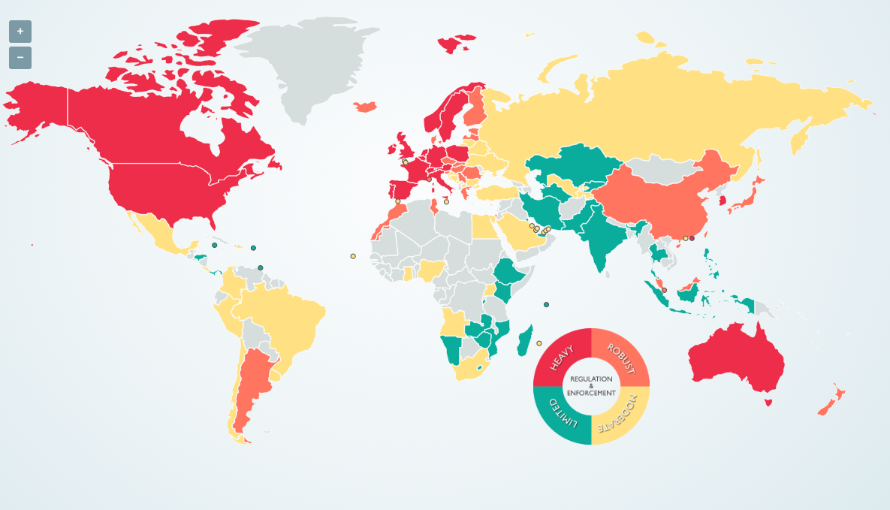
Data Regulation
Where do we stand?
=> Economically strong countries lead the process
Notes:
Background:
This map is taken from an online and interactive guidebook of the world’s data protection laws and regulations. The tool offers each countries’ law, regulator contact information and specifics on how it regulates anything from infosecurity to breaches to electronic marketing. It’s also possible to set two countries side by side and compare the way they regulate data protection.
What becomes clear is, that Economically strong countries / Unions lead the process (red).
Source: https://www.dlapiperdataprotection.com
Background:
Importantly for developing economies, the General Data Protection Regulation (which took effect in May 2018) applies to data on European Union citizens regardless of where data are stored or processed so that its law has in effect a global reach.
A number of countries have adopted similar approaches to the General Data Protection Regulation including Brazil, India, Japan and the Republic of Korea (🇧🇷 🇮🇳 🇯🇵 🇰🇷 ).
Coherent and internationally compatible national data protection regimes to facilitate cross-border trade will be ever-more important in the face of new technologies. More dialogue between all stakeholders is needed to achieve adequate protection.

Slide 7
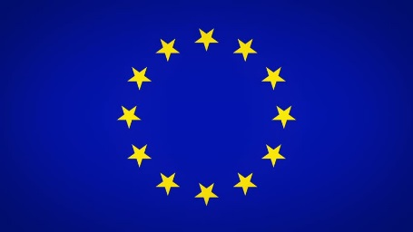

Data Regulation
Examples of Regulation
European Union General Data Protection Regulation (GDPR)
Data Protection and Privacy Act
Notes:
Trainer:
In May 2018, the EU’s General Data Protection Regulation (GDPR) came into effect. GDPR is a huge legislative change in Europe that outlines significant financial penalties for non-compliant handling of EU citizens’ data. It does not matter where you are based, where you do business or where your headquarters is located. If your company handles, processes, or stores data of EU citizens, you need to be GDPR compliant. The consequences of non-compliance are severe. Companies can face fines of up to €20,000,000 or 4 percent of global revenue.
Besides the union approach of the EU you have also Data protection and privacy laws on a national level for example Uganda, recently signed their own Data Protection and Privacy Bill into law in February 2019.
More information on Uganda
Uganda recently enacted the Data Protection and Privacy Act, 2019 (Act) to supplement constitutional privacy protections under Article 27 of the Constitution of the Republic of Uganda. The Act regulates personal data collection, processing, use and disclosure, and applies to any person, entity or public body within or outside of Uganda who collects, processes, holds, or uses personal data. The Act will go into effect pending publication in the Uganda Gazette.
Sector specific laws further incorporate data protection provisions applicable to regulated activities, including:
The Access to Information Act, 2005
The Regulation of Interception of Communications Act, 2010
The Computer Misuse Act, 2011
The Registration of Persons Act, 2015
A number of countries have adopted similar approaches to the General Data Protection Regulation including Brazil, India, Japan and the Republic of Korea (🇧🇷 🇮🇳 🇯🇵 🇰🇷 ).
Background:
Importantly for developing economies, the General Data Protection Regulation (which took effect in May 2018) applies to data on European Union citizens regardless of where data are stored or processed so that its law has in effect a global reach.
A number of countries have adopted similar approaches to the General Data Protection Regulation including Brazil, India, Japan and the Republic of Korea (🇧🇷 🇮🇳 🇯🇵 🇰🇷 ).
Coherent and internationally compatible national data protection regimes to facilitate cross-border trade will be ever-more important in the face of new technologies. More dialogue between all stakeholders is needed to achieve adequate protection.

Slide 8
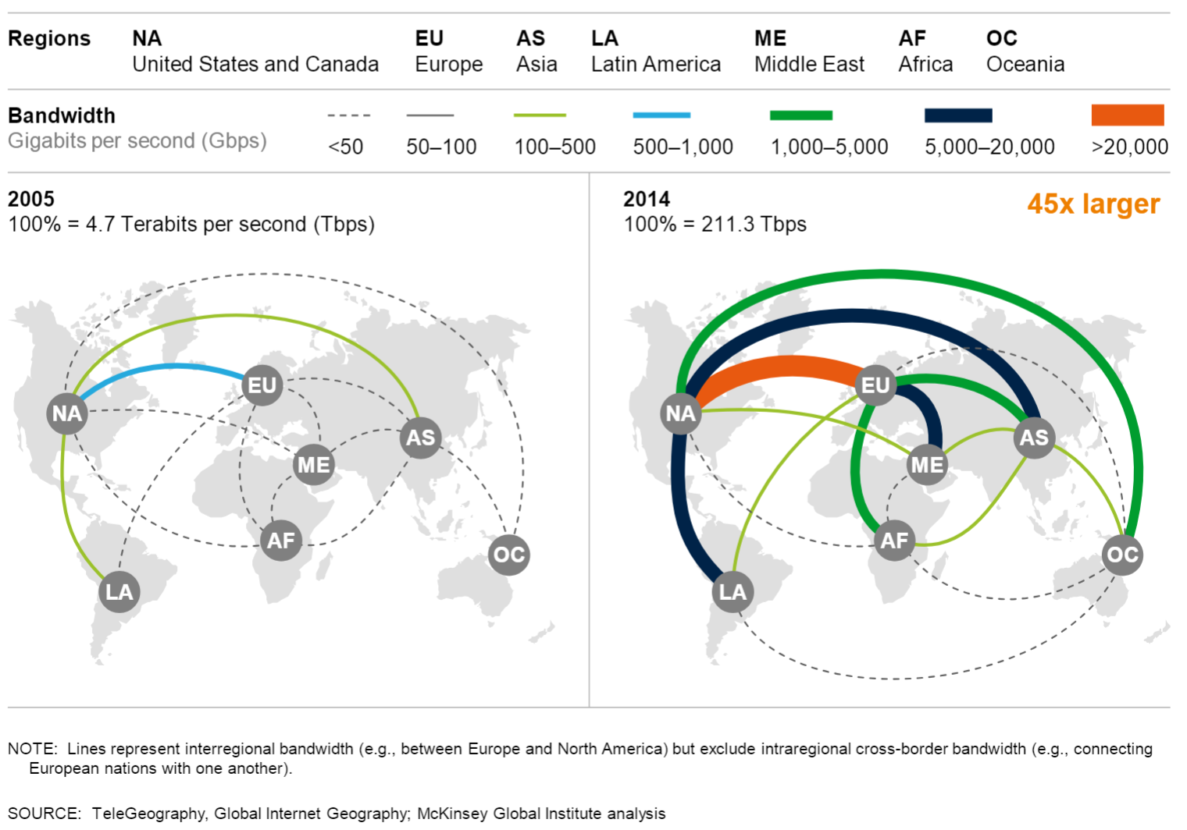
Data Regulation
Supporting innovation & development – Cross border flows
The world becomes increasingly interconnected. The economy is based on this.
Next to technical capacities, lack of adequate cross border regulation is a significant hurdle to the free flow of data
Notes:
Background:
The digital economy relies increasingly on cross-border data flows. A deep understanding among Governments and stakeholders of the role of data flows is therefore becoming increasingly important. For international trade it is also important that national regimes on regulating cross-border data flows are compatible across countries so as not to inhibit the adoption and proliferation of emerging technologies, with adverse effects on societal benefits.
Advocates of free cross-border data flows stress that such flows fuel the digital economy and generate:
new sources of employment,
innovation
and economic growth.
Restricting data flows would hamper innovation, growth and development. Some consultancy firms estimate that cross-border data flows increased global gross domestic product by approximately 10 per cent in around a decade, reaching $7.8 trillion in 2014. Data flows represented an estimated $2.8 trillion of the added value.
Coherent and internationally compatible national data protection regimes to facilitate cross-border trade will be ever-more important in the face of new technologies. More dialogue between all stakeholders is needed to achieve adequate protection.
Further Information on the History of Data Flows (Optional):
While issues relating to cross-border data flows have been discussed since the 1970s, they have recently become more controversial in international policy and trade discussions. Prior to the public Internet era of proprietary platforms, many multinational enterprises used international private networks to transfer data across national frontiers in pursuit of organizational efficiencies and competitive advantages. This trend provoked concerns among Governments that their national policy frameworks on privacy protection and economic regulation could be bypassed as data moved out of their national jurisdictions to other countries where they would be subject to different laws and policies.
Resources:
UNCTAD, 2019, The value and role of data in electronic commerce and the digital economy and its implications for inclusive trade and development
https://unctad.org/meetings/en/SessionalDocuments/tdb_ede3d2_en.pdf

Slide 9
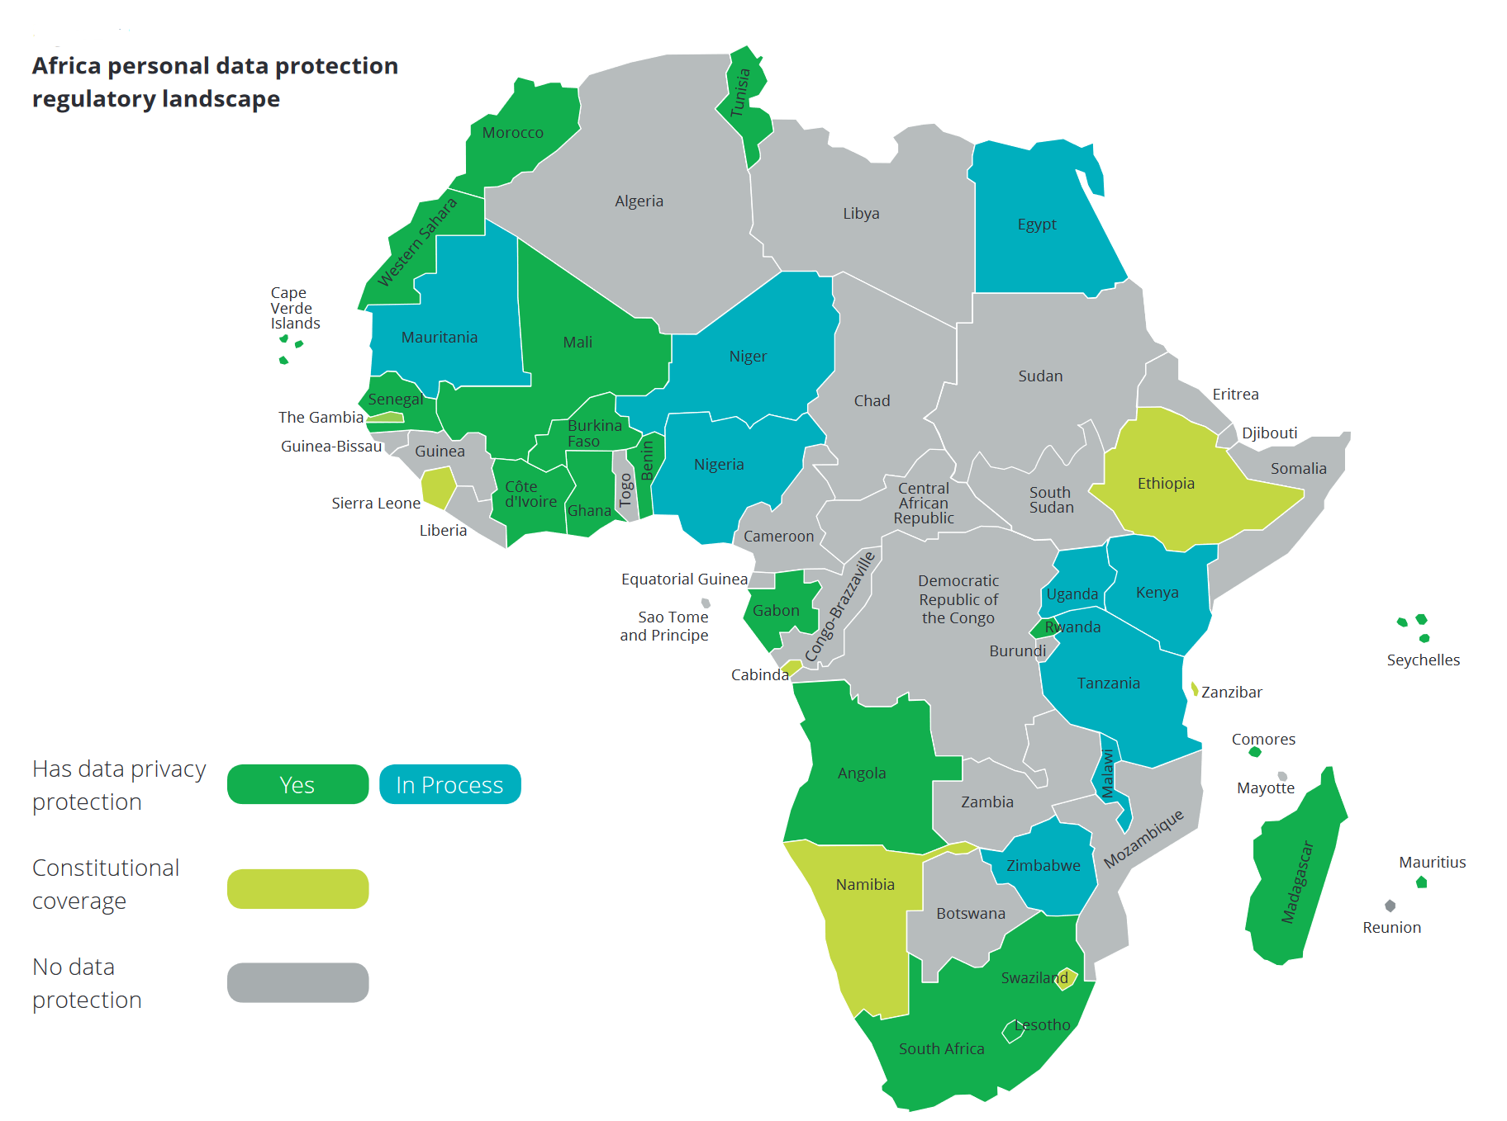
Data Regulation
Status-Quo Africa
Many African countries still lack data privacy regulations
(2017)
Deloitte (2017): Privacy is Paramount. Personal Data Protection in Africa
Notes:
Resources: https://www2.deloitte.com/content/dam/Deloitte/za/Documents/risk/za_Privacy_is_Paramount-Personal_Data_Protection_in_Africa.pdf

Slide 10
Data Regulation
Where do we stand?
The flow of data is by nature almost frictionless, regardless of national borders
Once the internet connects us, data moves freely unless governments impose restrictions
But fragmentation of protection laws makes globalized economy complex and costly
In the end data regulation is not a national task
One unifying initiative or a smaller number of initiatives that are compatible across countries
.
Notes:
Conclusion:
The flow of data is by nature almost frictionless, regardless of national borders. Once the internet connects us, data moves freely unless governments impose restrictions.
But we need to be aware; Data exchange needs to be possible in a globalized economy. Todays fragmentation of protection laws make such integrations complex and costly.
Data Protection is not a national task
The internet has vigorously developed as a private, decentralized initiative, rather than following a top-down approach by governments.
Thus, in the coming domestic and international rule-making for the flow of data and data-related businesses, we need to apply a multi-stakeholder approach including private companies, academics, and civil society.
Rather than pursuing multiple initiatives, it would be preferable for global and regional organizations to concentrate on one unifying initiative or a smaller number of initiatives that are compatible across countries

Slide 11




Data Regulation
Regulatory (policy) implications for individuals, businesses and governments
Individuals
Business
Governments
Regulatory implications:
Data and privacy protection
Consumer protection
Regulatory implications:
Market failure
ethical failures
Tax avoidance
Regulatory implications:
liberalization and facilitation
Important values
Information disclosure of firms and statistics
Notes:
Background:
Individuals
Business
Governments

Slide 12
Data Regulation
Regulatory (policy) implications for individuals, businesses and governments
Individuals
Data and Privacy Protection
As we have seen (data) privacy protection has become a prominent concern in the digital economy
Policies must be designed so as to unite social values with economic efficiency.
Consumer Protection
Transactions between businesses and consumers tend to be characterized by asymmetric information
Possibly the need for market monitoring mechanisms
EU has a series of policies that can act as a reference
Notes:
Background:
Data and privacy protection
As we have seen (data) privacy protection has become a prominent concern in the digital economy; indeed, given the ubiquity of both state and corporate surveillance, the issues have even been regarded as touching on basic human rights. Policies must be designed so as to reconcile these values with economic efficiency.
Consumer Protection:
Transactions between businesses and consumers tend to be characterized by asymmetric information; sellers are typically much more knowledgable regarding goods and services they sell than buyers. In addition, once a problem occurs, businesses are in an advantageous position compared to individual consumers in dealing with the consequences. To make consumers feel safe, to optimize welfare gains, and to encourage online markets to expand, there may be a role for government to intervene to protect consumers, including by monitoring the performance of market mechanisms.
The quality of the legal arrangements as well as their implementation also differ widely. Accordingly, there appears to be room for broader adoption of best practices in this area.
The EU has a series of policies for cross-border e-commerce under the umbrella of the Regulation on Consumer Protection Cooperation including online dispute resolution, alternative dispute resolution for consumers, European Consumer Centres Network, and European small claims procedure.

Slide 13
Data Regulation
Regulatory (policy) implications for individuals, businesses and governments
Business
Digital economy has built-in potential for market failure, Exemplified by technology giants in the past:
abuse of dominance
ethical failures in exploiting private information
tax avoidance
everaging their size to extract public subsidies
and pre-emptive takeovers of potential future competitors
No policy remedies but the design of effective and globally coherent distortion-canceling policies
Notes:
Background:
Market failure comes from the existence of externalities, the existence of public goods, economies of scale, imperfect competition, and incomplete information. We must identify where a market failure exists and apply appropriate policy..
The digital economy has built-in potential for market failure, given that big data gives rise to network externalities, economies of scale and scope, and pervasive information asymmetry. Each of these conditions individually can result in market failure; combined, they create a strong likelihood that problems will emerge.
Indeed, even in the early years of this emerging economy, examples have surfaced as the technology giants have been censured for:
abuse of dominance,
ethical failures in exploiting private information,
tax avoidance,
everaging their size to extract public subsidies,
and pre-emptive takeovers of potential future competitors.
As individual governments react to specific instances with policy remedies, the design of effective and globally coherent distortion-canceling policies thus become imperative.

Slide 14
Data Regulation
Regulatory (policy) implications for individuals, businesses and governments
Governments
Liberalization and facilitation
There is still room for further liberalizing and facilitating the flow of data and data-related transactions
Important values
Important values or social concerns other than economic efficiency such as privacy protection, public morals, human health, or national security exist.
Information disclosure of firms and statistics
No information on activities of giant international platformers that created problems in the context of competition policy, taxation, and statistics. A possible remedy would be to introduce a system of information disclosure for their activities
Notes:
Background:
Liberalization and facilitation
Although flow of data is by nature almost frictionless, regardless of national borders there is still room for further liberalizing and facilitating the flow of data and data-related transactions.
Important values
Important values or social concerns other than economic efficiency such as privacy protection, public morals, human health, or national security exist. Data Protection, cybersecurity and public morals as well as human, animal, or plant life or health are natural concerns. Furthermore, culture and non-discrimination in race or gender may be the issues to take care of. Achieving these goals while minimizing barriers to trade is a challenge as always.
Information disclosure of firms and statistics
A fundamental issue is that the information on the activities of giant international platformers is not well disclosed. Outsiders have little capacity to understand how they organize and operate their activities domestically and internationally, where they have servers to store the data, and how they make profits. These problems have created a series of concerns on international digital businesses, particularly in the context of competition policy, taxation, and statistics. A possible remedy would be to introduce a system of information disclosure for their activities

Slide 15
Data Regualtion
Keep the whole picture in mind!
Protection
Flexibility
Development
Restrictive and lack of regulation hinders development! (as restrictions in use of private data, or lack of agreements ensuring cross border data / service exchange or universal access)
Regulation needs to ensure the protection of the population and fair markets!
How and when will self-driving cars be on the roads? How can and must private data be protected?
Intangible property needs to be protected as well as fair taxations ensured in a more and more digitally borderless world
Especially the digital world is evolving at a pace traditional regulation cannot keep up with.
Regulation needs to be made more flexible
Notes:
Wrap up Modul 3
Data Regulation in particular and the Regulation of ICT in general is still at a nascent stage and needs a multi-stakeholder approach that calls for a smaller number of initatives that are compatible across countries. This also calls for more flexible approaches to keep track and ensure protection as well as development.

